Slide 1
LGAD Simulations with Ga doping:
An Exploration
F.R. Palomo¹, S.Hidalgo²
fpalomo@us.es
¹Dept. Ingeniería Electrónica, Escuela Superior de Ingenieros
Universidad de Sevilla, Spain
²CNM-IMB Barcelona, Spain

Slide 2
Introduction
Development of several LGAD models to test gain variation with bias and n+/pwell doping
Previous results (29th RD50 workshop, Nov 2016@CERN)
Analisis of radiation effects in LGAD Ga doped (a tentative): 300 um device
Analisis of radiation effects in LGAD Ga doped (a tentative): 50 um device

Slide 3
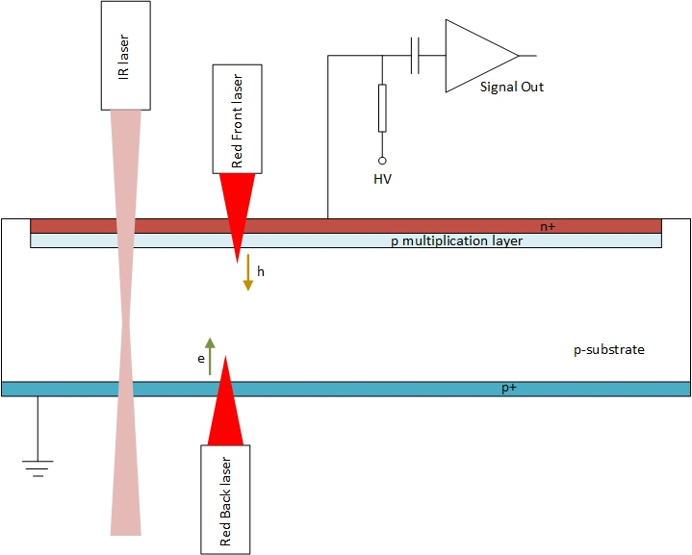
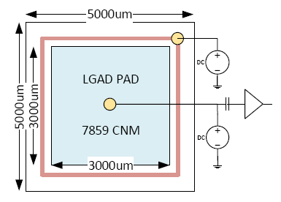
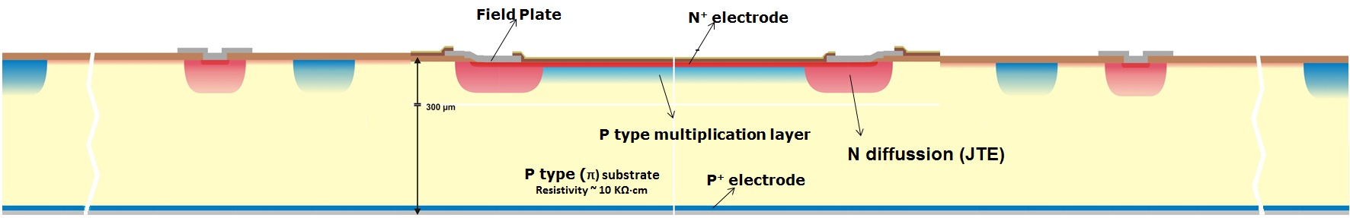
Sentaurus TCAD Simulation SetUp
Simulation Setup:
Red Pulsed Laser: 670 nm, 10 μm spot, 50W/cm², 200 ps,
BackIllumination at Device Center
2D detector model: 1 μm in Z direction, 5 mm in X direction,
300 μm in Y direction)
Simulation
Setup
z
x
y
Collector
Ring
P-Stop
C-Stop
Low Gain Avalanche Detector (LGAD)
cross-section
Doping profiles under confidenciality rules

Slide 4
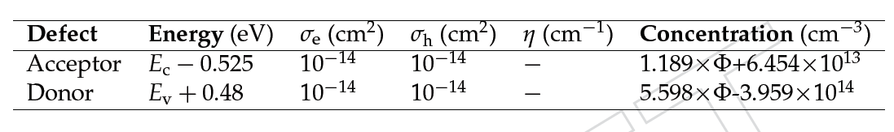
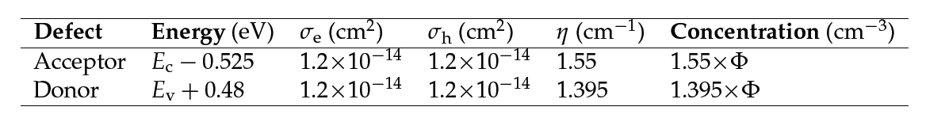
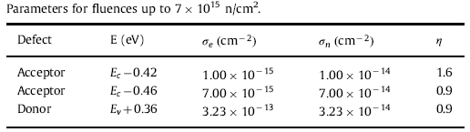
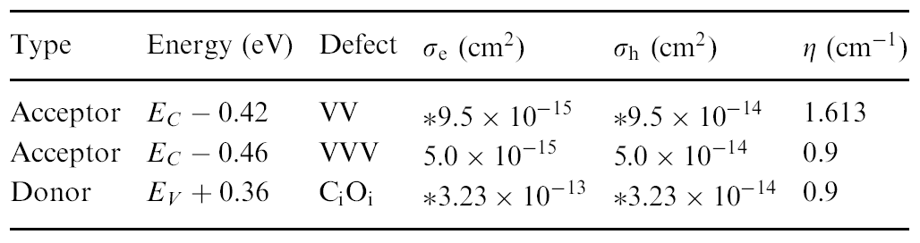
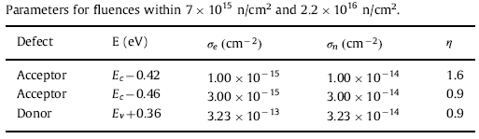
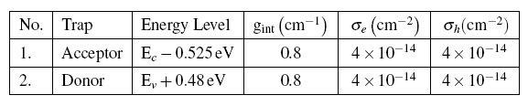
CMS Proton Model
From 29th RD50: Radiation Damage Models
Four damage models
Pennicard Model φ =1e12 up to 1e14 n_{eq}/cm²
CMS Proton and Neutron model φ = 1e14-1e15 n_{eq}/cm²
Two Level Model Proton φ = 1e14-1e15 n_{eq}/cm²
New Perugia Model φ =1e12 up to 2e16 n_{eq}/cm²
CMS Neutron Model
Simulation of Silicon Devices for the CMS Phase II Tracker Upgrade CMS Note 250887
Pennicard Model
N(cm⁻³)=η_{int} x φ
New Perugia
Simulations of radiation-damaged 3D detectors for the Super-LHC, D.Pennicard et al. NIMA 592(1-2), 2008, pp16-25
Eremin et al two level model*
N(cm⁻³)=g_{int} x φ
Combined effect of bulk and Surface damage on strip insulation properties of proton irradiated n+-p silicon strip sensors, R.Dalal et al. JINST 2014 9 P04007
*The origin of double peak electric field distribution in heavily irradiated silicon
detectors, V.Eremin, E.Verbitskaya, Z.Li, NIMA 476 (2002) 556-564
Modeling of radiation damage effects in silicon detectors at high fluences
HL-LHC with Sentaurus TCAD, D.Passeri et al, NIMA 824 (2016), 443-445

Slide 5
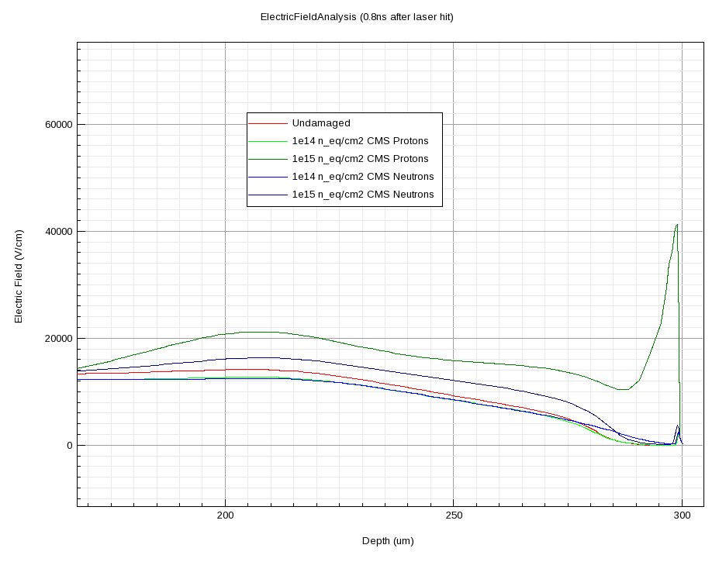
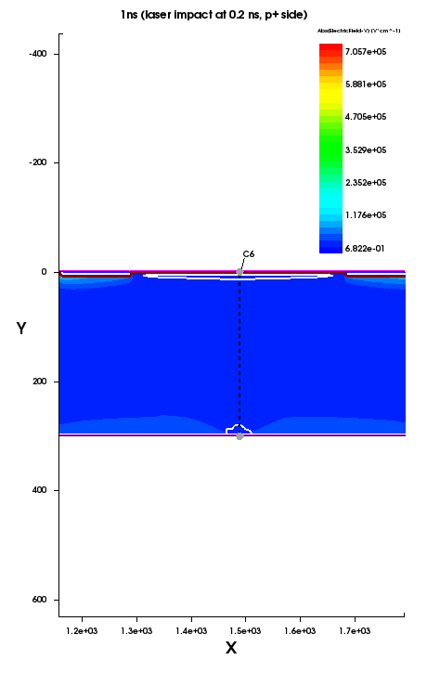
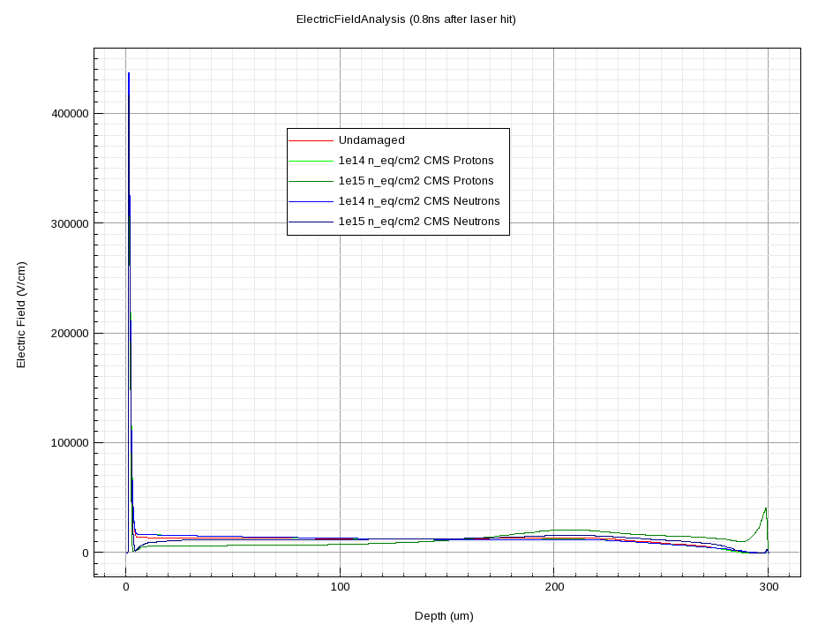
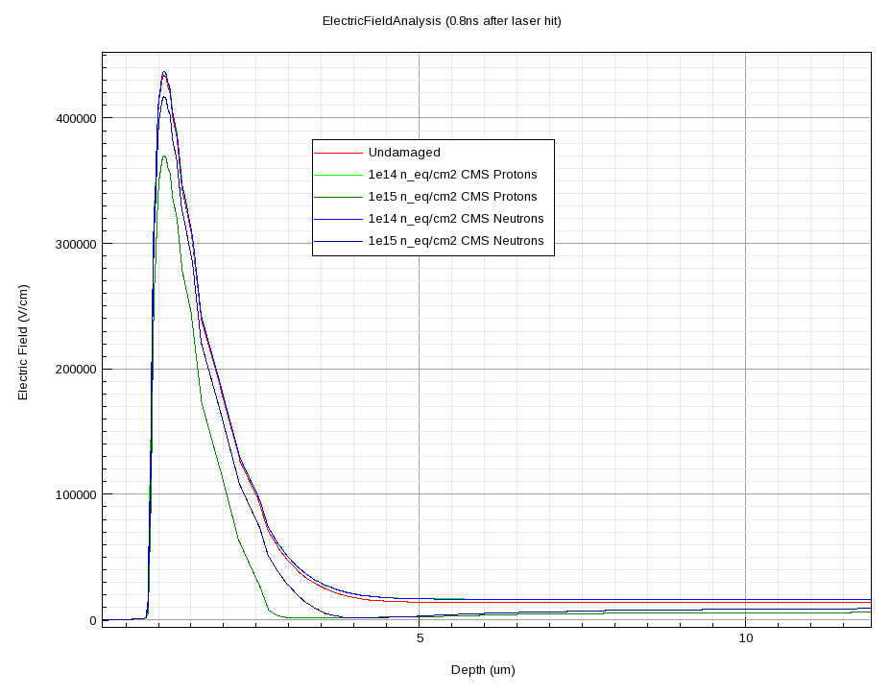
From 29th RD50 LGAD:
All Models show a similar panorama, for example:
CMS Model
Electric Field along Y axis
Back side detail
1e15
Front side
Back side
Front side detail
At 1e15 a double junction appears at P+ volumen (device back side)
1e15
Electric Field Profiling

Slide 6
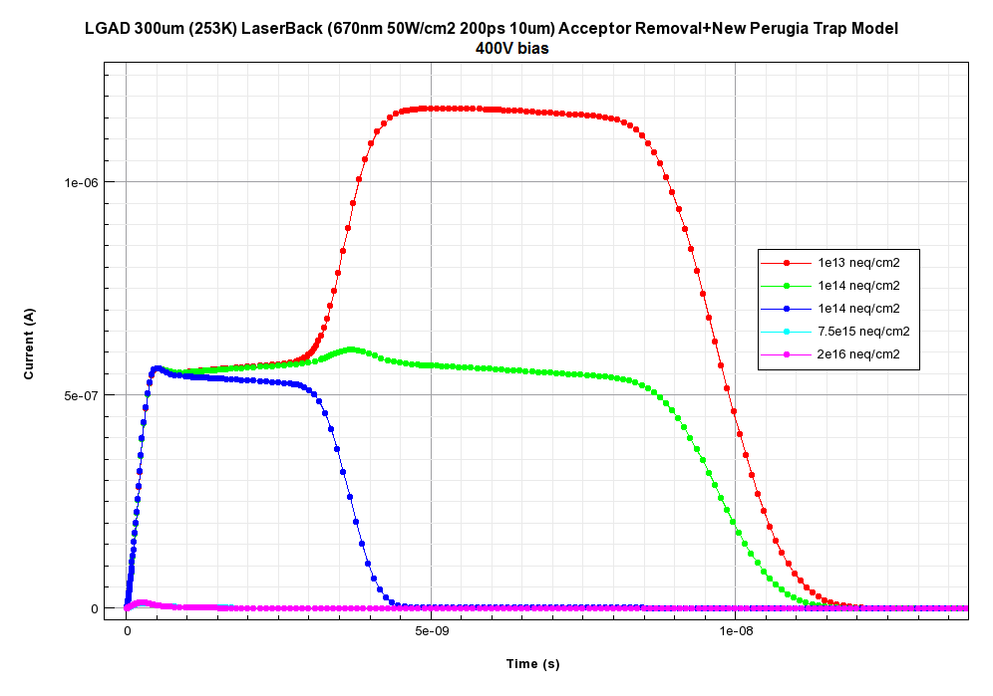
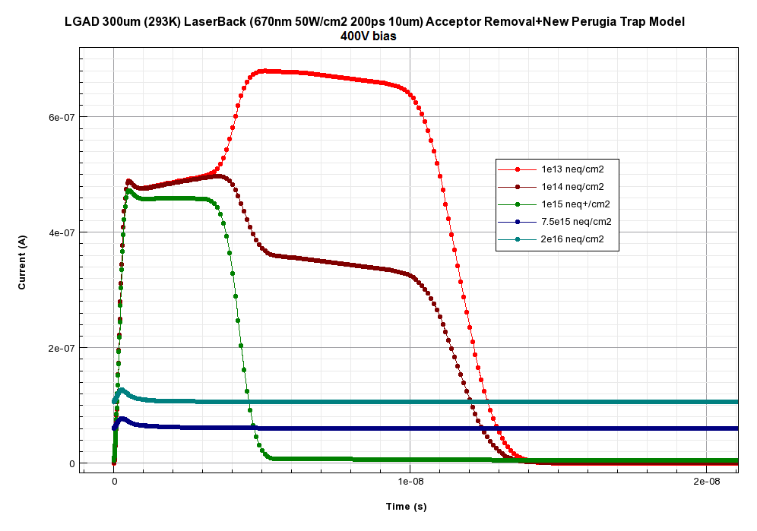

From 29th RD50: Acceptor Removal+Trap Model (New Perugia)
$$N_{A}=N_{A}e^{−cφ}$$
Boron Doping
Beyond 1e15 n_{eq}/cm² there is no p mult.layer for all practical purposes,
c=10e⁻¹⁶ cm⁻²
253K
293K
Radiation effects in Low Gain Avalanche Detectors after hadron irradiations, G.Kramberger et al., JINST 2015 10 P07006

Slide 7

Wafer Data (from Mar Carulla @ Trento Meeting)
 | Dopant | Doping(cm⁻³) | C_{A} (cm²)
Wafer9 (Mar) | Ga | 2,25E+16 | 6,90E-16
Kramb. Paper(2015) | B | 5,00E+16 | 9,10E-16
Wafer10 (Mar) | Ga | 1,00E+17 | 1,00E-16
Wafer11 (Mar) | Ga | 2,30E+17 | 3,30E-16
Wafer14 (Mar) | B | 3,00E+18 | 2,00E-17
;
;
(1998 Yamaguchi)
$${ N}_{A}=N_{A}e^{−cAφ}$$
(1999 Yamaguchi)
We consider the acceptor removal model from literature (Watkins’ removal mechanism)
From Mar Carulla we extrapolate C_{A}=4e-16 cm² for a Kramberger’s Paper type Gallium LGAD device, no T dependence as a first approach (also 2003 Kahn)
We consider also the trap model (new Perugia)
Simulation of Red Laser Back Transient
Maximum fluence damage 2e15 n_{eq}/cm² compatible with CMS ETL (Endcap Timing Layer) see Cartiglia’s talk
Explanation for carrier removal and type conversión in irradiated silicon solar cells, T.Yamaguchi et al. Applied Physics Letters 72(10), 1998
A detailed model to improve the radiation resistance of Si space solar cells, T.Yamaguchi et al. IEEE Trans on Electron Devices,46(10), 1999
Strategies for improving radiation tolerance of Si space solar cells, A.Kahn et al. Solar Energy Materials & Solar Cells, 75, 271-276, 2003
Defects in Semiconductors, L.Romano, V.Priviera, C.Jagadish, 2015 AP Elsevier publishers
Radiation effects in Low Gain Avalanche Detectors after hadron irradiations, G.Kramberger et al., JINST 2015 10 P07006
Last measurements and developments on LGAD detectors, Mar Carulla et al., 12th “Trento” Workshop February 2017
Notes:
Resultados de Mar, mecanismo de Watkins

Slide 8
LGAD-Ga analysis, a tentative one
We define a new LGAD with higher doping in the p multiplication layer
NO Ga physics card in Sentaurus so:
  We suppose that as a dopant, Ga behaves like B
  We use the acceptor removal coefficients from the Mar Carulla analysis of the Ga doped wafers
Tested several hypothetical devices, too high doping and the device goes to avalanche too soon
The LGAD doping profile is a narrow Street
From Mar Carulla wafer results, the acceptor removal coefficient goes down quickly
We extrapolate the value c_{A}=4e-16 for the simulations, no T dependence (~worst case)
  Probably the c_{A} value will be even lower if we consider the carbon interstitials effect (for the future)
For sure, we need more experimental data
First, we analyze the 300 um new LGAD device
Second, we analyze a posible 50 um LGAD device
Exploration of different damage fluences, trap & acceptor removal models, 293 & 253K, even variable bias
Everything ready to inject new data from experiments and the T dependence of c_{A}
Notes:
Mecanismo de Watkins, mejoras en el dispositivo

Slide 9
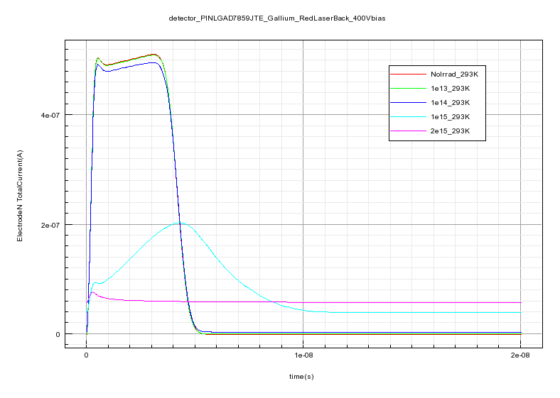
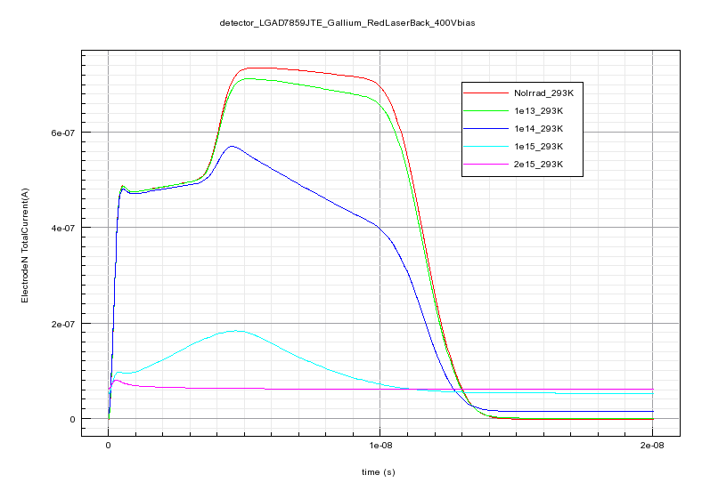

Acceptor Removal+Trap Model (New Perugia)
detector PINLGAD7859_Gallium_RedLaserBack_400V
detector LGAD7859_Gallium_RedLaserBack_400V
Fluence n/cm² | Charge LGAD (C) | Charge PIN (C) | Gain Q_{lgad}/Q_{pin}
NoIrrad | 7,42e-15 | 2,01e-15 | 3,689
1e13 | 7,19e-15 | 2,01e-15 | 3,581
1e14 | 5,6e-15 | 1,99e-15 | 2,818
1e15 | 1,86e-15 | 1,19e-15 | 1,563
2e15 | 1,28e-15 | 9,98e-16 | 1,284
LGAD300um
Red Laser Back
400V Bias 293K
1e13-2e15 n_{eq}/cm²
$$N_{A}=N_{A}e^{−cφ}$$
c=4x10e⁻¹⁶ cm⁻²
New Perugia Trap Model
Notes:
LGAD300um293K

Slide 10
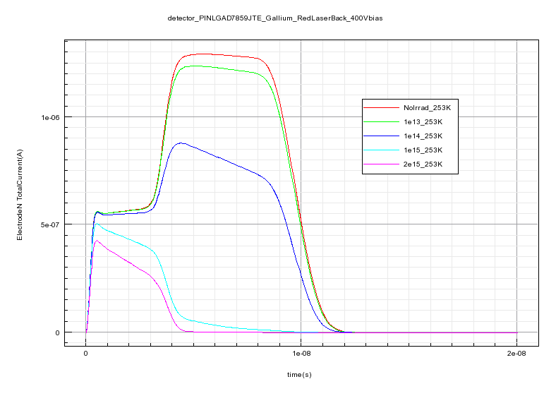
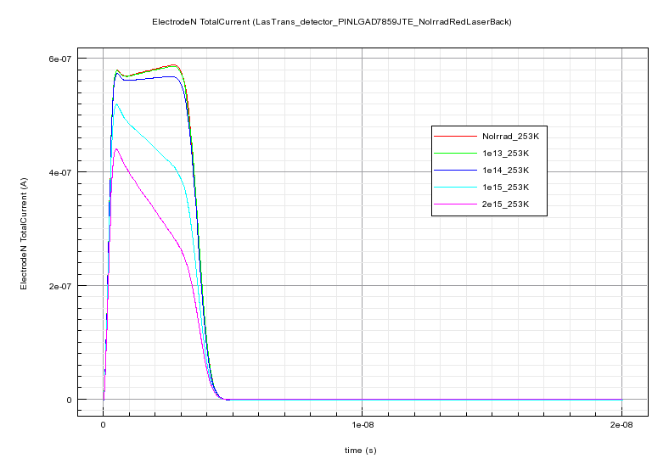

Acceptor Removal+Trap Model (New Perugia)
detector PINLGAD7859_Gallium_RedLaserBack_400V
detector LGAD7859_Gallium_RedLaserBack_400V
Fluence n/cm² | Charge LGAD (C) | Charge PIN (C) | Gain Q_{lgad}/Q_{pin}
NoIrrad | 9,86e-15 | 2,01e-15 | 4,91
1e13 | 9,46e-15 | 2,00e-15 | 4,72
1e14 | 6,77e-15 | 1,95e-15 | 3,46
1e15 | 1,74e-15 | 1,22e-15 | 1,42
2e15 | 1,28e-15 | 1,19e-15 | 1,08
LGAD300um
Red Laser Back
400V Bias 253K
1e13-2e15 n_{eq}/cm²
$$N_{A}=N_{A}e^{−cφ}$$
c=4x10e⁻¹⁶ cm⁻²
New Perugia Trap Model
Notes:
LGAD300um253K

Slide 11
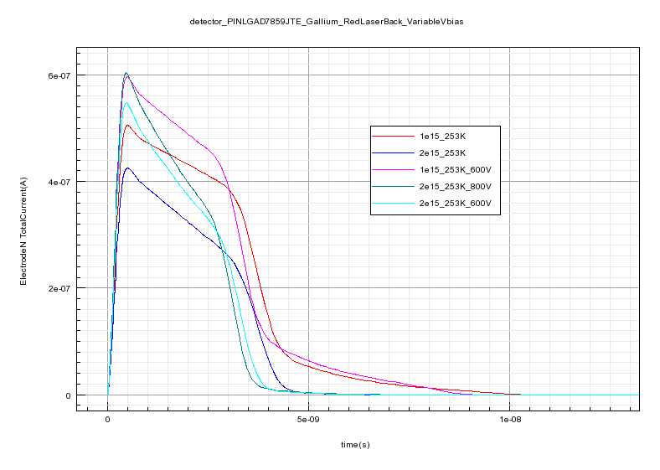

detector LGAD7859_Gallium_RedLaserBack_Variable Bias
detector LGAD7859_Gallium_RedLaserBack_400V
New Perugia Trap Model
$$N_{A}=N_{A}e^{−cφ}$$
c=4x10e⁻¹⁶ cm⁻²
LGAD 300um
Red Laser Back
Variable Bias,253K
1e15-2e15 n_{eq}/cm²
detector PINLGAD7859_Gallium_RedLaserBack_400V
Fluence n/cm² | Charge LGAD (C) | Charge PIN (C) | Gain Q_{lgad}/Q_{pin}
NoIrrad | 9,86e-15 | 2,01e-15 | 4,91
1e15(400V) | 1,74e-15 | 1,22e-15 | 1,42
1e15(600V) | 1,86e-15 | 1,22e-15 | 1,53
2e15(400V) | 1,28e-15 | 1,19e-15 | 1,08
2e15(600V) | 1,30e-15 | 1,19e-15 | 1,09
2e15(800V) | 1,34e-15 | 1,19e-15 | 1,13
Notes:
LGAD300um253K Variable bias

Slide 12
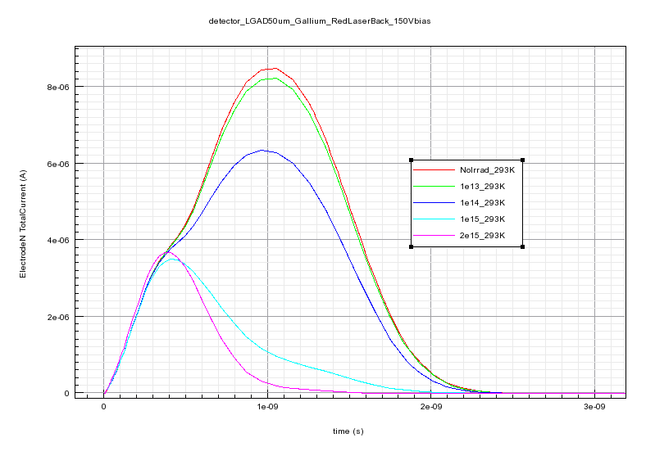
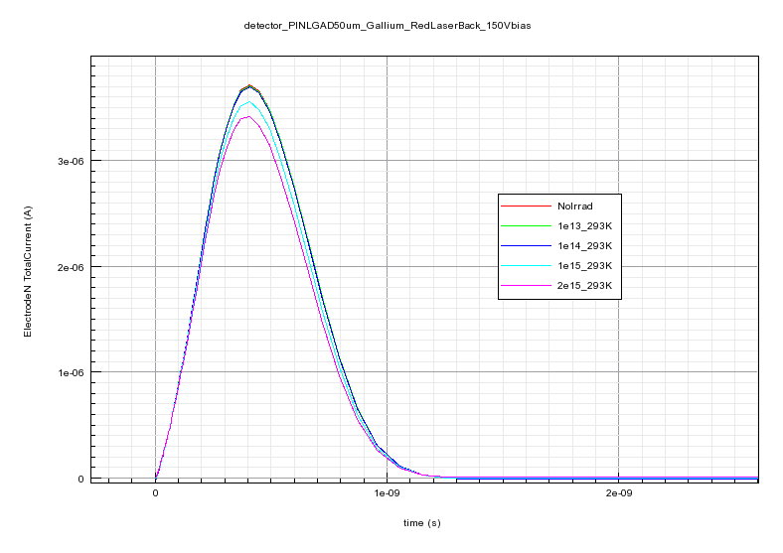

detector PINLGAD7859_Gallium_RedLaserBack_150V
detector LGAD7859_Gallium_RedLaserBack_150V
Fluence n/cm² | Charge LGAD (C) | Charge PIN (C) | Gain Q_{lgad}/Q_{pin}
NoIrrad | 9,52e-15 | 2,02e-15 | 4,72
1e13 | 9,27e-15 | 2,02e-15 | 4,60
1e14 | 7,49e-15 | 2,02e-15 | 3,71
1e15 | 2,72e-15 | 1,92e-15 | 1,42
2e15 | 1,98e-15 | 1,84e-15 | 1,08
LGAD50um
Red Laser Back
150V Bias 293K
1e13-2e15 n_{eq}/cm²
$$N_{A}=N_{A}e^{−cφ}$$
c=4x10e⁻¹⁶ cm⁻²
New Perugia Trap Model
Notes:
LGAD50um293K

Slide 13
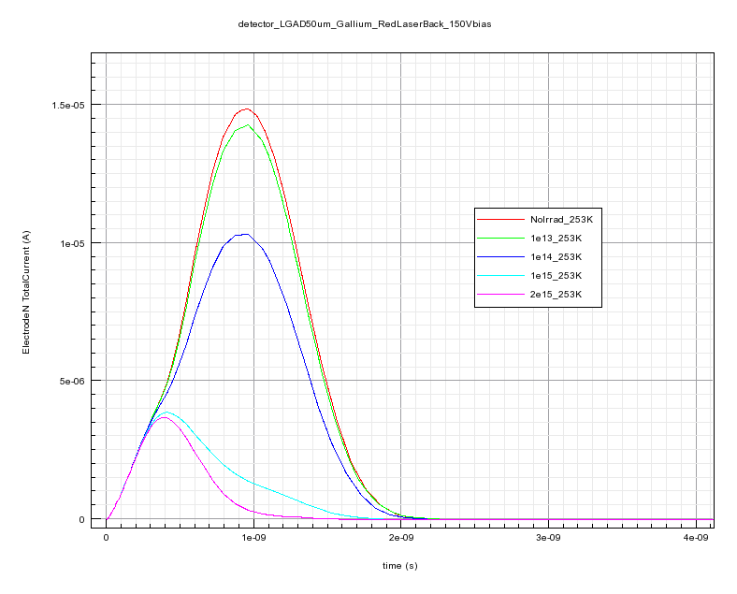
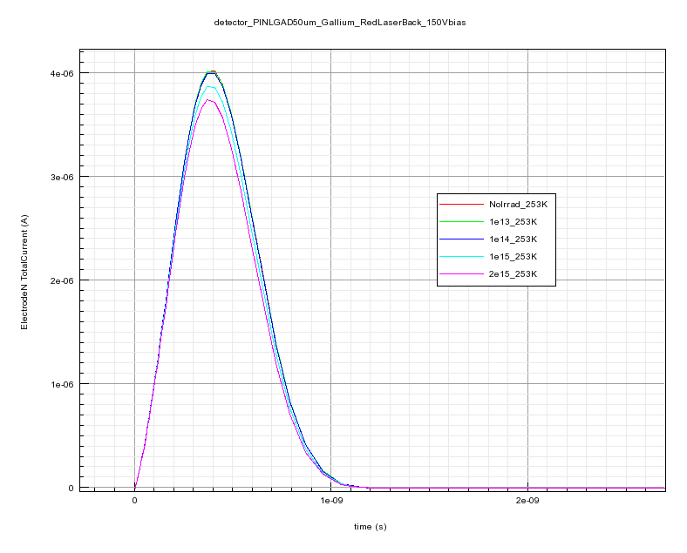

detector LGAD7859_Gallium_RedLaserBack_150V
detector PINLGAD7859_Gallium_RedLaserBack_150V
Fluence n/cm² | Charge LGAD (C) | Charge PIN (C) | Gain Q_{lgad}/Q_{pin}
NoIrrad | 1,37e-14 | 2,02e-15 | 6,78
1e13 | 1,32e-14 | 2,01e-15 | 6,54
1e14 | 9,94e-15 | 2,01e-15 | 4,96
1e15 | 2,84e-15 | 1,93e-15 | 1,47
2e15 | 1,98e-15 | 1,87e-15 | 1,05
LGAD50um
Red Laser Back
150V Bias 253K
1e13-2e15 n_{eq}/cm²
$$N_{A}=N_{A}e^{−cφ}$$
c=4x10e⁻¹⁶ cm⁻²
New Perugia Trap Model
Notes:
LGAD50um253K

Slide 14
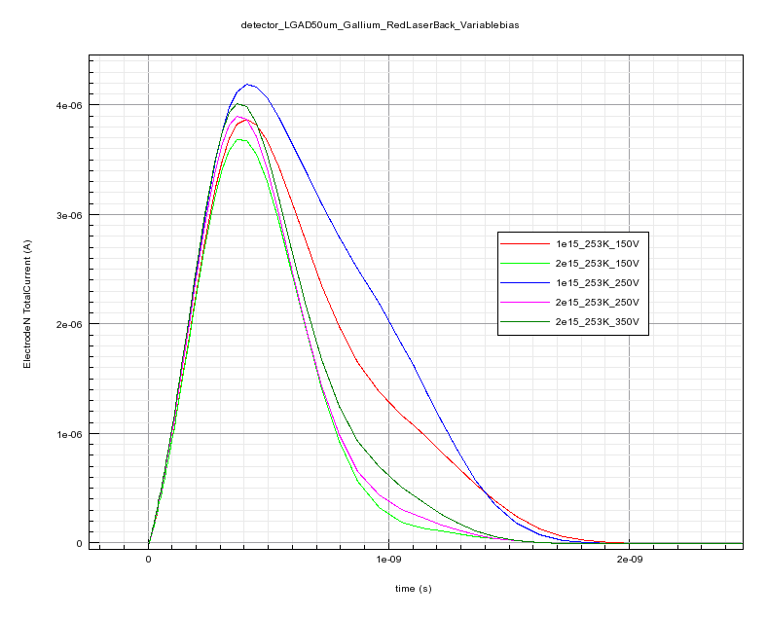

detector LGAD7859_Gallium_RedLaserBack_Variable Bias
detector LGAD7859_Gallium_RedLaserBack_150V
New Perugia Trap Model
LGAD50um
$$N_{A}=N_{A}e^{−cφ}$$
c=4x10e⁻¹⁶ cm⁻²
LGAD 50um
Red Laser Back
Variable Bias,253K
1e15-2e15 n_{eq}/cm²
detector PINLGAD7859_Gallium_RedLaserBack_150V
PIN50um
Fluence n/cm² | Charge LGAD (C) | Charge PIN (C) | Gain Q_{lgad}/Q_{pin}
NoIrrad | 1,37e-14 | 2,02e-15 | 6,78
1e15(150V) | 2,84e-15 | 1,93e-15 | 1,47
1e15(250V) | 3,4e-15 | 1,93e-15 | 1,77
2e15(150V) | 1,98e-15 | 1,87e-15 | 1,05
2e15(250V) | 2,11e-15 | 1,87e-15 | 1,13
2e15(350V) | 2,31e-15 | 1,87e-15 | 1,23
Notes:
LGAD50um253K Variable bias

Slide 15
Conclusions
New experimental data are desperately needed
Ga and C doping could be the solution up to 2e15 n_{eq}/cm² damage (ELT@CMS)
The simulation models are ready for the new data

Slide 16
Thanks for your attention
fpalomo@us.es

