Slide 1





The CELESTA 1U CubeSat
Project Design and Status
Raffaello Secondo
10th May 2017
CERN – ESA Meeting

Slide 2

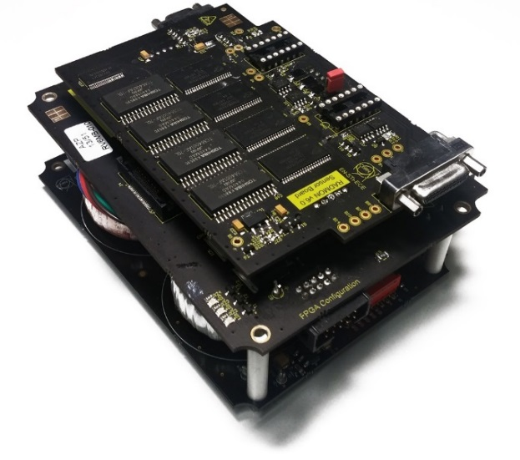
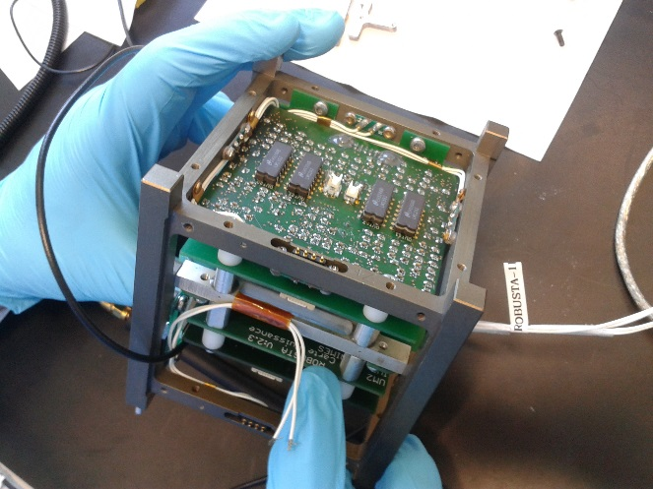


CELESTA: CERN Latchup Experiment and STudent sAtellite
The scientific Payload of the first CERN-driven Small Satellite.
Why CELESTA? - Mission GOALS
CubeSat-Payload version of the CERN RadMon V6.
Nanosatellites radiation qualification procedure at CHARM.
Comparison of radiation effects between LEO space environment and CHARM.
SRAM Latch-up Experiment: Compare radiation levels between equator and poles.
Test the ROBUSTA platform.

Slide 3


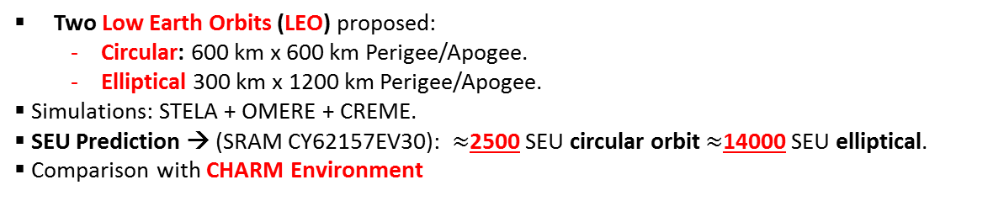
Workplan
STEP 1
Impact of radiation on a given orbit
Two Low Earth Orbits (LEO) proposed:
  Circular: 600 km x 600 km Perigee/Apogee.
  Elliptical 300 km x 1200 km Perigee/Apogee.
Simulations: STELA + OMERE + CREME.
SEU Prediction → (SRAM CY62157EV30): $≈$2500 SEU circular orbit $≈$14000 SEU elliptical.
Comparison with CHARM Environment
STEP 2
Feasibility Study – Mission Constraints
Prototype Boards.
Characterization of sensors and full system at CHARM.
Design of Final Payload.
STEP 3
3D Model - FASTRAD
TID: $≈$ 84 Gy.
Total Fluence (HEH>20 MeV): order of 10¹⁰ HEH/cm² , elliptical.

Slide 4
Mission Analysis

Slide 5
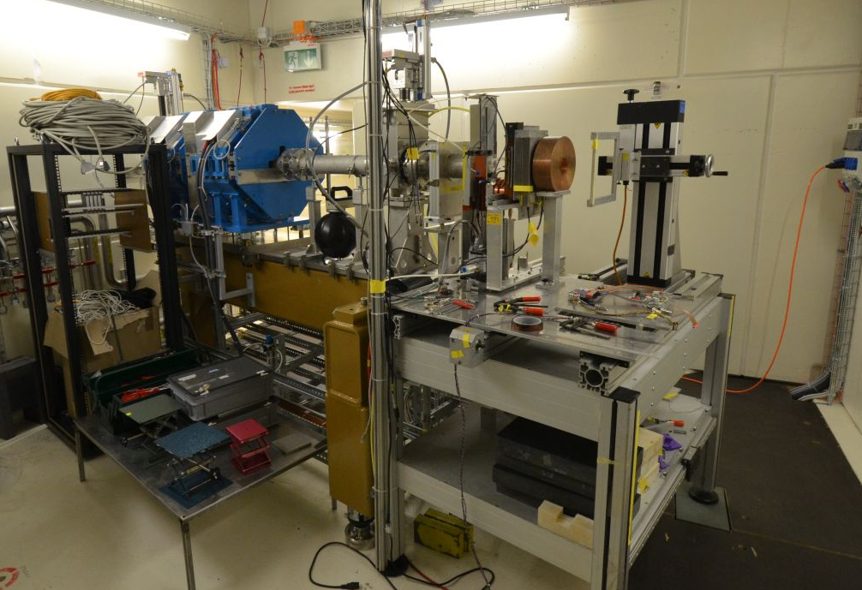
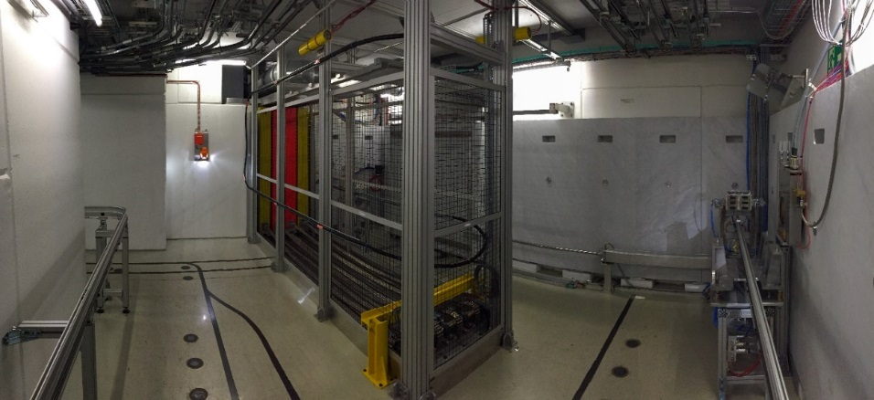
CERN Payload: Selection of COTS – Testing Effort
The PSI-PIF Irradiation Area
CHARM: Cern High Energy AcceleRator MixedField/Facility
PSI:
Focused Mono-energetic proton beam.
COTS Characterization.
CHARM:
Mixed-particle field
Testing at System Level
Representative radiation fields

Slide 6
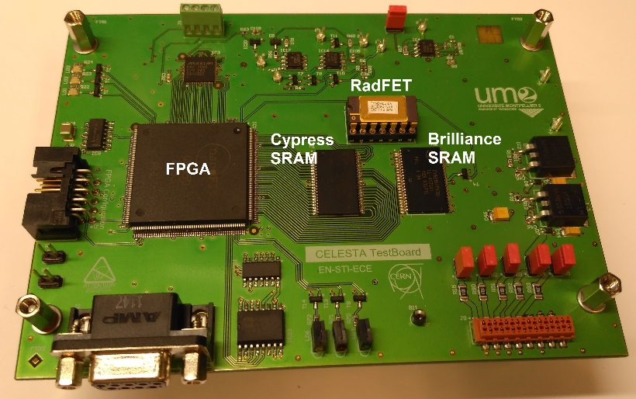
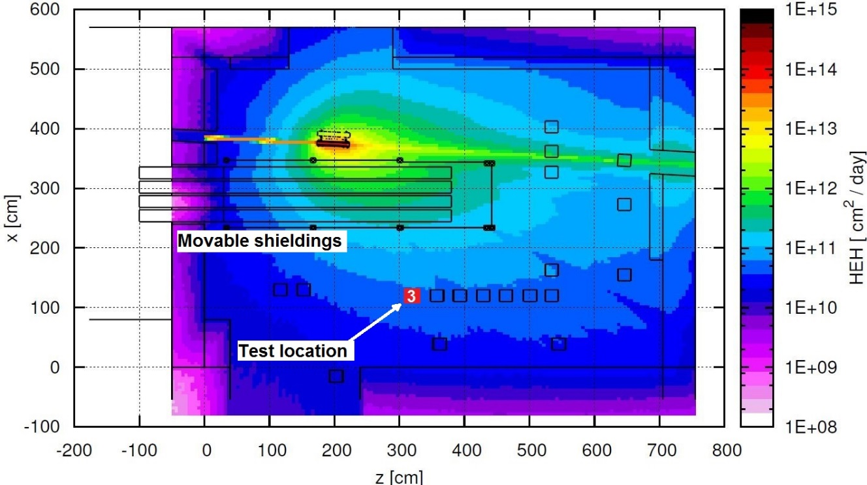
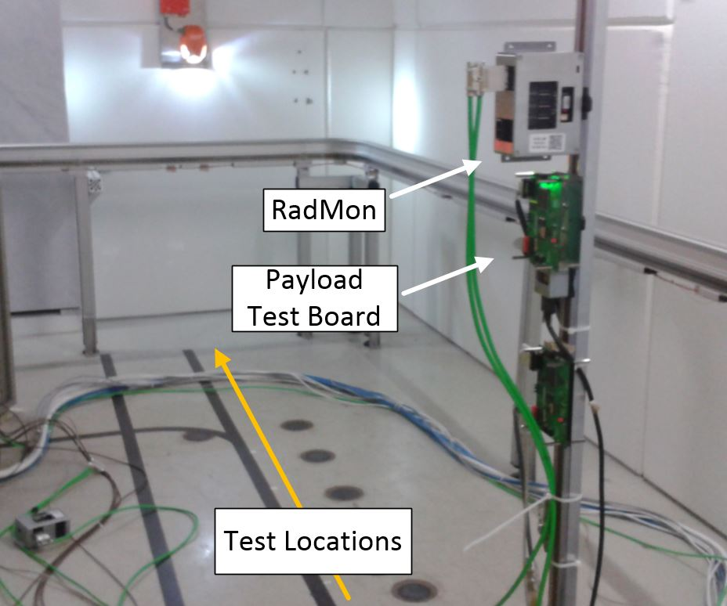
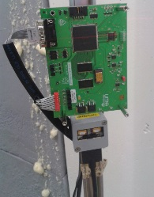
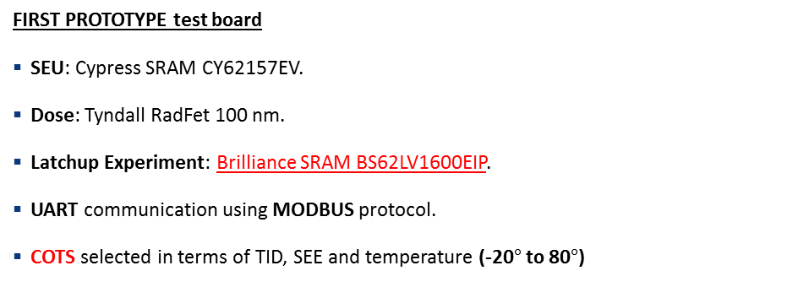
First Feasibility test
FIRST PROTOTYPE test board
SEU: Cypress SRAM CY62157EV.
Dose: Tyndall RadFet 100 nm.
Latchup Experiment: Brilliance SRAM BS62LV1600EIP.
UART communication using MODBUS protocol.
COTS selected in terms of TID, SEE and temperature (-20$°$ to 80$°$)

Slide 7
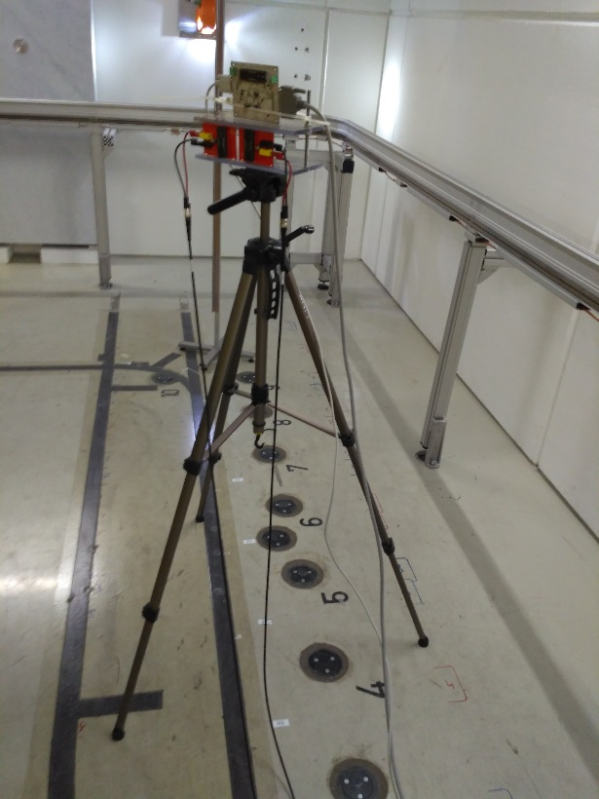
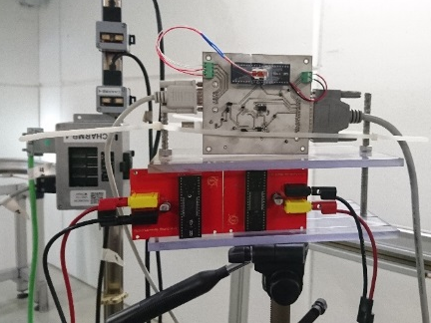
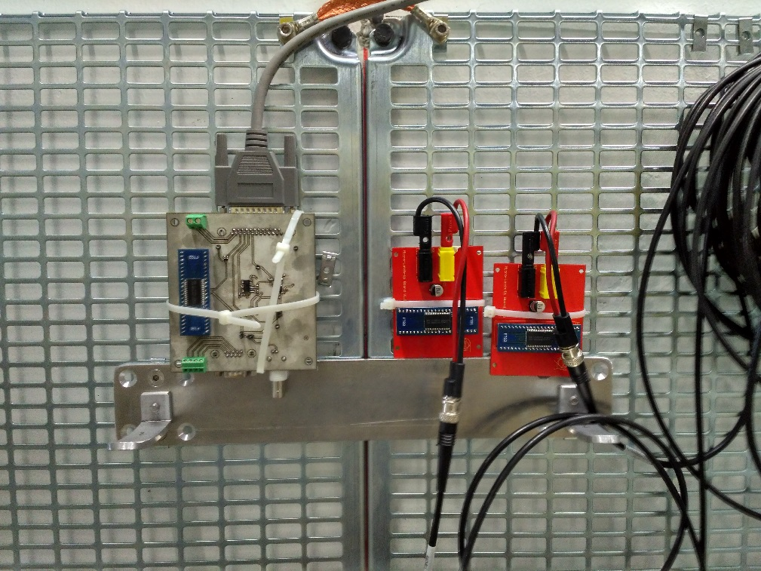
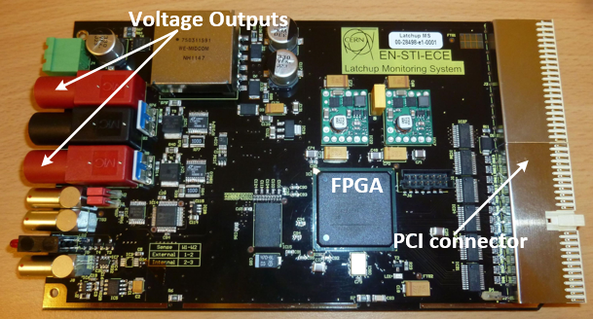
SEL SRAM Characterization
CHARM position: 4
CHARM position: G0
Simple Power Supply control.
Commercial equipments: GUARD
CERN LatMon: 2µs sampling period, fast recovery of current profiles.
test locations

Slide 8
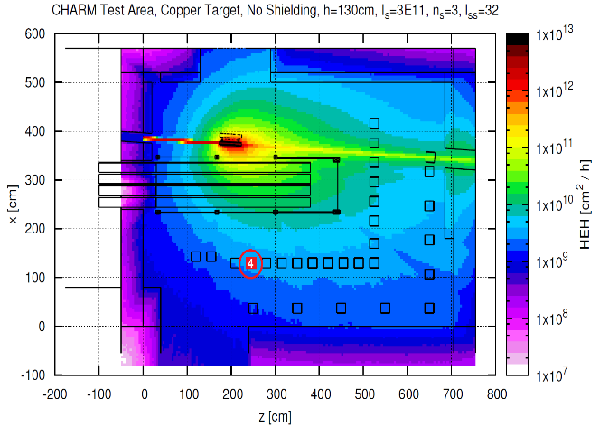
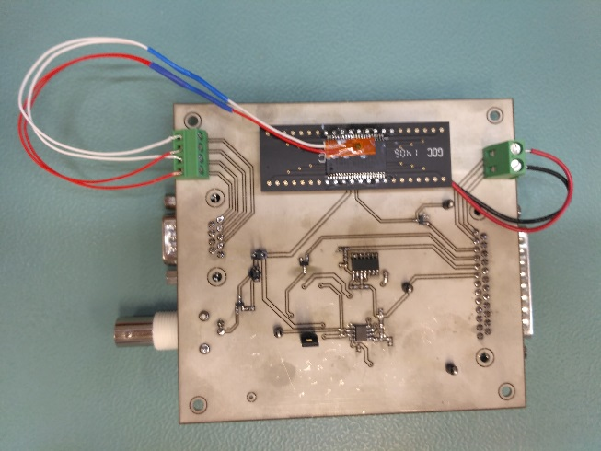
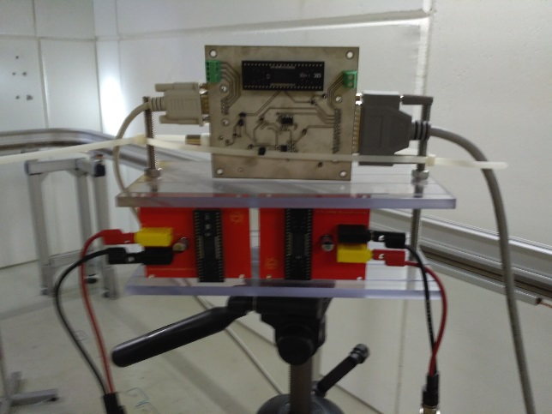
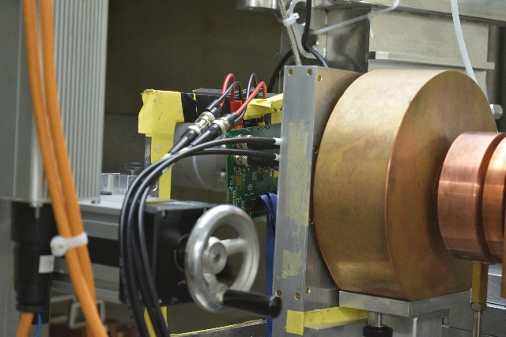
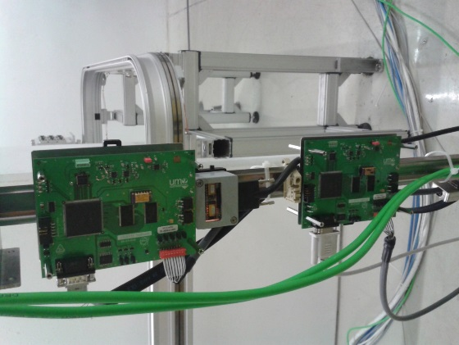
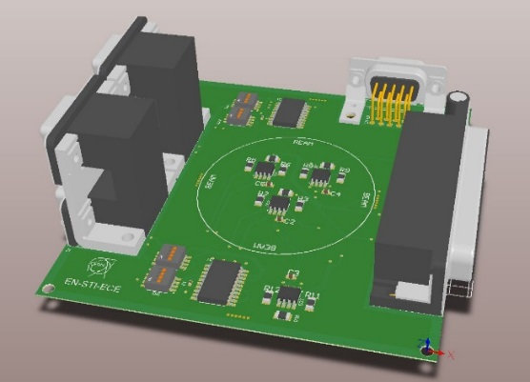
COTS Tests and Selection
SEL characterization
Mission Analysis and first test on a prototype board
Tests on candidates COTS at PSI (ADC, Voltage regs, opamps…)
CAN transceiver

Slide 9
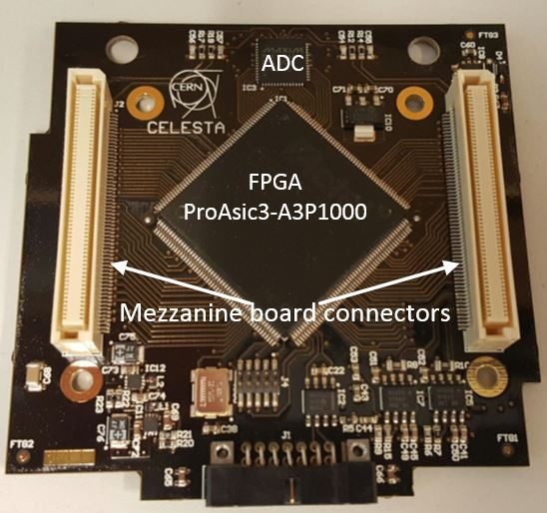
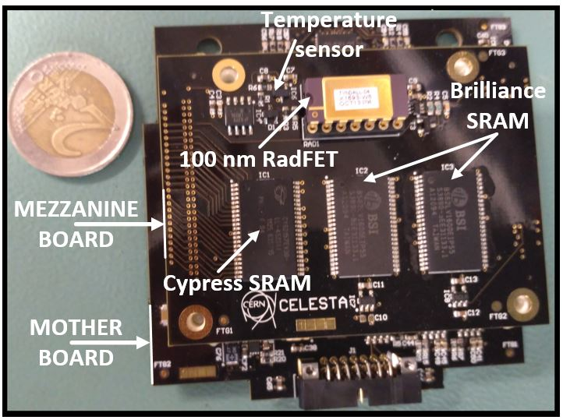
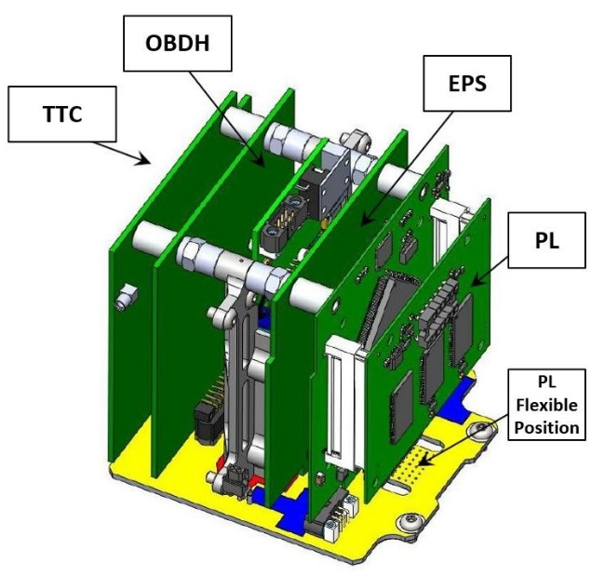
The Payload
Mass: 52 g.
Modular: “Mother Board” + Mezzanine.
180 mW average power.
300 mW peak power.
ROBUSTA compatible, CAN compatible.

Slide 10
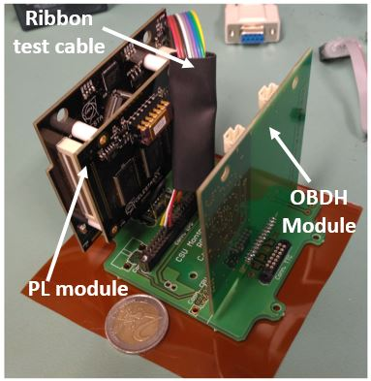
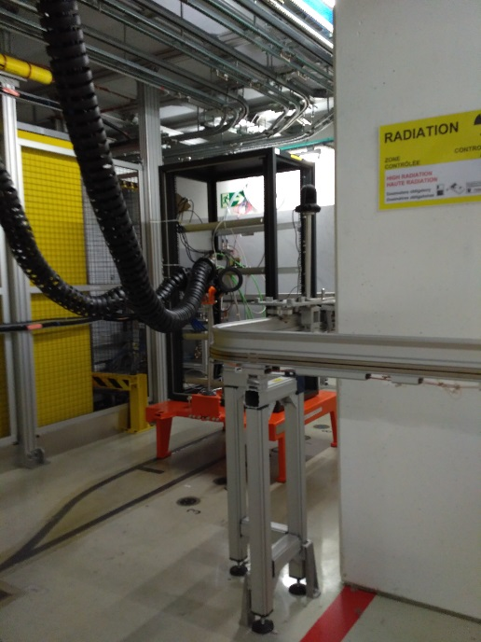
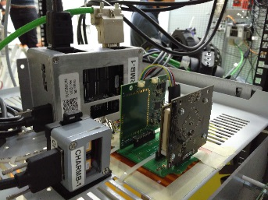
Test at CHARM

Slide 11
Snapshot of Sensors Results

Slide 12
CSU Facilities
Mechanical and thermal tests
Integration analysis
Compliant with FYS

Slide 13
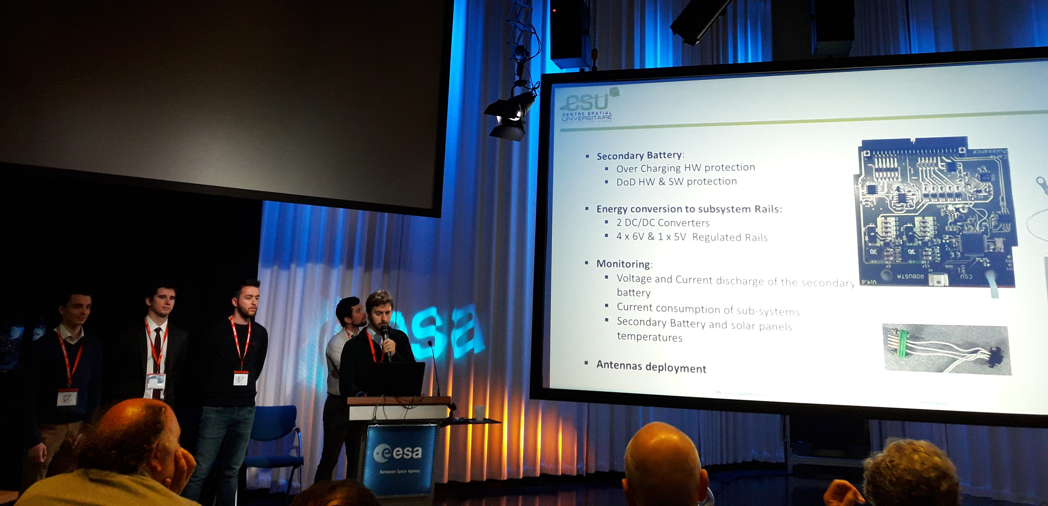
Conclusions
Waiting for FYS approval.
Evaluating new sensors/upgrades (floating gates?)
Possible launch in 2019 ( according to FYS schedules eventually)

