Slide 1
CERN-ESA bilateral meeting Collaborations on radiation issues
10/05/2017
Enrico Chesta
CERN IPT/KT

Slide 2

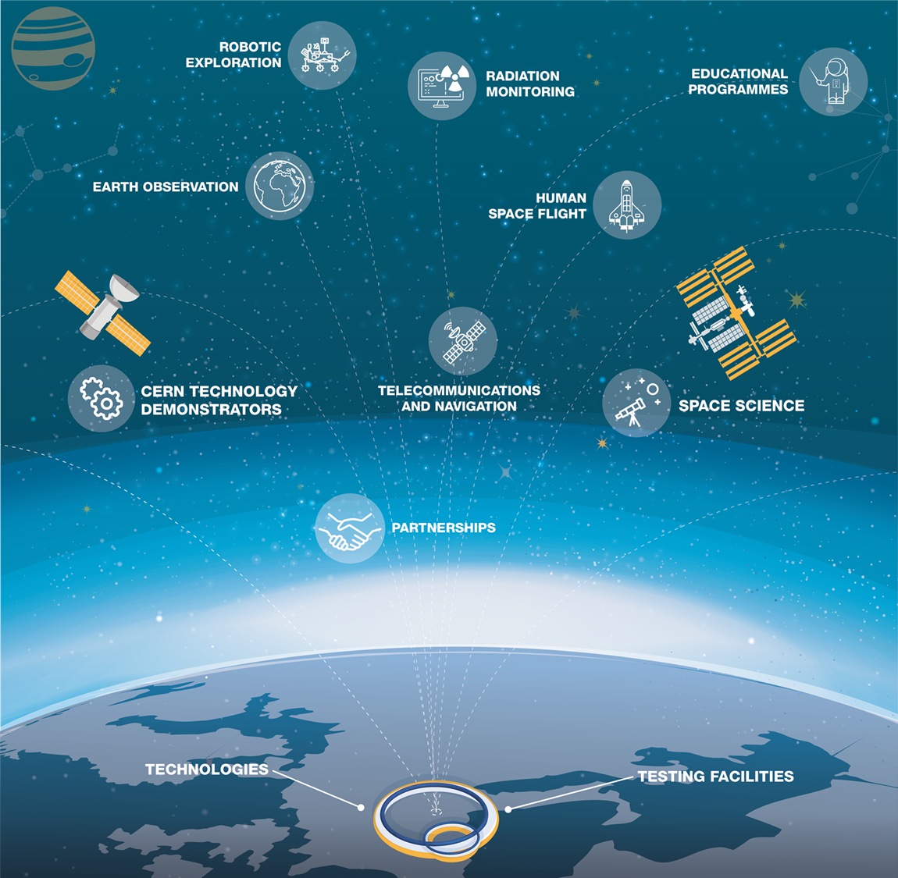
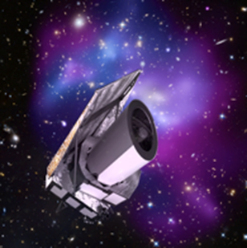
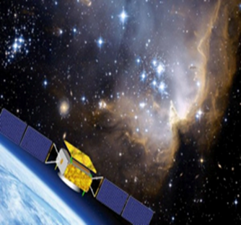
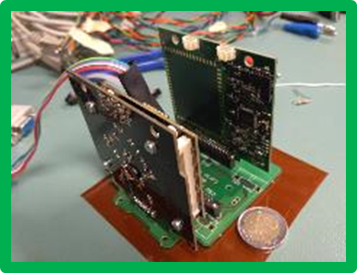
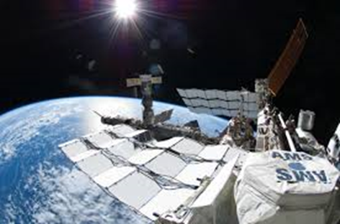
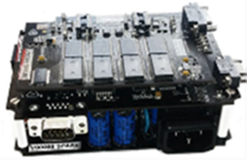
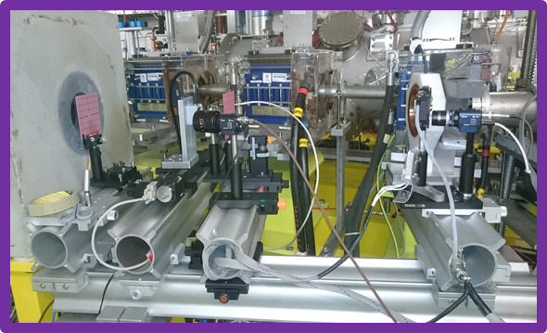
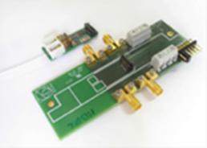
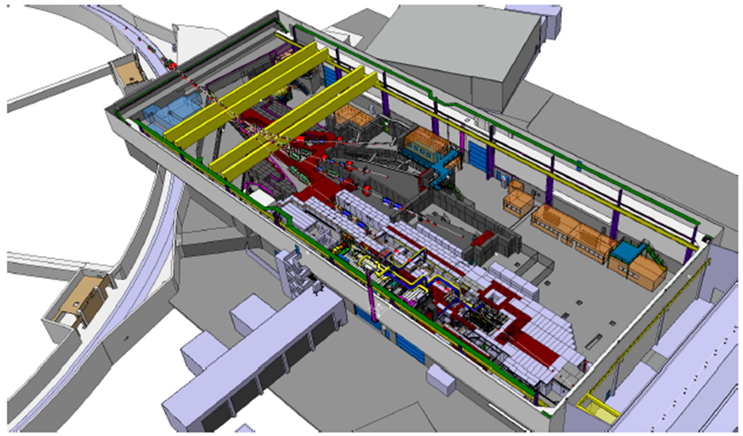
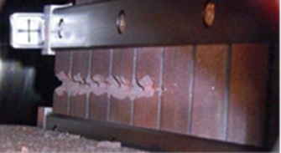
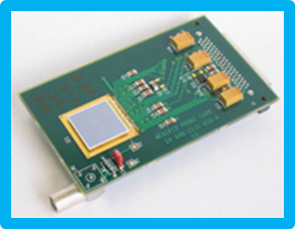
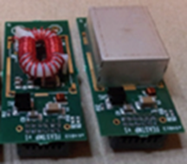

Slide 3
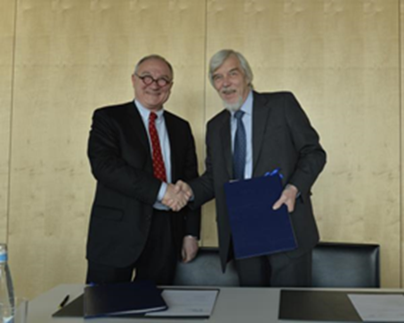
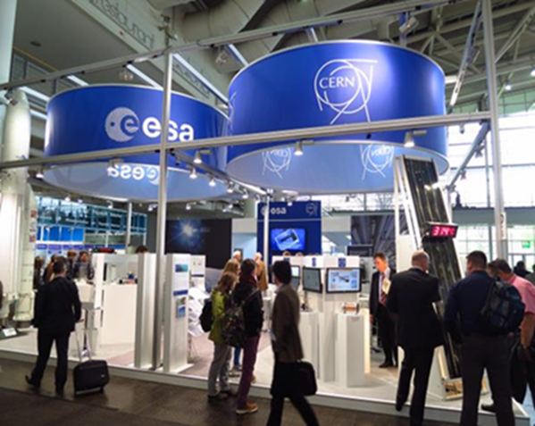
CERN-ESA bilateral cooperation
Geneva, 28/03/14
Signature of CERN-ESA framework co-operation agreement:
“CERN and ESA have common roots and share a long history of pioneering research work in their respective fields. This new cooperation agreement will foster synergies between the expertise, know-how and facilities available in the two Organizations.”

Slide 4
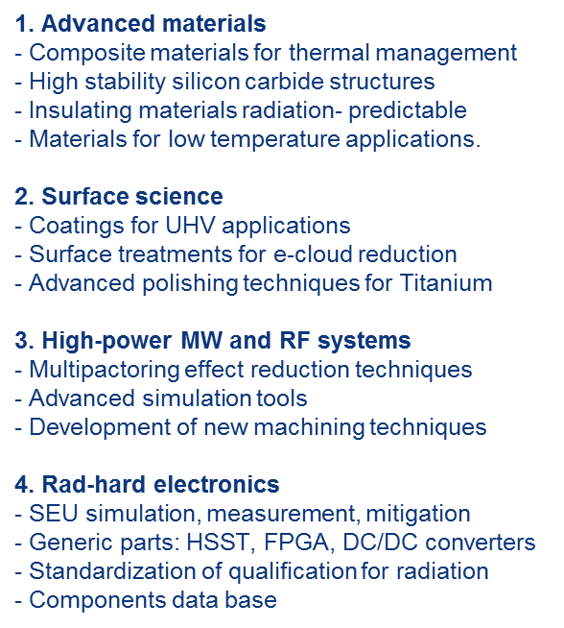
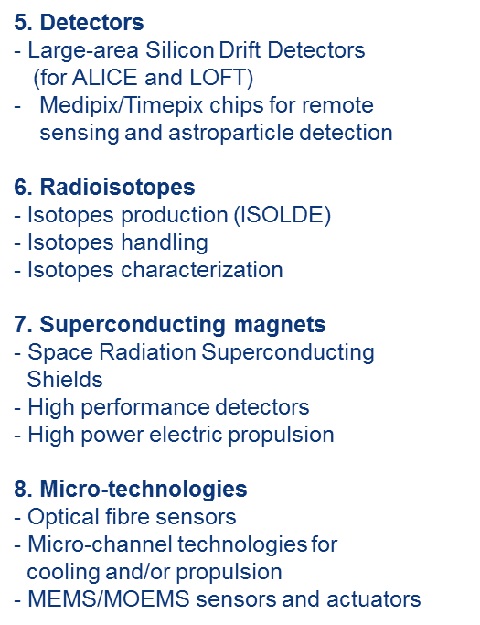
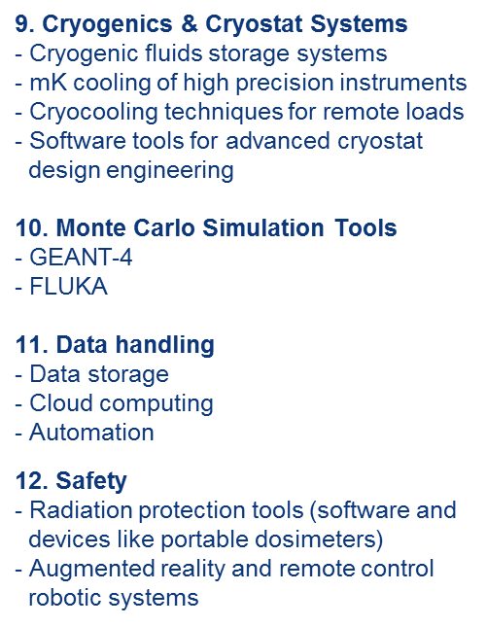
Identified technology areas of potential collaboration:
Proposal: establishing the first CERN-ESA cooperation implementing protocol on «Radiation Environments, Technologies and Facilities»

Slide 5
CERN-ESA Implementing protocol on
«Radiation Environments, Technologies and Facilities»
Identification of subcategories
Identification of esperts from both sides
Identification of specific projects
Rad-hard electronics
Radiation testing
Radiation monitoring
Radiation protection
Reliable microtechnologies
Radiation modelling
Facilities:
  CHARM
    Ex. CERN/ESA qualification protocol of COTS components/systems
  VESPER
    Ex. JUICE technology validation tests
Technologies:
  SSDP, FEAST-2, RadMon, Timepix, NG-FPGA, personal dosimeters…
Montecarlo simulations (GEANT4, FLUKA)
CELESTA (launch / data)
Ongoing / future NPI projects
Joint «external beam time» procurement
RADECS 2017 and RADSAGA initiatives

