Slide 1
Optical system
BGC

Slide 2
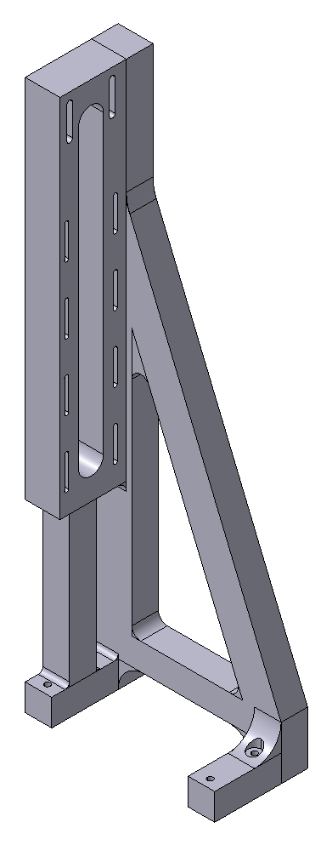


Slide 3
