Slide 1

Migration of PyECLOUD simulation campaigns
to HTCondor
G. Iadarola
Many thanks to: P. Dikstal, K. Li, A. Mereghetti, G. Skripka
e-cloud meeting, 10 May 2017

Slide 2
Introduction
IT is presently changing the software used to manage the load on the linux batch cluster (lxbatch) moving from the LSF (IBM) to HTCondor (open).
  This changes the way the user interacts with the system (how you submit your jobs to the cluster…)
Computing resources are gradually being moved from one system to the other
Timeline for resources dedicated to BE-ABP (defined by the ABP-CWG):
  From 18 April 2017: 50% in LSF – 50% in HTCondor
  From 18 May 2017: 10% in LSF – 90% in HTCondor
  End 2017: end of LSF support
PyECLOUD buildup simulations are heavy users of the lxbatch system
  → we need to move before being affected by resource shrinkage in LSF

Slide 3
Useful material
Information on the new system can be found at:
CERN batch service: http://information-technology.web.cern.ch/services/batch
CERN Batch Service User Guide: http://batchdocs.web.cern.ch/batchdocs/
HTCondor website: https://research.cs.wisc.edu/htcondor/
Presentations at the ABP-CWG meetings:
  B. Jones, “LSF -> HTCondor migration”, ABP-CWG meeting 29/09/2016
  K. Li, ``First experience using HTCondor for PyHEADTAIL”, ABP-CWG meeting 30/03/2017

Slide 4
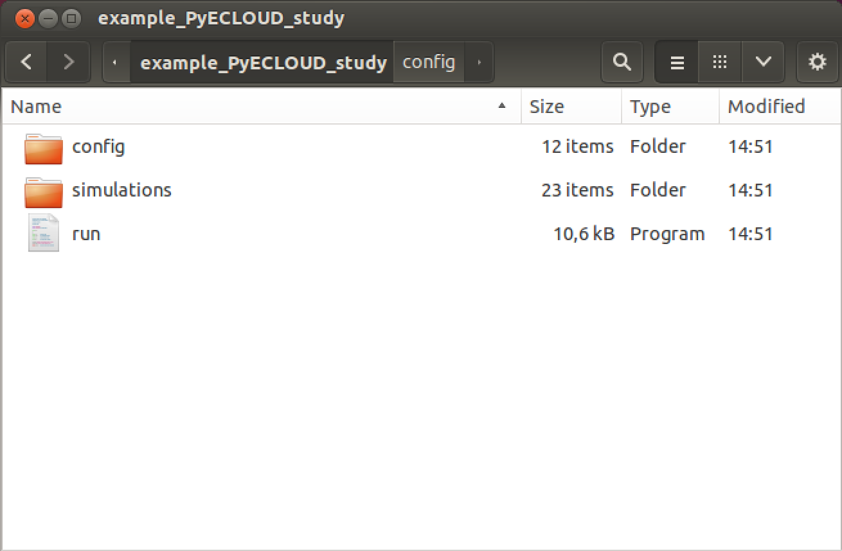
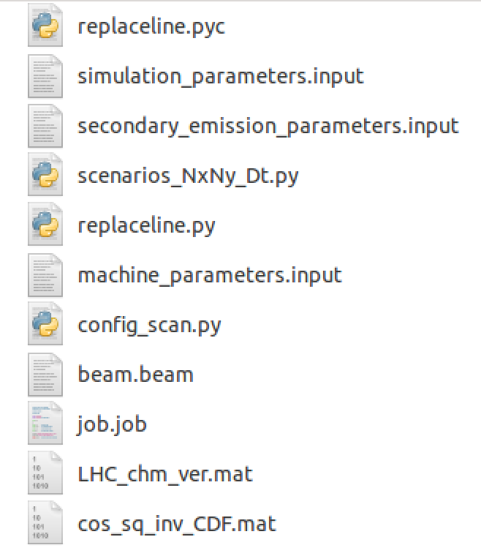

Reminder on LSF submission procedure
We typically setup a study using a configuration script which prepares our folder structure (one folder per simulation, containing its input and output)
Execute the configuration script

Slide 5
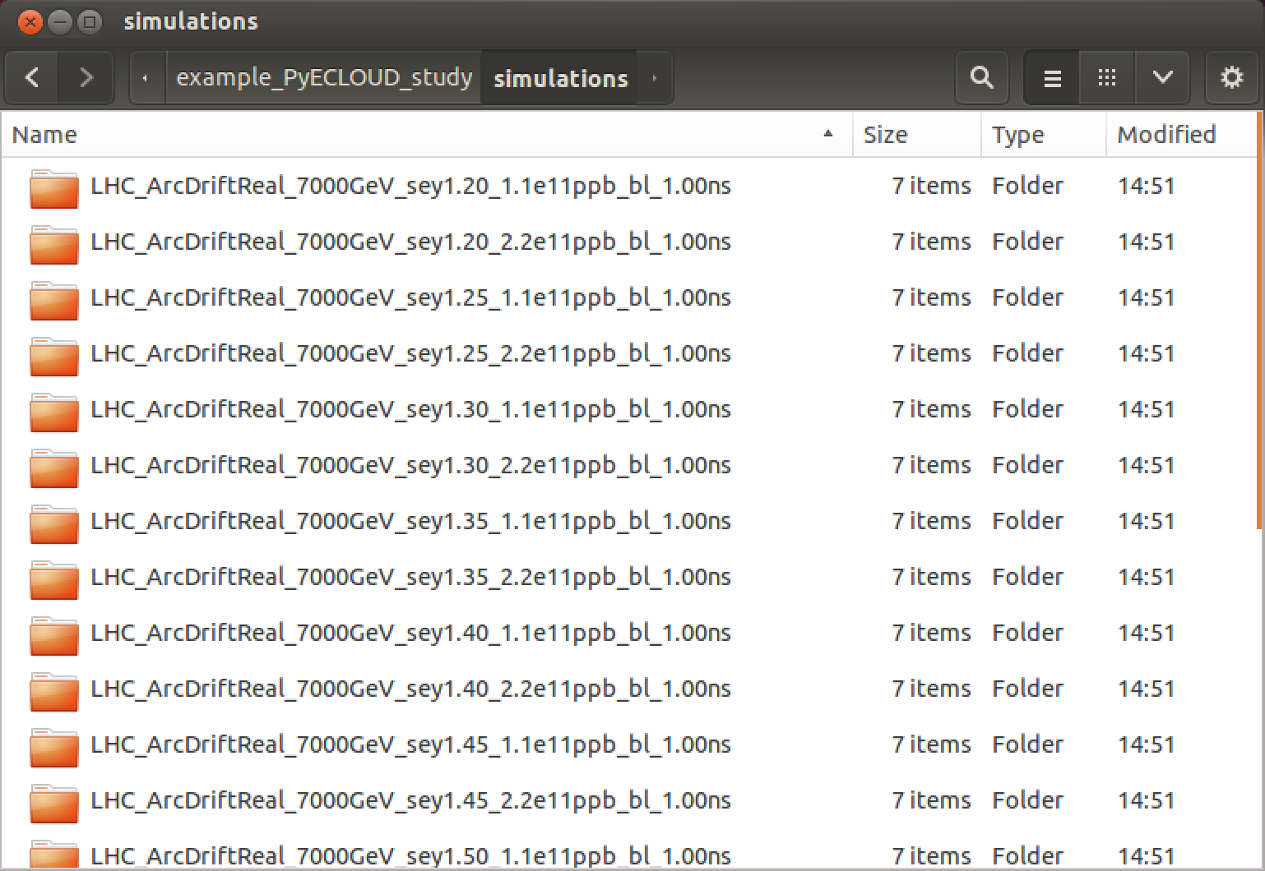
Reminder on LSF submission procedure
We typically setup a study using a configuration script which prepares our folder structure (one folder per simulation, containing its input and output)

Slide 6
Reminder on LSF submission procedure
We typically prepare a study using a configuration script which prepares our folder structure (one folder per simulation, containing its input and output)
Execute ./run on lxplus to run submit the jobs to with LSF

Slide 7
How to submit PyECLOUD jobs using HTCondor
Decided to keep the present configuration scripts and folder structure (your post-processing script should work without changes)
Wrote a simple additional module that can be included inyour configuration script in order to setup the HTCondor submission
An example study can be downloaded from the indico page

Slide 8
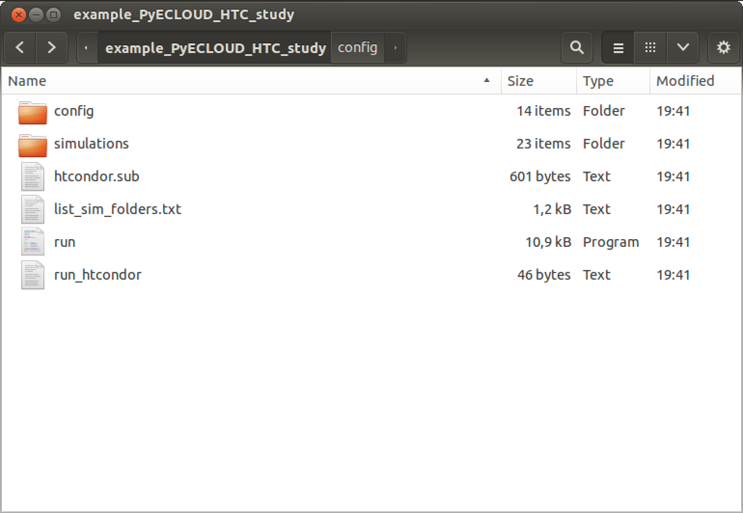
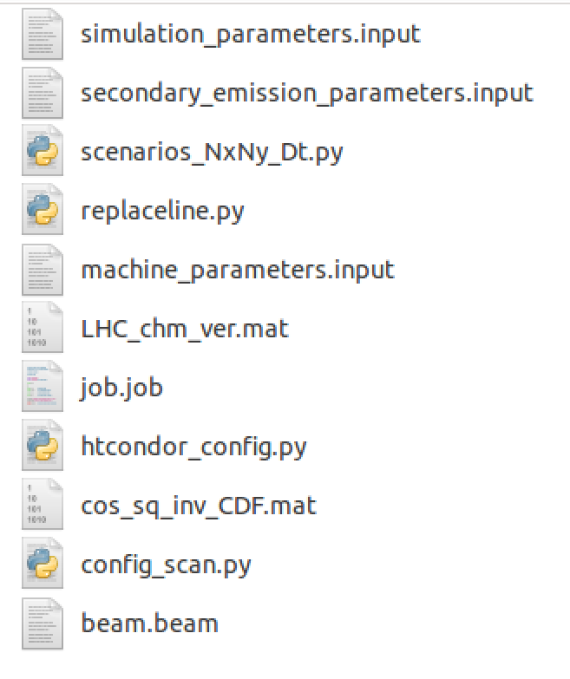
How to submit PyECLOUD jobs using HTCondor
Start with the “config” folder as you would have prepared it for LSF
Add the “htcondor_config.py” module (from the zip attached in the indico page)

Slide 9
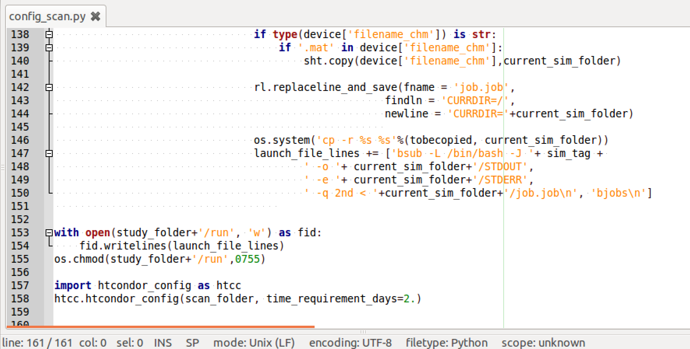
How to submit PyECLOUD jobs using HTCondor
Add these two extra lines to your “config_scan.py” as shown below
In HTCondor there no queue distinction, just indicate the max time you expect your simulations to take (with some margin)

Slide 10
How to submit PyECLOUD jobs using HTCondor
Add these two extra lines to your “config_scan.py” as shown below
In HTCondor there no queue distinction, just indicate the max time you expect your simulations to take (with some margin)
Execute the configuration script

Slide 11
How to submit PyECLOUD jobs using HTCondor
The usual folder structure will be created…
…together with three extra files needed for the HTCondor submission

Slide 12
How to submit PyECLOUD jobs using HTCondor
The usual folder structure will be created…
…together with three extra files needed for the HTCondor submission
You can still choose to submit the jobs to LSF executing “./run”
Submit the jobs with HTCondor executing “./run_htcondor” on lxplus

Slide 13
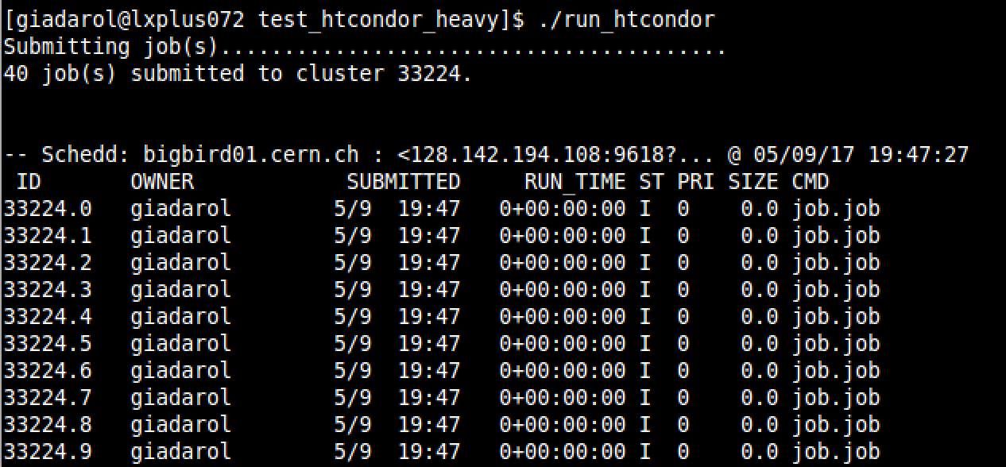
How to submit PyECLOUD jobs using HTCondor
All jobs submitted together form an HTCondor cluster to which in ID number is assigned
Individual jobs are identified with progressive numbers

Slide 14
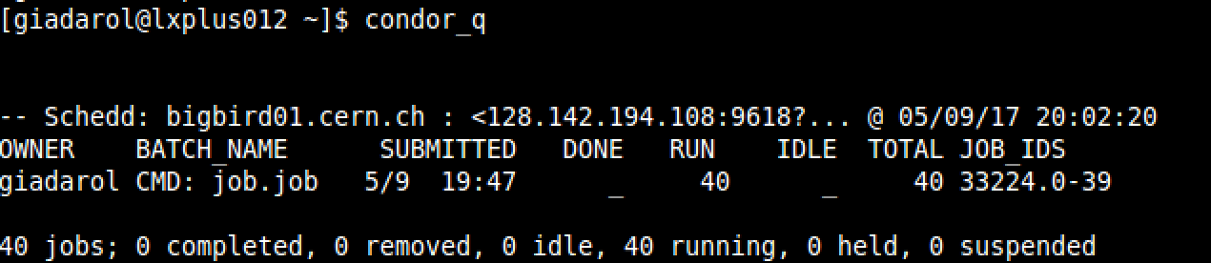
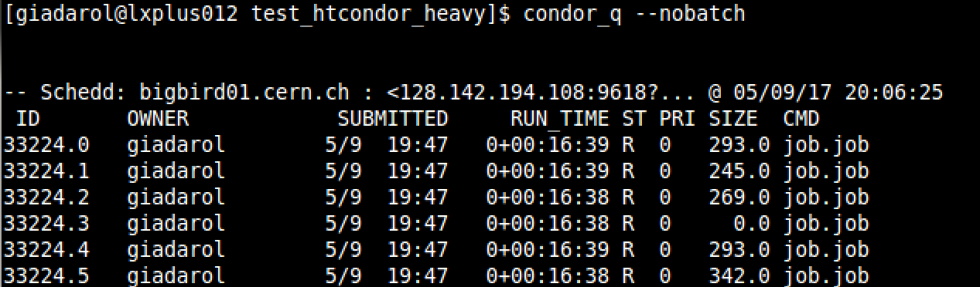
How to submit PyECLOUD jobs using HTCondor
The command “condor_q” can be used to know the state of your cluster
Use “--nobatch” to see individual jobs
To kill a single job:
To kill the entire cluster

Slide 15
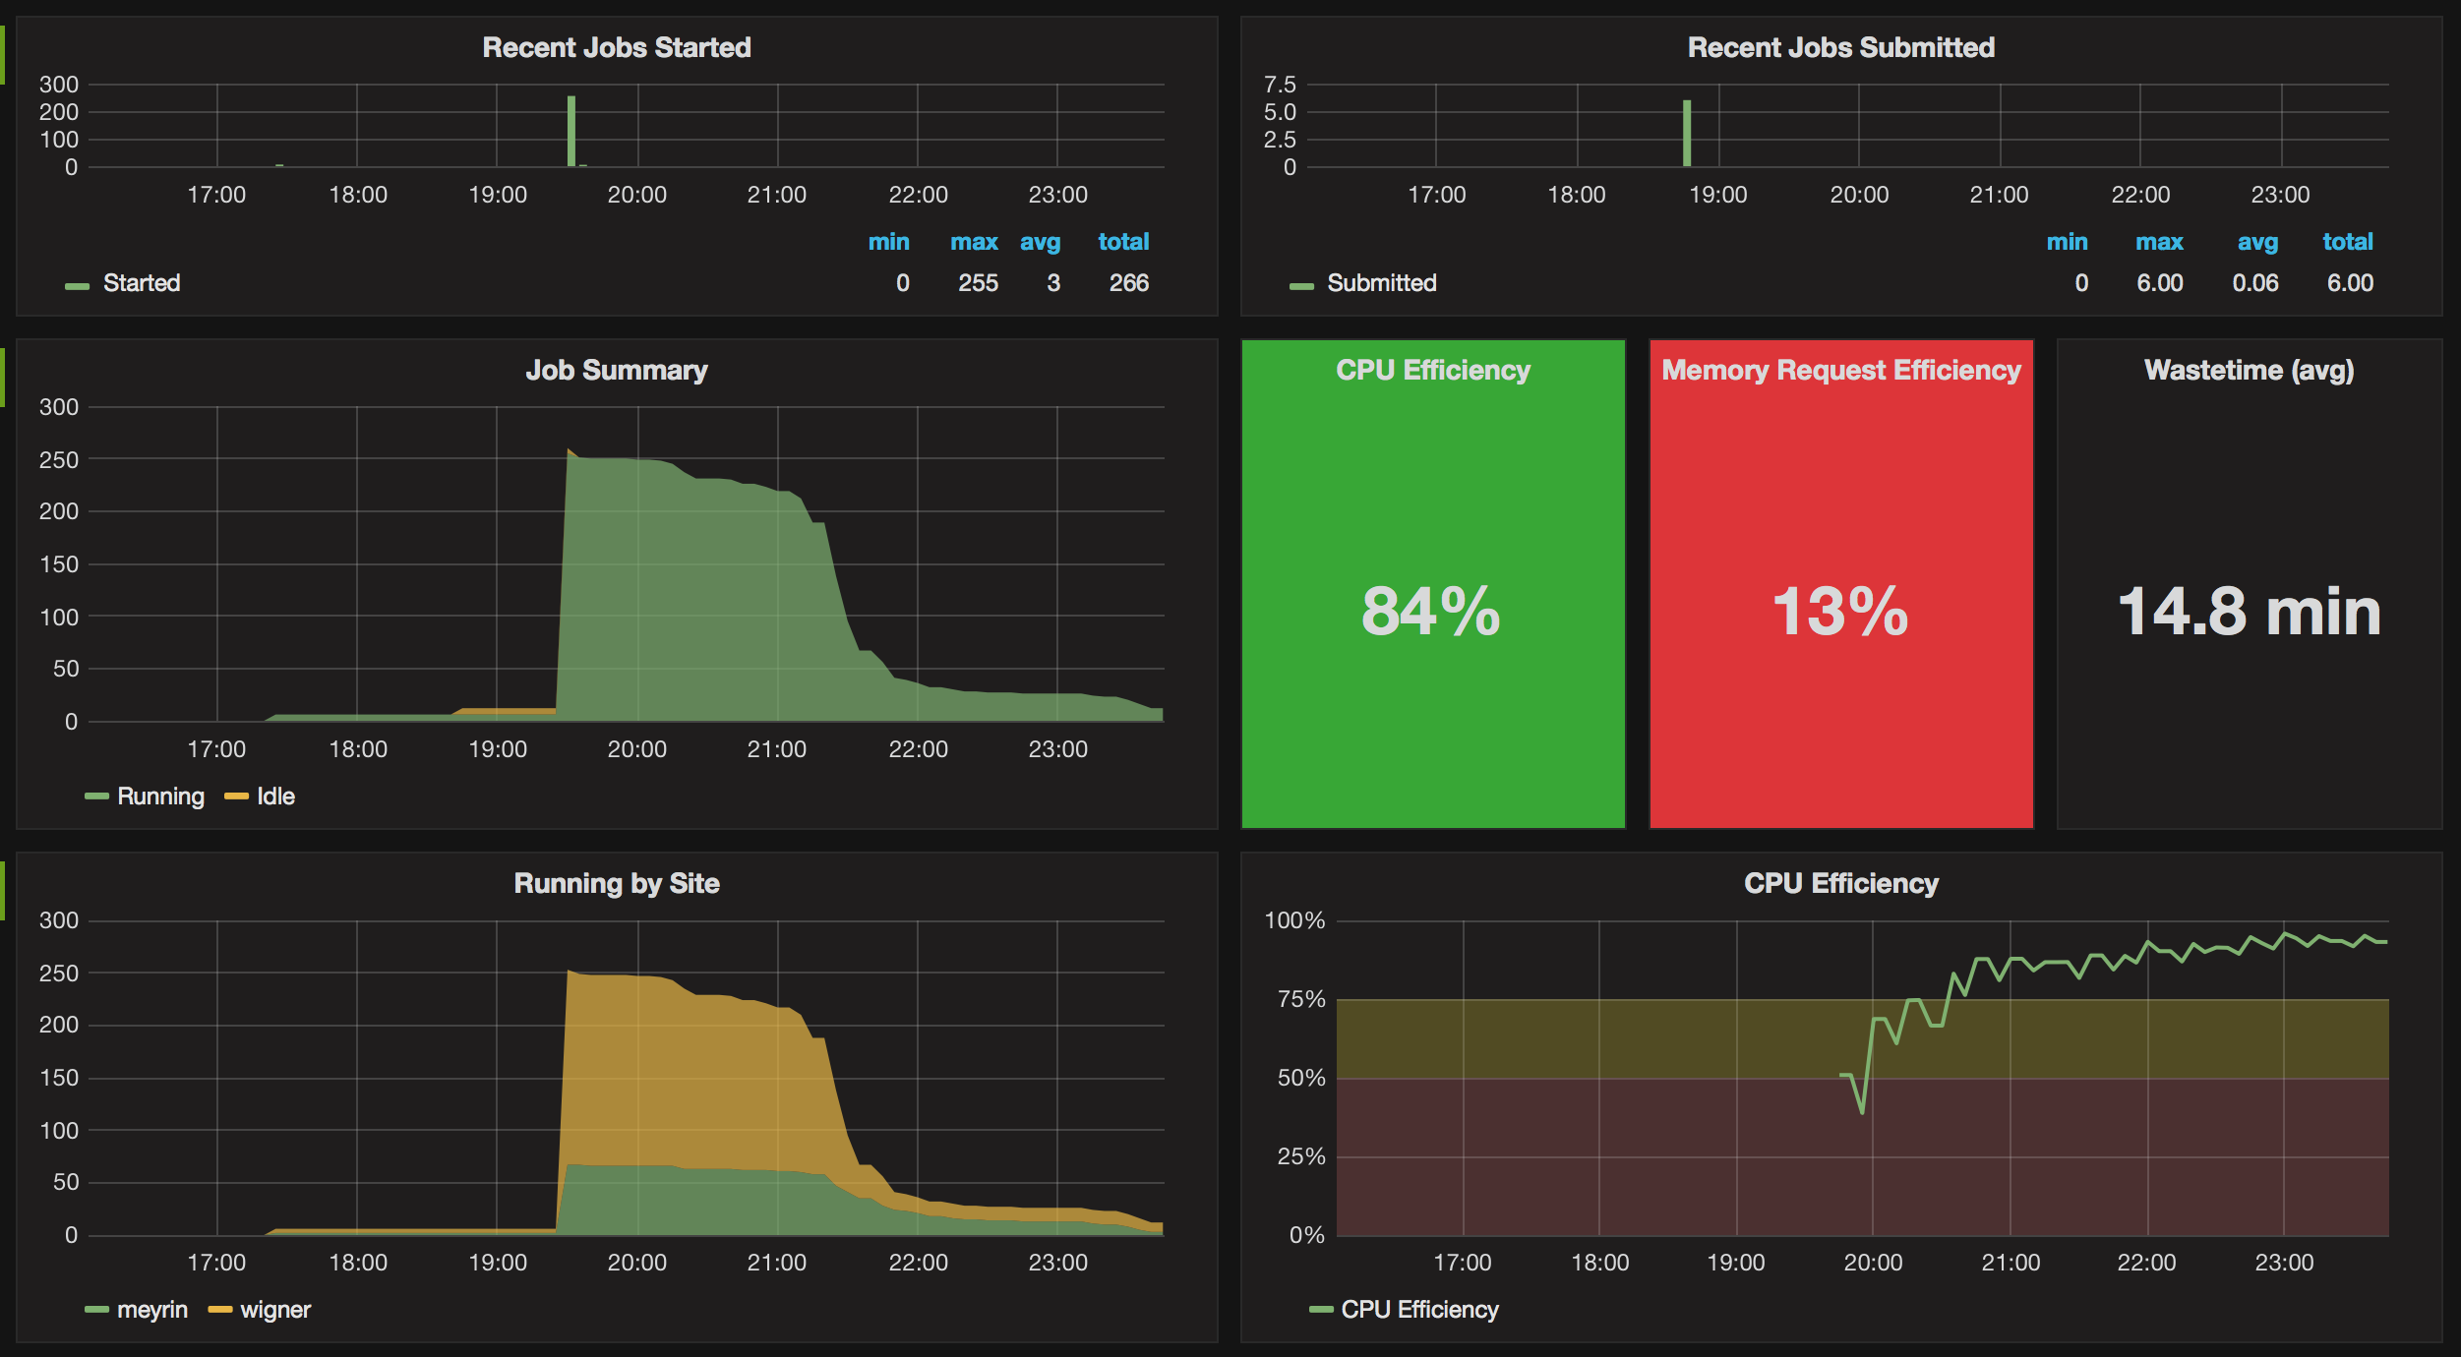
How to submit PyECLOUD jobs using HTCondor
HTCondor dashboard can be also used to monitor the jobs of a single user
http://information-technology.web.cern.ch/services/batch

Slide 16
Thanks for your attention!

