Slide 2

CHARM Dose Gradient Assessment
SMA Connector Test
Melanie Krawina
EN – STI FDA

Slide 3





Outline
Experiment
FLUKA
Plots
Comparison with RPL
Gradient

Slide 4
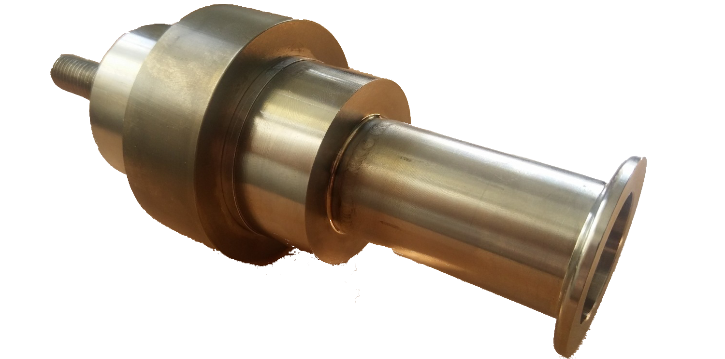
Shape Memory Alloy (SMA)
SMA Components
Connection device for vacuum chambers
Change their shape according to the temperature
Future use in the HL – LHC
Tested at CHARM to analyze the effects of strong radiation on them

Slide 5
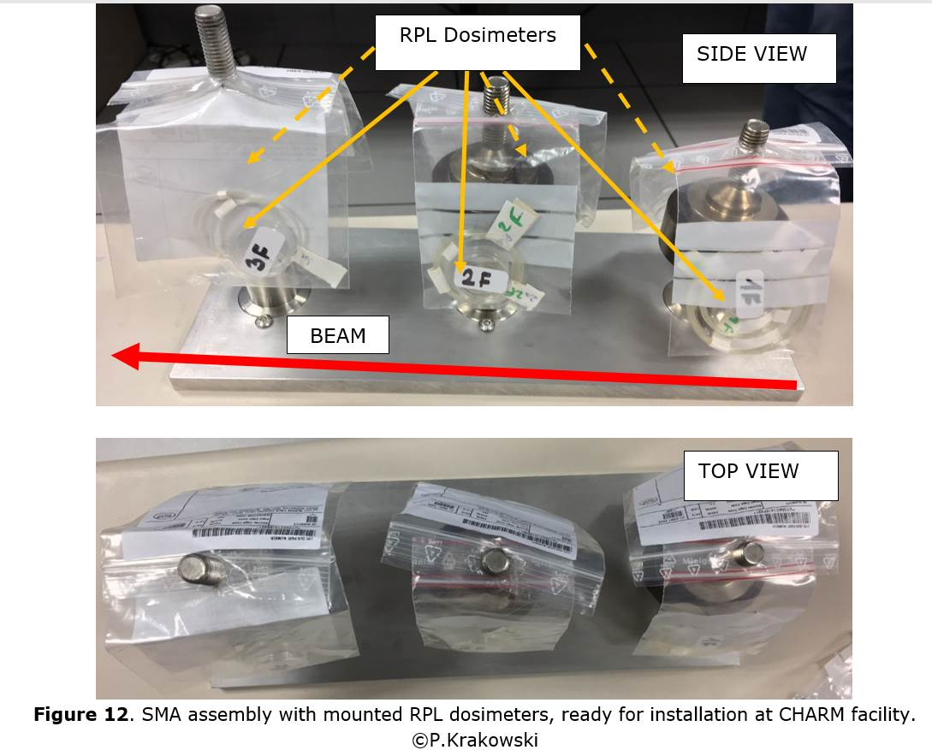

Experimental Set up
Experiment
For each sample two RPL dosimeters
In front and behind the SMAs
Placed on test position T0
Irradiated for 90 days to get a dose around 100 kGy

Slide 6
FLUKA Set up
6
Simplified Geometry
Due to the close distance to the target we did not simulate the whole CHARM geometry because some effects are not significant or negligible
Primary
We used 50.000.000 primaries on target
USRBIN
We scored for the dose and the 1MeV Neutron on the table

Slide 7
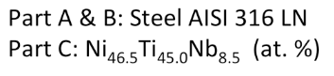
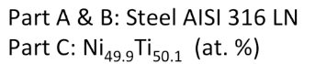
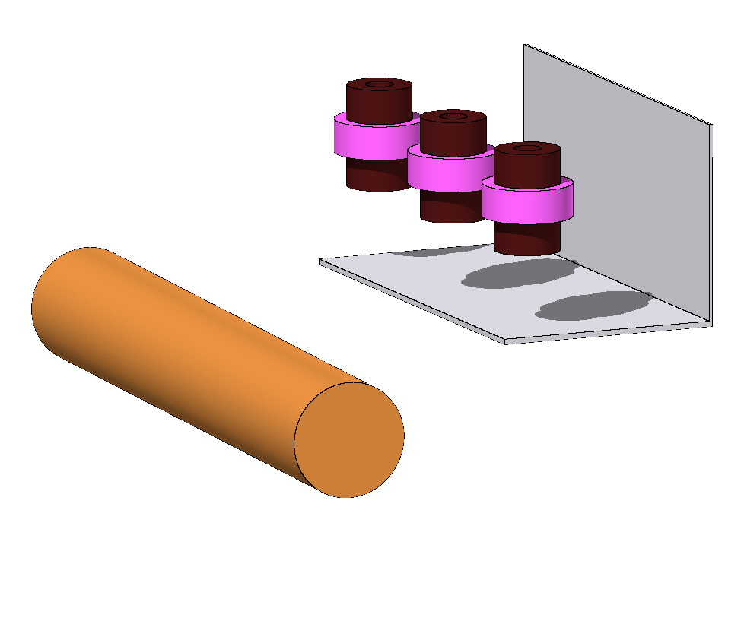
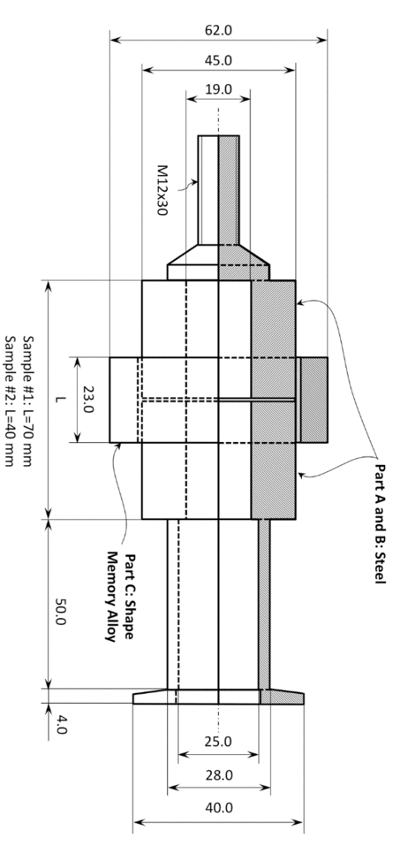
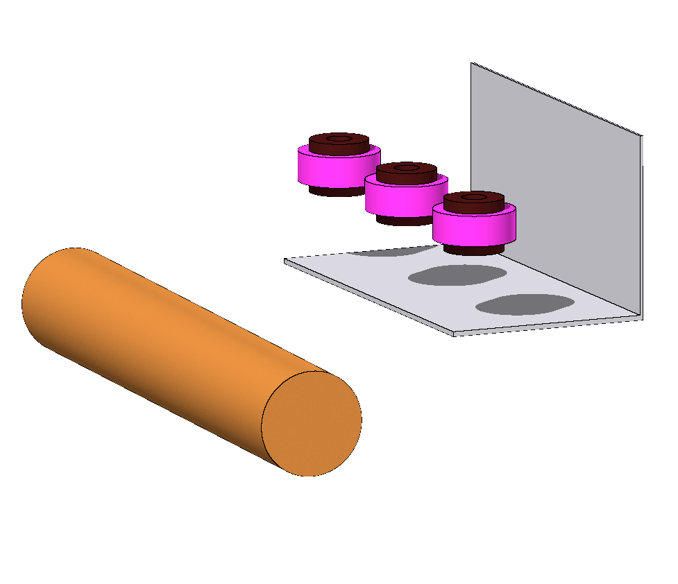
Geometry
Layout 1
Layout 2
24 GeV
24 GeV

Slide 8
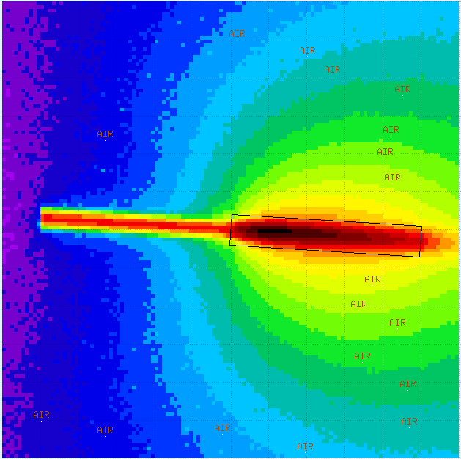
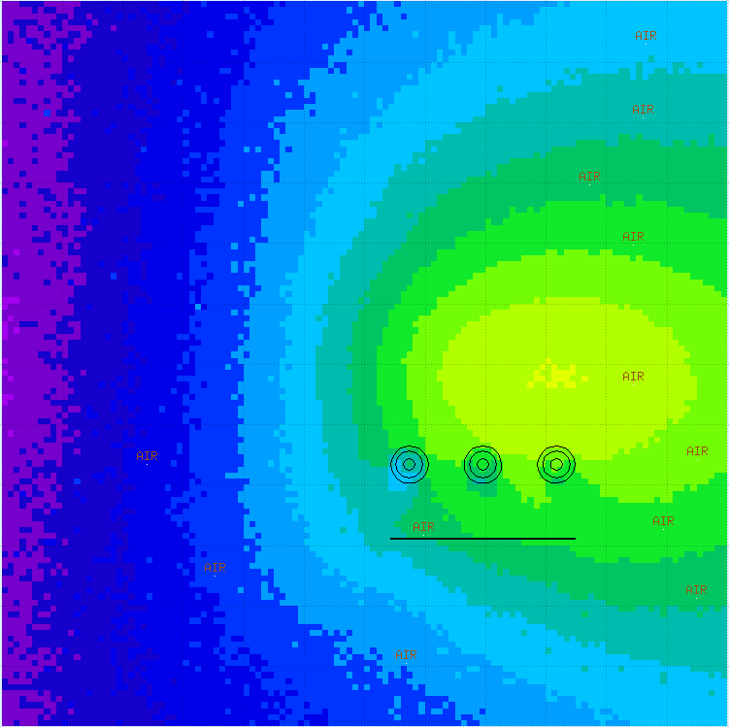
FLUKA
TARGET HEIGHT
LAYOUT 1
Regular Cartesian mesh
0.5 cm x 0.5cm x 0.5cm
∼ 1kGy/d
∼ 1kGy/d
[Gy/d]

Slide 9
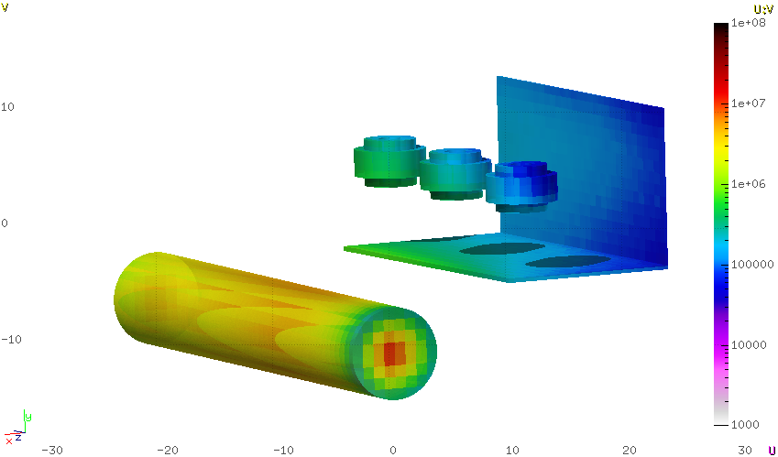
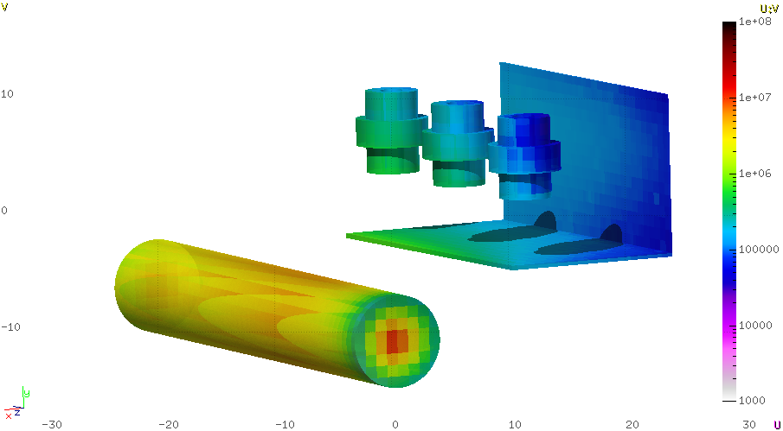
FLUKA
Layout 1
Layout 2
3
2
1
3
2
1
Z
X
Z
X
24 GeV
24 GeV
[Gy]

Slide 10
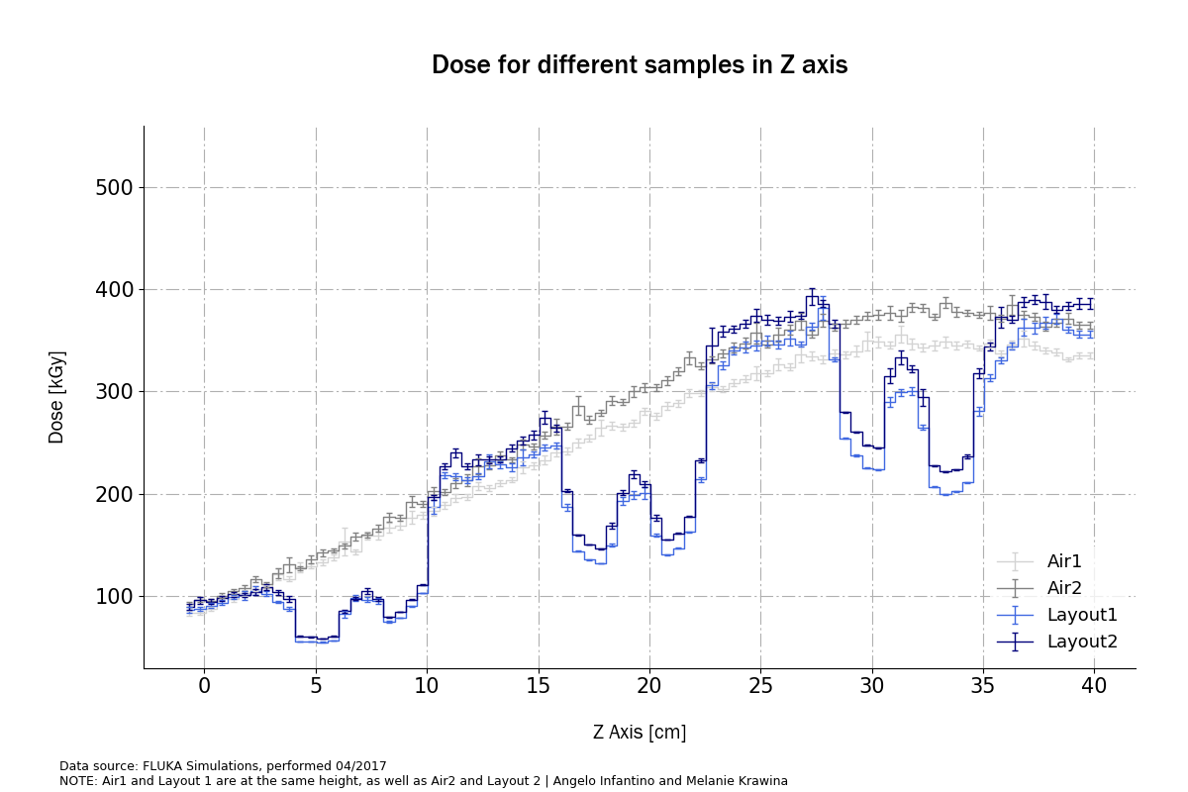
Plot Z Axis
Simulated with Air and Samples
Three samples distributed on the z Axis
Air1 and Layout 1 are on the same height, v.v
Beam

Slide 11
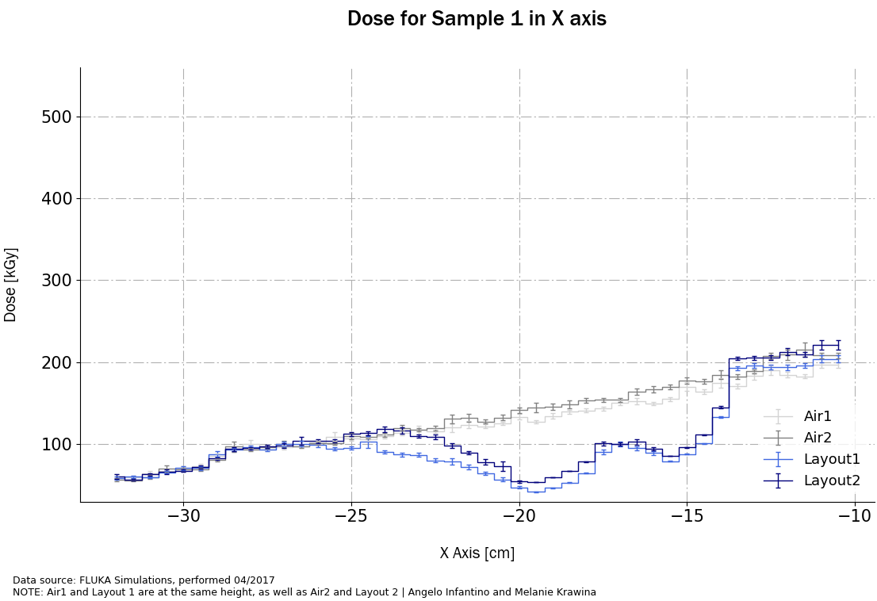
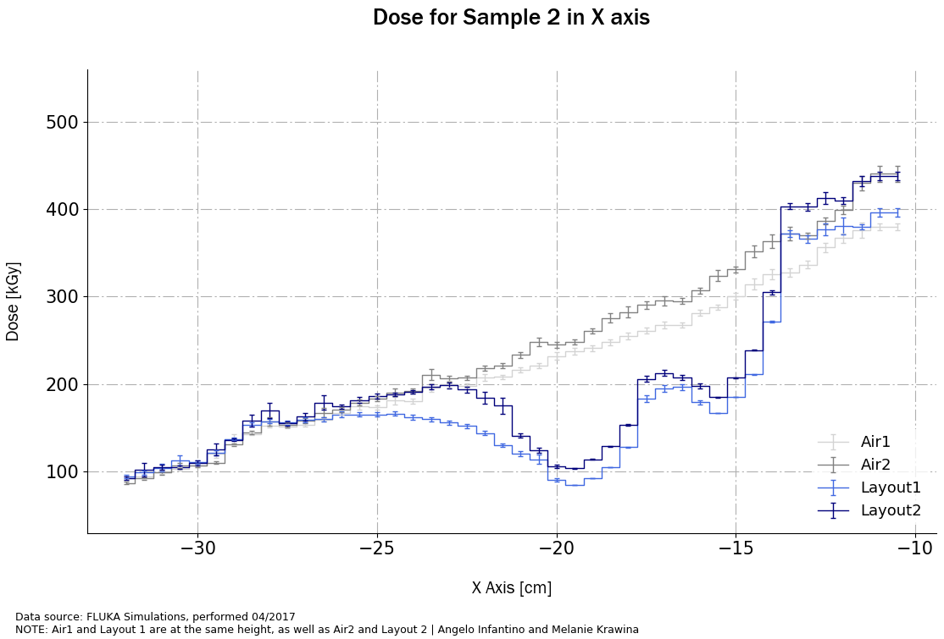
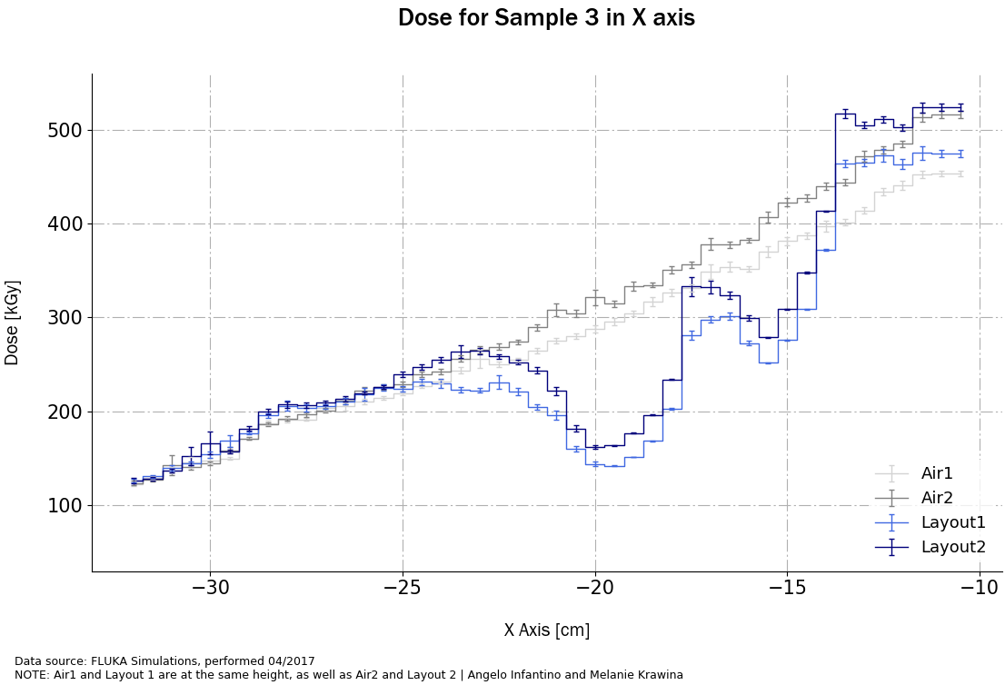
Plot X Axis : Dose
X

Slide 12
Comparison with RPL : Layout 1
RPL [kGy] |  | FLUKA [kGy] | FLUKA/RPL
1B | 55 | 52.1 | 0.94
1F | 100 | 163 | 1.63
2B | 75 | 102 | 1.36
2F | 150 | 321 | 2.14
3B | 90 | 152 | 1.69
3F | 140 | 418 | 2.98
3
2
1
24 GeV

Slide 13
Comparison with RPL : Layout 2
RPL [kGy] |  | FLUKA [kGy] | FLUKA/RPL
1B | 55 | 63.7 | 1.16
1F | 100 | 175 | 1.75
2B | 75 | 115 | 1.53
2F | 150 | 354 | 2.36
3B | 90 | 172 | 1.91
3F | 140 | 465 | 3.32
3
2
1
24 GeV

Slide 14
Gradient
Gradient effects due to height differences
Height difference of 2 cm
Stronger gradient with increasing Z value
We want to quantify these effect for three different positions
Results between 0.2 and 15 % according to the position

Slide 15
Comparison of the Gradient in Z Axis
Start Table
Middle Table
End Table
0 [cm]
15.25 [cm]
30.5 [cm]
1.28E+02 [kGy]
2.18E+02 [kGy]
3.42E+02 [kGy]
1.27E+02 [kGy]
3.04E+02 [kGy]
3.75E+02 [kGy]
0.95 %
8.19 %
9.60 %

Slide 16
Comparison of the Gradient in X Axis : Sample 1
Start Table
Middle Table
End Table
0 [cm]
7.75 [cm]
15.5 [cm]
8.52E+01 [kGy]
1.24E+02 [kGy]
1.71E+02 [kGy]
8.05E+01 [kGy]
1.32E+02 [kGy]
1.83E+02 [kGy]
5.5 %
6.62 %
6.81 %

Slide 17
Comparison of the Gradient in X Axis : Sample 2
Start Table
Middle Table
End Table
0 [cm]
7.75 [cm]
15.5 [cm]
1.37E+02 [kGy]
2.08E+02 [kGy]
3.28E+02 [kGy]
1.31E+02 [kGy]
2.21E+02 [kGy]
3.72E+02 [kGy]
4.26 %
6.04 %
13.56 %

Slide 18
Comparison of the Gradient in X Axis : Sample 3
Start Table
Middle Table
End Table
0 [cm]
7.75 [cm]
15.5 [cm]
1.50E+02 [kGy]
2.64E+02 [kGy]
4.01E+02 [kGy]
1.58E+02 [kGy]
2.89E+02 [kGy]
4.44E+02 [kGy]
5.84 %
9.41 %
10.68 %

Slide 19
Gradient at the Table
Gradient effects due to height differences
We see an increasing gradient in positive Z axis
The strongest gradient in X axis for the middle of the table/Sample 2
In fact we have an angular distribution of the gradient
3
2
1
Z
X

Slide 20


FLUKA vs. RPL?
Do we trust the FLUKA values ?
If we know the exact position of the RPLs

Slide 21
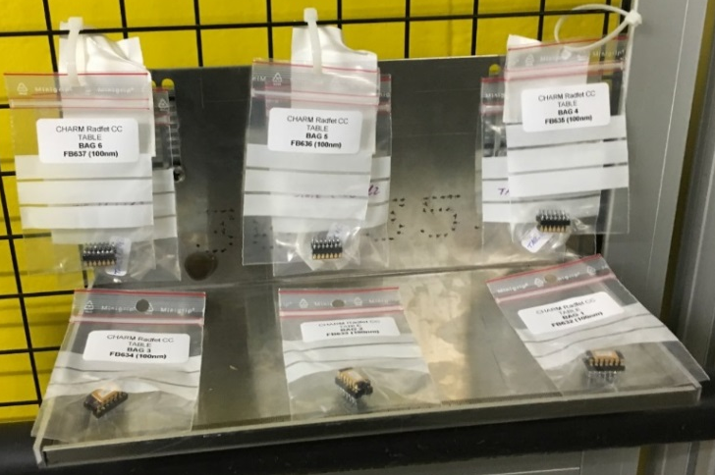
Comparison with RPL (Joao)
RPL [Gy] |  | FLUKA [Gy] | FLUKA/RPL
1 | 644.7 | 571.0 | 8.86E-01
2 | 674.2 |  | 8.47E-01
3 | 579.0 | 465.0 | 8.03E-01
4 | 547.8 |  | 8.49E-01
5 | 371.1 | 282.2 | 7.61E-01
6 | 416.7 |  | 6.77E-01
1
2
3
4
5
6

Slide 22
Comparison with RadFET (Joao)
RF [Gy] |  | FLUKA [Gy] | FLUKA/RF
1 | 525 | 631.4 | 1.20E+00
2 | 441 | 440.7 | 9.99E-01
3 | 307 | 271.7 | 8.85E-01
4 | 1326 | 2056.0 | 1.55E+00
5 | 1172 | 1700.9 | 1.45E+00
6 | 684 | 828.4 | 1.21E+00
2
1
3
4
5
6

Slide 23
Conclusion
Dose Gradient
We see indeed a strong dose gradient on the table
Exact Position
To compare the values from the dosimeters with the FLUKA Simulation we need to know the exact positions
Future Experiments
We have to quantify the gradient effect for the test positions to ensure the dose for future CHARM users

Slide 24


Melanie Krawina
Tech. Student @ CERN - EN/STI - FDA
R2E Project
melanie.krawina@cern.ch

Slide 25
Appendix

Slide 26
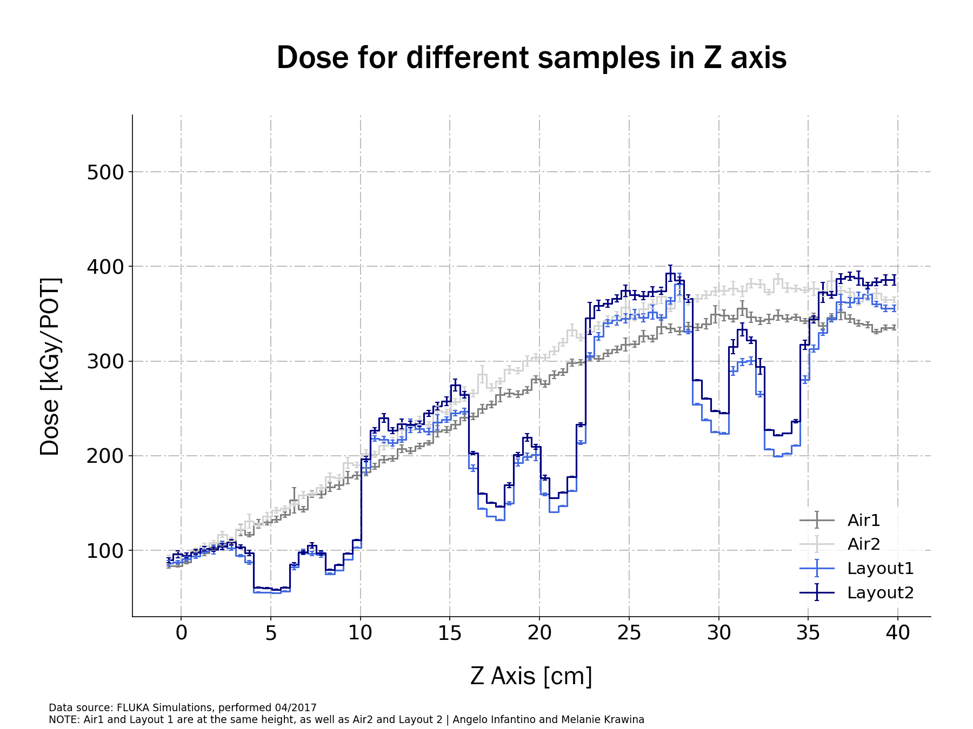
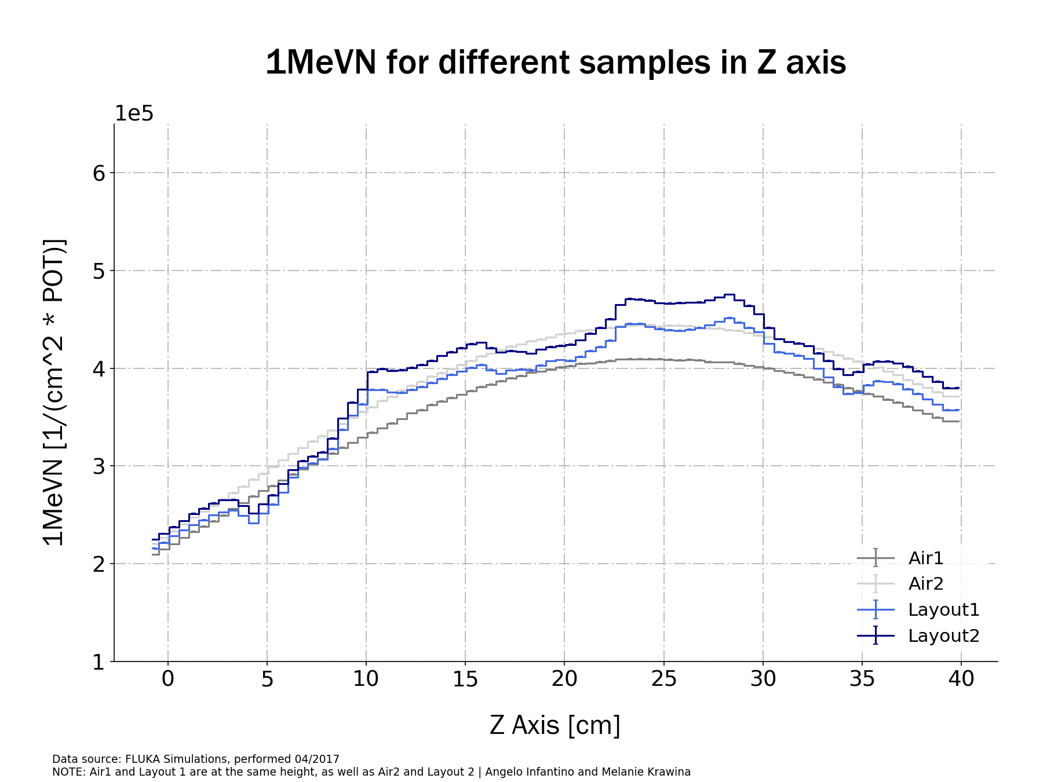
Plot Z Axis
Beam

Slide 27
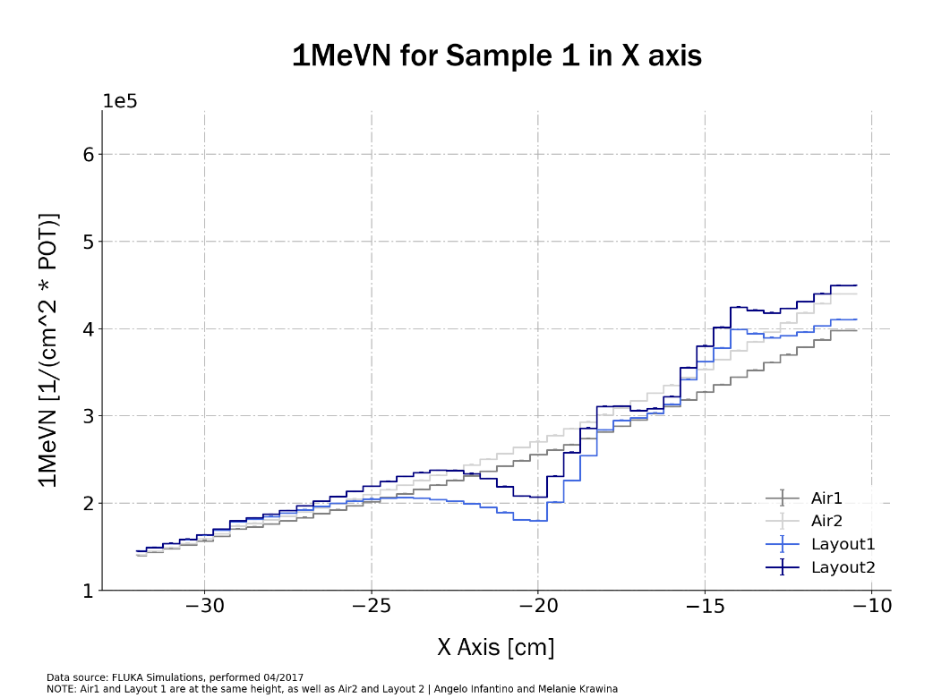
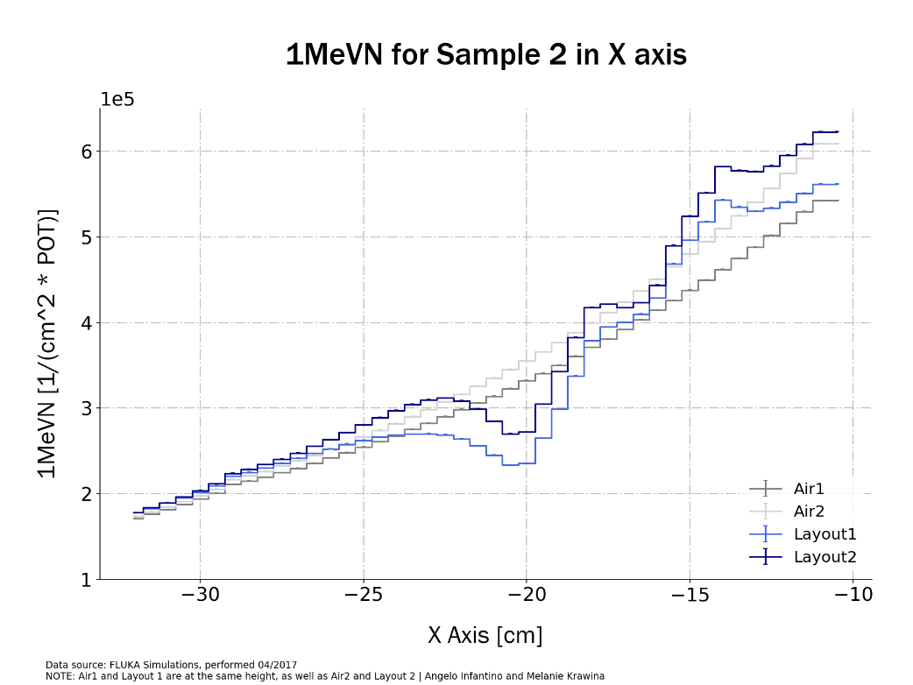

Plot X Axis : 1MeVN

Slide 28
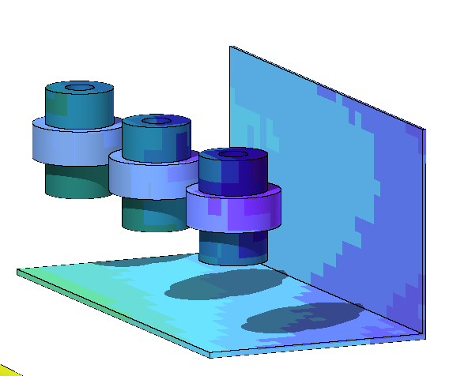
Comparison Data 2016
RPL [kGy] |  | FLUKA [kGy] | FLUKA/RPL
1B | 55 | 58.8 | 1.07
1F | 100 | 145 | 1.45
2B | 75 | 107 | 1.42
2F | 150 | 282 | 1.88
3B | 90 | 156 | 1.73
3F | 140 | 350 | 2.50
3
2
1

Slide 29
Comparison of the Gradient in Z Axis
Start Table
Middle Table
End Table
Center S1
Center S2
Center S3
0 [cm]
15.25 [cm]
30.5 [cm]
3.1 [cm]
15.25 [cm]
27.4 [cm]
1.28E+02 [kGy]
2.69E+02 [kGy]
3.42E+02 [kGy]
1.59E+02 [kGy]
2.69E+02 [kGy]
3.46E+02 [kGy]
1.27E+02 [kGy]
3.00E+02 [kGy]
3.75E+02 [kGy]
1.60E+02 [kGy]
3.00E+02 [kGy]
3.82E+02 [kGy]
0.95 %
11.42 %
9.60 %
0.23 %
11.42 %
10.30 %

Slide 30
Comparison of the Gradient in X Axis : Sample 1
Start Table
Middle Table
End Table
Before S1
Center S1
After S1
0 [cm]
7.75 [cm]
15.5 [cm]
15.5 [cm]
12.4 [cm]
9 [cm]
8.52E+01 [kGy]
1.24E+02 [kGy]
1.71E+02 [kGy]
1.71E+02 [kGy]
1.52E+02 [kGy]
1.25E+02 [kGy]
8.05E+01 [kGy]
1.32E+02 [kGy]
1.83E+02 [kGy]
1.83E+02 [kGy]
1.64E+02 [kGy]
1.32E+02 [kGy]
5.5 %
6.62 %
6.81 %
6.81 %
7.63 %
5.68 %

Slide 31
Comparison of the Gradient in X Axis : Sample 2
Start Table
Middle Table
End Table
Before S2
Center S2
After S2
0 [cm]
7.75 [cm]
15.5 [cm]
15.5 [cm]
12.4 [cm]
9 [cm]
1.37E+02 [kGy]
2.08E+02 [kGy]
3.28E+02 [kGy]
3.28E+02 [kGy]
2.67E+02 [kGy]
2.21E+02 [kGy]
1.31E+02 [kGy]
2.21E+02 [kGy]
3.72E+02 [kGy]
3.72E+02 [kGy]
2.95E+02 [kGy]
2.48E+02 [kGy]
4.26 %
6.04 %
13.56 %
13.56 %
10.21 %
12.34 %

Slide 32
Comparison of the Gradient in X Axis : Sample 3
Start Table
Middle Table
End Table
Before S3
Center S3
After S3
0 [cm]
7.75 [cm]
15.5 [cm]
15.5 [cm]
12.4 [cm]
9 [cm]
1.50E+02 [kGy]
2.64E+02 [kGy]
4.01E+02 [kGy]
4.01E+02 [kGy]
3.54E+02 [kGy]
2.80E+02 [kGy]
1.58E+02 [kGy]
2.89E+02 [kGy]
4.44E+02 [kGy]
4.44E+02 [kGy]
3.78E+02 [kGy]
3.04E+02 [kGy]
5.84 %
9.41 %
10.68 %
10.68 %
6.73 %
8.79 %

