Slide 1
Simulation of SEE with Sentaurus TCAD
Including an example on a very simple VDMOS model
Pablo Fernández Martínez
R2E/FDA Update Meeting
11th May 2017

Slide 2
Outline
Introduction:
What TCAD Simulations are and how they work
Example:
Threshold LET of SEB in a power MOSFET
Conclusion:
What TCAD simulations can and what they can’t do for you

Slide 3






Semiconductor Device Simulation (a.k.a. TCAD Simulation):
    Find the solution of the semiconductor equations for a model of a semiconductor device, under some specific boundary conditions, taking into account the solid state physics and by using numerical (Finite Difference / Finite Element) methods.
Device Model
Semiconductor Equations
Layout details:
  2D or 3D, full/partial model, etc…
Technological details:
  Materials, Doping profiles, etc…
Poisson:
$$ε_{s}∇∙E=ρ$$
Semiconductor
$$ε_{s}∇^{2}ψ=−q\left(n−p+N_{D}^{+}−N_{A}^{−}\right)$$
e Continuity:
$$\frac{∂n}{∂t}=\frac{1}{q}∇∙J_{n}+G−R$$
Boundary Conditions
h Continuity:
$$\frac{∂p}{∂t}=−\frac{1}{q}∇∙J_{p}+G−R$$
Structural:
  Dirchlet (space-charge neutrality on the contacts), Neumann (reflecting on the edge), etc..
Operational:
  Bias, Charges, etc…
Drift
Diffusion
Drift-Diffusion
Formalism:
$$J_{n}=qμ_{n}nE+qD_{n}∇n$$
$$J_{p}=qμ_{p}pE−qD_{p}∇n$$
Alternative formalisms (less simplified):
  Thermodynamic: Including temperature
  Hydrodynamic: Taking into account Energy balance
Solid State Physics (Models)
Numerical models:
  Recombination (SRH, Auger…), Generation, Impact Ionization (Avalanche), High Field effects, Tunneling, Carrier Scattering, etc..
More details: W. Fichtner, et al. “Semiconductor Device Simulation”, IEEE TNS 30, 9, 1018-1030 (1983)

Slide 4
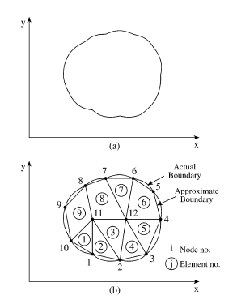





Finite Element Technique: How to solve Partial Differential Equations (PDE) in a Computer
Discretization of the solution region into a finite number of elements
Setting the equations for a typical element (Test Functions)
Assembling all elements in the solution region (Variationals)
Solving the system of equations obtained (Iteration Solver: Newton, Bank-Rose, etc..)
Test Function
Element Variational
(potential energy)
3
Test Function
in terms of finite
element vertex
values
Total Energy
1
PDE Solution in discretized region
is the variational minimum
2
4
More details: R. Bank, et al. “Numerical Methods for Semiconductor Device Simulation”, IEEE TNS 30, 9, 1031-1041 (1983)

Slide 5
How simulate the effects of Radiation:
Displacement Damage (cumulative effect):
  We include localized states (carrier traps) in the bandgap
    The Energy, trapping/detrapping Cross Section and Concentration of the carrier traps is correlated with the received Fluence
    Occasionally, some physical properties (e.g. carrier mobility or lifetime) can be also modified in correlation with Fluence.
Total Ionizing Dose (cumulative effect):
  We include Charge Densities in the semiconductor/dielectric Interface (or within the dielectric bulk)
    The Charge Concentration is correlated with the Total Absorbed Dose
    Very often, Interface states (carrier traps) can also be included. Their properties are also correlated with the Dose.
Single Event Effects (stochastic effect):
  We act on the physical model for the carrier Generation, including a Charge Distribution in a specific region of the semiconductor and then we simulate its evolution.
    The Charge Distribution Profile (amount of charge, length, width… ) is correlated with the incident radiation properties (LET, range, etc…)
    but the relationship is not calculated in the TCAD Simulation (we need the input from FLUKA or similar….)

Slide 6
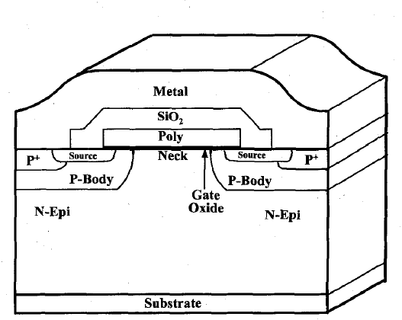
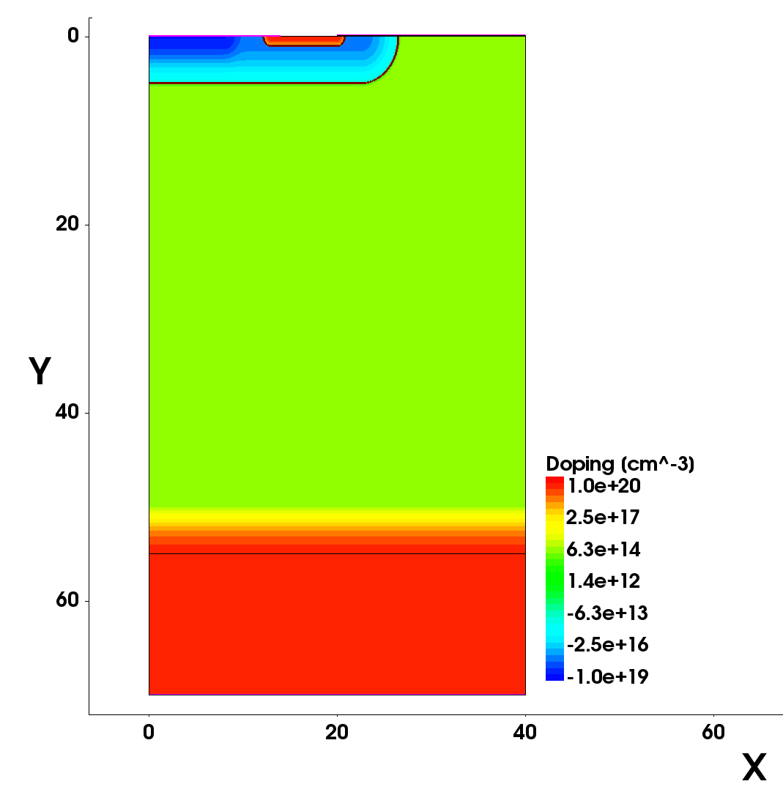
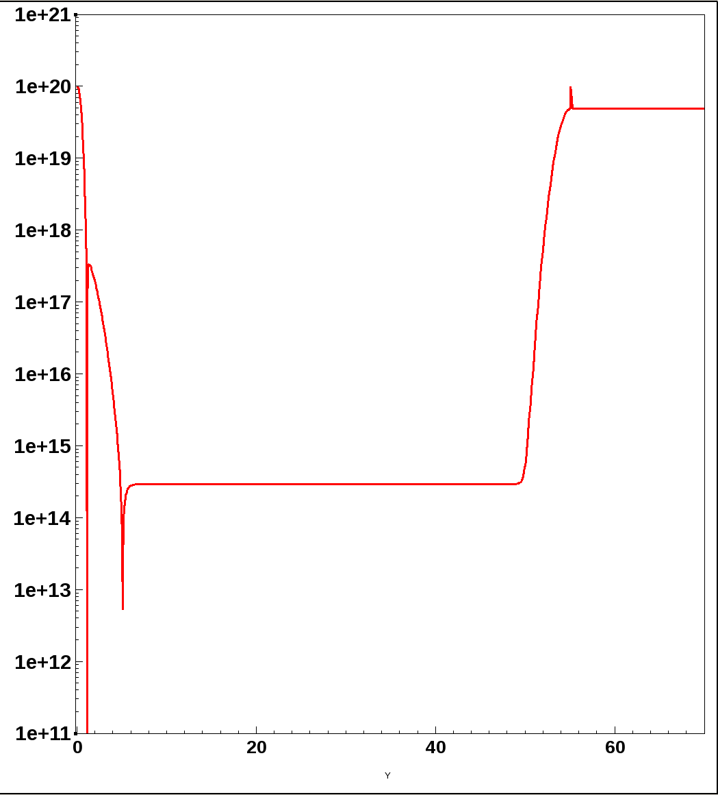
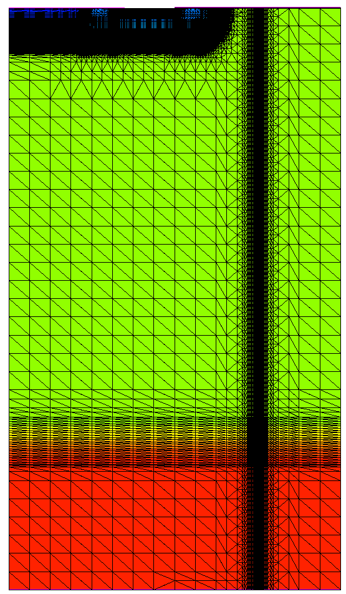
Example:
Reference example: A. Luu et al. “Sensitive volume and Triggering Criteria of SEB in Classic Planar VDMOS”, IEEE TNS 57, 4, 1900-1907 (2010)
N/N++
transition
2D
Half Cell
N+
Gate Oxide (100 nm)
Source
Gate
P+
N+ source
N+ Substrate
P Body
P Body
N- Epitaxy
Sentaurus TCAD
Model
N Epitaxy
Gaussian transition
(Silvaco TCAD model
would be quite similar)
N+ Substrate
Refinement for the SEE
Parametrized position and shape
(can be displaced and redefined)
Drain

Slide 7
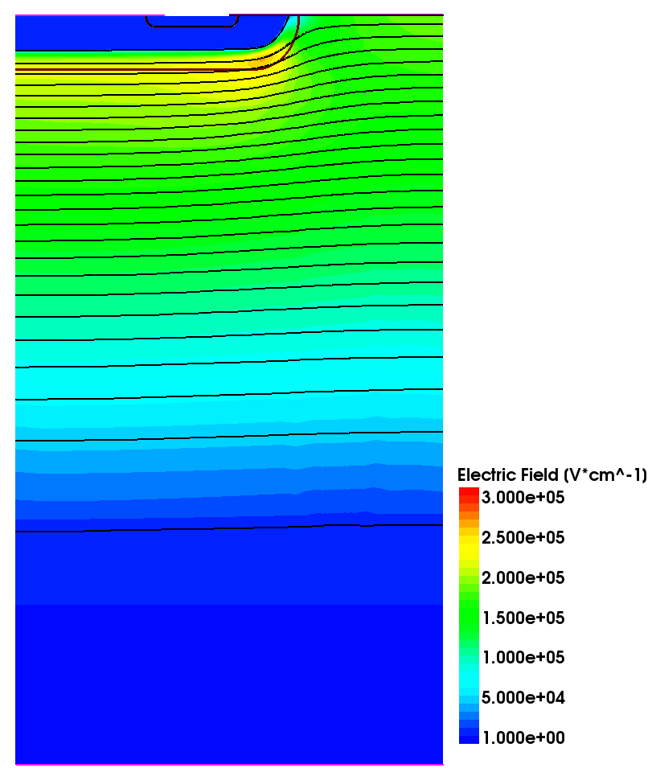
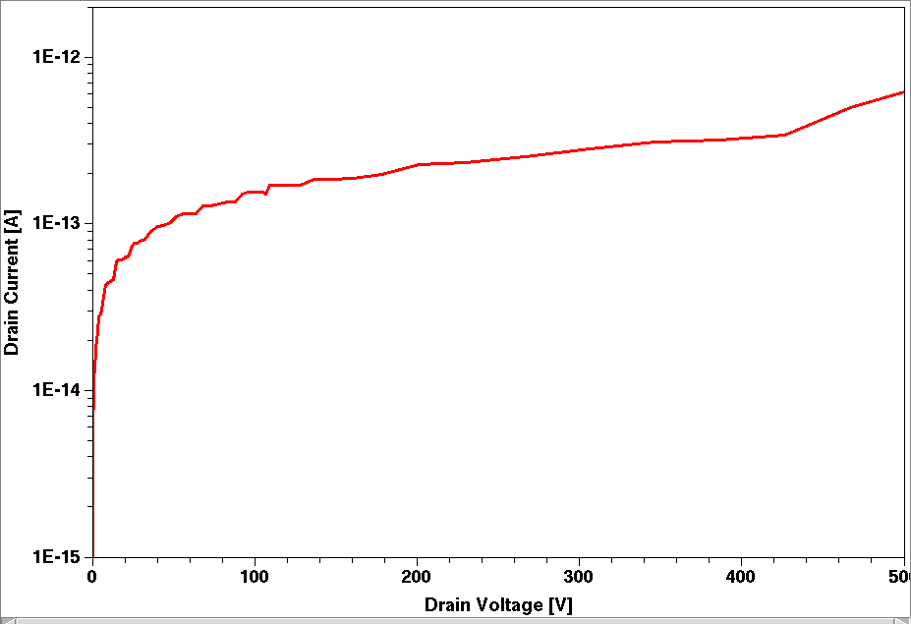
Simulation Flow:
Electrostatic
Potential
1st Creation of the Structure
  With a proper refinement mesh for both the electrical and the SEE simulation
  Different particle positions require different mesh, i.e. different structure files
0 V
100 V
180 V
260 V
320 V
2nd Electrical Simulation
Initial electrical conditions: Vg = Vs = Vd = 0 V
Quasi-stationary ramp up to the target Vd (e.g. Vd = 500 V)
Final solution is save to be used in the next step
380 V
420 V
460 V
480 V
Current level is not quantitatively relevant
(only half of a 2D cell has been simulated)
500 V
Distributions of the Electric Field, Electrostatic Potential, Charge Carriers, Carrier Currents, etc… are saved in the final solution

Slide 8
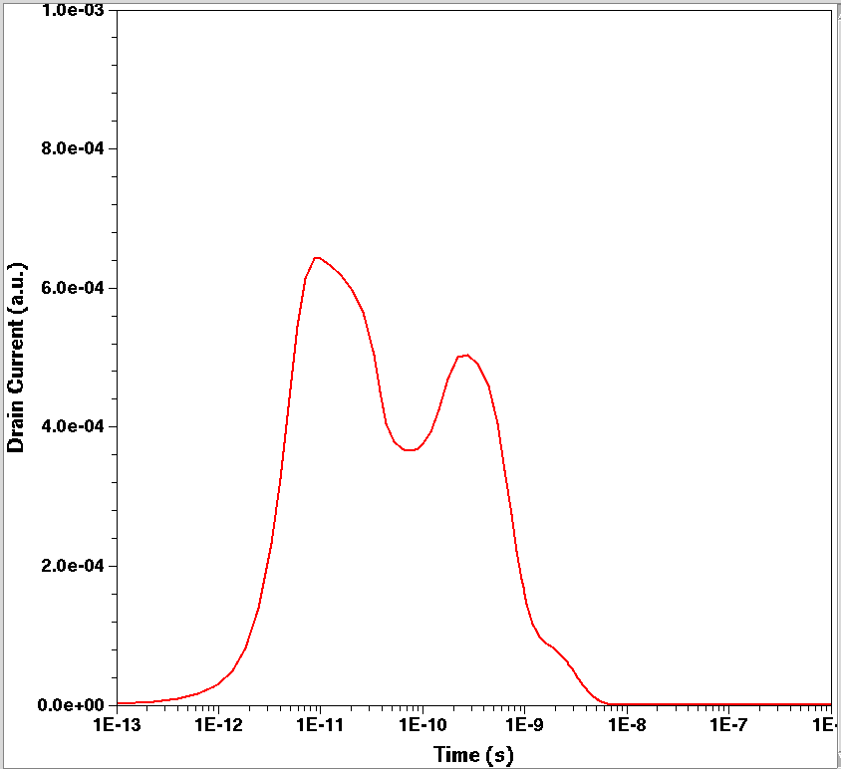
Simulation Flow:
(0,1) = perpendicular, downwards
3rd Single Event Simulation
  Load the previous solution
    Bias conditions
    Electric field distribution, electrostatic potential, charge carriers density, etc…
HeavyIon (
Direction= (0,1)
Location= (@Xpart@, 0)
Time= 4.0e-12
Length= @Length@
Wt_hi= @rpart@
LET_f= @LET@
Gaussian
PicoCoulomb
)
e.g. (30,0) = located at x = 30 µm and the front surface (y = 0 µm)
HI charge density is introduced at t = 4 ps
Transient simulation (time is the running variable)
  Holding the same bias conditions on the electrodes
  At a given time (e.g. t = 4 ps), SE charge density is introduced
  For every time step, the simulation calculates the new situation:
    The new charge distribution, considering the boundary conditions at this precise time step
    The new boundary conditions, considering the charge distribution at this precise time step
e.g. 20 = HI range is 20 µm
e.g. 0.05 = HI with is 0.05 µm
e.g. 0.01 = LET is 0.01 pC/µm
The charge density has a lateral Gaussian profile (with Wt_hi the characteristic width)
LET is expressed in pC/µm, and distances in µm.
Time interval of the simulation (e.g. from t = 0 to t = 10 ns)
Transient (
InitialTime=0 FinalTime=1e-8
InitialStep=1e-13 MaxStep=1e-10 MinStep=1e-15
Increment=1.3
)
{ Coupled { Poisson Electron Hole }
Plot ( Time= (1.0e-12; 4.0e-12; 5.0e-12)
}
For each time step: Coupled calculation of Poisson equation and the Continuity equations for electrons and holes
- i.e. the new boundary conditions (Efield/potential), and the new carrier distribution
Parameters to modulate de size of the time steps
Save solutions at given t
(e.g. 1, 4 and 5 ps)

Slide 9
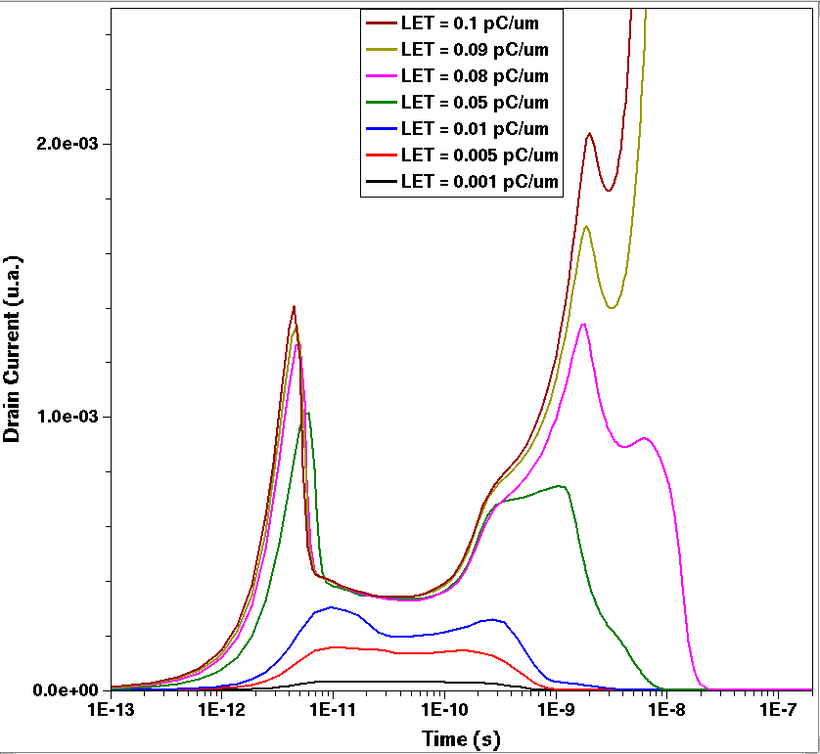
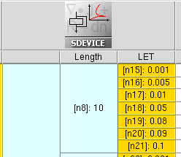
Example:
1st Creation of the Structure
  X_part = 30 µm (SE position)
    r_part = 0.05 µm (characteristic width of the generated charge density)
2nd Electrical Simulation
  Vs = Vg = 0 V (fixed)
  Vd = 500 V (sweep from 0 to 500 V)
  Final solution saved
LET_{th} = 0.09 pC/um
3rd Single Event Simulation
Different @Length@ values (Range)
Different @LET@ values
Transient
Simulation

Slide 10
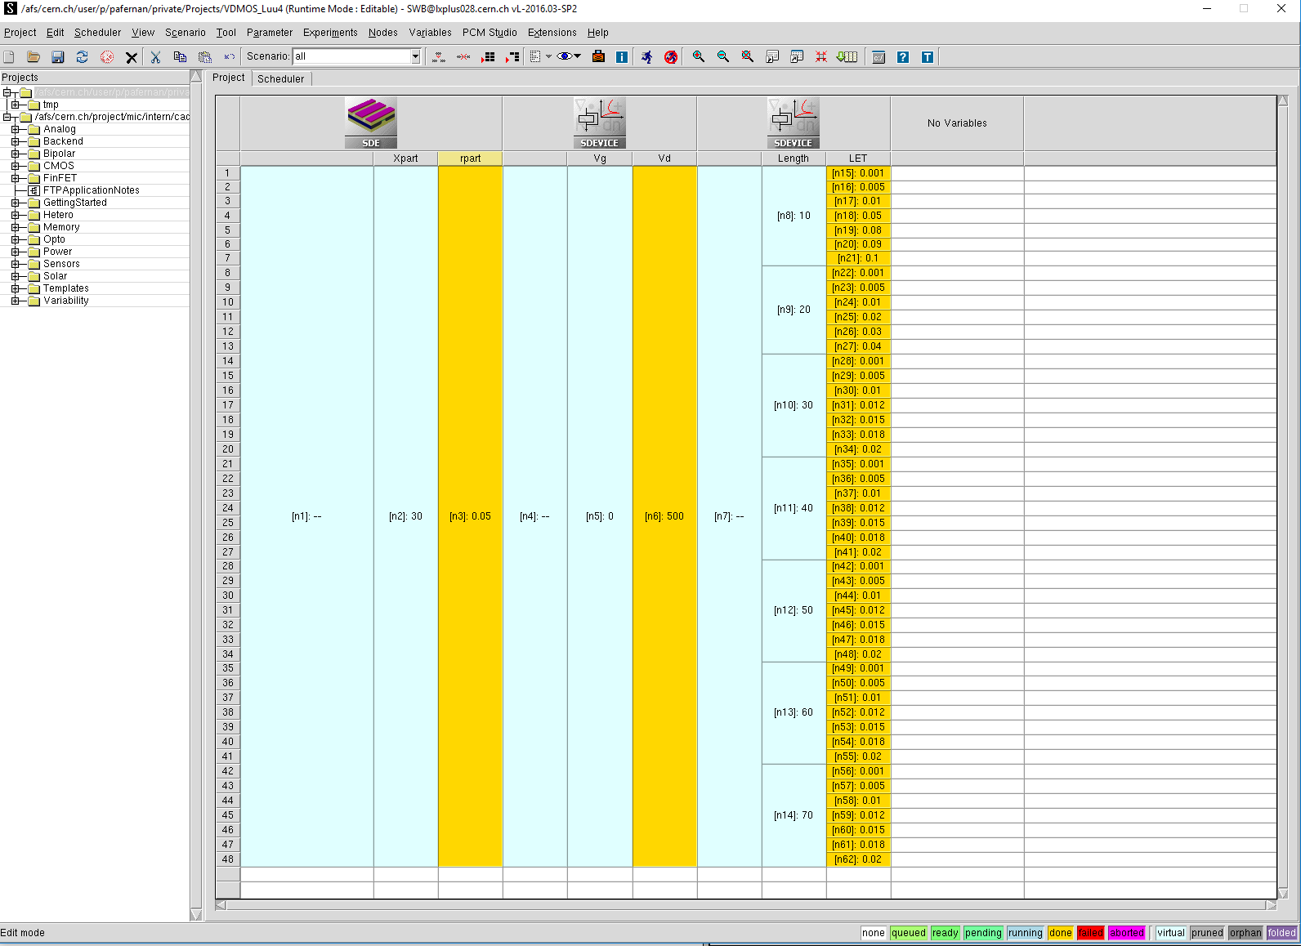
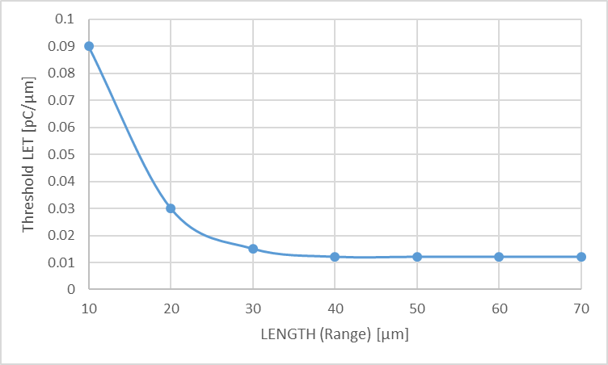
Front-side incidence
V_{DS} = 500 V
We can fiddle with the parameters (V_{DS}, Incidence X position, front or back incidence, etc…) to complete an study of the device sensitivity: sensitive volumes, worst cases, etc…
  See Luu 2010 paper on TNS
Results give a qualitative understanding of the matter. As we didn’t use an exact model for the structure (2D, half a cell, profiles not based on technology, etc...) we cannot extract quantitative conclusions (the HI profile was not even correlated with a real Heavy Ion!)
(IMHO) The most interesting use of TCAD simulations is that they help to understand the failure mechanisms.
4 to 10 hours to run all these experiments
(depending on how busy is the server)

Slide 11
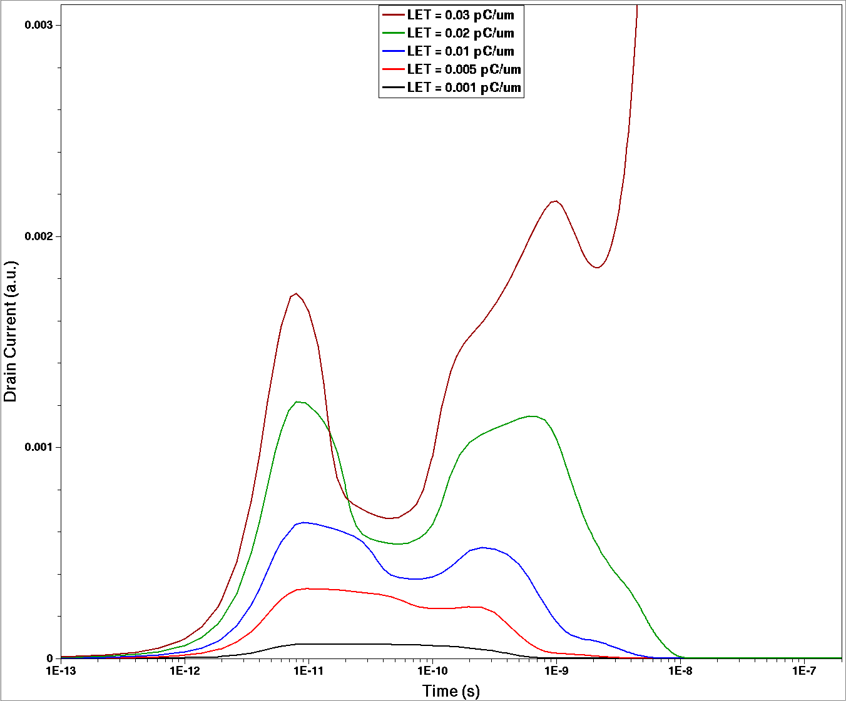
@Length@ = 20 µm
LET_{th} = 0.03 pC/µm
First peak:
Prompt collection
Burn-Out
Current grows more than 3 orders of magnitude (not shown)
Second peak:
Collection of Secondaries

Slide 12
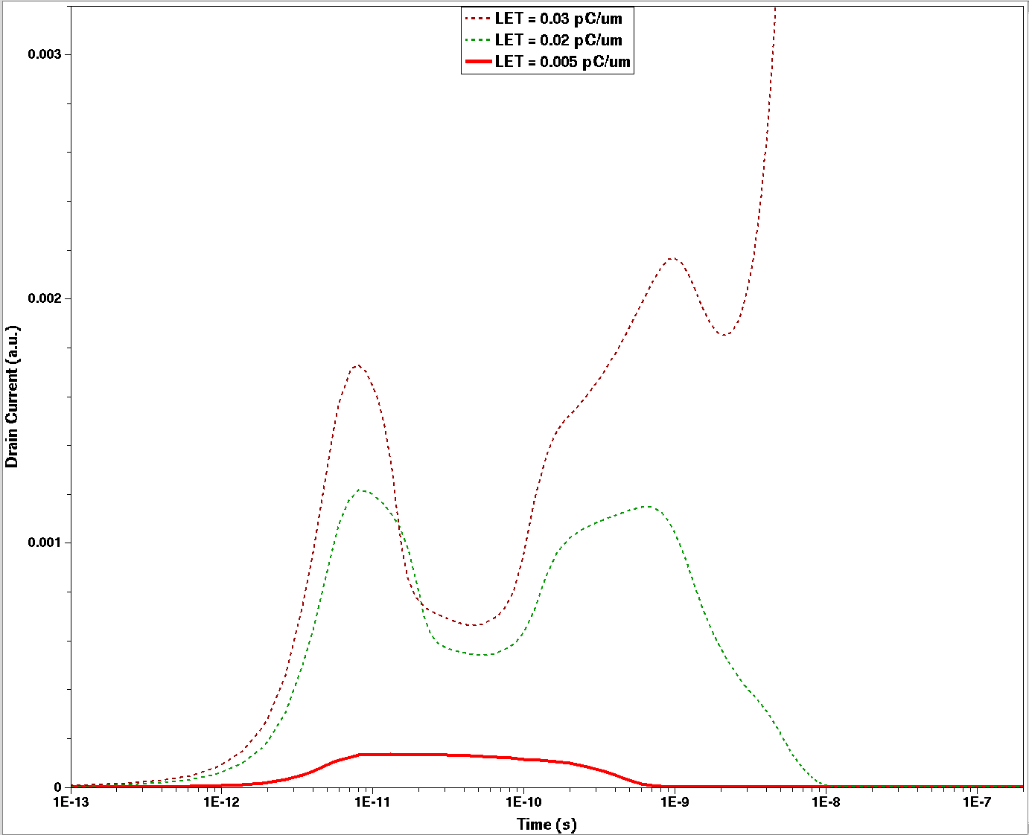
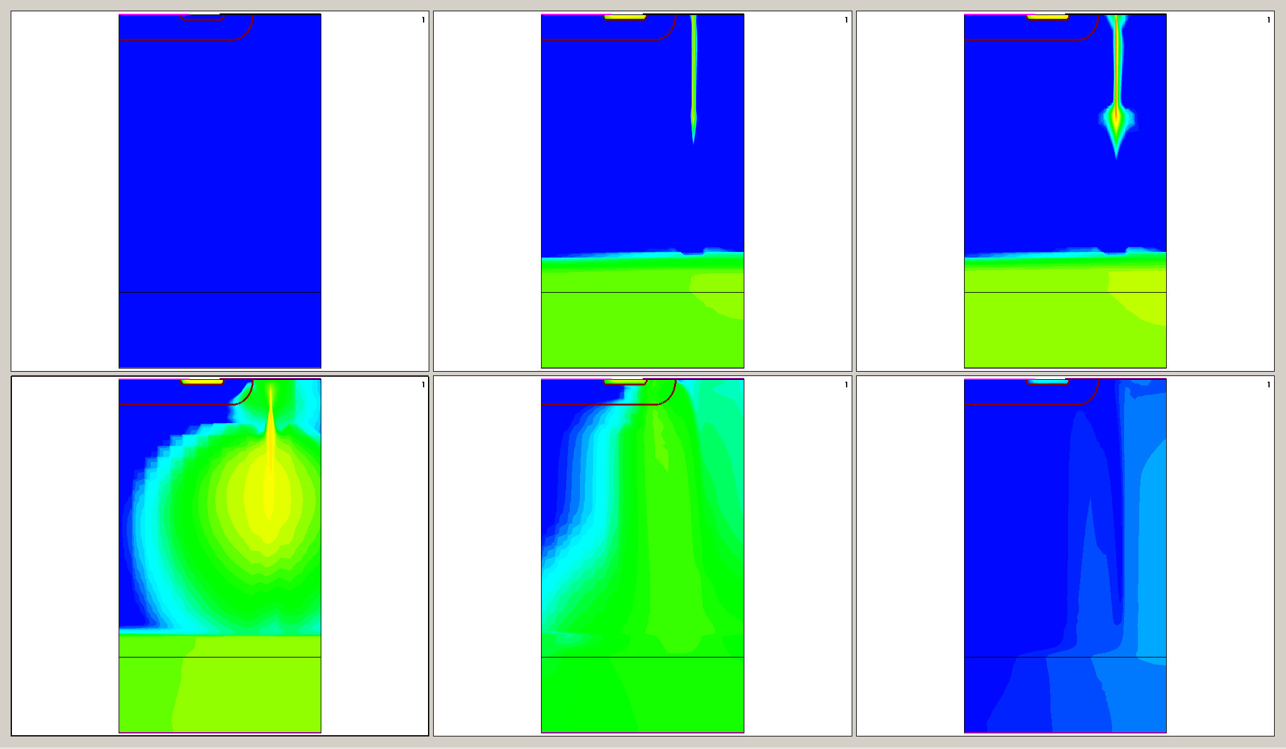
LET = 0.005 pC/µm
Electron Current Density
t=0 ps
t=4 ps
t=10 ps
t=0.1 ns
t=1 ns
t=10 ns

Slide 13
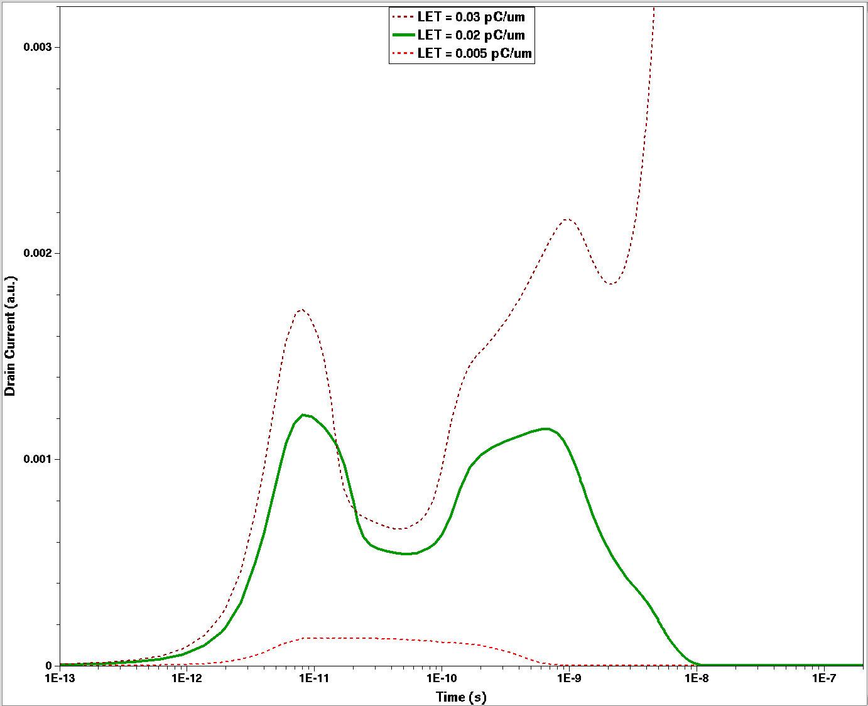
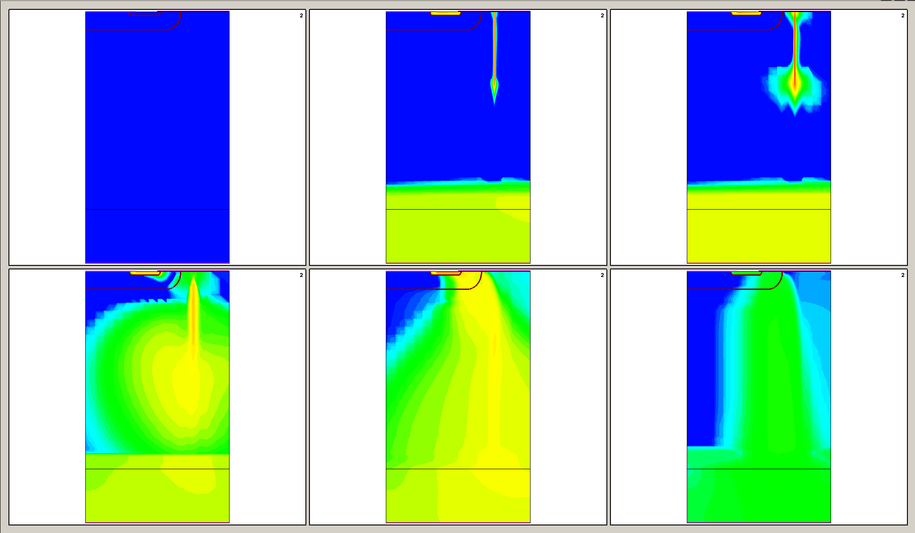
LET = 0.02 pC/µm
Electron Current Density
t=0 ps
t=4 ps
t=10 ps
t=0.1 ns
t=1 ns
t=10 ns

Slide 14
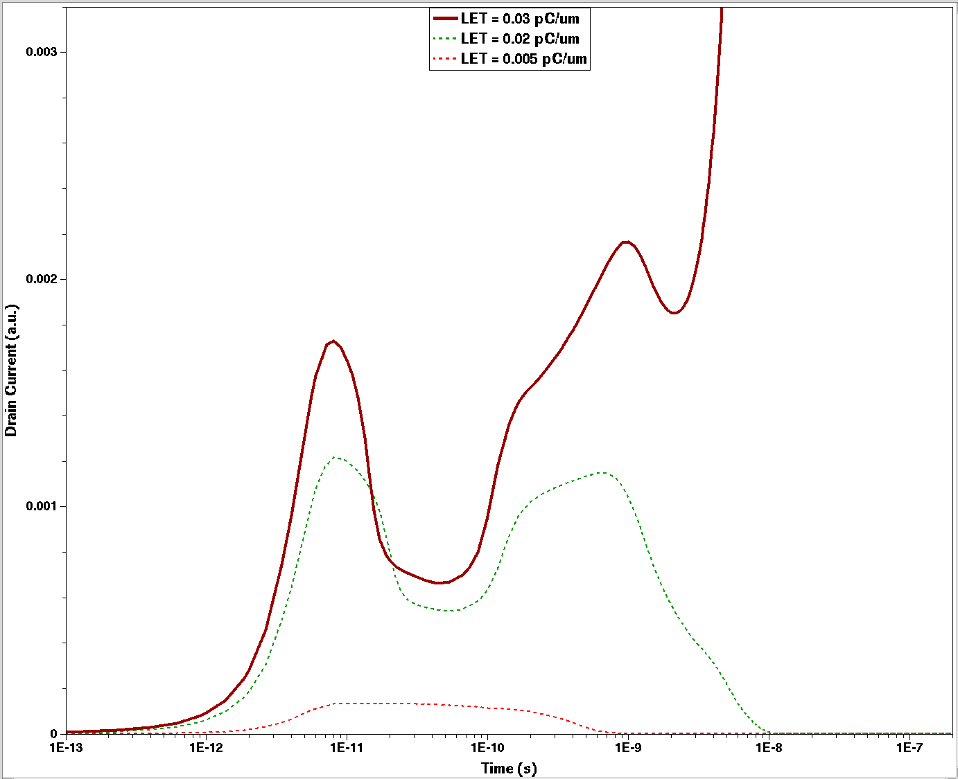
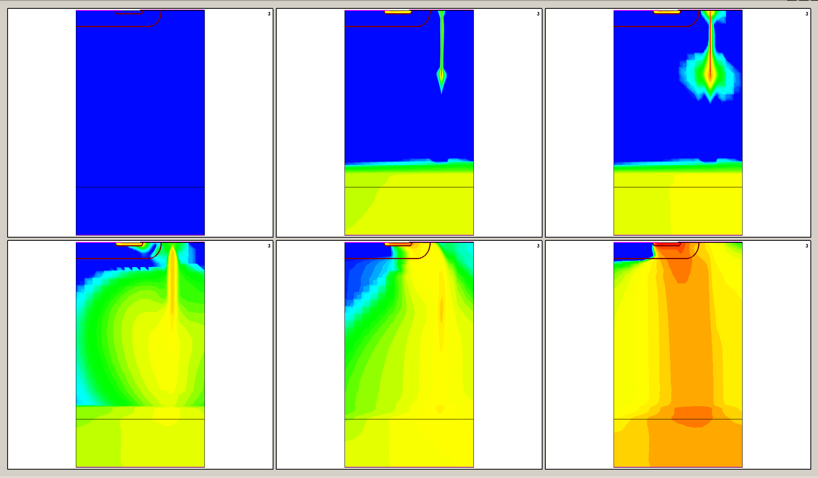
LET = 0.03 pC/µm (LET_{th})
Electron Current Density
t=0 ps
t=4 ps
t=10 ps
t=0.1 ns
t=1 ns
t=10 ns

Slide 15
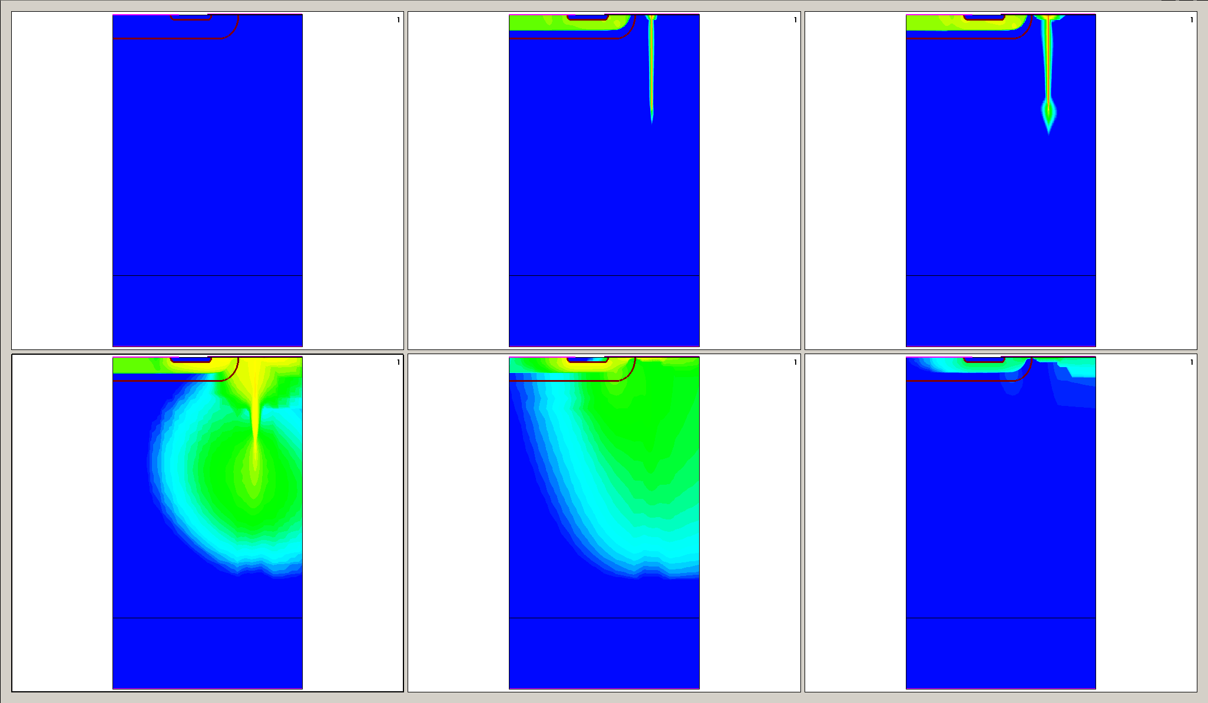
LET = 0.005 pC/µm
Hole Current Density
t=0 ps
t=4 ps
t=10 ps
t=0.1 ns
t=1 ns
t=10 ns

Slide 16
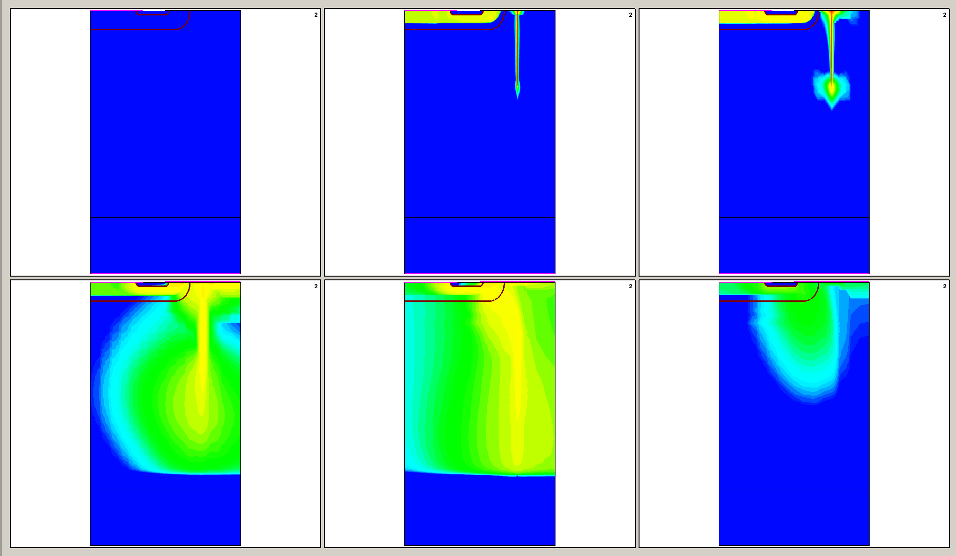
LET = 0.02 pC/µm
Hole Current Density
t=0 ps
t=4 ps
t=10 ps
t=0.1 ns
t=1 ns
t=10 ns

Slide 17
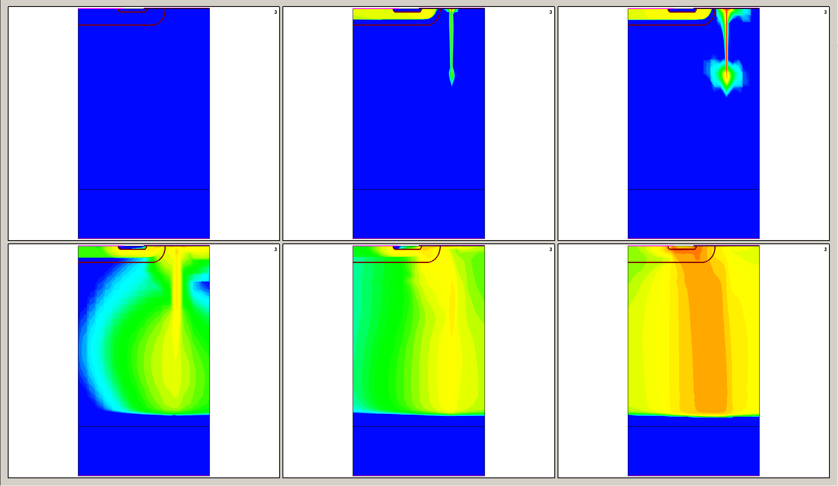
LET = 0.03 pC/µm
Hole Current Density
t=0 ps
t=4 ps
t=10 ps
t=0.1 ns
t=1 ns
t=10 ns

Slide 18
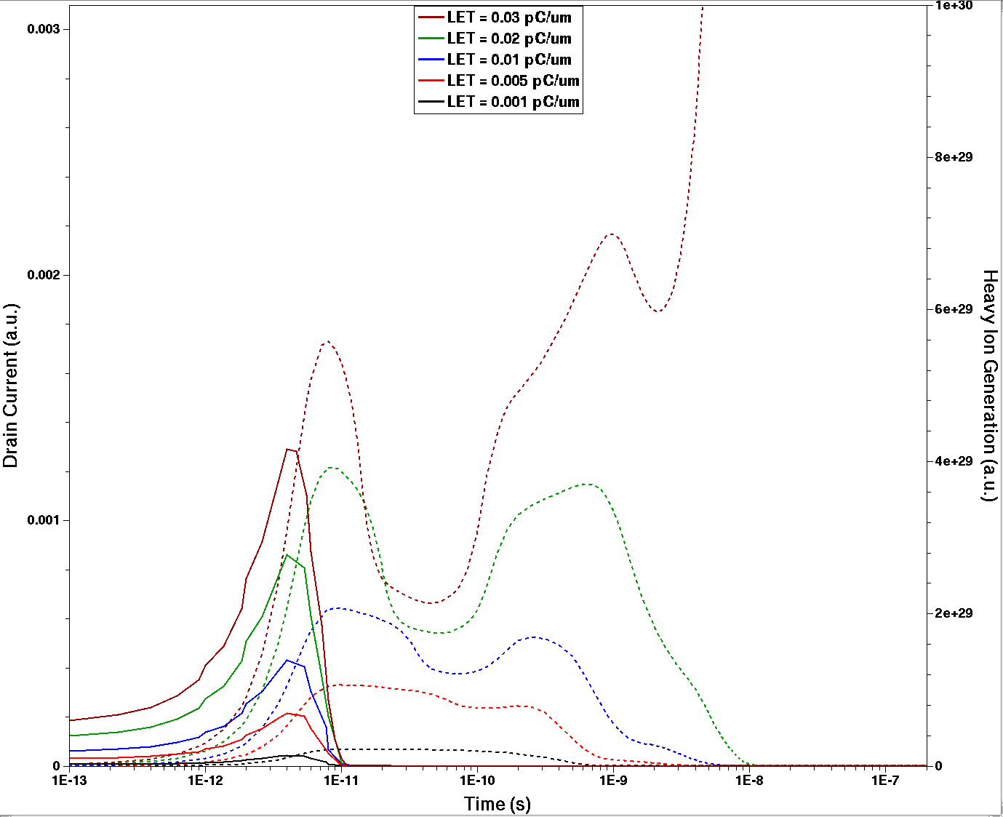
@Length@ = 20 µm
LET_{th} = 0.03 pC/µm
First peak:
Collection of the primary generated charge
Heavy Ion Generation

Slide 19
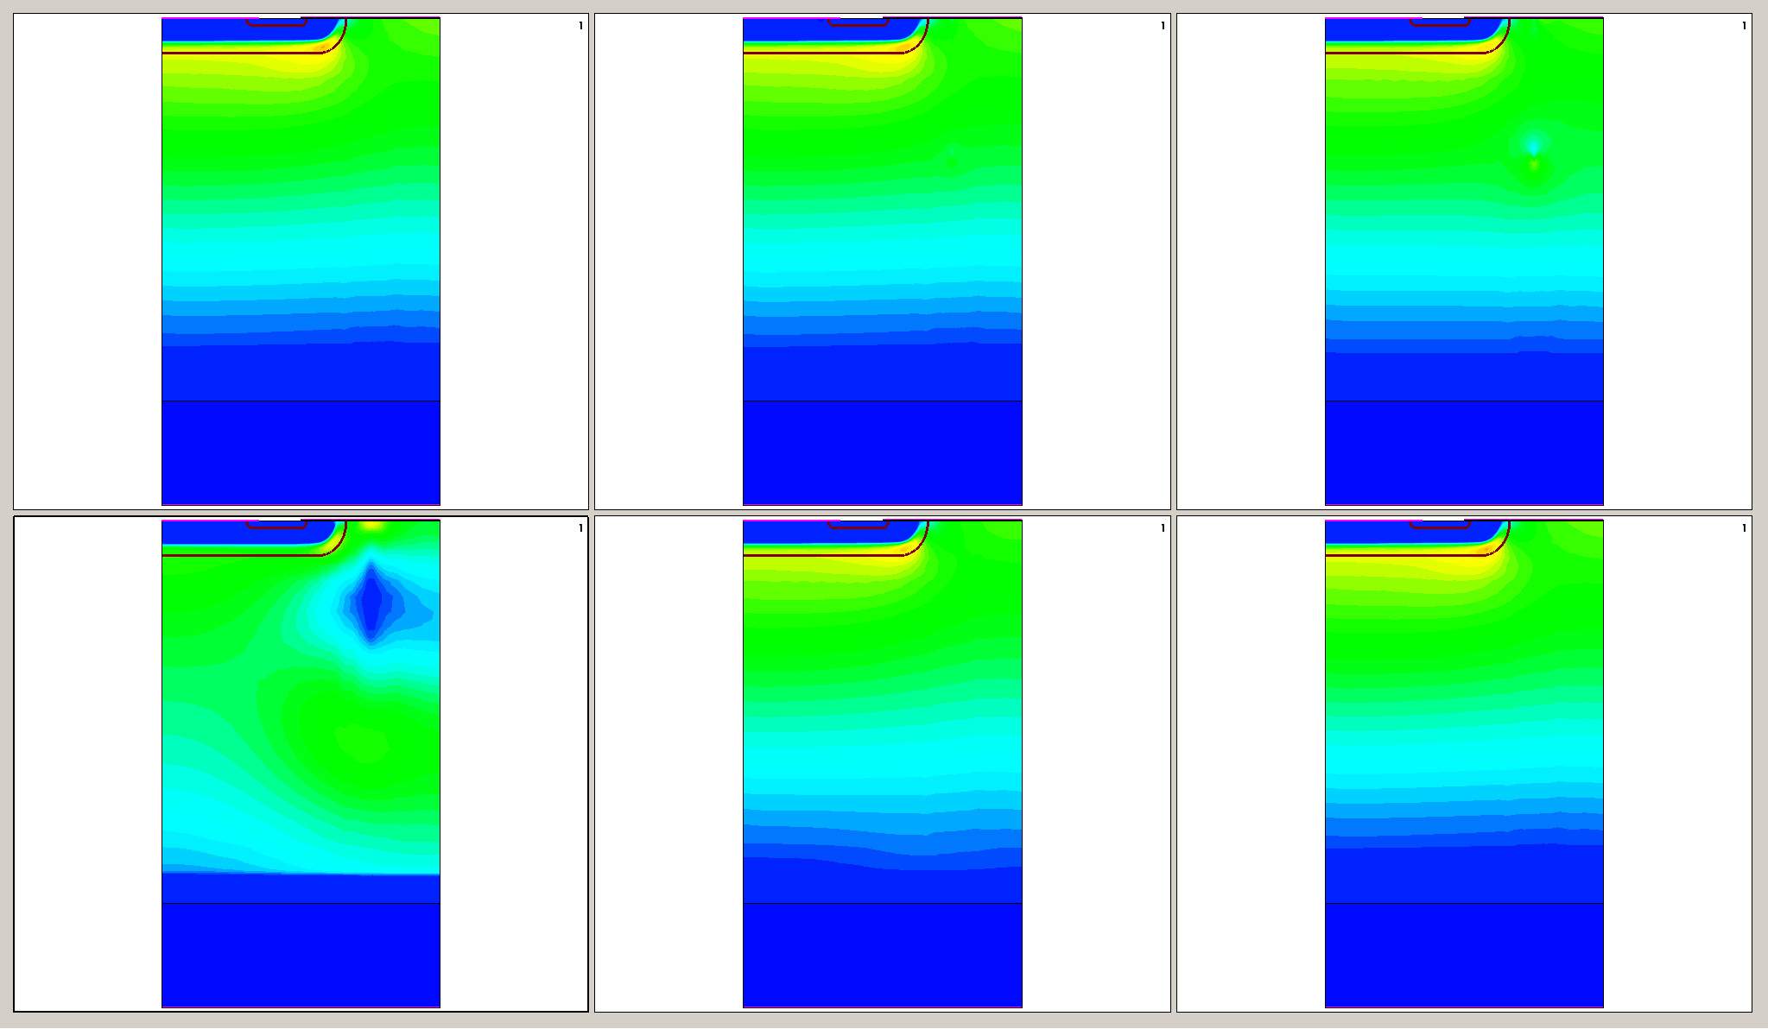
LET = 0.005 pC/µm
Electric Field
t=0 ps
t=4 ps
t=10 ps
t=0.1 ns
t=1 ns
t=10 ns

Slide 20
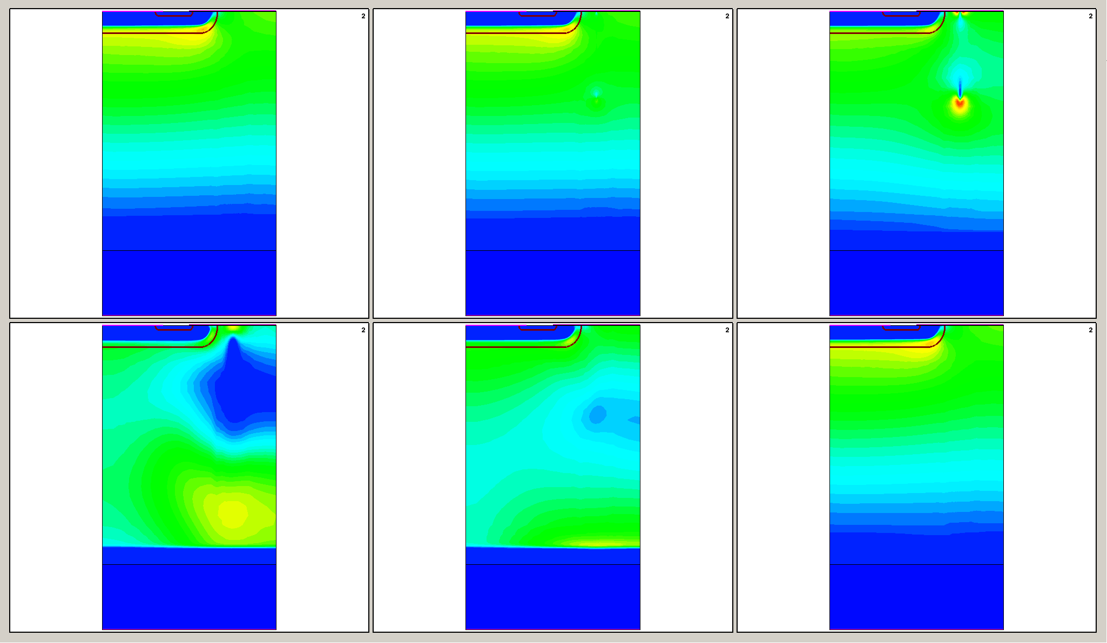
LET = 0.02 pC/µm
Electric Field
t=0 ps
t=4 ps
t=10 ps
t=0.1 ns
t=1 ns
t=10 ns

Slide 21
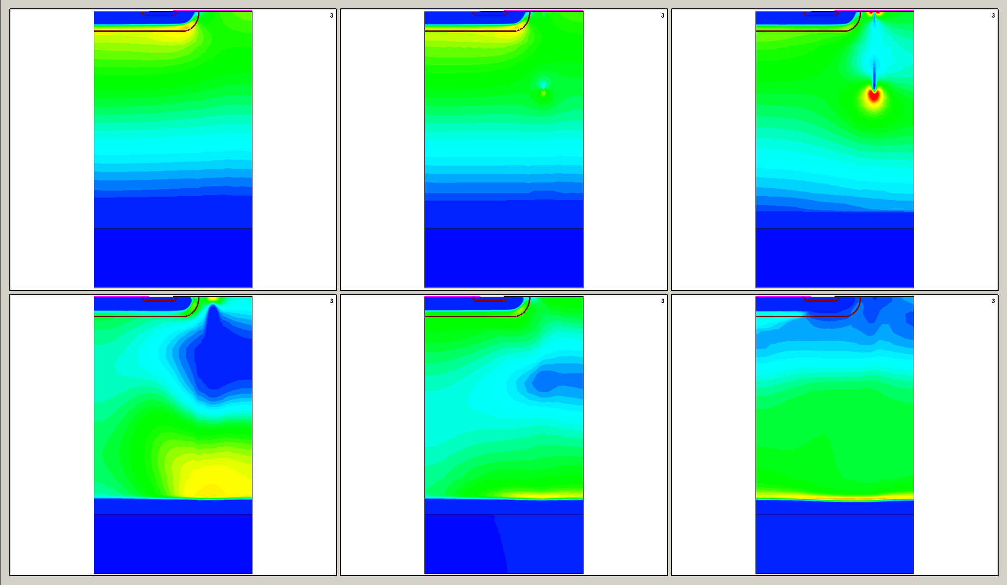
LET = 0.03 pC/µm
Electric Field
t=0 ps
t=4 ps
t=10 ps
t=0.1 ns
t=1 ns
t=10 ns

Slide 22
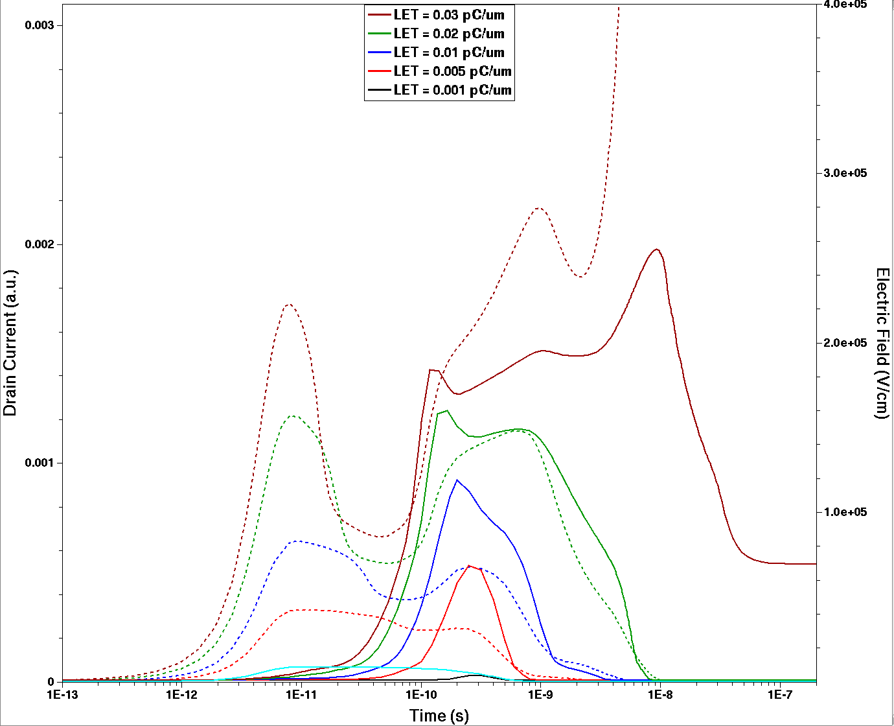
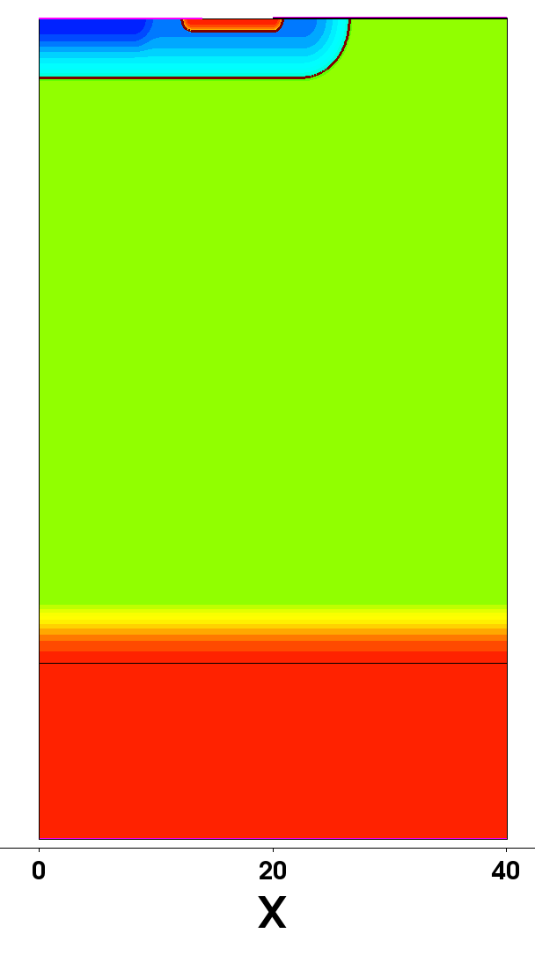
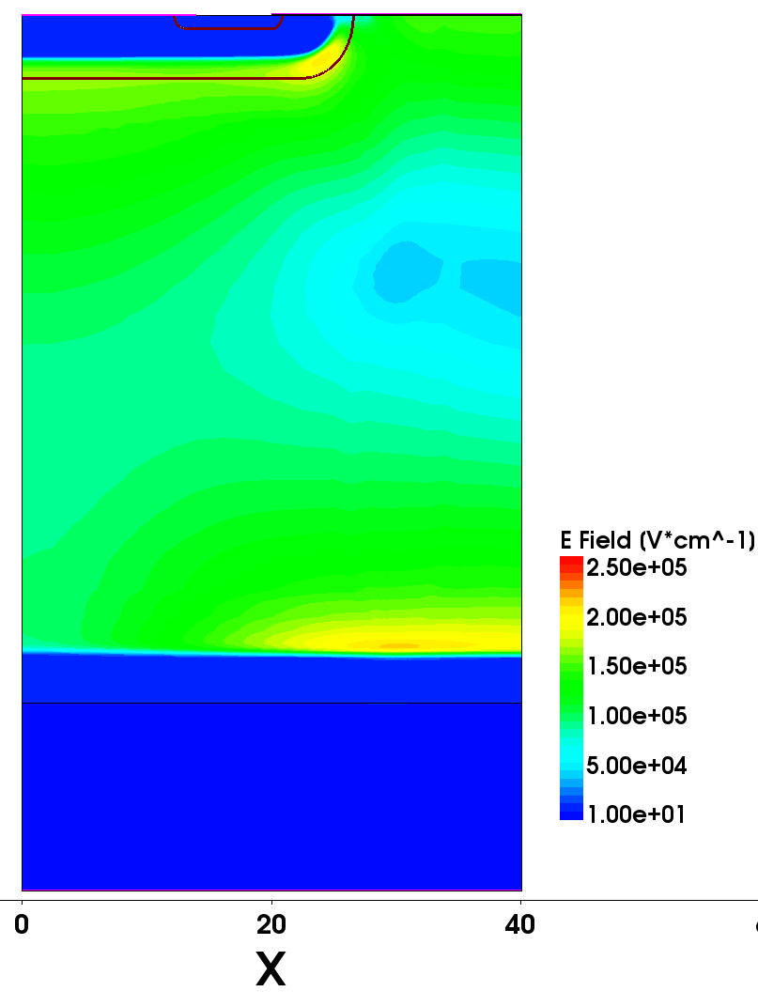
Electric Field
@Length@ = 20 µm
LET_{th} = 0.03 pC/µm
Burnout:
For LET_{th}, the increment in electric Field is high enough to induce avalanche breakdown
Electric Field at this point
Second Peak:
Corresponds to an Electric Field increment at the Epi/Substrate interface

Slide 23
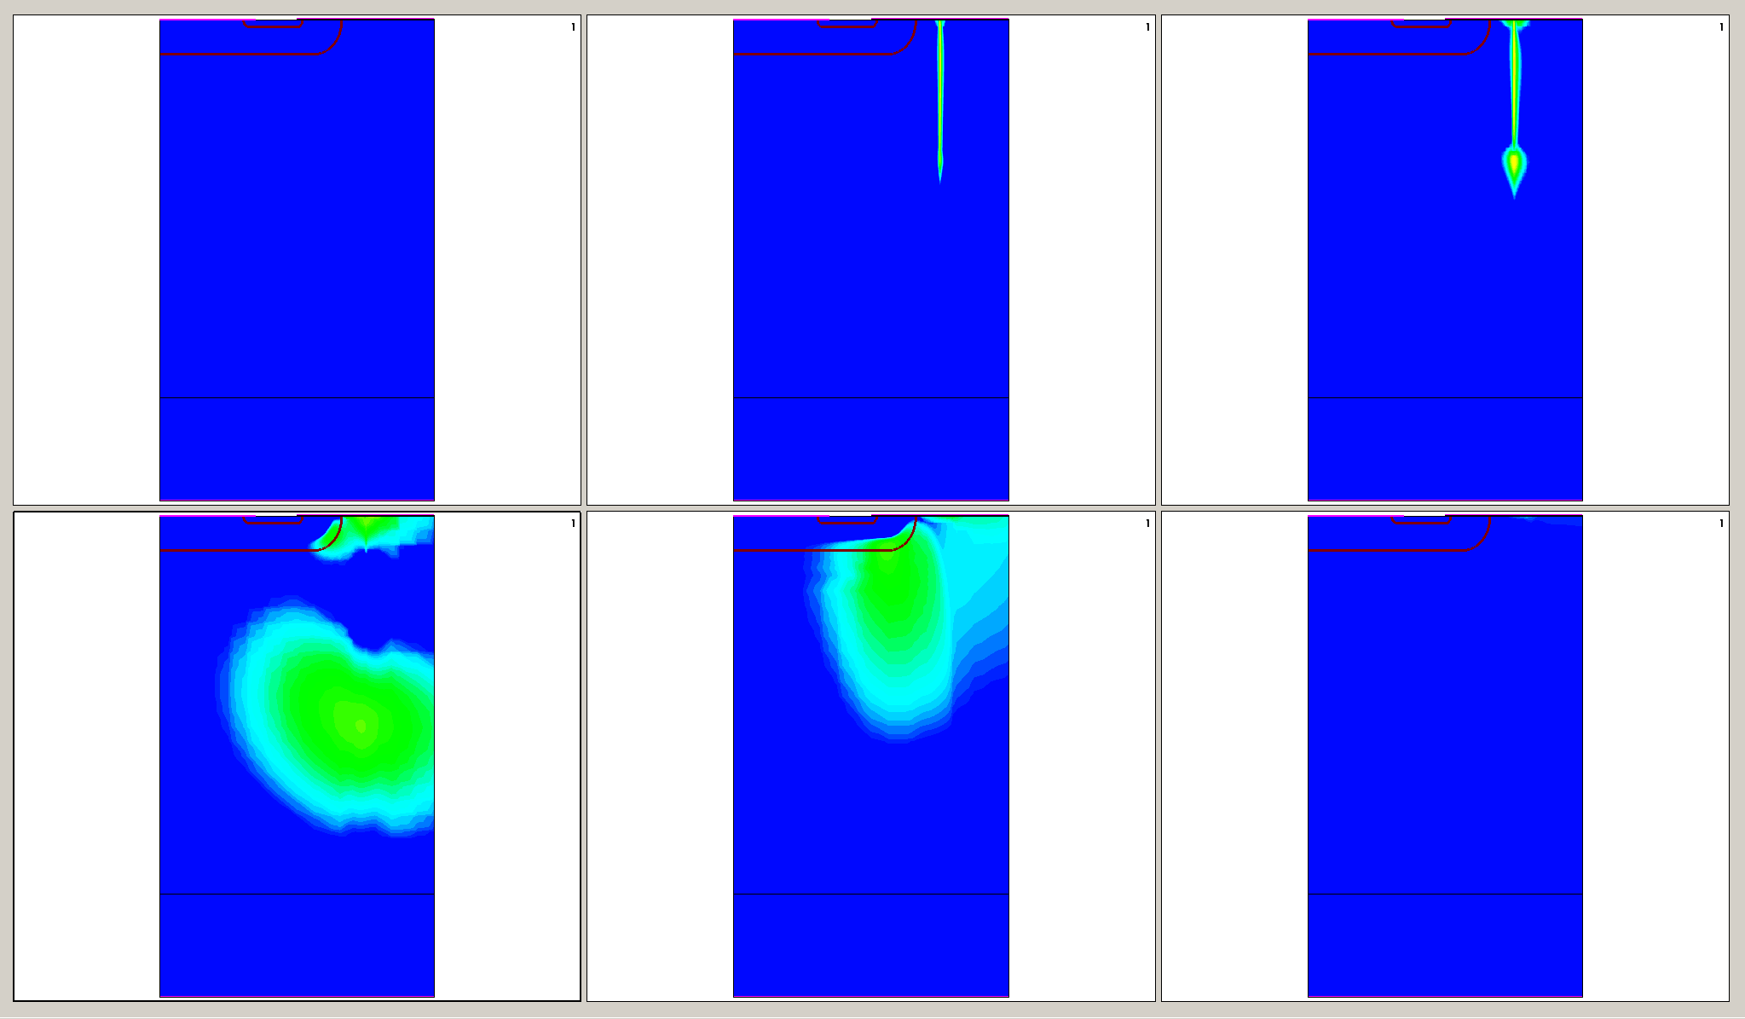
LET = 0.005 pC/µm
Impact Ionization (Avalanche Generation)
t=0 ps
t=4 ps
t=10 ps
t=0.1 ns
t=1 ns
t=10 ns

Slide 24
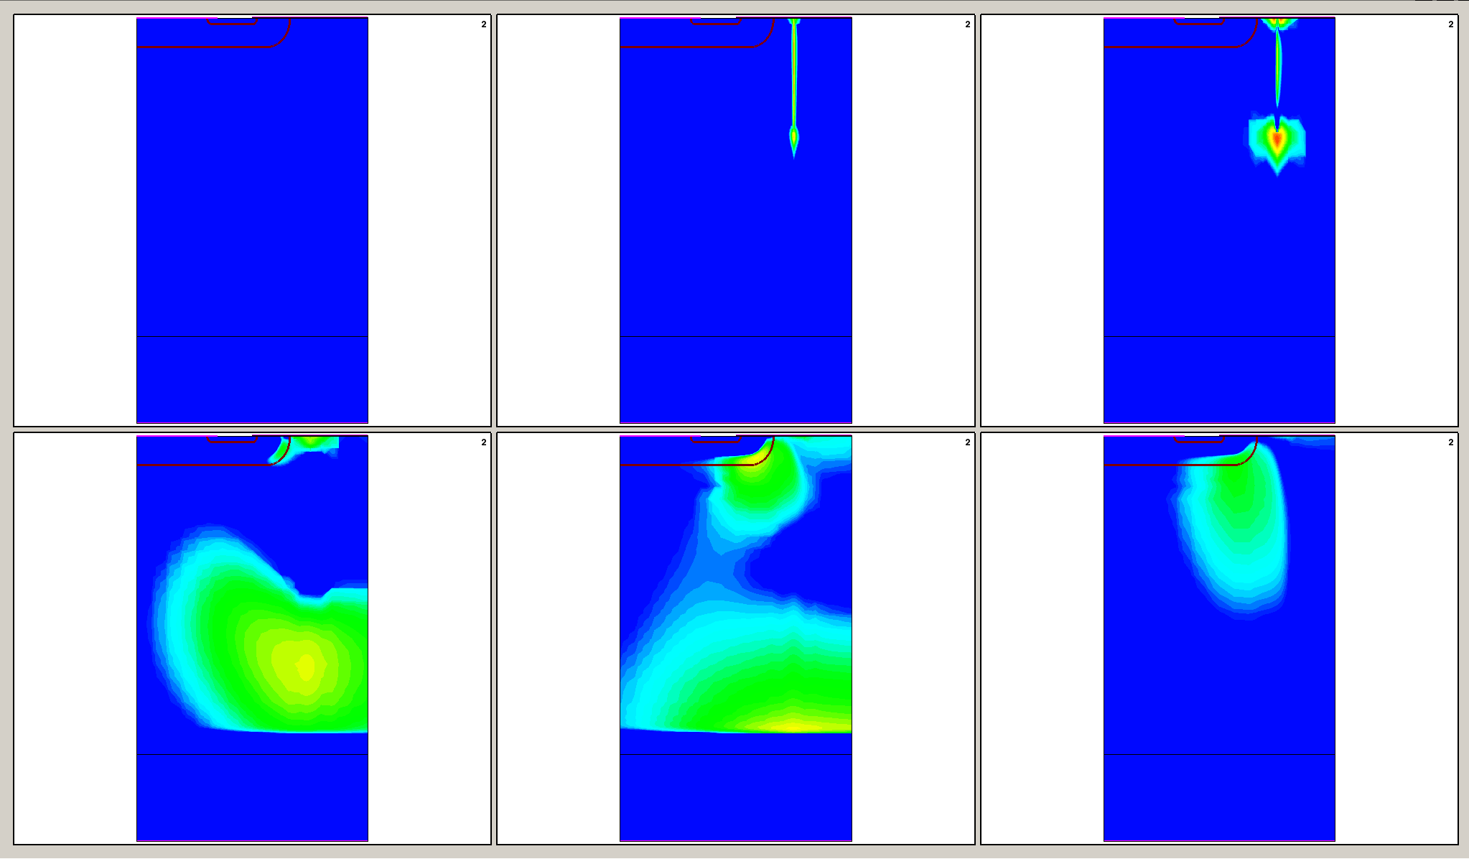
LET = 0.02 pC/µm
Impact Ionization (Avalanche Generation)
t=0 ps
t=4 ps
t=10 ps
t=0.1 ns
t=1 ns
t=10 ns

Slide 25
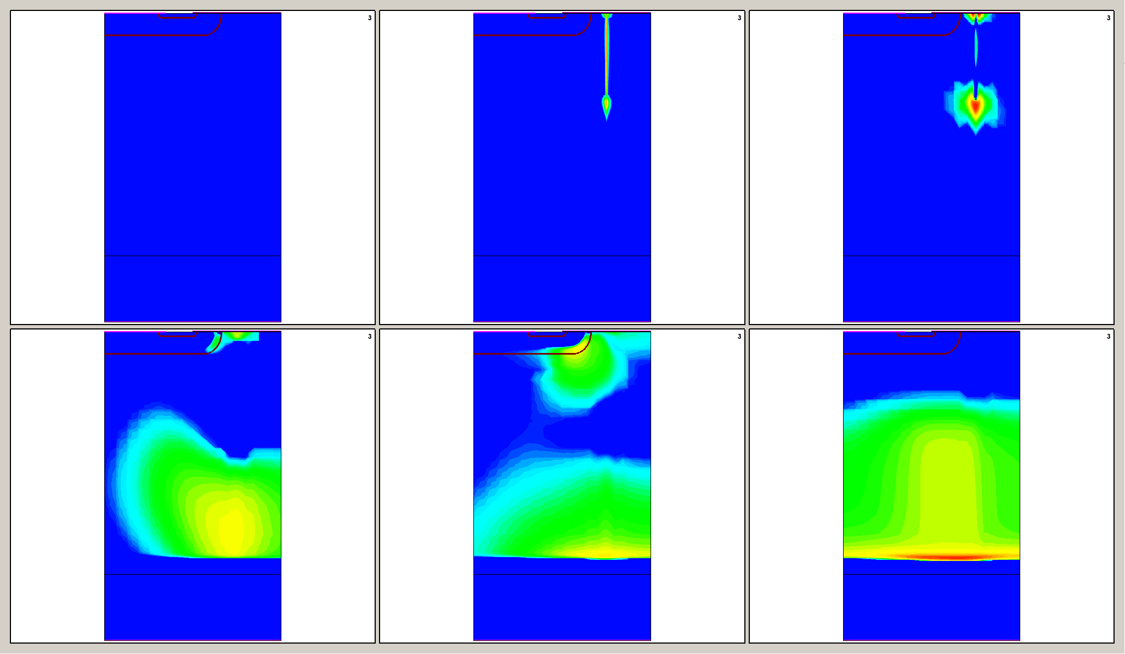
LET = 0.03 pC/µm
Impact Ionization (Avalanche Generation)
t=0 ps
t=4 ps
t=10 ps
t=0.1 ns
t=1 ns
t=10 ns

Slide 26
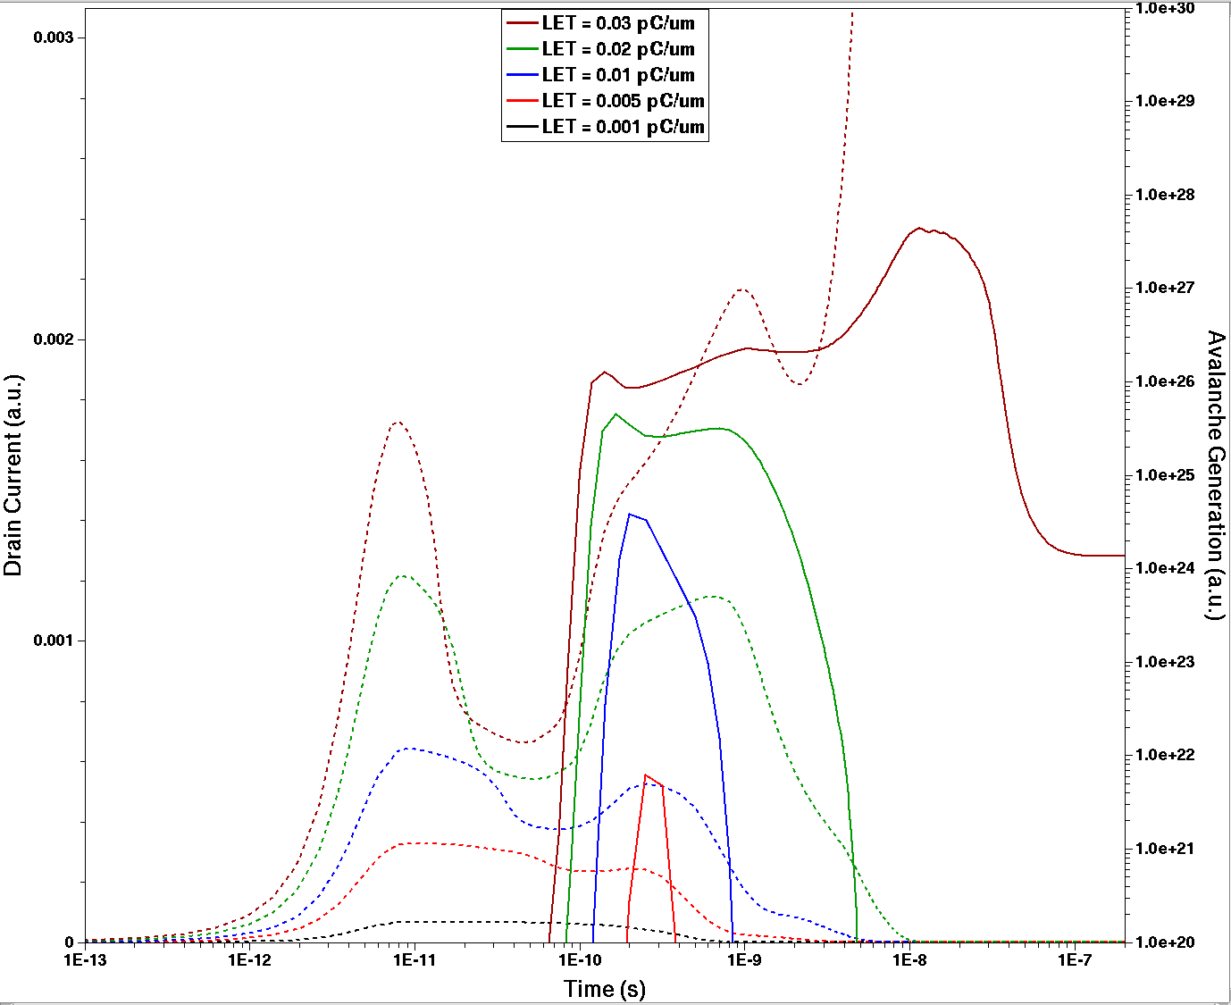
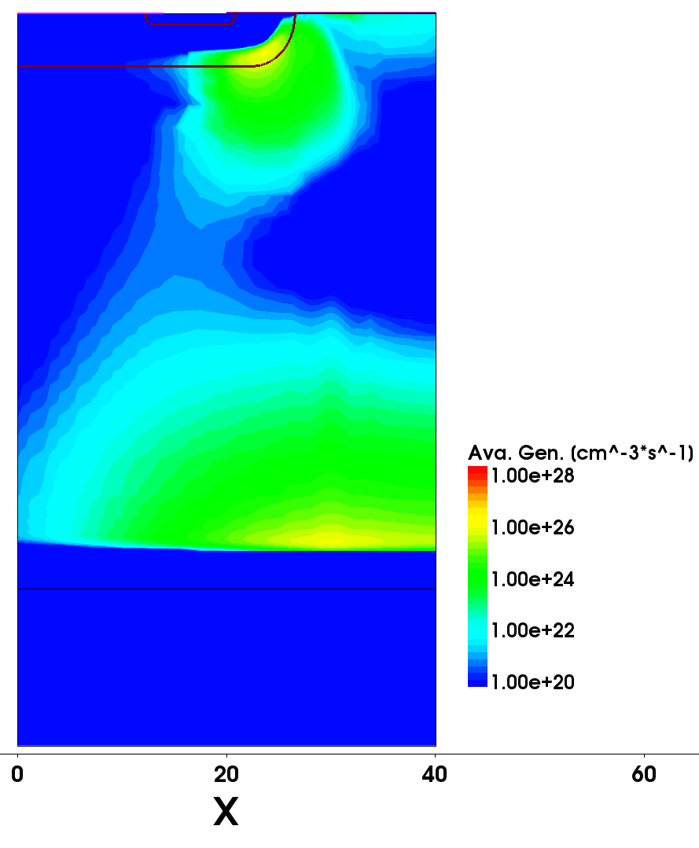
Impact Ionization (Avalanche Generation)
Avalanche Gen. at this point
Avalanche Generation:
Impact Ionization at the Epi/Substrate interface increases with increasing LET, and leads to breakdown for LET_{th}

Slide 27
Conclusion:
  (Goodness, Utility and Limitations of Semiconductor Device Simulation, for the emulation of SEE)
What Sentaurus CAN’T do
What Sentaurus CAN do
Given a certain radiation environment or a even a single ionizing particle, Sentaurus TCAD CANNOT calculate the Generated Charge Profile
  We must better use, for instance, FLUKA
Sentaurus TCAD IS NOT useful to study Rad. Eff. in different Materials
  You can just simulate Semiconductors (Silicon, in particular) and the typical dielectrics (just to a certain extent…)
Sentaurus TCAD CANNOT assess the SEE Cross Section
  TCAD simulations are deterministic, no statistics can be extracted from them
Sentaurus TCAD CANNOT replace Experimental Tests
Given a generated charge profile, Sentaurus TCAD CAN simulate the Transient Evolution of the Carriers
Sentaurus TCAD CAN evaluate the consequences of the Single Event at a Device level
  Is an excellent tool to evaluate Sensitive Volumes, LET/Range thresholds, etc…
  In general, results should be considered qualitative; (although the accuracy can be increased, improving the precision of the models)
Sentaurus TCAD CAN help to understand the physical mechanisms that lead to a SEE

Slide 28
¡Muchas Gracias!

Slide 29
Sentaurus Workbench
Device Creator
(Sentaurus Structure Editor)
Electrical Simulation
(Sentaurus Device)
Parameters
Xpart = HI position
Rpart = HI charact. width
Vg = Gate voltage
Vd = Drain voltage
Length = HI Range
LET = HI Range
Experiments
Each “line” is a different experiment
(different parameter values)

Slide 30
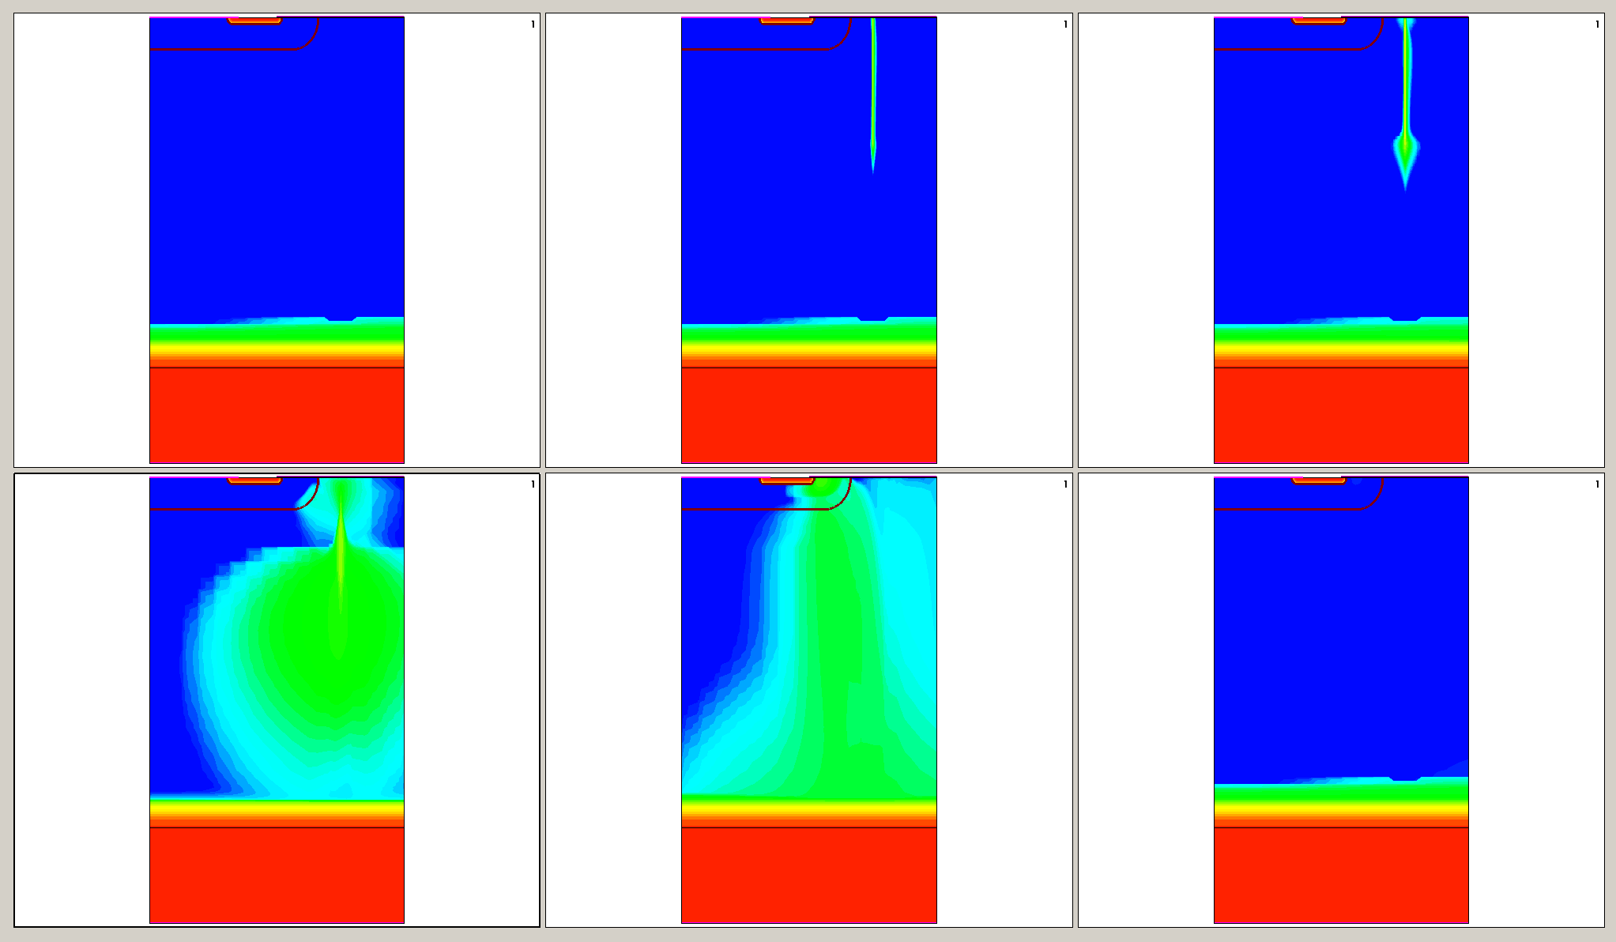
LET = 0.005 pC/µm
Electron Density

Slide 31
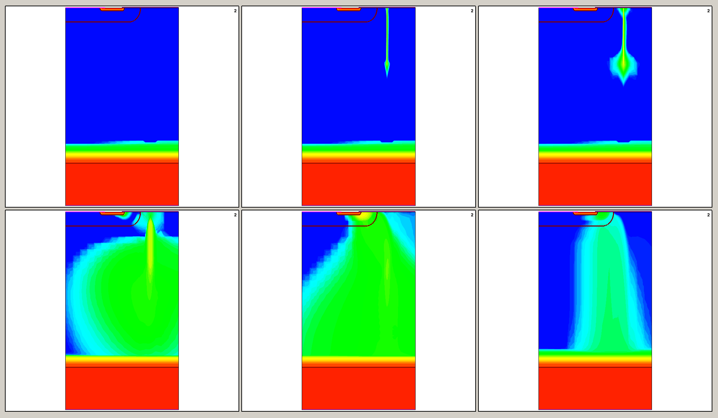
LET = 0.02 pC/µm
Electron Density

Slide 32
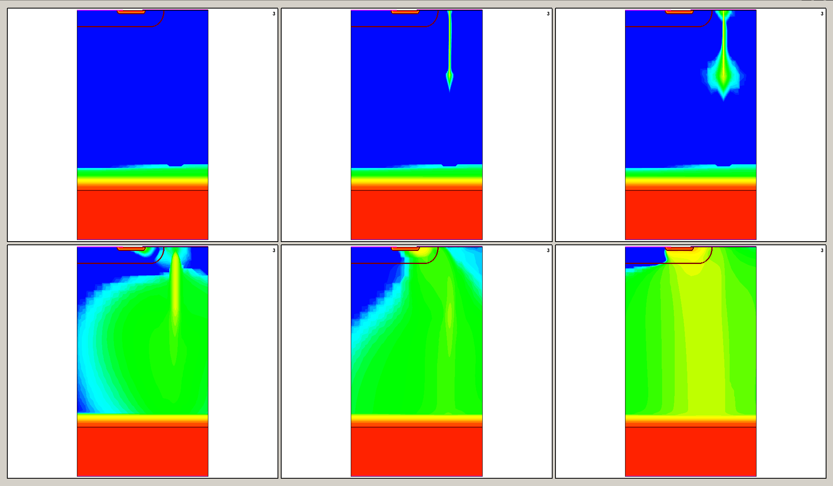
LET = 0.03 pC/µm (LET_{th})
Electron Density

