Slide 1

Status and News
Overview of the PBC-acc activities
Details of the BDF planning
Future PBC meetings
Mike Lamont for PBC coordination (Joerg Jaeckel, Claude Vallée)
and the BDF team
7th June 2017

Slide 2
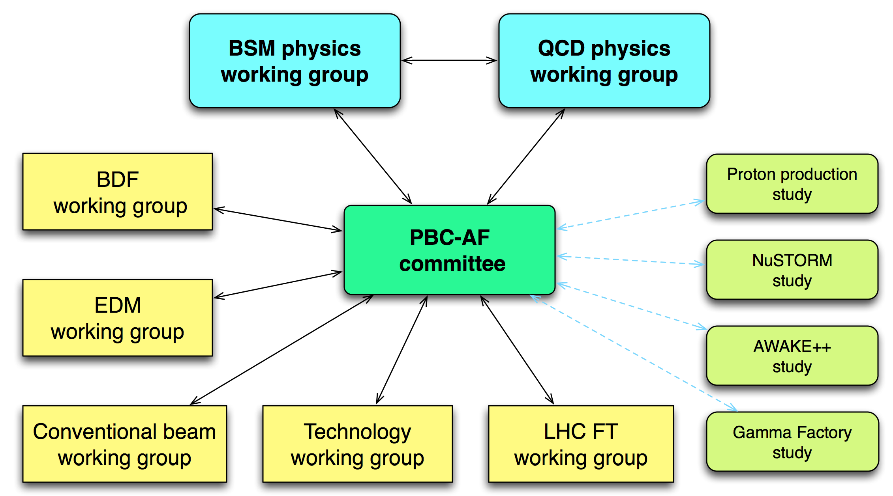
Organization
See //cern.ch/pbc for details

Slide 3
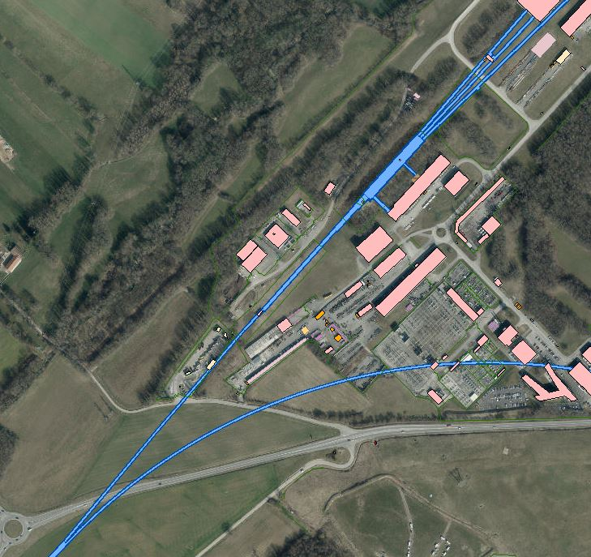
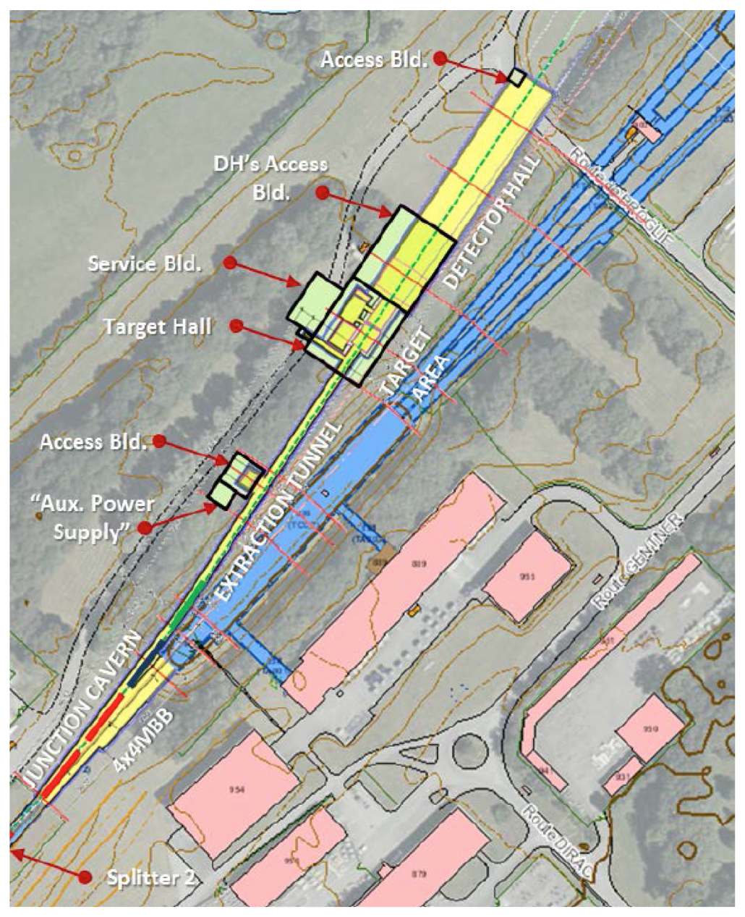
Civil engineering
Geotechnical and hydrogeology of site
Existing users
New beam line
Dilution
Construction of junction cavern
Switching into new beam-line
Radiation protection of personnel and environment
Safe exploitation
Target and target complex
Beam delivery by SPS
Slow extraction with acceptable losses

Slide 4
BDF deliverables
Beam requirements specification for all potential users
Evaluation of SPS performance reach per requested beam type
Design and feasibility evaluation for engineering subsystems (extraction, beam-lines, splitting, dilution, target and target complex, interface to experiment(s))
Preliminary integration and infrastructure study
Preliminary civil engineering design
RP simulation, impact and optimization studies
Safety impact studies
Preliminary project safety folder
Projection execution analysis and planning
Cost analysis
Comprehensive Design Report plus CDR input for SHiP

Slide 5
BDF work packages
Target and target complex (Marco Calviani)
  BDF target & target complex WG
Extraction and beam transfer (Brennan Goddard)
  SPS Losses and Activation WG (SLAWG)
  SPS Crystal-Assisted Slow Extraction WG (SPS-CASE WG)
  TT20 for BDF WG: splitters and TL design
Radiation protection (Heinz Vincke)
Safety engineering (Fernando Pedrosa)
Integration and infrastructure (Lau Gatignon, Markus Brugger)
  Junction cavern, beam-line, target complex, detector hall
Civil engineering (J. Osborne)
  Preliminary studies - 2017

Slide 6
BDF activities - May 2017
Extraction and beam transfer
  Loss mitigation studies
  Two polarity splitter magnet design and prototyping
  TT20 optics studies
Target and target complex
  Beam dilution sweep on target optimization
  Target material studies and characterization
  Target cooling simulations
  Target complex handling and integration studies (OTL design study)
  Target shielding studies
  T6 target test preparation
Safety engineering Impact studies on existing installations and environment
  Support on the definition of Safety based design, installation, and maintenance procedures
  PBC hazard register
  Preliminary qualitative flooding risk assessment for the BDF target building
  Definition of the strategy to perform the hydrogeological study
  Preliminary list of hazards for the BDF
  Preliminary list of qualitative risk assessments
Radiation protection
  Update of the new, quite complex FLUKA geometry followed by update of estimates of prompt dose rates…
  Optimization of the design of the target bunker
  The production of radionuclides in air, helium & water compartments/circuits of the BDF; beam extraction and transfer tunnels; TDC2/TCC2.
Integration
  Studies to start on integration for target complex, beam lines, junction cavern and eventually the experimental hall.

Slide 7
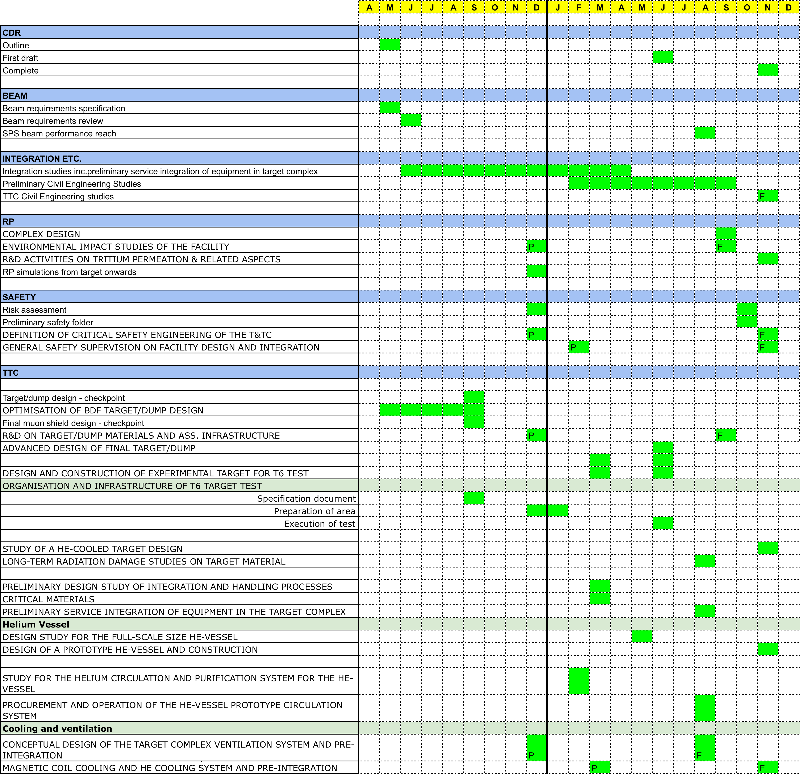
BDF

Slide 8

Resources
BDF fellows
Section | Subject | Status
EN/STI | Target design | In place
EN/MME | Target complex | In place
EN/CV | Target complex | In place
HSE/SEE | Safety | In place
HSE/RP | Radiation protection studies | In place
TE/MSC | Splitter magnet design | In place
TE/ABT | Extraction and beamline studies | AFC May 17
EN/EA | Target and EA integration | AFC May 17
EN/ACE | Beam line and junction cavern integration | AFC May 17
SMB/SE | Civil engineering studies | 2018
Assigned material budget is also being utilized

Slide 9

CPEDM collaboration established between JEDI, srEDM and CERN
  Kick-off meeting 1-2 March 2017
Huge amount work already gone into proton (pure E) and deuteron (mixed B,E) storage rings
Targeting a feasibility study for possible implementation at CERN
Work packages and coordinators established
  CERN concentrating on possible siting, beam delivery and getting up to speed on systematics
  PBC fellow selected at May AFC

Slide 10
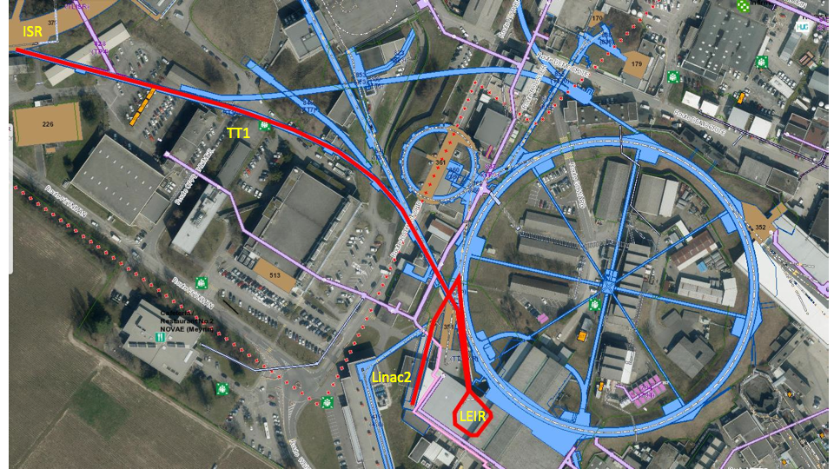
Beam delivery – one possibility
Polarized proton source

Slide 11
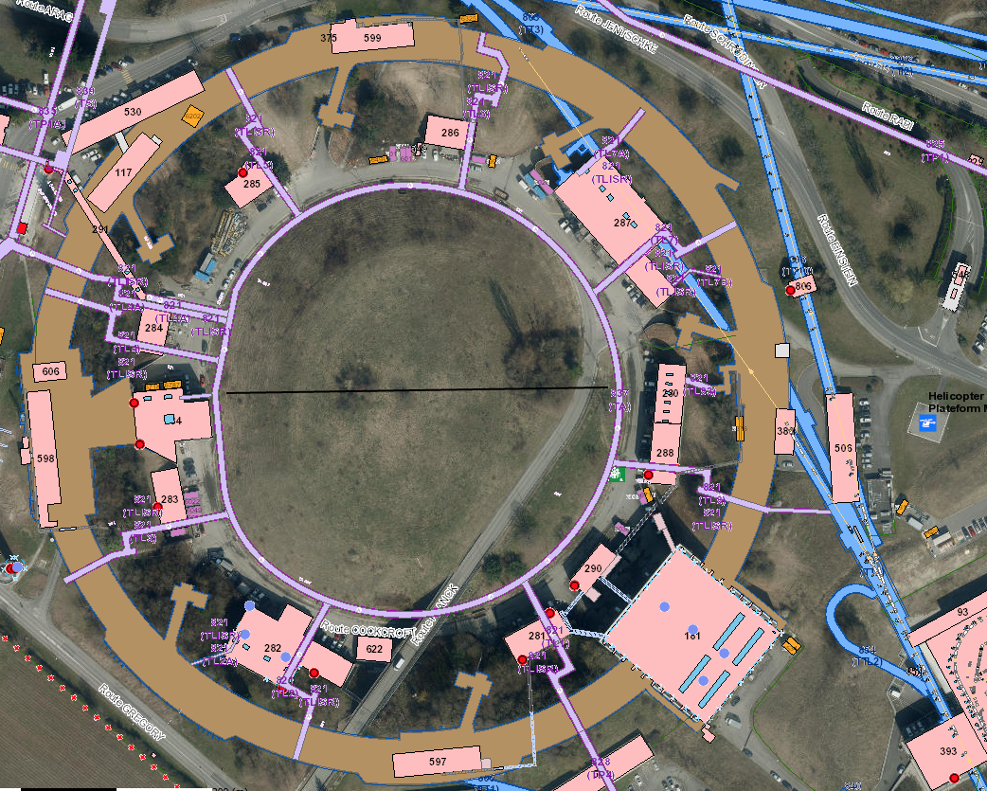
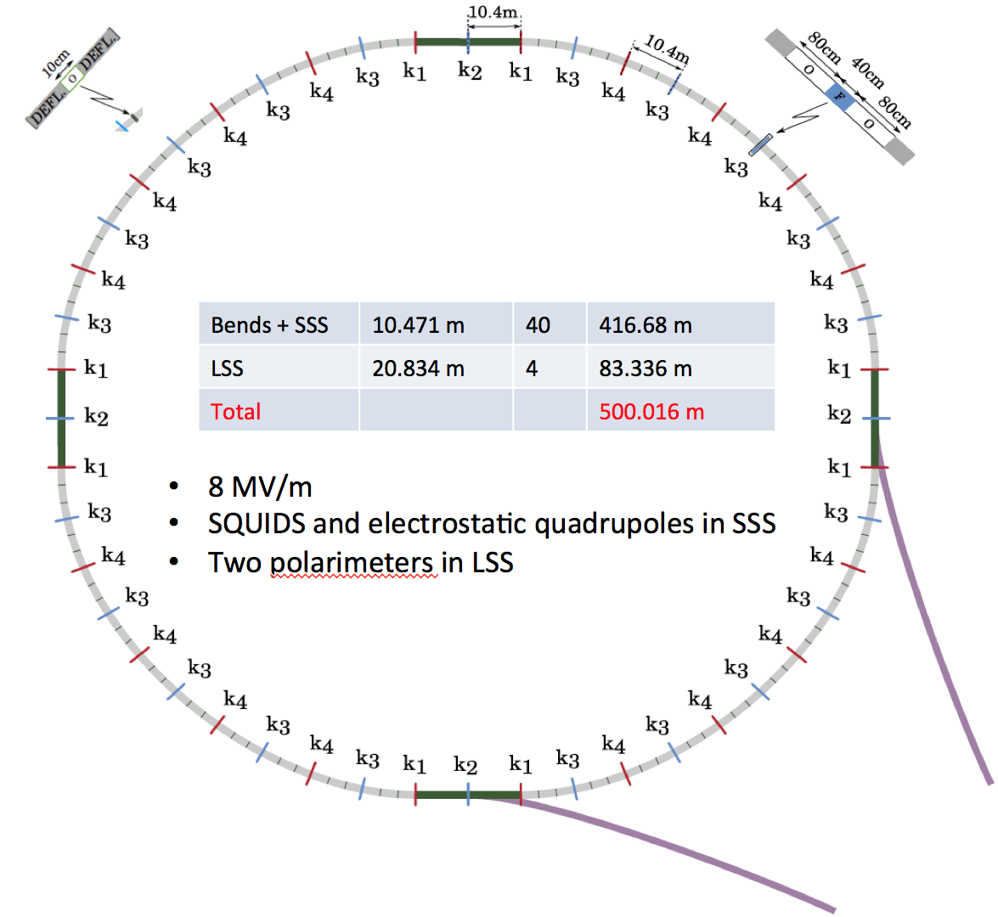
160 m

Slide 12
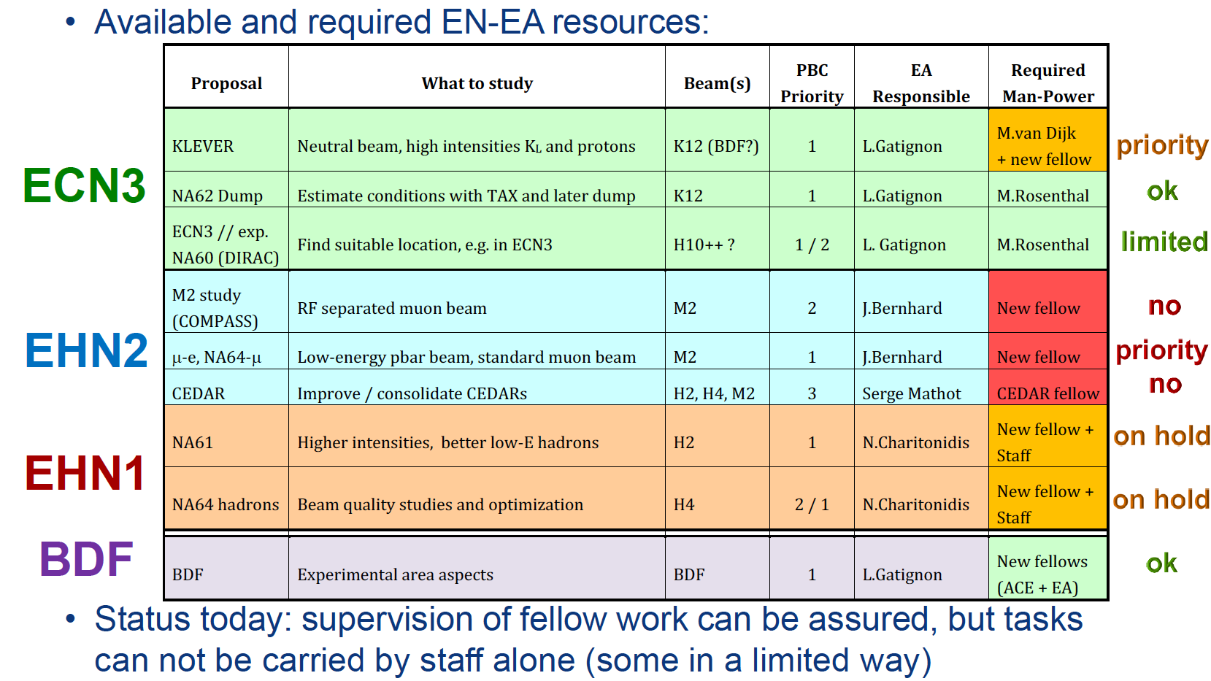
Conventional beams
Lau Gatignon, Markus Brugger

Slide 13
Injector complex performance after LIU
Proton delivery through the CERN accelerator complex will be developed in view of the potential provided by LIU; included in the analysis:
  LHC and HL-LHC
  Existing non-LHC physics users and their future perspectives
  Potential new physics users, in particular SHiP
  Considerations on the optimization of the delivery rates
  Limitations, areas of improvement, challenges
Beam losses in all accelerators - machine activation
Other intensity limitations and mitigation
  PS
    RF power, instabilities, extraction beam loss
    MTE, barrier bucket, higher extraction energy…
  SPS
    RF power, instabilities, e-cloud, beam dump, extraction losses
    RF capture, 800 MHz, gamma jump quads, extraction monitoring and control, collimators
1 fellow for fixed target beams intensity limitations (Giovanni, Hannes)
1 Ph.D. for PS barrier bucket studies (Heiko)
Giovanni Rumolo, Hannes Bartosik

Slide 14
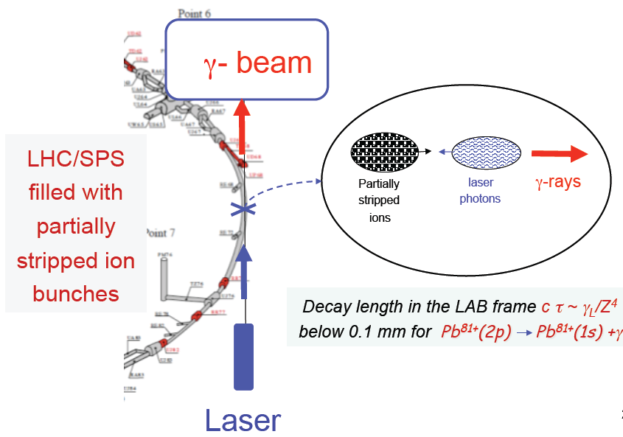
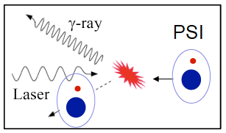

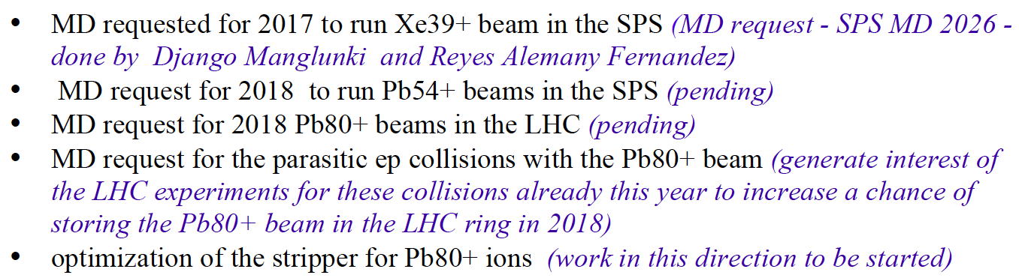
Gamma factory
Well-motivated initiative
  team at CERN and elsewhere already formed
Scientific associate at CERN for ~1 year to concentrate on this effort
MD program established
Simulation software development and tests
GF workshop incoming
Conceptual studies of applied GF research tools
Witek Krasny

Slide 15
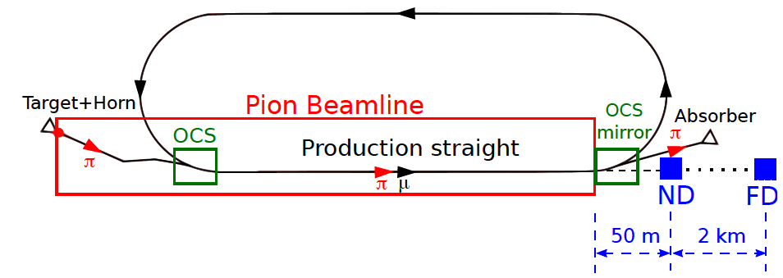
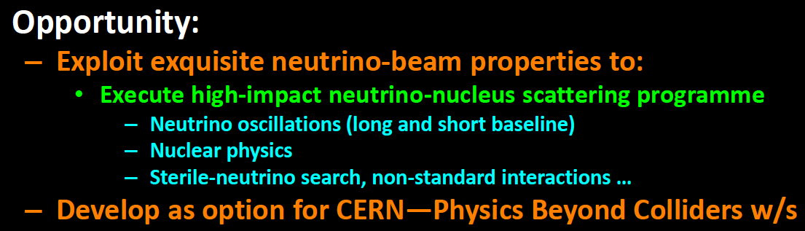
nuSTORM
Meeting in UK in Feb. Keen on exploring options to site at CERN.
Production/capture/ring design already well-developed (along with possible siting at FNAL).
Targeting a preliminary proposal for siting and exploitation at CERN
  Possible material outlay to support some (very) preliminary civil engineering/RP studies

Slide 16
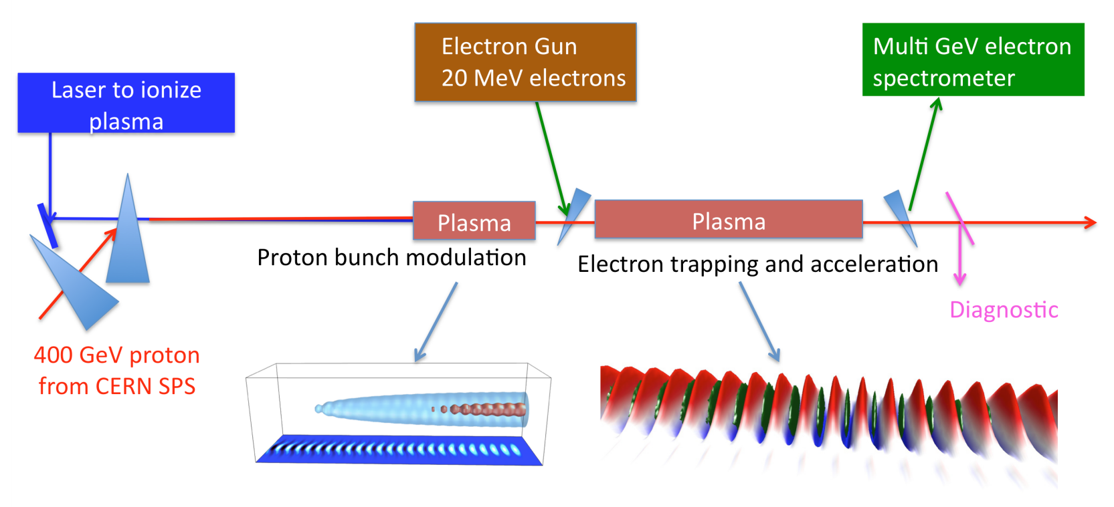
AWAKE@PBC
Exploratory study of possible applications of the AWAKE concept
  Leads: E. Gschwendtner, M. Wing
Possibilities:
  Use of electron beam for test-beam campaigns
  Fixed-target experiments using electron beams
  Searches for dark photons (NA64-like)
  High energy electron-proton collider
Key studies
  Particle physics: development of physics cases and experimental design
  Accelerator systems and realistic range of parameters
  Infrastructure and siting
  Possible synergies with AWAKE Run 2 integration studies
Request for fellow – not successful

Slide 17
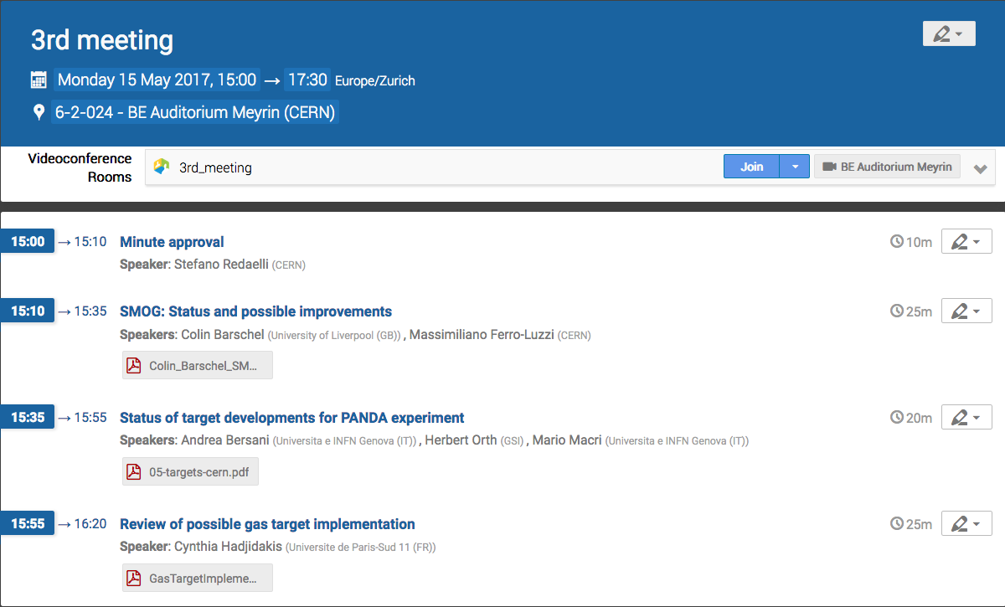
LHC Fixed Target
Considerable lively interest in the various options (internal gas-jet; target-crystal; crystal-target-crystal). LHCb, ALICE, UA9 in the mix.
Stefano Redaelli, Massi Ferro-Luzzi

Slide 18
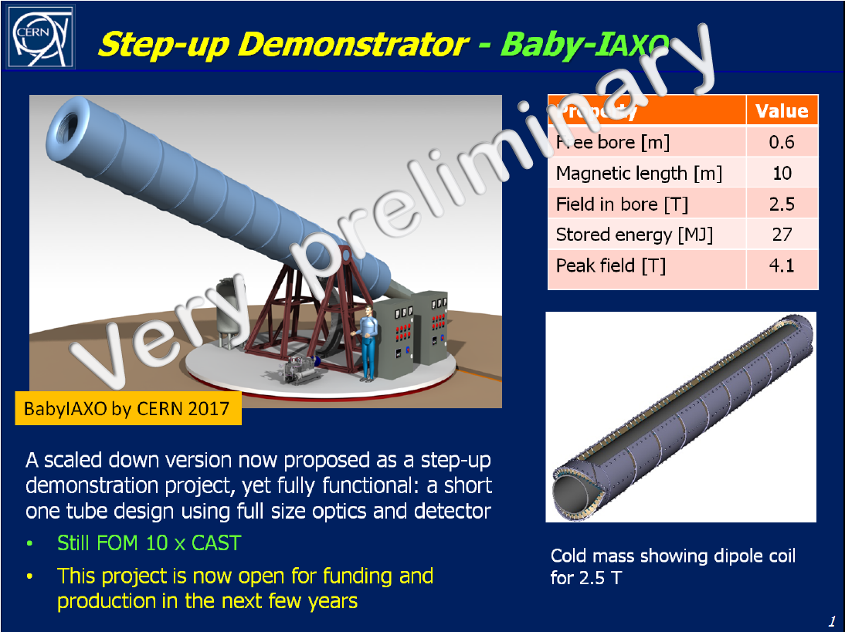
Technology
Mini-IAXO concept: An intermediate stage with prototyping activities + relevant physics reach.
Strongly pursued at the moment. High motivation in the collaboration
Work in progress. Conceptual design quite advanced, incl. rough cost & physics reach
First sketch : 10 m 60 cm diameter bore.
PBC fellow to work on IAXO magnet development -- AFC Nov 17
Discussions with LSW/ALPS also in progress

Slide 19
Accelerator domain - deliverables
COMPLEX | Fully developed proton performance plan – post LIU era
BDF | Complete technical feasibility studies Preliminary Comprehensive Design Report
EDM | Fully developed proposal including preliminary costing
CONV. BEAMS | Establish requirements, initiate feasibility studies
LHC FT | Preliminary conceptual design report(s)
GAMMA | Exploratory study, initiate initial tests
nuSTORM | Exploratory study of implementation at CERN Review potential scientific impact
AWAKE+ | Exploratory study for potential application of AWAKE concept
Technology | Explore possible technological contributions by CERN to externally hosted facilities Facilitate potential use of CERN infrastructure Study physics case and technical requirements as input to ESU
All groups up and running – resources limited in some areas

Slide 20
MTP
The Physics Beyond Colliders study heading, shown explicitly in the MTP for the first time, reports the budget allocated to PBC studies until 2019 to prepare the necessary input to the ESPP
  e.g. to complete technical feasibility studies for a possible beam-dump facility at the North Area, and to perform initial civil engineering studies for a possible proton EDM ring at CERN

Slide 21


