Slide 1
Status of BDF/SHiP target & target complex (TTC) studies
11th SHiP Collaboration Meeting
7th June 2017
M. Calviani (EN/STI/TCD)
for the BDF TTC WG

Slide 2
Outline
Context of BDF TTC activities
TTC integration & handling studies
BDF target/dump design status
BDF CV activities overview
BDF T6 target test
Target/dump material R&D
HSE feedback on BDF

Slide 3
Status of BDF TTC studies
Design & integration studies of the BDF TTC (including hadron absorber magnetisation (HAM) follow-up)
BDF target/dump optimisation, design and manufacturing
Realisation of the test area in T6 and design of a prototype target
Design of cooling systems, ventilation and He-purification
R&D on advanced materials
Support in the muon flux replica target

Slide 4
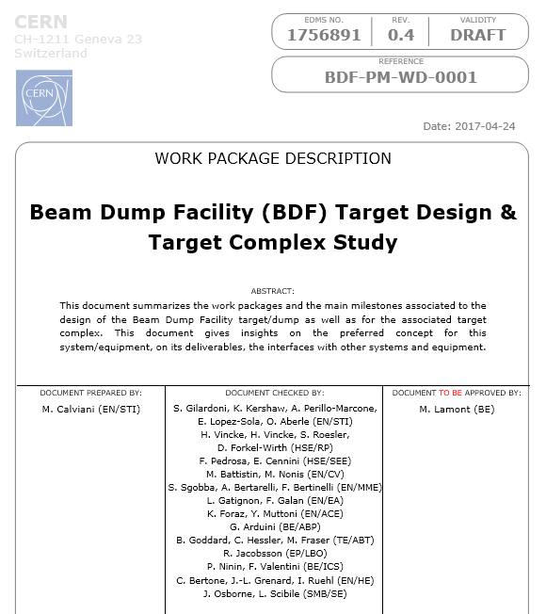

Slide 5
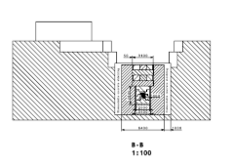
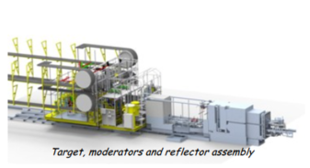
TTC design and handling studies
Preliminary study specification based on two concepts
Crane handling concept
  Shielding, target, etc. moved by crane with pure vertical movement (SHiP TP)
ISIS/RAL facility concept
  Trolley and services on trolleys on rails (side movement)
K. Kershaw, J.-L. Grenard

Slide 6
TTC design and handling studies
Contract placed with Oxford Technologies Ltd (OTL), Abingdon, UK
  Work started officially 2 May 2017
  Progress meetings already started
CERN provided revised 3D models for both concepts with:
  Single coil for HAM, located above shielding
  Complete separation of the HAM (uncooled US1010) vs. proximity shielding (cooled cast iron)
Close discussion with HSE/RP & HSE/SEE for key aspects of the TC design
First review at CERN on July 25th
K. Kershaw, J.-L. Grenard

Slide 7
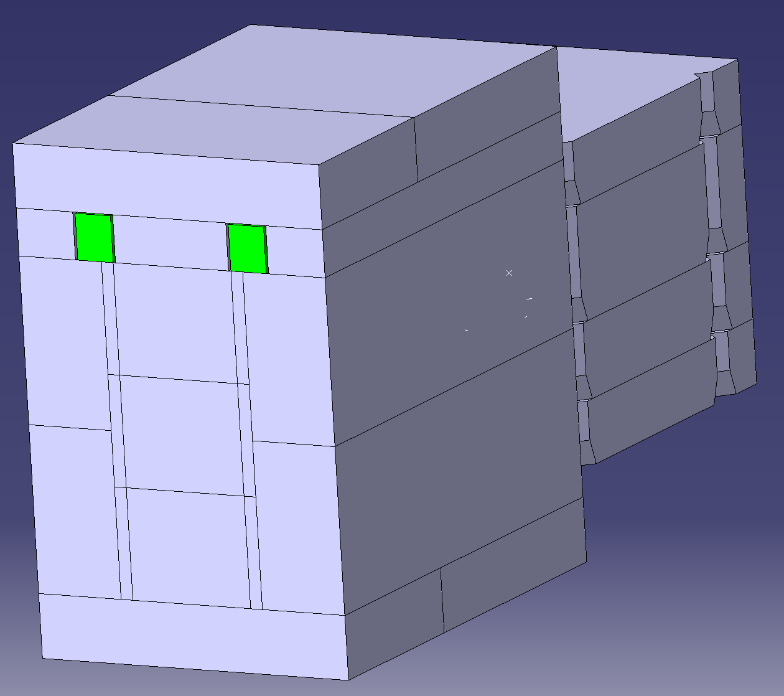
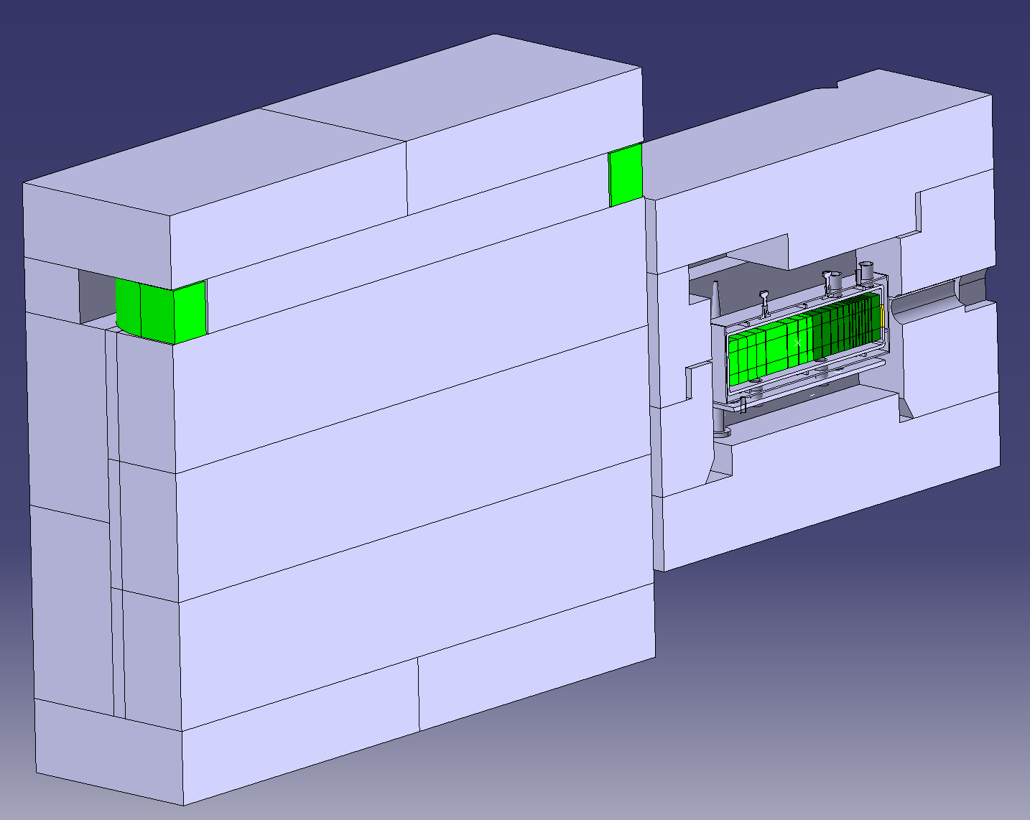
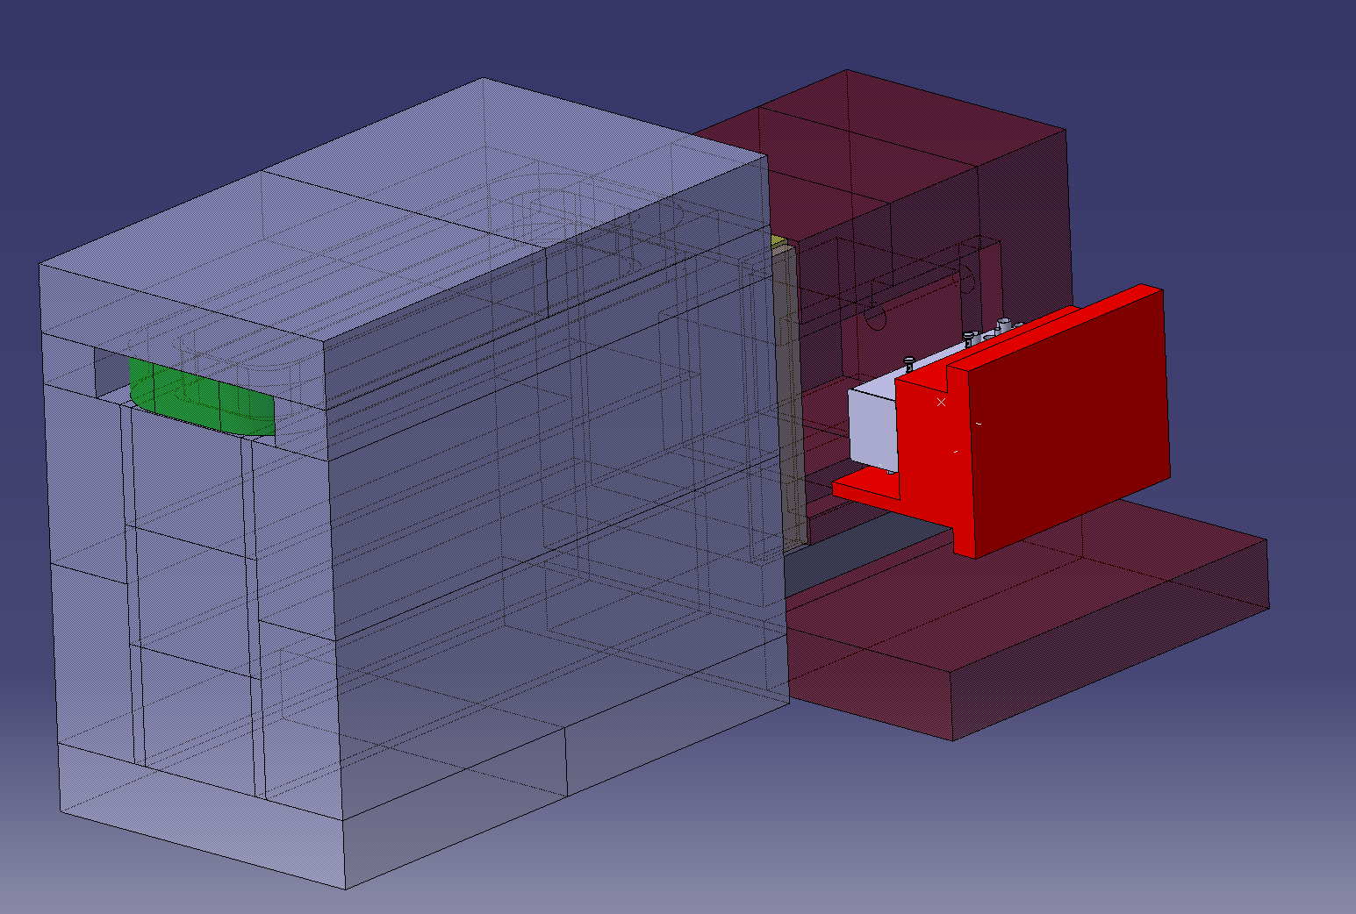
Crane version
US1010
coils
Trolley version
SS316L

Slide 8
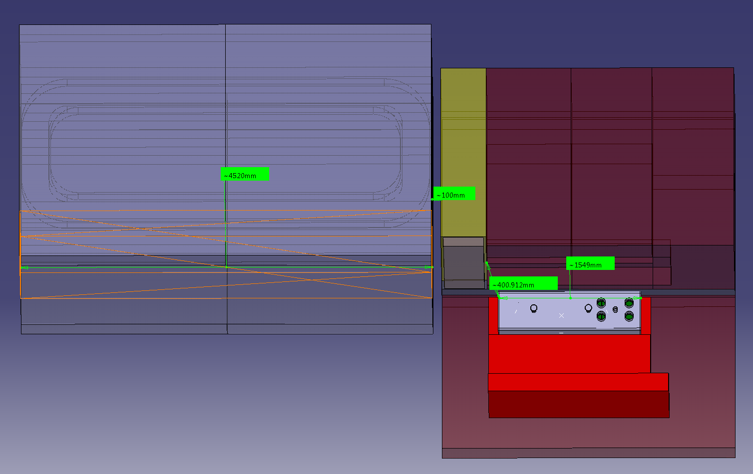
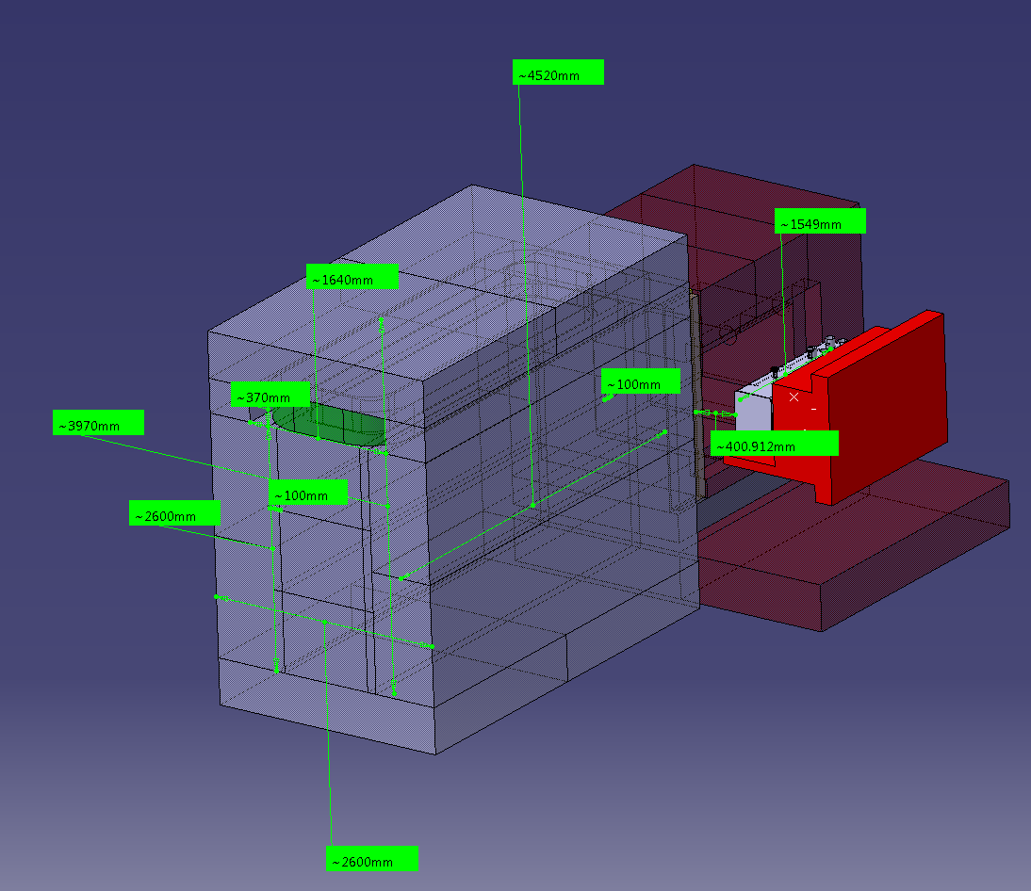
K. Kershaw, J.-L. Grenard

Slide 9
Outstanding items with SHiP on TTC
Need to work hand in hand with SHiP on the design/optimisation of the HAM, since handling/support/cooling will have to be secured within the framework of the TTC design
Important aspects:
  Forces, assembly of the magnets, global optimisation, cooling connection of coil, reliability, etc.

Slide 10
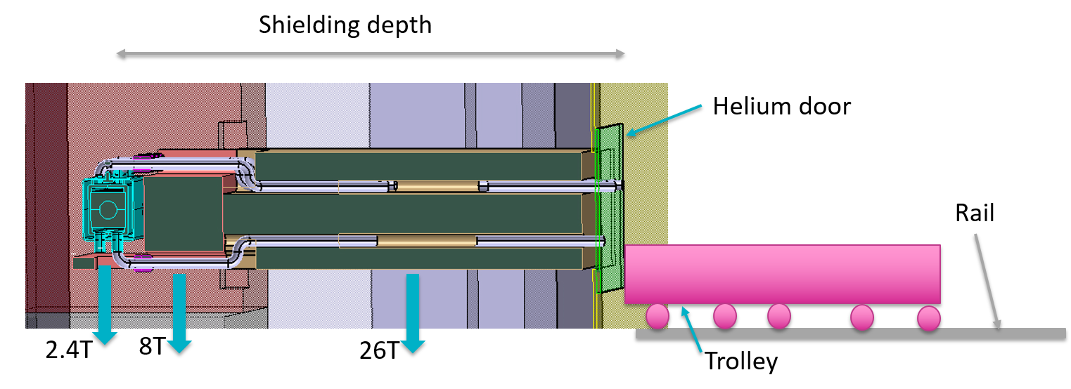
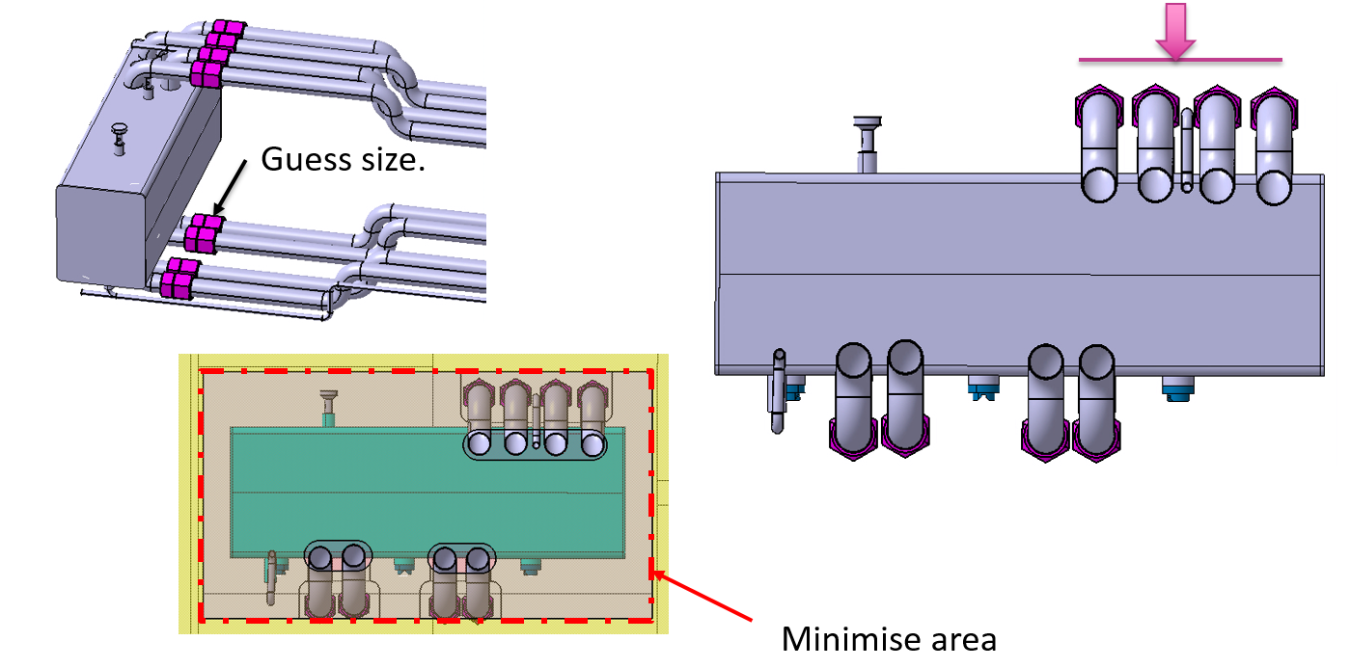
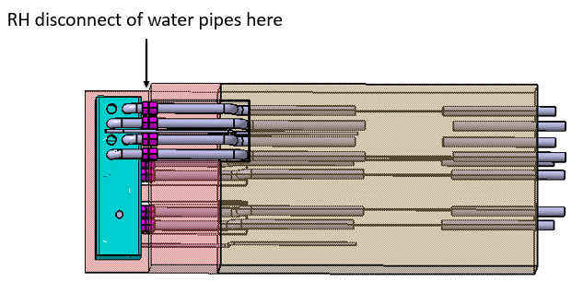
Ideas on trolley concept handling
Target cooling connections

Slide 11
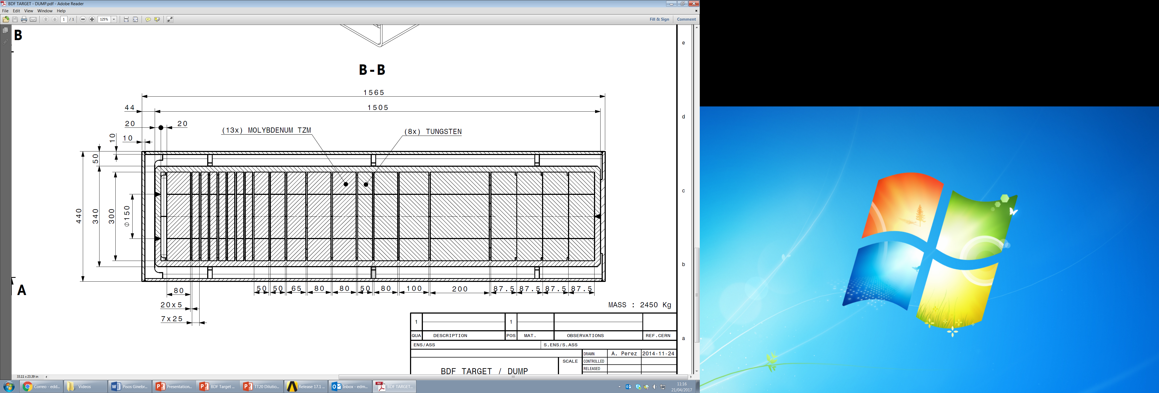
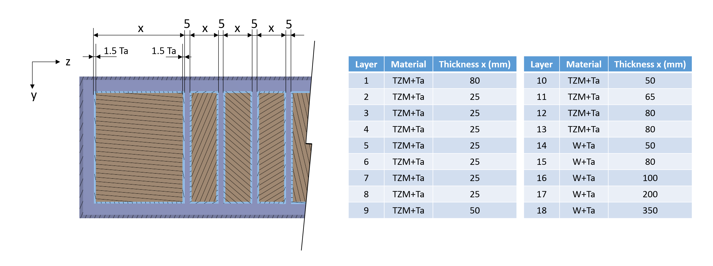
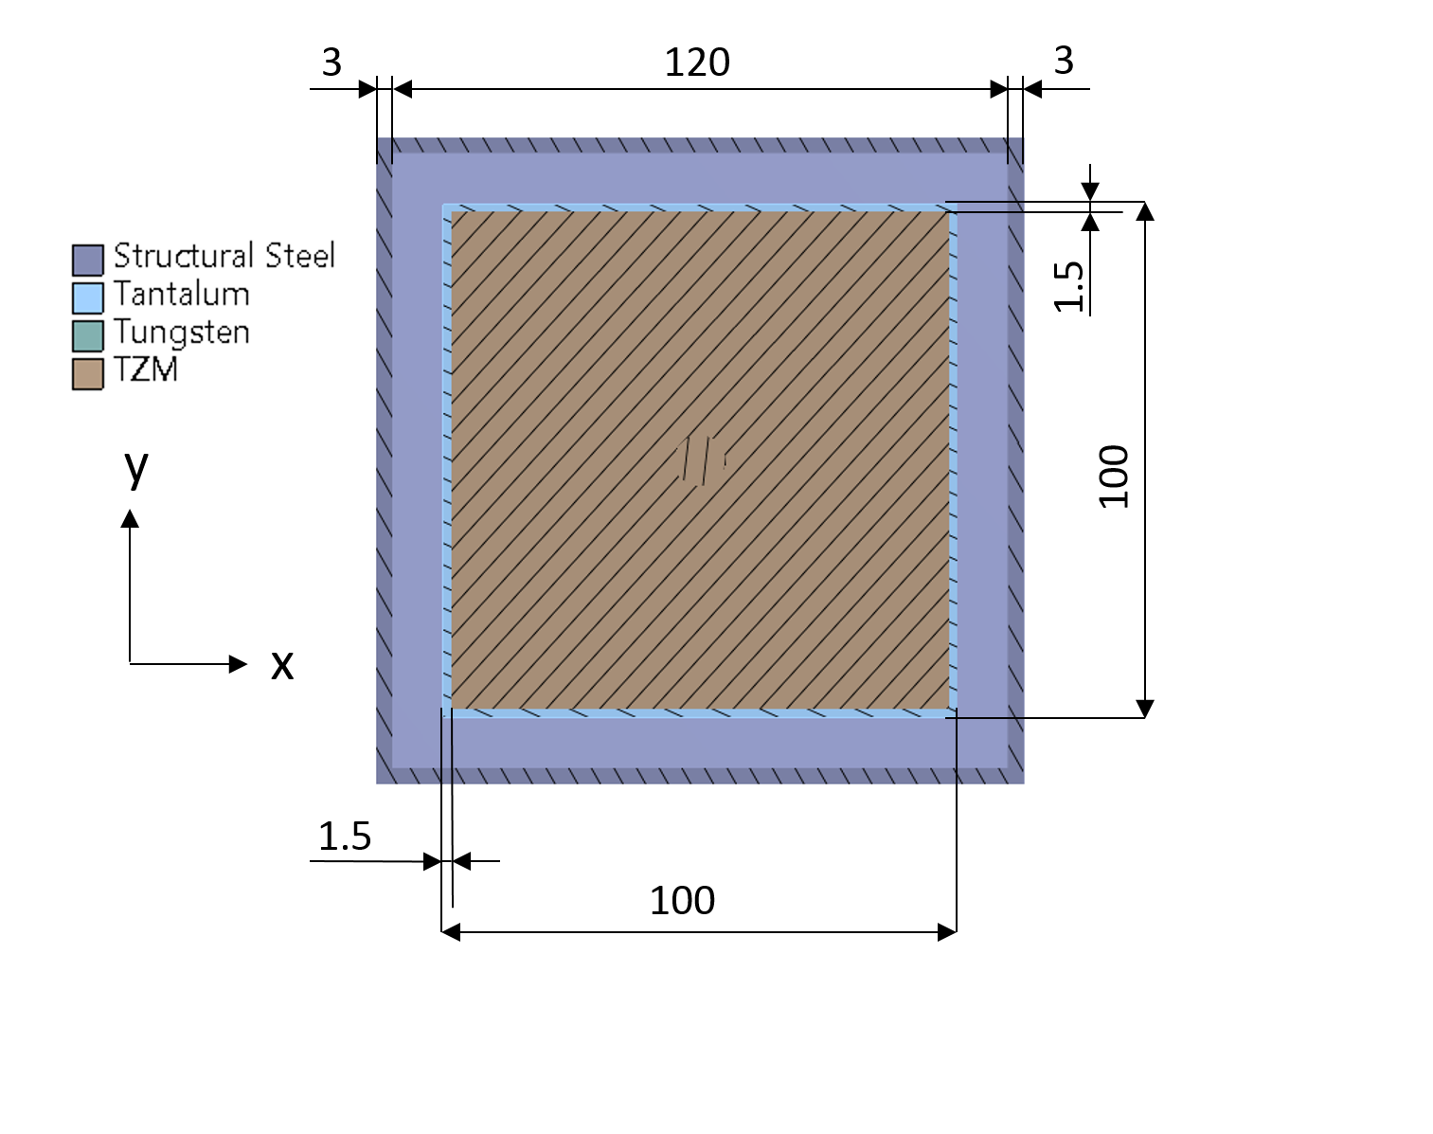
BDF target mechanical design status
13 TZM blocks + 5 tungsten blocks. All blocks are Ta-cladded
30x30 cm² rectangular plates with variable thickness
  Highly probable to switch to 25 cm diameter circular plates
  Total target length = 1.445 m
5 mm longitudinal gap between the blocks
E. Lopez Sola

Slide 12
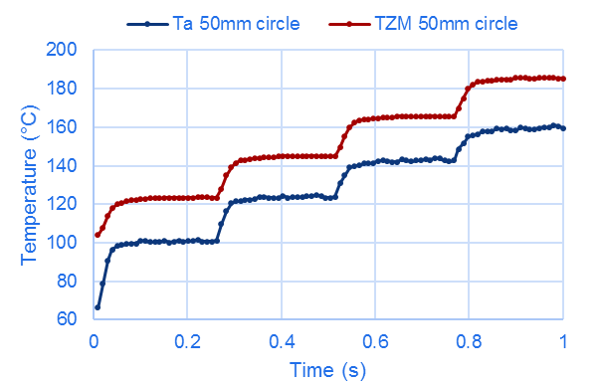
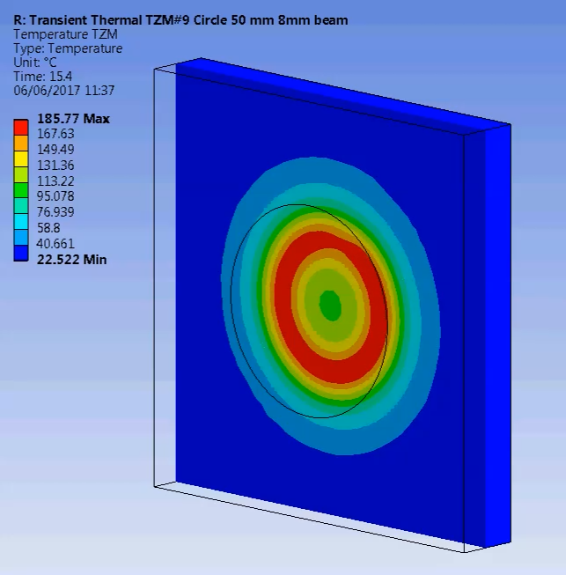
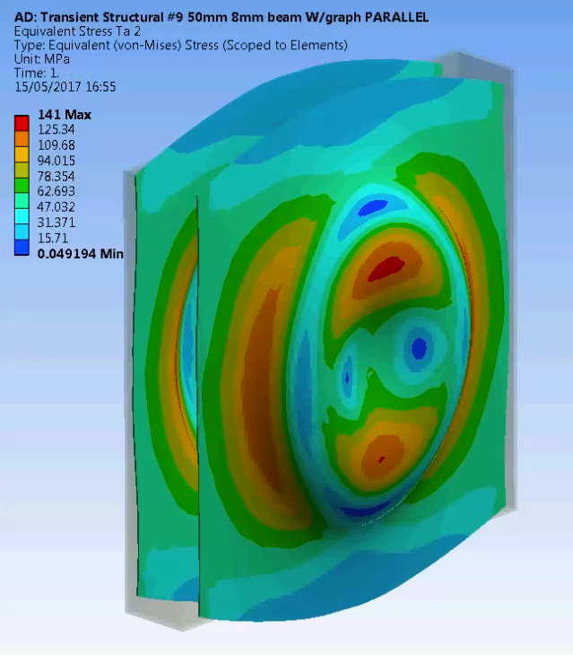
Target configuration
Circular beam dilution:
  50 mm radius circle
  1 second extraction in 4 turns
  8 mm 1σ beam
Maximum temperatures:
  Tantalum cladding: 160°C
  TZM core: 185°C
Maximum Von Mises equivalent stress:
  Tantalum cladding: 120 MPa
  TZM core: 175 MPa
E. Lopez Sola

Slide 13
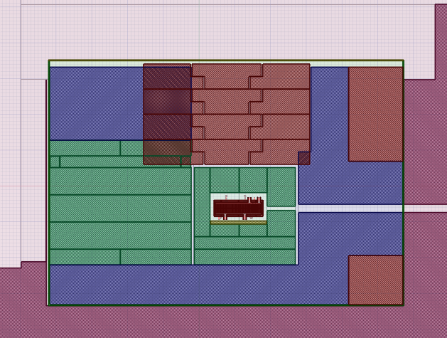
Proximity shielding design status
Around 25 kW deposited in the proximity shielding blocks
Active cooling necessary in the cast iron blocks
Proposed design avoids active water cooling in the US1010 part
Trolley concept:
  Proximity shielding blocks cooled by conduction through horizontal and vertical plates
Crane concept:
  Proximity shielding blocks cooled by embedded SS pipes
US1010
E. Lopez Sola

Slide 14
Overview of CV activities
He-vessel design
  Task 1: Design of He circulation/purification system
  Task 2: Economic study on purification vs. flushing
  Task 3: Study of purification system by external partner
  Task 4: Procurement and operation of prototype
Ventilation systems
  Task 5: Conceptual design and pre-integration of ventilation systems
Cooling systems
  Task 6: Conceptual design and pre-integration of cooling systems
  Task 7: Optimization of target cooling
P. Avigni

Slide 15
Status – He vessel design
Started preliminary design of He circulation system
  Setup of preliminary CAD models for CFD simulations
  Preliminary considerations on blocks and gaps distribution; He volumes; He source and sink locations; He flowpath
  Started discussion on concrete/iron releases and vessel leak-tightness for definition of purification requirements
Defined options for purification approaches and respective economic analysis
Established preliminary contact with external partner for study of purification system
  Definition of He purification general requirements
Started procedure for procurement of He gas purification system (MS, IT)
P. Avigni

Slide 16
Status – Ventilation systems
Defined preliminary pressure cascade according to nuclear ISO standard and CENF experience
  He-vessel room: -140 Pa
  Handling area / CV room: -80 Pa
  Access staircase: -40 Pa
  Target hall: -20 Pa
Setup of integration approach
  Defined preliminary list of ventilation components needed
  Started calculation of volumes for integration (OTL)
P. Avigni

Slide 17
Status – cooling systems
Started preliminary design of cooling systems:
  Target cooling: 350 kW, ~200 m³/h
  Proximity shielding: 25 kW, ~2 m³/h
  Magnetic coil: 150 kW, ~15 m³/h
Setup of integration approach
  Component list based on work performed for CENF
  Calculation of piping/system and fluid volumes for
    integration (OTL)
    water activation (RP)
Target cooling
  Performed single-channel water CFD analysis
  Assessment of He target cooling feasibility
P. Avigni

Slide 18
Short-term plans
Run preliminary CFD simulations for He circulation
  Needed to establish requirements for He circulation system
Perform He circulation study with external contract
  Needed to establish requirements for prototype procurement
Define baseline cooling and ventilation systems
  Preliminary P&ID
  Calculation of volumes for integration and activation calculations
P. Avigni

Slide 19
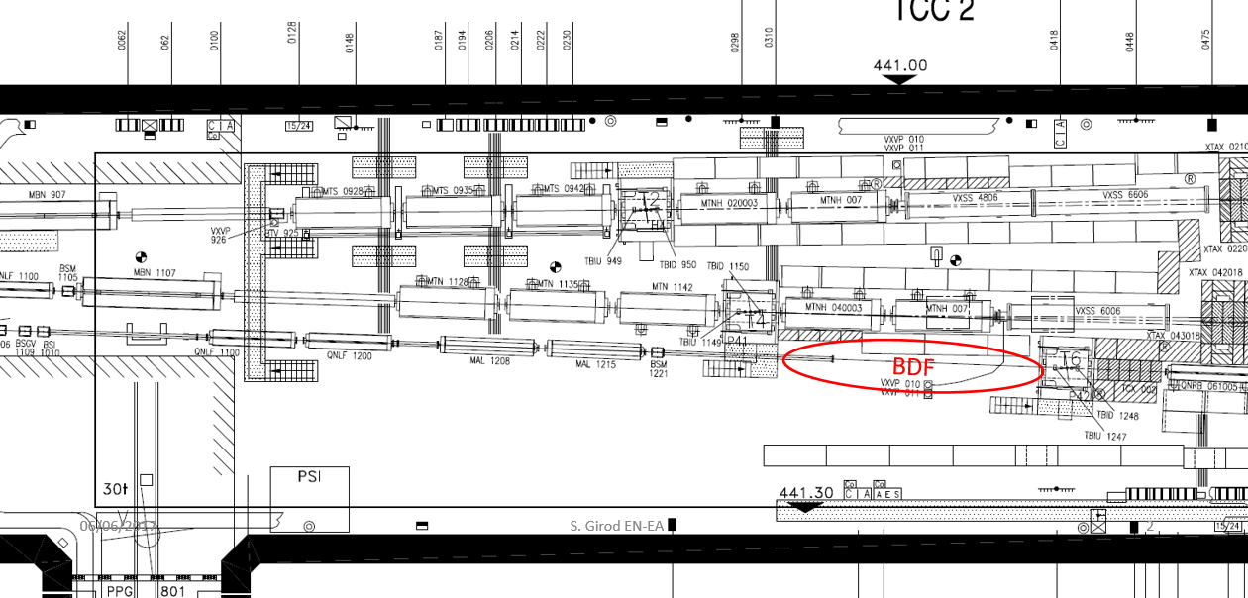
BDF beam test prototype in T6
Proposition to run a dedicated high intensity (O(10¹²-10¹³)) test in TCC2 during 2018 → slow extraction & high intensity
Possibly need for dedicated NA beam – collaboration with TE/ABT to define the optics and with PS/SPS coordination to assess the scheduling
Memo to SPSC to be prepared for August 2017
Preparation of the area in collaboration with EN/EA

Slide 20
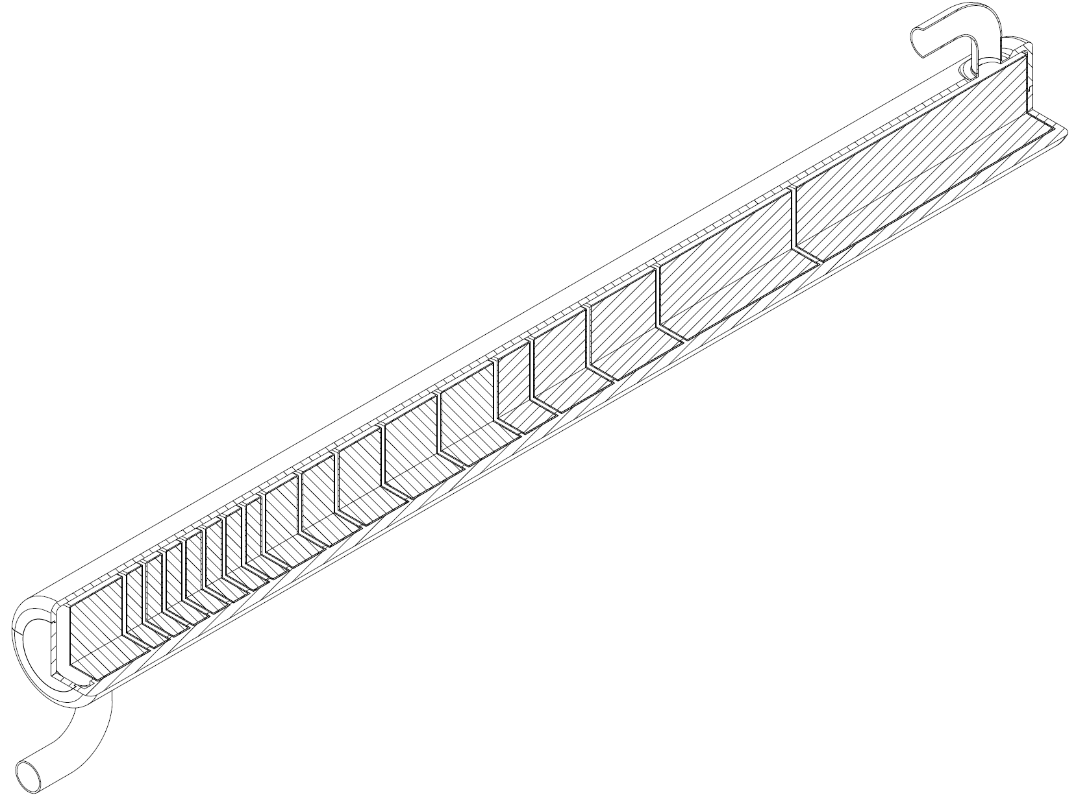
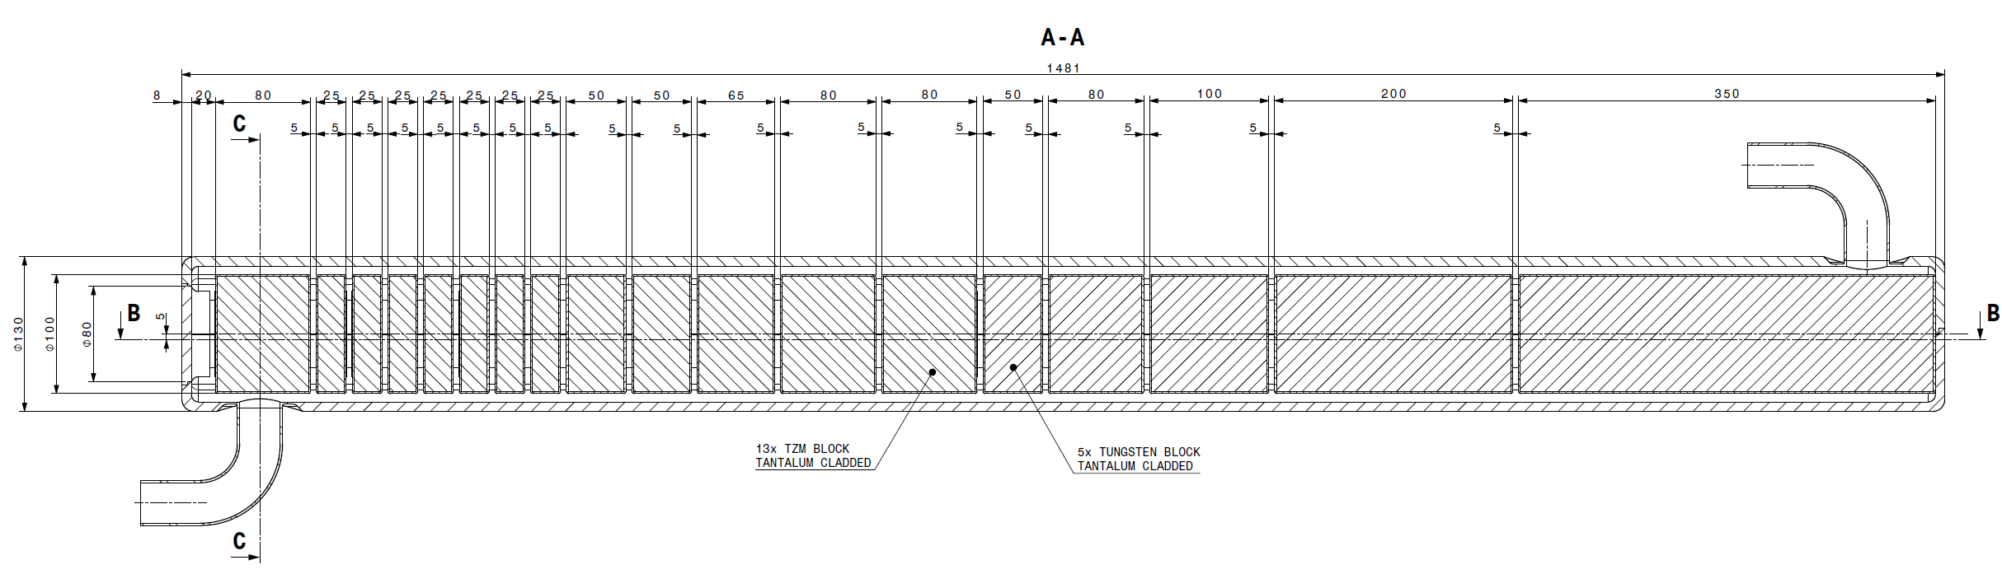
BDF beam test prototype in T6
Reduced scale prototype
  100 mm diameter plates, same thicknesses as the final target
  Recreate level of T and stresses during operation
  PIE foreseen after irradiation
~1500 mm
~100 mm
A. Perez, E. Lopez Sola

Slide 21
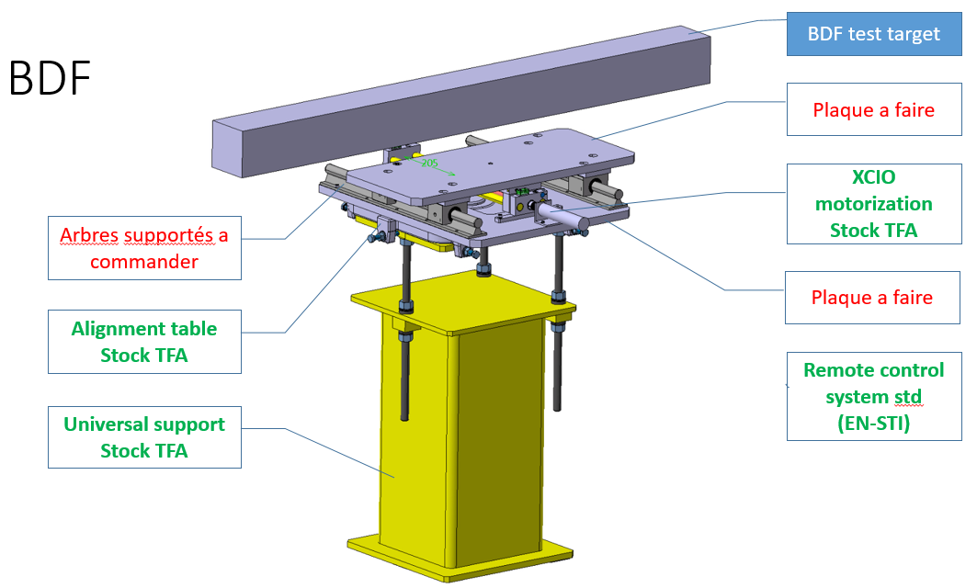
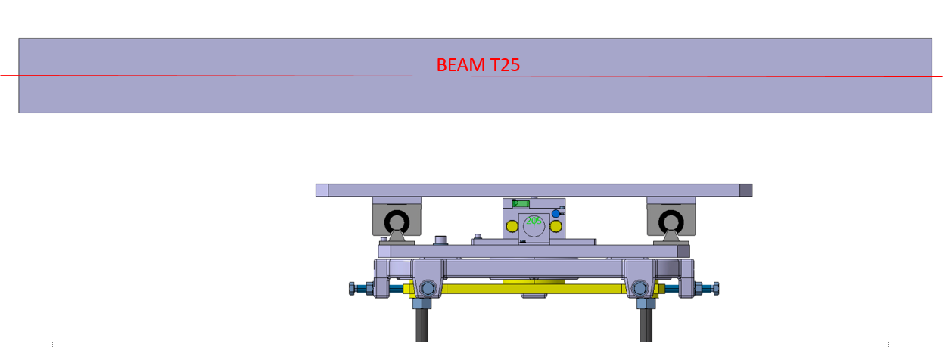
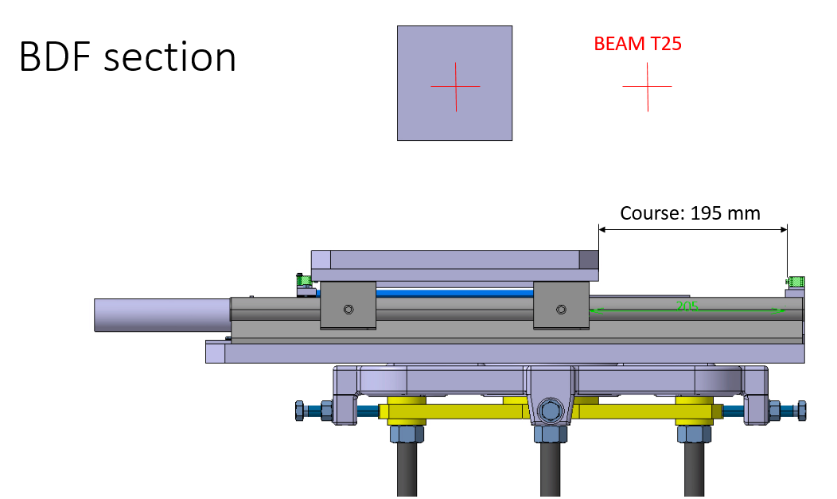
S. Girod, O. Aberle

Slide 22
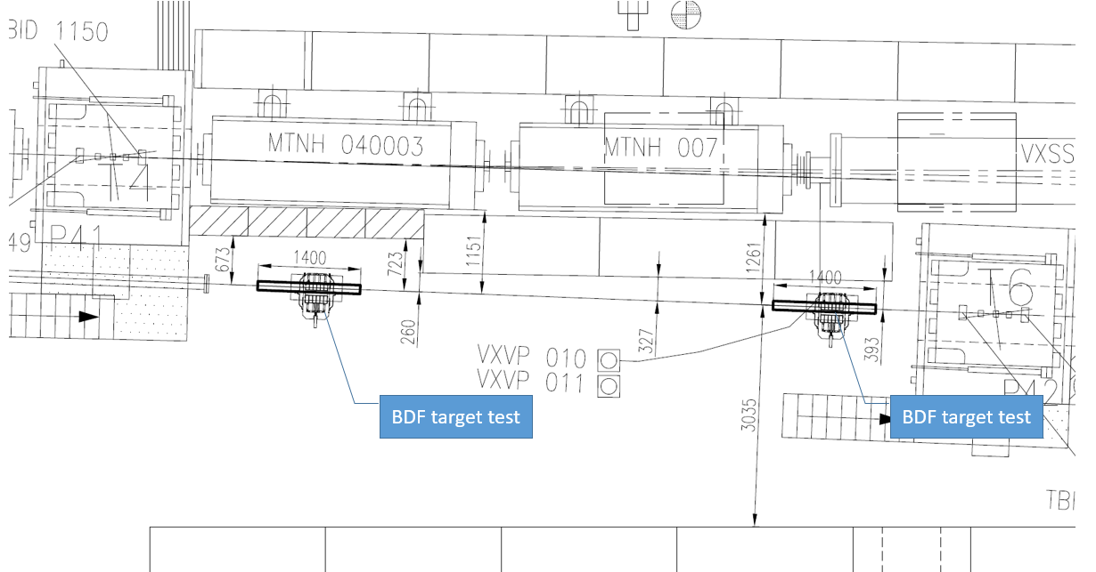
BDF T6 test location(s)
T4
T6
Proposed position #1
(preferred)
Proposed position #2
S. Girod, O. Aberle

Slide 23
BDF materials R&D status
Several ongoing parallel sub-projects:
Intermetallic bonding follow-up
Raw material characterisation campaign
Evaluation of Ta gettering properties
Investigation of W/Gr as a candidate material to substitute TZM
J. Busom

Slide 24
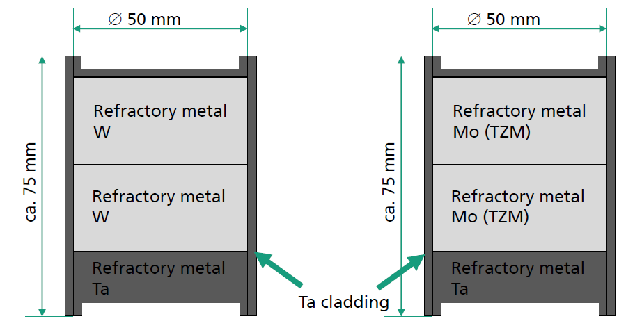
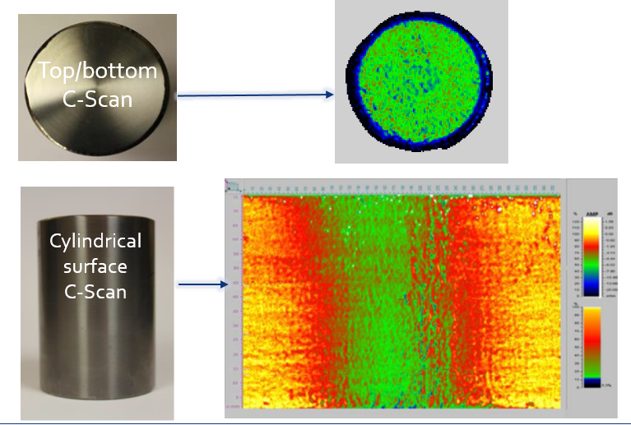
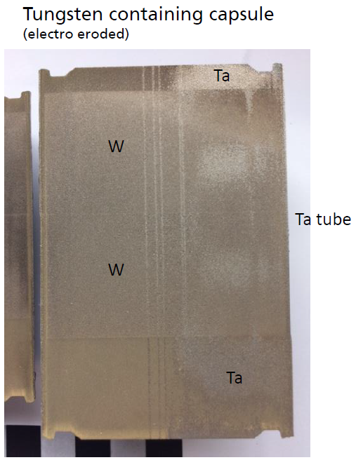
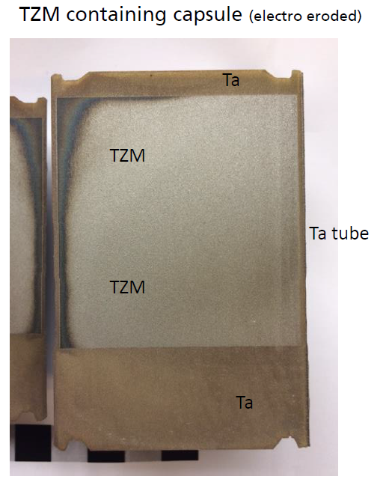
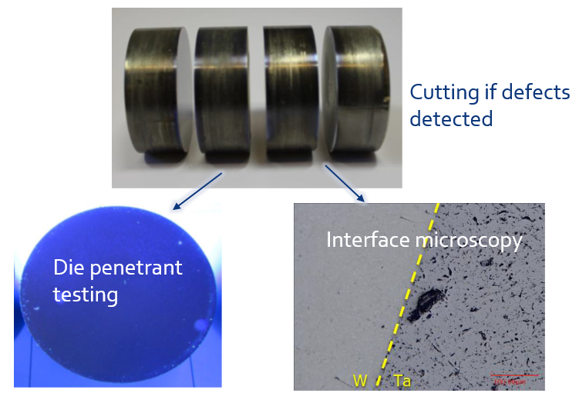
Just some flavour…
J. Busom

Slide 25
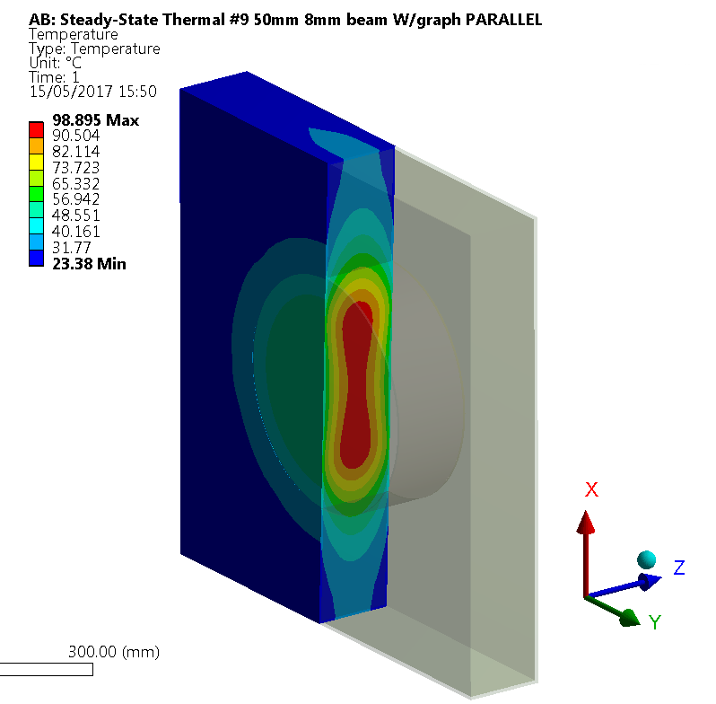
W/Gr studies
High thermal conductivity in the XY plane
Sintered from powder metallurgy – tunable density – possible alternative to TZM
Thermal conductivity and CTE improved in the pressing direction
Density around 11 g/cm³ (50 vol% of graphite)
Material complete characterization launched

Slide 26

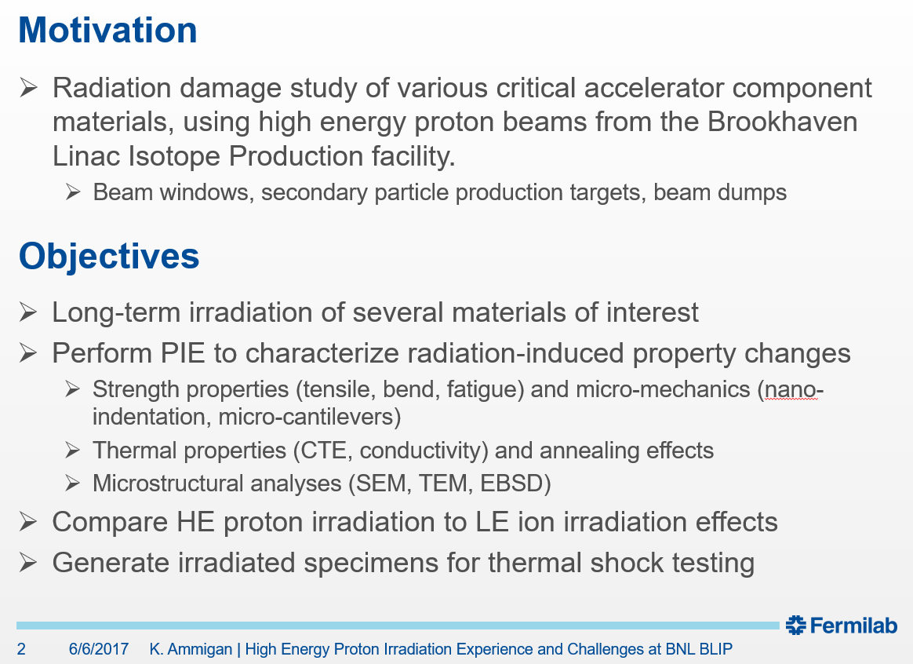
Material irradiation

Slide 27
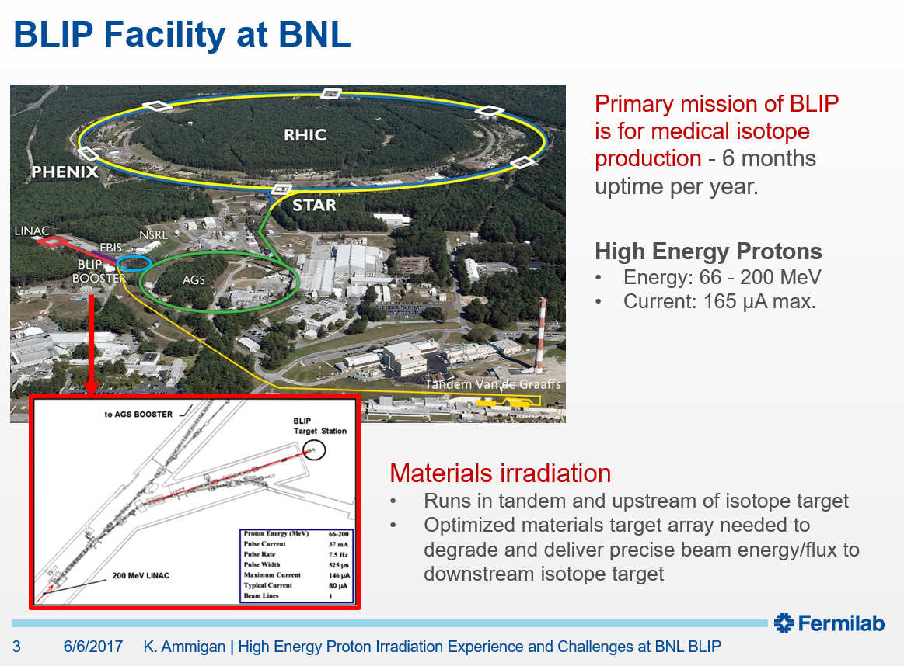

Slide 28
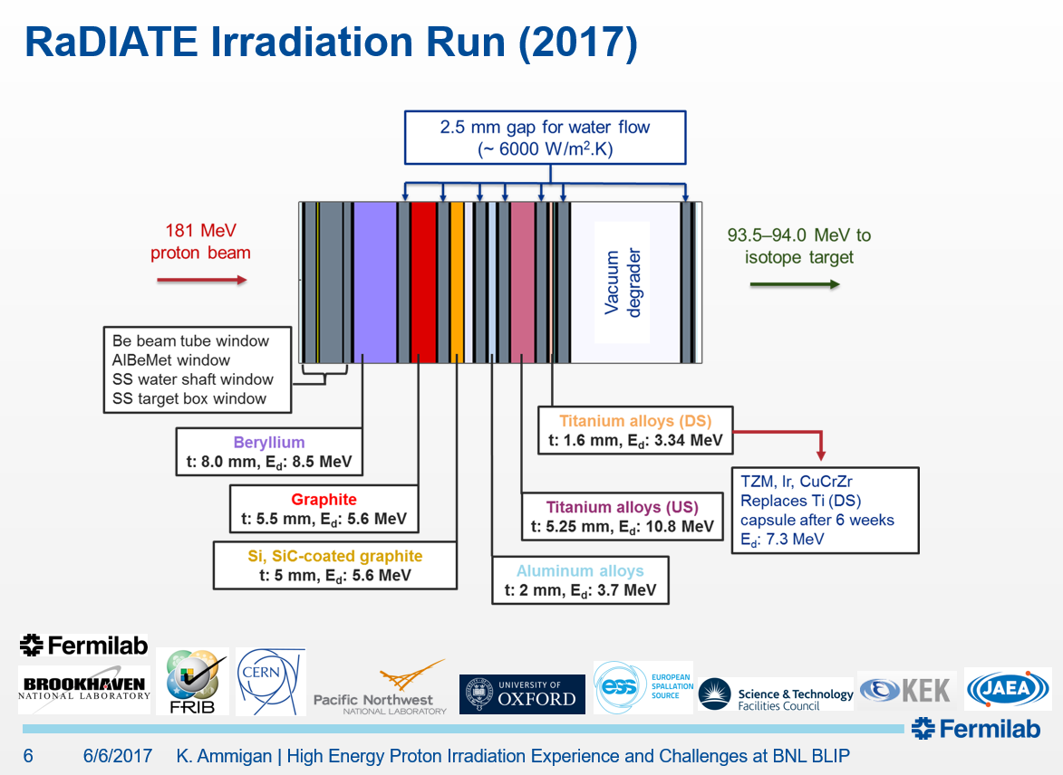

Slide 29
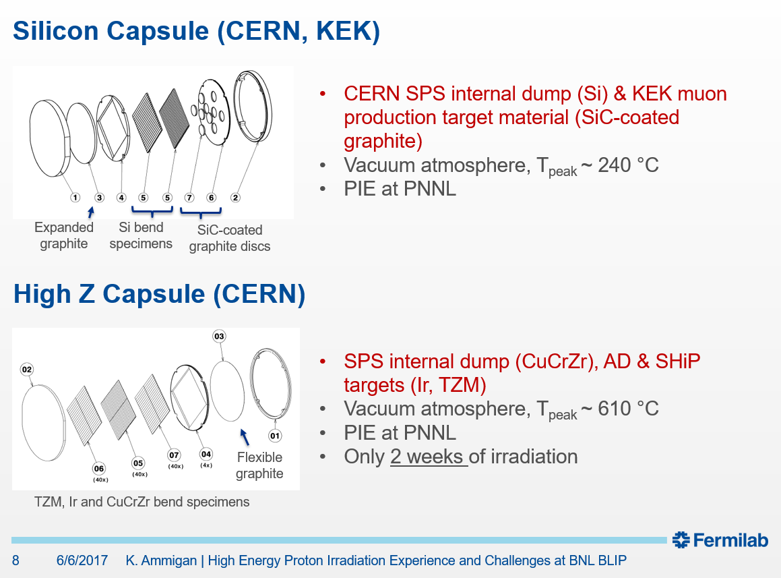
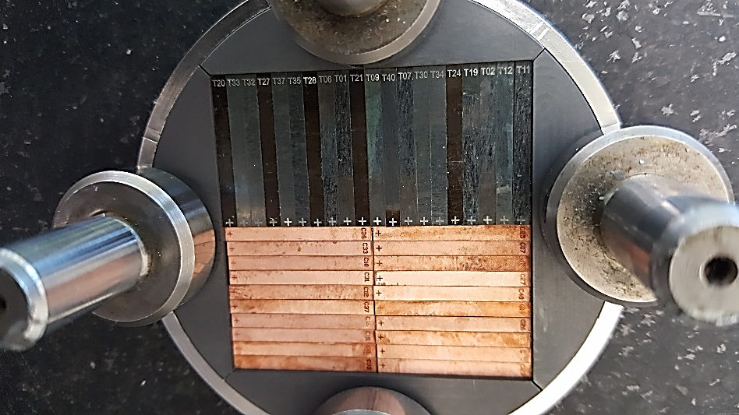

Slide 30
HSE-SEE
Ongoing
  Organize the hydrogeological study for the area where the BDF will be implemented
  Flooding risk assessment due to internal and external sources for the BDF and the SHiP experimental hall
  Helium vessel discussions on possible ways of making it leak tight, and the options between under pressure or over pressure vessel
  Fire risk analysis for the BDF ventilation compartments as required by the ISO 17873 chapter 7.3 (some data is still needed)
  Helium release into the atmosphere
Other subjects under discussion
  Use of tritium reducer materials in some of the existing infrastructures affected by the BDF connection to the SPS
  Ventilation and environment emissions optimization for the TT20, TDC2, TCC2, new junction cavern, new transfer tunnel and BDF
  Definition of a unique hazard list for all PBC projects
F. Pedrosa

Slide 31
Conclusions
Good progresses on all fronts – starting from BDF Target Complex integration studies
Important “starting point/agreement” for the design of the hadron absorber magnetisation between BDF WG and SHiP reached
Target/dump configuration “stabilized”, including beam dilution requirement on target
Material irradiation (TZM) ongoing

