Slide 1
  Status of the μ-flux proposal
Eric van Herwijnen
9 June 2017

Slide 2
Contents
Motivation (reminder)
H4 area
Layout
Target
Drift tubes
Muon tagger

Slide 3
Motivation
~2.6x10¹⁰ μ’s/spill in SHiP acceptance
~4x10⁸ with p>100 GeV
In 10¹⁰ simulated pp ints: 166 muons with p>100 GeV, p_{T}>3 GeV, too small!
Proposal: accumulate ~10¹¹ pot at H4 using the charm x-section setup early 2018
Expected μ phase space for 1 spill (4x10¹³ pot)

Slide 4
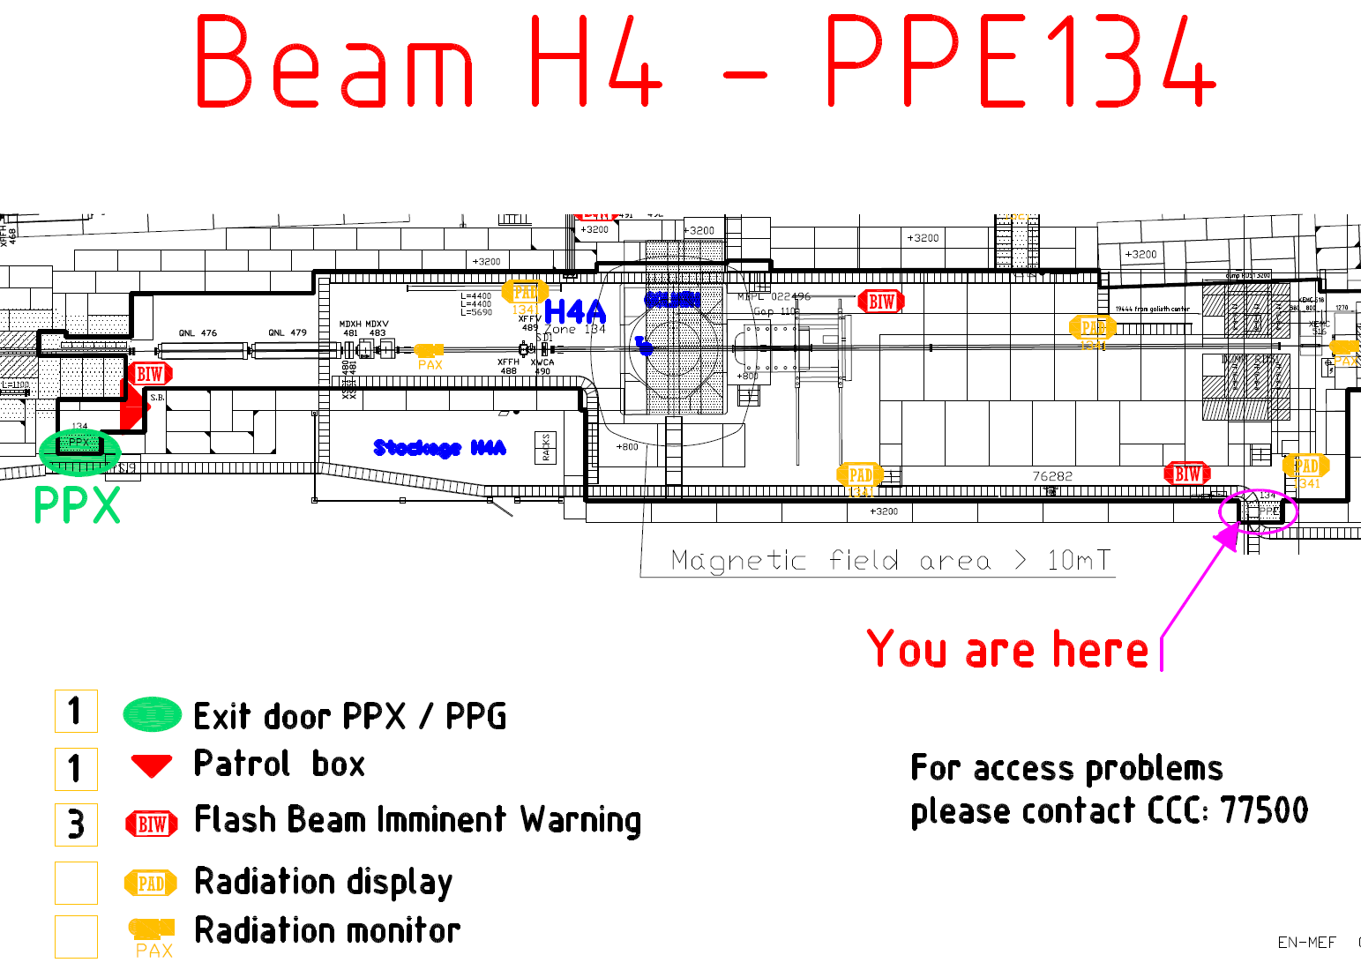
Situation in H4

Slide 5
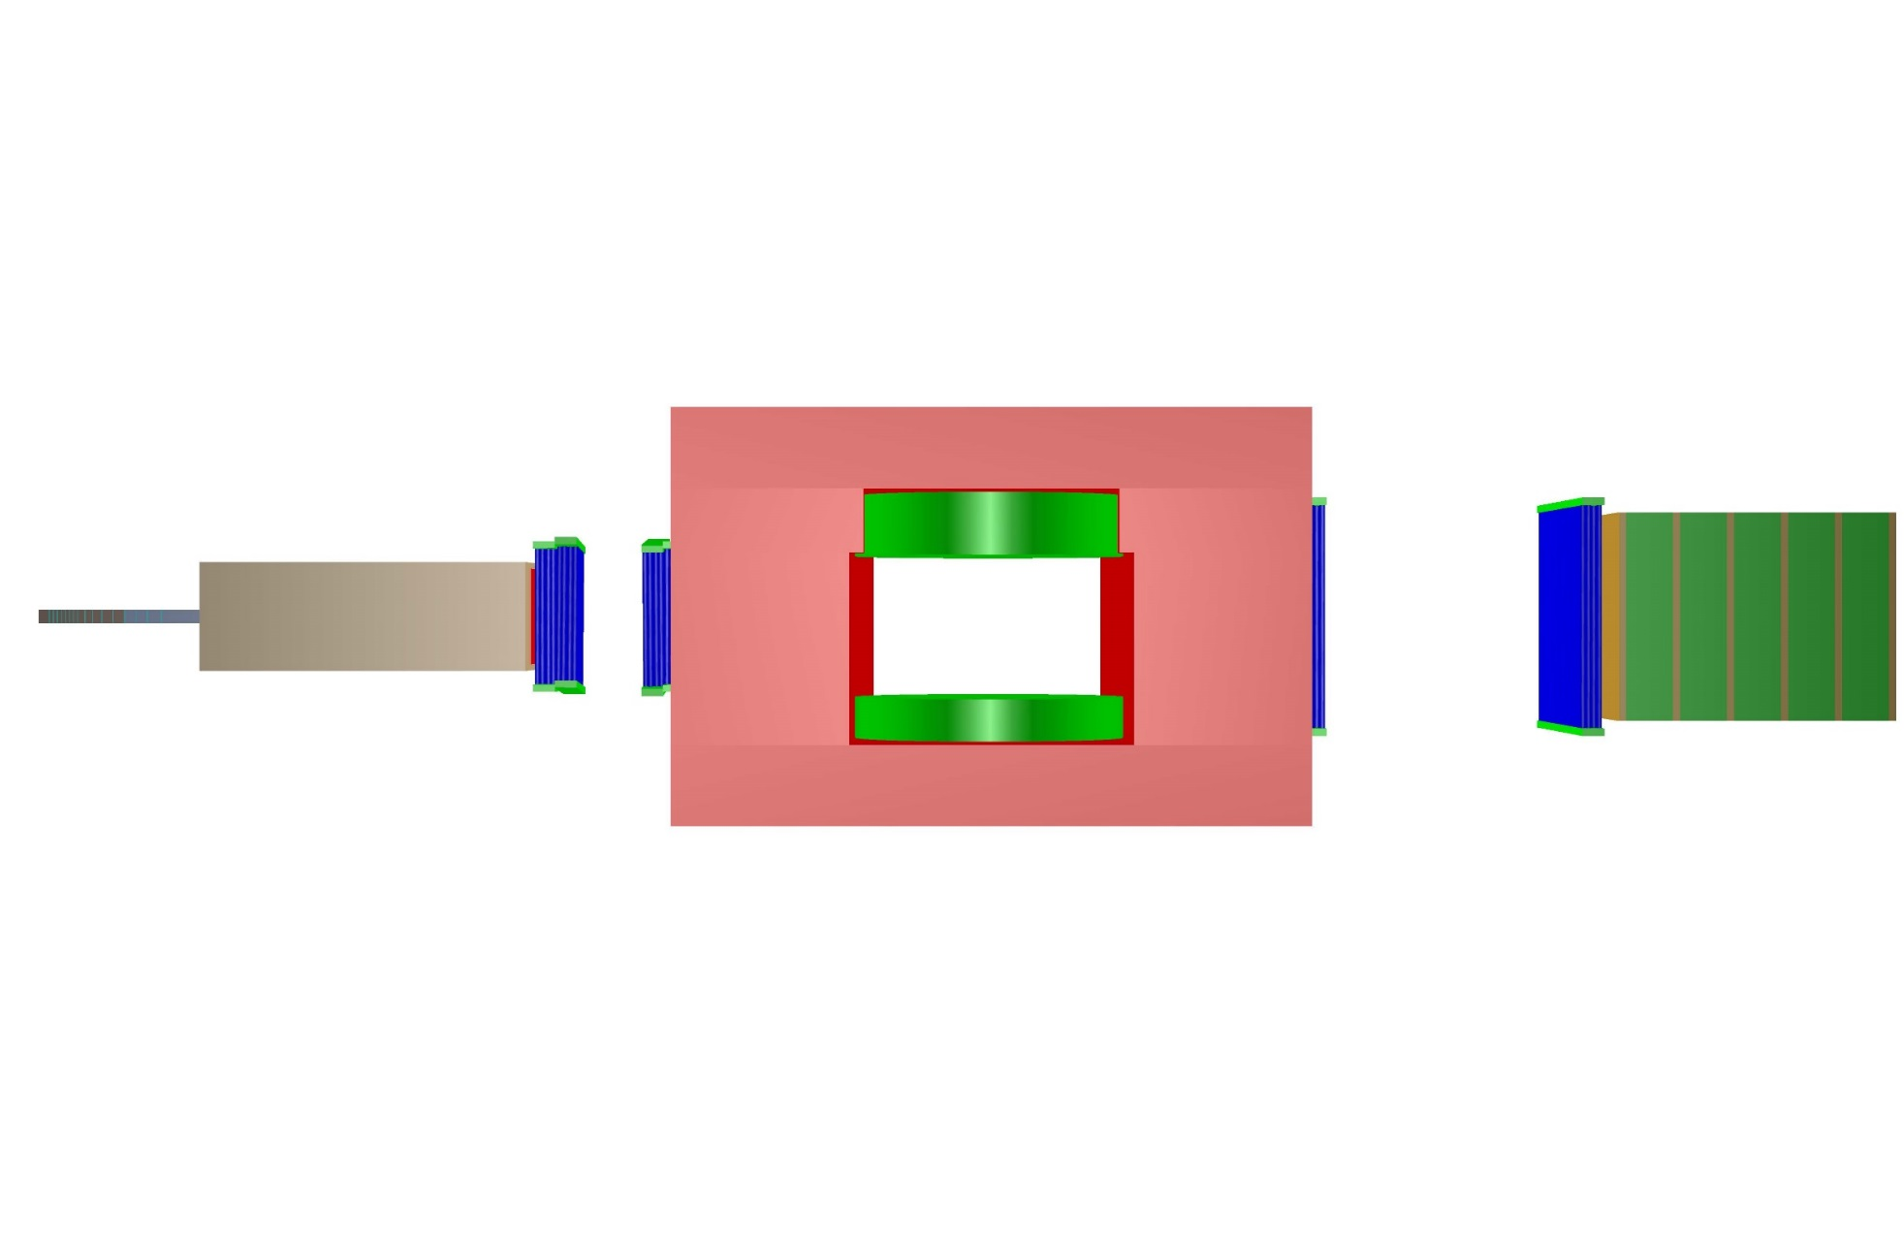
Layout
T1,T2
50x100cm
T3,T4
200x160cm
2
2
Scintillator
50x70cm²
Goliath
Target
10x10x116cm³
yu
vy
y
y
Muon tagger
Absorber
80x80x240cm
3
D
80 cm
D P1-P2 = 100 cm
200 cm

Slide 6
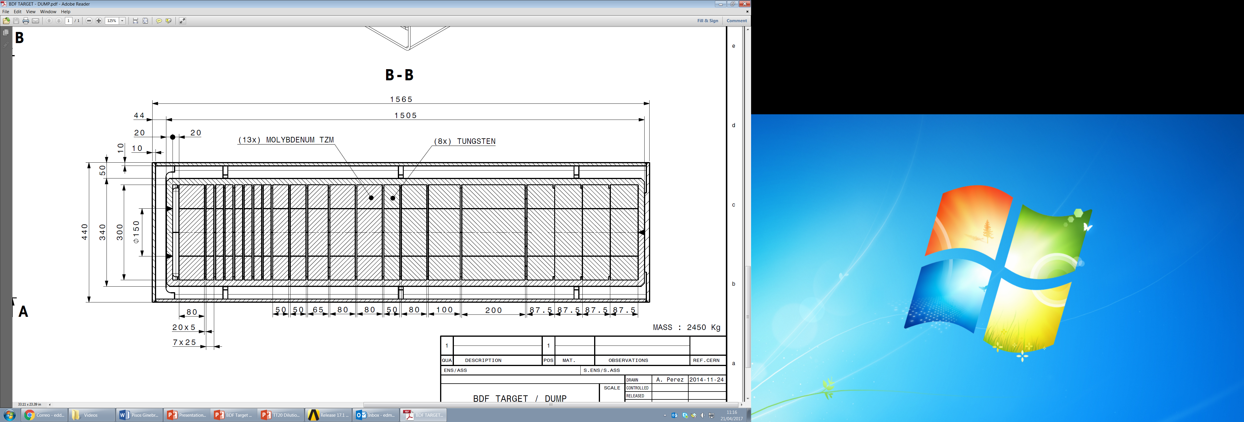
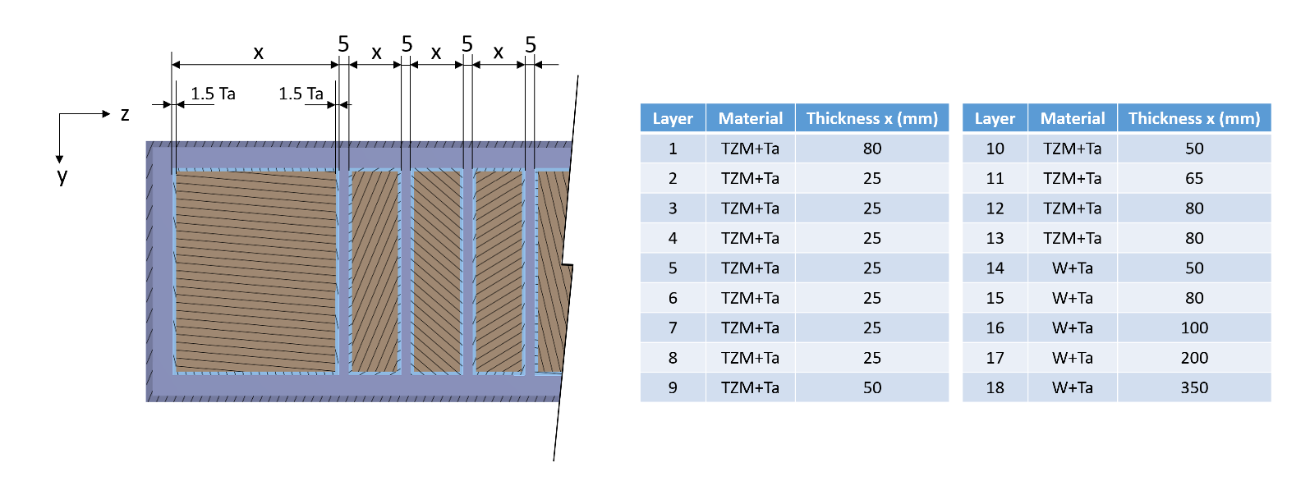
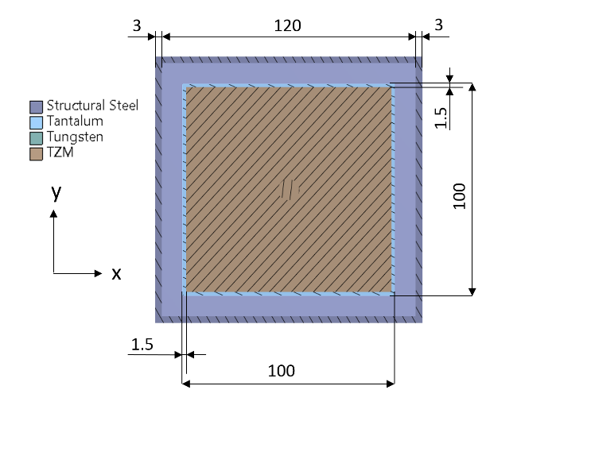
BDF target mechanical design status (M.Calviani)
13 TZM blocks + 5 tungsten blocks. All blocks are Ta-cladded
30x30 cm² rectangular plates with variable thickness
  Highly probable to switch to 25 cm diameter circular plates
  Total target length = 1.445 m
5 mm longitudinal gap between the blocks
E. Lopez Sola
7 June 2017
M. Calviani for the BDF TTC - 11th SHiP Collaboration Meeting
6

Slide 7
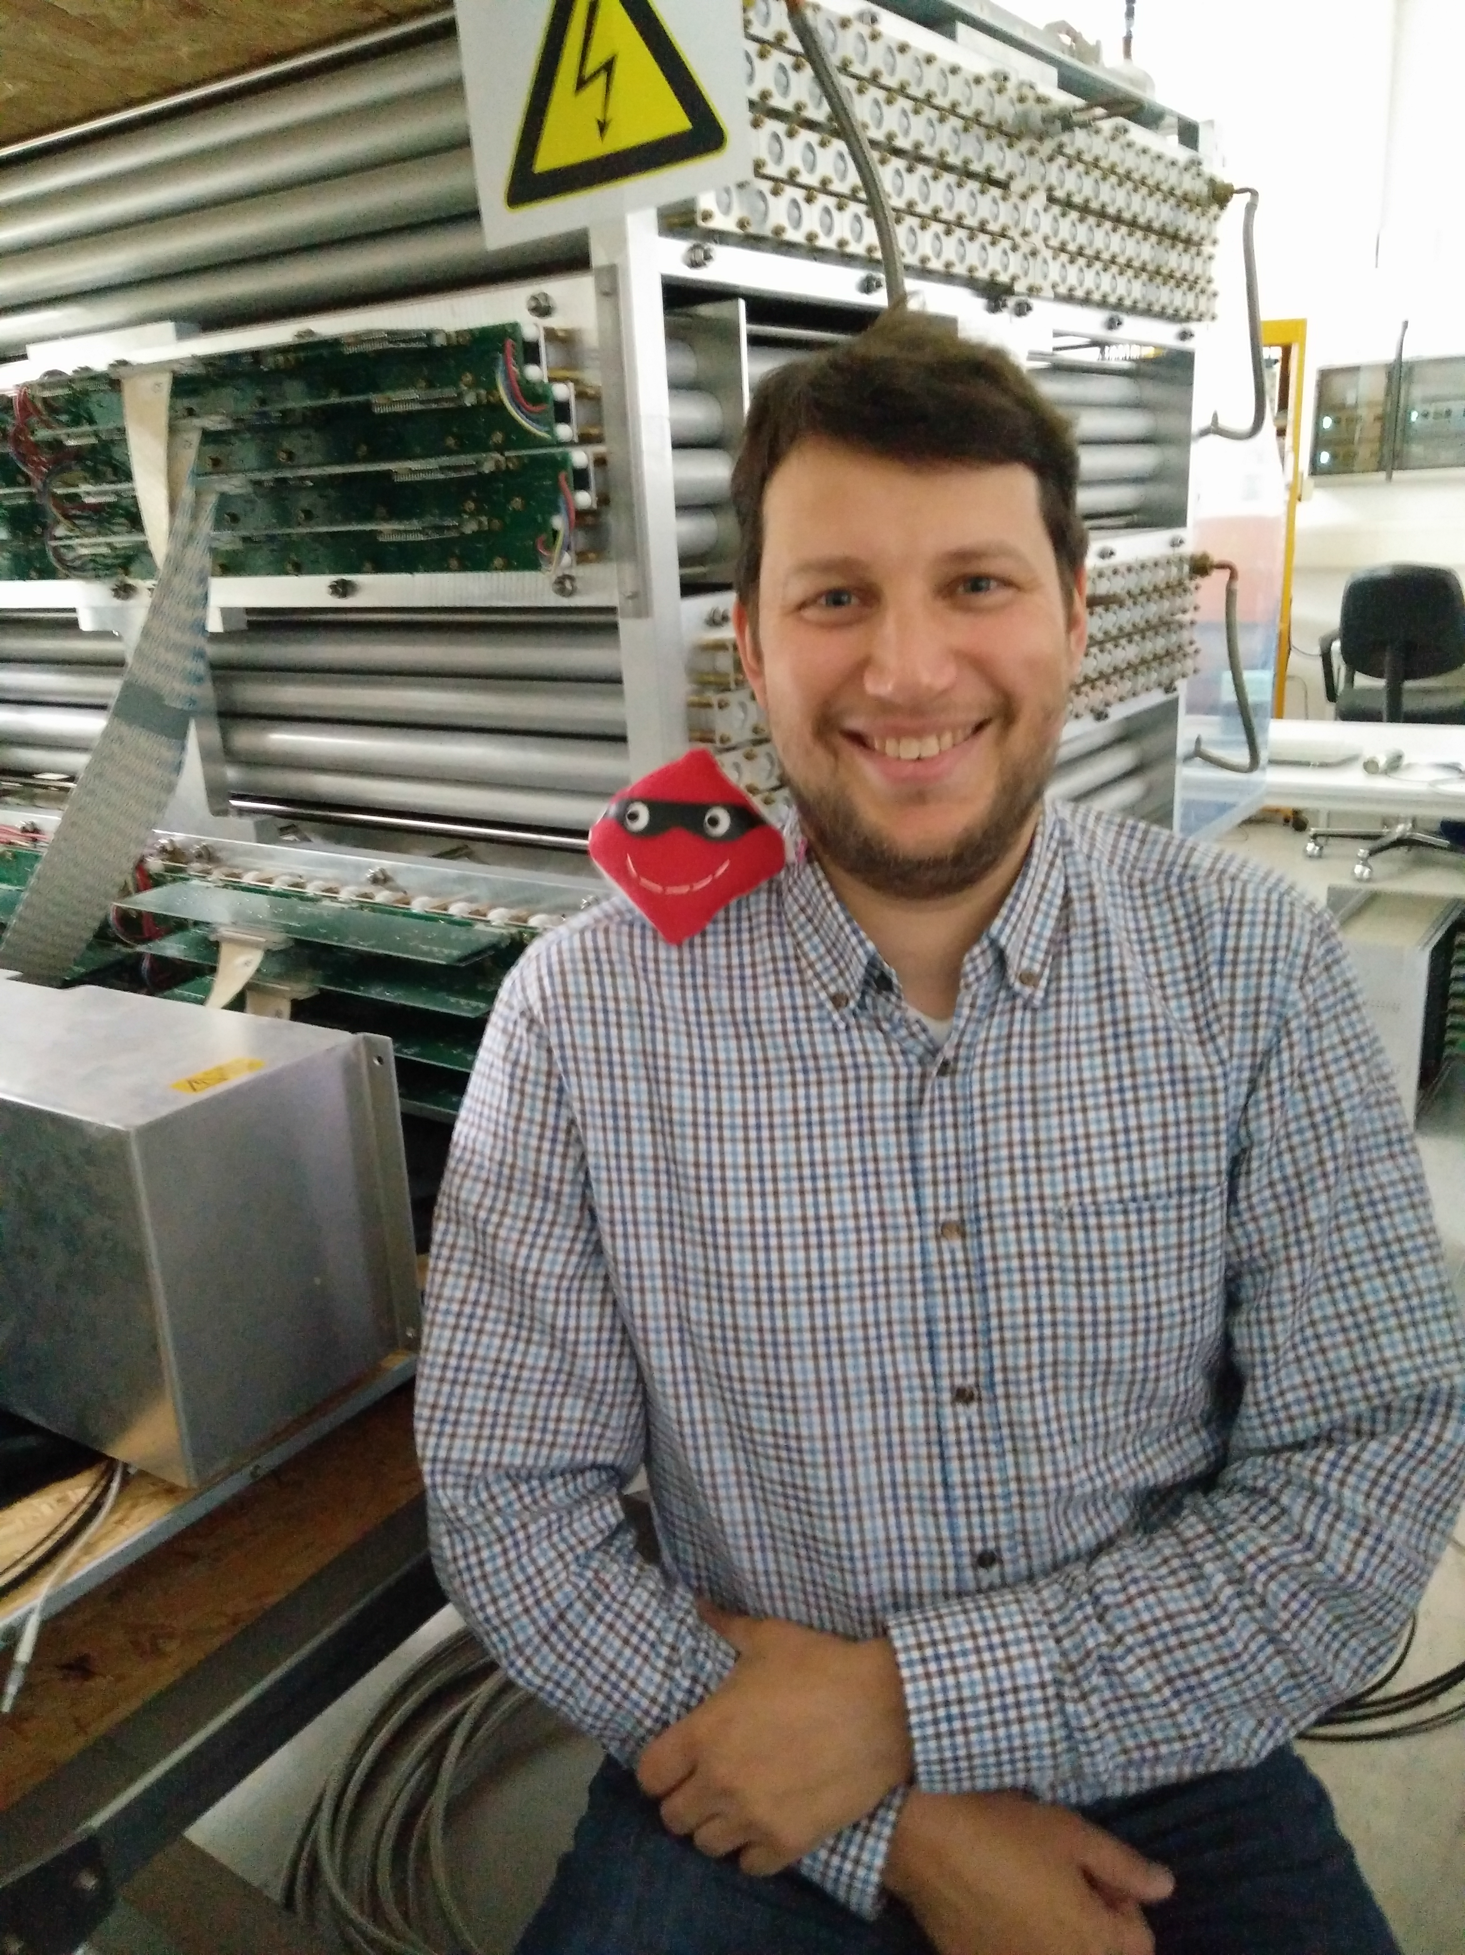
Drift tubes
Opera test modules, some used for Borexino
Electronics: FE boards, power supplies and logic elements for trigger available
DAQ (3kHz) being tested
Commissioning on going: faster drift gas being tried out, data taking next week
Scintillator plane for trigger purchased
Next steps: mechanical integration, setup of all modules

Slide 8
Muon tagger
RPCs will be built in Korea by KODEL, synergy with CMS
Module-0 for SHiP
FE electronics developed by Napoli/Bari
  Test ALICE boards coupled to readout electronics for RPCs in streamer mode
  Production of 150 boards under investigation
  FE electronics for avalanche RPCs under study

Slide 9
Status
SPSC proposal submitted:
  https://cds.cern.ch/record/2267770/files/SPSC-EOI-016.pdf
Mailing list created:
  ship-charmandmuons@cern.ch
Monthly meetings
  Detailed project time schedule at the next meeting
Aim to do this early next year, ie. setup in February 2018
Shifters needed!

