Slide 1
Welcome to the ESRs!
EASITrain Induction session for ESRs
CERN – 05 March 2018
Cécile Granier - Human Resources Department - CERN
Anita Ivanova – Finance and Administrative Processes Department - CERN

Slide 2
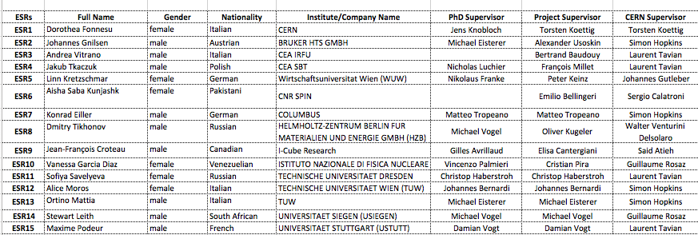
Who are you?

Slide 3

Agreements for us
The full Grant Agreement
  Annex 1
  Part A: Beneficiaries, Workplan, Work packages, milestones, etc.
  Part B: Description of the action
  Annex 2 – Estimated budget for the action
  Annex 3 – Accession form for beneficiaries
  Annex 4 – Financial statement model
The Annotated Model Grant Agreement

Slide 4
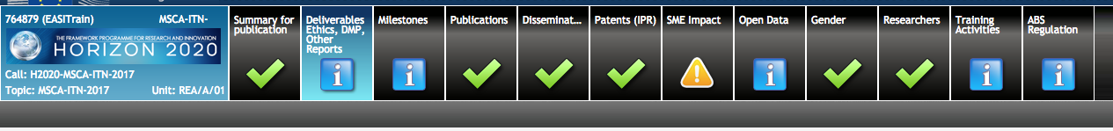
Other documents for us
Researcher Declaration
  within 20 days of contract start
  submitted on Research Participant Portal by beneficiary
Consortium Agreement
  a more legal document
  provisions for any disputes
  IPR arrangements if not already in GA
  must not contradict contractual conditions

Slide 5

Information for you
Clarity needed between the researcher and the host organization
Explanations about:
  obligations of both parties
  amounts to be received by researcher (allowances)
  social security
ESRs have access to the Grant Agreement via the project website
https://fcc.web.cern.ch/easitrain/Documents/EC/764879_Annex%201%20-%20Description%20Of%20Action%20(part%20B).pdf
Recommendation
  Identify the service in your organization
  who can help you with questions

Slide 6
Recruitment – how it worked
Posts were published centrally on CERN e-RT
Widely advertised
EURAXESS, CERN Careers page, Twitter, LinkedIn, Facebook, IEEE CSC site, Glassdoor, NEUVOO, Global Academy Jobs, UNCAREER, 12jobs.nl, Job Is Job, Oil and Gas Jobs Register, Recruit.net, Times Higher Education, GraduateLand, Brunel University, http://te-palvelut.fi, arbetsformedlingen, EASITrain pages, EASITrain network/consortium etc.
Researchers could be of any nationality
Nothing that could discriminate against applicants
40% females selected / 21% females applicants
Mobility is key

Slide 7
Recruitment – what is an ESR?
Early Stage Researcher definition
  at the time of recruitment, the researchers must be
  in the first 4 years (full-time equivalent experience)
  of their research careers
  full-time equivalent experience is measured from the date when the researcher obtained the degree that would formally entitle him/her to embark on a doctoral programme of study, either in the country where the degree was obtained or in the country where the researcher is recruited, regardless of whether or not a doctorate is or was ever envisaged
  the researcher must not have been awarded
  a doctoral degree

Slide 8
Recruitment – Mobility Rule
  The researcher must not have resided or carried out their normal activities in the country (or international organization) in which the beneficiary is based for more than 12 months in the 3 years immediately prior to appointment
  We have to be careful
  An ineligible recruitment will lead to any costs incurred
  being made ineligible

Slide 9
Recruitment – EC contractual issues
Duration of employment contract :
  ESRs for 3‐36 months
  full‐time employment
  part-time only for family or personal reasons
  include health and pension cover
Secondments are encouraged
- If secondment period > 30% duration of the appointment, you should be recruited by the beneficiary offering secondment
- During secondment, you keep the employment contract with your employer
- Employer pays for travel and subsistence expenses according to their rules
(follow their rules and procedures for secondments)
A calendar of secondments shall be established with supervisor

Slide 10
ITN Budget Categories
Costs for Recruited researchers (living, mobility and family allowance)
Institutional costs (RTN and Management/Overheads)
Research, Training and Networking cost category (RTN):
lump sum of 1 800 € per researcher/month
Amount revised by Consortium: 1 170 €
What for?
- Publication of vacant positions;
- Training costs;
- Research costs, organization and attendance of conferences, etc.;
- Coordination between participants including network meetings, expenses for attending trainings, workshops, any kind of network activities.

Slide 11
Contacts with Brussels
Dedicated Project Officer
Contacts by CERN
Reports to be submitted
  Progress report at end of month 13
  Draft periodic report as input for the compulsory
  Mid-Term Review in month 13-15
  Periodic and financial reports at end of month 26
  Periodic, financial and final reports 2 months after the end of
  the Grant Agreement
Mid-Term Review to make sure that everything is on track:
14 January 2019, Brussels
  Project Officer present
  Beneficiaries + Partner Organizations attend with all ESRs
Project Officer is supportive – wants the ETN to succeed

Slide 12
Once you have started your contract…
Information to the recruited researcher
Welcome / induction / integration
Career Development Plan
  identifies research aims & training needs
  gives researcher some responsibility for financial planning
Regular contacts
  review progress
  log book
Outreach and communication activities
(as distinct from dissemination)
http://ec.europa.eu/assets/eac/msca/documents/documentation/publications/outreach_activities_en.pdf

Slide 13
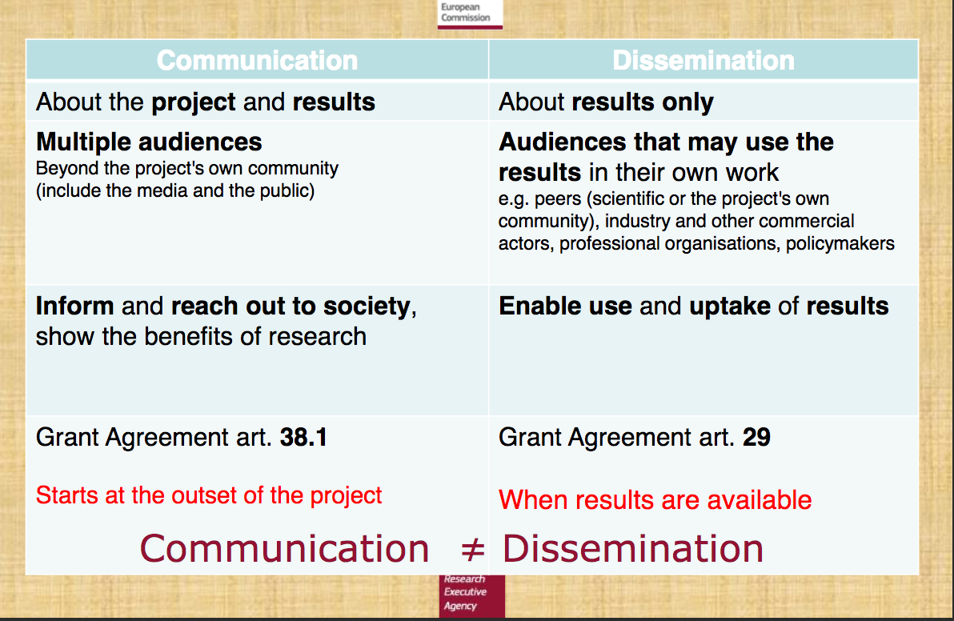
Communication / Dissemination

Slide 14



MSCA specific channels
Facebook Marie Curie Actions
Twitter@MSCActions
Hashtags: #MSCA #MSCAjobalert #H2020

Slide 15

Think of …
Acknowledging EU funding
“This research project has been supported by a Marie Skłodowska-Curie Innovative Training Network Fellowship of the European Commission’s Horizon 2020 Programme under contract number 764879 EASITrain”
in all papers, articles, publications, presentations, posters, etc., and using the European Commission emblem.
Becoming part of the MSCA Alumni Association (MCAA)
https://www.mariecuriealumni.eu/home

Slide 16

Career development plan
Let’s work on it!

Slide 17


Slide 18
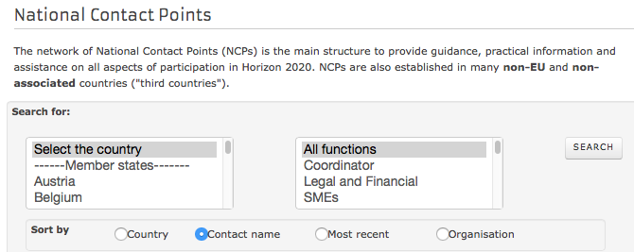
Useful Contacts
Information on EC sites to help you
- The Research Participant Portal
- The European Charter for Researchers and the Code of Conduct for the Recruitment of Researchers
The National Contact Points in your
country namely for questions
on tax and social cover
At CERN
- Emilie David: emilie.nicole.david@cern.ch
- Cécile Granier: cecile.granier@cern.c
- Anita Ivanova: anita.ivanova@cern.ch

