Slide 1
Non-Ionizing Radiation Awareness
Steve Hutchins
DIR 2013/35 EU: EM fields, 0Hz-300GHz
DIR 2006/25 EU: AOR, λ 1mm-100nm
n.b. λ 1mm= 300GHz
This is EU law, extra local rules may be applied too.
Notes:
EU law will cover all countries labs

Slide 2
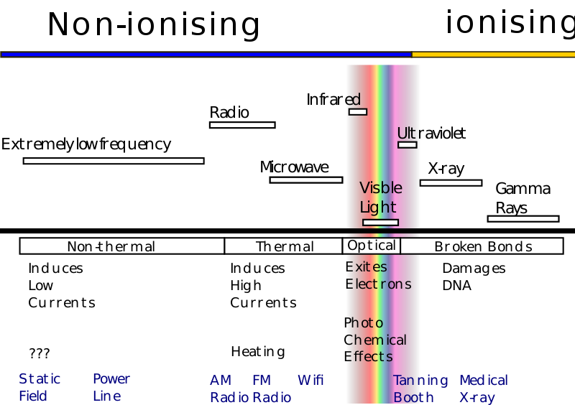
Notes:
Different wavelengths either induce currents in the body (low frequency) or heats the flesh (high frequency : microwave oven) or burns, or causes photochemical effects or DNA damage.
The sources on bottom line are frequency indicators, not harmful in normal exposure.

Slide 3
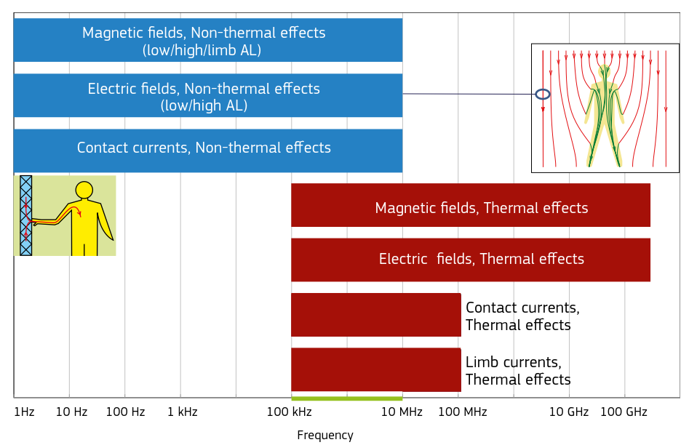
Notes:
Different types of exposure limit values depending on frequency and type of health effect: no simple exposure limit. Many years of work, experience and experiments by the ICNIRP to find these limits.
The limits are for workers (higher level than for PUBLIC)

Slide 4
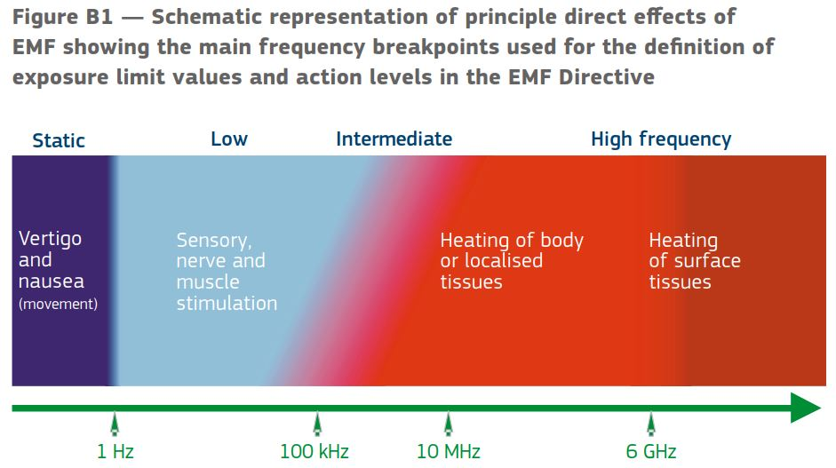
Notes:
As the effects are on different parts of your body, and in different ways : induced currents or heating, a range of perceptions exist. Remember: heating at higher levels = burning.

Slide 5
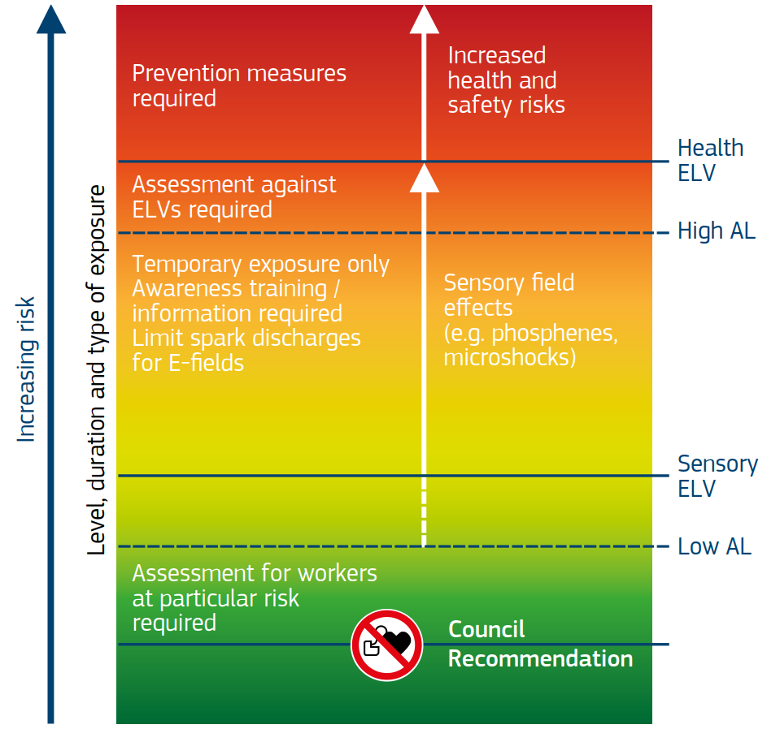
Notes:
Different types of exposure limit values depending on frequency and type of health effect some are intensity of exposure, others absorbed energy per day..

Slide 6
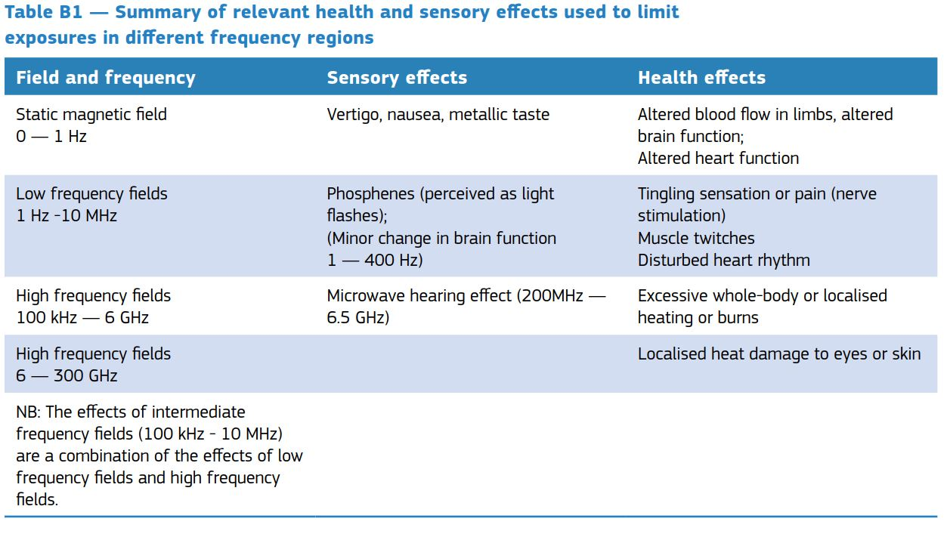
Notes:
The types of effect felt at higher levels, these are well above what you should expose yourselves to.

Slide 7
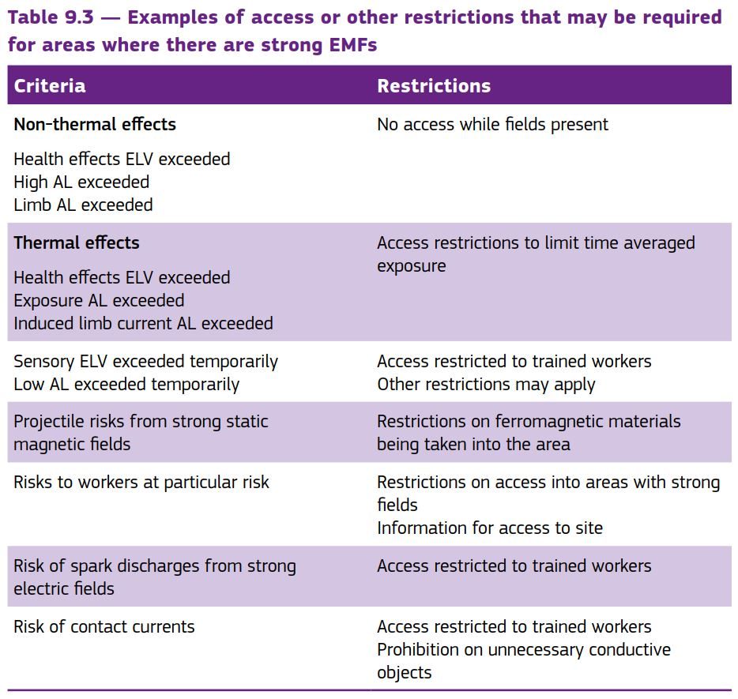
Notes:
Areas can be restricted if there are high levels of EMF, but note even when Exposure AL is exceeded , limited time working is still possible, average over days work is key, but avoiding High AL.

Slide 8
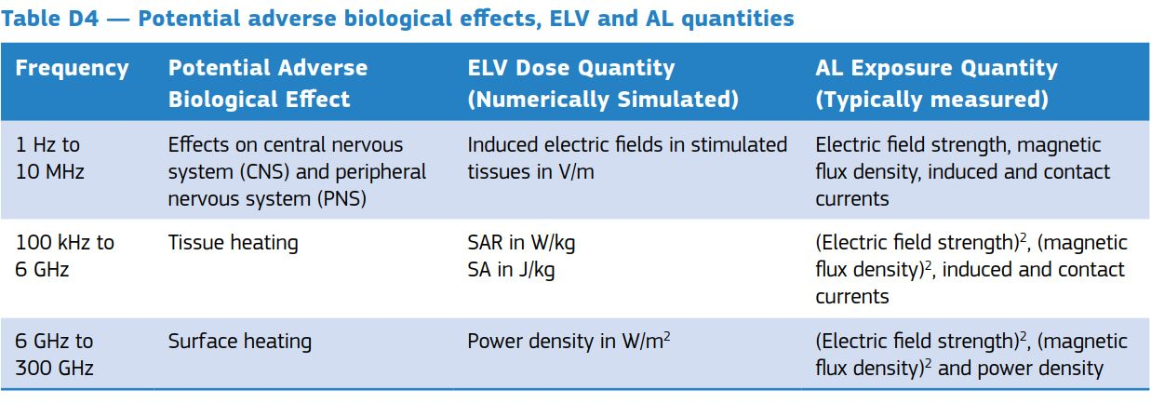
Notes:
Again types of field, frequency, types of organic material , needs quantification in different ways. No simple number.

Slide 9
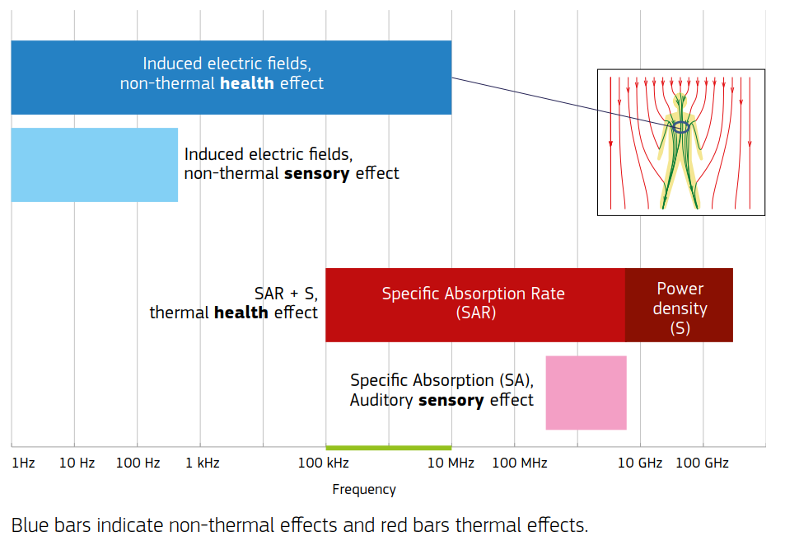
Notes:
Different types of exposure limit values depending on frequency and type of health effect

Slide 10
Hazards due to effects on the body are:
induced currents, heating, burns, cell damage, cancers…
Effects are dependent on type of tissue material concerned (arms, organs, eyes..)
Exposure time, intensity and wavelengths of radiation are critical factors.
There is no simple “safe level” for the whole spectrum, or for the whole body.
All CE standard equipment -when used as intended- will not present a hazard.
But your non-standard experiments may need to be evaluated against the following limits and any local regulations.
Notes:
So this awareness covers what you will be exposed to, and what you must protect others from when you introduce some non-standard equipment.
You are responsible for everyones safety!

Slide 11
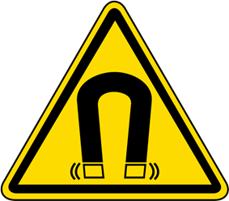
Static Magnetic Fields
Medical implants: Action level = 0.5mT
Magnetic objects may move independently : Action Level = 3mT
(tools, piercings, scaffolding….) if source is >100mT
Action Level: the employer must identify and manage the risks
Magnetic field sign, floor marking, barriers…
Public Exposure limit :10mT
EFFECTS: Dizziness, nausea: Exposure Limit Value 2T (nominal body)
and 8T for limbs in controlled working conditions.
ALARA applies (as low as reasonably achievable)
Notes:
The sign is mandatory, the floor marking and barriers are not.
Question: why is the action level lower if the source intensity is higher? Answer: this is not a health effect but attraction of magnetic objects, a 100mT field is not a powerful attractor so less hazard.
Earths field is about 50uT (+/- 25) at the last count!

Slide 12
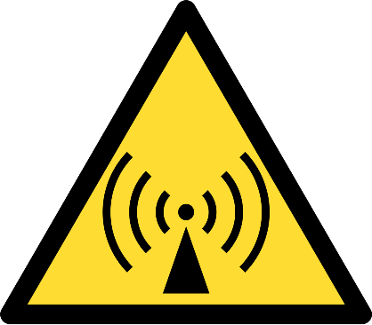
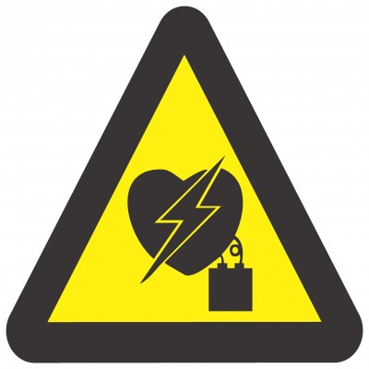
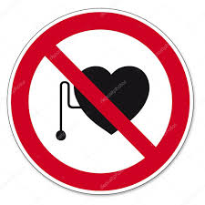
Medical Implants
Active electrical circuits:
heart, brain, medicines dosing, monitoring…
Static and RF fields may affect operation:
access to these areas is excluded. (n.b. MRI scanners, airport security…)
These areas must be indicated if over 0.5mT!
Passive Implants: hip replacement, pins, clips.. Follow your medical advice.
Notes:
The implant warnings are mandatory at 0.5mT, the magnetic field at 3 or 10mT, so already too late. There have been several deaths due to poor marking or instruction. You must ensure the warnings are in place and respected.

Slide 13
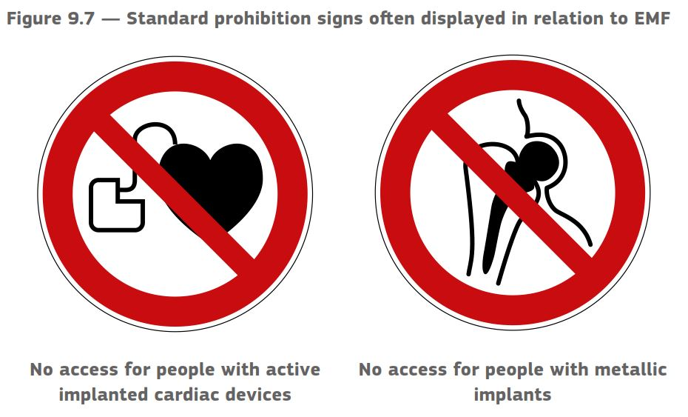
Notes:
Active implants are more sensitive than passive.

Slide 14
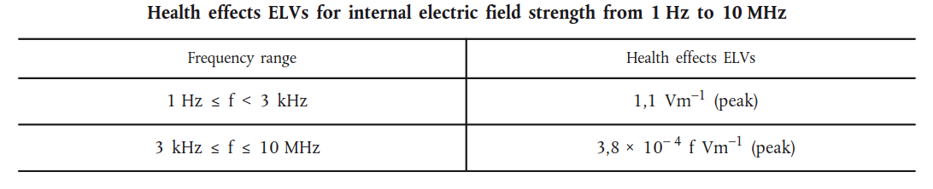
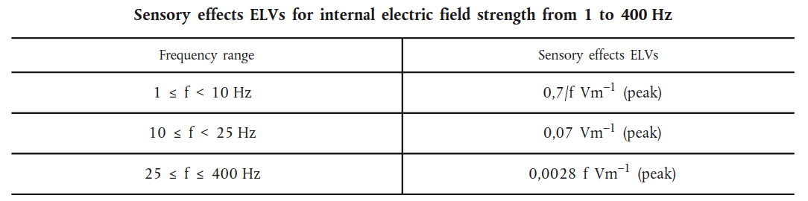
Low frequency Electro-Magnetic Fields
Induced voltages in the nervous system: Exposure Limits
Retinal effects and brain function: Exposure limits
Notes:
These are the fields inside the body: the skin is a better insulator, but the nervous system a good conductor, we are very sensitive to small currents internally and these currents are induced inside the body, not electrocution.

Slide 15
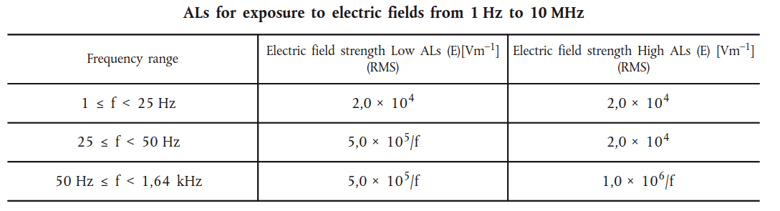
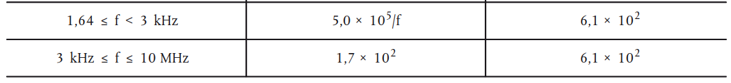
Low frequency Electro-Magnetic Fields
Action Levels for the external field:
Actions needed: to identify zone, provide training and information and record the risk assessment…
Notes:
These are the external fields: 100s of volts per meter
Some countries have made precautionary lower limits :Public Swiss is 1000x lower near schools, hospitals etc.

Slide 16
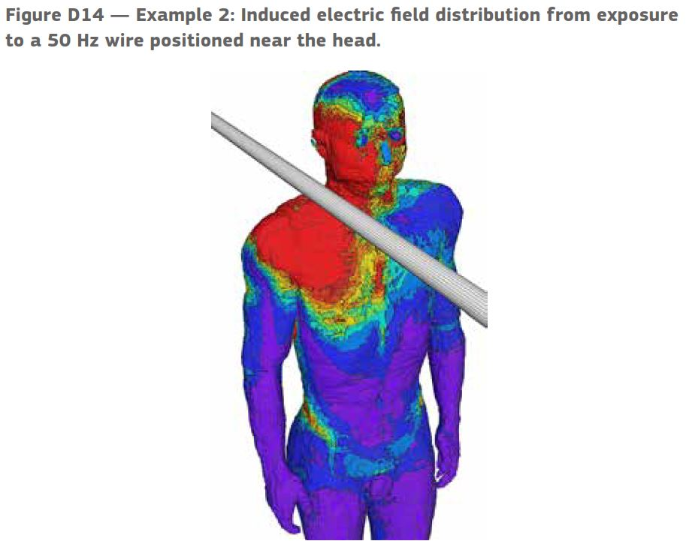
Notes:
This is anyone investigating working equipment, the fields are localized, close contact may exceed the Action Level, but you are not likely to be exposed like this for long periods. The wire is hopefully well insulated – otherwise EM fields are not a big worry.

Slide 17
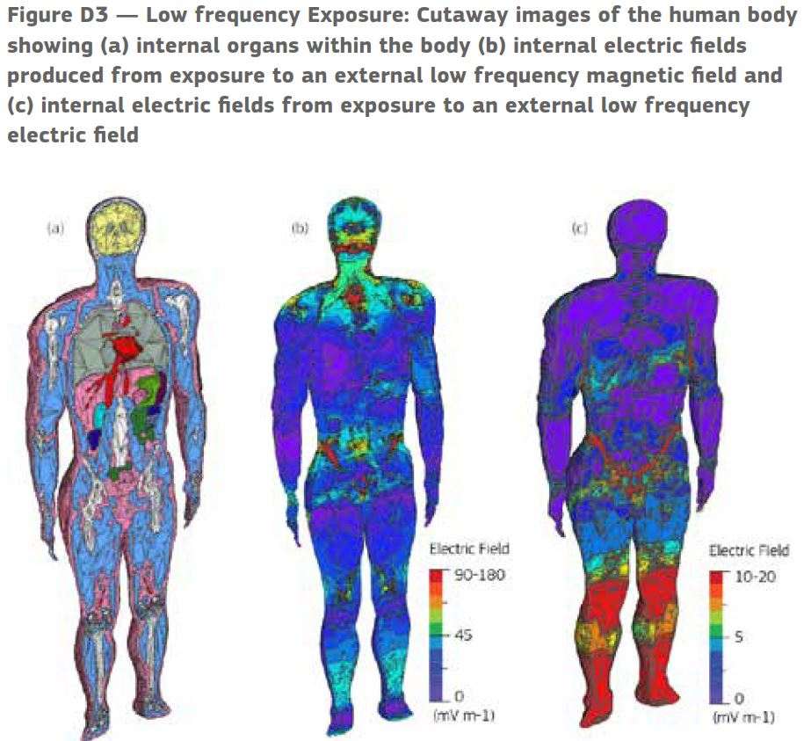
Notes:
external electric or magnetic fields can induce currents in different organs in the body, magnetic fields affecting the head more, electric concentrated on the legs

Slide 18
Low frequency EM fields:
Sources: Power networks (50Hz and harmonics): areas would be enclosed and not accessible,
from Switching power converters/UPS (100kHz +), normally in closed cabinets, not accessible.
Electric welding, induction heating: possible local exposure.
“home made” experimental equipment? You may be working inside the equipment, electrically isolated but exposed to the fields and completely ignoring EC directives on EMC…
Sparks and heating are ignition sources: beware of flammable gasses and solvents.
Induction effects, but also shielding is possible..
Notes:
Electro – Explosive devices anybody? Detonators “This effect requires the presence in the workplace of electro-explosive devices and field strengths sufficient to cause their detonation” but in the in the unlikely event you are using airbags for safety…
Flammable gasses or solvents?
Induction of currents in concrete or metal fences…
Faraday cages

Slide 19
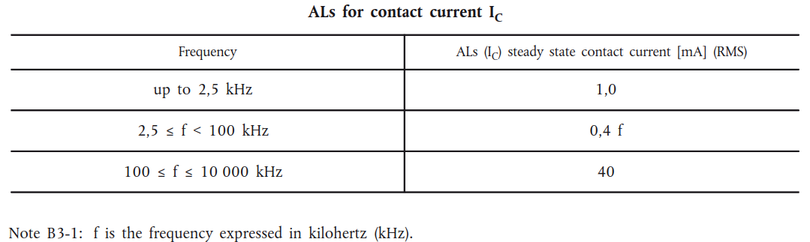
Low frequency Electro-Magnetic Fields
Action Levels for Contact current:
For all Low frequency E-M Fields:
Indirect effects: interference, electric shocks, sparks
Sensory effects: Nausea, vertigo, metallic taste in mouth, tingling
Contact currents: (metal object not grounded) shock or burns
Shielding is possible: Faraday Cage, best at source.
Notes:
In a field a non grounded metal object can have high voltages or currents induced, long cables, etc. earthing is a protection if you are earthed too.
Example working inside an electrical transformer.

Slide 20
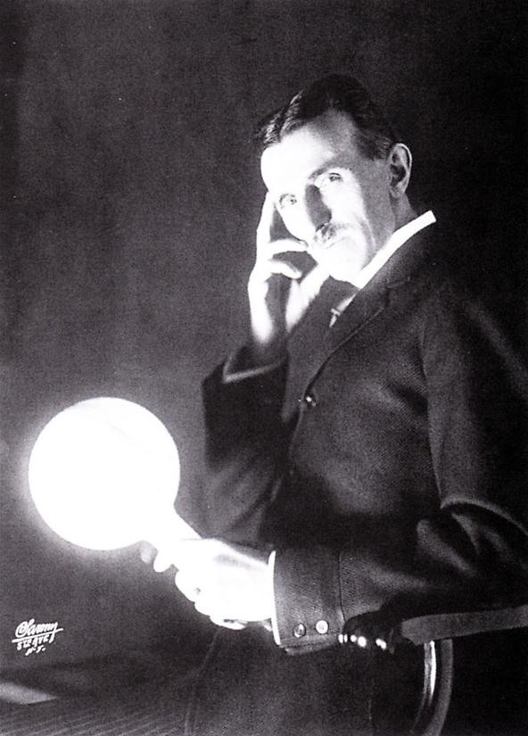
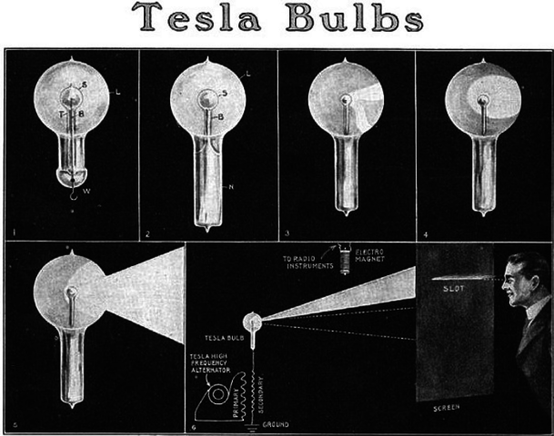
Do not do this at home….
Notes:
…and you think HSE people are unreasonable? And it is a UV emitter. Way above the Action Levels over so much of the spectrum…

Slide 21
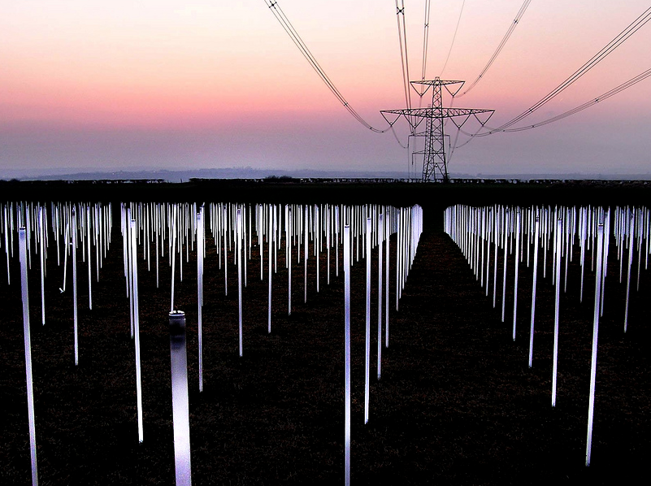
…but Do try this….
Notes:
Be careful with the glass tubes! The electric field from an overhead power line can ionize the gas in a fluorescent tube: wireless light.

Slide 22
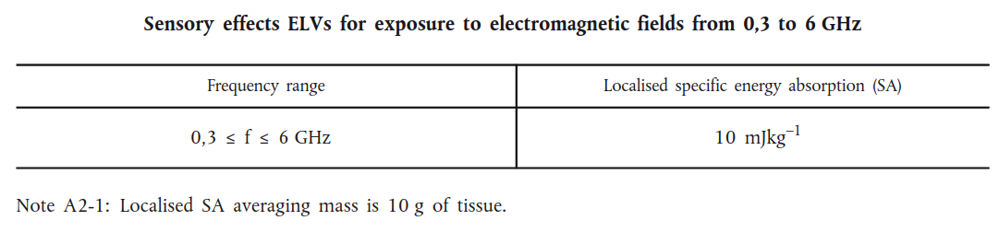
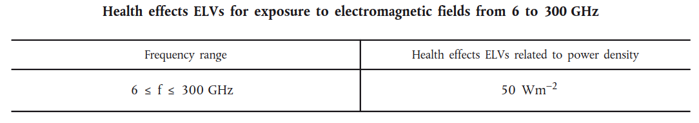
RF Electro-Magnetic Fields
Heating effects in tissue
Above 6GHz the RF power is absorbed near the surface, so incident power density is used to define the limits.
Notes:
Story …the woman in England whose loft kept catching fire, without apparent cause. The first time it happened, the fire brigade came and put it out and her insurance company paid for the damage. But when it happened again a few weeks later, questions began to be asked. Her insurance company held back payment, awaiting reports. But before those reports could be completed – it happened yet AGAIN.
THIS time the police became involved, convinced she was a NUT. Luckily, just before she got COMMITTED, the truth came out. The culprit was a communications company who had recently installed a microwave link between two towers. The pathway SHOULD have been high enough to only fry the occasional bird in flight (imagine sitting in your garden, feeling hungry, when out of a clear, blue sky…) but her house was on top of a HILL.

Slide 23
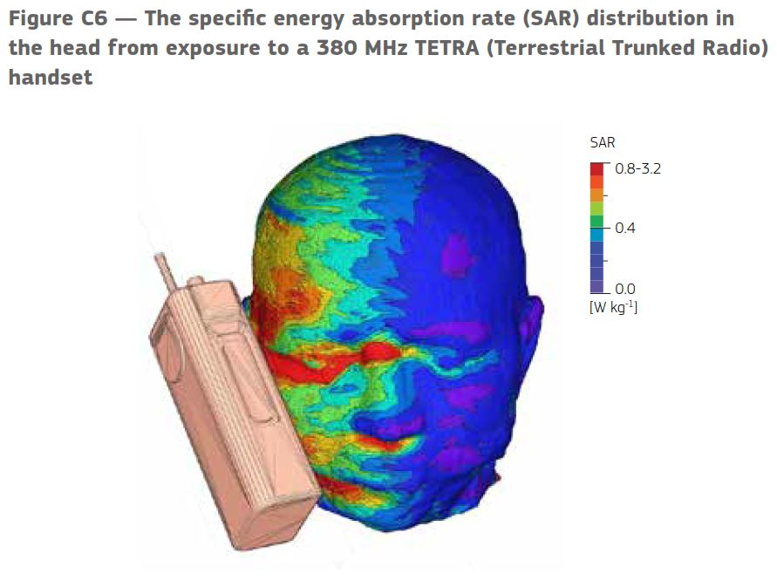
Notes:
The tetra phones are used by our rescue teams, worn on the vest. They are more powerful than normal mobile phones, but exposure is localized.

Slide 24
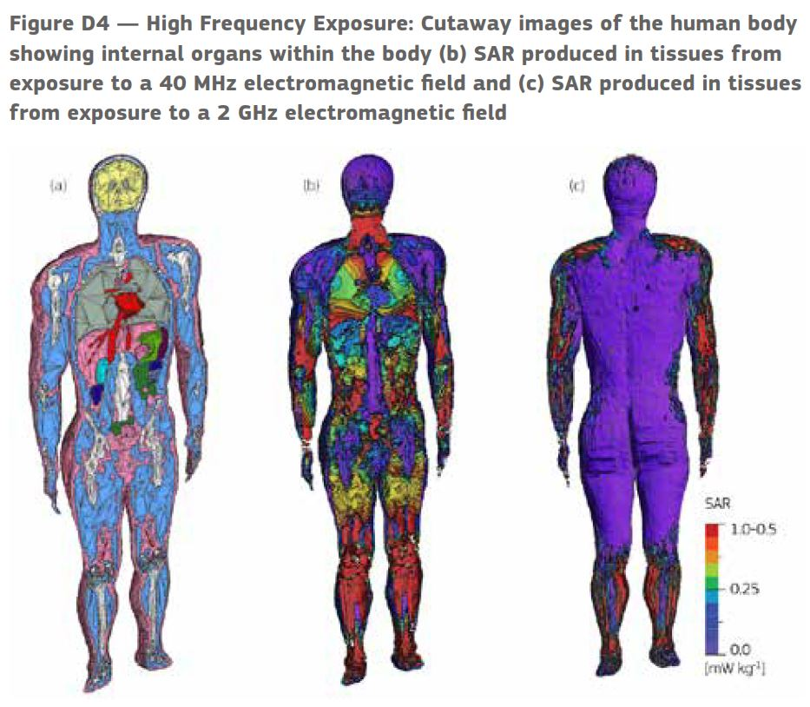
Notes:
2mm resolution man with 40MHz field – penetrates and is absorbed in specific organs, 2GHz is absorbed on the surface, less effects on the organs, but shame about the skin. So not all RF is the same

Slide 25
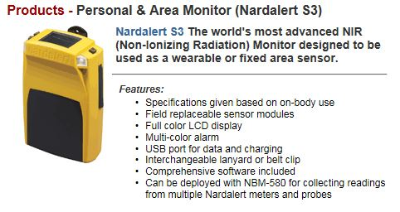
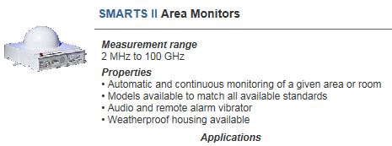
Radio Frequency EM waves:
Sources:
Telecoms transmitters: not accessible, restricted access.
WiFi: very low level.
Mobile phone: exceeds low action level, consider not using 24/7.
“home made” experimental equipment? Have it checked.
RF connections (waveguide or coax) may have leaks if incorrectly assembled, RF leakage detectors are commercially available.
Notes:
RF shielding is also useful in case of exposed fields. RF absorbers for lower powers and shielded enclosures. Note also RF fields are reflected off metal surfaces, local hot spots are possible!

Slide 26
From 300GHz we consider the radiation as infra red heat, absorbed near the surface.
Exposure Limit Value = 100W/m² for exposure over 1000s (corneal burns etc.)
and
20000 t^{0.25} J/m² for skin burns (exposures less than 10 seconds)
The average human body is an Infra red emitter of about 100W.
Burns would penetrate beneath the skin.
Notes:
Far infra red/ TeraHertz are not yet very high power, not yet…Low power THz is being used in airport scanners for “non-ionizing x-rays”

Slide 27
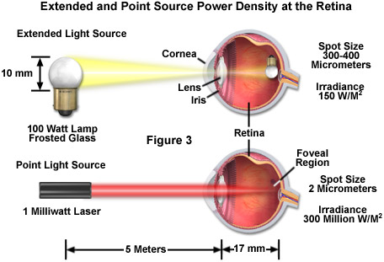
Optical Hazards
Light can harm your eyes and skin: i.e. sunlight and bright sources
Laser beams do not follow the 1/r² law : hazard over long distances
Notes:
This shows the major difference in hazard between lasers and other non-coherent sources. Extra vigilance is needed for even moderate power lasers as the light will focus to a very small point on the retina.
Also because the laser light is collimated, the hazard does not reduce with distance as for most conventional light sources. Which is why we like to limit lasers to enclosed rooms “designated laser area”= DLA

Slide 28
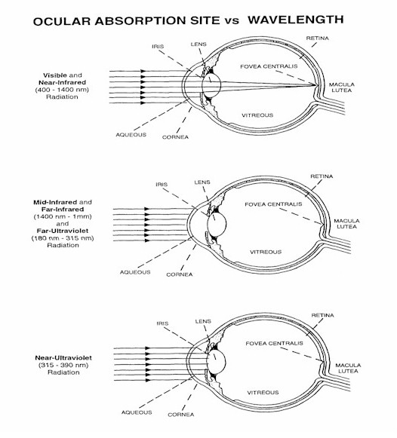
Optical Hazard depends on
Wavelength, pulse duration
And energy.
We calculate the energy density
and apply EN207 standards to
find the safety glasses for eye
protection.
We calculate the maximum
energy density for skin
exposure too. This may give a
safe working distance even when
glasses are used.
Class 2 lasers will damage the retina if stared into.
Notes:
Here we see the eye absorbs different wavelengths in different parts: cornea, lens and retina, in addition the retinal damage can be a burn or photochemical damage, where certain wavelengths are more hazardous.
This training course does not cover the detailed calculation of laser exposures, so you should always have these calculations from an expert, or LSO.
EN207 simplifies the safety calculations!

Slide 29
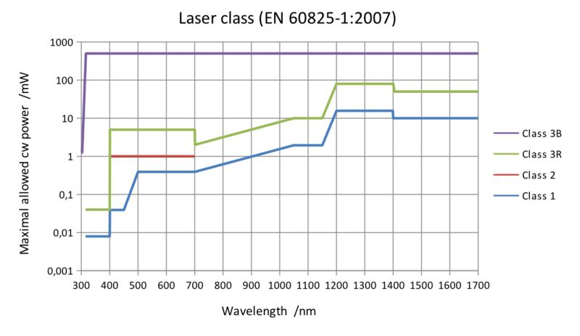
Notes:
Again simplified but showing the wavelength complexity of the different hazard levels.
Everything under the blue line is safe
Under the red line is safe if you blink
Under the green line should be used under controlled conditions, by trained people, low risk if used correctly.
Above the green line, needs risk assessment, controlled areas,
Above the purple line includes skin burns, risk of fire, even diffuse reflections may cause eye damage.
The graph shapes reflect the changing absorption and eye reaction: below 400nm there is no blink response
400-500 is limiting the blue light hazard
700-1000 increases as less power gets as far as the retina
The flat line at 500mW is the burns and fire risk

Slide 30
Lasers are classified and controlled by their risk level
Class 1: no hazard
Class 2: blink reflex 0.25 sec visible light only (a bit dodgy)
Class 3: training recommended, interlocks and safe area working
Class 4: training essential, risk assessment, interlocked laser area…
The classification follows the biological hazard level,
Class 4 : any laser exceeding 0.5W CW which is an ignition
and diffuse reflection hazard.
Notes:
Class 2 – “dodgy” - a grey area between safe and nasty, a class2 laser can harm your retina if you stare at it, and there are no pain sensors in the retina, so you would not feel any discomfort. World and EC law says these are safe, however, as you will not stare but will have an automatic blink reflex limiting the exposure to 0.25seconds. European law: you will blink.
In 2004 Hans Dieter Reidenbach of Cologne, DE, tested 2250 people to confirm this, and found that only 50% of people will blink at 5x the class 2 level. It depends on colour too, as we perceive green as “brighter” for the same power. Generally less than 10% will blink the rest are criminals.

Slide 31
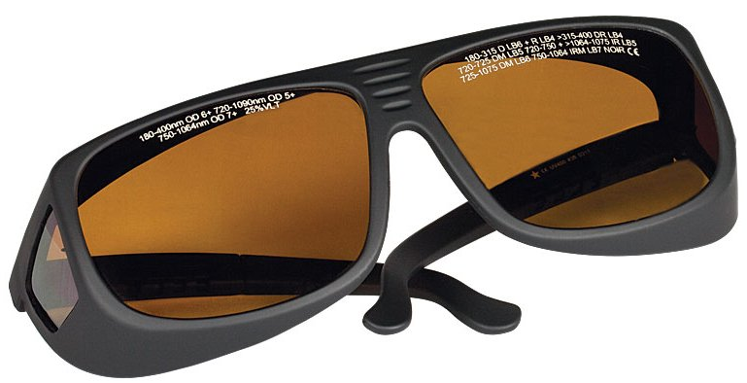
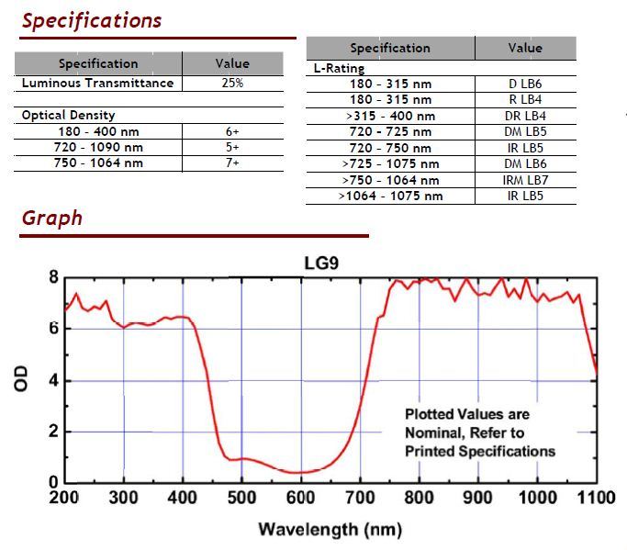
Code:
720-725 DM LB5
Wavelength in nm,
DM= CW and short pulses
LB5= EN207 coding OD5
Use only if CE marked
Notes:
CE marking is important as it ensures the testing methods: ANSI standards allow degradation of the filters when impacted by intense beams. Avoid cheap imports! (China Exports logo is similar)
Codes are difficult to read: so if a choice is to be made mark the glasses clearly.
CODE: wavelength range, D=continuous, I= pulsed .25s – 1us, R = pulsed 1us-1 ns, M= Modelocked (sub ns pulses), LBn= Laser protection to EN207, n is the optical density
Also note for alignment glasses (EN208) code reads RBn : very dangerous unless only one defined laser is used!
These Safety glasses only have to resist 50 pulses or 5 seconds at maximum power density!

Slide 32
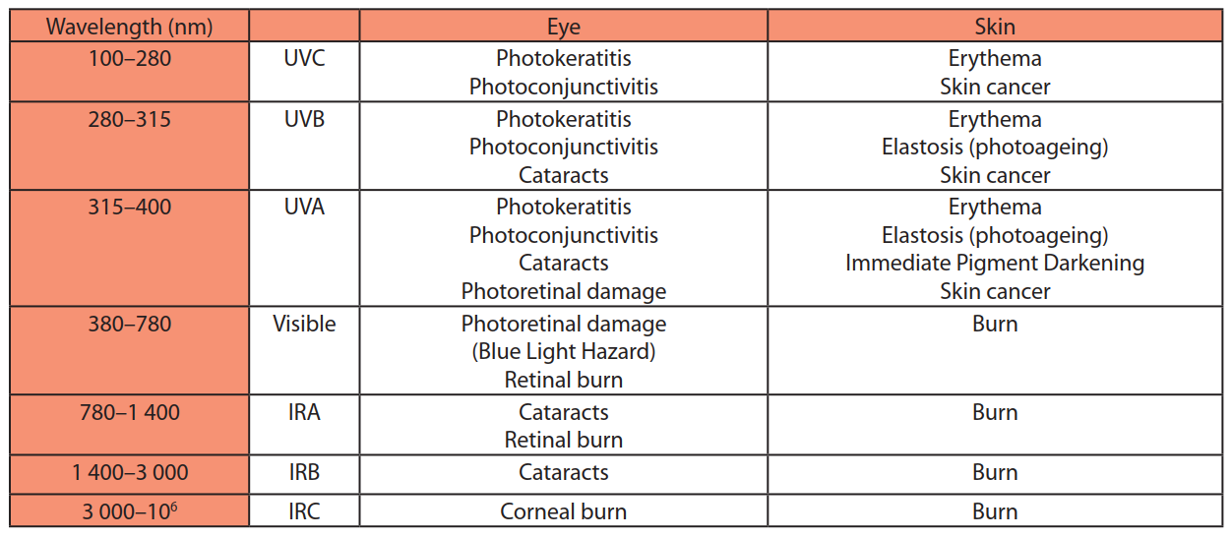
Non-Laser Light Sources
These sources may also cause harm to eyes and skin, there are 15 different limit curves depending on the type of damage, wave length and exposure time.
Seek advice! There will always be a safety responsible where you are working. EC marking = ok (DIR 2006/25 EU)
Notes:
EC marking is your safety guarantee, have non-standard equipment checked! Experienced Specialists are needed for these investigations on non standard equipment.

Slide 33
Ionizing, Photo-chemical and photo-sensitive effects.
“Ionising” is usually considered to be UV λ shorter than 380nm, where skin cancer becomes a risk.
But visible light can excite biological cells which can cause skin reactions and sensitivities. Chemicals, some medicines and plants can all cause heightened photo-sensitivity to eyes and skin.
Notes:
Many common prescribed medicines can cause photo-sensitivity: of eye-sight or skin. Contact with Giant Hogweed plant can cause acute local skin UV photosensitivity lasting several years: i.e. sunburn.

Slide 34
Sound hazards.
Ultra- and Infra- sound: sonic waves beyond our hearing range
Can cause nausea, headaches and physical injury.
May be caused by machinery or air or water cooling systems where a “resonant cavity” has been created, amplifying any turbulence noise.
Infra sound may be sensed as a vibration, an ultrasound vibrating surface is painful to touch.
These can both be measured if in doubt.
Also pulsed electrical equipment: high power acoustic shock, but “low” average noise.
Notes:
Pulsed equipment: audible click but ear damaging pressure levels are possible.

Slide 35
Free information is available from the EU in all EU languages:
https://publications.europa.eu
Non-binding guide to good practice for implementing Directive 2013/35/EU Electromagnetic Fields Volume 1, Practical guide pp214
Non-binding guide to good practice for implementing Directive 2006/25/EC
"artificial optical radiation"
Notes:
If in doubt seek advice, and check for extra local restrictions: by Lab, institute or country may have particular precaution. Like Swiss public EM fields…

Slide 36
RECAP:
NIR covers a huge spectrum
Can cause a wide variety of health effects
Standard EC marked equipment is safe
Follow operating instructions
The action levels are conservative
Home-made equipment: seek to achieve EC standards.
You are responsible for others
Thank you
Notes:
If in doubt seek advice, and check for extra local restrictions: by Lab, institute or country may have particular precaution. Like Swiss public EM fields…

