Slide 1
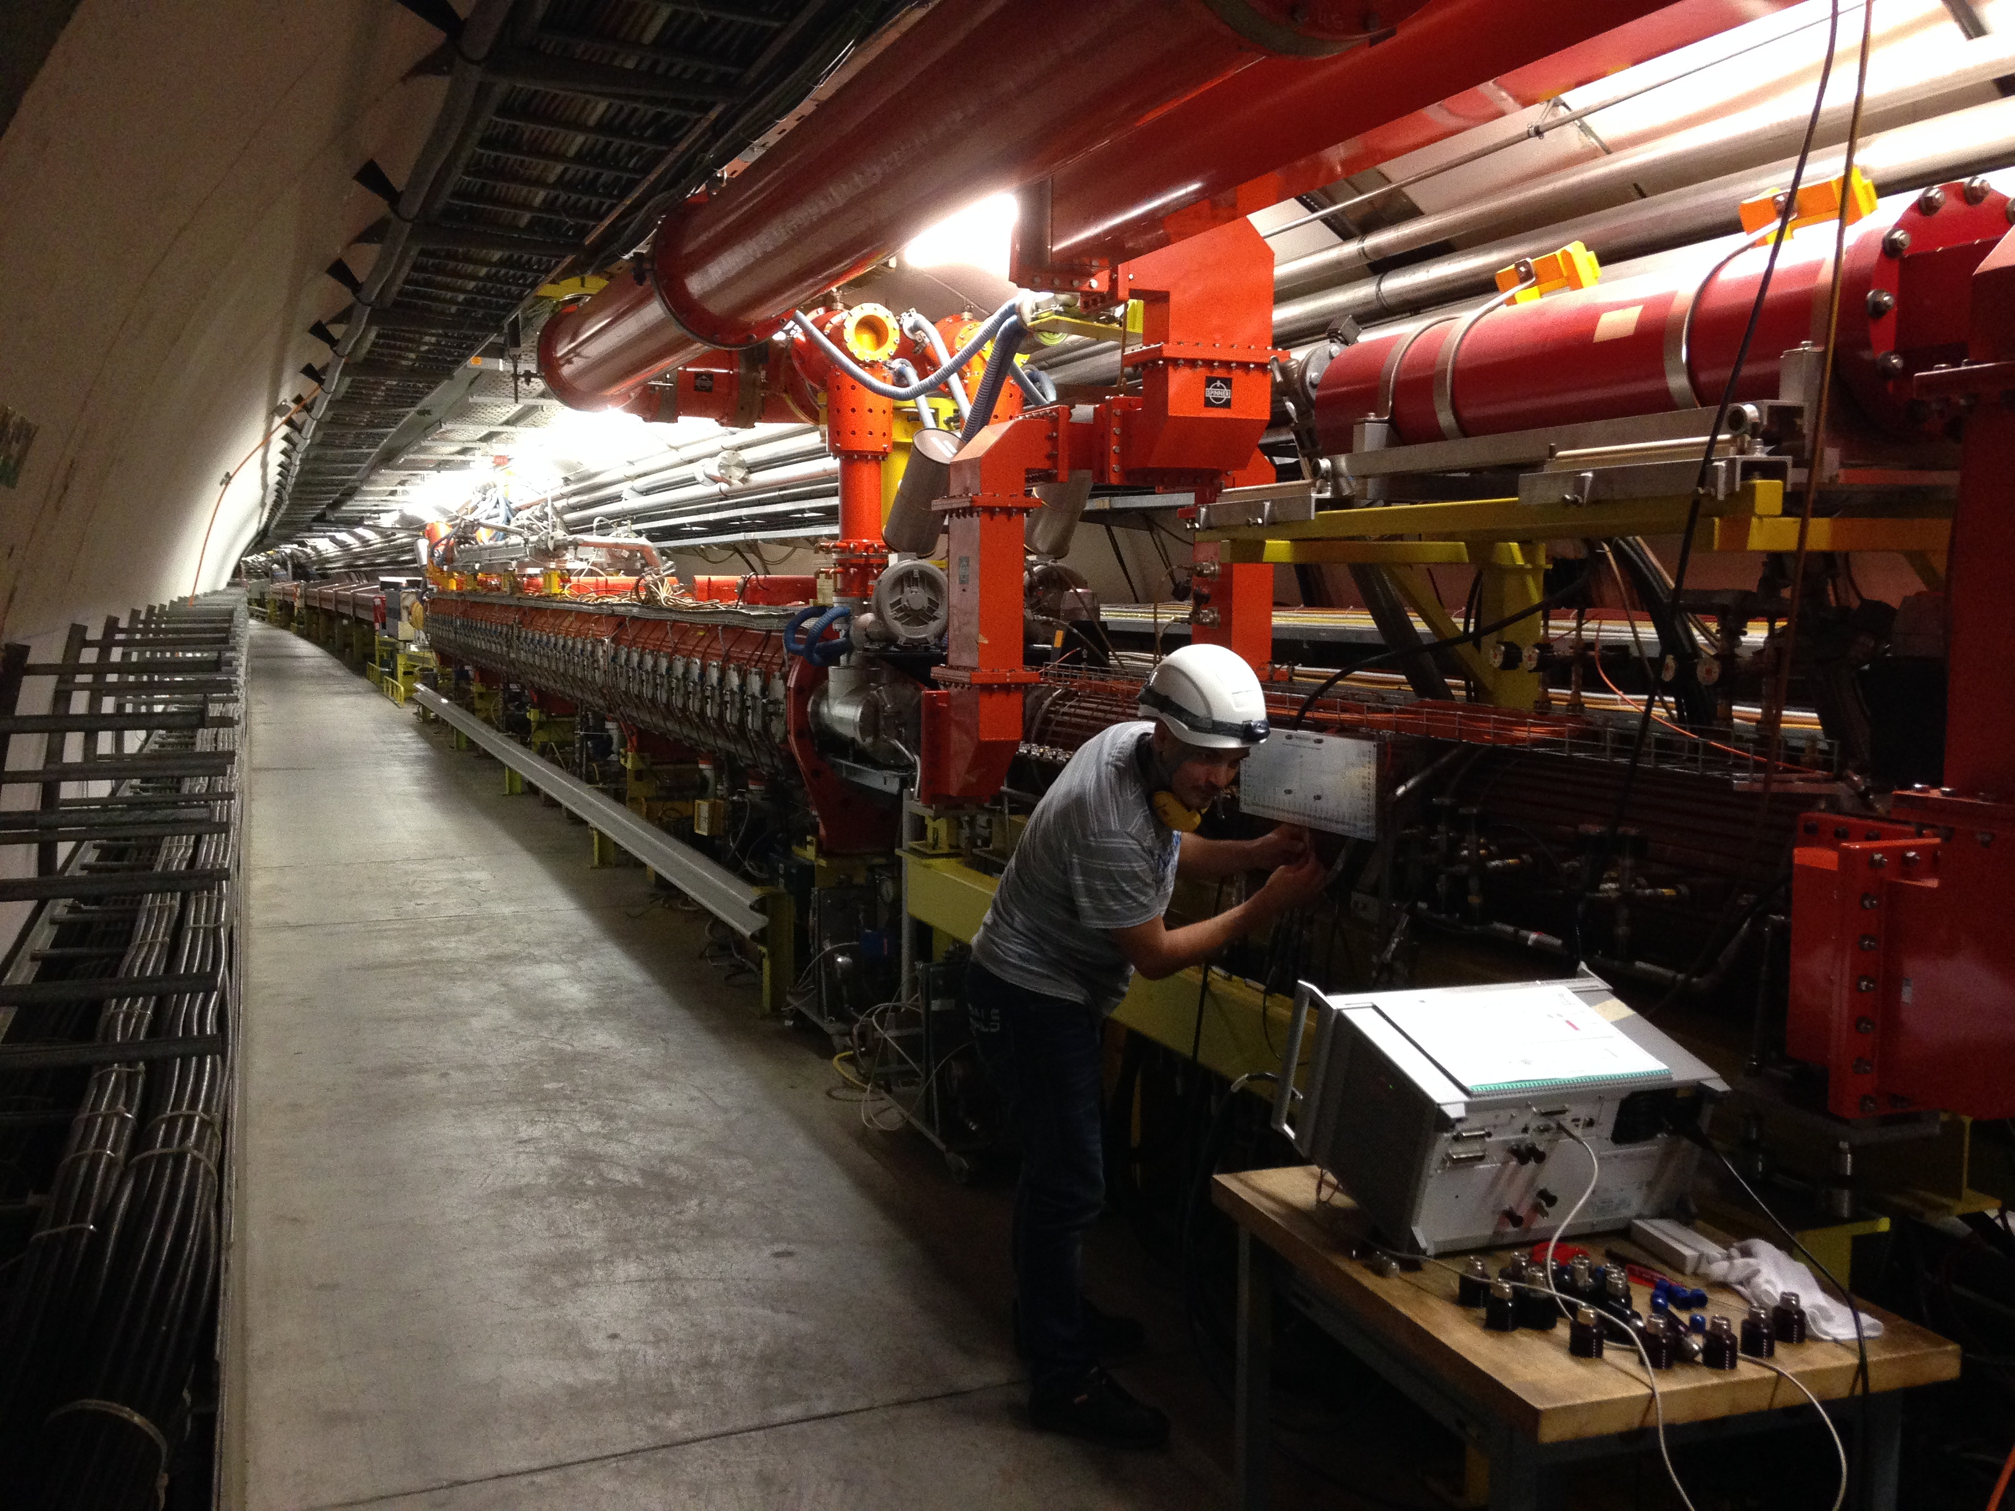
Introduction to RF measurements and instrumentation
Daniel Valuch, CERN BE/RF, daniel.valuch@cern.ch

Slide 2
Purpose of the course
Introduce the most common RF devices
Introduce the most commonly used RF measurement instruments
Explain typical RF measurement problems
Learn the essential RF work practices
Teach you to measure RF structures and devices properly, accurately and safely to you and to the instruments

Slide 3
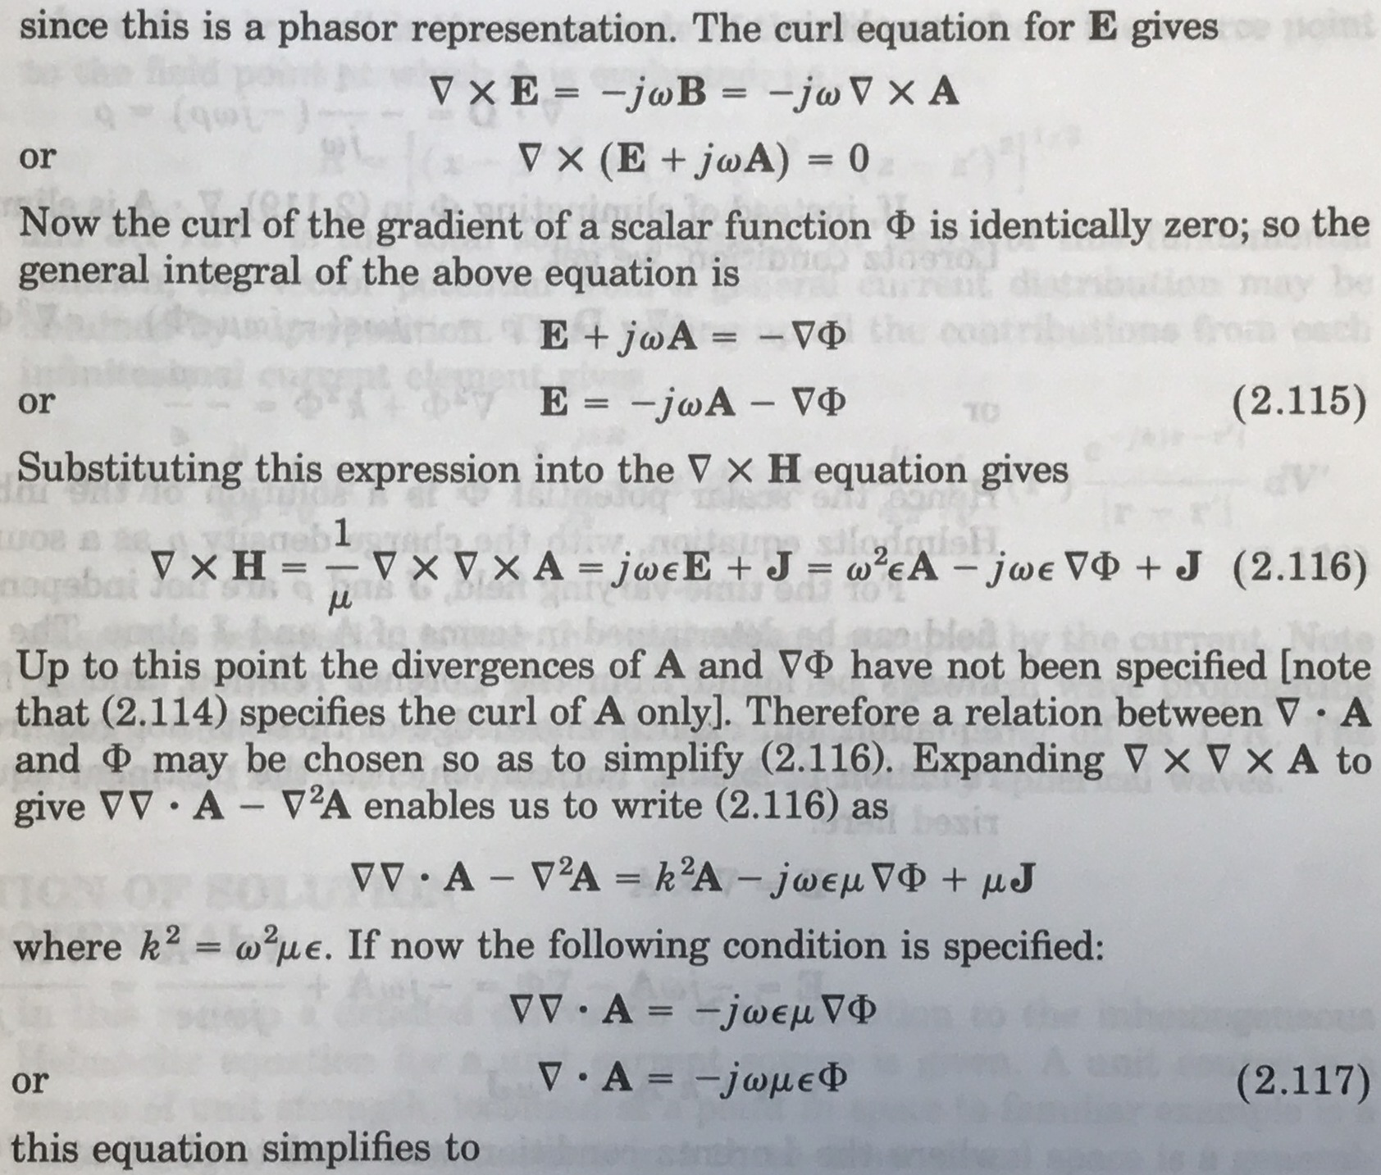
Purpose of the course
What are we NOT going to do…
But we still need a little bit of math…

Slide 4
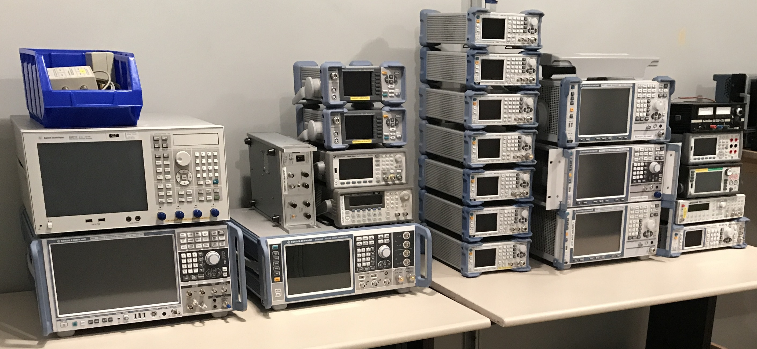
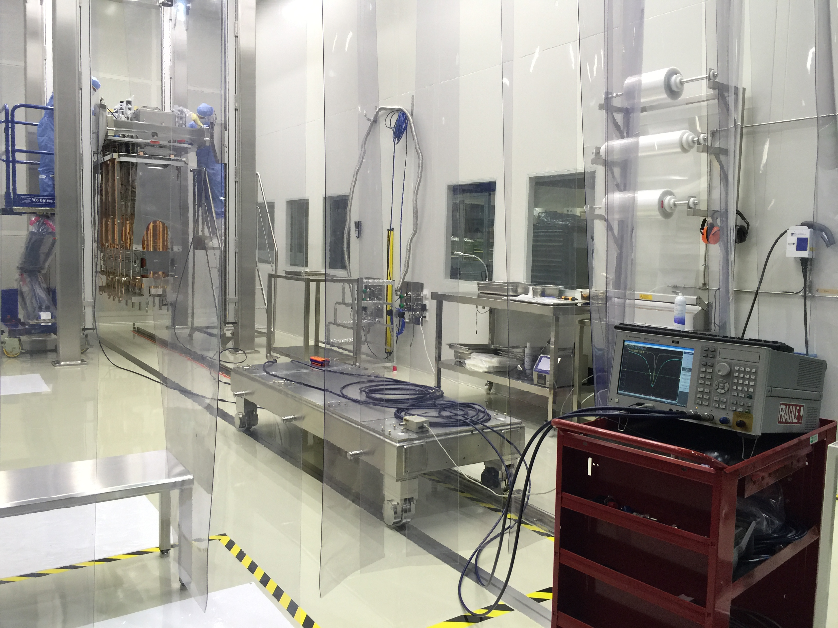
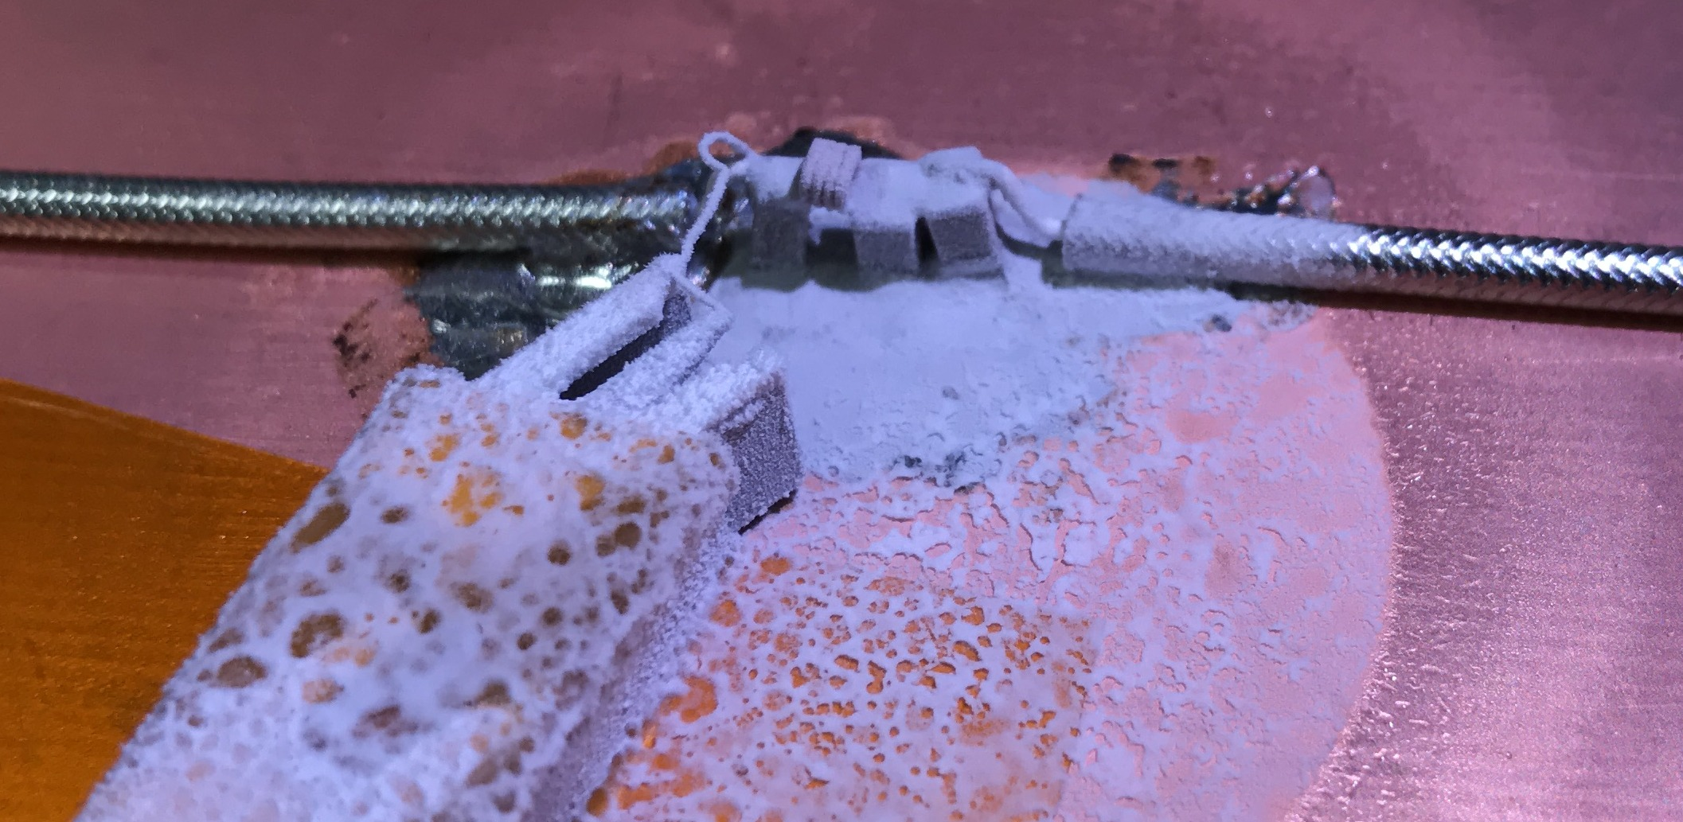
Purpose of the course
We will rather focus on:
Instruments:
…and practices:
Methods:

Slide 5
Transmission line theory 101
Transmission lines are defined as waveguiding structures that can support transverse electromagnetic (TEM) waves or quasi-TEM waves.
For purpose of this course: The device which transports RF power from the source to the load (and back)

Slide 6
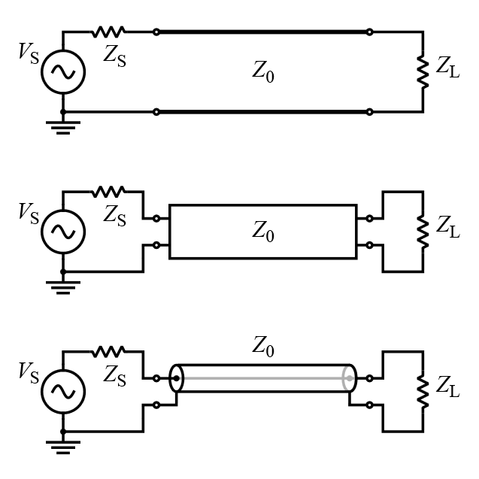
Transmission line theory 101
Transmission line
Source
Load

Slide 7
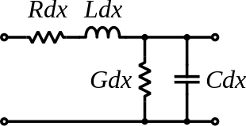


Transmission line theory 101
The telegrapher's equations are a pair of linear differential equations which describe the voltage (V) and current (I) on an electrical transmission line with distance and time.
The transmission line model represents the transmission line as an infinite series of two-port elementary components, each representing an infinitesimally short segment of the transmission line:
Distributed resistance R of the conductors (Ohms per unit length)
Distributed inductance L (Henries per unit length).
The capacitance C between the two conductors is represented by a shunt capacitor (in Farads per unit length).
The conductance G of the dielectric material separating the two conductors is represented by a shunt resistor between the signal wire and the return wire (in Siemens per unit length).
Source and more reading: https://en.wikipedia.org/wiki/Transmission_line

Slide 8
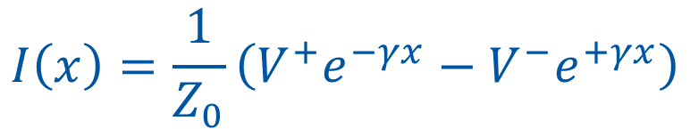



Transmission line theory 101
Solution of telegrapher's equations:
Introduction of an important concept: forward and reflected waves
$$V\left(x\right)=V^{+}e^{−γx}+V^{−}e^{+γx}$$
$$I\left(x\right)=\frac{1}{Z_{0}}\left(V^{+}e^{−γx}−V^{−}e^{+γx}\right)$$
Forward wave
$$V^{+}e^{−γx}$$
Reflected wave
$$V^{−}e^{+γx}$$

Slide 9


Transmission line theory 101
Introduction of an important transmission line parameters: Propagation constant and characteristic impedance
$$γ=\sqrt{(R+jωL)(G+jωC)}$$
Propagation constant
of a sinusoidal electromagnetic wave is a measure of the change undergone by the amplitude and phase of the wave as it propagates in a given direction. The quantity being measured can be the voltage, the current in a circuit, or a field vector such as electric field strength or flux density. The propagation constant itself measures the change per unit length, but it is otherwise dimensionless.
Propagation constant of a lossless line is purely imaginary. Only phase of the waves changes with distance along the line and the change is linear with distance and frequency.
It becomes more complicated for lossy lines (different attenuation and propagation velocity for different frequencies, nonlinear phase, dispersion etc…).
$$γ=α+jβ$$
Attenuation constant (Np/m)
Phase constant (rad/m)

Slide 10

Transmission line theory 101
Introduction of an important transmission line parameters: Propagation constant and characteristic impedance
$$Z_{0}=\sqrt{\frac{R+jωL}{G+jωC}}$$
Characteristic impedance
of a uniform transmission line is the ratio of the amplitude of a single voltage wave to its current wave propagating along the line.
Characteristic impedance is determined by the geometry and materials of the transmission line and, for a uniform line, is not dependent on its length.
The unit of characteristic impedance is Ohm.
Since most transmission lines also have a reflected wave, the characteristic impedance is generally not the impedance that is measured on the line.

Slide 11




Transmission line theory 101
Reflection coefficient Γ describes how much of an electromagnetic wave is reflected by an impedance discontinuity in the transmission medium.
It is equal to the ratio of the amplitude of the reflected wave to the incident wave, with each expressed as phasors
Forward wave
$$V^{+}$$
Reflected wave
$$V^{−}$$
$$Γ_{L}=\frac{Z_{L}−Z_{0}}{Z_{L}+Z_{0}}$$
$$Γ=\frac{V^{−}}{V^{+}}$$

Slide 12


Transmission line theory 101
Standing wave ratio (SWR) is a measure of impedance matching of loads to the characteristic impedance of a transmission line or waveguide. SWR is defined as the ratio of the partial standing wave's amplitude at an antinode (maximum) to the amplitude at a node (minimum) along the line.
$$SWR=\frac{1+\sqrt{{P_{RFL}}/{P_{FWD}}}}{1−\sqrt{{P_{RFL}}/{P_{FWD}}}}$$
$$VSWR=\frac{\left|V_{max}\right|}{\left|V_{min}\right|}=\frac{1+\left|Γ\right|}{1−\left|Γ\right|}$$
Note: V = Voltage standing wave ratio

Slide 13





Exercise 1 – transmission line theory
Calculate the reflection coefficient and the voltage standing wave ratio for the following configurations:
Load
terminated
51 Ω
short
open
100 pF capacitor at 100 MHz
= 50 Ω
= 50 Ω
$$Z_{L}$$
$$Γ_{L}$$
$$VSWR$$
= 50 Ω
= short
= 50 Ω
= open
= 50 Ω
100 pF
$$Γ_{L}=\frac{Z_{L}−Z_{0}}{Z_{L}+Z_{0}}$$
$$VSWR=\frac{\left|V_{max}\right|}{\left|V_{min}\right|}=\frac{1+\left|Γ\right|}{1−\left|Γ\right|}$$

Slide 14
Exercise 1 – transmission line theory
Calculate the reflection coefficient and the voltage standing wave ratio for the following configurations:
Load
terminated | 50 Ω | 0 | 1.00
51 Ω | 51 Ω | 0.01 | 1.02
short | 0 Ω | -1 | ∞
open | ∞ 377 Ω | 1.00 0.765 | ∞ 7.54
100 pF capacitor at 100 MHz | -j15.9 Ω | -0.81 - j0.57 | ∞
= 50 Ω
= 50 Ω
$$Z_{L}$$
$$Γ_{L}$$
$$VSWR$$
= 50 Ω
= short
= 50 Ω
= open
= 50 Ω
100 pF
$$Γ_{L}=\frac{Z_{L}−Z_{0}}{Z_{L}+Z_{0}}$$
$$VSWR=\frac{\left|V_{max}\right|}{\left|V_{min}\right|}=\frac{1+\left|Γ\right|}{1−\left|Γ\right|}$$

Slide 15
RF network parameters
Most popular method to characterize parameters of linear RF networks is by means of scattering parameters (s-parameters)
A square matrix describes coupling between all of the device’s ports

Slide 16
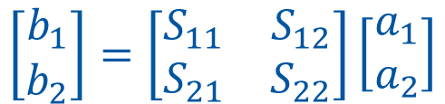
s-parameters
$$\left[\begin{matrix}b_{1} \\ b_{2}\end{matrix}\right]=\left[\begin{matrix}S_{11} & S_{12} \\ S_{21} & S_{22}\end{matrix}\right]\left[\begin{matrix}a_{1} \\ a_{2}\end{matrix}\right]$$

Slide 17
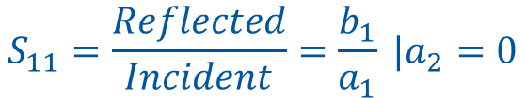
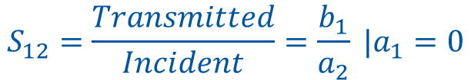
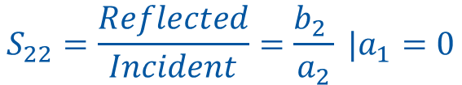
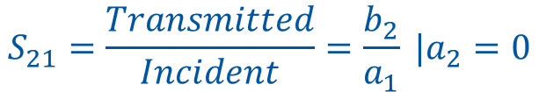
s-parameters
$$S_{11}=\frac{Reflected}{Incident}=\frac{b_{1}}{a_{1}} |a_{2}=0$$
$$S_{22}=\frac{Reflected}{Incident}=\frac{b_{2} }{a_{2}} |a_{1}=0$$
$$S_{21}=\frac{Transmitted}{Incident}=\frac{b_{2}}{a_{1}} |a_{2}=0$$
$$S_{12}=\frac{Transmitted}{Incident}=\frac{b_{1}}{a_{2}} |a_{1}=0$$

Slide 18
s-parameters
Simplified approach for lower frequencies: Use voltages/currents instead of waves
Forward direction
Backward direction
V₁⁺
Incident
S
21
Transmitted
V₂⁻
a
b
1
2
V₁⁻
Reflected
b
DUT
1
S
11
Common notation:
+ what goes into the port
- what leaves the port

Slide 19




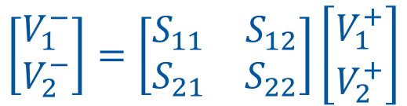
s-parameters
How do we work out the signals from the s-parameters?
$$\left[\begin{matrix}V_{1}^{−} \\ V_{2}^{−}\end{matrix}\right]=\left[\begin{matrix}S_{11} & S_{12} \\ S_{21} & S_{22}\end{matrix}\right]\left[\begin{matrix}V_{1}^{+} \\ V_{2}^{+}\end{matrix}\right]$$
Example: amplifier output voltage as a function of gain and input stimulus:
$$V_{2}^{−}=S_{21}V_{1}^{+}$$
$$V_{1}^{−}=S_{11}V_{1}^{+}+S_{12}V_{2}^{+}$$
Example: amplifier gain calculated from input stimulus and output voltage:
$$V_{2}^{−}=S_{21}V_{1}^{+}+S_{22}V_{2}^{+}$$
$$S_{21}=\frac{V_{2}^{−}}{V_{1}^{+}}$$

Slide 20
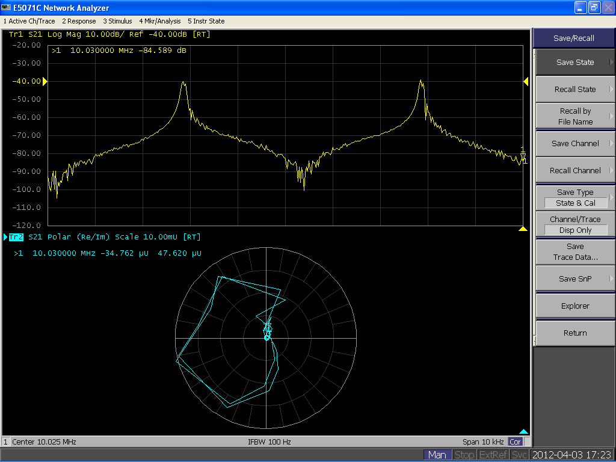

s-parameters
A typical notation:
$$S_{ij}$$
To port
From port
A typical two port device:
S11 reflection at the input (input return loss)
S21 forward transmission (gain, attenuation)
S22 reflection at the output (output return loss)
S12 reverse transmission

Slide 21
Exercise 2: S-parameters
S₂₁
1
1
Z₀
S₁₁
G = 2
G = 1/10
1
2
1
2
1
2
1
2

Slide 22
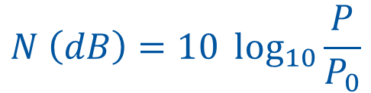
Decibel (dB)
Decibel: universal unit of measurement to express ratio of two quantities in logarithmic scale
Primary definition uses ratio of “power quantities”
$$N \left(dB\right)=10 \log_{10}{\frac{P}{P_{0}}}$$
Where:
P is e.g. the measured power,
P₀ reference power
N their ratio in dB

Slide 23

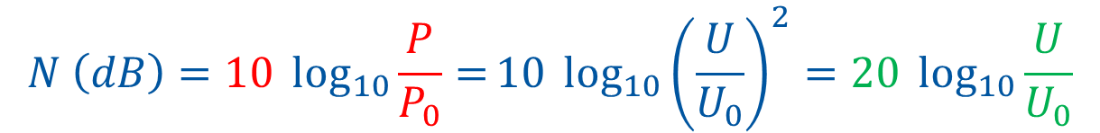


Decibel (dB)
Derivation for state or field quantities
E.g. case of power expressed by means of voltage and impedance
$$P=\frac{U^{2}}{R}$$
$$P_{0}=\frac{U_{0}^{2}}{R}$$
Where:
U is e.g. the measured voltage,
U₀ reference reference voltage
$$\frac{P}{P_{0}}=\frac{\frac{U^{2}}{R}}{\frac{U_{0}^{2}}{R}}={\left(\frac{U}{U_{0}}\right)}^{2}$$
$$N \left(dB\right)=10 \log_{10}{\frac{P}{P_{0}}=}10 \log_{10}{{\left(\frac{U}{U_{0}}\right)}^{2}=20\log_{10}{\frac{U}{U_{0}}}}$$

Slide 24
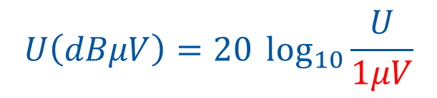
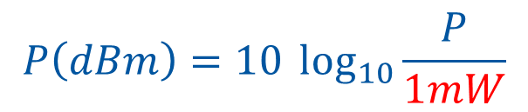
Decibel (dB)
dB is a very convenient unit for RF work
Gain or attenuation is typically expressed in dB
  The amplifier gas a voltage gain of 1000, or 60dB
Power can be expressed in dB
  dBm – use 1 mW for P₀
Voltage can be expressed in dB
  dBμV – use 1 μV for U₀
$$P\left(dBm\right)=10 \log_{10}{\frac{P}{1mW}}$$
$$U\left(dBμV\right)=20 \log_{10}{\frac{U}{1μV}}$$

Slide 25
Decibel (dB) – important numbers
Ratio linear | Ratio power dB | Ratio voltage dB
1 000 000 | +60 | +120
1 000 | +30 | +60
10 | +10 | +20
2 | +3 | +6
√2 (1.4142) | +1.5 | +3
1 | 0 | 0
1/√2 (0.7071) | -1.5 | -3
1/2 | -3 | -6
1/4 | -6 | -12
1/10 | -10 | -20
0.000 000 000 000 000 1 | -160 | -320

Slide 26
Decibel (dB)
dB is a very convenient unit for RF work
Multiplication in linear scale converts to addition in logarithmic scale
RF source
out power
Amplifier
gain
Coaxial line
attenuation
Cavity
input power
~
P_{mW} = 20 mW
P_{dBm} = 13 dBm
A_{P} = 2000
G_{P} = 33 dB
A_{CABLE} = 0.5
G_{CABLE} = -3
Linear: P_{cavity} = P_{mW} * A_{P} * A_{CABLE} = 0.020 W * 2000 * 0.5 = 20 W
dB: P_{cavity} = P_{dBm} + G_{P} + G_{CABLE} = 13 dBm + 33 dB – 3 dB = 43 dBm

Slide 27
Exercise 3 – Using the decibel

Slide 28
Transmission line types
Coaxial cables
Coaxial transmission lines
Waveguides
Microstrip/stripline

Slide 29
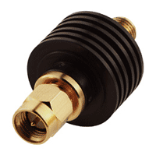
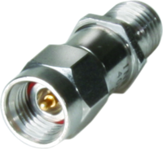
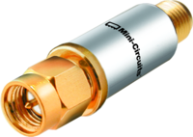
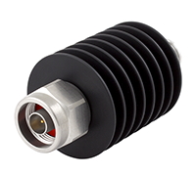
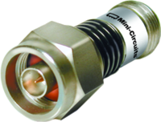
Most common RF blocks/devices
Attenuator: Device that reduces the signal amplitude (power) without distorting the frequency content
Important parameters:
  Attenuation value (dB)
  Power dissipation capacity (Watts)
  Usable frequency range
Special case - terminator

Slide 30
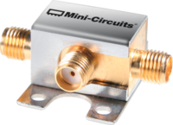
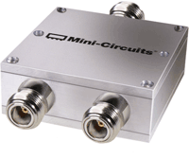
Most common RF blocks/devices
Power divider: Device that splits power from one port into two, or multiple output ports.
Power combiner: Device that combines power from two, or multiple input ports into one output port.
Important parameters:
  Number of ports (2+)
  Split ratio (usually equal)
  Insertion loss above ideal (dB)
  Power handling capacity (Watts)
  Usable frequency range

Slide 31
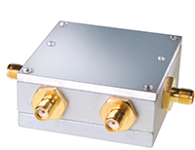

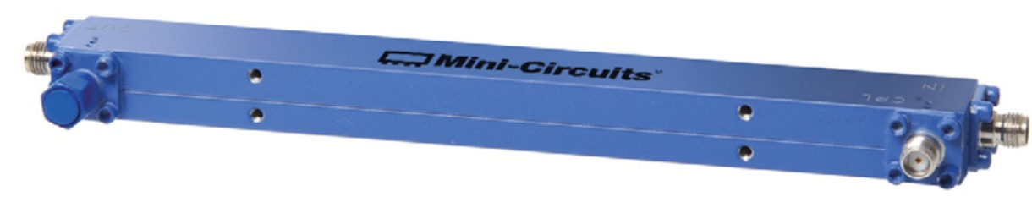
Most common RF blocks/devices
Directional coupler: device that couples out a given fraction (usually small) of the forward, or reflected power from a transmission line
Important parameters:
  Coupling (dB)
  Directivity (dB)
  Power handling capacity (Watts)
  Usable frequency range

Slide 32
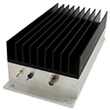
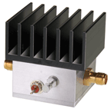
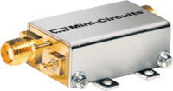
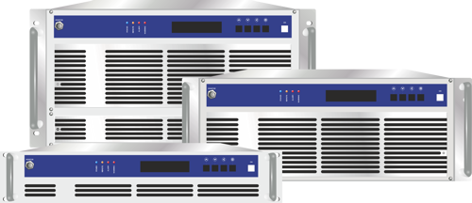
Most common RF blocks/devices
Amplifier: Device that increases the signal amplitude (power) without distorting the frequency content
Important parameters:
  Gain (dB)
  Max. output power (1 dB compression point)
  Frequency range
  Noise figure
  In/out matching

Slide 33
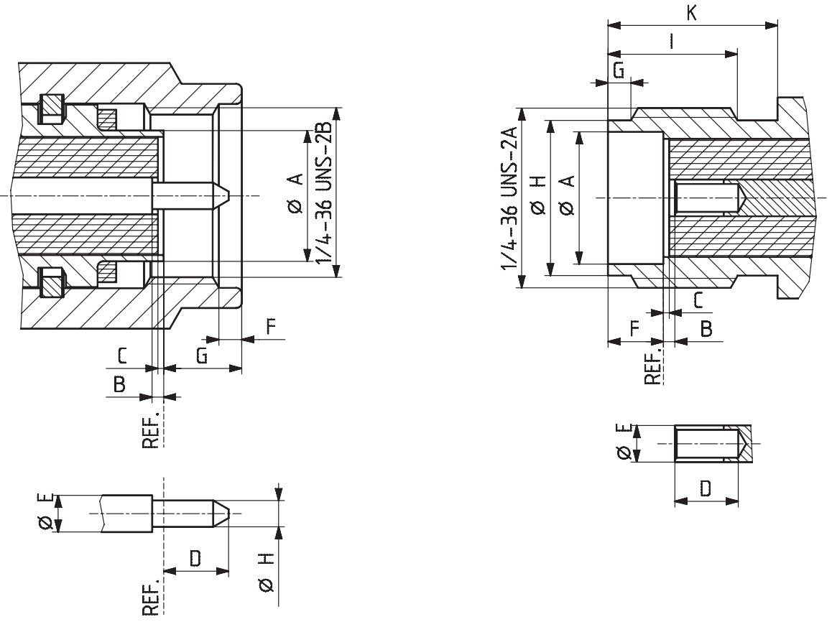
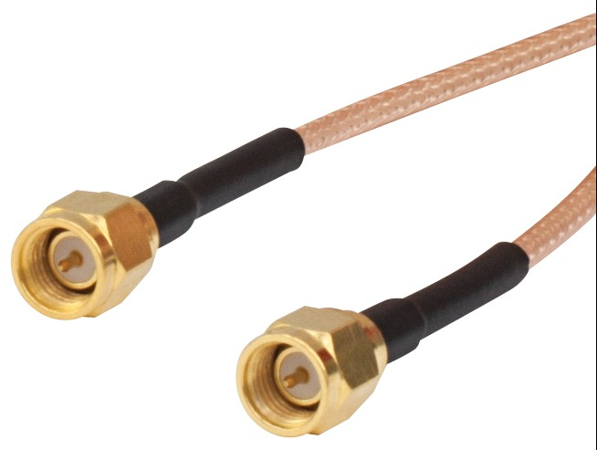
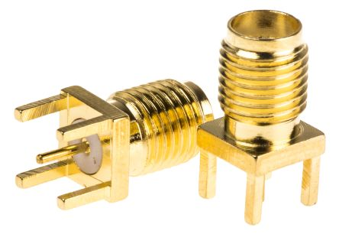
RF connectors
RF connectors are essential part of your measurement setup.
If not properly selected, installed and maintained they can become your worst nightmare
Important parameters:
  Characteristic impedance
  Usable frequency range
  Power handling capacity (Watts)
  Number of mating cycles

Slide 34
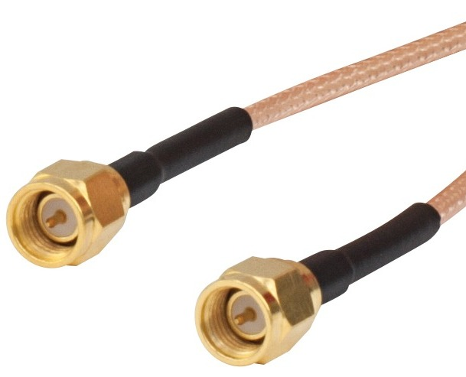
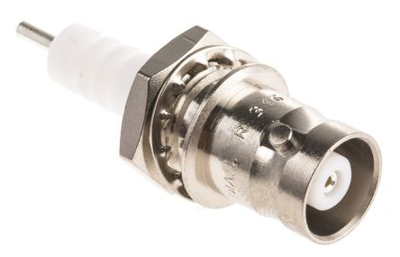
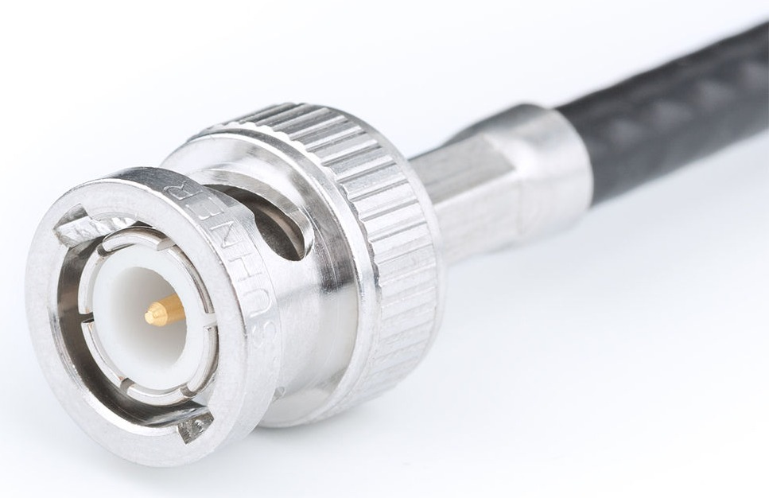
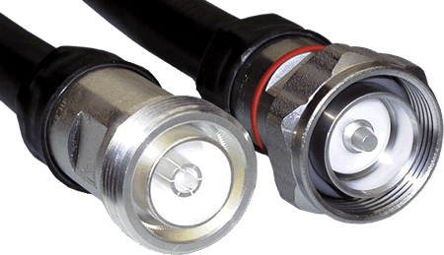
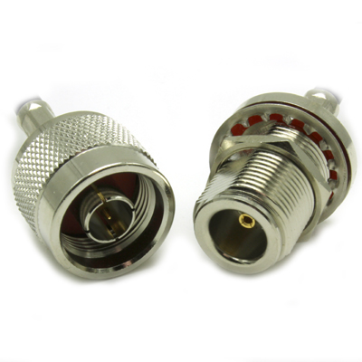
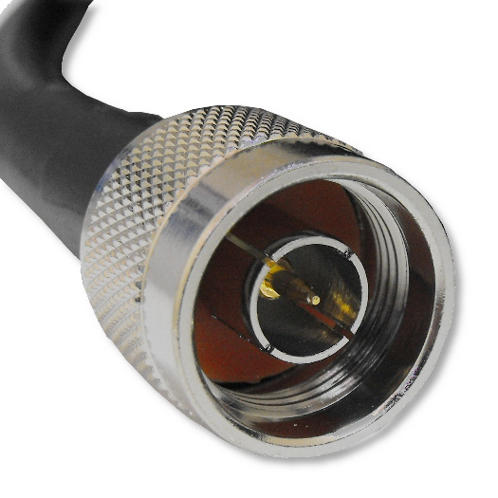
RF connectors (most popular types in RF instrumentation)
SMA
Good for 6/18GHz
100W @ low frequency
Reliable connection for low power signals, high frequency and microwave signals
BNC
Good <500MHz
Not suitable for power transmission
Fast connection for low power signals
N
Good for 4/8GHz
500W @ low frequency
Robust and reliable, low loss connection for medium power signals
7/16
Good for 1GHz
kW @ low frequency
Extremely robust and reliable, very low loss connection for high power signals

Slide 35
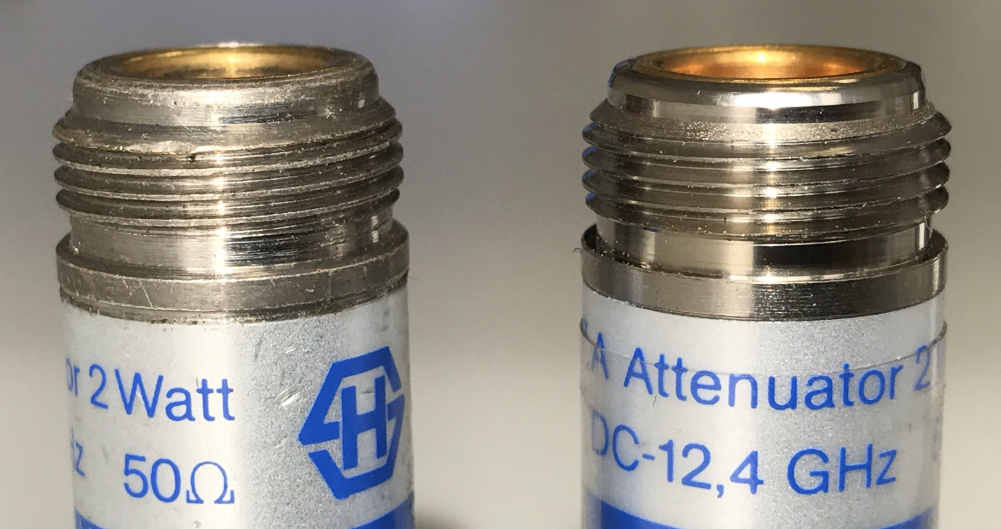


Connector care
RF connectors are precision mechanical devices, proper care and handling is essential
Never do this!

Slide 36



Connector care
Never turn the connectors bodies against each other. Instead insert, slide and turn the nut
Never force the connector when mounting, they have to slide with no resistance
Step 1:
align
Step 2:
slide in, start to screw
Step 3:
turn and tighten to torque

Slide 37

Connector care
Never turn the connectors bodies against each other. Instead insert, slide and turn the nut
Never force the connector when mounting, they have to slide with no resistance
Flat wrenches
N: 19, SMA: 5/16”
Pliers with parallel sliding jaws
Recommended tools:
Torque wrenches

Slide 38


Connector care
Always use protection!

Slide 39


And never, EVER, do this!!!!!!!!!!!!!!!

