Slide 1
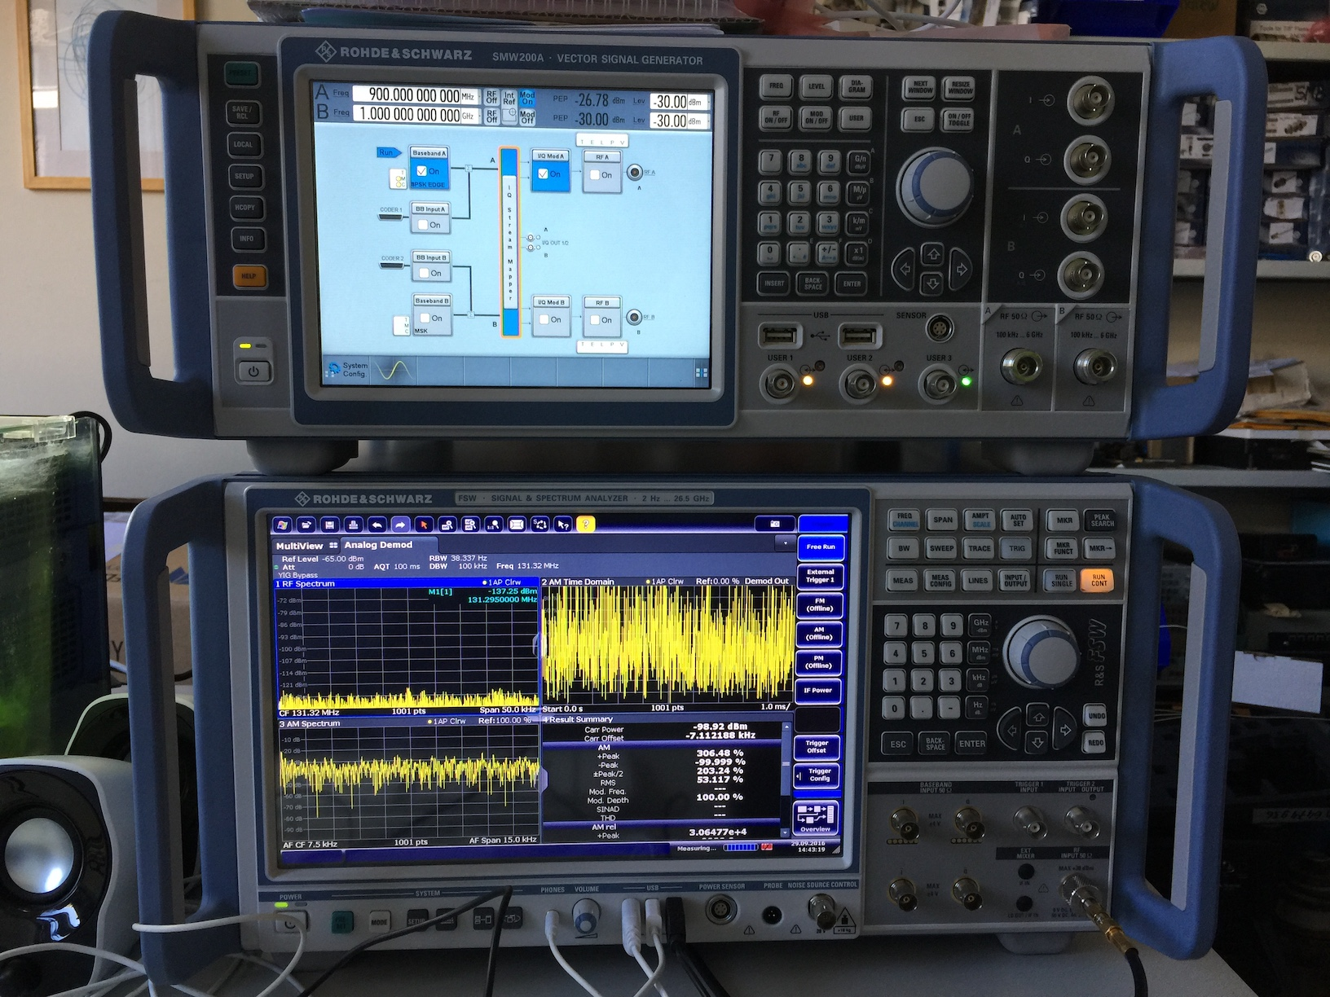
Introduction to RF measurements and instrumentation
Daniel Valuch, CERN BE/RF, daniel.valuch@cern.ch

Slide 2
Content
RF power measurement
Spectrum analyzers
Vector network analyzers

Slide 3
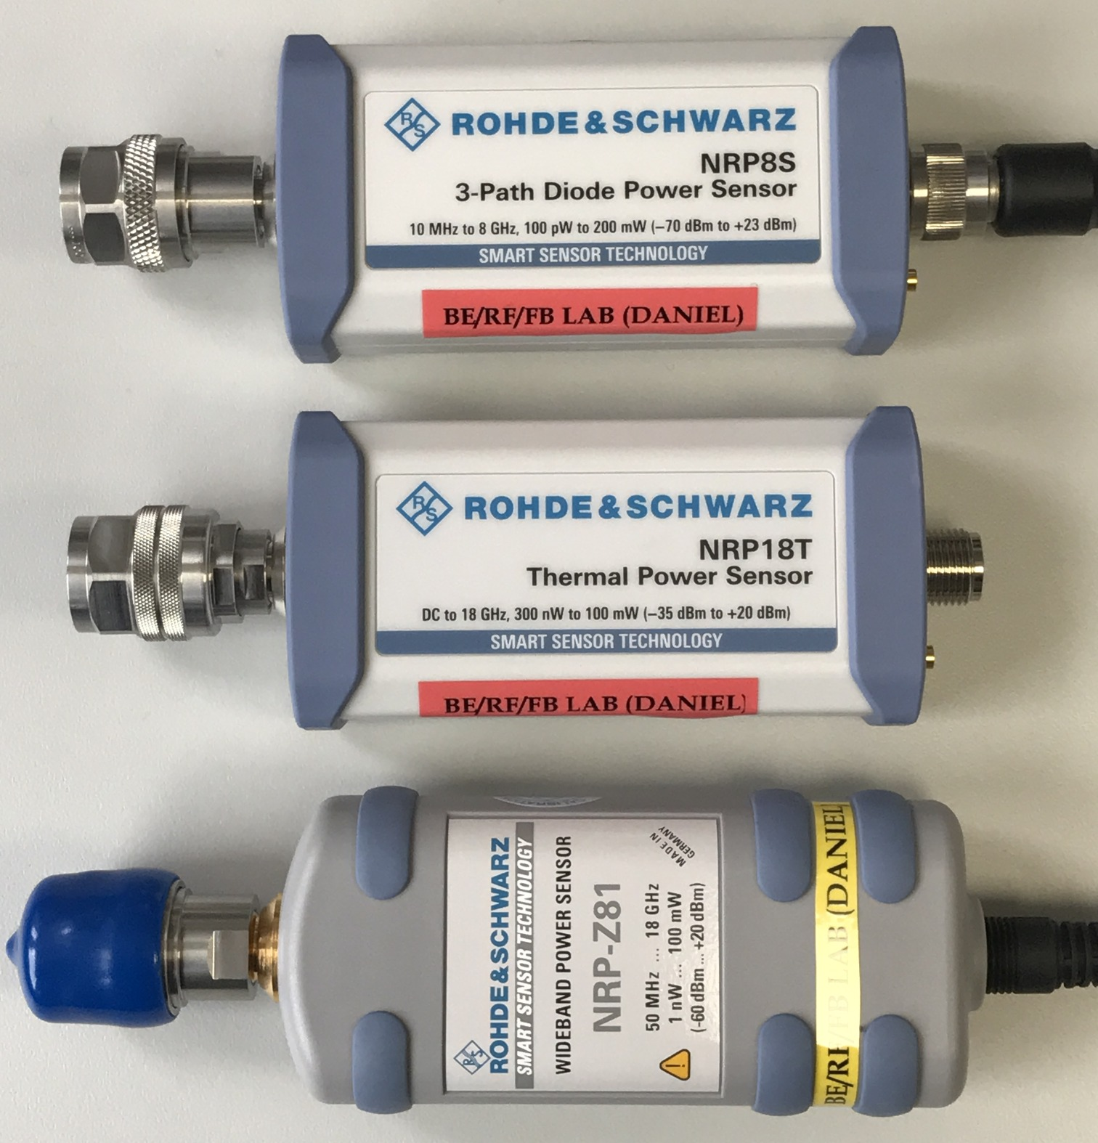
RF power measurement
Most popular methods to measure the RF power
  Diode envelope detection: Most common, large dynamic range, suitable for constant signals
  Thermal: Very accurate, limited dynamic range, ideal for complex modulated signals
  Electronic receivers: Most complex, suitable for fast, pulsed signals

Slide 4
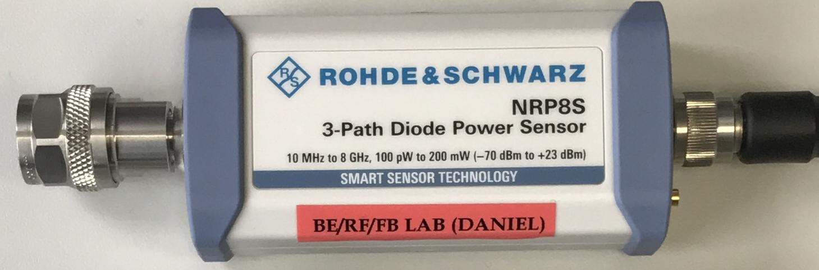
RF power measurement
How to read specifications of a power sensor
Frequency range:
Diode sensors ~10MHz
Thermal sensors DC
Pulsed sensors 50-100MHz
Power/dynamic range:
Minimum and maximum power for your application. Values change typ. factor 1000+ between room temperature and superconducting state
External trigger and interface:
Synchronized acquisition, USB interface, ethernet…

Slide 5
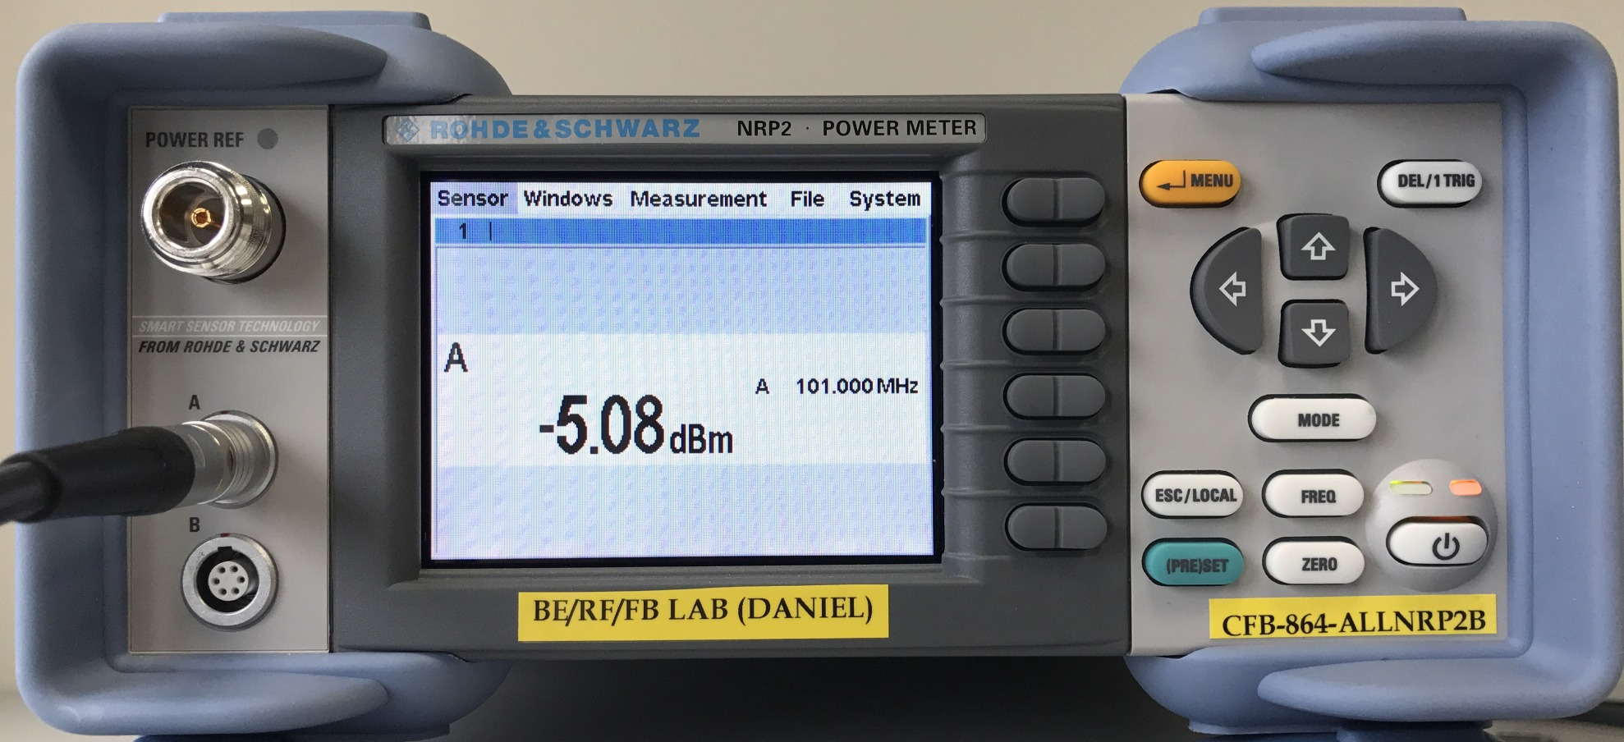
RF power measurement
How to use a RF power meter
1. Set the frequency
2. Zero the offset
3. Connect sensor to the signal source

Slide 6
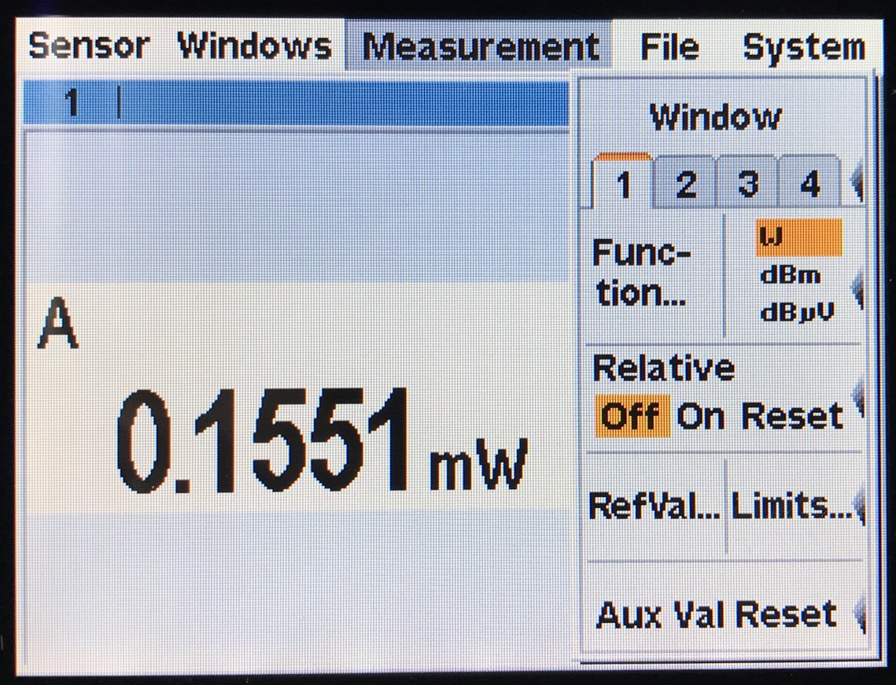
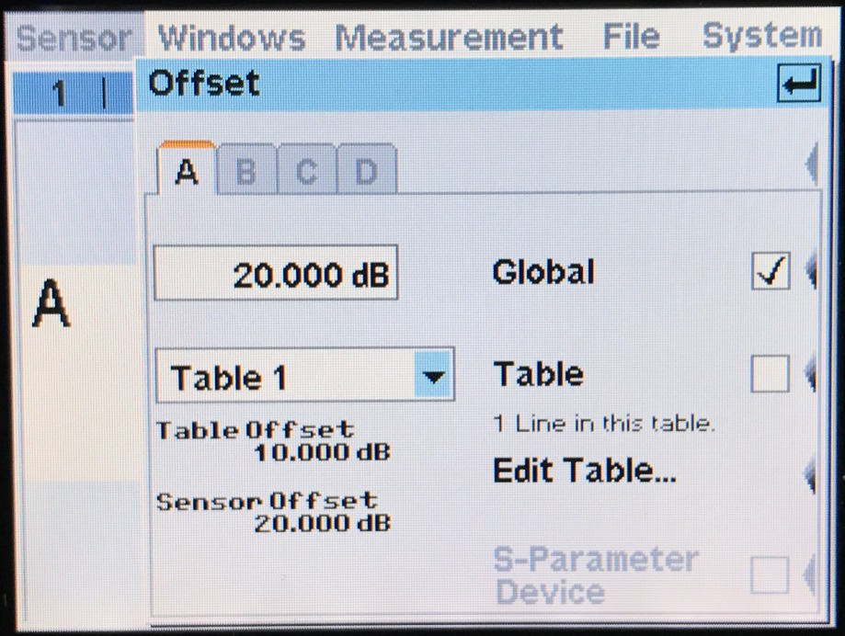
RF power measurement
Chose the desired measurement unit
If measuring through couplers/ attenuators etc. set-up the offset for direct reading of the source power value, instead of measured power value

Slide 7
RF power measurement
Some comments:
  The reading is noisier at the bottom of the dynamic range
  The power sensor really burns when overloaded (very costly to repair)
  Sensors have optimized dynamic range for type of measurements they do (very accurate, very fast, RMS…)
  Sensors and instruments need certain time to measure a data point, be careful with automation
  Decide what to buy based on how are you going to use the instrument: Table top, USB sensor, Ethernet sensor…

Slide 8
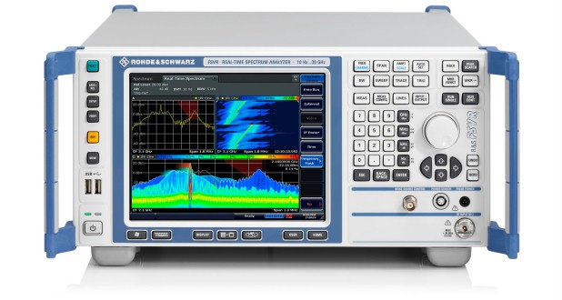
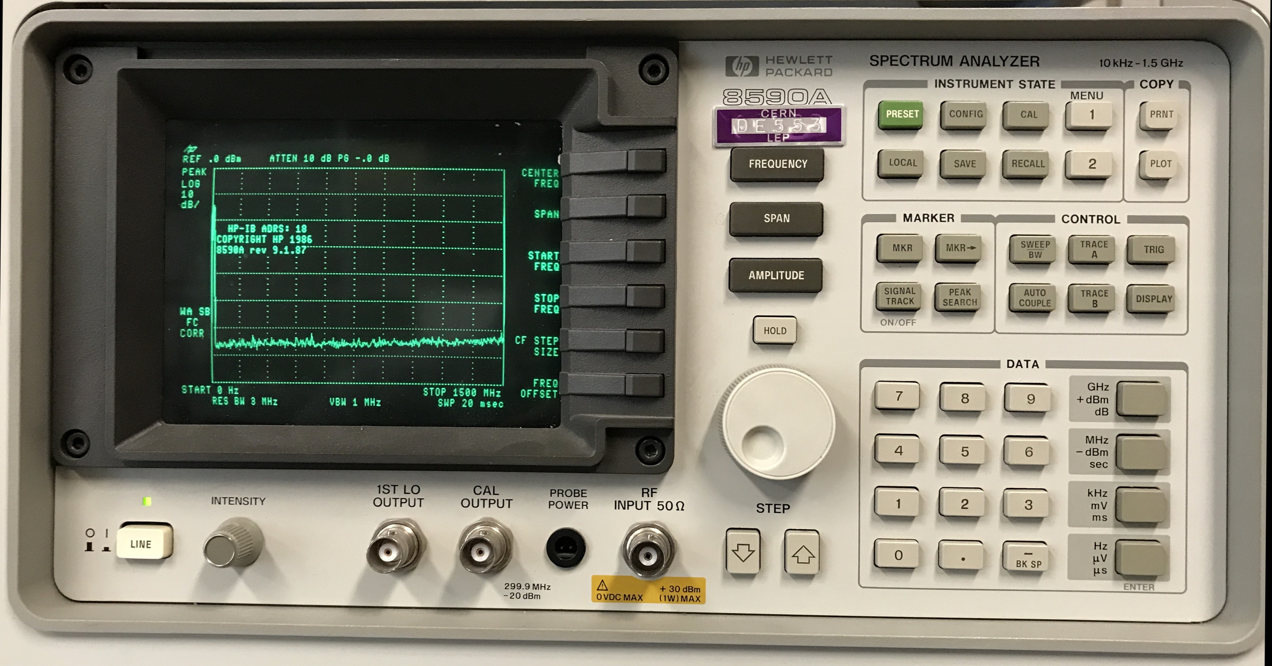
Spectrum analyzer
Spectrum analyser is a device, which measures frequency content of a signal.

Slide 9
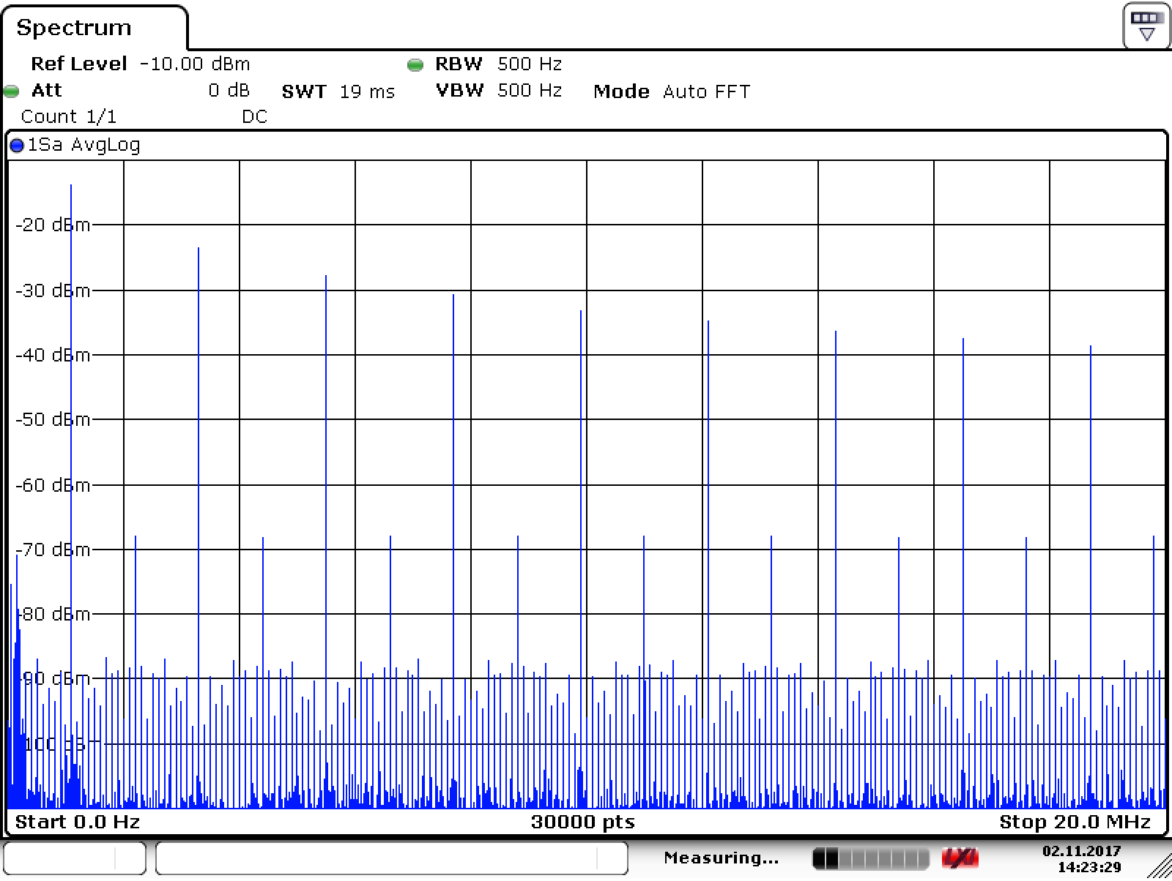
Spectrum analyser user interface
Amplitude
Frequency

Slide 10
Spectrum analyser user interface
X axis, frequency span: Span
Center frequency: Center
Start
Stop

Slide 11
Spectrum analyser user interface
Y axis, 1 square (/division)
Y axis, full scale 10 square
Set by: Amplitude/scale

Slide 12
Spectrum analyser user interface
Other important settings

Slide 13
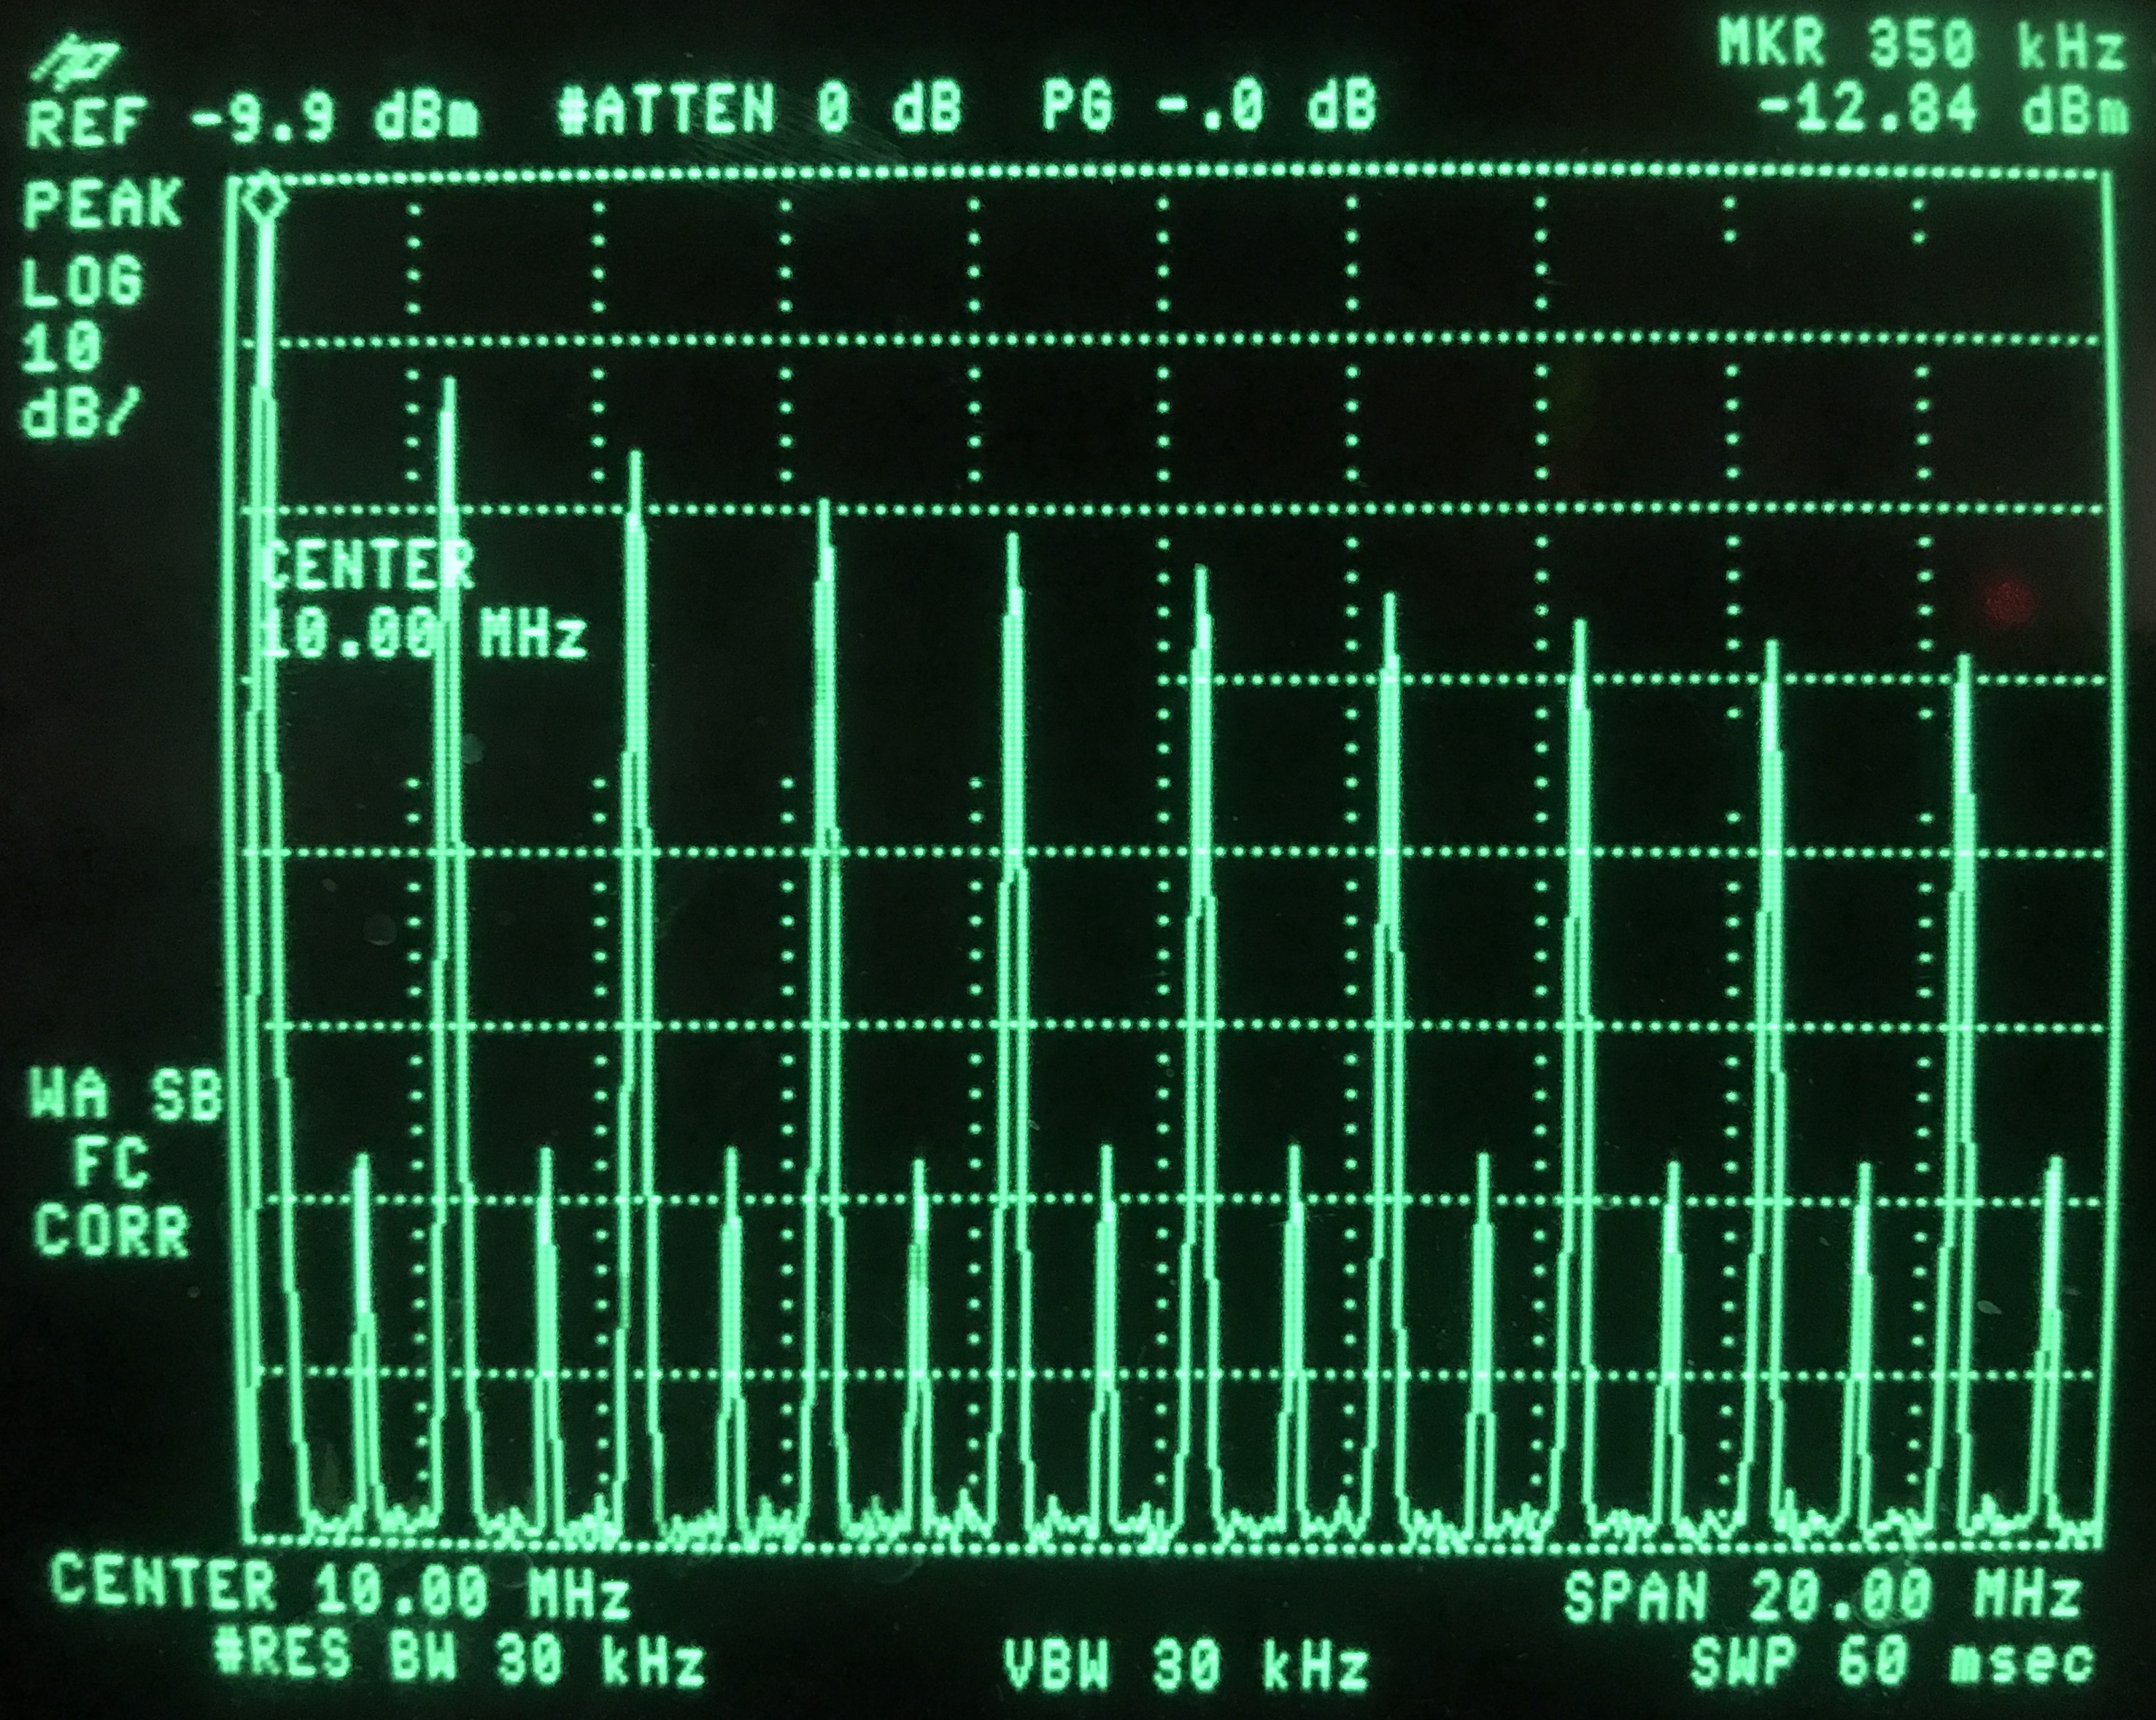
Spectrum analyser user interface

Slide 14
Spectrum analyzer user interface

Slide 15
Spectrum analyzer user interface
Frequency and amplitude
Markers and advanced
Screen + Soft keys
RF input

Slide 16
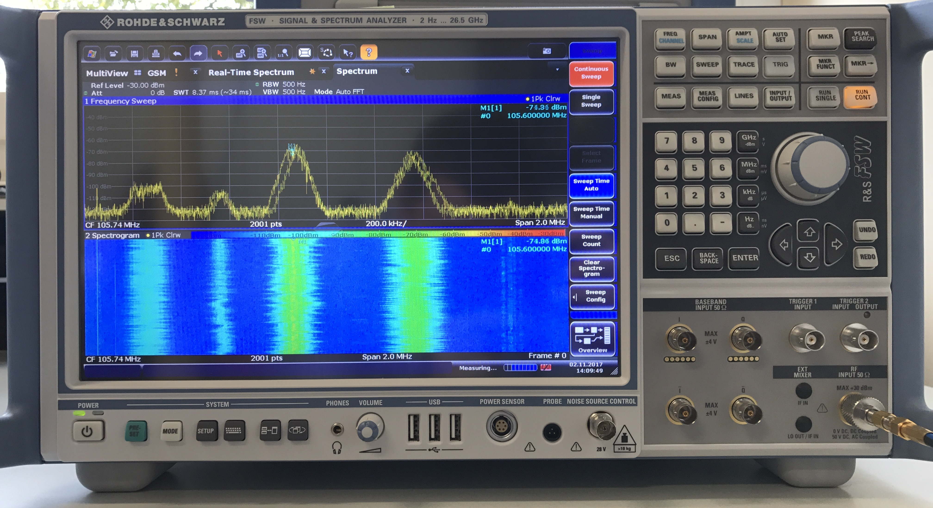
Spectrum analyser user interface

Slide 17
Spectrum analyser user interface
Frequency and amplitude
Markers and advanced
Screen + Soft keys
RF and IF inputs

Slide 18
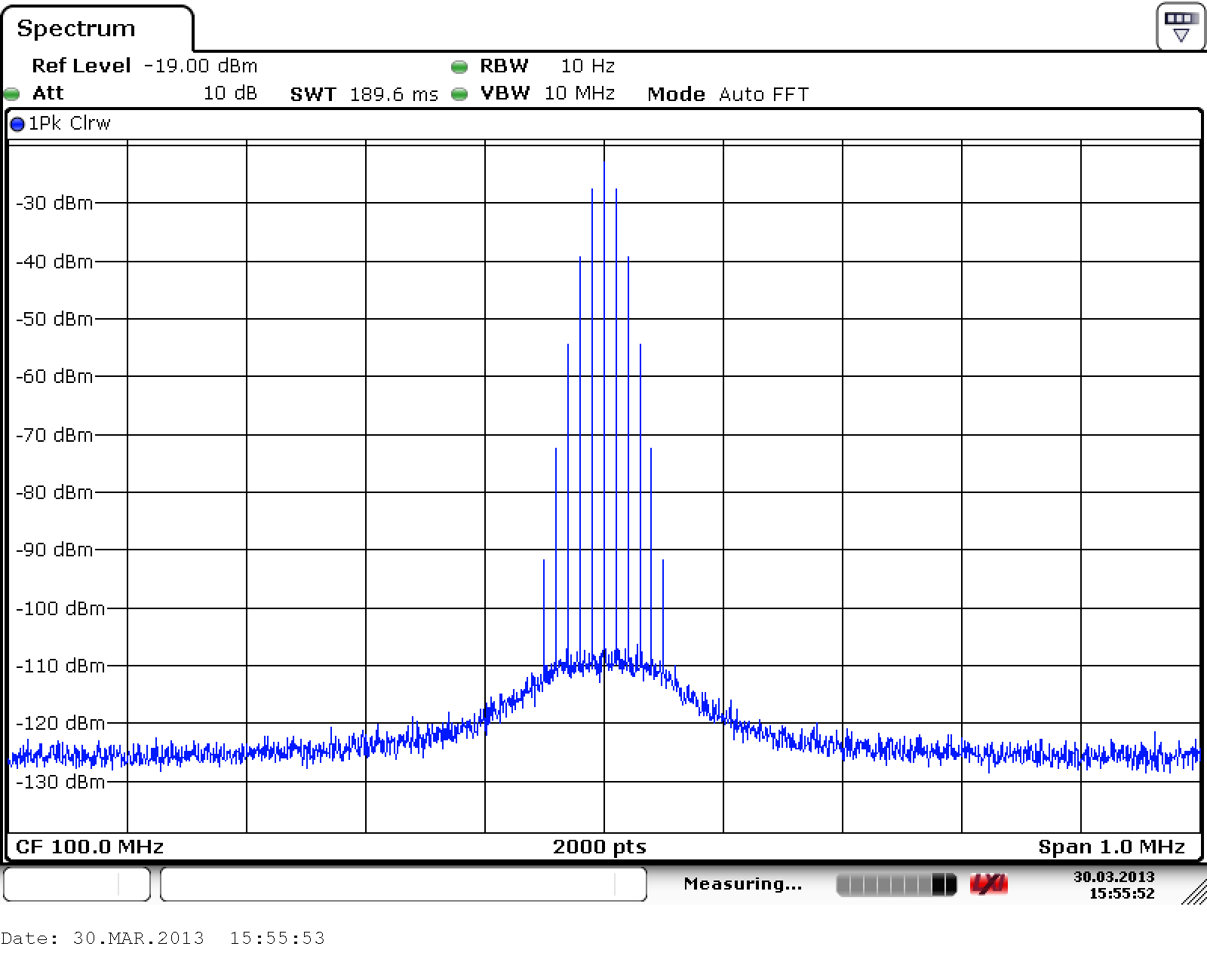
IF detector bandwidth – resolution bandwidth
Receiver signal bandwidth prior the power detector
IF/resolution bandwidth defines the measurement noise floor AND how close two different signals can be in order to still distinguish them
Sweep time
Resolution bandwidth
Noise floor
Different signals

Slide 19
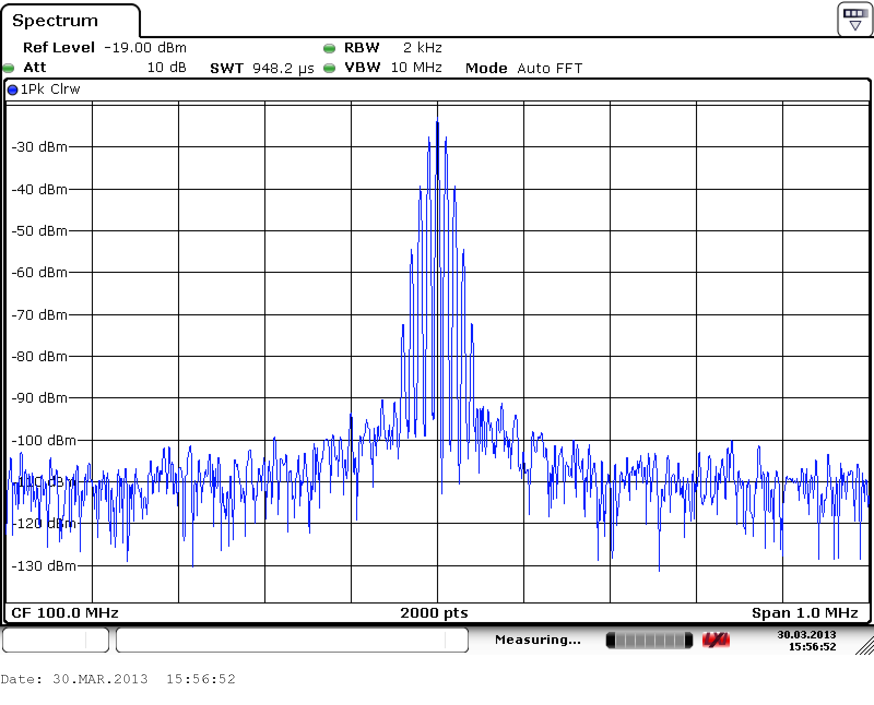
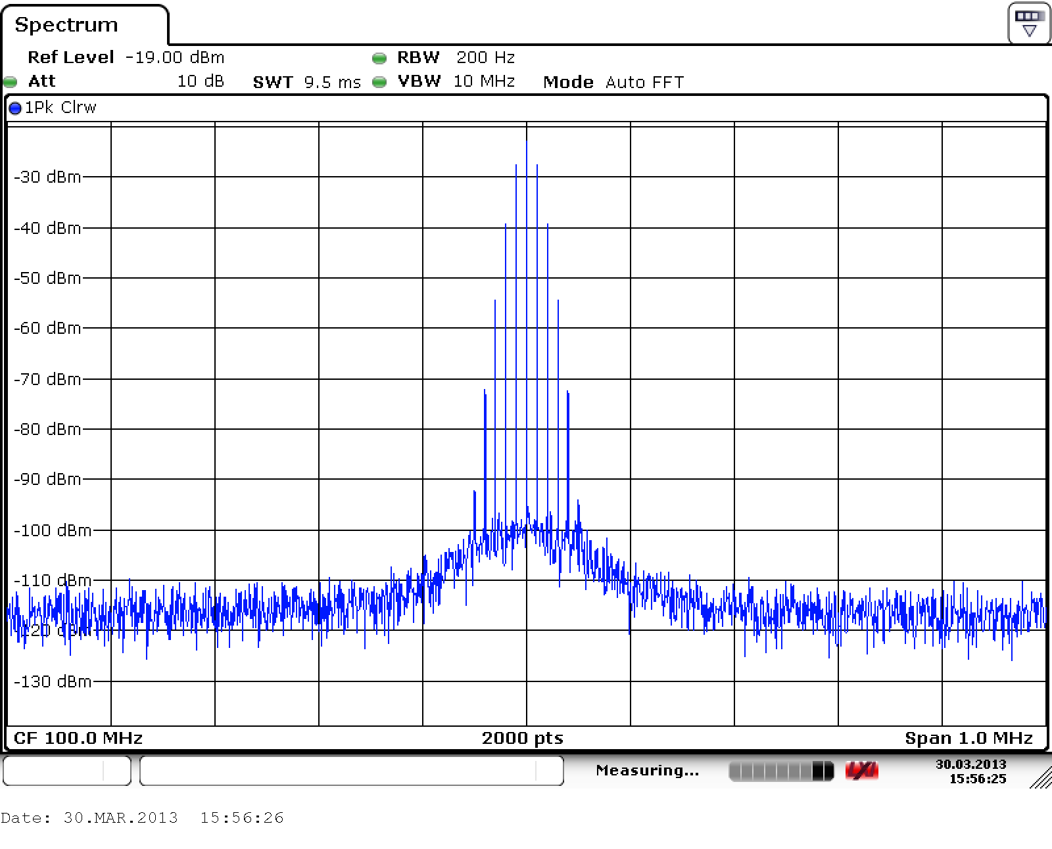
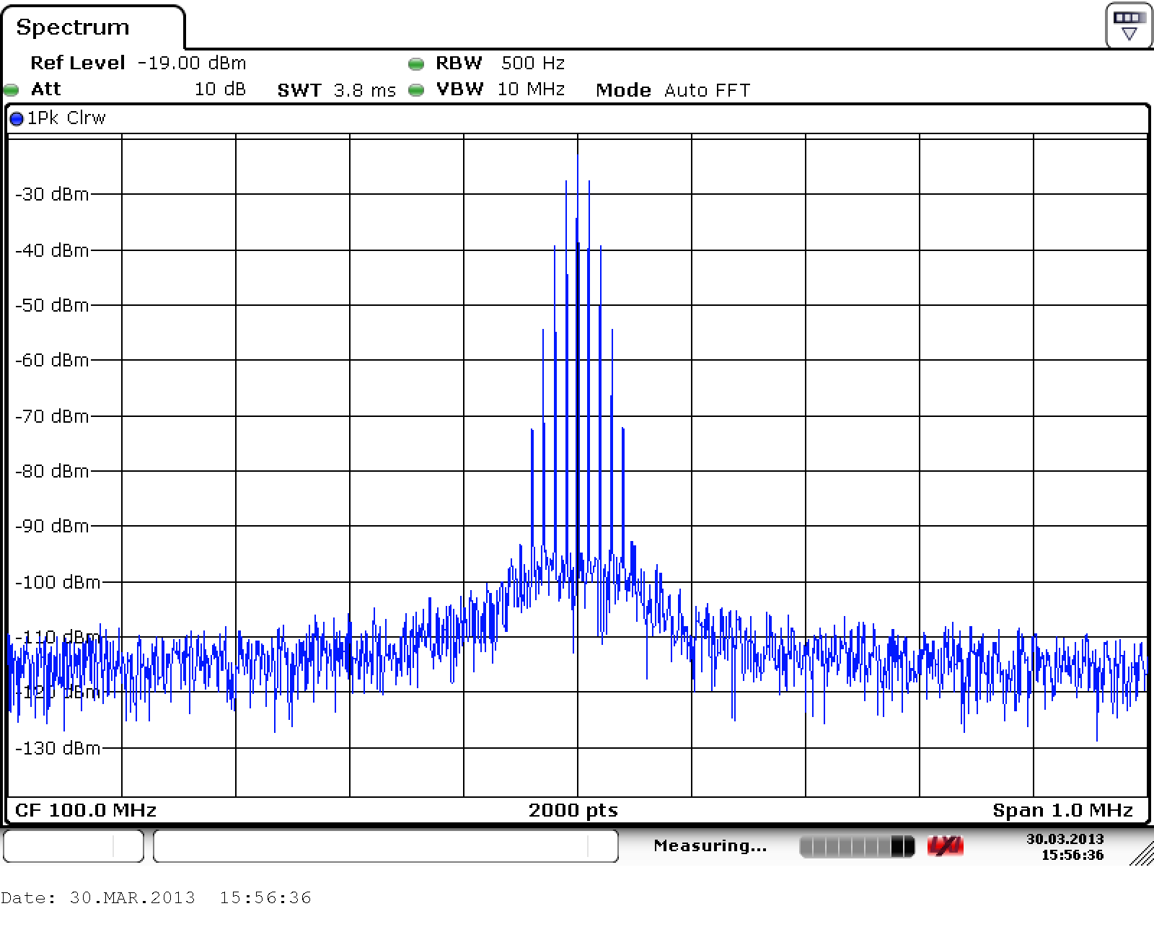
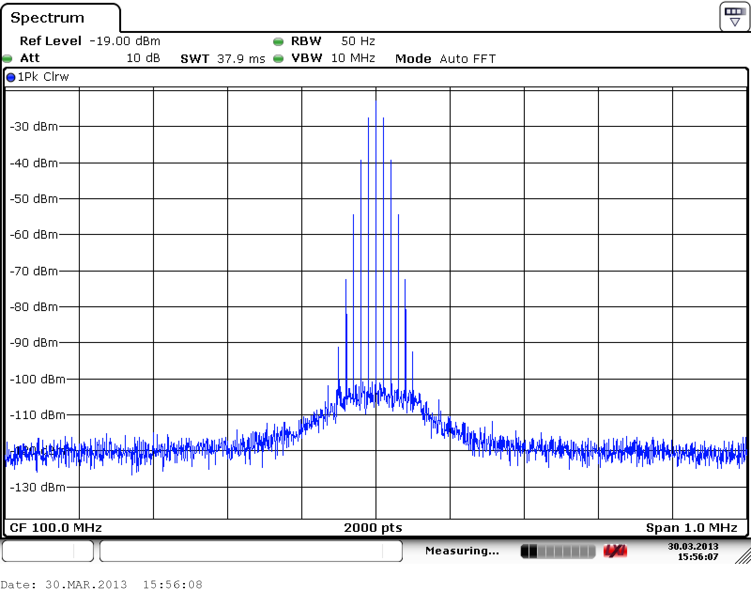
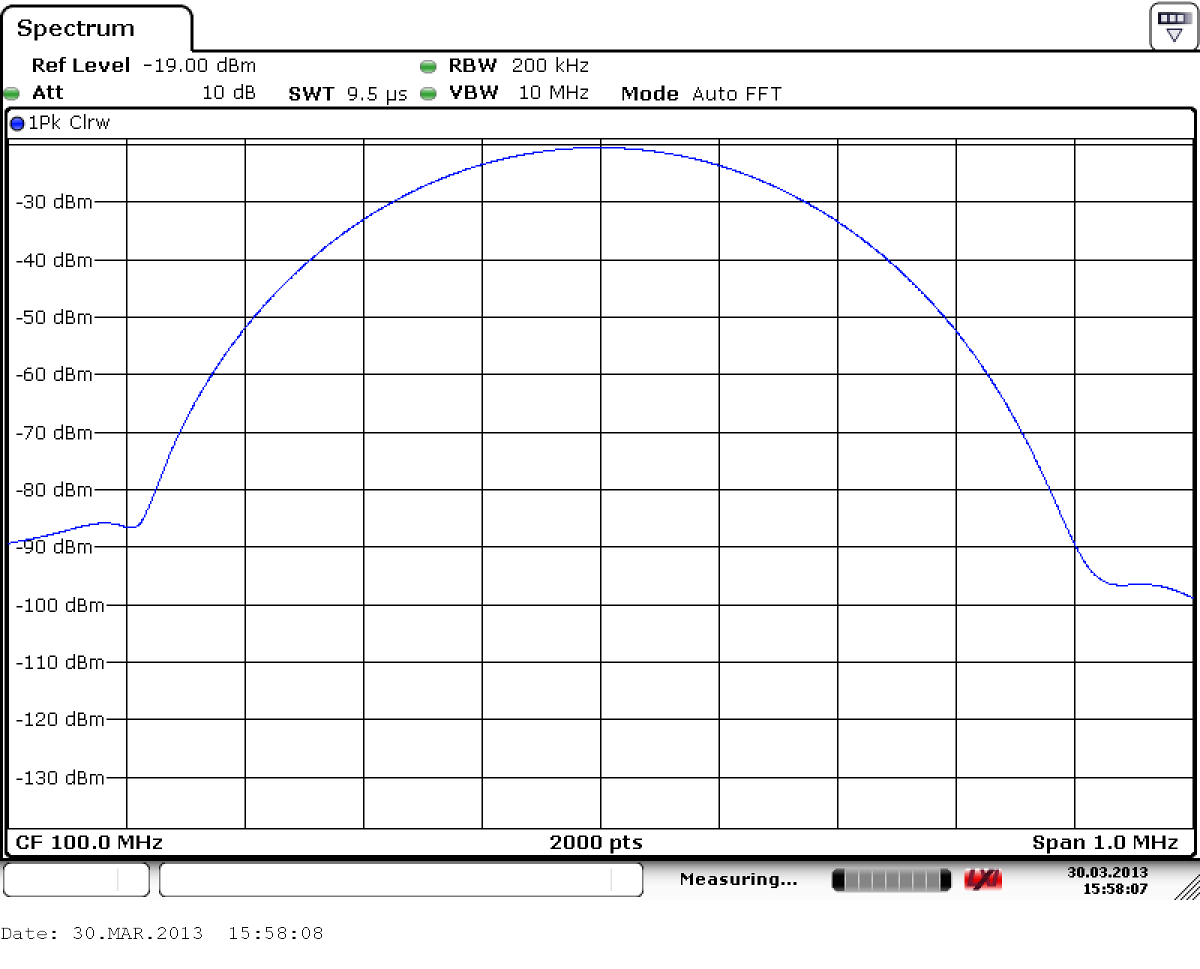
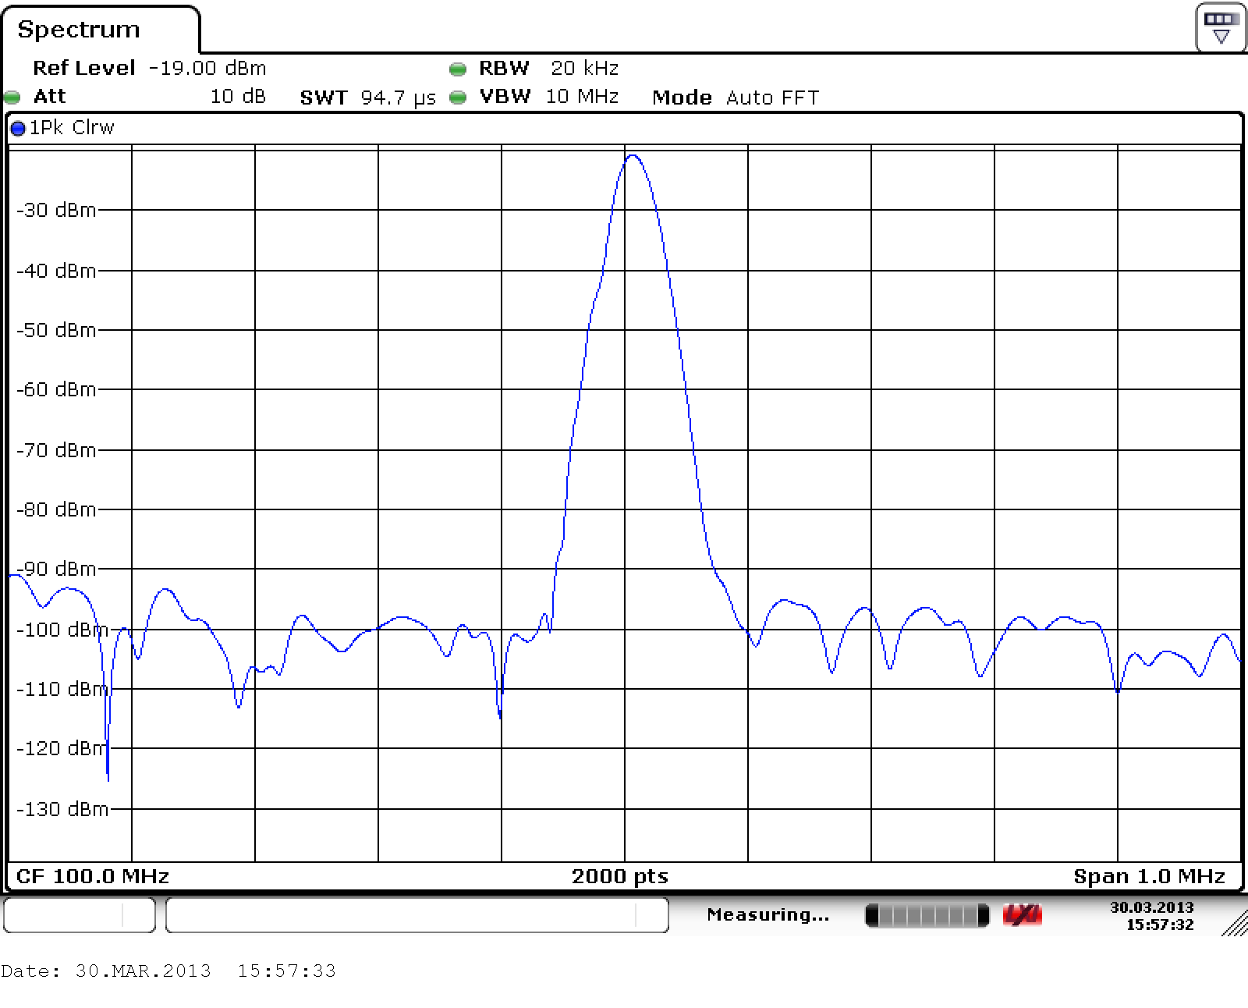
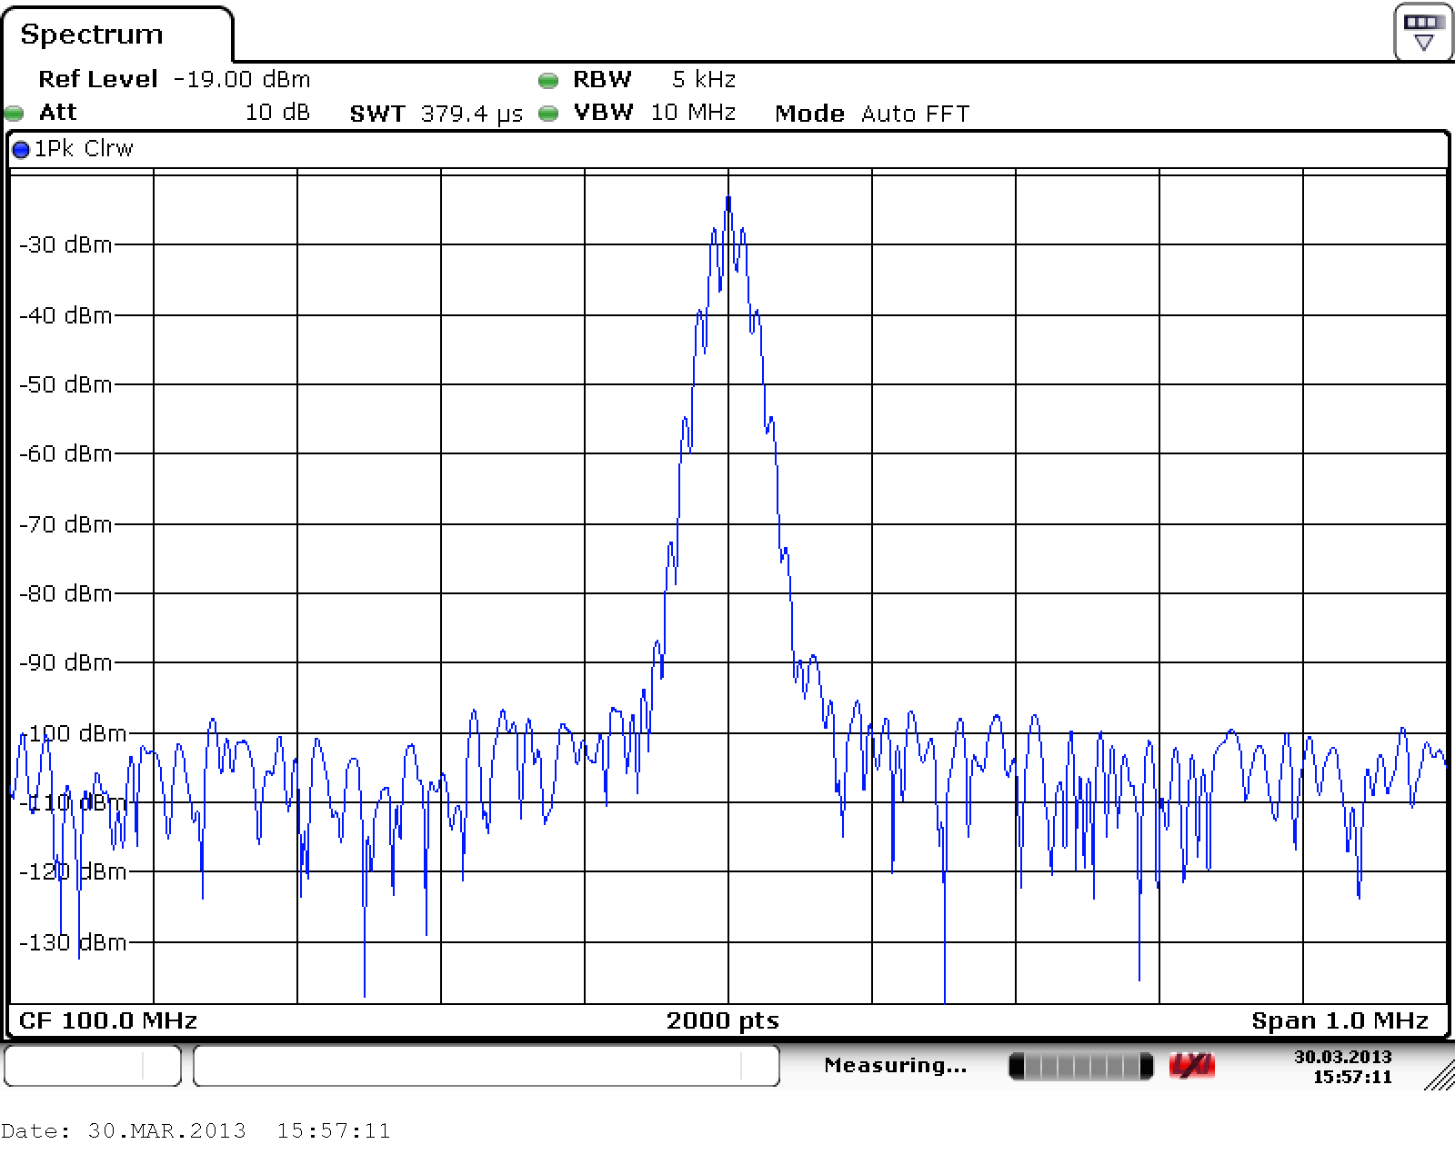
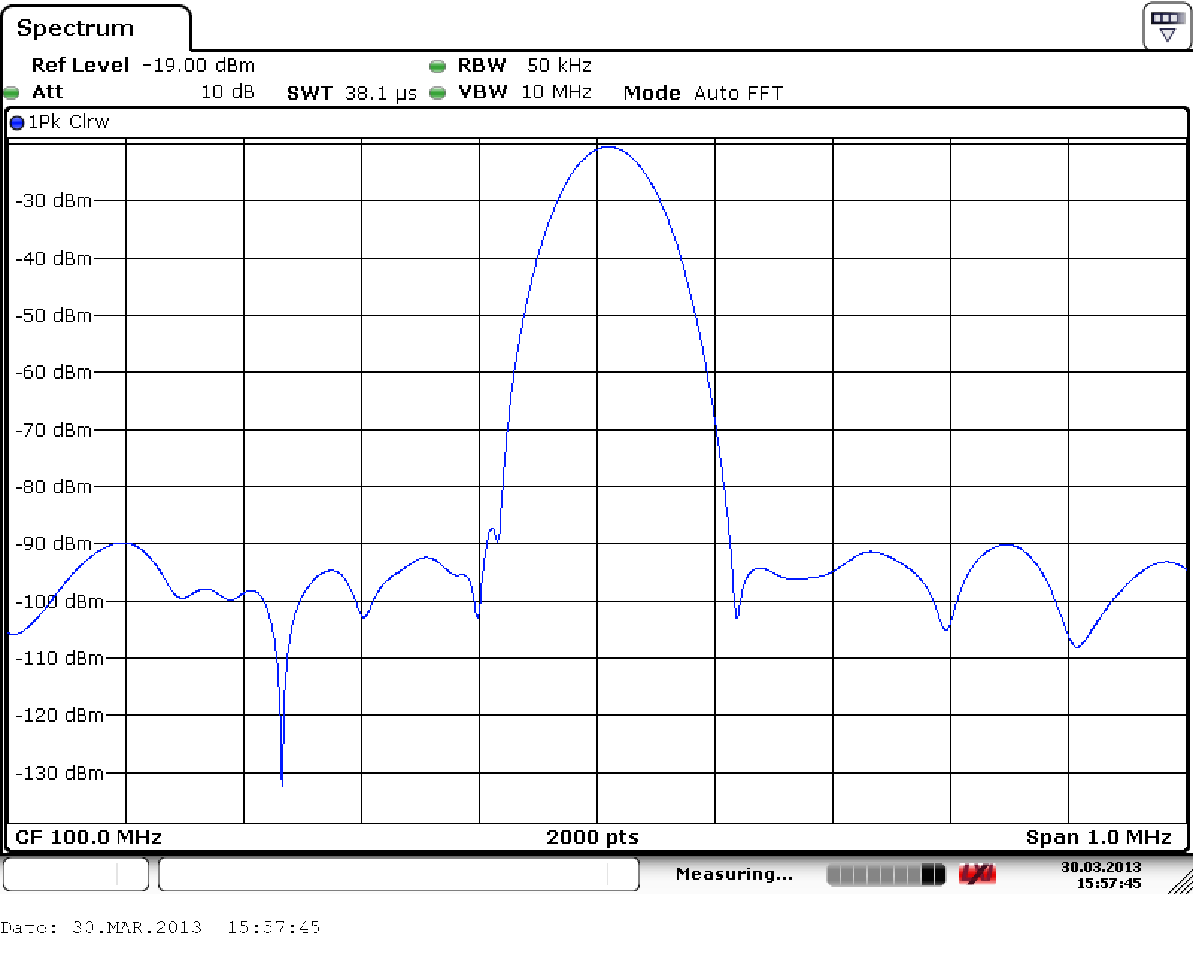
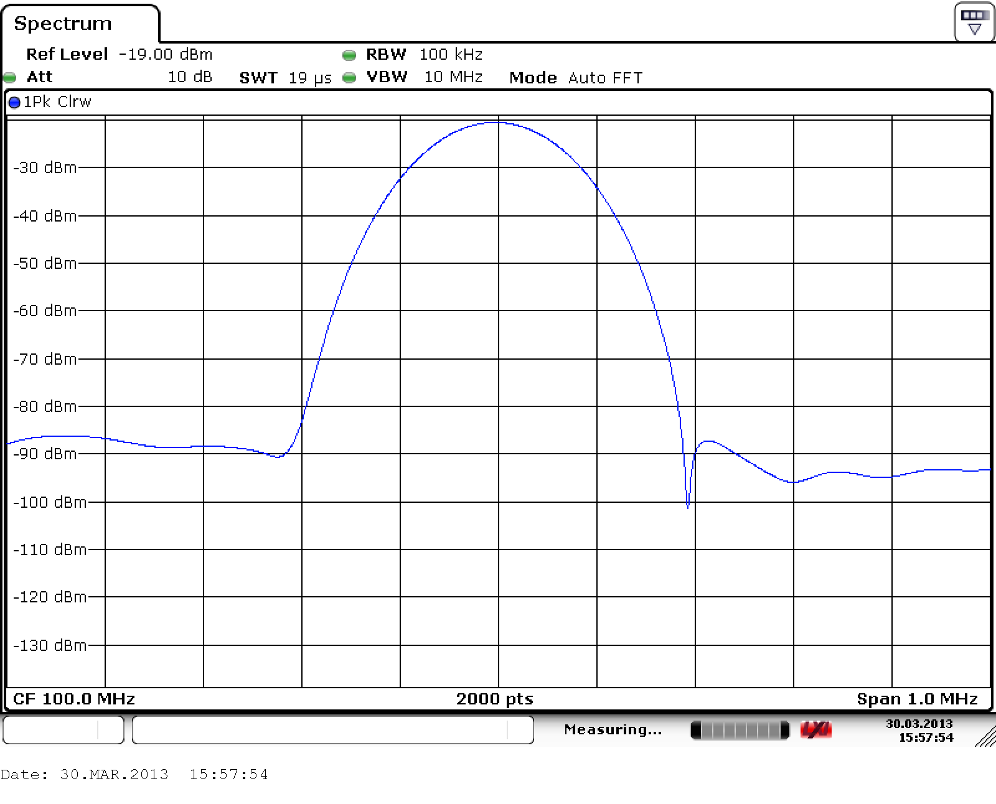
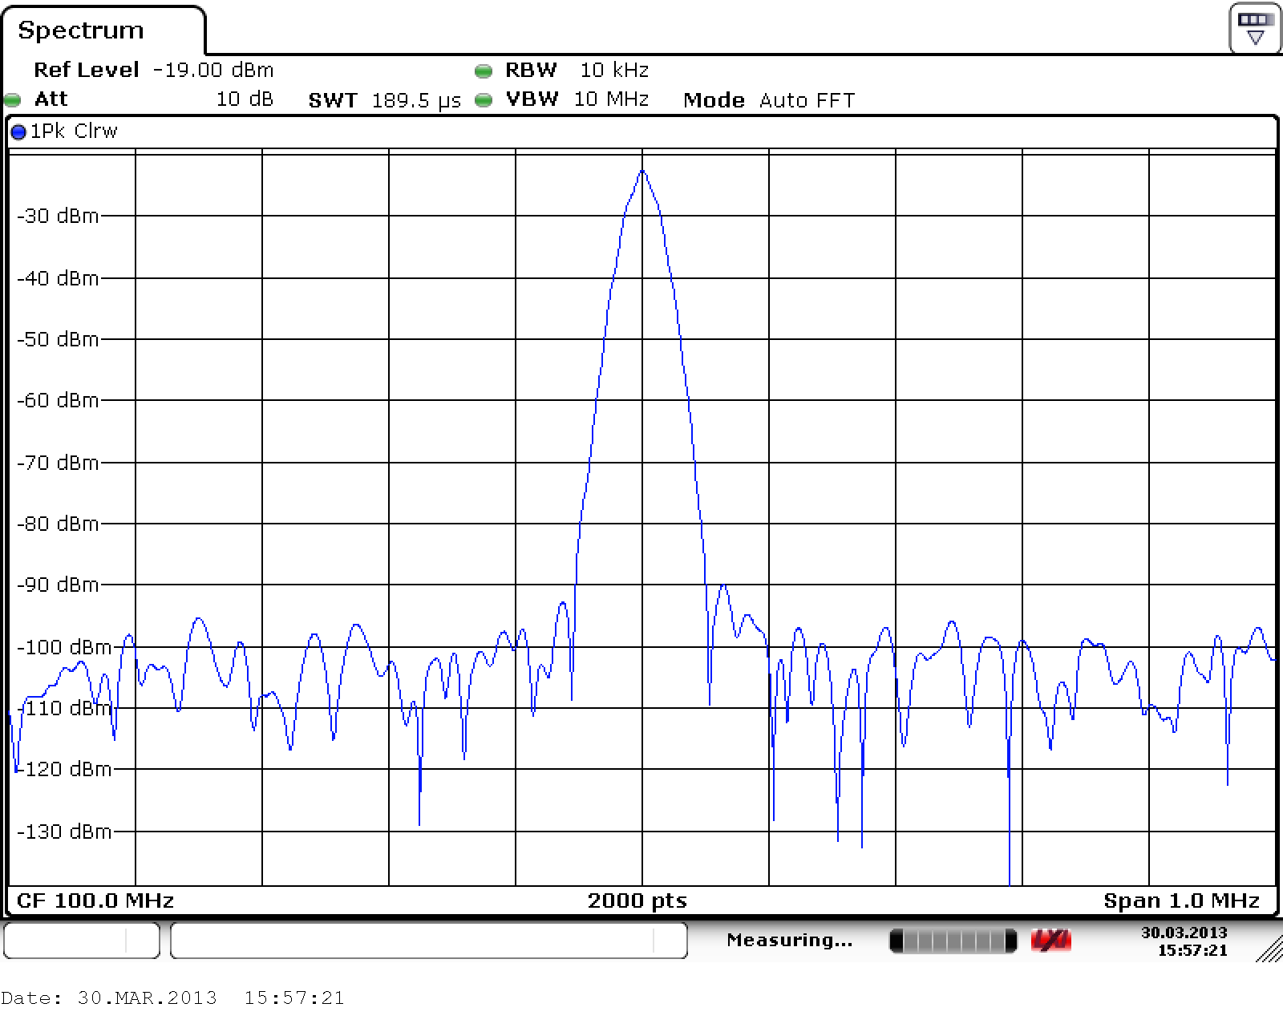
IF detector bandwidth – resolution bandwidth
Receiver signal bandwidth prior the power detector
IF/resolution bandwidth defines the measurement noise floor AND how close two different signals can be in order to still distinguish them

Slide 20
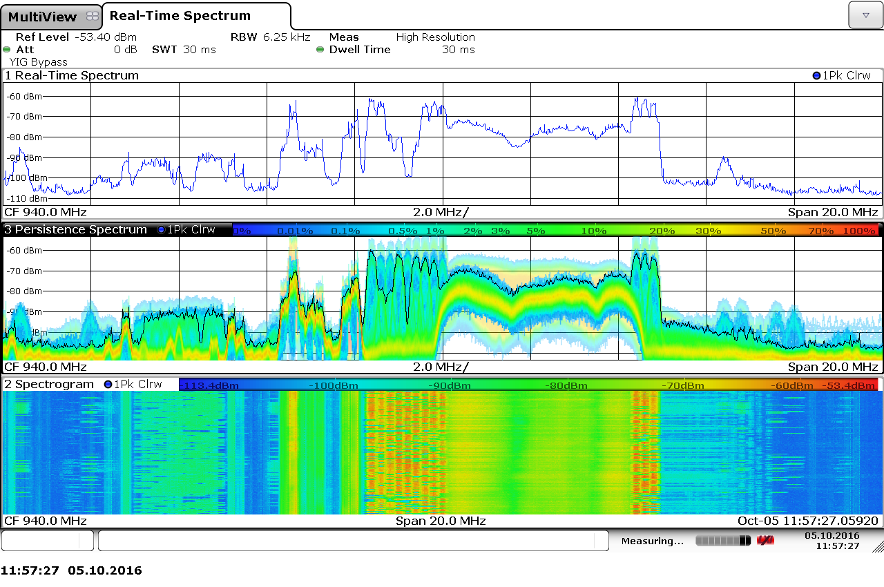
Real time spectrum analyzer

Slide 21
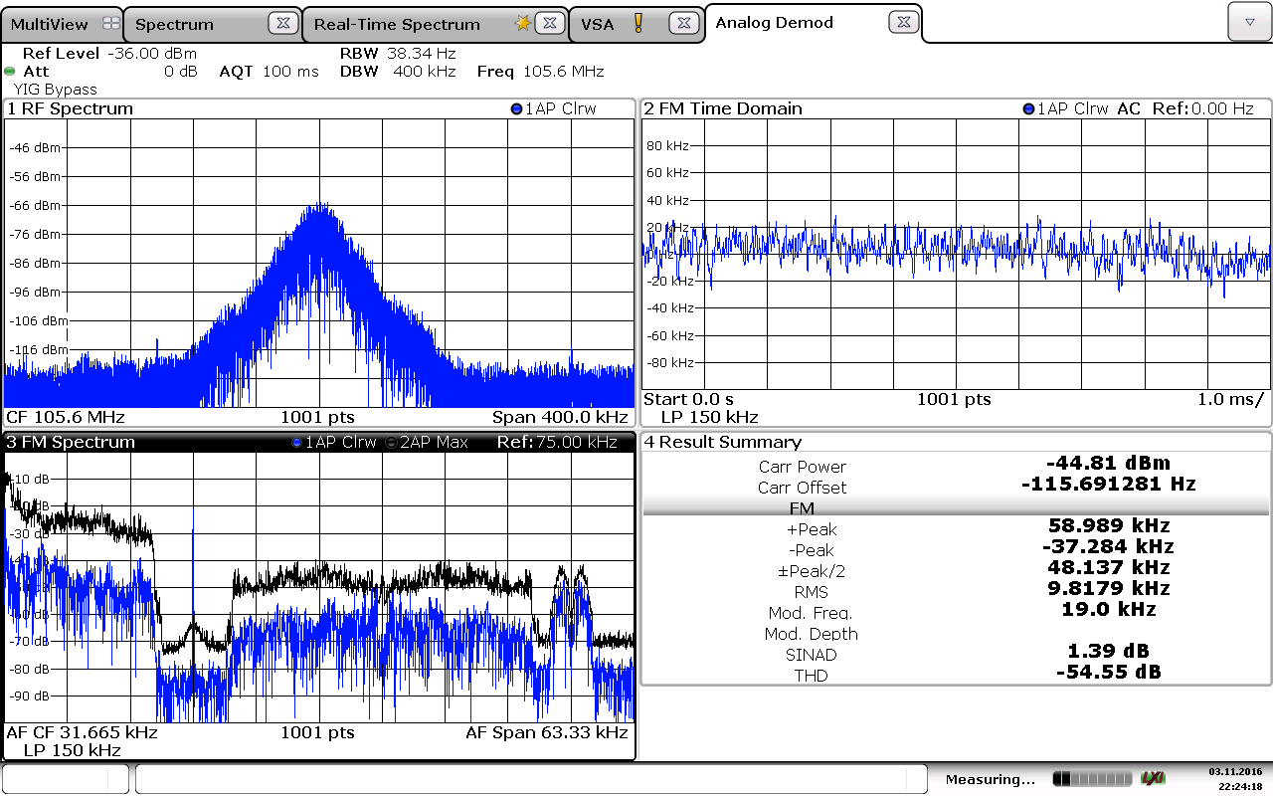
Signal demodulation by s.a.

Slide 22
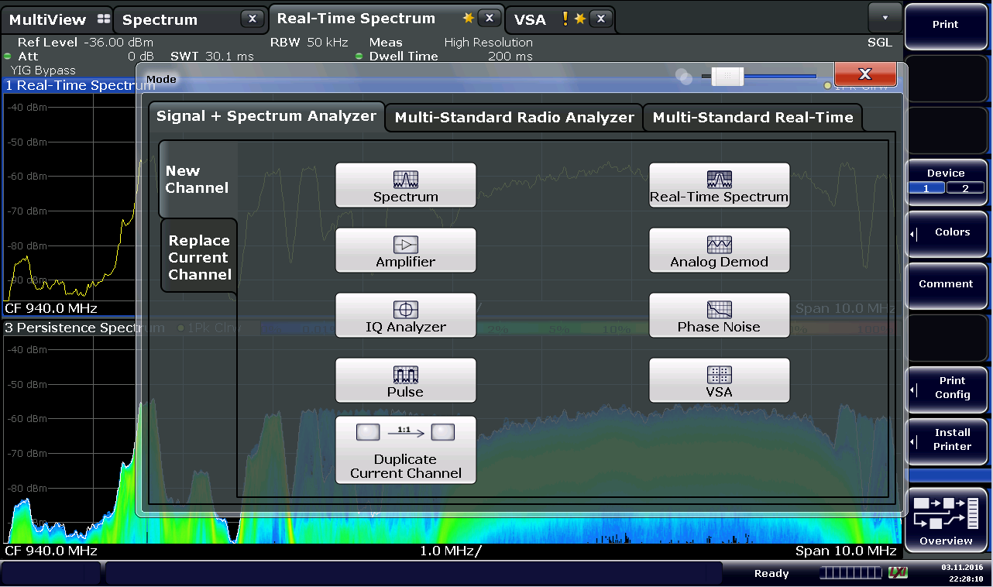
Modern spectrum analysers

Slide 23
Vector network analyser
Vector network analyser is a device, which excites a RF network and measures a response from its ports. All signals are measured as phasors.
If we know RFL and FWD
we can calculate:
VSWR
S-parameters S₁₁, S₁₂
Reflection coefficient Γ
Impedance R+jX
Admitance Y+jB
Input matching
If we know TRN and FWD
we can calculate:
Gain, attenuation
S-parameters S₂₁, S₂₂
Transmission coefficient T
Group delay
Phase shift

Slide 24
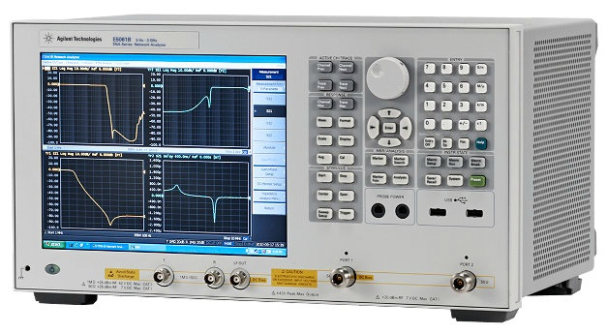
Vector network analyser

Slide 25
Vector network analyser
How does the VNA measure?
  Send signal from port 1 and measure the response at port 1 and port 2

Slide 26
Vector network analyser
How does the VNA measure?
  Send signal from port 1 and measure response at port 1 and port 2
S₁₁=A⁻/R

Slide 27
Vector network analyser
How does the VNA measure?
  Send signal from port 1 and measure response at port 1 and port 2
S₂₁=B⁻/A⁺

Slide 28
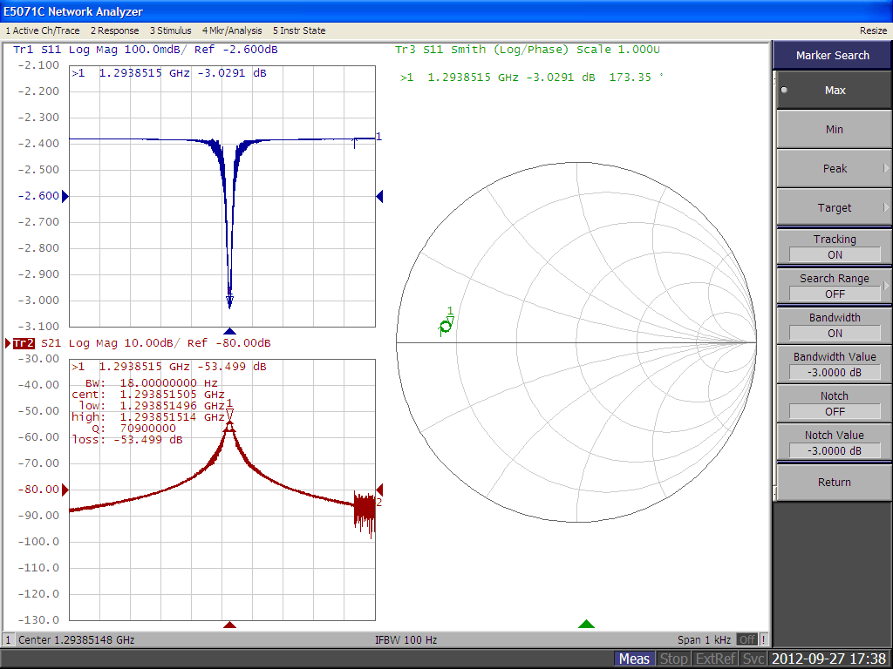
VNA user interface
Menu bar
X Axis, typ. Frequency
Start/stop
Center/span

Slide 29
VNA user interface
Y axis, measured parameter

Slide 30
VNA user interface
Instrument status, calibration, reference etc.

Slide 31
VNA user interface
Calculation of a derived parameter using the measured trace

Slide 32
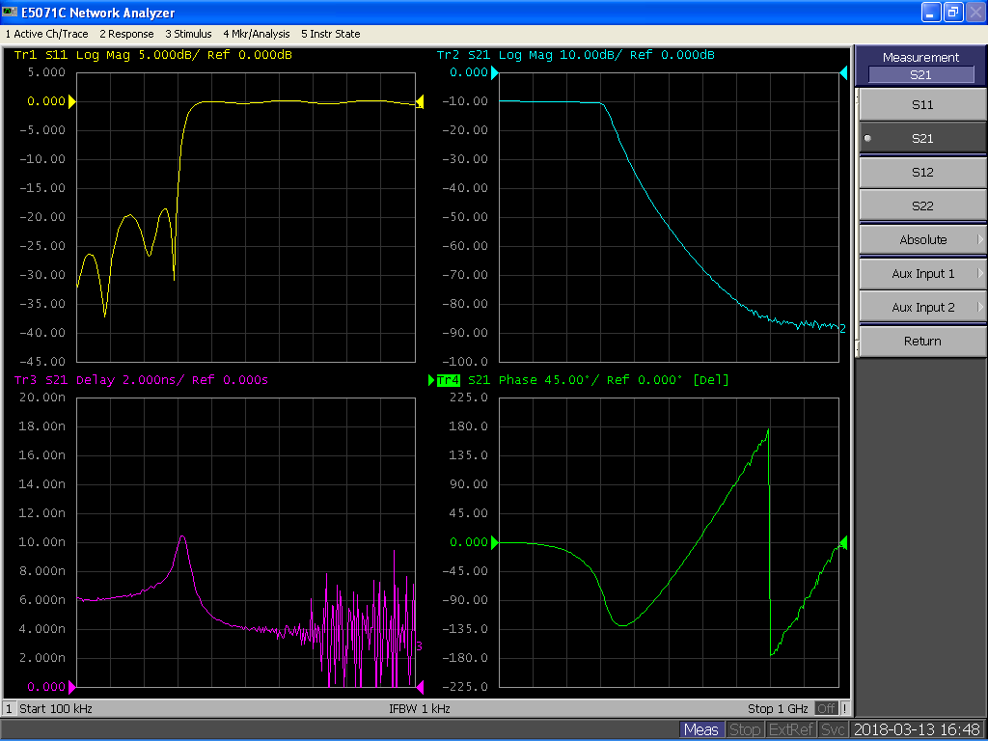
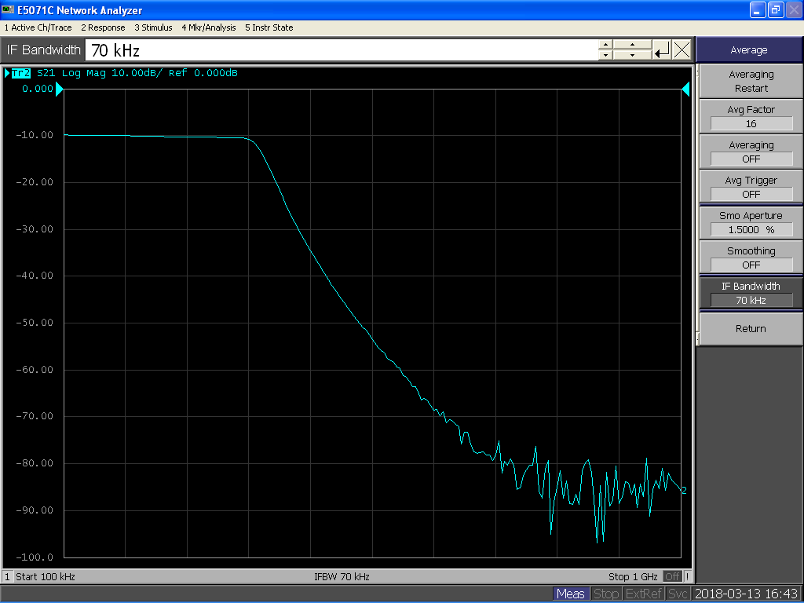
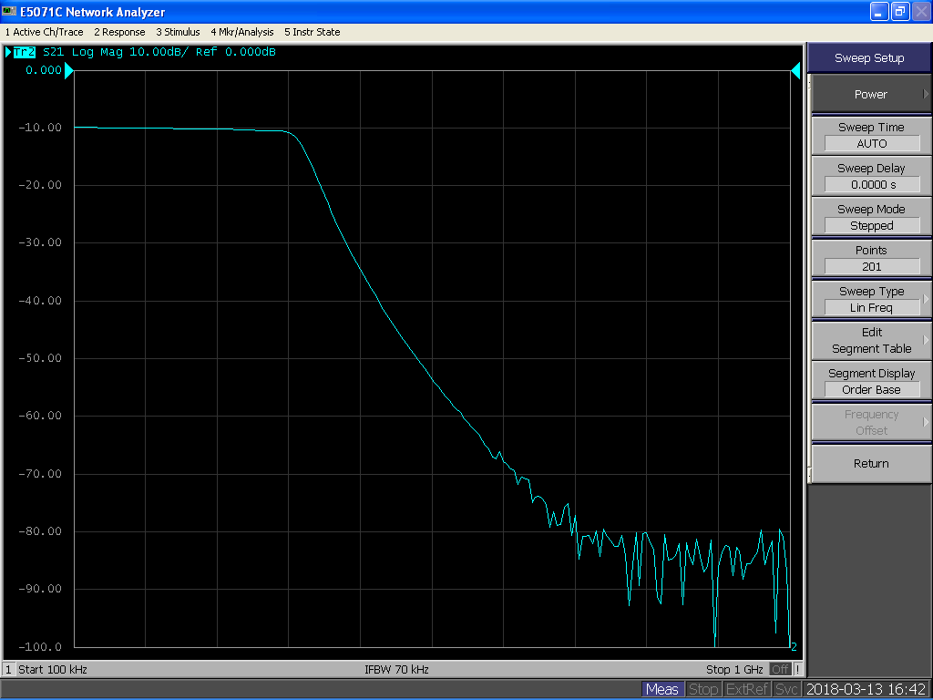
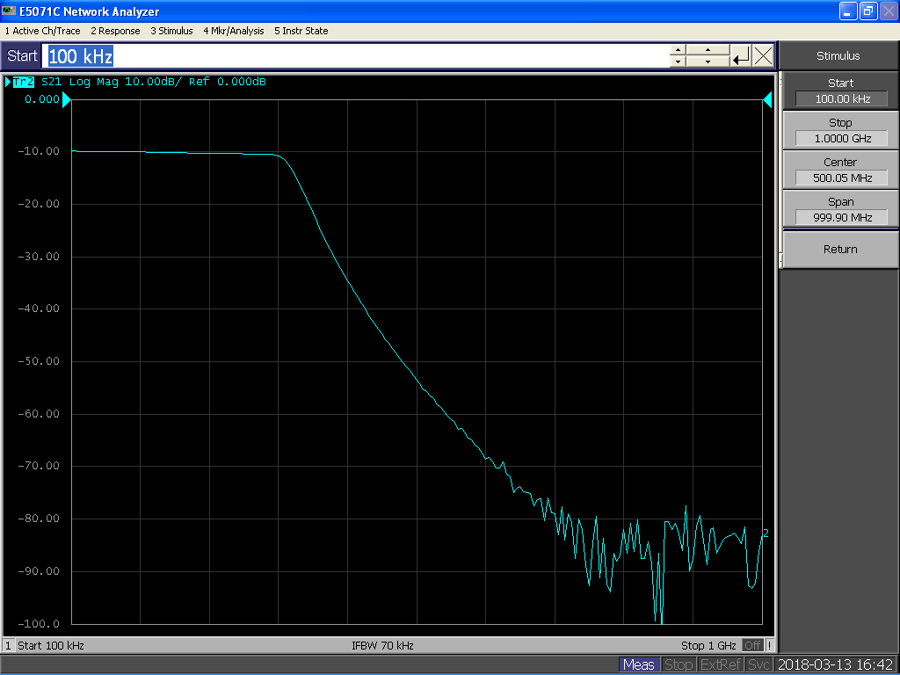
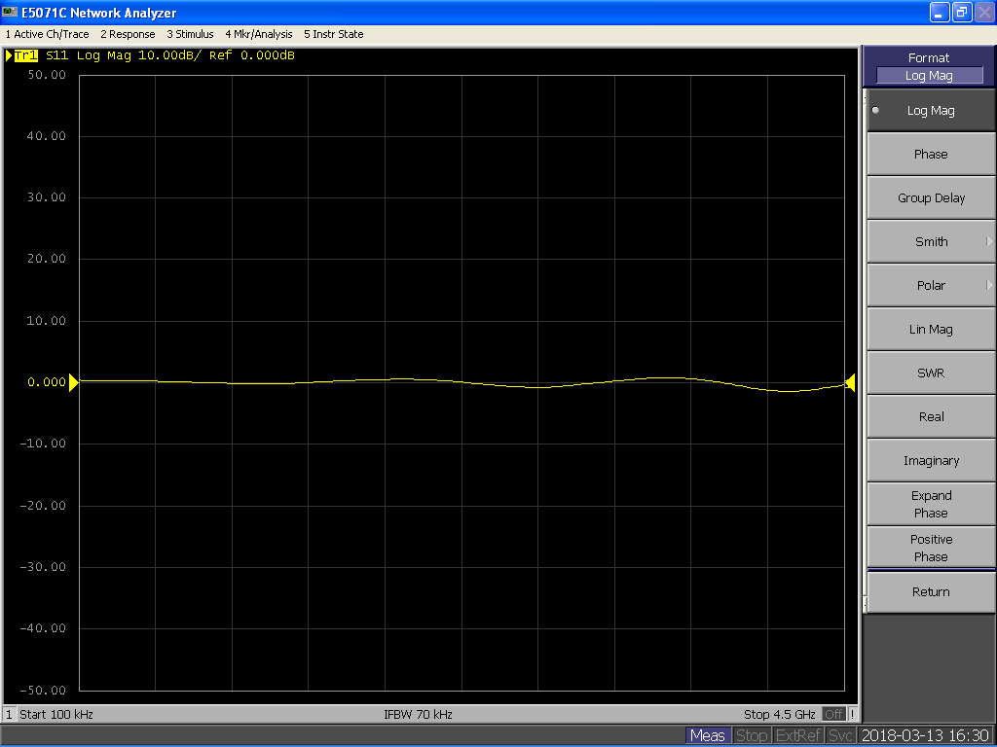
Setting up process…
Super important for high-Q device measurements

Slide 33
Few notes on IF bandwidth
VNA uses a super-heterodyne receivers to measure the RF signals
Same noise handling procedures as for the spectrum analyser apply

Slide 34
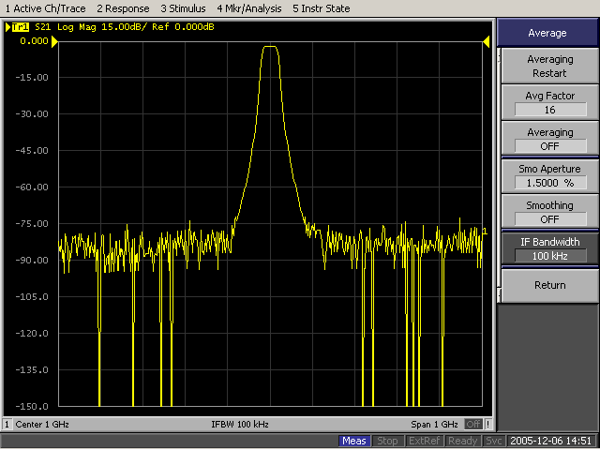
IF (detector) bandwidth
Bandpass filter measurement, fc=1GHz
IF bandwidth 100kHz

Slide 35
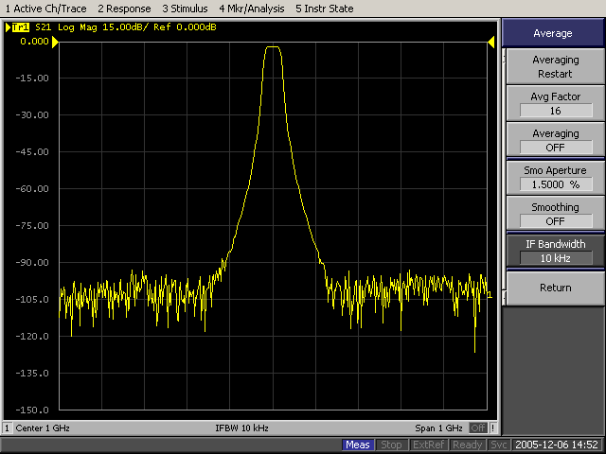
IF (detector) bandwidth
Bandpass filter measurement, fc=1GHz
IF bandwidth 10kHz

Slide 36
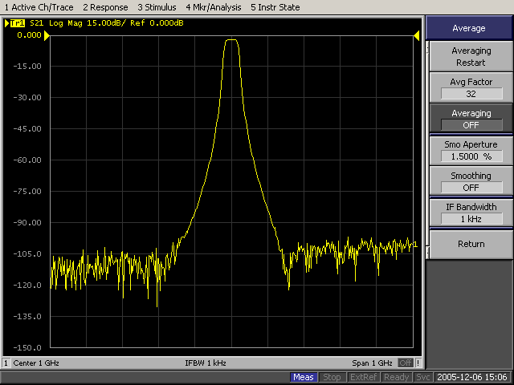
IF (detector) bandwidth
Bandpass filter measurement, fc=1GHz
IF bandwidth 1kHz

Slide 37
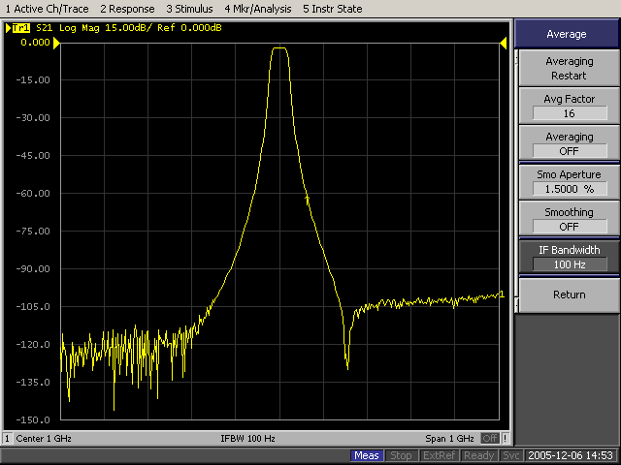
IF (detector) bandwidth
Bandpass filter measurement, fc=1GHz
IF bandwidth 100Hz

Slide 38
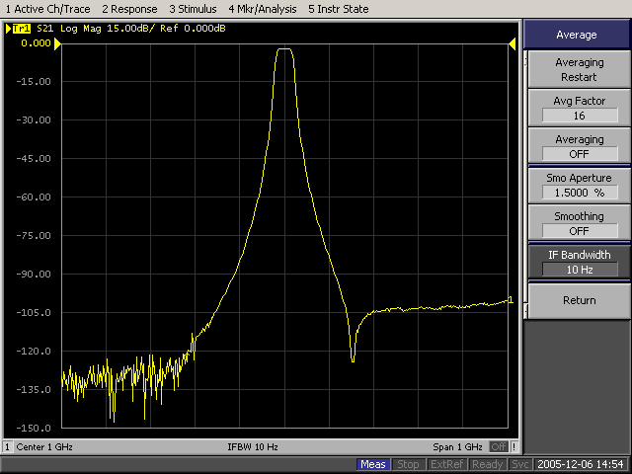
IF (detector) bandwidth
Bandpass filter measurement, fc=1GHz
IF bandwidth 10Hz
Noise floor for IFBW=100kHz
Noise floor for IFBW=10Hz

Slide 39
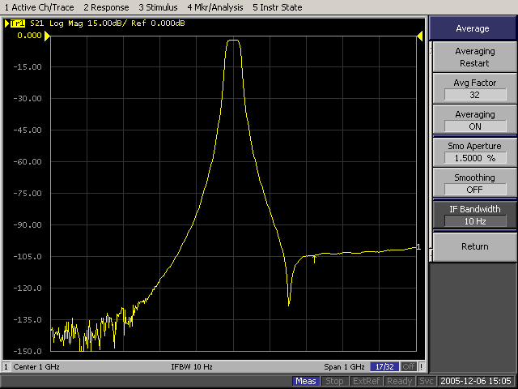
IF (detector) bandwidth
Bandpass filter measurement, fc=1GHz
IF bandwidth 10Hz
Plus averaging

Slide 40
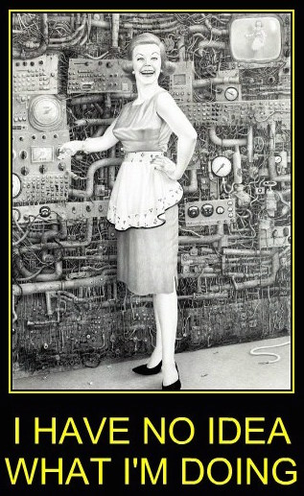
Measurement errors and calibration
The instrument always shows some curves…
…but in 99% cases this is not what you want to measure
verydemotivational.com

Slide 41
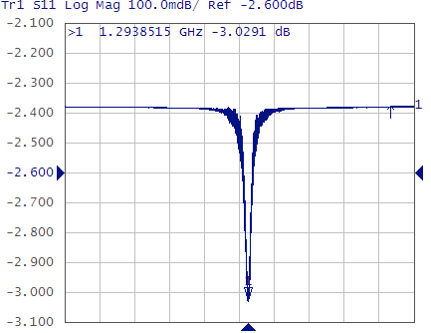
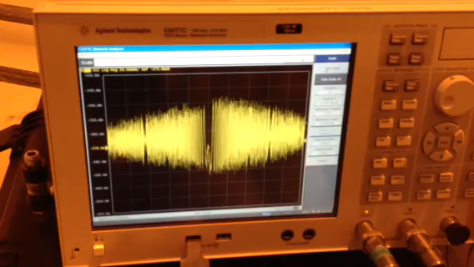
Measurement errors and calibration
“Hello Daniel, this is Nikolai. We are trying to measure the 1.3GHz superconducting cavity but the instrument shows something strange…”

Slide 42
Measurement errors and calibration
We work in the RF domain
The instrument measures our DUT
…but also everything around (cables, connectors, adapters, spurious reflections etc.)
…and the instrument is sensitive to temporal alignment of the signals as well
…finally the instrument also measures himself

Slide 43
Measurement errors and calibration
All networks which connect DUT to the instrument introduce static systematic errors
We can measure them and mathematically de-embed them from the measurement
This process is called Calibration

Slide 44
Measurement errors and calibration
All networks which connect DUT to the instrument introduce static systematic errors
We can measure them and mathematically de-embed them from the measurement
This process is called Calibration

Slide 45
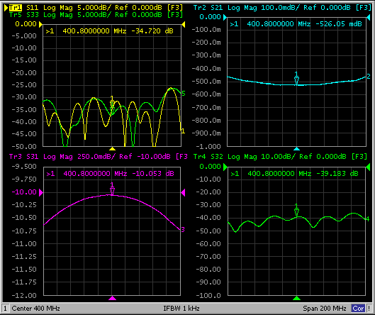
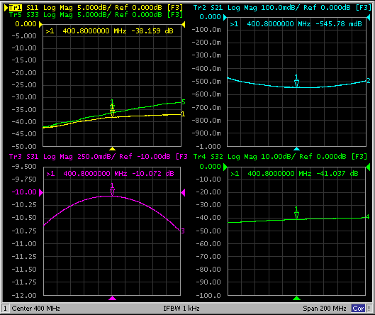
Measurement errors and calibration
Directional coupler measurement without and with full calibration
Without calibration
Full calibration

Slide 46
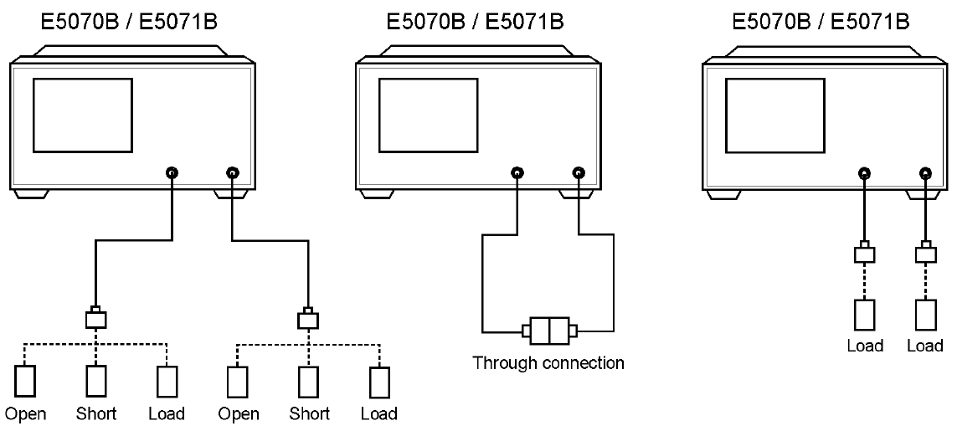
Calibration process
3 standards: Open, Short, Load + Thru

Slide 47
Thank you for your attention
Thank you for your attention
After the break: hands on part

