Slide 1
Executive Coordination Committee
WPx Status
FIRSTNAME LASTNAME
CERN
MONTH DAY, YEAR

Slide 2
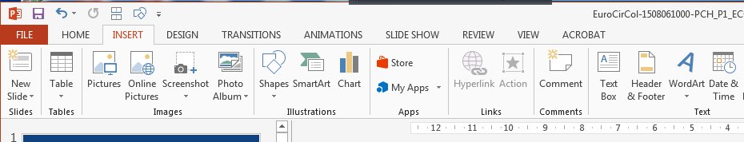
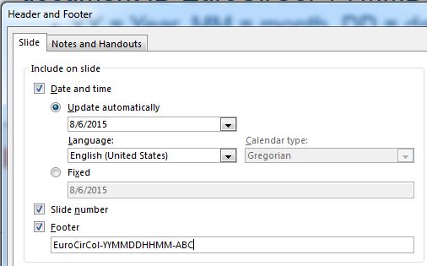
TEMPLATE GUIDELINE
In Powerpoint, go to INSERT -> Header & Footer and edit the document ID EASITrain-YYMMDDHHMM-PPP:
  YY = Year, MM = month, DD = day, HH = hour when you create the slides, MM = minute when you create the slides, ABC = short name of editor (A= 1st letter of first name, B = 2nd letter of last name, C = 3rd letter of last name)
Remove this slide!
Save the document as
EASITrain_YYMMDDHHMM-ABC_Px_ECC_WPy,
where x = reporting period
(now we are in P1),
y = number of your work package

Slide 3

Outline
Work Package Team
Objectives
Description of Work
Deliverables
Milestones
Resources
Coordination Needs
Hiring Plan
Current Work
Next steps (until March 2018)
Showstoppers
Co-funded by the
​The European Circular Energy-Frontier Collider Study (EuroCirCol) project has received funding from the European Union's Horizon 2020 research and innovation programme under grant No 654305. The information herein only reflects the views of its authors and the European Commission is not responsible for any use that may be made of the information.

Slide 4
Work Package Team
Composition of the team for that particular work package at all participating beneficiary and partner sites, potentially also additional cooperation partners from academia and industry. Indicate clearly, which roles remain to be filled and when.
Institute | Name | Role/Description
University of X | John Doe | Leads the microstructure analysis work
University of X | Jane Roe | Sample preparation
Company Y | Pippo | Produces Nb3Sn thin film samples
Centre of Z | Pluto | Simulates material behaviour at cryogenic temperatures

Slide 5
Objectives
Summarise the project goals referring to the Description of Work submitted and the foreseen milestones and deliverables.

Slide 6
Description of Work
Summarise, how the project objectives will be achieved, i.e. what concrete research work is planned in cooperation with beneficiaries and partners.
Show very clearly how the work packages, beneficiaries and partners will work together as one consortium to achieve the objectives.

Slide 7
Deliverables Until M18 (Mid Term)
ID | Title | Due | What to do

Slide 8
Milestones Until M18 (Mid Term)
ID | Title | Due | What to do

Slide 9
Resources
Describe, which personnel and material resources are already in place, which resources need to be put in place to be fully operational.
Resource | Purpose | Date
Resources already in place
Nb3Sn wire samples | For analysis | Since 1.6.2017
Resources to be put in place
Turbocompressor Test stand | Learn how to build suitable compressor for Nelium refrigeration cycle | 1.7.2018

Slide 10
Coordination Needs
Items (technical, resources, schedule) that need to be aligned with other WPs or with work units outside EASITrain (e.g. FCC, EuroCirCol, ARIES or other related projects or organisations)
Complementary work and projects that need to be set up in order to achieve the project objectives (e.g. test-stands, material contracts and shipments)

Slide 11
Hiring Plan
Preferred candidates
Support needs
Planned employment contract starting date
ESR project supervisor
ESR home university for doctoral studies
ESR doctoral supervisor
Doctoral study enrollement plan

Slide 12
Current Work
Brief description of current activities

Slide 13
Next Steps
Item list of activities until next meeting
(March 2018 at CERN)

Slide 14
Showstoppers
Any issues (technical or managerial), which need to be addressed

