Slide 1
Thin films and surfaces treatments in accelerator technology
S. Calatroni / G. Rosaz
On behalf of TE-VSC
9/4/2015

Slide 2
Outline
Surface treatment
Thin film activities – general
SRF Thin films
Visit

Slide 3
Surface Treatment

Slide 4
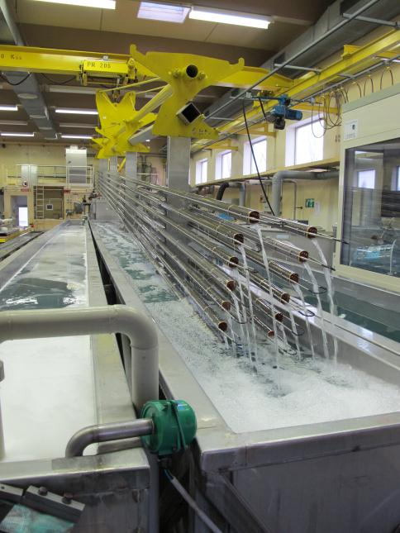
Cleaning UHV components and monitoring cleanliness :
CH₃ asymmetric deform. of Si-CH₃
Si-C stretching and CH3 rocking
Precision cleaning is important to reduce outgassing and achieve UHV (standard up to 7m length)
CH stretching of CH₃
Transmittance [%]
CH₃ symmetric deform. of Si-CH₃
Si-O-Si stretching
FTIR
Through elution with C₆H₁₄
Wavenumber [cm⁻¹]
S.Ilie, C.Petitjean, C.Dias-Soares
Stainless steel 316LN
XPS

Slide 5
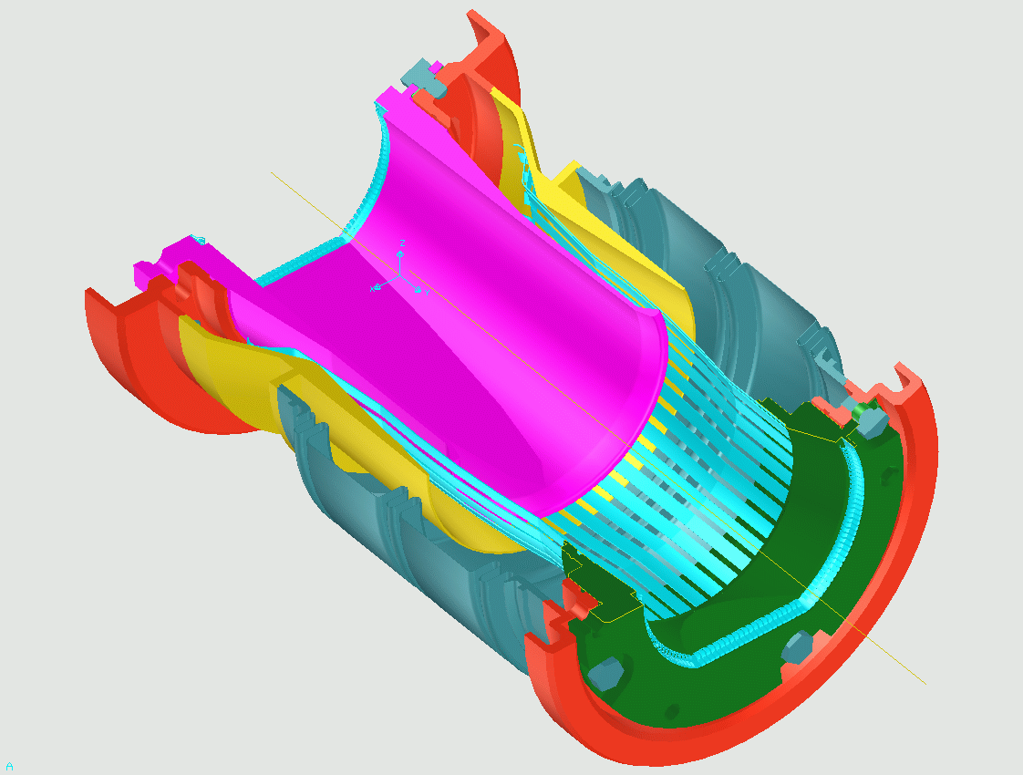
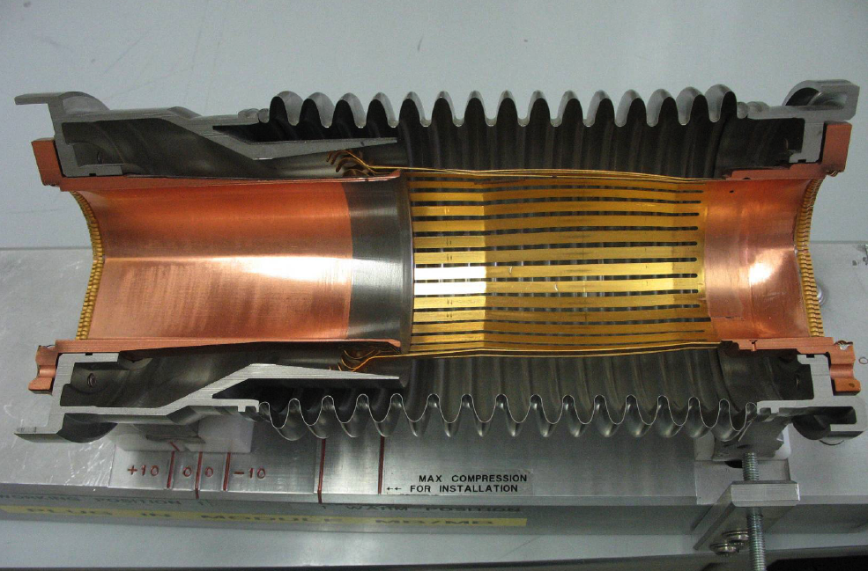
Plug-in Modules with RF Fingers
RF bridge (fingers) to interconnect superconducting magnets (~ 1 700 PIM)
Au/CuBe and Rh/Cu plating: different metals to avoid cold welding under vacuum and soft-on-hard contact to have sufficiently low resistivity (< 0.1 mOhm contact resistance)
Rh
Au
Screw & Spring washer
Upstream flange
Copper transition tube
RF bellows
RF-contact strips
coating 5 μm
Indium brazed
Rhodium coating 3 μm
RF-contact Gold coating 5 μm
Screw & Spring washer
Plug-in module transition tube
RF-contact transition flange
Downstream flange
Courtesy R. Veness
RF-contact strips
coating 5 μm
Indium brazed
Room temperature position
Working position at cryogenic temperature
cooling

Slide 6
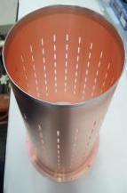
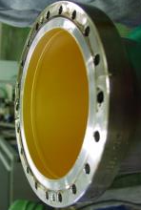
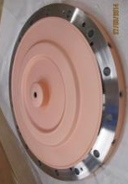
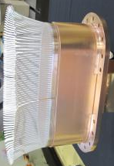
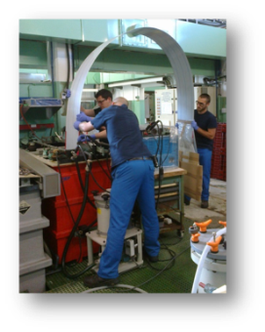
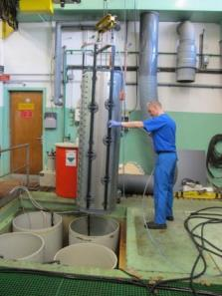
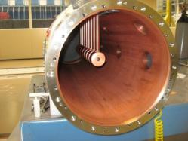
Electrolytic deposition: on stainless steel, copper and aluminum
Gold electroplating
Copper electroplating
Silver electroplating
Rhodium electroplating
LINAC3 test chamber
Cover of DTL LINAC 4
RF fingers TDI shield
RF transition LHCVSR
Ag plating on Al stripline contact AD
Cu plating on DTL tank of Linac 4

Slide 7

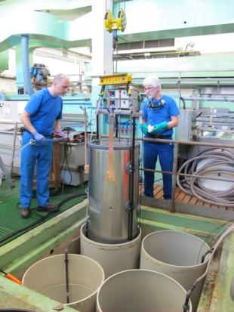
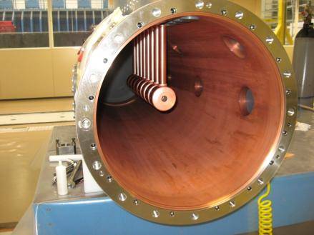
Wet surface treatments: Cu plating of DTL tank of LINAC4
Difficult to obtain uniform plating
and plating in the ports
Final assembly with the electrodes for the accelerator
7

Slide 8
Thin Films for Accelerators

Slide 9
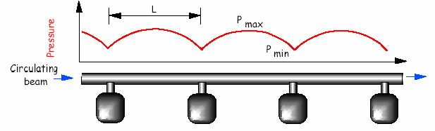
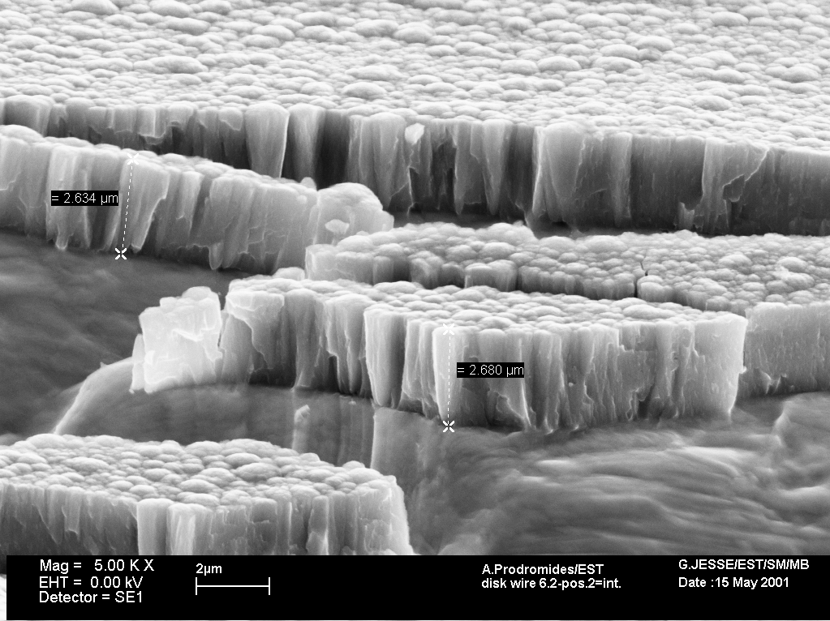
Thin film of Non-Evaporable-Getter as vacuum pump
In accelerators at ultra-high-vacuum (<10⁻¹⁰ mbar) the trend is to bring the pump closer to the outgassing source and distribute the pumping speed evenly.
Pump space hindrance and conductance vs pressure profile!
pump
pump
pump
pump
➔ transform the entire vacuum chamber in a pump by coating it with a getter thin film: ~2μm of TiZrV deposited by DC magnetron; activated with a standard vacuum bake-out at 180°C-230°C (24h), operates at RT
LEP dipole vacuum chamber
Pumps (chemisorption) H₂, CO, CO₂, …..
Does not pump CHx and noble gases
Characterised by XRD, EDX, SEM, XPS…
NEG
coating
Why?...

Slide 10
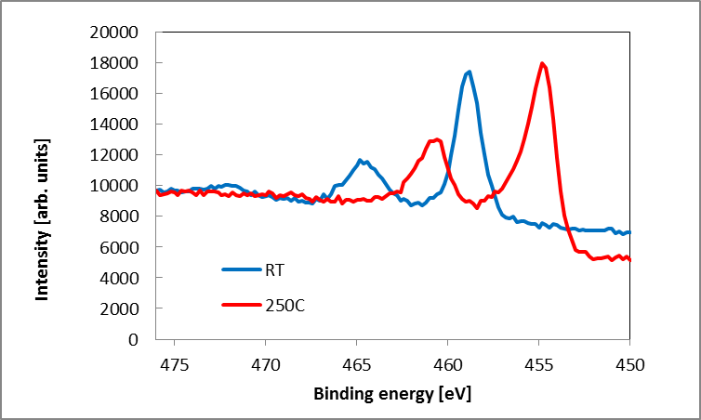
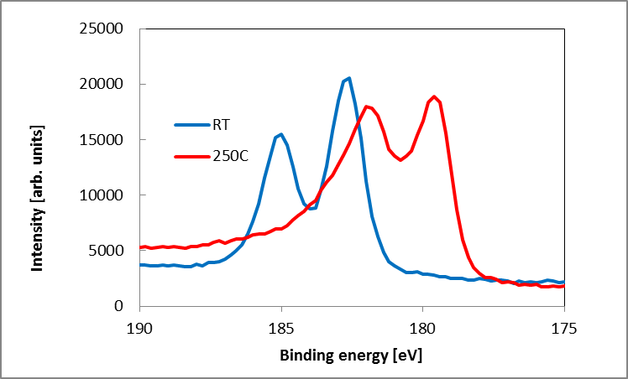
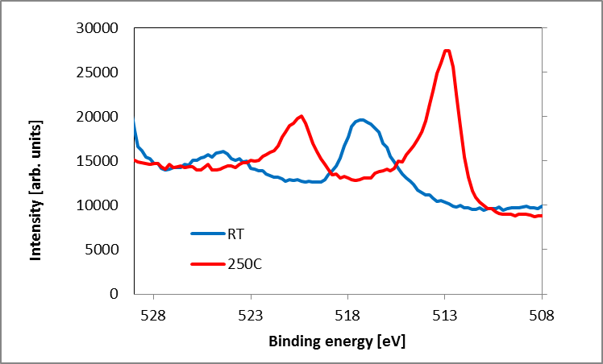
Activation process: Monitoring by surface analysis (XPS)
Ti
ox
Heating stepwise for 1h at each T
met
Diffusion of O into the bulk
Reduction of the surface oxides of all the metals: the surface is metallic and reactive
Zr
met
ox
Surface Oxygen decrease
V
met
ox

Slide 11
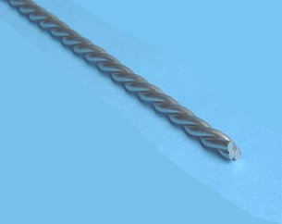
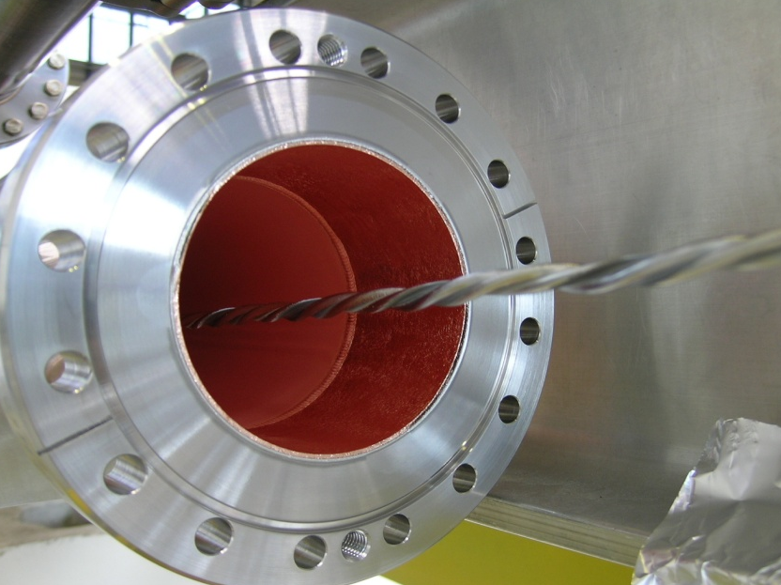
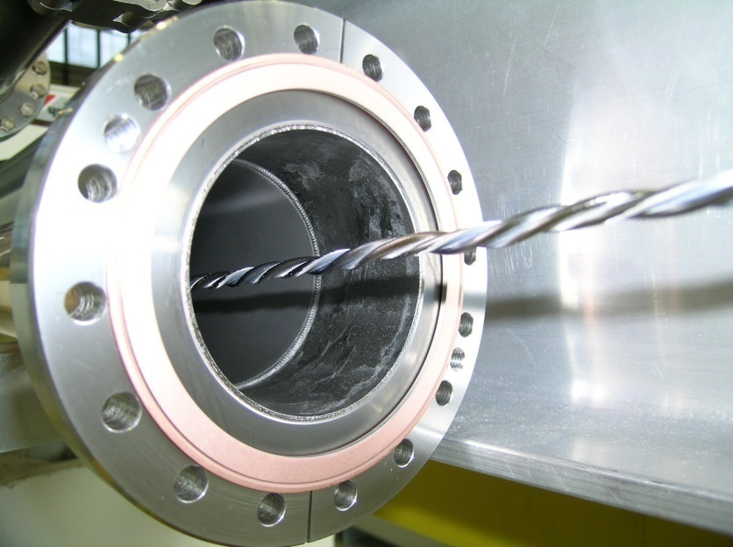
The NEG thin film is obtained by ion bombarding a target
made of inter twisted wires of titanium, zirconium and vanadium. The atoms of the target are then sputtered and deposited on the beam pipe walls.
-U
Ti, Zr, V
beam pipe
wall
Kr⁺
Kr⁺
Kr⁺
Kr⁺
Kr⁺
Kr⁺
Kr⁺
3mm wires of Ti, Zr and V
Kr⁺
Kr⁺
Kr⁺
Kr⁺
B
Before coating
Kr⁺
Kr⁺
after coating
Kr⁺
Kr⁺
Kr⁺
Kr⁺
Kr⁺
Kr⁺
Kr⁺
Kr⁺
Kr⁺
Kr⁺
Kr⁺
Kr⁺

Slide 12
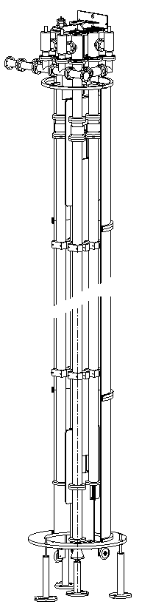
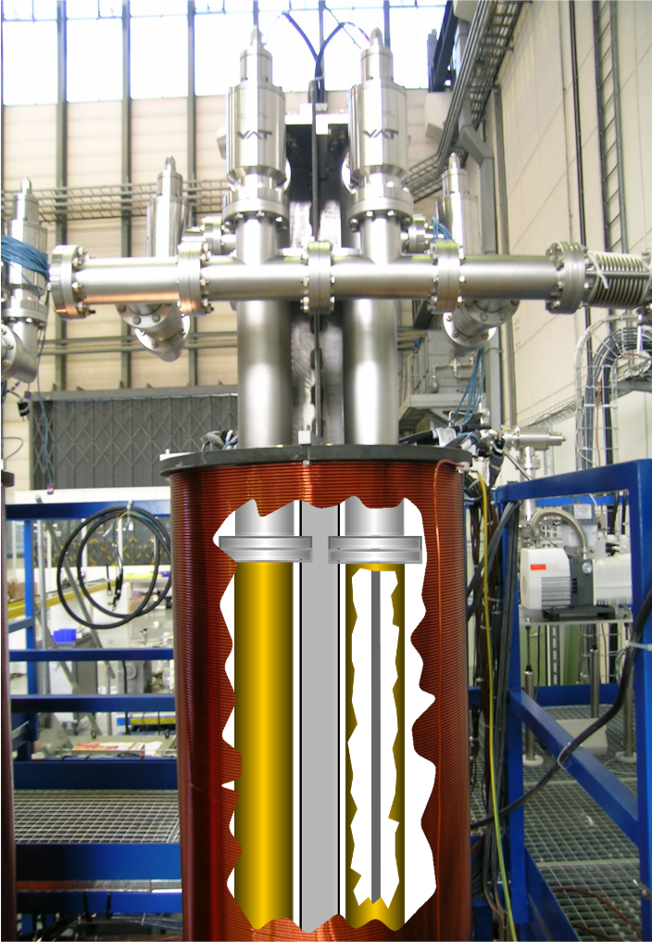
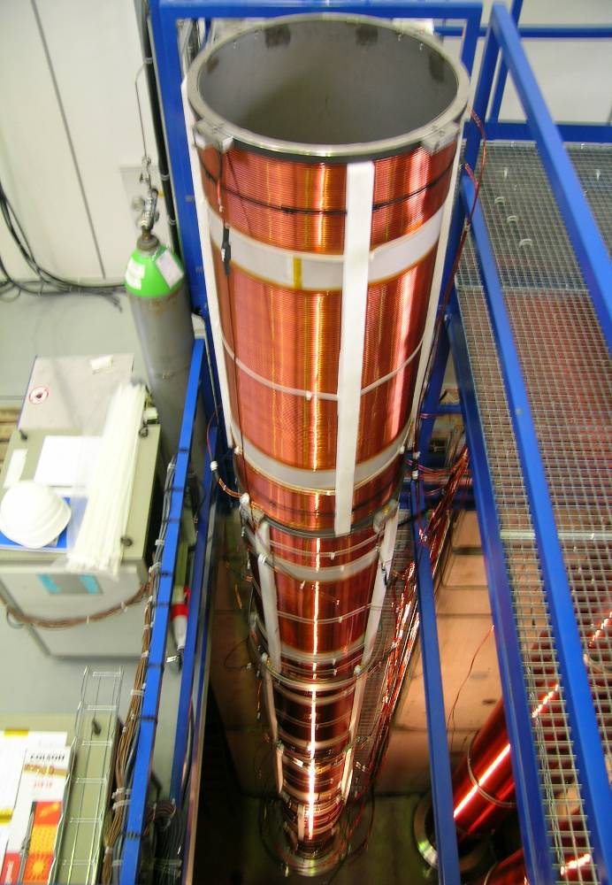
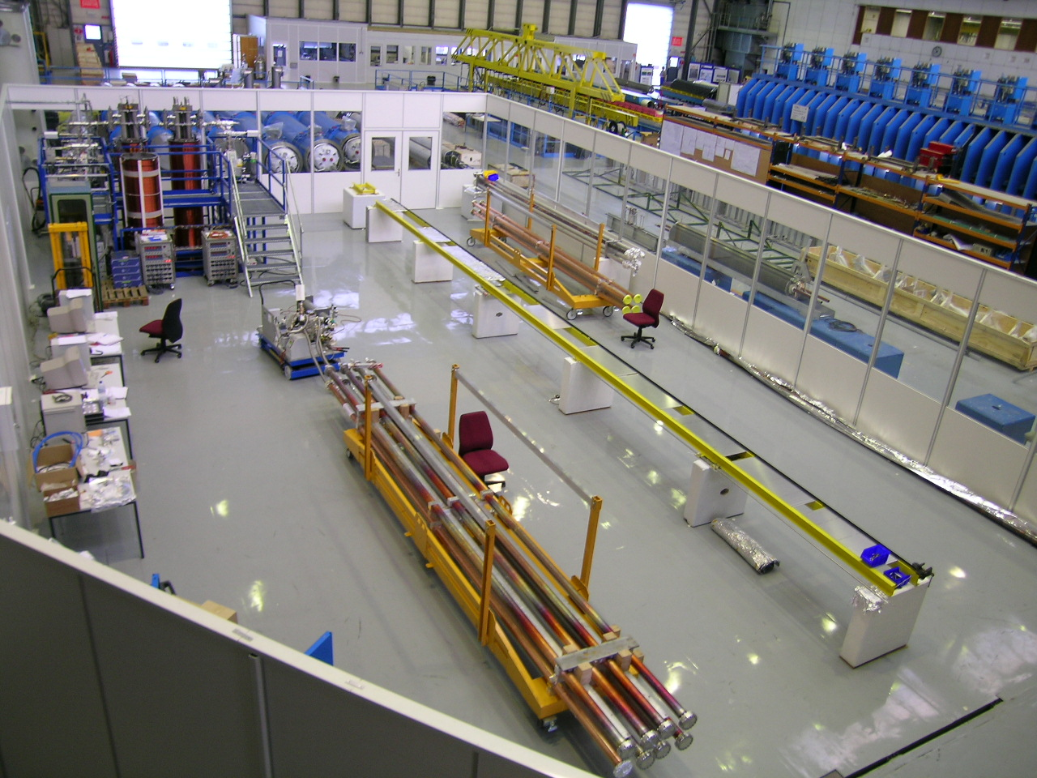
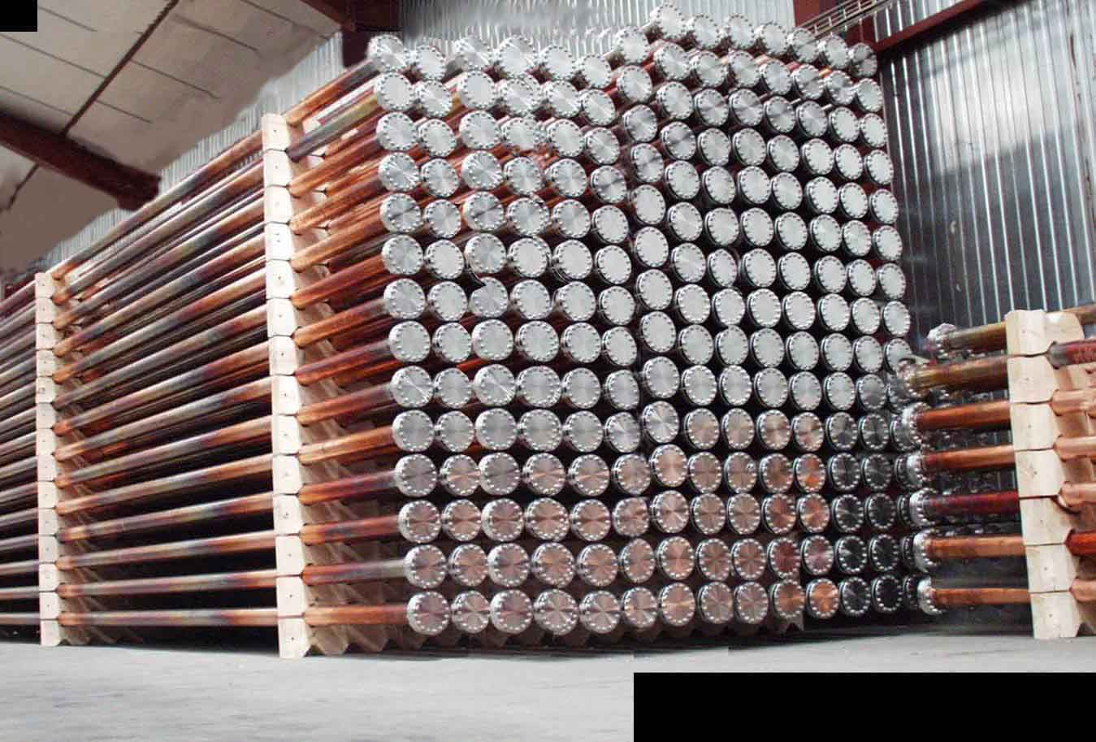
NEG coatings for LHC LSS & experiments
Large scale production for the LHC and experiments by DC Cylinder Magnetron sputtering (DCCM) from a target of Ti, Zr and V wires (more than 1300 chambers)
3mm wires of Ti, Zr and V
8 meter solenoid
Notes:
Appropriate situation with the CERN logotype
Mixture of different logotypes
All of them are circulating
All CERN clubs were also very creatives

Slide 13
Electron cloud and SEY
+
+
+
+
Proton bunch (charge +)
Gas molecule
Electron (charge -)
→ Perturbation of the beam (emittance growth), thermal load on cryogenics, noise on beam instrumentation; the problem is more important for high beam currents (beam potential) and short bunch spacing
To reduce the effect one must reduce the secondary electron yield (SEY) of the walls or attract the generated electrons by other means

Slide 14
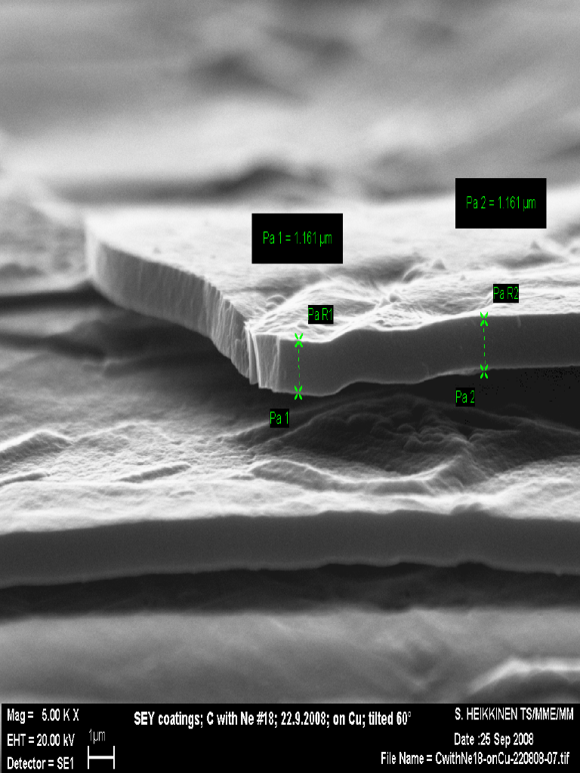
The possible solution : carbon a-C coatings
as received
a-C(Ne9)
Dose below
10⁻⁶ Clb/mm²
-Carbon (graphitic) coating on copper deposited by magnetron sputtering
-SEY does not change for thicknesses above 50 nm
-development started in 2008 for an upgrade of SPS

Slide 15
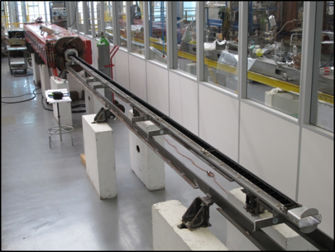
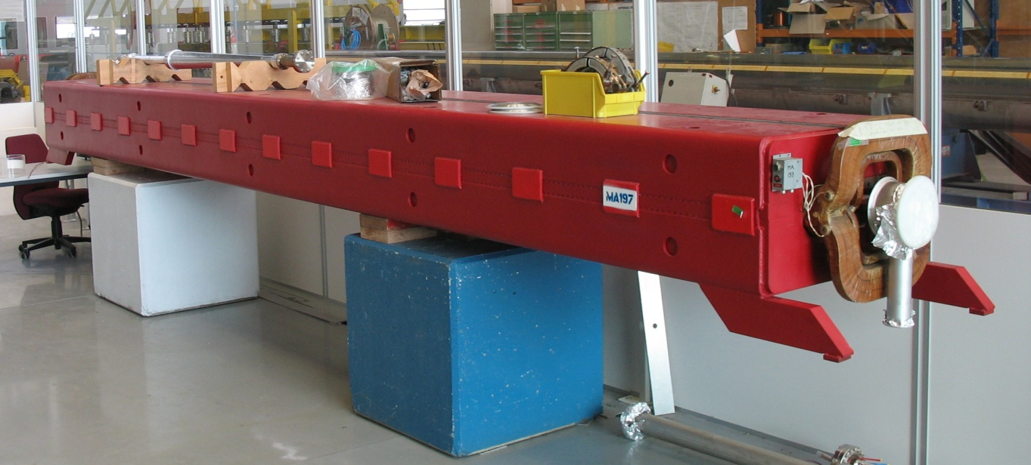
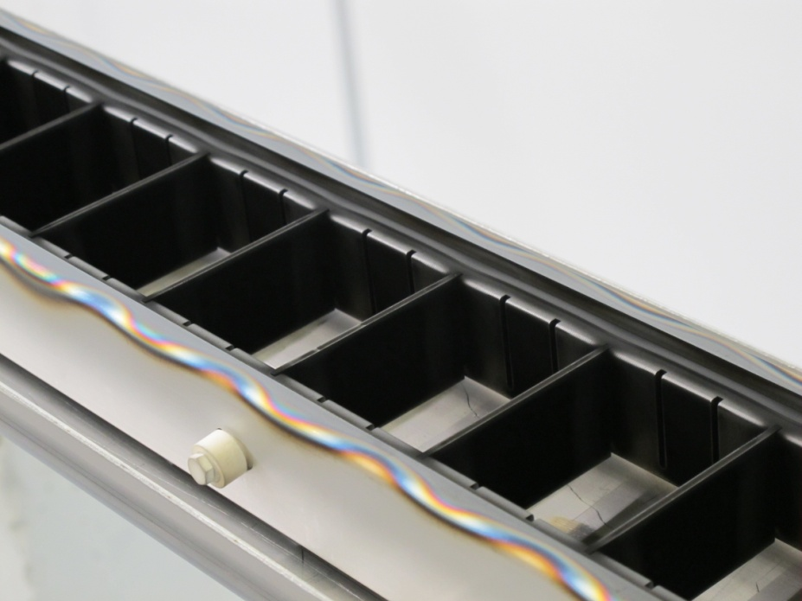
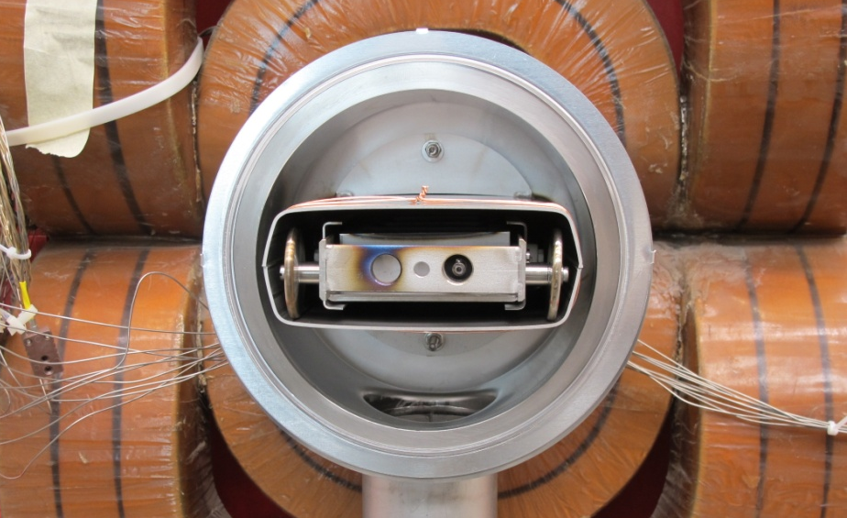
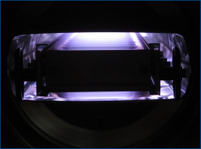
LIU-SPS: Carbon coating of the SPS vacuum chambers
`
Project of coating of the Super Proton Synchrotron dipoles with carbon to mitigate electron cloud (744 dipoles x 6.5 m each, 18 t)
hollow cathode coating (cannot apply axial B-field for magnetron in the yokes)
successful on short section, tested with beam in SPS (section ~200 m)
development ongoing to do the coating in the tunnel in 2018
6.5 m
6.5 meter
Cathode:
graphite targets
(cells)
Cathode in the SPS MBB dipole

Slide 16
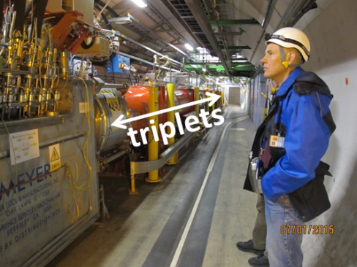
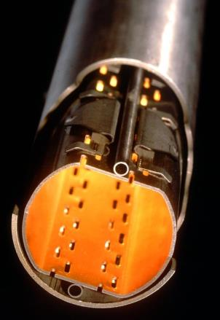
Carbon coating of triplet magnets of LHC in situ during LS2
In order to cope with the thermal load on cryogenics provoked by e-cloud
Close to interaction points
Coating 35 m of beamscreen without dismounting the cryogenic magnets
ARC types, ≥Q7 (c.bore inner diam. 50 mm)
LSS types, Q1–Q6 (cold bore inner diameters 50, 53, 63, 69 and 74 mm)
35 m

Slide 17
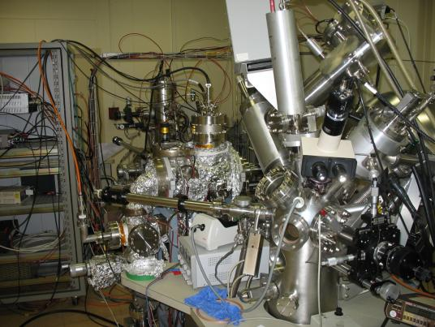
Measurement of SEY
electron gun
I_{p}
A
I_{c}
I_{c}
Sample
I_{s}
A
SEY
measurement
XPS
I_{p} = I_{s} + I_{c}
δ = I_{c} / (I_{s} + I_{c})
Coatings

Slide 18
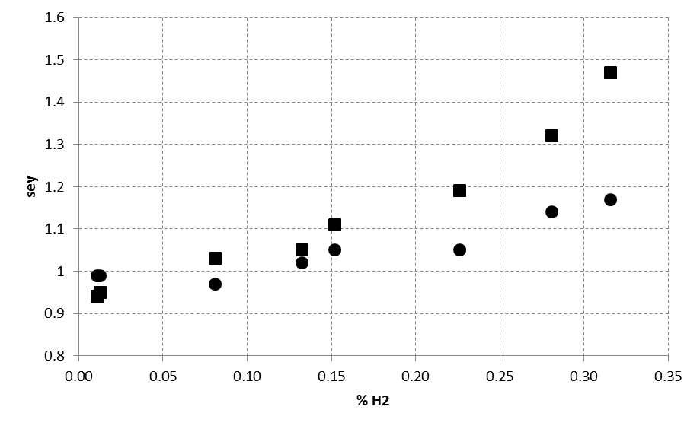
Effect of hydrogen content in the sputtering gas
1.6
1.5
1.4
1.3
1.2
1.1
1.0
0.9
0.8
Effect of hydrogen
SEY
0 0.05 0.10 0.15 0.20 0.25 0.30 0.35
H₂% in Ar gas
Hydrogen is the most important residual gas in a baked vacuum system (outgassing), therefore a special care must be taken to have a «clean» coating system
Remark: it is very difficult to measure the H content in a carbon coating!

Slide 19
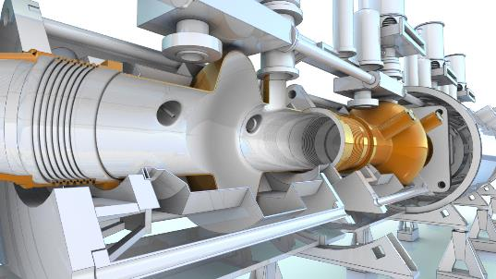
Superconducting Radio Frequency (SRF)
Thin Films activities at CERN

Slide 20
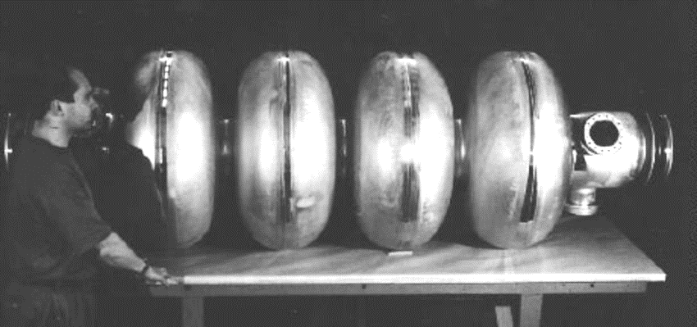
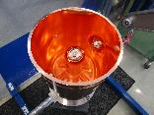
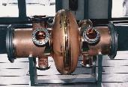
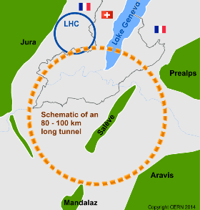
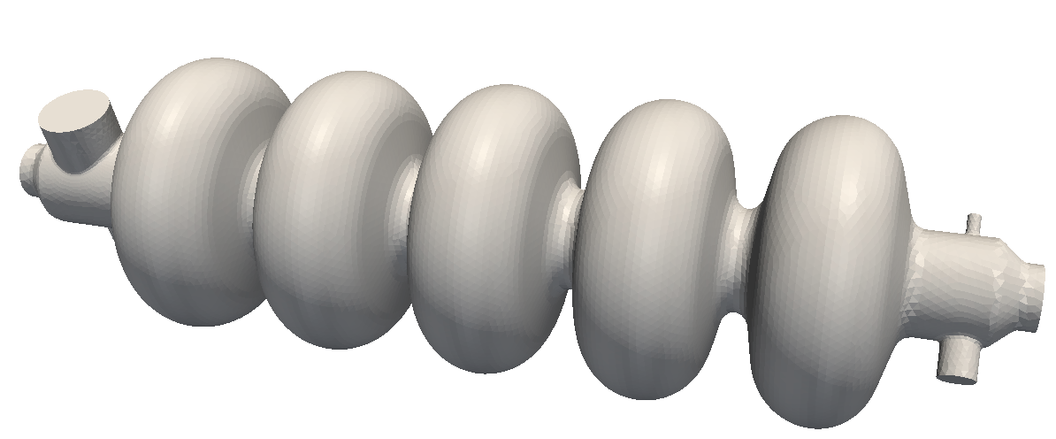
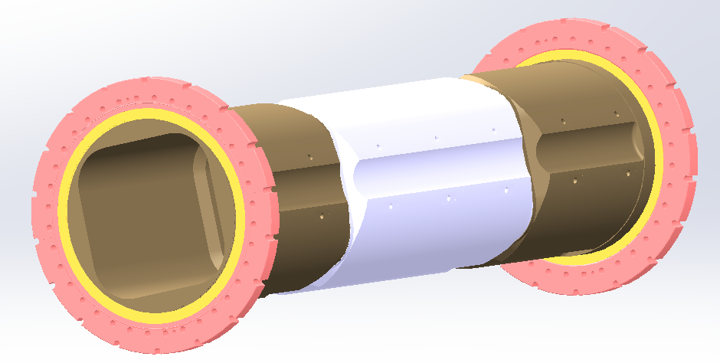
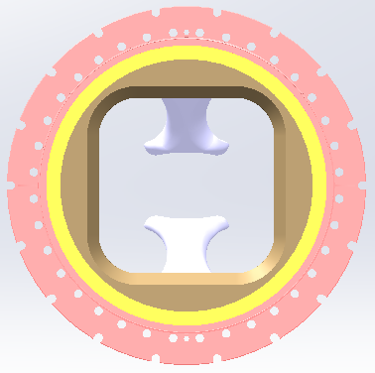
Thin Film SRF at CERN
Thin Film SRF projects at CERN
Past:
x288 Nb/Cu 350 MHz 4-cells cavities for LEP2 (90’s)
x16 Nb/Cu 400 MHz single cell cavities for LHC (2008)
LEP2 4-cells cavity
Current:
x25 Nb/Cu 100 MHz cavities for HIE-ISOLDE
x8 Nb/Cu spare 400 MHz cavities for LHC
HIE-ISOLDE cavity
LHC cavity
Future: FCC (Future Circular Collider) study
  400 MHz elliptical single cell, quantities ~ 300
  400/800 MHz elliptical multi-cells, quantities > 1000
  400 MHz Wide Open Waveguide for “crabbing”
FCC study

Slide 21
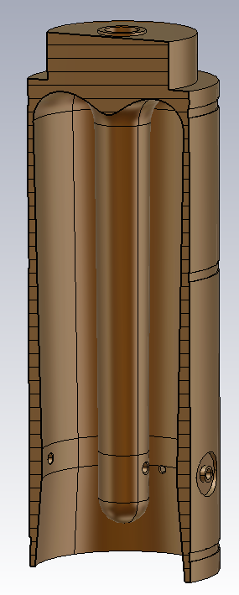
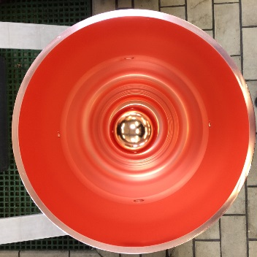
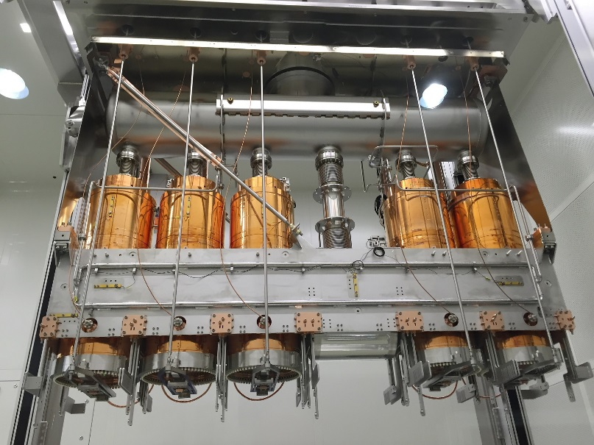
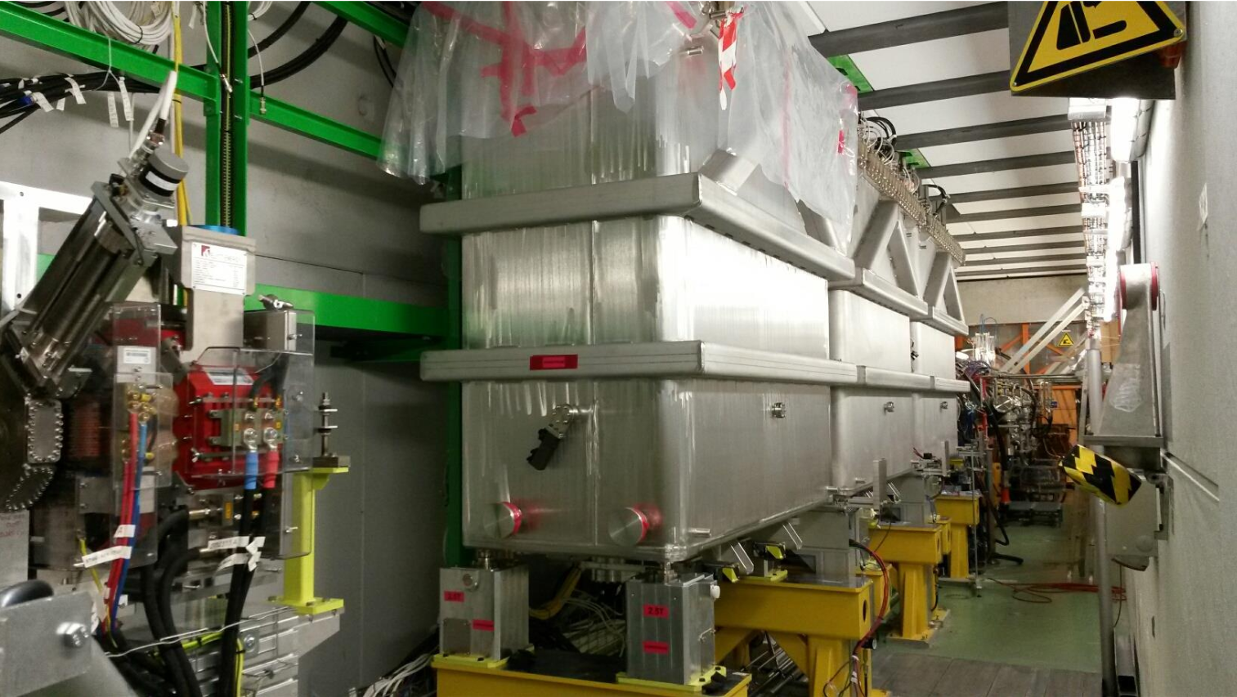
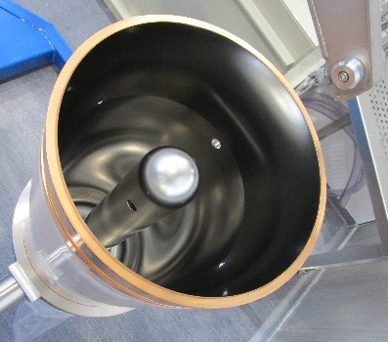
SRF Cavities production
1. HIE-ISOLDE QWR Nb/Cu cavities
Superconducting booster for ISOLDE radioactive ion beam facility at CERN
39 MV needed to reach 10 MeV/u
for A/q = 4.5 (highest possible at ISOLDE)
25 Quarter Wave Resonators cavities
→ cavities production for phase 2 completed,
→ 4th cryomodule under commissioning,
→ + 3 spare cavities produced out of 5
@ 4.5K
950 mm
7 W
10 W
13 W
Frequency | 101.28 MHz
Specification | 6 MV/m @ Q₀ = 4.7x10⁸
First 2 seamless (no weld) cavity coated
→ Best RF performance of all the production!
300 mm
Beam direction

Slide 22
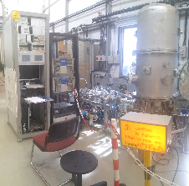
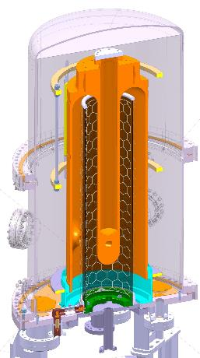
SRF Cavities production
1. HIE-ISOLDE QWR cavities – Nb coating hardware and process
  Cavity in UHV chamber
  (10⁻⁸ mbar base vacuum)
  Cu cavity substrate, biased at -80 V
  Nb cylindrical cathode used on both sides, not cooled
  Anode grids on both sides of cathode, grounded
  → DC-bias diode sputtering, 8 kW, 0.2 mbar Ar
  Cavity bake-out to 650°C (IR lamps) prior to coating
  Coating at high temperature (300 → 620°C)
  15 runs of 25’ each, net coating duration = 6h
  Multi-layers due to coating run/cool-down cycles
  Nb layer thickness ranging from 1.5 μm to 12 μm

Slide 23


SRF Cavities production
2. LHC spare cavities – Nb coating hardware and process
Cathode
  Cavity as UHV chamber
  (10⁻⁸ mbar base vacuum)
  Cavity = anode, grounded
  Nb cylindrical cathodes tubes
  movable electromagnet inside, liquid cooled
  → DC-magnetron sputtering, 6.4 kW, 6.10⁻⁴ mbar Kr
Magnet
  Cavity bake-out (bake-out tent) to 180°C
  Coating 7 steps for the 7 different electromagnet positions
  Duration = 1h 20’ at low temperature (150°C)
  Nb layer thickness ~ 2 μm
Coating apparatus schematic

Slide 24




SRF Cavities production
2. LHC spare Nb/Cu cavities
→ 8 Spare cavities to be manufactured, Nb coated and dressed with He-tank
@ 4.5K
Practice cavities (PC): 3 coatings
PC01 recoated: substrate structural defect
PC05: coated, RF test pending
PC02 recoated:
Cavity at specs (Q₀ = 2.2.10⁹ at 6 MV/m)
Coating recipe and assembly flow validated
Ability to recover a heavily damaged cavity by surface machining
Frequency | 400.8 MHz
Specification | 5 MV/m @ Q₀ = 2x10⁹
1 m
1 m

Slide 25


R&D: HiPIMS coatings for SRF cavities
GOALS AND MOTIVATION
Mitigate the high field Q-slope in Nb/Cu cavity
Low surface resistance (<10 nΩ, 1.3 GHz, 2K) with Nb layer
High Power Impulse Magnetron Sputtering
Layer densification
To this
From this
GOALS AND MOTIVATION
Very encouraging results on 1.3 GHz cavities: 20 nΩ residual resistance
Target: 5 nΩ.
Q-slope among the best for sputtered cavities
Bias effect: lower values induce lower surface resistance
Substrates affected by surface defects → collaboration with Jlab for surface finishing (centrifugal barrel polishing)
Coating on β = 0.65 704 MHz cavities enabled by tuning magnetic configuration : Best candidate to evaluate the Q-slope dependence to layer density
Ions Energy Analysis → bias delayed to mitigate working gas incorporation

Slide 26
R&D: A15 Materials for SRF cavities
GOALS AND MOTIVATION
CHALLENGES
Switch from Nb/Cu to A15/Cu
Higher Tc ,Higher efficiency
Low surface resistance R_{BCS} ~ 0.25 nΩ @ 4.2K / 400MHz (Nb ~ 60 nΩ)
Toward leptonic machine compatible thin film on copper
Synthesize A15 crystalline phase
Obtain theoretical Tc (18.3K for Nb₃Sn) on copper substrate
Manage stress in the film
RESULTS
Substrate plays a major role in the layer final properties
XRD
Best T_{c} obtained on Cu: 16.5K
FCC cubic phase synthesized on Cu
Impact of layer microstrain on superconducting properties
SRF properties to be characterized in 2018

Slide 27



Bulk Nb superconducting cavities: Optimization of the Electropolishing
5-cell cavity
Electrode and current density map
Simulation with smooth electrode (red) and optimized electrode (blue) to get more uniform current and polishing
COMSOL
software

Slide 28


Future Circular Collider Study
Beam Screen Impedance

Slide 29

FCC-hh: pushing the energy frontier
The name of the game of a hadron collider is energy reach
Compared to the LHC:
Factor ~6 in energy → E_{cms} 100 TeV pp
Factor ~3 in radius → ρ_{bending} 100 km
Factor ~2 in field → B_{dipole} 16 T
Factor ~144 in synchrotron radiation power → E⁴ρ⁻²
$$E∝B_{dipole}{×ρ}_{bending}$$

Slide 30


Synchrotron radiation/beam screen
High synchrotron radiation load (SR) of protons @ 50 TeV:
~30 W/m/beam (@16 T)
5 MW total in arcs (LHC <0.2W/m)
New type of ante-chamber
absorption of synchrotron radiation
avoids photo-electrons, helps vacuum
Taking into account vacuum requirements, overall cryogenic efficiency and power consumption of the accelerator, the synchrotron radiation has to be absorbed at 50 K
Copper coating for impedance as in the LHC…
…might not be good enough for the FCC-hh
Courtesy: C. Garion

Slide 31
Impedance basics
Image charges flow on the surface of the beampipe and produce wakefields
The wakefields potential is proportional to surface impedance
Power dissipation from wakes is where is a summation of over the bunch frequency spectrum
Wakefields have an effect on beam stability, in particular the transverse plane: the Transverse Coupled-Bunch Instability (TCBI)
Risetime of resistive-wall instability depends on the surface impedance
with at the frequency of the unstable mode
Transverse mode-coupled impedance (TMCI) limits the maximum
bunch intensity, also linked to the surface impedance

Slide 32


HTS films requirements for beam screen
Bunches of 10¹¹ protons, 8 cm long
Beam instantaneous image current
Frequency spectrum for various bunch shapes
Beam screen of ~30mm diameter.
Assuming a film thickness / skin depth of 1 µm the HTS material should have a critical current density
Jc of about 25 kA/cm² (2.5x10⁸ A/m²) at 50 K and 16T

Slide 33

Material choices
Data from:
Nature 414, 368-377 (15 November 2001)
High-Tc superconducting materials for electric power applications
David Larbalestier, Alex Gurevich, D. Matthew Feldmann & Anatoly Polyanskii
Superconductor Science and Technology, Volume 11, Number 8
Synthesis and properties of fluorine-doped Tl(1223): bulk materials and Ag-sheathed tapes
E Bellingeri, R E Gladyshevskii, F Marti, M Dhallé and R Flükiger
Courtesy: E. Bellingeri

Slide 34
Challenges for HTS coatings
YBCO and Tl-based HTS are the only possible candidates
How to obtain good quality HTS inside tube geometry
  Considerable experience exists in coated tape production for YBCO, scalability to tubes is extremely challenging: develop forming techniques.
  Tl-based HTS has characteristics similar to YBCO, and should allow full scalability to tubes thanks to electrodeposition on silver (coated) substrates: develop this (old) new material

Slide 35
Surface impedance basics
The surface impedance depends strongly on the depinning frequency

Slide 36


HTS films projected performance:
YBCO relative to Cu at 50 K and 16 T
Surface resistance of superconductors in the presence of a dc magnetic field: frequency and field intensity limits, S. Calatroni and R. Vaglio
IEEE Trans. Appl. Supercond. 27-5 (2017) 3500506

Slide 37

HTS films projected performance:
Tl-1223 relative to Cu at 50 K and 1.06 T / 16 T
Thallium-based high-temperature superconductors for beam impedance mitigation in the Future Circular Collider, Calatroni, S.; Bellingeri, E.; Ferdeghini, C.; Putti, M.; Vaglio, R.; Baumgartner, T.; Eisterer, M.,
Superconductor Science and Technology, Volume 30, Issue 7, article id. 075002 (2017).

Slide 38
Re(Z) [Ohm/m]

Slide 39
Im(Z) [Ohm/m]

Slide 40
THANK YOU!

