Slide 1


Future Circular Collider Study - Status
Michael Benedikt
gratefully acknowledging input from FCC coordination group global design study team and all other contributors
LHC
PS
FCC
SPS
http://cern.ch/fcc
Work supported by the European Commission under the HORIZON 2020 project EuroCirCol, grant agreement 654305

Slide 2

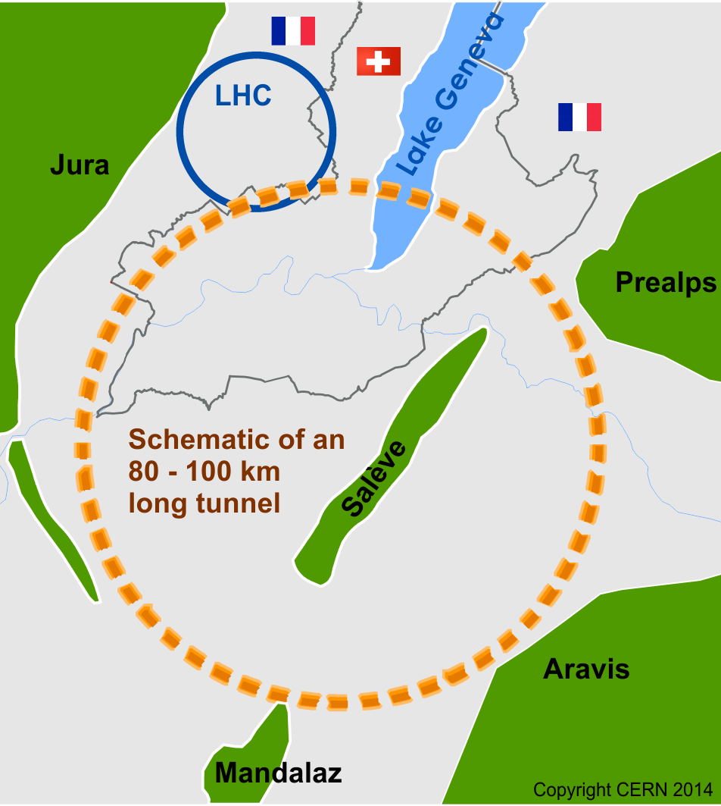
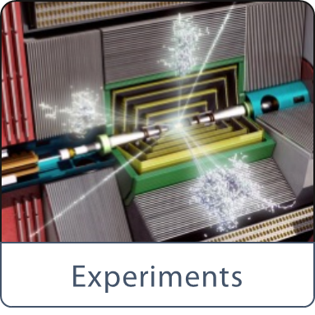

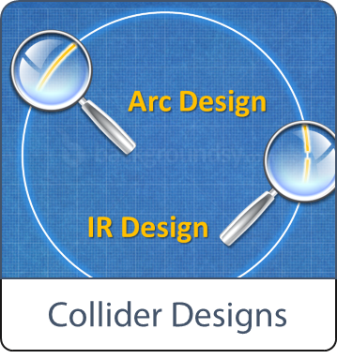
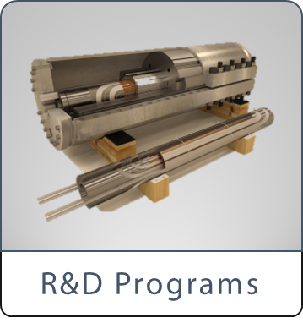


Scope of FCC Study
International FCC collaboration (CERN as host lab) to study:
pp-collider (FCC-hh) → main emphasis, defining infrastructure requirements
~100 km tunnel infrastructure in Geneva area, site specific
e⁺e⁻ collider (FCC-ee), as potential first step
HE-LHC with FCC-hh technology
p-e (FCC-he) option, integration of one IP, e from ERL
CDR for end 2018
~16 T ⇒ 100 TeV pp in 100 km

Slide 3
CERN Circular Colliders & FCC
1980
1985
1990
1995
2000
2005
2010
2015
2020
2025
2030
2035
2040
Constr.
Physics
LEP
Design
Proto
Construction
Physics
LHC – operation run 2
HL-LHC - ongoing project
Design
Construction
Physics
~20 years
FCC – design study
Design
Proto
Construction
Physics
Must advance fast to be ready with new research infrastructure for ~ 2040
Goal of phase 1: CDR by end 2018 for next update of European Strategy

Slide 4
FCC-pp collider parameters
parameter | FCC-hh |  |  | HE-LHC | HL-LHC | LHC
collision energy cms [TeV] | 100 |  |  | 27 | 14 | 14
dipole field [T] | 16 |  |  | 16 | 8.33 | 8.33
circumference [km] | 97.75 |  |  | 26.7 | 26.7 | 26.7
beam current [A] | 0.5 |  |  | 1.12 | 1.12 | 0.58
bunch intensity [10¹¹] | 1 |  | 1 (0.2) | 2.2 (0.44) | 2.2 | 1.15
bunch spacing [ns] | 25 |  | 25 (5) | 25 (5) | 25 | 25
synchr. rad. power / ring [kW] | 2400 |  |  | 101 | 7.3 | 3.6
SR power / length [W/m/ap.] | 28.4 |  |  | 4.6 | 0.33 | 0.17
long. emit. damping time [h] | 0.54 |  |  | 1.8 | 12.9 | 12.9
beta* [m] | 1.1 | 0.3 |  | 0.25 | 0.20 | 0.55
normalized emittance [μm] | 2.2 (0.4) |  |  | 2.5 (0.5) | 2.5 | 3.75
peak luminosity [10³⁴ cm⁻²s⁻¹] | 5 |  | 30 | 25 | 5 | 1
events/bunch crossing | 170 |  | 1k (200) | ~800 (160) | 135 | 27
stored energy/beam [GJ] | 8.4 |  |  | 1.3 | 0.7 | 0.36

Slide 5
FCC-ee collider parameters
parameter | Z | W | H (ZH) | ttbar
cm collision energy [GeV] | 91 | 160 | 240 | 350
beam current [mA] | 1400 | 147 | 29 | 6.4
no. bunches | 71000 | 7500 | 740 | 62
bunch intensity [10¹¹] | 0.4 | 0.4 | 0.8 | 2.1
bunch spacing [ns] | 2.5 / 5.0 | 40 | 400 | 5000
SR energy loss / turn [GeV] | 0.036 | 0.34 | 1.71 | 7.72
total RF voltage [GV] | 0.25 | 0.8 | 3.0 | 9.5
long. damping time [turns] | 1280 | 235 | 70 | 23
horizontal beta* [m] | 0.15 | 1 | 1 | 1
vertical beta* [mm] | 1 | 2 | 2 | 2
horiz. geometric emittance [nm] | 0.27 | 0.26 | 0.61 | 1.33
vert. geom. emittance [pm] | 1.0 | 1.0 | 1.2 | 2.66
bunch length with SR & BS [mm] | 4.1 | 2.3 | 2.2 | 2.9
luminosity [10³⁴ cm⁻²s⁻¹] | 130 | 16 | 5 | 1.4

Slide 6
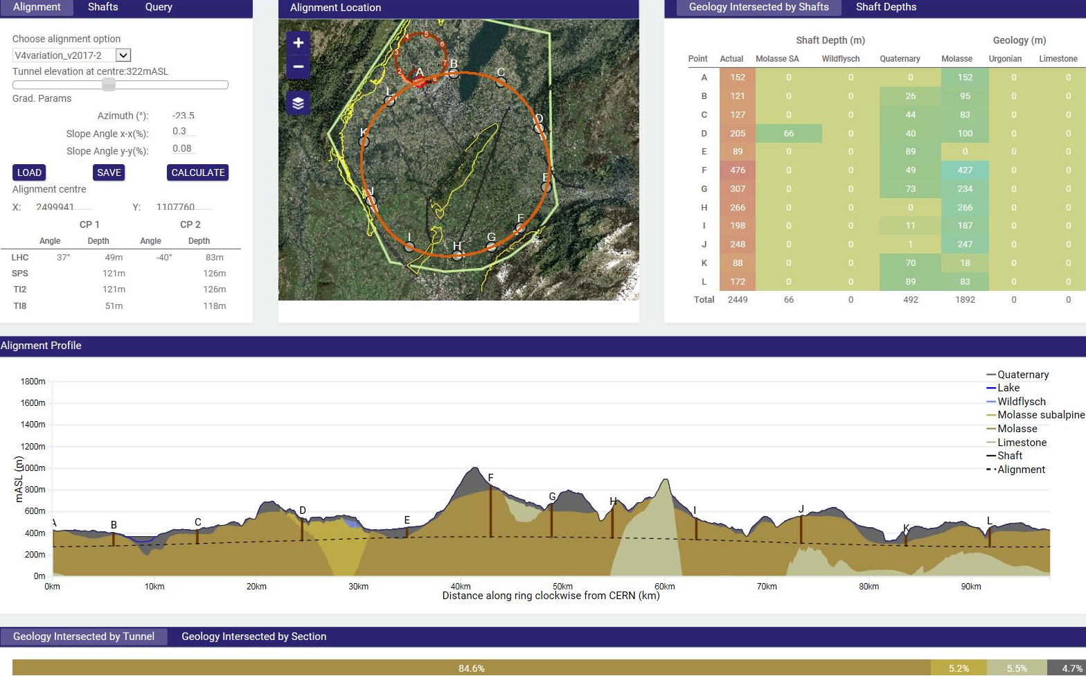
Implementation - new footprint baseline
Optimisation criteria
tunneling rock type,
shaft depth accessibility
surface points, etc.
Tunneling
Molasse 90%, Limestone 5%, Moraines 5%
Present status on implementation
90-100 km fits well geological situation in Geneva basin
LHC suitable as potential injector

Slide 7
FCC-hh layout and optics
Two high-luminosity experiments (A & G)
Two other experiments combined with injection (L & B)
Two collimation insertions
  Betatron cleaning (J)
  Momentum cleaning (F)
Extraction insertion (D)
Clean insertion for RF only (H)
Compatible with LHC or SPS as injector
Full integrated lattice existing
Beam dynimcs studies confirm design goals
Focus on optimization of collimation system and extraction system performances
Based on EuroCirCol DS
Contributions from EPFL

Slide 8
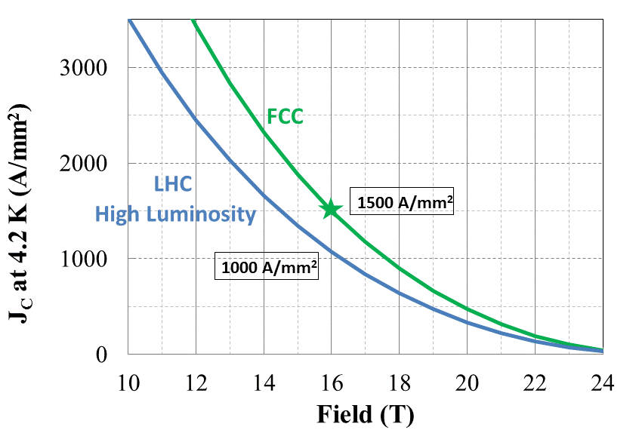
Nb₃Sn conductor program
Nb₃Sn is one of the major cost & performance factors for FCC-hh / HE LHC
Main development goals until 2020:
J_{c} increase (16T, 4.2K) > 1500 A/mm² i.e. 50% increase wrt HL-LHC wire
R&D collaborations with TU Wien and Uni Geneva (amongst others)
Impact on coil section and conductor mass
5400 mm²
3150 mm²
~1.7 times less SC
~10% margin
HL-LHC
~10% margin
FCC ultimate

Slide 9
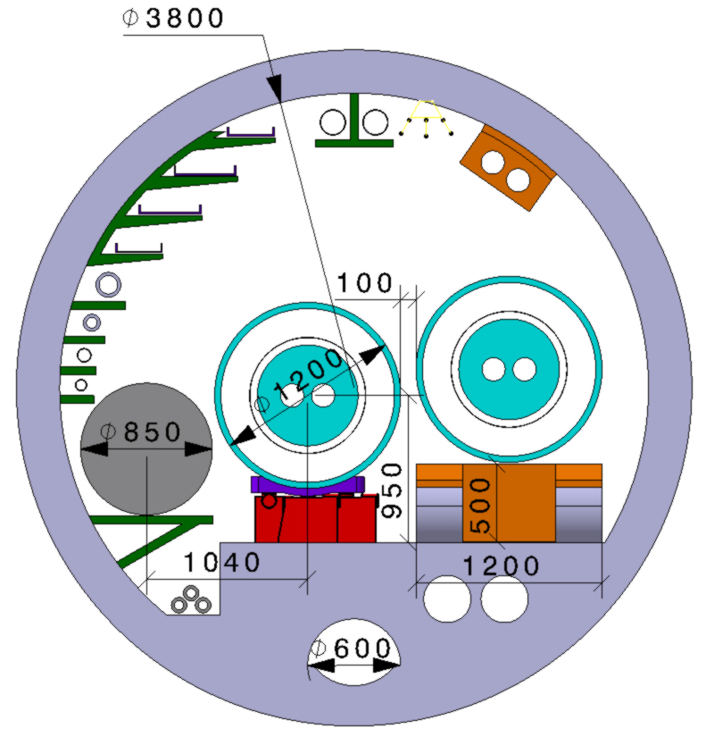
HE-LHC integration aspects
  Requirement: No major CE tunnel modifications
  Maximum magnet cryostat external diameter compatible with LHC tunnel ~1200 mm
  Classical 16 T cryostat design based on LHC approach gives ~1500 mm diameter!
Strategy: develop a single 16 T magnet, compatible with both HE LHC and FCC-hh requirements:
  Allow stray-field and/or cryostat as return-yoke
  Active compensation with (simple) shielding coils
  Optimization of inter-beam distance (compactness)
  → Smaller diam. also relevant for FCC-hh cost optimization

Slide 10

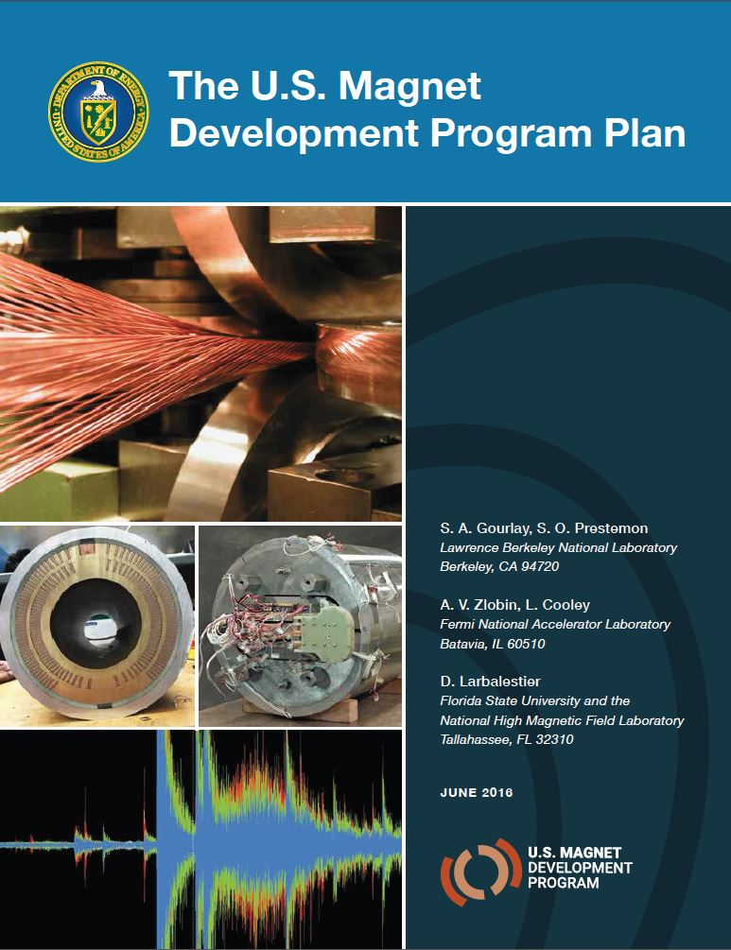
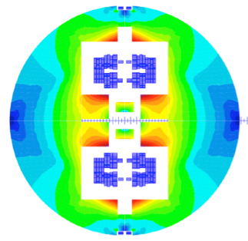

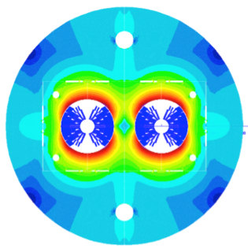
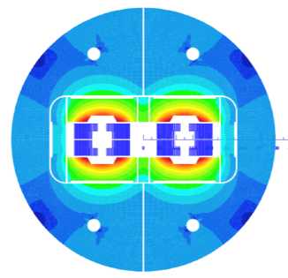
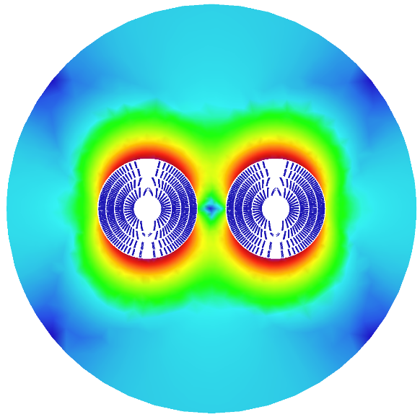
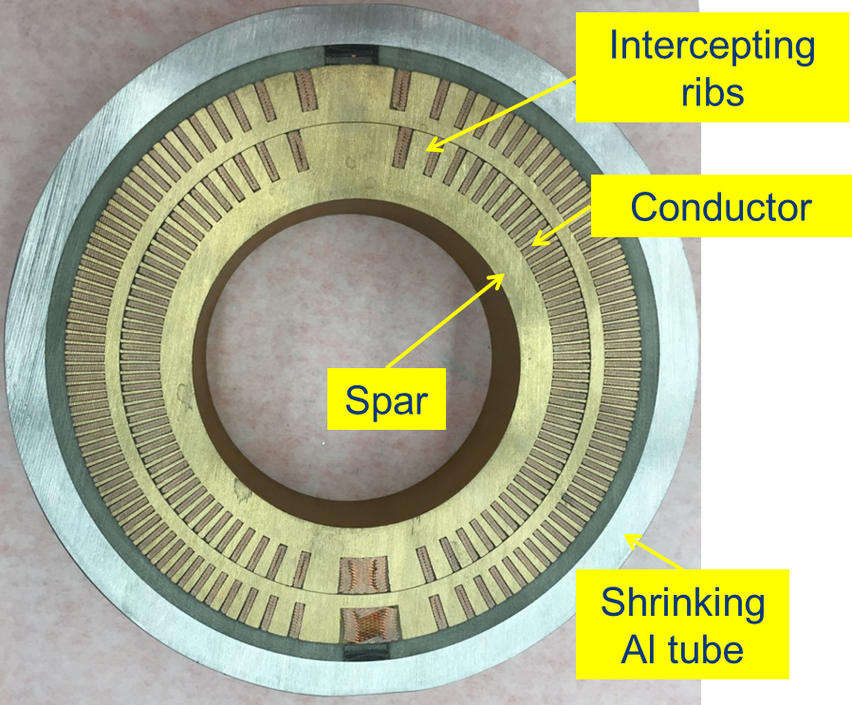
16 T dipole design activities and options
H2020
Swiss contribution
Cos-theta
Common coils
Canted
Cos-theta
Blocks
INFN
CIEMAT
LBNL
CEA
PSI
FNAL
Short model magnets (1.5 m lengths) will be built from 2017 - 2021

Slide 11
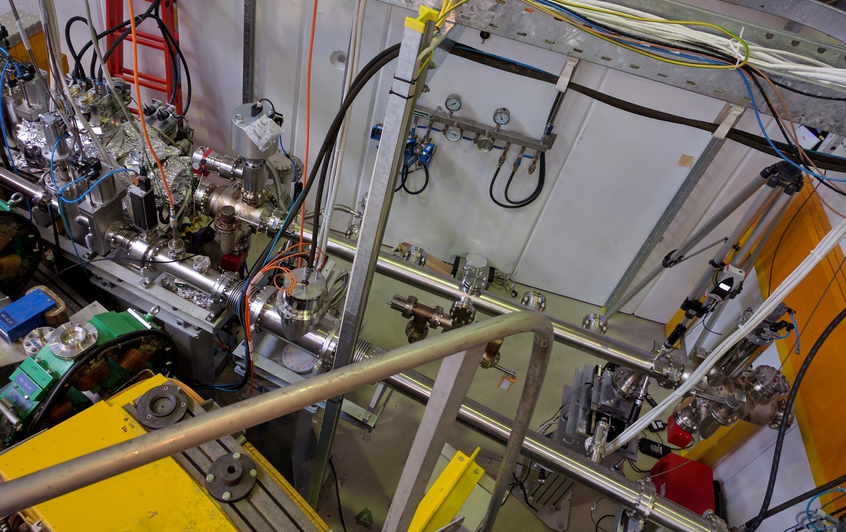
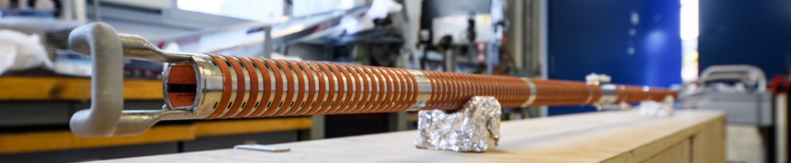
FCC-hh beam screen test @ ANKA
One of the most critical elements for FCC-hh
Absorption of synchrotron radiation at ~50 K for cryogenic efficiency (5 MW total power)
Provision of beam vacuum, suppression of photo-electrons, electron cloud effect, impedance, etc.
FCC-hh beam-screen test set-up at ANKA:
Complete system installed in the ANKA ring;
Beam tests since June 2017
X-ray fan
2.5 GeV ANKA storage ring

Slide 12
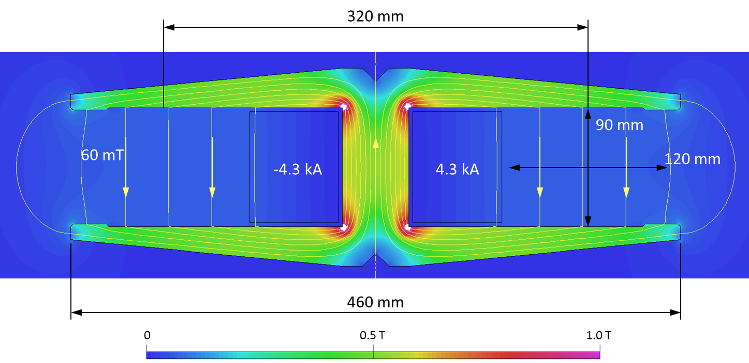
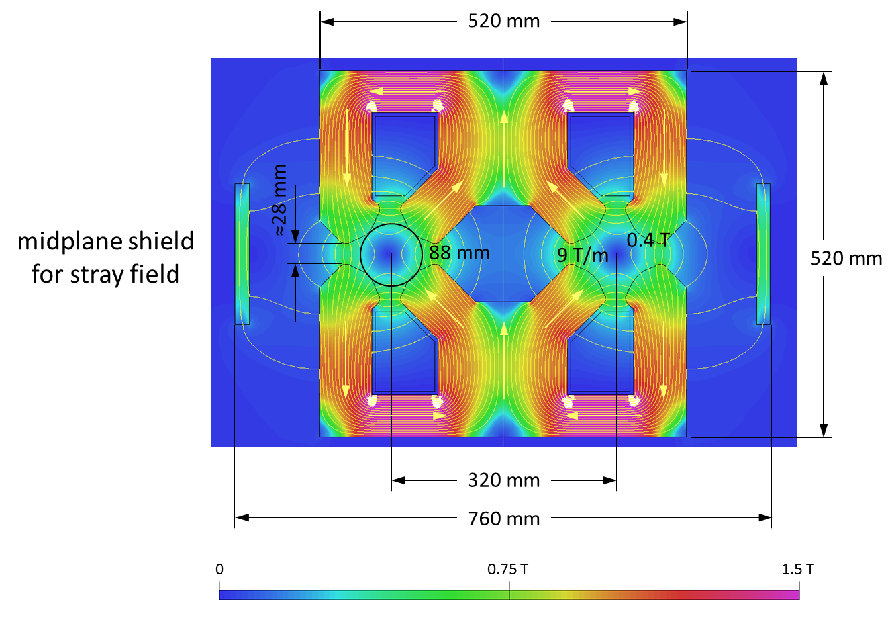
FCC-ee dual aperture main magnets
Prototyping launched of main dipole and quadrupole magnets (~1 m units)
Dipole:
twin aperture yoke, single busbars as coils
Quadrupole:
twin 2-in-1 design
Considerable savings in Ampere-turns and power consumption by novel dual aperture designs
Power consumption twin quad: 22 MW at 175 GeV with Cu coil (half of single-aperture quads) and power consumption twin dipole: = 17 MW at 175 GeV with Al bus bar

Slide 13
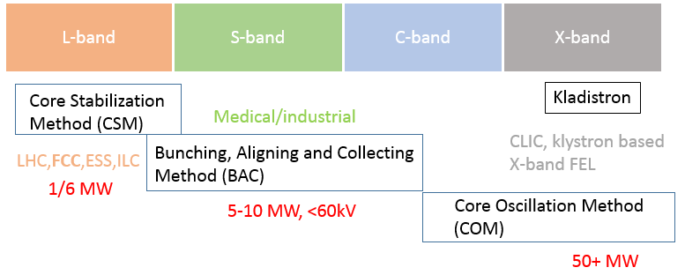
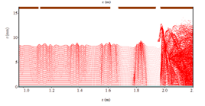
Efficient klystron technology
Development of new klystron bunching technologies to increase RF power production efficiency to almost 90%, was initiated at CERN in 2013 (HEIKA), essential for FCC-ee
Towards fabrication of the first high efficiency CSM tube
Presently negotiations with industry for protoype production for end 2018
Single beam, 1.4 MW, 0.8 GHz, 134 kV, 12.55 A
85.7% efficiency in simulations
See I. Syratchev’s talk on Tuesday
Notes:
HEIKA = High Efficiency International Klystron Activity
Bunching technologies developed for different frequency band (this has to do with the specific parameters (e.g. power requirements) and klystron length (e.g. L-band klystron
With COM method would be too long)

Slide 14

EASITrain Marie Curie Training Network
European Advanced Superconductivity Innovation and Training Network
selected for funding by EC in May 2017, start 1 October 2017
SC wires at low temperatures for magnets (Nb₃Sn, MgB₂, HTS)
Superconducting thin films for RF and beam screen (Nb₃Sn, Tl)
Turbocompressor for Nelium refrigeration
Magnet cooling architectures
13 Beneficiaries
I-CUBE
12 Partners

Slide 15

FCC Collaboration & Industry Relations
111
Institutes
25
Companies
32
Countries
EC
H2020

Slide 16
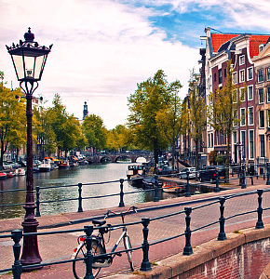
Summary and outlook
FCC WEEK 2018
  Confirmed parameter sets for FCC-hh, FCC-ee, HE-LHC and FCC-he as solid basis for the Design Report end 2018
  Work ongoing on optimisation of machine designs as well as on technology R&D topics
  International FCC collaboration is growing steadily, addressing all the challenging subjects and research lines
  Strong contributions from Austrian and Swiss Institutes and Universities to the FCC Study
AMSTERDAM
9-13 April 2018

