Slide 1
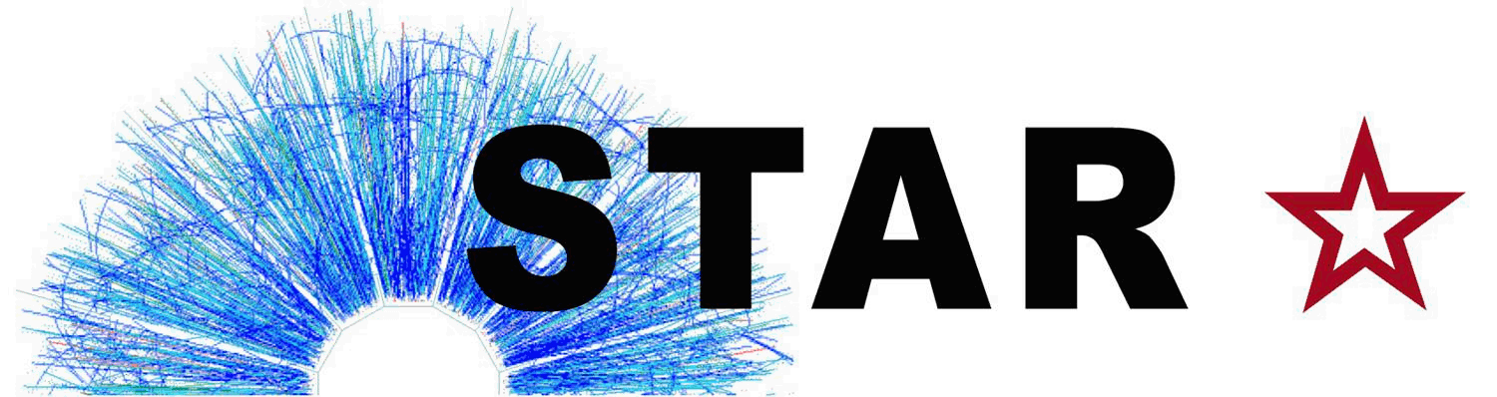

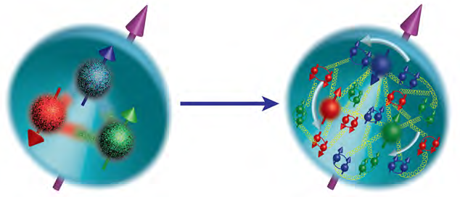
STAR Recent Results and Future
Zhangbu Xu
(BNL/SDU)
Probing nucleon structure:
jets and W±
Hard Probes of QGP properties:
Jets and Heavy-Flavor
Chiral Symmetry Restoration
Search for QCD Critical Point
Forward Upgrade and Physics
Summary

Slide 2
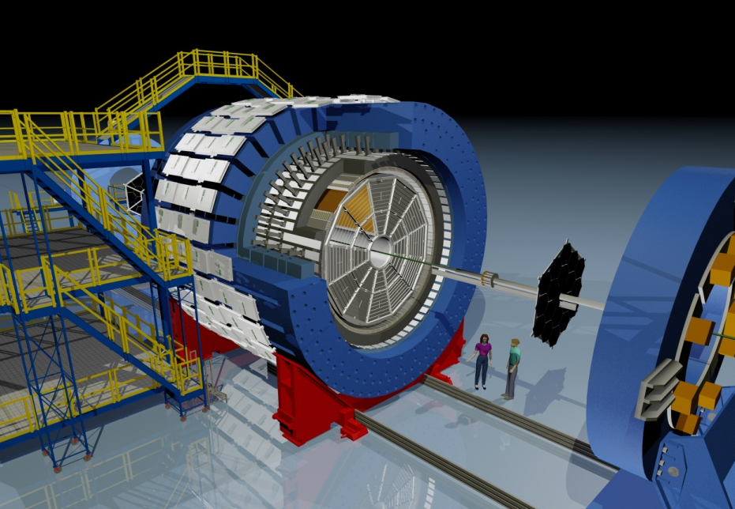
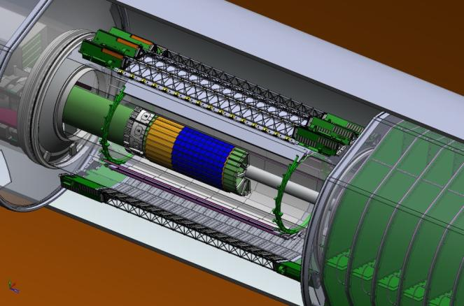
STAR Detector System
EEMCESMD
Magnet
MTD
BEMC
BSMD
TPC
TOF
BBC
FMS
FPS
RP
ZDC
NSAC RECOMMENDATION #I:
The upgraded RHIC facility provides unique capabilities that must be utilized to explore the properties and phases of quark and gluon matter in the high temperatures of the early universe and to explore the spin structure of the proton.
HFT
X10³ increases in DAQ rate since 2000, most precise Silicon Detector (HFT 2014-16)

Slide 3

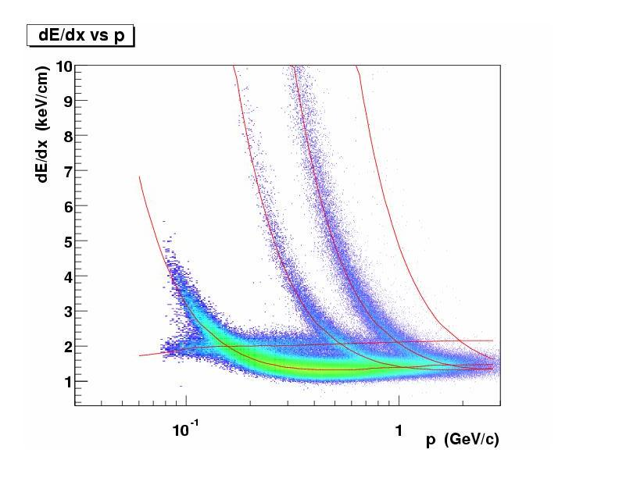
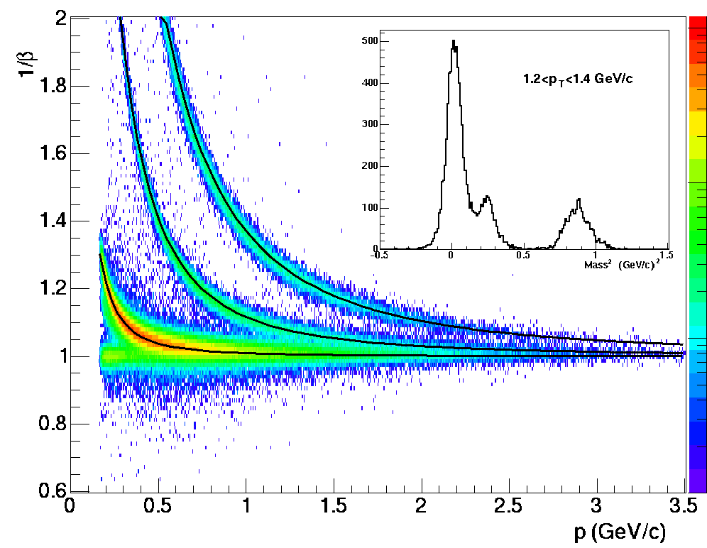
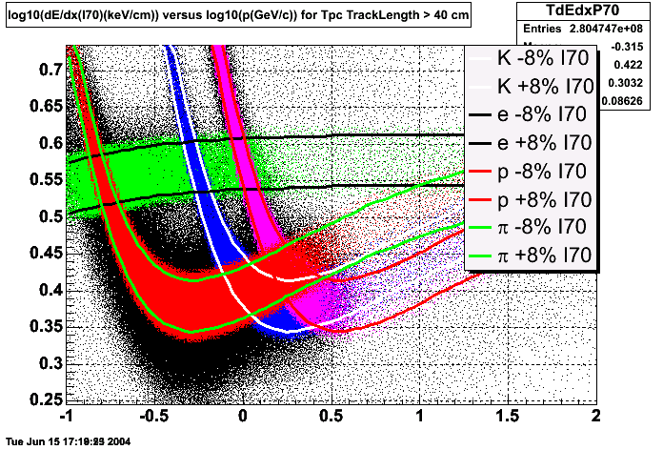
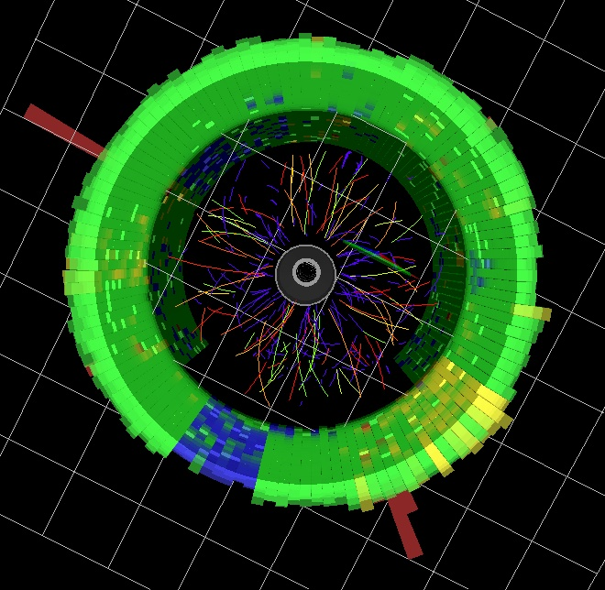
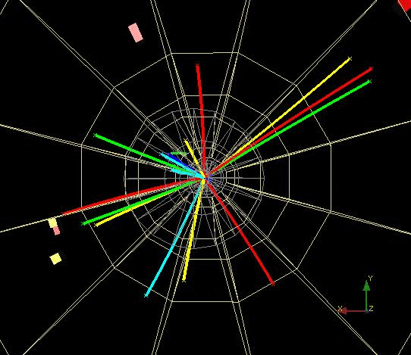
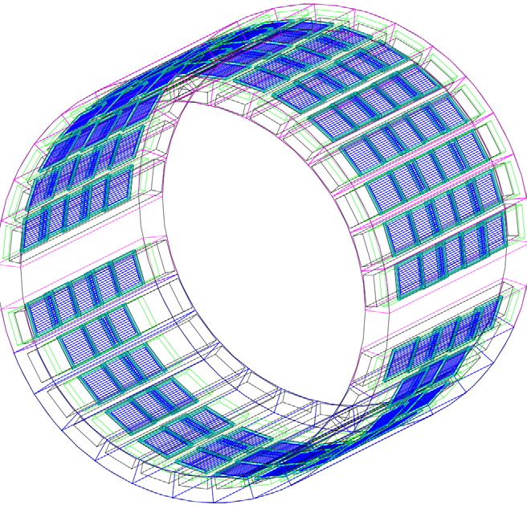
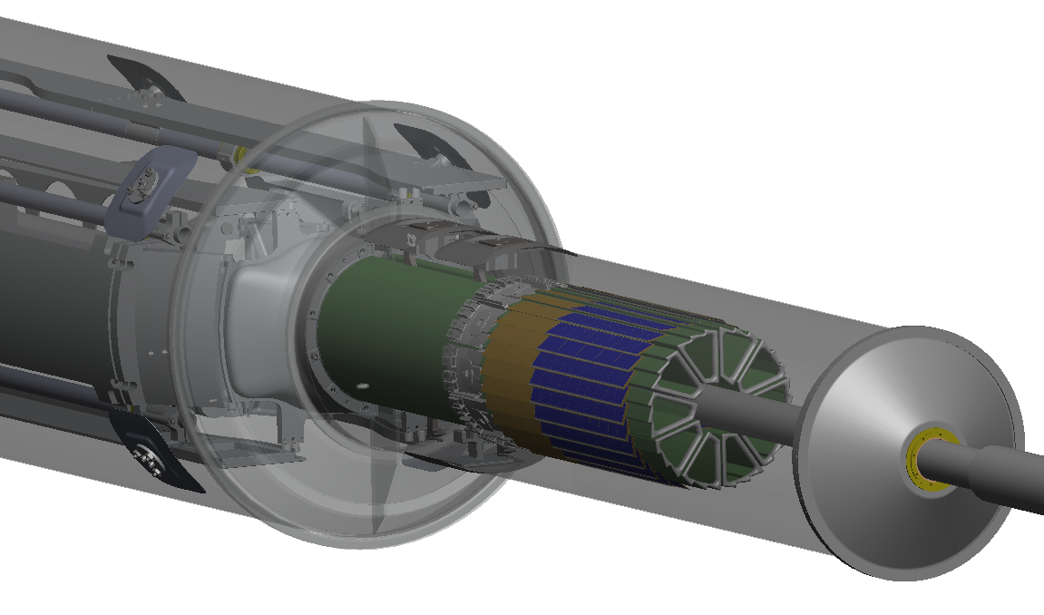
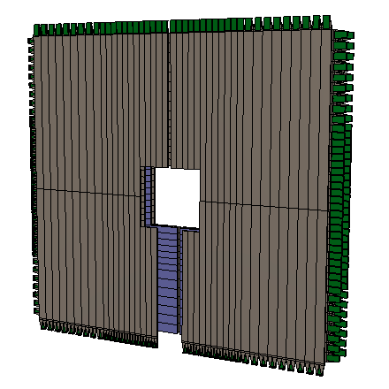
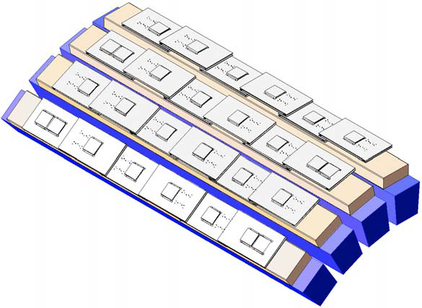
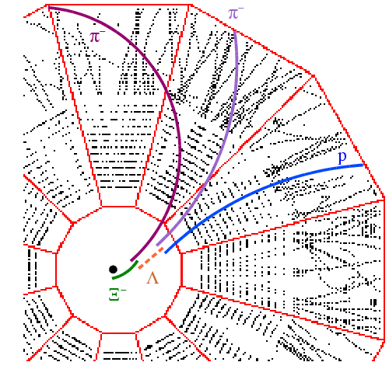
Particle Identification at STAR
TPC TOF TPC
TPC
K p d
π
e, μ
TOF
Log₁₀(p)
Charged hadrons
Hyperons & Hyper-nuclei
EM particles
MTD
HFT
EMC
Jets
Jets & Correlations
High p_{T} muons
Heavy-flavor hadrons
Forward protons
Forward photons
Multiple-fold correlations for identified particles!

Slide 4
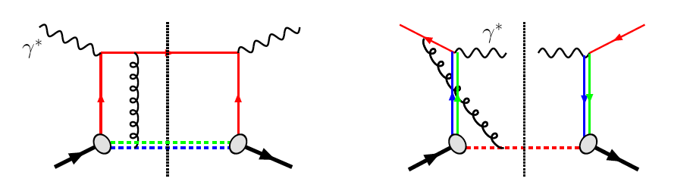
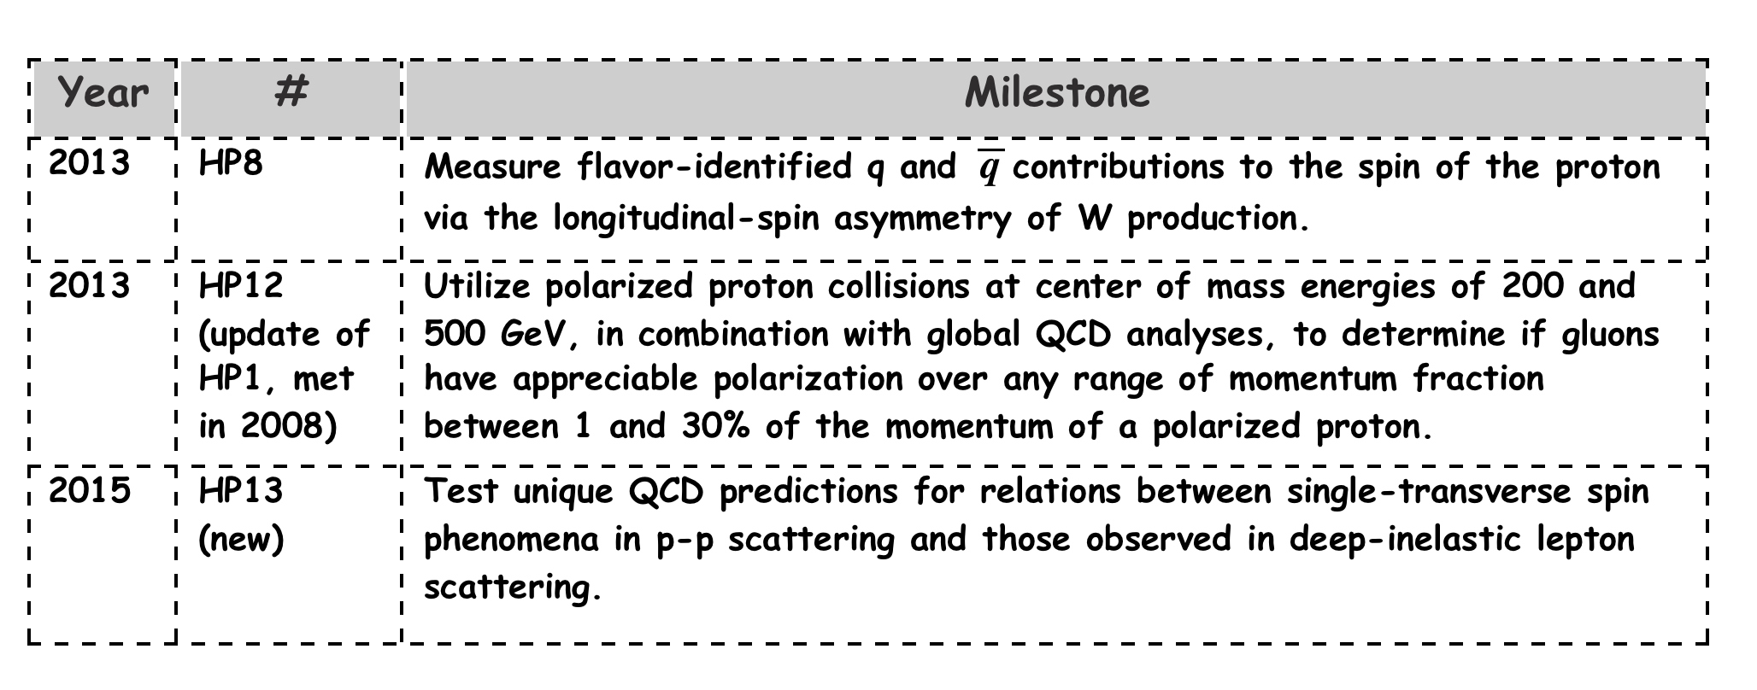
Probe Nucleon Structure: jets and W±
✓
✓
A_{N} of W±,γ, DY in pp 500 are all sensitive to the Sivers sign-change.
STAR can access all three world-class measurements in the data-taken 2017 Run – Significant discovery potential before 2020!
Notes:
Not written here but you need to say verbally that one of the more interesting and important tests for these relations between single transverse spin in pp and SIDIS is sign of the Sivers function and we have access to that in A_N of W, gamma and DY.

Slide 5
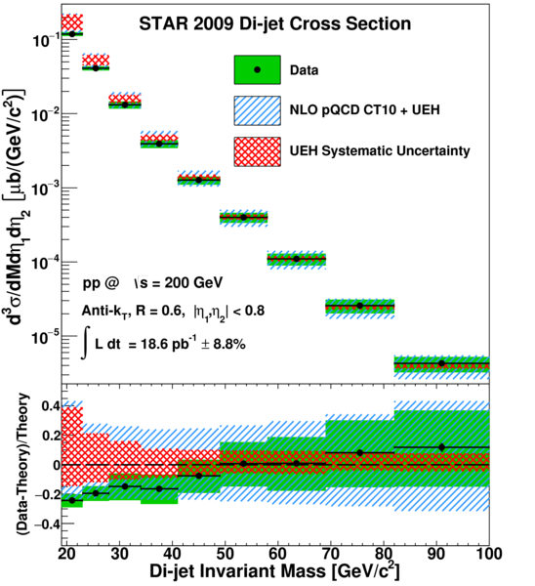
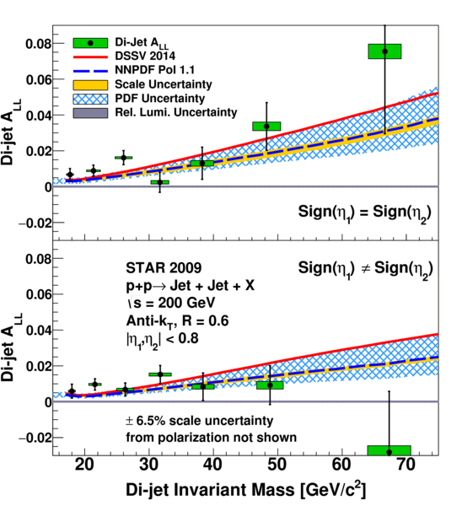
Constraining Gluon polarization with dijets
PRD 95 (2015)
First dijet measurement;
Non-zero Gluon polarization contribution

Slide 6
W ± probes Sea Quark Polarization
New preliminary AL results at near-forward rapidity !
STAR 2013 results are the most precise measurements of W AL so far.
Consistent with 2011+2012published results, with 40% uncertainty reduced.
Further confirmed the preference of positive Δu
_

Slide 7
Glimpse of the recent publications

Slide 8
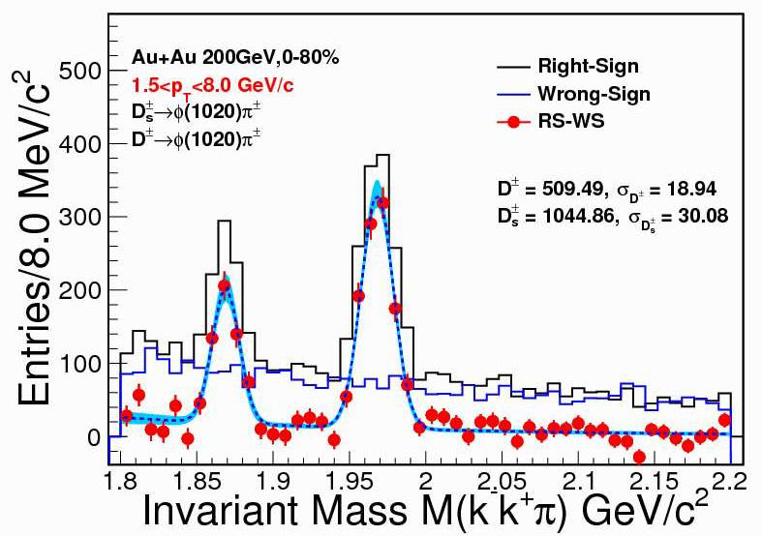
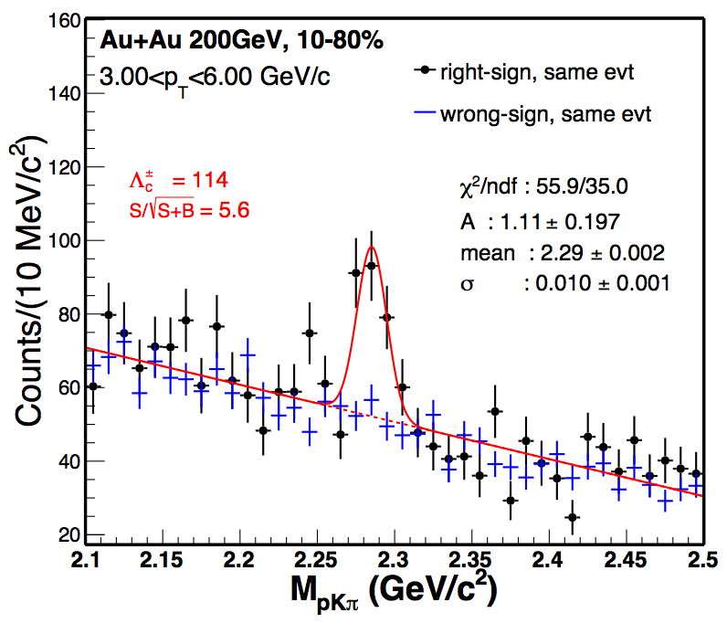
New Heavy-Flavor results from upgrades
HFT
MTD

Slide 9
RHIC has been adaptable to science needs
2010-2013 | 2014 | 2015 | 2016 | 2017 | 2018 | 2019 | 2020 |  | 2022+
Au+Au p+p | Au+Au | p+p p+A | Au+Au d+Au | p+p Au+Au | Isobar Au+Au | Au+Au | Au+Au |  | Au+Au pp,pA
ΔG, QGP property | Charm flow | Ref. A_{N} | D_{c}, Λ_{c} ϒ, Jets | Fc sign | CME, Λ↑ | Critical Point, Phase Transition |  |  | Jets, ϒ forwardA_{N}
BES-I | 200, 14.5 | 200 | 200-19.6 | 500, 54.4 | 200, 27 | BES-II 11-20 | BES-II 7-11 |  | 200
BES-I
BES-II
Expand to include several programs:
p+A in run 15,
pp500 and 54.4GeV Au+Au in run17,
Isobar (Zr, Ru-96) and 27GeV Au+Au in run 18
BES-II more compelling, detector and machine upgrades in 2018
Future high-luminosity jets and Upsilon in 2020+
3+1D hydrodynamics and Unique Cold QCD (DY) portal to EIC

Slide 10
https://drupal.star.bnl.gov/STAR/starnotes/public/sn0670
Two Highest Priorities for the next three RHIC runs ( run 18 and 19-20) focus on two compelling programs key to RHIC mission
Run 18: isobar collisions at 200 GeV
Decisive test of role of magnetic field
in charge separation measurements
Run 19-20: Beam Energy Scan search
for QCD Critical Point
BES energies (7.7 to 19.6 GeV) +
Fixed Target (FXT) program

Slide 11
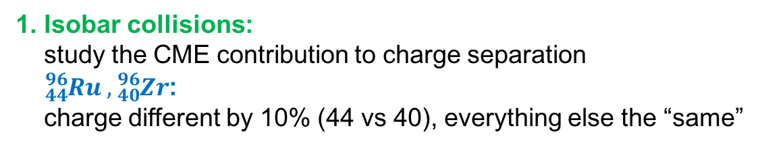
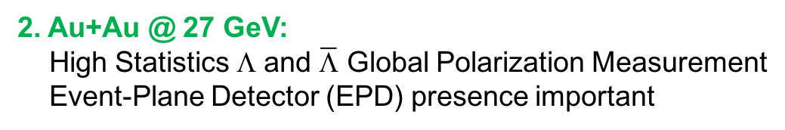
Run 18 Beam Use Request
Run | Energy | Duration | System | Goals | priority | Sequence
18 | √s_{NN}=200 GeV √s_{NN}=27 GeV √s_{NN}=3 GeV(FXT) | 3.5-wk 3.5-wk 3-wk 2 days | Zr+Zr Ru+Ru Au+Au Au+Au | 1.2B minbias 1.2B minbias 1B minbias 100M minbias | 1 1 2 3 | 1 2 3 4
1. Isobar collisions:
study the CME contribution to charge separation
${}_{44}^{96}{Ru} , {}_{40}^{96}{Zr}$:
charge different by 10% (44 vs 40), everything else the “same”
2. Au+Au @ 27 GeV:
High Statistics Λ and $\overline{\text{L}}$ Global Polarization Measurement
Event-Plane Detector (EPD) presence important
3. Au+Au @ 3 GeV:
Fluctuation measurement at energies between HADES and BES-I
Significant statistics in FXT mode with large acceptance
Competition with BM@N (NICA) scheduled for 2019

Slide 12
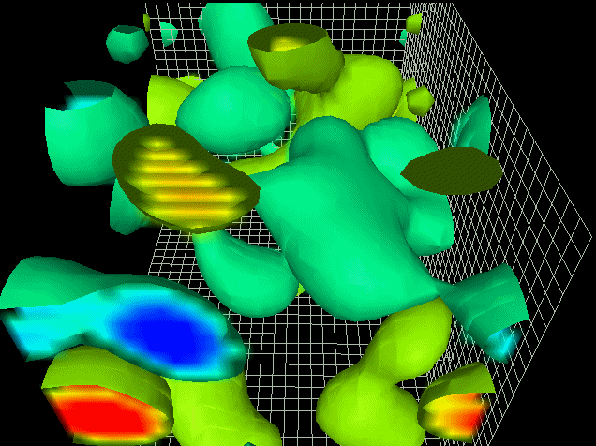
Observing Topological Charge Transitions
To observe in the lab
- add massless fermions
- apply a magnetic field
Paul Sorensen: QM2017
CME task force report: arXiv: 1608.00982
Talk by Yuji Hirono (afternoon)
A required set of Extraordinary Phenomena:
QCD Topological Charge
+ Chiral Symmetry Restoration
+ Strong Magnetic Field
Observable:
Chirally restored quarks separated
along magnetic field
PRC 81 (2010) 54908
PRL 103 (2009) 251601
Experimental strategy:
Measure 2 particle correlations (++,--,+-)
WRT reaction plane;
1/3 observed values
reproduced by conventional models
A decade of disentanglement
Derek Leinweber, University of Adelaide

Slide 13
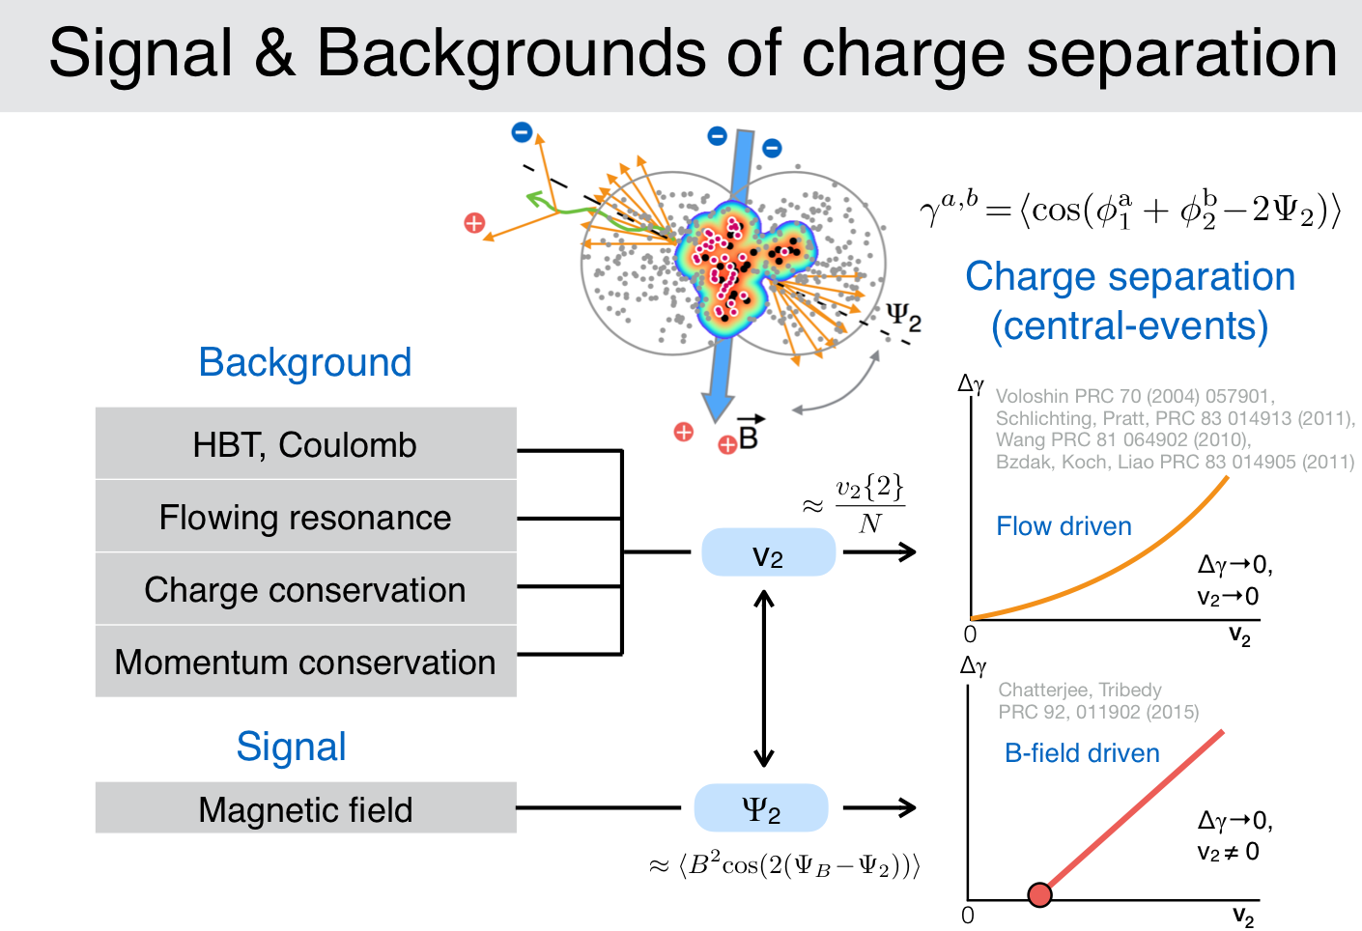
P. Tribedy, QM2017

Slide 14
A decisive test with Isobars
CAD has obtained enriched Ruthenium-96 source
with the refurbished Oak Ridge Isotope Facility,
Run with natural abundance reduces luminosity by x5
Can reach 1.2 Billion events within 3.5 weeks of operation
PRC 94(2016)041901

Slide 15
Chiral Symmetry & Magnetic Field
Two other Extraordinary phenomena to make this possible (QCD topology
reflects in charge separation)
Disentangle and assess
necessary conditions
Chiral Symmetry Restoration
  low-mass dilepton excess (change of vector meson ρ spectral function)
Strong Magnetic Field
  Coherent photo-production of J/Ψ and low-mass dilepton in non-central A+A collisions
  Global Hyperon Polarization

Slide 16
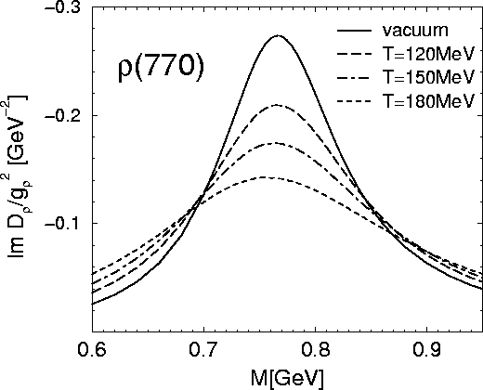
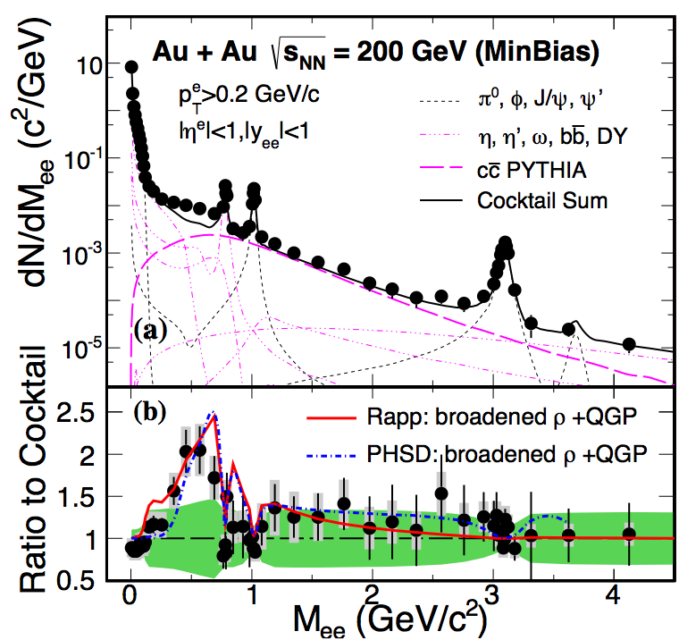
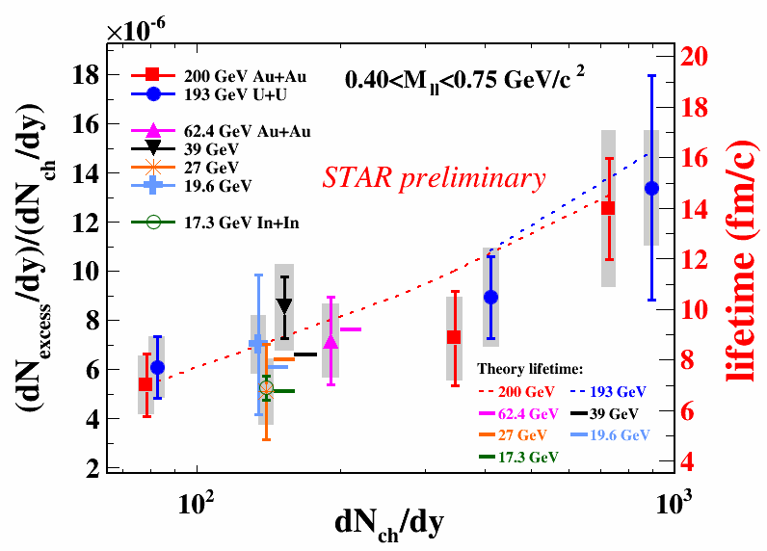
QCD phase transition is a chiral phase transition
Golden probe of chiral symmetry restoration:
change vector meson (ρ→e⁺e⁻) spectral function
RHIC+SPS data:
Consistent with continuous QGP radiation and
broadening of vector meson in-medium
PRL113(2014)
PLB750(2015)

Slide 17
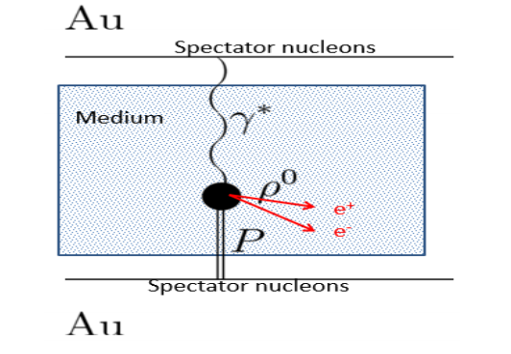
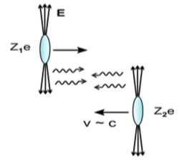
Coherent photoproduction in violent non-central A+A collisions?
https://arxiv.org/abs/1705.01460
Shower the nucleus with electromagnetic field
and test the effect with isobar collisions:
Non-central but not UPC photoproduction
Large enhancement of dilepton and J/Ψ
production at very low p_{T} (<150MeV)
Consistent with strong electromagnetic field
interacting with nucleus target collectively
Test with Isobar collisions (dilepton at LMR)
Photon-photon (Z⁴)
Photon-Pomeron (Z²)
Hadron-Hadron (Z⁰)
LMR excess B-field driven (Z²)

Slide 18
Au+Au at <=27GeV
Run | Energy | Duration | System | Goals | priority | Sequence
18 | √s_{NN}=200 GeV √s_{NN}=27 GeV √s_{NN}=3 GeV(FXT) | 3.5-wk 3.5-wk 3-wk 2 days | Zr+Zr Ru+Ru Au+Au Au+Au | 1.2B minbias 1.2B minbias 1B minbias 100M minbias | 1 1 2 3 | 1 2 3 4
1. Isobar collisions:
study the CME contribution to charge separation
${}_{44}^{96}{Ru} , {}_{40}^{96}{Zr}$:
charge different by 10% (44 vs 40), everything else the “same”
2. Au+Au @ 27 GeV:
High Statistics Λ and $\overline{\text{L}}$ Global Polarization Measurement
Event-Plane Detector (EPD) presence important
3. Au+Au @ 3 GeV:
Fluctuation measurement at energies between HADES and BES-I
Significant statistics in FXT mode with large acceptance
Competition with BM@N (NICA) scheduled for 2019

Slide 19
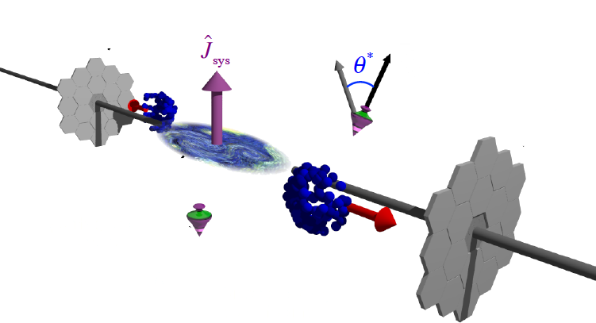
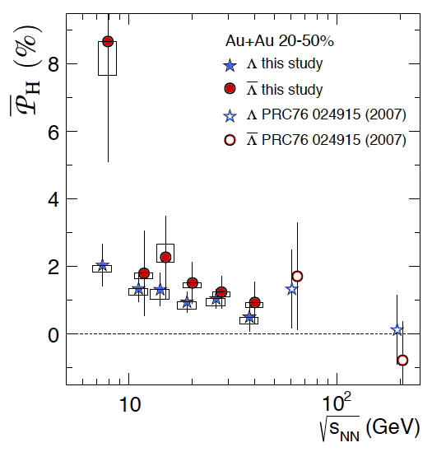
Global Hyperon Polarization
new tool to study QGP and relativistic Quantum fluid Vorticity in general
arXiv:1701.06657
NATURE COVER
Non-zero global angular momentum
transfer to hyperon polarization

Slide 20
QCD fluid responds to external field
Positive Global Hyperon Polarization
indicating a spin-orbit (Vortical) coupling
Current data not able to distinguish
Lambda/AntiLambda polarization difference,
(potentially) Direct measure of
Magnetic Field effect
Need >x10 more data
(3σ at current central value)
STAR Preliminary
sum
difference
arXiv:1706.09467

Slide 21
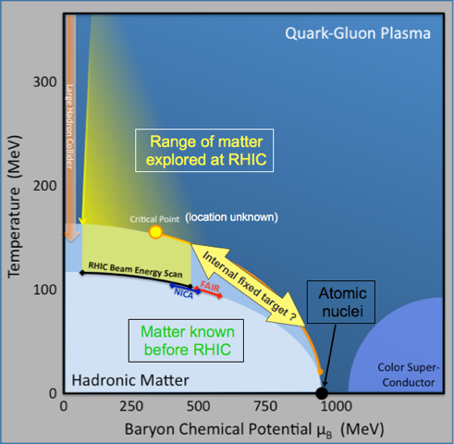
Mapping the QCD Phase Diagram
RHIC uniquely suited to map the QCD phase diagram at finite baryon density
Thermodynamics applicable
Change of Symmetry (degree of freedom)
  Chiral symmetry restoration
  Quark and gluon degree of freedom
  Response to external field
Equation of State (soft)
Critical behavior
  Critical exponent
  Critical fluctuation
Hints of new behavior in first Beam Energy Scan
Beam Energy Scan Phase 2 (BES II):
from hints to quantitative understanding

Slide 22
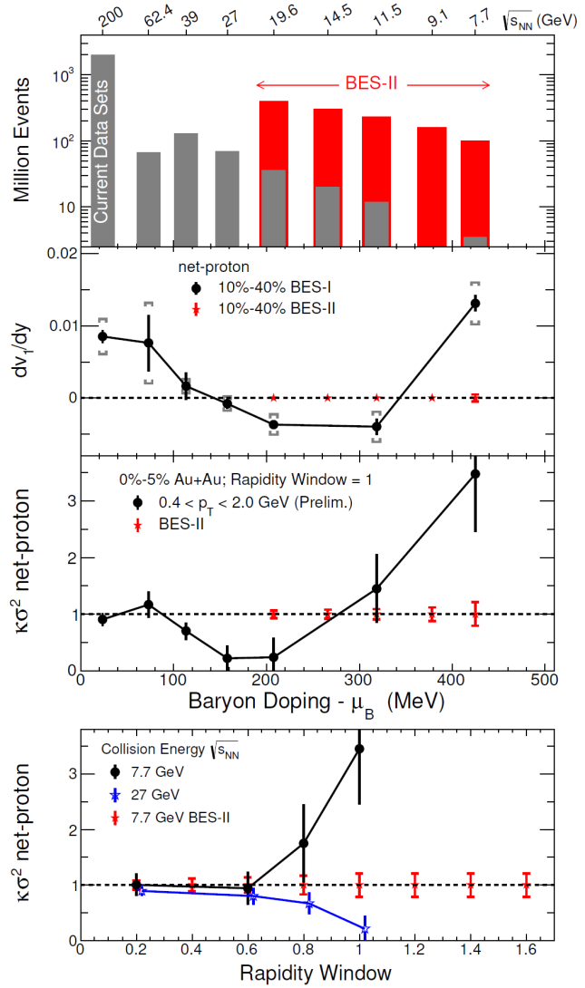
Highlights of BES-II and Upgrades in LRP 2015
Strong Endorsement by the NSAC 2015
http://science.energy.gov/~/media/np/nsac/pdf/2015LRP/2015_LRPNS_091815.pdf
Data from BES-I provide qualitative evidence for a reduction in the QGP pressure, with consequences for flow patterns and droplet lifetimes that have long been anticipated in collisions that form QGP not far above the crossover region. (See second panel of Figure 2.10.)
The detector upgrades planned for BES-II focus on maximizing the fraction of the particles in each collision that are measured, which is particularly important for fluctuation observables.
The trends and features in BES-I data provide compelling motivation for a strong and concerted theoretical response, as well as for the experimental measurements with higher statistical precision from
BES-II. The goal of BES-II is to turn trends and features into definitive conclusions and new understanding.

Slide 23
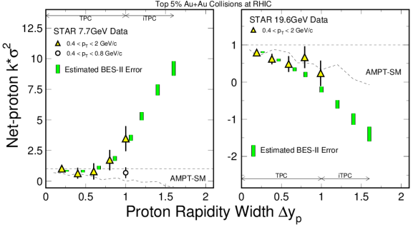
BES-II Physics highlights (I): net-proton Kurtosis
Reach the necessary rapidity width of the correlation/fluctuation (~1-2 unit)
B. Ling and M. Stephanov, Phys.Rev. C93 (2016) 034915

Slide 24
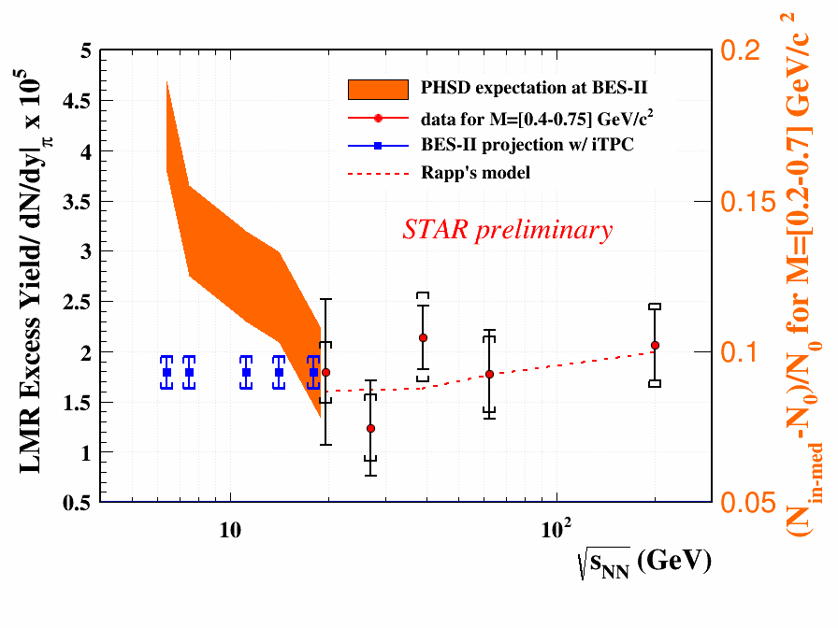
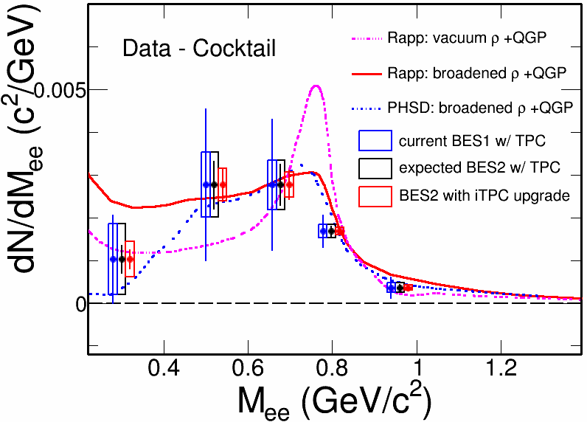
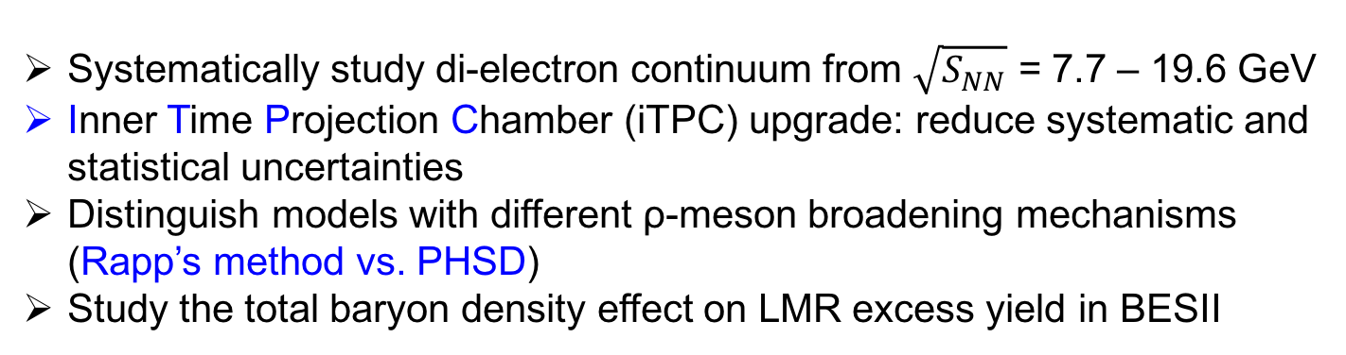
BES-II Physics highlights (II):
Di-electron measurements
Systematically study di-electron continuum from $\sqrt{S_{NN}}$ = 7.7 – 19.6 GeV
Inner Time Projection Chamber (iTPC) upgrade: reduce systematic and statistical uncertainties
Distinguish models with different ρ-meson broadening mechanisms (Rapp’s method vs. PHSD)
Study the total baryon density effect on LMR excess yield in BESII

Slide 25
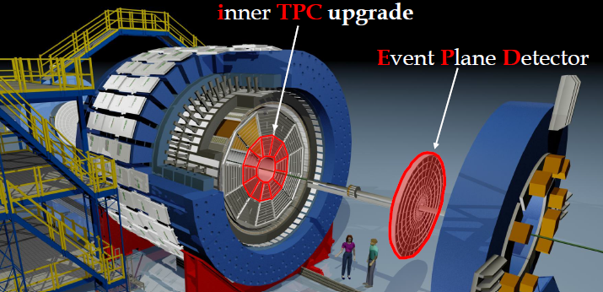
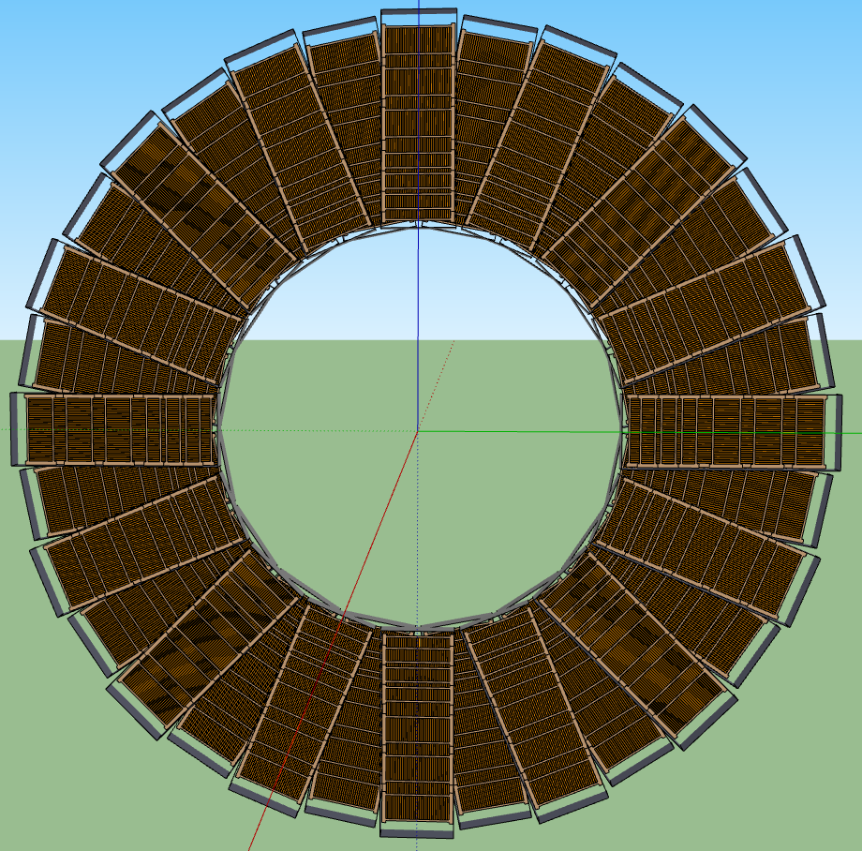
Major Upgrades for BES-II
Endcap TOF
EPD:
Improves trigger
Reduces background
Allows a better and independent reaction plane measurement critical to BES physics
iTPC:
Rebuilds the inner sectors of the TPC
Continuous Coverage
Improves dE/dx
Extends η coverage from 1.0 to 1.5
Lowers p_{T} cut-in from 125 MeV/c to 60 MeV/c
EndCap TOF:
Rapidity coverage is critical
PID at η = 0.9 to 1.5
Improves the fixed target program
Provided by CBM-FAIR
Funding sources:
iTPC: DOE+MoST+NSFC
eTOF: CBM
EPD: MoST fund + NSF Universities

Slide 26
RHIC has been adaptable to science needs
2010-2013 | 2014 | 2015 | 2016 | 2017 | 2018 | 2019 | 2020 |  | 2022+
Au+Au p+p | Au+Au | p+p p+A | Au+Au d+Au | p+p Au+Au | Isobar Au+Au | Au+Au | Au+Au |  | Au+Au pp,pA
ΔG, QGP property | Charm flow | Ref. A_{N} | D_{c}, Λ_{c} ϒ, Jets | Fc sign | CME, Λ↑ | Critical Point, Phase Transition |  |  | Jets, ϒ forwardA_{N}
BES-I | 200, 14.5 | 200 | 200-19.6 | 500, 54.4 | 200, 27 | BES-II 11-20 | BES-II 7-11 |  | 200
BES-I
BES-II
Expand to include several programs:
p+A in run 15,
pp500 and 54.4GeV Au+Au in run17,
Isobar (Zr, Ru-96) and 27GeV Au+Au in run 18
BES-II more compelling, detector and machine upgrades in 2018
Future high-luminosity jets and Upsilon in 2020+
3+1D hydrodynamics and Unique Cold QCD (DY) portal to EIC

Slide 27
STAR is a multi-purpose detector; with modern capabilities
Period | Physics | Upgrades
2008 | Generic | Trigger QT
2009 | Generic | TPC/DAQ1000
2010-2011 | BES I, PID | TOF
2013--2015 | Heavy-Flavor | HFT, MTD
2015--2016 | Heavy-Flavor Diffractive, nPDF | FMS, FPS, Roman Pots, HLT
2017 | Spin Sign Change Diffractive | FMS Post-shower
2018 | Isobar (Zr, Ru), CME, dileptons | EPD
2019--2020 | BES II | iTPC, EPD, CBM endcap TOF
2022-2023 | High-statistics Unbiased Jets, Open Beauty, PID FF Drell-Yan, Longitudinal correl | Forward Upgrade
STAR Detector: >100M$, RHIC operation budget 174M$

Slide 28
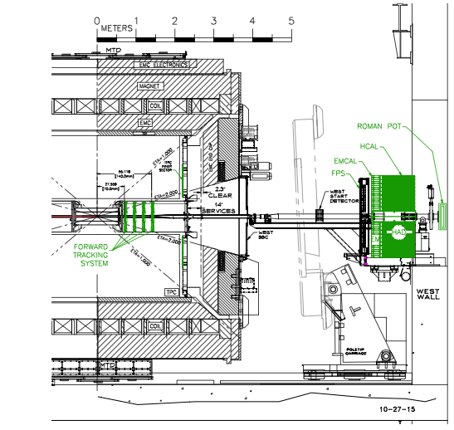
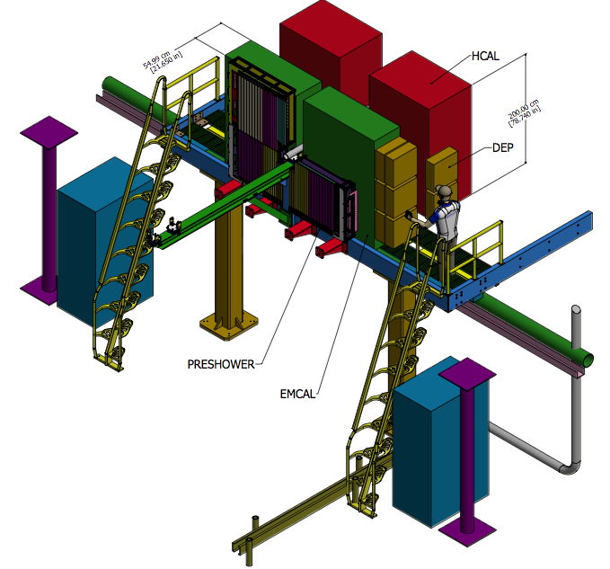
Possible Forward Implementation
Forward Electromagnetic calorimeter and hadronic calorimeter
Complete energy measurement with high granularity.
https://drupal.star.bnl.gov/STAR/starnotes/public/sn0648
And
The RHIC Cold QCD Plan from 2017 to 2023: A portal to the EIC - Jan. 2016

Slide 29
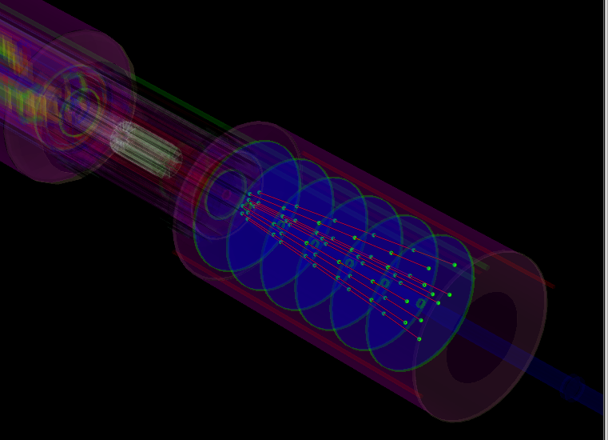
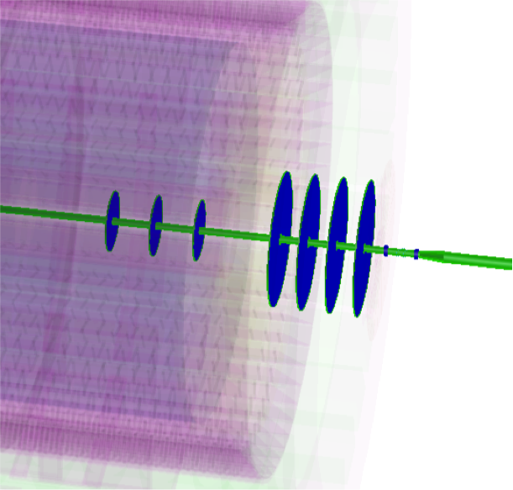
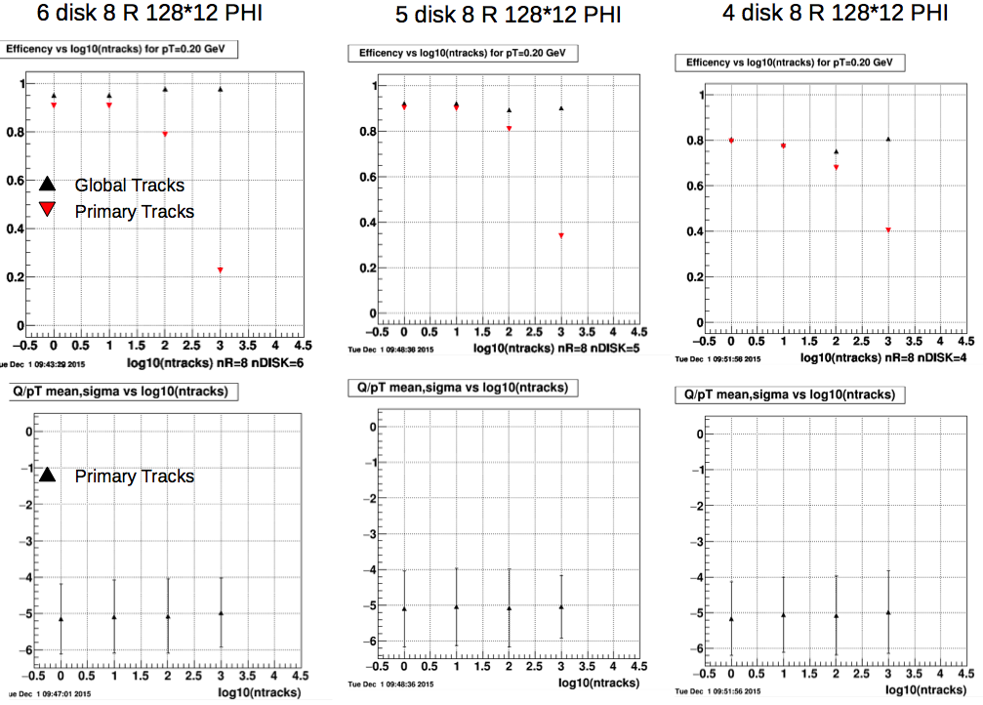
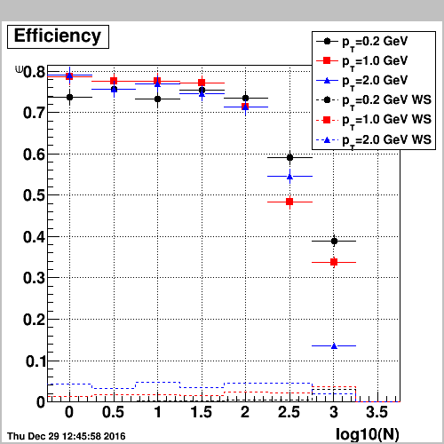
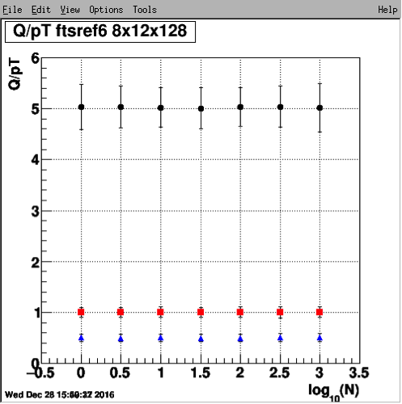
The STAR Forward Upgrade
Silicon mini-Strip Detectors only
Si + Small-strip Thin Gap Chambers
6 disks
12 wedges, each with
128 strips in ϕ at
fixed radius and 8
strips in the radial
direction at a fixed ϕ
60 – 180 cm from IP
3 Si disks + 4 sTGC
Si- disks:
90, 140, 187 cm from IP
sTGC:
270, 300, 330, 360 cm
from IP (outside Magnet)
Momentum resolution: 20-30%
for 0.2 < p_{T} < 2 GeV/c
track finding efficiency: 95%@100 tr/ev
Momentum resolution: 20-30%
for 0.2 < p_{T} < 2 GeV/c
track finding efficiency: 80%@100 tr/ev
0.2 GeV/c
pions
1 GeV/c
2 GeV/c
Cost: 4.1 M$
Cost: 3.3 M$

Slide 30
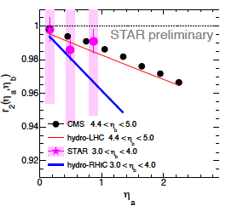
Physics Cases
Parton Transverse Momentum Distribution
Nucleus Parton Distribution Function
Gluon Saturation Effect at Low-x
(rapidity correlation) 3+1D Hydrodynamics

Slide 31
Transverse Momentum Distributions
Till today TMDs come only from fixed target data → high x @ low Q²
need to establish concept at high Q² and wide range in x
STAR unique kinematics with polarized pp at RHIC: from high to low x at high Q²

Slide 32
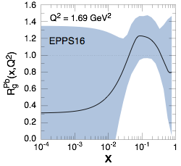
Initial State in Heavy-Ion Collisions
Current knowledge including
first LHC pA data
What are the nPDFs at low-x?
How saturated is the initial state of the nucleus?
What is the spatial transverse distributions
of nucleons and gluons?
pA@RHIC: unique kinematics
can measure nPDF in a x-Q² region
where nuclear effects are large
Observables free of final state effects
Scan A-dependence prediction by
saturation models
can access saturation regime at
forward rapidities
RHIC pA y≤4
direct photon
2.8 < η < 3.8
Saturation

Slide 33
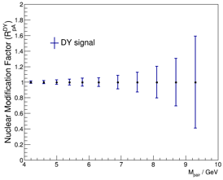
How Does The initial state IN AA Look?
pA: DY@2.5 < η < 4.5
pA: Direct Photon@2.5 < η < 4.5
DY: Q²: ~M²; Q²>16 GeV²
Uncertainties: 2023 pp & pA
direct photon: Q²: ~p_{t}²;Q²>5 GeV²
Uncertainties:2015 + 2023 pp&pA
Impact on
nPDFs:
→ gluons
Impact on
nPDFs:
→ sea quarks
Both DY and direct photon R_{pA} give significant constraints on nPDF
alternative observables and kinematics to EIC

Slide 34
Rapidity (de)correlations
Hot QCD study 𝞰/s and dynamic evolution
Cold QCD γ-h correlation => saturation effect

Slide 35
Summary
Successful and Compelling Spin Program in run17
Three measurements related to TMD evolution and sign change
(A_{N} W^{+/-}, γ, DY)
Rapidity Correlation and temperature dependence of eta/s from 54GeV
Compelling Heavy-Ion Programs for run 18
  Decisive test of Chiral Magnetic Effect
  Quantifying the role of external field in Global Hyperon Polarization
  Bridge the BES-II and world programs (HADES/CBM/NICA/JPARC)
  with competitive FXT program
Preparation for BES-II
  Science cases and Detector upgrades
  New compelling and complimentary measurements (FXT)
and beyond
(3+1D hydro and Cold QCD)
Maintain track record in Results and Publications
  Productivities in paper publication and PhD graduations
  Continue to find external resources (computing), funding (hardware) and attract new members

