Slide 1
8th FCC-ee EPOL meeting 11 May 2017

Slide 2
News from FCC coordination group (1)
An ITN (training network) was approved for Superconductivity.
Selected Students topics:
Cryogenic properties of Nb3Sn and NbN superconductors on substrate
Radiofrequency properties of superconducting Nb3Sn and NbN thin films
High velocity forming of superconducting structures with bulk Nb and Cu substrate
Advanced surface coating techniques for superconducting radiofrequency cavities
Production of superconducting Nb3Sn and NbN thin films
…
Assessment of high-performance Nb3Sn wires
Cryogenic and thermal properties of superconducting magnet coils
Cooling architectures and cryogen distribution in superconducting magnets
Development of MgB2 wire for high-field magnet applications
Characterisation of superconducting properties of Thallium-based coatings and MgB2 wires
….
➔ As can be seen ~similar weight on SC RF and SC High field magnet applications

Slide 3
FCC week Epol Session Wednesday 13:30-15:00.
Energy calibration & polarization
chair: J. Wenninger (CERN)
Review Overview Alain Blondel (U. Geneva) 20
Review Transverse polarization Eliana Gianfelice (FNAL) 20
Review Resonant depolarization process and systematic errors Anton Bogomyakov (BINP) 20
Review Polarimeter design *Jorg Wenninger* (CERN) 20

Slide 4
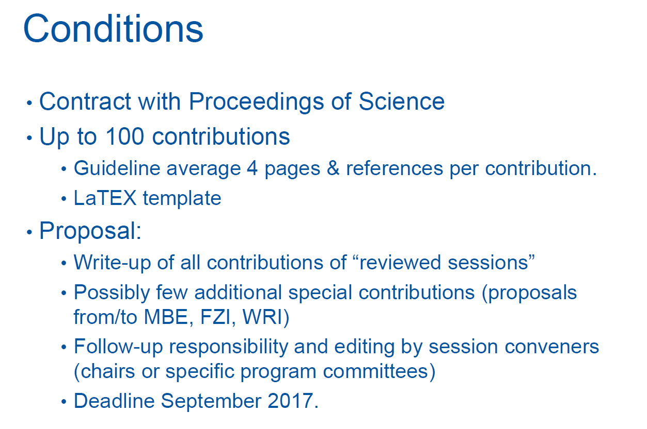
News from FCC coordination group (2)

Slide 5
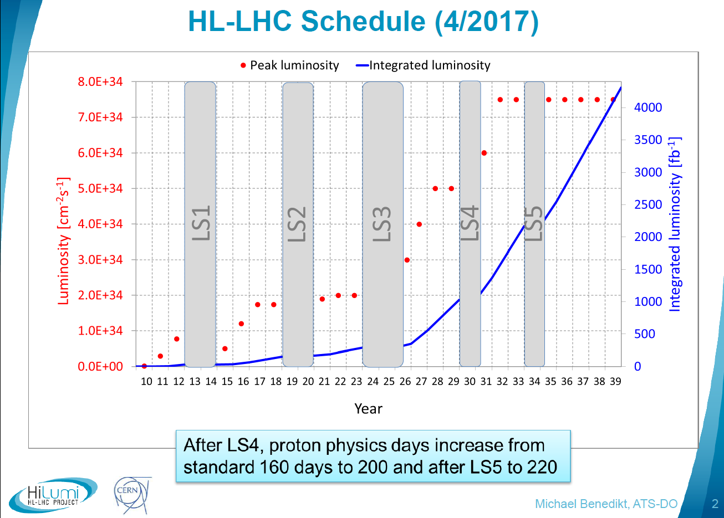

Slide 6
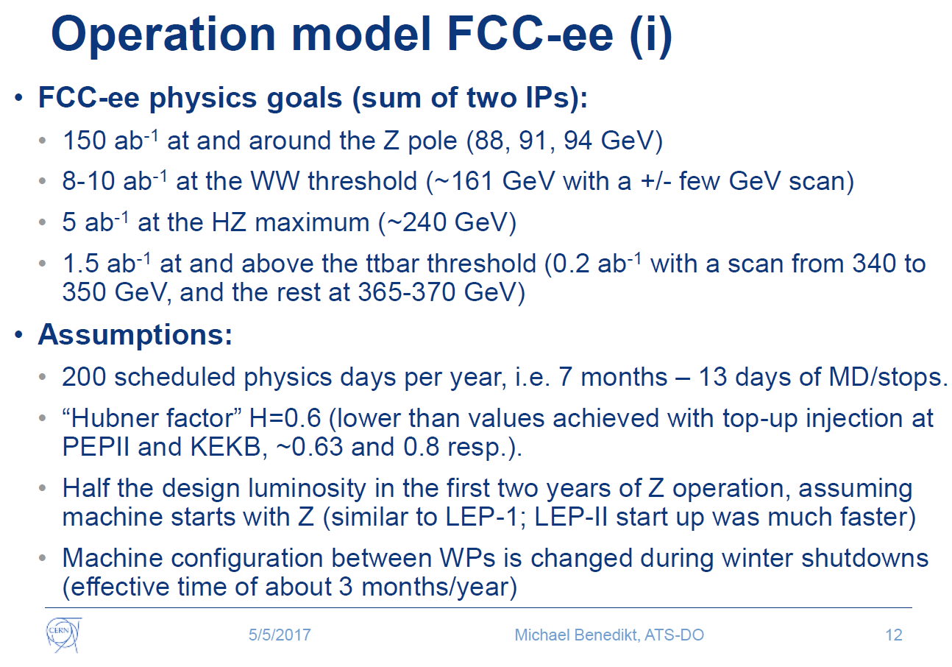

Slide 7
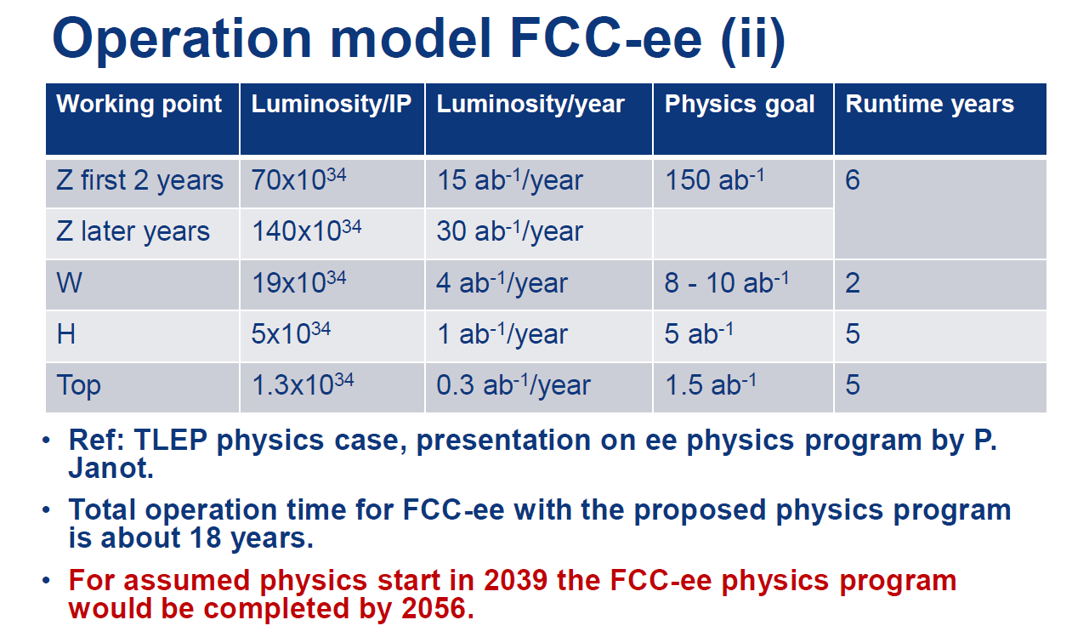
THESE ARE THE OFFICIAL LUMINOSITY NUMBERS

