Slide 1
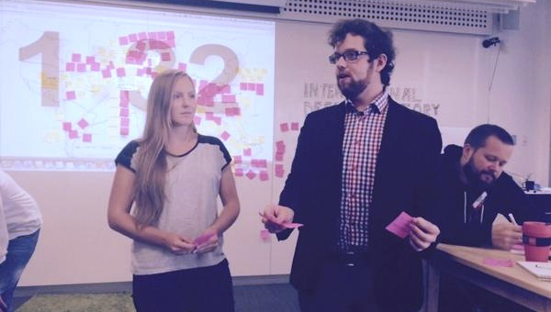

JIVA
HILL
RE
TREAT
2017
T&J
Porto
Reflections
2017

Slide 2
“Genius is one percent inspiration, ninety nine percent perspiration.”
-Thomas Alva Edison
CBI: evolution
Increasing quality
  Intensive format (150% time commitment)
  Strict selection – only good and committed people
  Over 50 teams vs. 2 showcases
    Smaller groups max 20 (enough coaching time)
  Expert participants (less time lost on basics education)
Cumulative projects
  Avoid re-inventing another iFridge yet again once more
  Solving a problem until its solved
  Gaining knowledge team by team, year by year

Slide 3
CBI: R&D
Mega projects
  Online tool development for globally distributed large teams
  Also possible on CERN/research teams e.g. egg drop
Meta projects
  Team challenge: “Improve the CBI course” (pilot with Aalto online)
Open World Wide call for the Coolest/Hottest course on universe ;)
  Tight online selection (engage CERN comms, benchmark Porto selections)
  Admission fee + stipends
  Prototyping for ATTRACT and scalability

Slide 4
+ cool stuff
In-house projects
  Ice cream machine
  Brain fish school flight (or brain murder ;)
Residency program
Observing the observers

