Slide 1
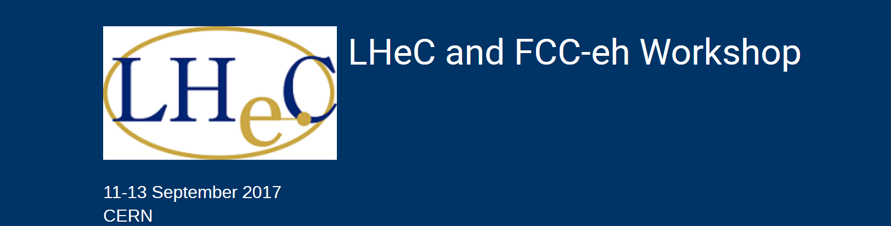
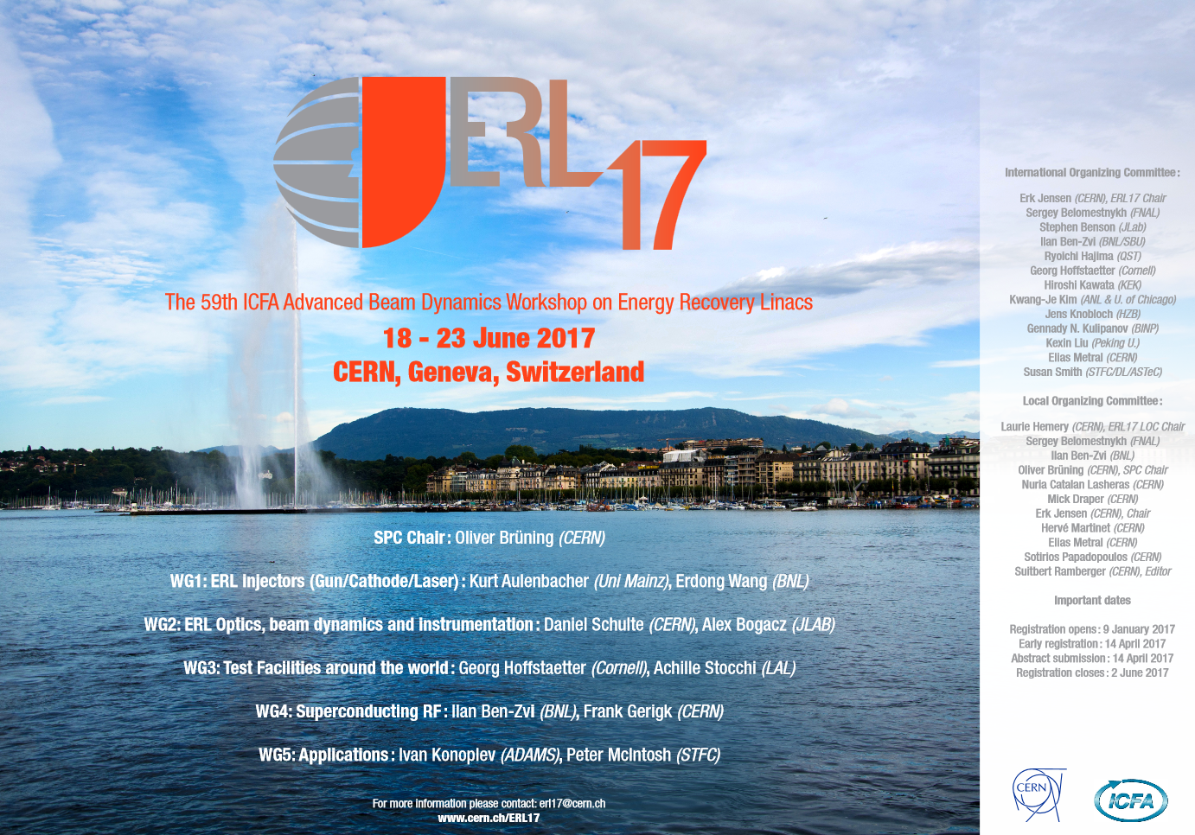
Report from the ERL17 Workshop
Erk JENSEN/CERN

Slide 2
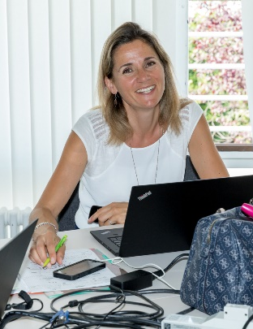
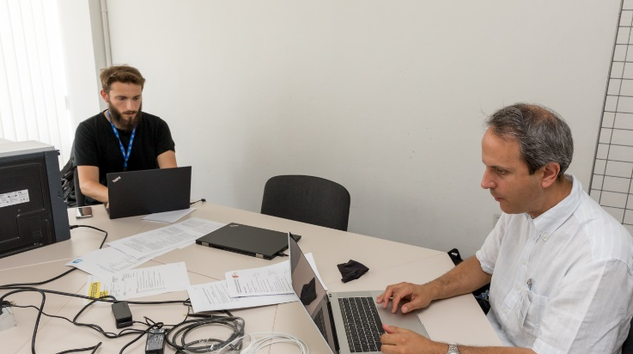
Committees
Scientific Program Committee (chair O. Brüning), working groups:
  ERL Injectors
  ERL Optics, beam dynamics & instrumentation
  Test Facilities around the world
  Superconducting RF
  Applications
International Organizing Committee (chair: E. Jensen)
Local Organizing Committee (chair: L. Hemery)
…. Plus the Editors team - publications via Jacow
Big thanks! The committees were very efficient and did a great job!

Slide 3
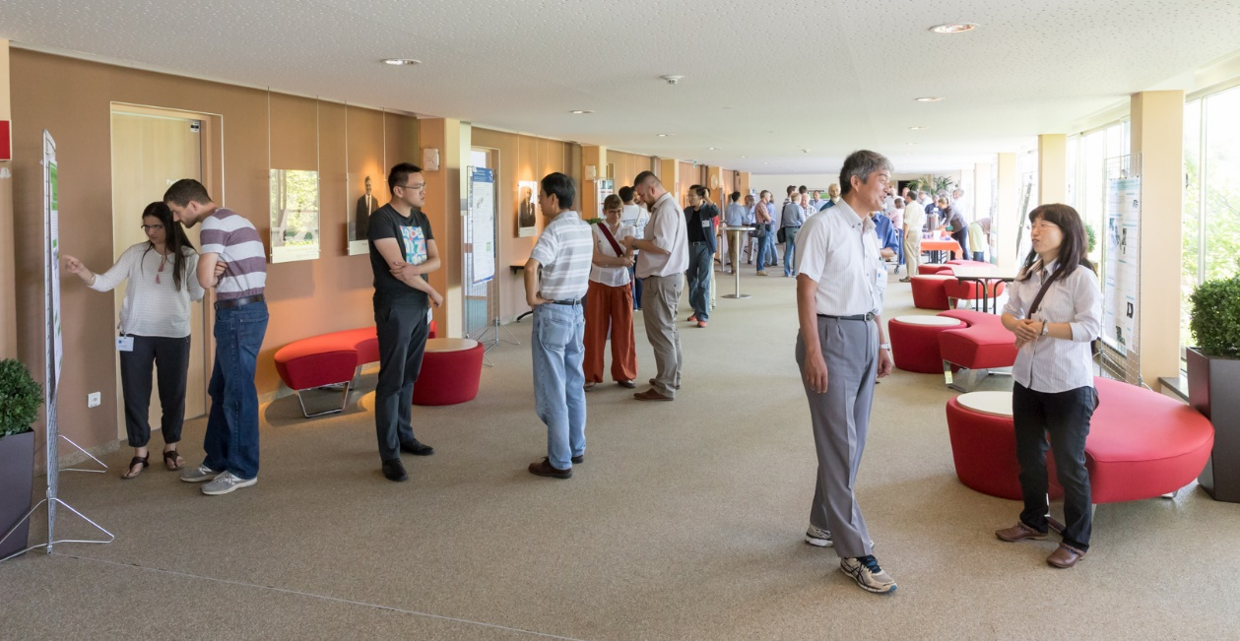
Particular choices:
No parallel sessions
Posters on display during the entire workshop

Slide 4
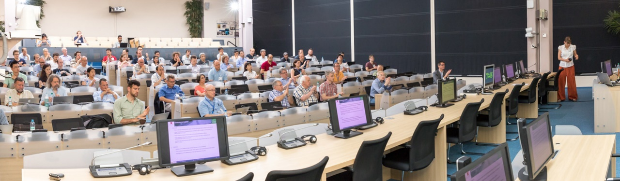
Some statistics
90 participants
60 plenary talks
20 posters

Slide 5
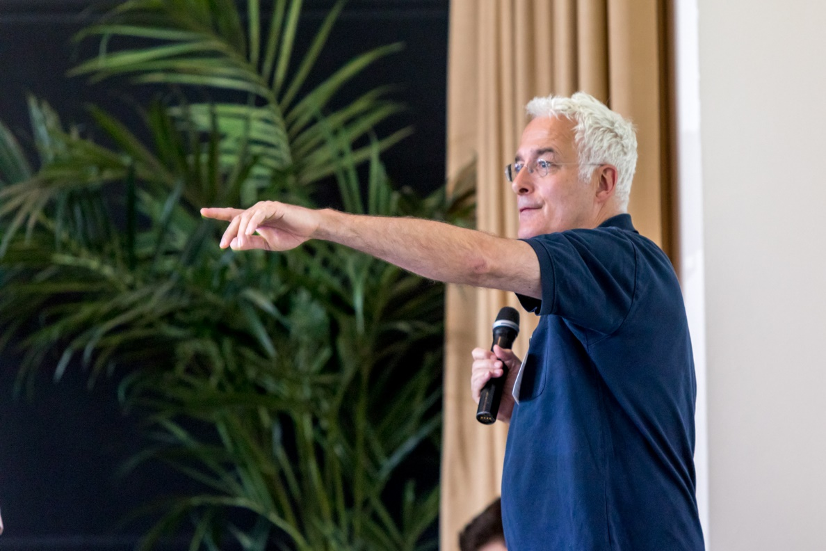
WG1:
Injectors
K. Aulenbacher, E. Wang

Slide 6
Photocathodes:
1
7 presentations
1
6
1
1
1
3
5
3

Slide 7
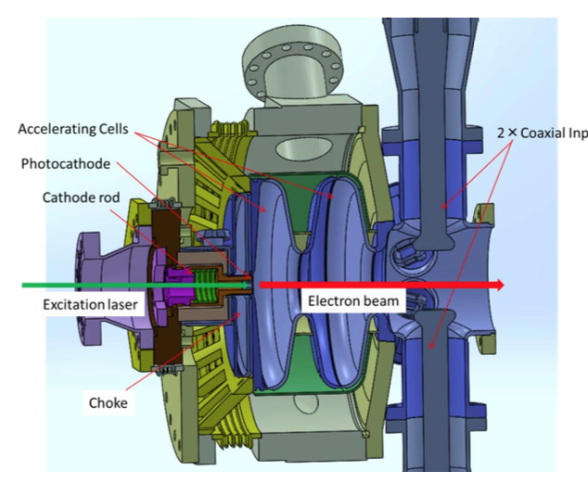
Highlight: back-illuminated cathodes
KEK (T. Konomi): Development of cathodes with laser back-illumination, using a transparent superconducting layer.
Cornell (I. Bazarov):

Slide 8
Electron Guns:
8 presentations
1
4
1
1
2
4

Slide 9
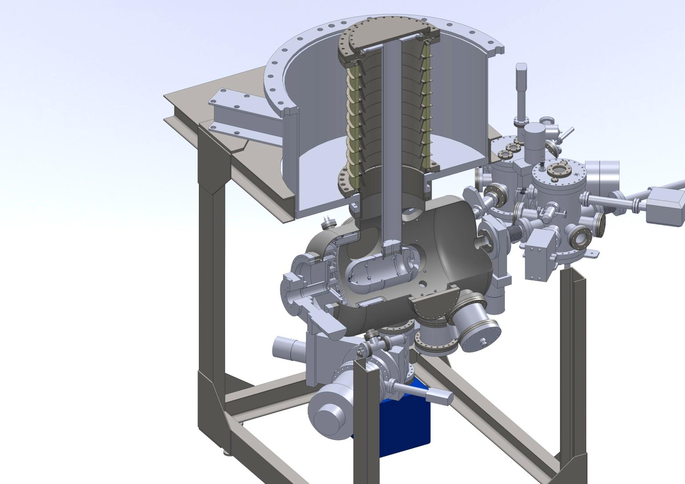
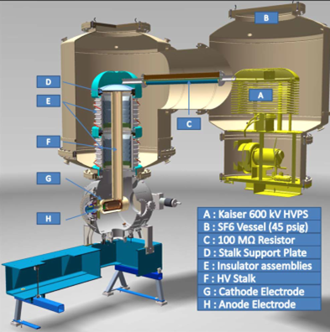

Highlights: some DC guns
DC gun at KEK (N. Nishimori) – operated at 550 kV,
1 mA stable at 390 kV, > 30 C from GaAs cathode:
DC gun for CBETA (K. Smolenski) – delivered 75 mA (!)
2.6 days $ⅇ^{−1}$ lifetime @ 65 mA
Satisfies needs for CBETA!

Slide 10
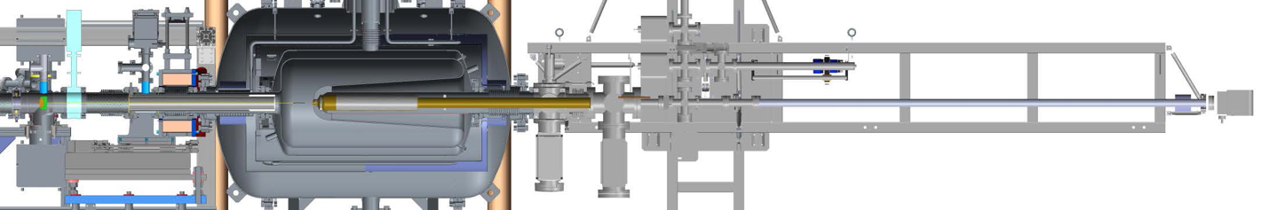
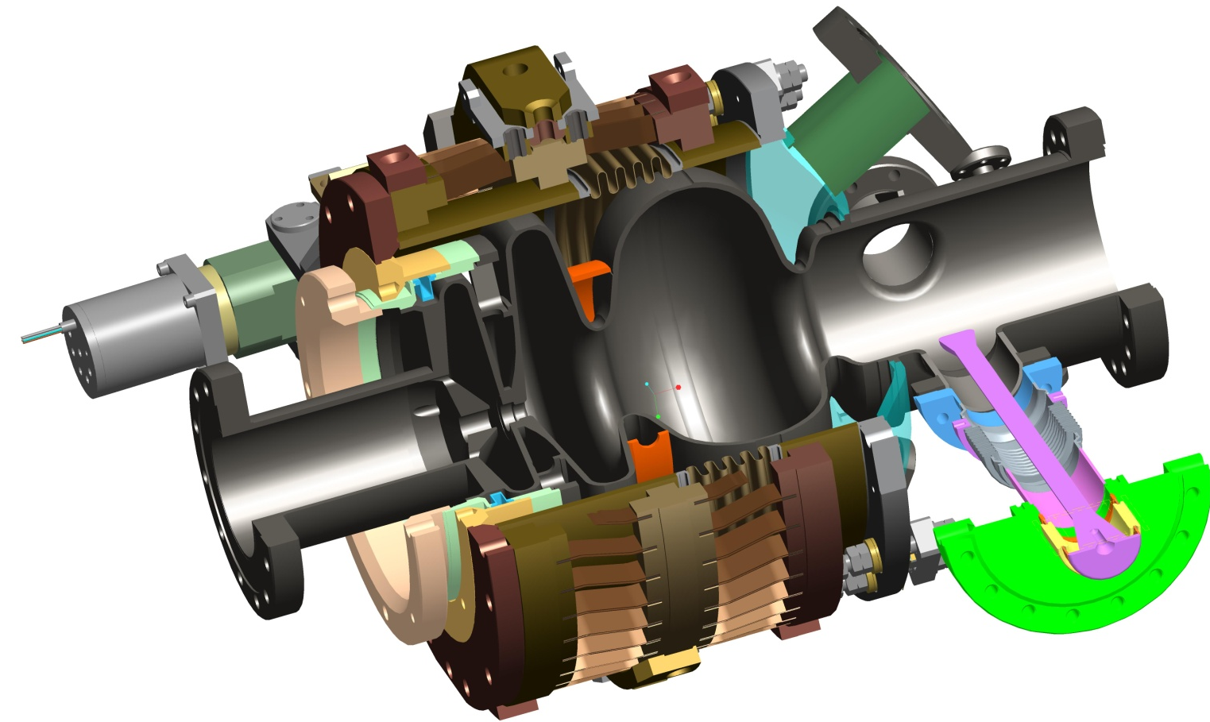
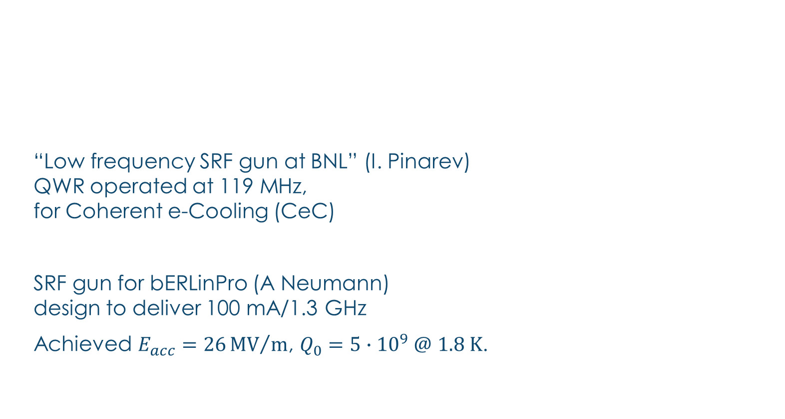
Highlight: SRF guns
 | FZDR | HZB | NPS | Wisconsin | CeC
Charge [pC] | 300 | 6 | 78 | 100 | 3900
E [MV/m] | 5 | 5-7 | 6.5 | 12 | 21
Frequency [MHz] | 1300 | 1300 | 500 | 200 | 113
Cathode | Cs₂Te | Pb | Nb | Cu | CsK₂Sb
“Low frequency SRF gun at BNL” (I. Pinarev)
QWR operated at 119 MHz,
for Coherent e-Cooling (CeC)
SRF gun for bERLinPro (A Neumann)
design to deliver 100 mA/1.3 GHz
Achieved $E_{acc}=26{MV}/m$, $Q_{0}=5∙{10}^{9} @$ $1.8 K$.
Laser cross
FPC
cathode

Slide 11
WG1 Summary
DC Photo-injectors mature
High QE photocathodes – alkali-antimonide: lifetime!!
SRF guns have made significant progress (HZDR, BNL)
Semiconductor cathodes show encouraging lifetimes (months!)

Slide 12
WG2:
Beam Dynamics, Optics and Instrumentation
D. Schulte, A. Bogacz

Slide 13
Learn from past experience
Projects discussed (present and past, construction, planned):
cERL, ALICE, CBETA, MESA, bERLinPro, PERLE, LHeC, eRHIC
Lessons learnt from past ERLs (e.g. ALICE):
  Provide diagnostics to verify your lattice and your beam in all planes!
  Model step-by-step procedures how you will commission and operate!
  Don’t compromise on feedback systems – they’re key to stability!
Issues to be solved for multi-turn ERLs (e.g. CBETA):
High current effects
  space charge
  halo dynamics
  HOM heating
  Intra-Beam Scattering
  Touschek scattering
  Rest Gas scattering
  Ion accumulation
    optics changes
    nonlinear dynamics
    scattering
Beam Quality
  Emittance matching
  Time of flight control of energy spread
  Wakefield interactions
  Micro bunching instability
  Coherent Synchrotron Radiation
Transport of damaged beam
  Phase space rotation for energy spread
  Large 6-D phase-space-aperture optics
Recovery topics
  Energy spread growth during deceleration.
  Halo transverse growth during deceleration.
  Recirculative Beam Breakup instabilities.
    Transverse Dipole BBU
    Longitudinal BBU
    Quadrupole BBU
  Ion instabilities
  Simultaneous control of multiple beams

Slide 14

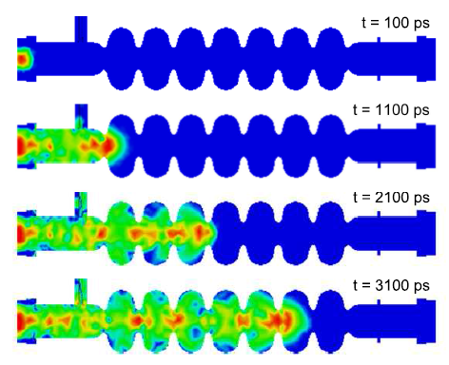

Beam break-up – the current current limit
Beam break-up: a potential limit to ERL currents
Higher Order Modes!
G. Hoffstaetter:
$$V\left(t\right)=T_{12}\frac{e}{c}\int_{−∞}^{t}{W\left(t−τ\right) V\left(τ−T\right) I\left(τ\right)ⅆτ}$$
… and
$$I_{threshold}∝\frac{1}{Q_{HOM}}$$

Slide 15

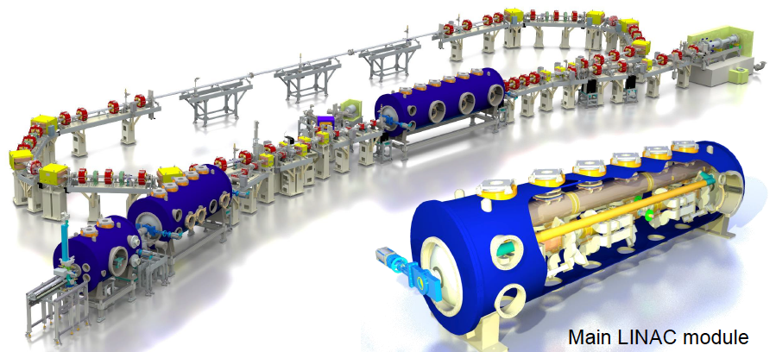

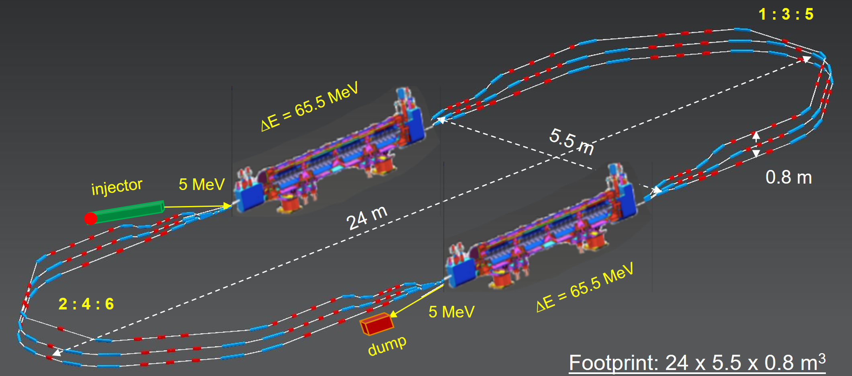


Virtual power
100 mA
50 MeV
A. Jankowiak, M. Abo-Bakr
Virtual power: $5 MW$.
15 mA
400 MeV
W. Kaabi, A. Bogacz
Virtual power: $6 MW$.

Slide 16
WG2 Summary
There is valuable experience out there with existing/past ERL’s – use it:
  Think of plenty diagnostics for lattice and beam!
  Think of how you will set up your machine!
  Invest in sufficient feedback!
There are a number of multi-turn ERL’s planned, conceived or under construction! Especially for those, BBU limits the current – an substantial effort is underway to overcome this limit.

Slide 17
WG3:
Facilities around the world
G. Hoffstaetter, A. Stocchi

Slide 18
Highlight Outcome: table of ERLs
Live document – at present 30 entries! See under www.cern.ch/ERL17 “ERL Facility Summary”

Slide 19
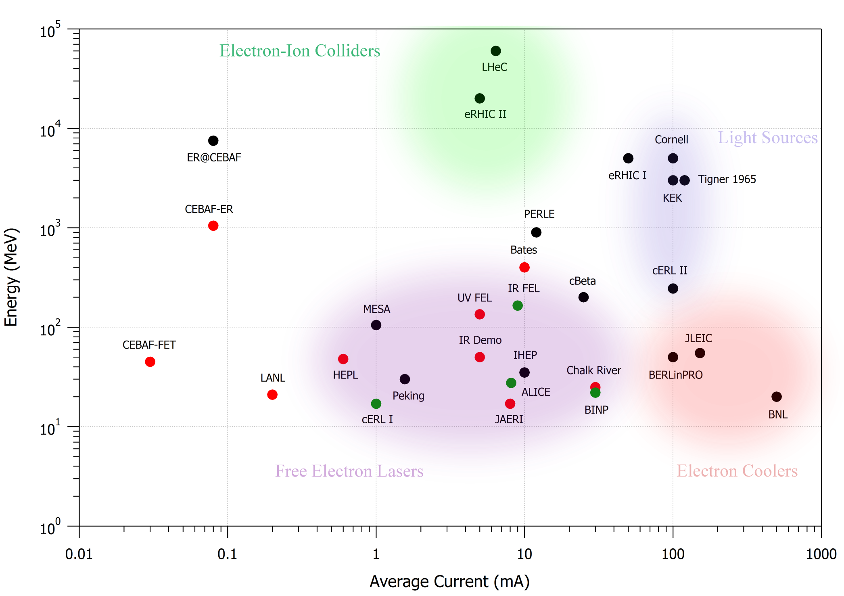
Global ERL Landscape (C. Tennant)
1 GW
100 MW
10 MW
1 kW
10 kW
100 kW
1 MW

Slide 20
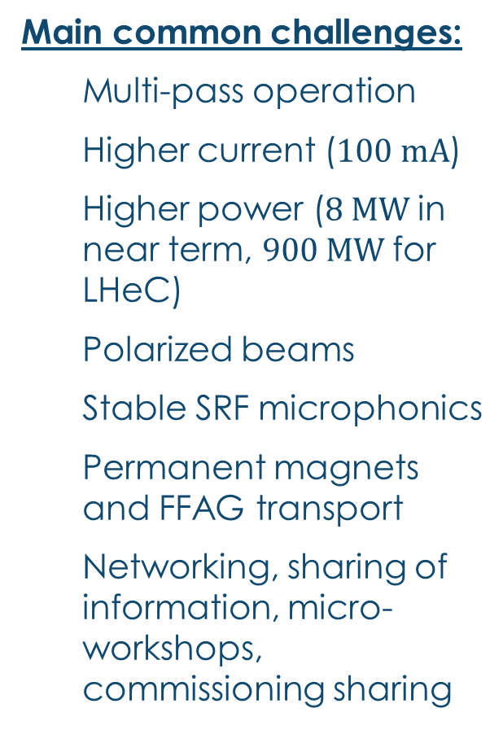
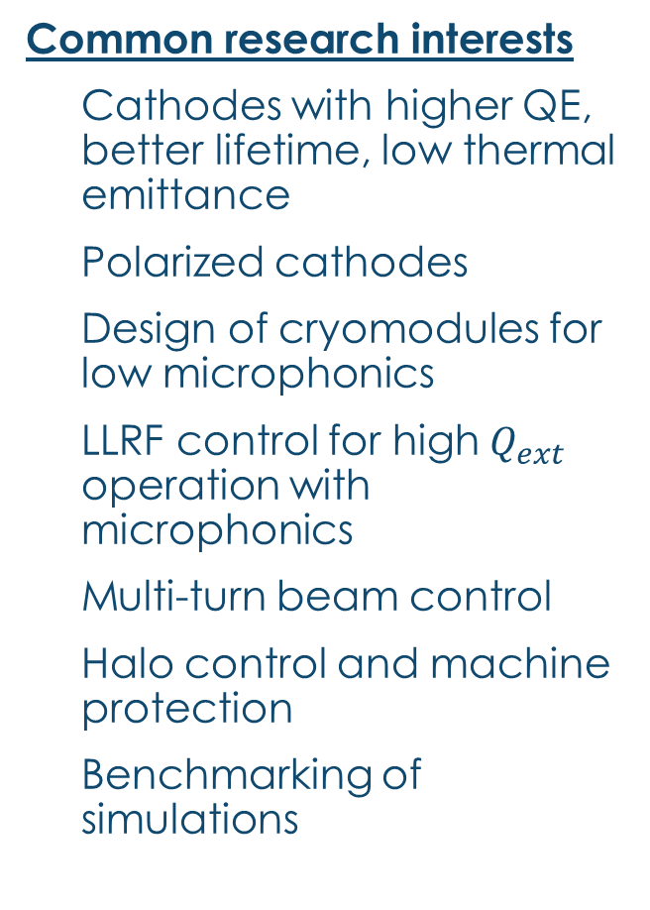
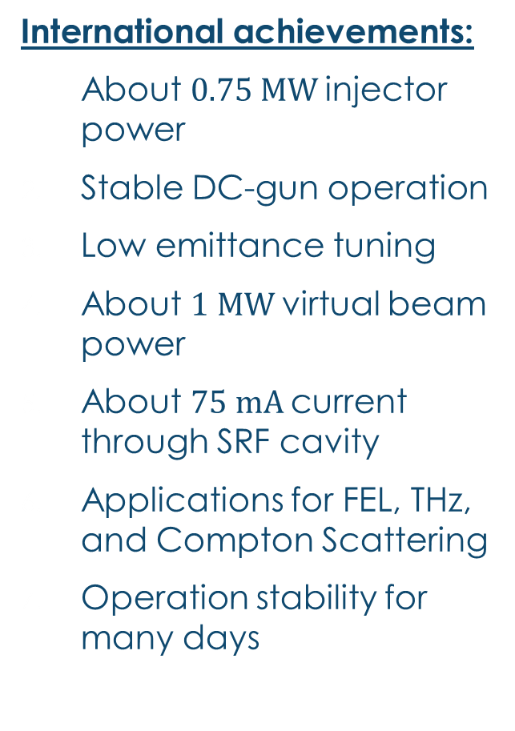
Common achievements & challenges
International achievements:
About $0.75 MW$injector power
Stable DC-gun operation
Low emittance tuning
About $1 MW$virtual beam power
About $75 mA$current through SRF cavity
Applications for FEL, THz, and Compton Scattering
Operation stability for many days
Main common challenges:
Multi-pass operation
Higher current ($100 mA$)
Higher power ($8 MW$in near term, $900 MW$for LHeC)
Polarized beams
Stable SRF microphonics
Permanent magnets and FFAG transport
Networking, sharing of information, micro-workshops, commissioning sharing
Common research interests
Cathodes with higher QE, better lifetime, low thermal emittance
Polarized cathodes
Design of cryomodules for low microphonics
LLRF control for high $Q_{ext}$ operation with microphonics
Multi-turn beam control
Halo control and machine protection
Benchmarking of simulations

Slide 21
WG3 Summary
For the first time, facilities (in construction or planned) reach the multi-MW-range for the virtual beam power (MESA: 1 MW, bERLinPro: 5 MW, C-BETA: 6 MW, PERLE: 8 MW)
The trend clearly goes towards multi-pass operation
Both these features mean new challenges that are now addressed.
The community is coherent and working together well. Common interests are clearly identified.

Slide 22
WG4:
Superconducting RF
I. Ben-Zvi, F. Gerigk

Slide 23
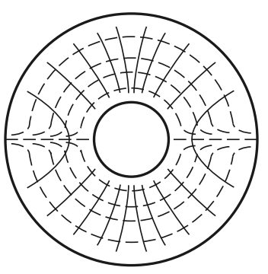
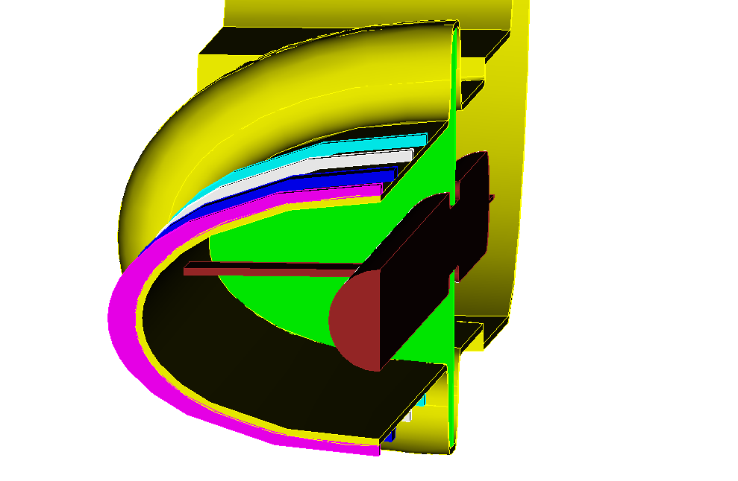
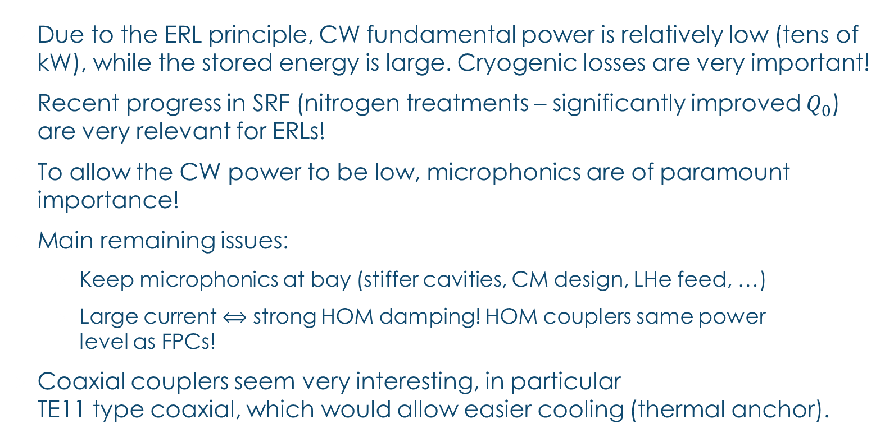

WG4 Summary
Due to the ERL principle, CW fundamental power is relatively low (tens of kW), while the stored energy is large. Cryogenic losses are very important!
Recent progress in SRF (nitrogen treatments – significantly improved $Q_{0}$) are very relevant for ERLs!
To allow the CW power to be low, microphonics are of paramount importance!
Main remaining issues:
  Keep microphonics at bay (stiffer cavities, CM design, LHe feed, …)
  Large current $⟺$ strong HOM damping! HOM couplers same power
  level as FPCs!
Coaxial couplers seem very interesting, in particular
TE11 type coaxial, which would allow easier cooling (thermal anchor).
$$TE_{11}$$

Slide 24
WG5:
Applications
I. Konoplev, P. MacIntosh

Slide 25
WG5 Summary
An increasing interest in a variety of photon applications can be observed.
THz, IR-FEL, EUV-FEL and Laser Compton Scattering (LCS) X-Ray applications, all require
  Good stability, low emittance, good availability!
Applications presented:
  LERF: “Dark Light” experiments (e- p interaction internal target)
  NovoFEL (BINP), user facility: THz, IR and EUV. E.g.: Spectrometry, photo-chemistry, surface plasmon polaritons (SPP)
  Asymmetric ERL (JAI proposal): THz: security, EUV: lithography
  CBETA: Specific test facility for e-RHIC, many of the above plus:
    Beam for time-resolved electron diffraction from 1-6 MeV,
    Beam for Plasma Wakefield Acceleration with High Transformer Ratio
  PERLE: Many of the above plus:
    Testing of SRF components with beam,
    Testing of detector components for LHC & FCC
  With LCS: Vortex beams (beams with helical wave front, could solve “proton spin puzzle”)
  MESA: nuclear physics applications, proposed eperiments
    “MAGIX” (MAinz Gas Internal eXperiment, to solve “proton radius puzzle”, dark photon searches, …)
    “P2” (external target experiment, no energy recovery)

Slide 26
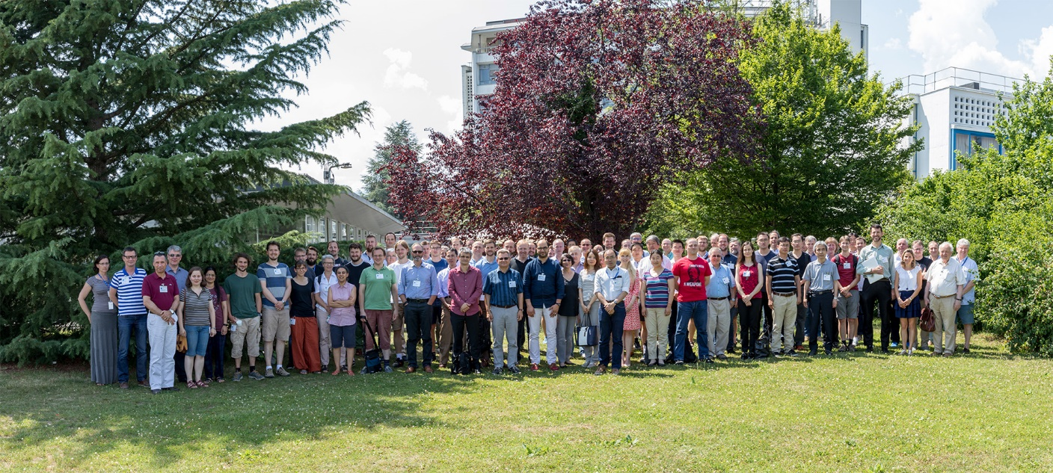
Thank you very much!

