Slide 1
What can the LHeC/FCCeh and LHC achieve in terms of precision on PDFs
LHeC workshop CERN 2017

Slide 7
So let’s see how well the LHC is doing
NNPDF3.1 includes modern LHC data on W,Z +jets+top+Zpt from 7 and 8 TeV running
Compare PDFs with an without LHC

Slide 8
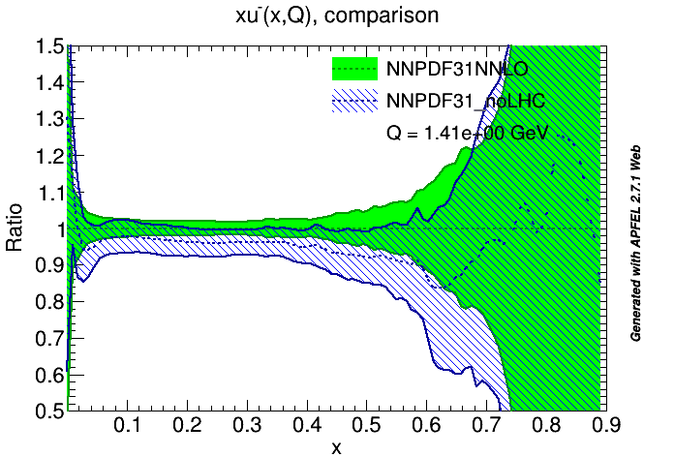
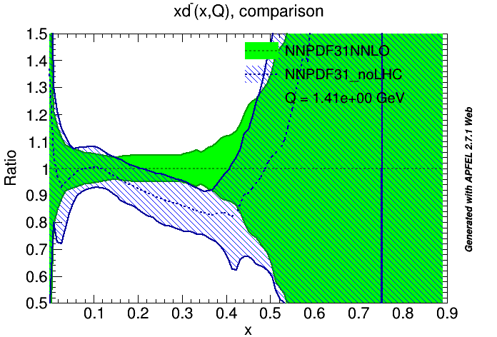

Slide 10
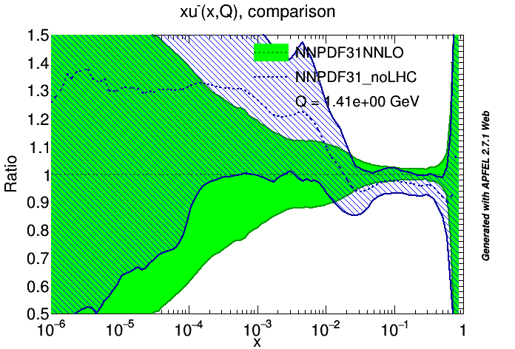
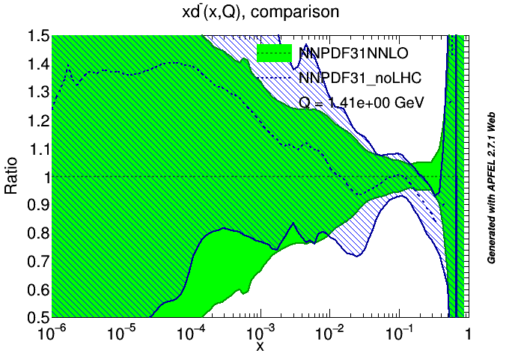

Slide 11
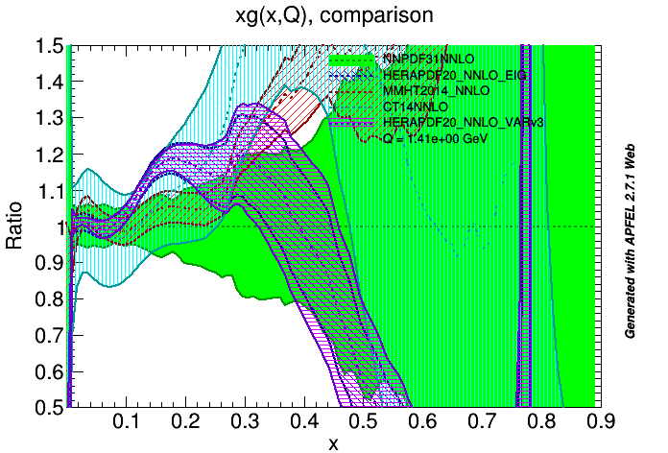
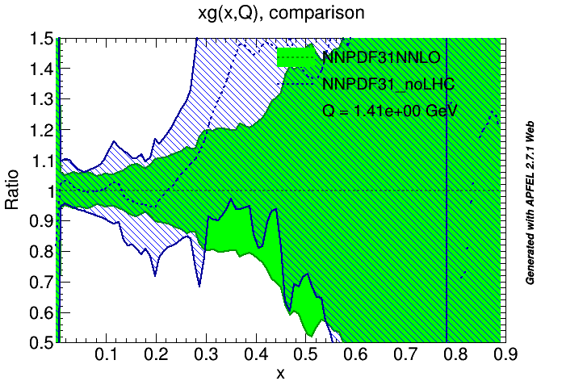
3.1

Slide 13
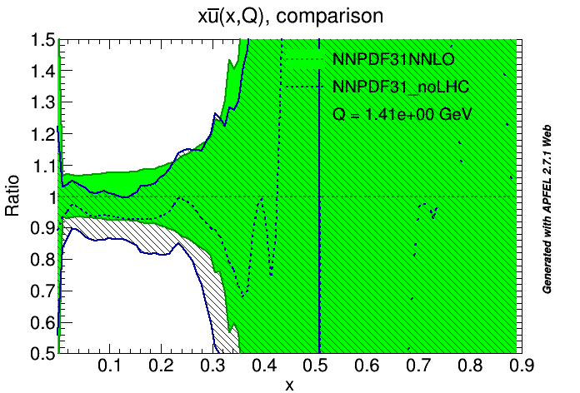
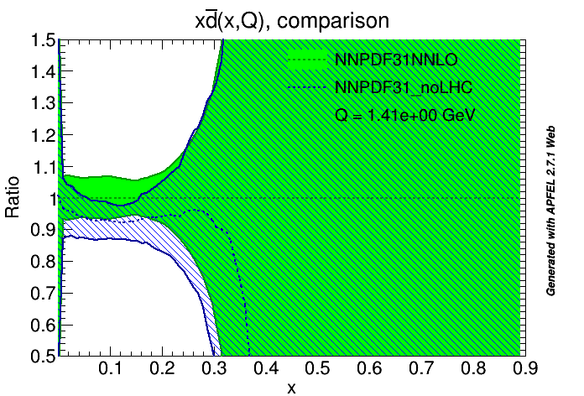

Slide 15
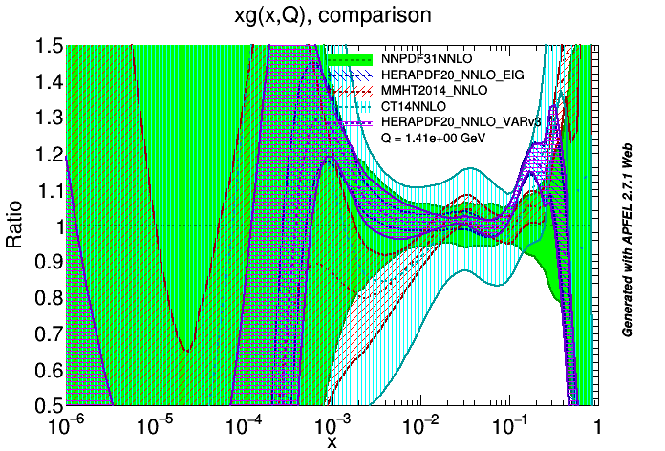
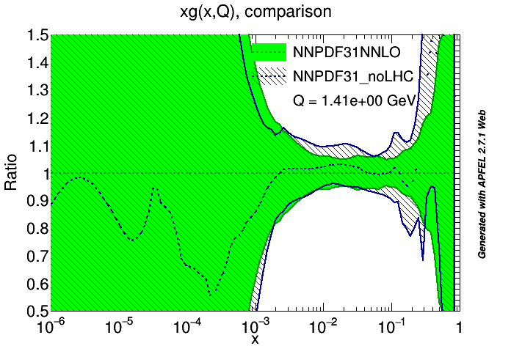

Slide 16
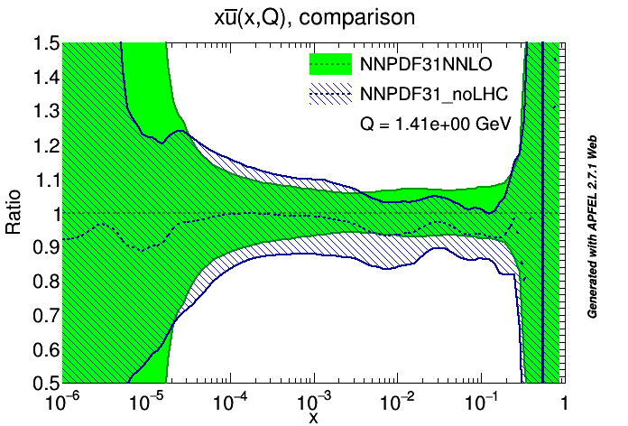
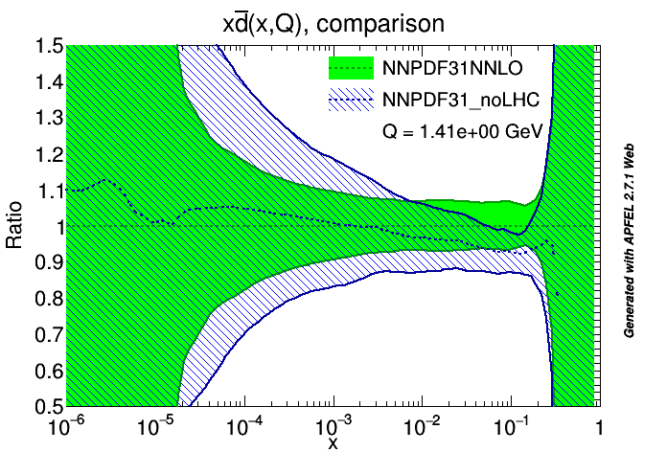

Slide 18
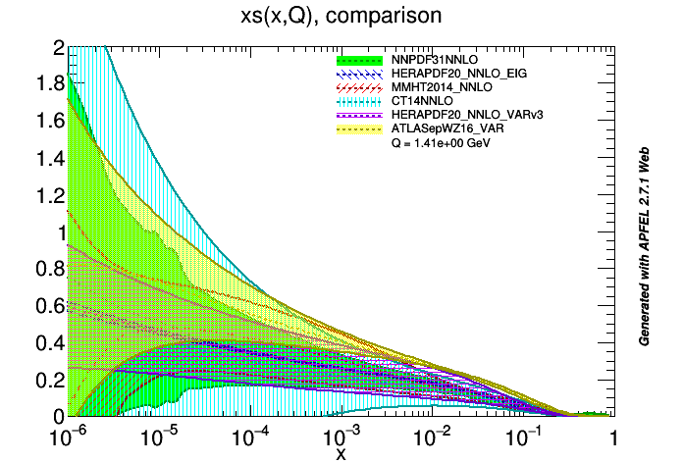

Slide 19
We have been discussing how much better the LheC in terms of PDF precision and comparing to today’s LHC results
But how well can the LHC itself do in future-in the next few years?
The change from NNPDF3.0 to 3.1 shows us how much improvement is coming from recent LHC measurements on W,Z+jets+top+Zpt
The improvements are substantial but still modest compared to the potential of the LHC
But won’t this level of improvement keep on happening?
ALMOST CERTAINLY NOT because we have already hit the ultimate limit of precision- at least with regard to q-qbar.
The NNPDF3.1 already contains the ultimate precision on W,Z production

Slide 21
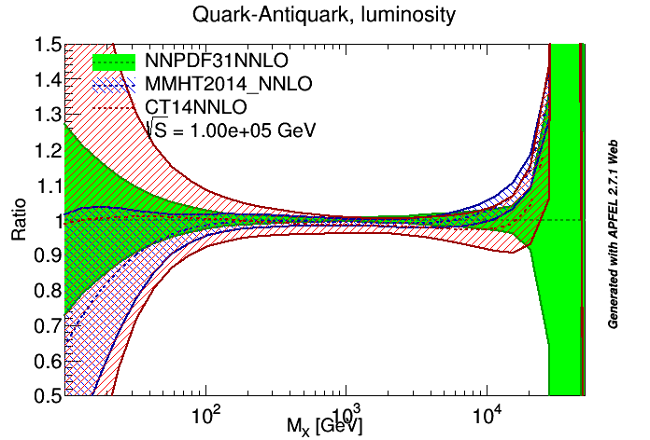
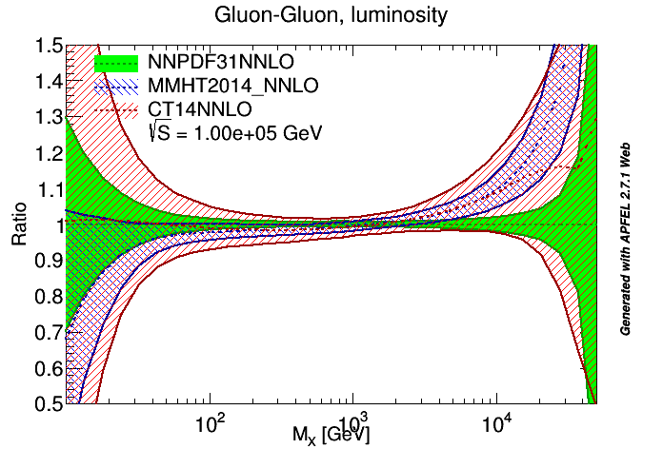
Now let’s consider parton luminosities at future colliders

Slide 22
What if we put the electron LINAC in the FCC ring– how much could we improve on the LHeC?

Slide 23
FCCeh vs LHeC

Slide 25
This estimated accuracy of 0.3% comes from te inclusive data scaling violations- there will also be LHeC jet data, to improve on this

Slide 26
Furthermore PDF uncertainties and α_{S} DOMINATE the Higgs cross-section
The LHeC can give a tremendous improvement on this– see talks in the Higgs
session

Slide 27
Summary
The LHeC/FCC-eh can give an increase in the kinematic reach of Deep Inelastic Scattering and an increase in the luminosity
This would yield a tremendous increase in the precision of Parton Distributions
Data from the LHC itself cannot improve current PDFs to the same degree
Precision PDFs are needed for BSM physics- both at the LHC and FCC-hh
Furthermore the LHeC could yield per mille precision on α_{S}
Reduction in α_{S} uncertainty and PDF uncerarinty together will reduce the uncertainty predictions for the Higgs cross section substantially
Finally the LHeC allows the exploration of a kinematic regime at low-x where we learn more about QCD beyond DGLAP evolution and beyond linear evolution. The FCC-eh extends this further- see tomorrow’s session

Slide 28
Back ups

