Slide 1



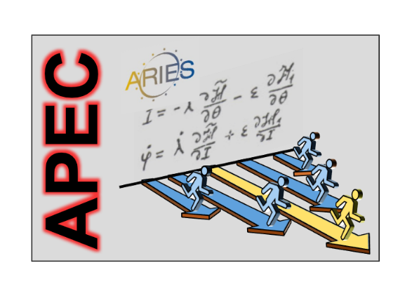
future uses of the LHeC – motivation, ERL as γγ collider SAPPHiRE, as injector for FCC-ee ,or …
Frank Zimmermann
LHeC & FCC-eh workshop
CERN, 13 September 2017
many thanks to I. Chaikovska, F. Hug,
S. Ogur, Y. Papaphilippou, D. Shatilov,
V. Shiltsev,..
ARIES is co-funded by the European Commission in the HORIZON 2020 Research and Innovation programme under grant agreement no 730871.

Slide 2
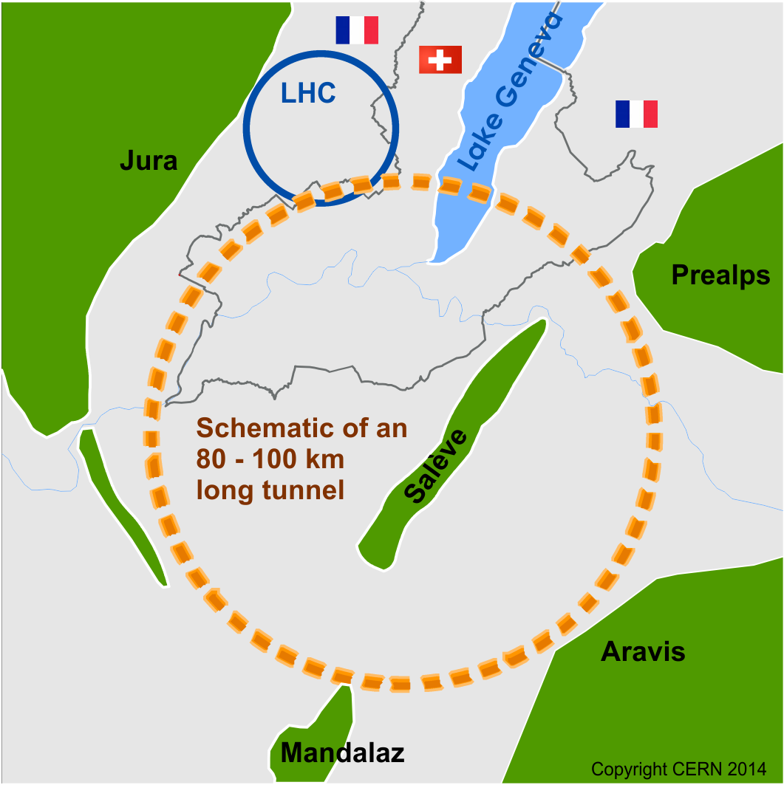
Future Circular Collider Study
Goal: CDR for European Strategy Update 2019/20
international FCC collaboration (CERN as host lab) to design:
pp-collider (FCC-hh) → main emphasis, defining infrastructure requirements
80-100 km tunnel infrastructure in Geneva area, site specific
e⁺e⁻ collider (FCC-ee), as a possible first step
p-e (FCC-he) option, one IP, FCC-hh & ERL
HE-LHC w FCC-hh technology
HE-LHC
~16 T ⇒ 100 TeV pp in 100 km
suggested
in 2010

Slide 3
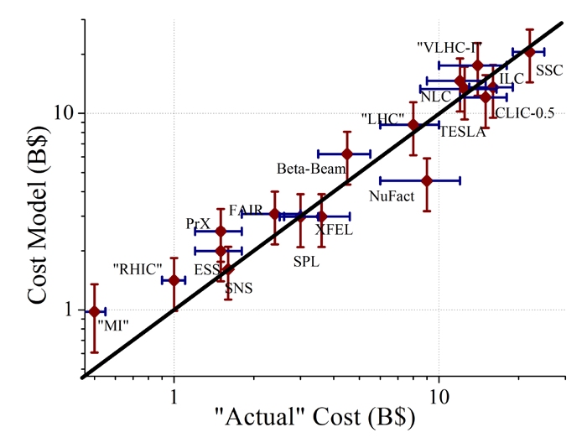
project costs fitted by αβγ model
Cost(TPC) = α L^{1/2} + β E^{1/2} + γ P^{1/2}
The αβγ-model is good to +-30%
V. Shiltsev

Slide 4
technology cost drivers
“SRF is the most expensive technology ever invented”
β≈ 10 B$/sqrt(E/TeV)
“only plasma acceleration is even more expensive”
β≈ XX B$/sqrt(E/TeV)
V. Shiltsev

Slide 5
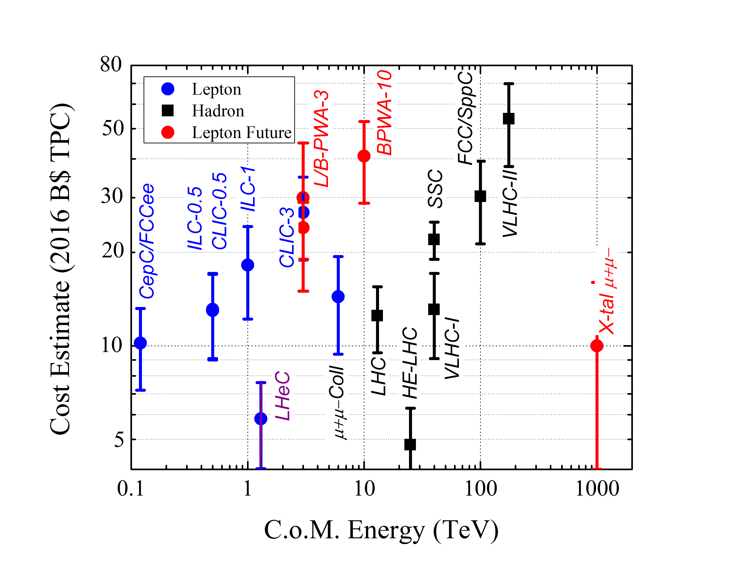
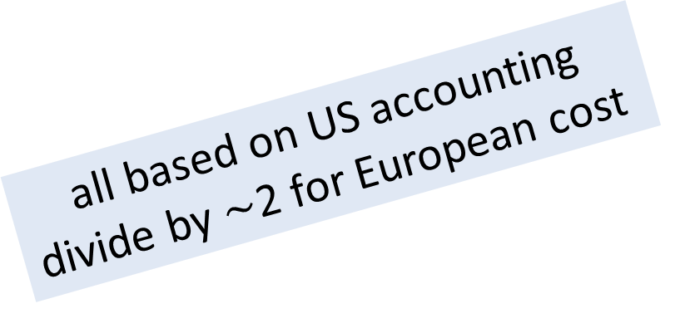
predicting costs by αβγ model
all based on US accounting
divide by $\sim$2 for European cost
V. Shiltsev

Slide 6
V. Shiltsev
3 recipes to lower the cost of future highest-energy colliders
reduce the technology cost
  - LHeC: N doping etc.
build on a site with existing injector complex
  - or make LHeC part of the complex
consider staging (see next!)

Slide 7

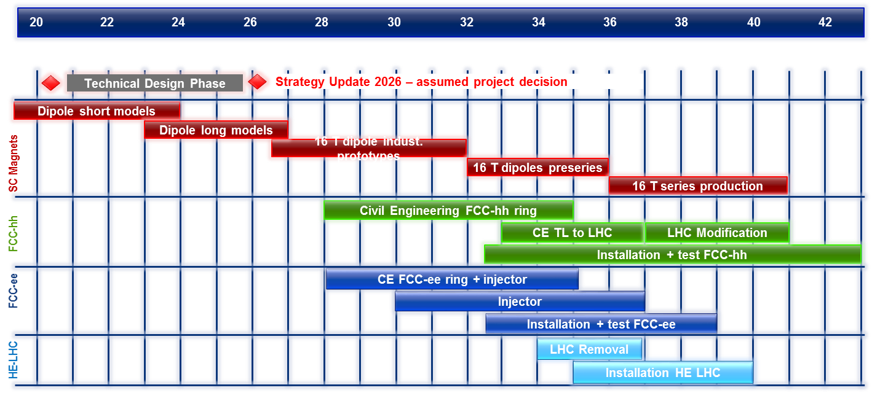
FCC Fastest Possible Technical Schedule
technical schedule defined by magnets program and by CE
→ earliest possible physics starting dates:
FCC-hh: 2043
FCC-ee: 2039
HE-LHC: 2040 (with HL-LHC stop at LS5 / 2034)
M. Benedikt

Slide 8
fitting the LHeC
LHeC
SAPPHiRE
FCC-eh
HE-LHeC
FCC-ee injector

Slide 9
fitting the LHeC
LHeC
SAPPHiRE
FCC-eh
HE-LHeC
FCC-ee injector

Slide 10
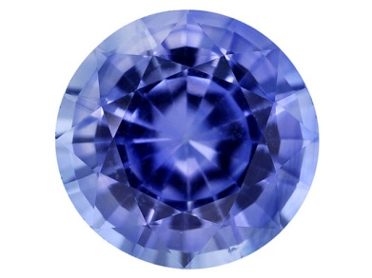
SAPPHiRE

Slide 11
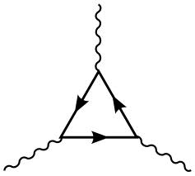
a new type of collider?
γ
s-channel production;
lower energy;
no e⁺ source
t, W, …
H
another advantage:
no beamstrahlung
→ higher energy reach
than e⁺e⁻ colliders
γ
γγ collider Higgs factory

Slide 12
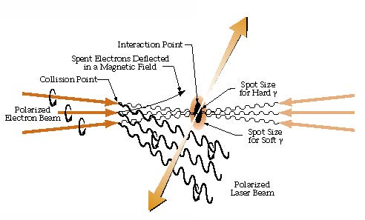
combining photon science & particle physics!
γγ collider based on e⁻
K.-J. Kim, A. Sessler
Beam Line
Spring/Summer 1996
few J pulse
energy with
λ~350 nm

Slide 13
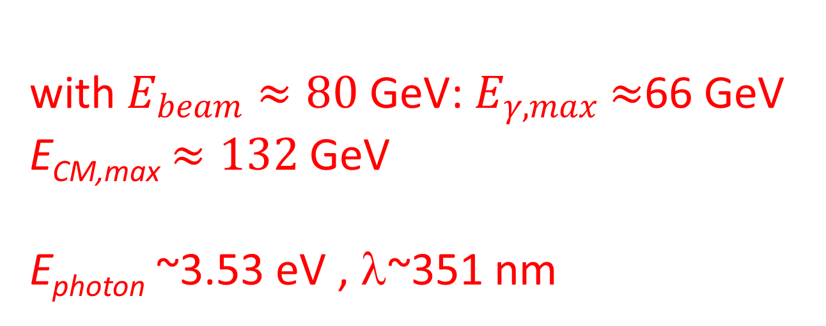
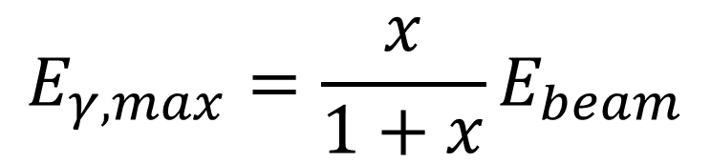
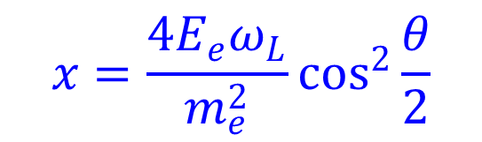
which beam & photon energy / wavelength?
$$E_{γ,max}=\frac{x}{1+x}E_{beam}$$
$$x=\frac{4E_{e}ω_{L}}{m_{e}^{2}}\cos^{2}{\frac{θ}{2}}$$
example x ≈ 4.3
(for x>4.83 coherent pair production occurs)
$\text{with} E_{beam}≈80 \text{GeV}\text{:}{ E}_{γ,max}$ $≈$66 GeV
E_{CM,max} $≈132$ GeV
E_{photon} ~3.53 eV , λ~351 nm

Slide 14
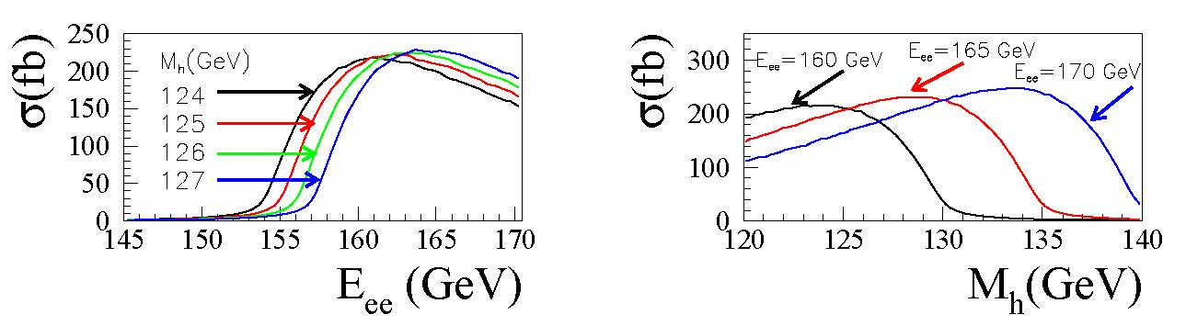
Higgs γγ production cross section
S. A. Bogacz, J. Ellis, L. Lusito, D. Schulte, T. Takahashi, M. Velasco, M. Zanetti, F. Zimmermann,
‘SAPPHiRE: a Small Gamma-Gamma Higgs Factory,’ arXiv:1208.2827
Left: The cross sections for γγ → h for different values of Mh as functions of ECM(e⁻e⁻).
Right: The cross section for γγ→ h as a function of Mh for three different values of ECM(e⁻e⁻).
Assumptions: electrons have 80% longitudinal polarization and lasers are circularly polarized, so that produced photons are highly circularly polarized at their maximum energy.

Slide 15
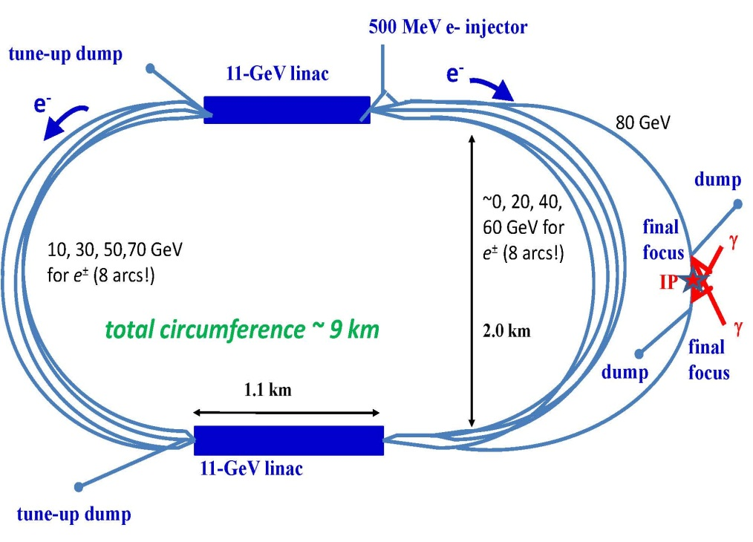
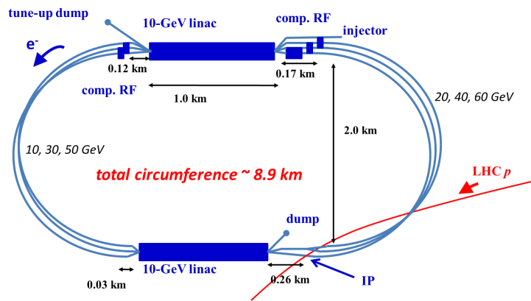
Reconfiguring LHeC → SAPPHiRE
SAPPHiRE*
γγ Higgs factory
LHeC-ERL
*Small Accelerator for Photon-Photon Higgs production using Recirculating Electrons
S. A. Bogacz, J. Ellis, L. Lusito, D. Schulte, T. Takahashi, M. Velasco, M. Zanetti, F. Zimmermann,
‘SAPPHiRE: a Small Gamma-Gamma Higgs Factory,’ arXiv:1208.2827

Slide 16

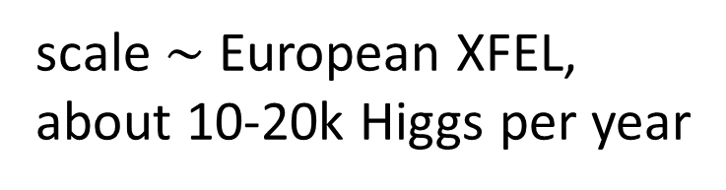
SAPPHiRE: a Small γγ Higgs Factory
scale $\sim$ European XFEL,
about 10-20k Higgs per year
SAPPHiRE: Small Accelerator for Photon-Photon Higgs production using Recirculating Electrons

Slide 17
SAPPHiRE | symbol | value
total electric power | P | 100 MW
beam energy | E | 80 GeV
beam polarization | P_{e} | 0.80
bunch population | N_{b} | 10¹⁰
repetition rate | f_{rep} | 200 kHz
bunch length | σ_{z} | 30 μm
crossing angle | θ_{c} | ≥20 mrad
normalized horizontal/vert. emittance | γε_{x,y} | 5,0.5 μm
horizontal IP beta function | β_{x}* | 5 mm
vertical IP beta function | β_{y}* | 0.1 mm
horizontal rms IP spot size | σ_{x}* | 400 nm
vertical rms IP spot size | σ_{y}* | 18 nm
horizontal rms CP spot size | σ_{x}^{CP} | 400 nm
vertical rms CP spot size | σ_{y}^{CP} | 440 nm
e⁻e⁻ geometric luminosity | L_{ee} | 2x10³⁴ cm⁻²s⁻¹
average beam current 2x0.3 mA

Slide 18
SAPPHiRE | symbol | value
total electric power | P | 100 MW
beam energy | E | 80 GeV
beam polarization | P_{e} | 0.80
bunch population | N_{b} | 10¹⁰
repetition rate | f_{rep} | 200 kHz
bunch length | σ_{z} | 30 μm
crossing angle | θ_{c} | ≥20 mrad
normalized horizontal/vert. emittance | γε_{x,y} | 5,0.5 μm
horizontal IP beta function | β_{x}* | 5 mm
vertical IP beta function | β_{y}* | 0.1 mm
horizontal rms IP spot size | σ_{x}* | 400 nm
vertical rms IP spot size | σ_{y}* | 18 nm
horizontal rms CP spot size | σ_{x}^{CP} | 400 nm
vertical rms CP spot size | σ_{y}^{CP} | 440 nm
e⁻e⁻ geometric luminosity | L_{ee} | 2x10³⁴ cm⁻²s⁻¹
average beam current 2x0.3 mA

Slide 19
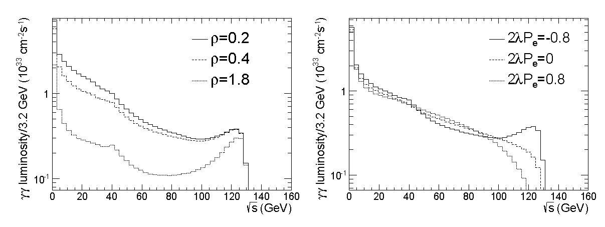

SAPPHiRE γγ luminosity
M. Zanetti
luminosity spectra for SAPPHiRE as functions of E_{CM}(γγ), computed using Guinea-Pig for three possible normalized distances ρ≡l_{CP-IP}/(γσ_{y}*) (left) and different polarizations of in-coming particles (right)
ρ=1 ↔ l_{CP-IP}$\sim$2 mm

Slide 20
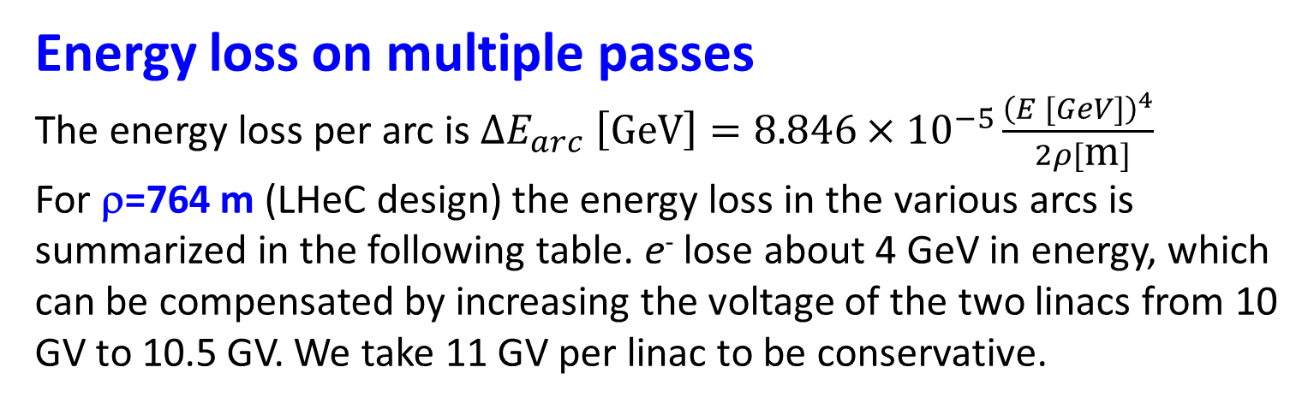
Energy loss on multiple passes
The energy loss per arc is $∆E_{arc} \left[\text{GeV}\right]=8.846×{10}^{−5}\frac{{\left(E [GeV]\right)}^{4}}{ 2ρ[\text{m}]}$
For ρ=764 m (LHeC design) the energy loss in the various arcs is summarized in the following table. e⁻ lose about 4 GeV in energy, which can be compensated by increasing the voltage of the two linacs from 10 GV to 10.5 GV. We take 11 GV per linac to be conservative.
beam energy [ GeV] | ΔE_{arc} [GeV] | Δσ_{E} [MeV]
10 | 0.0006 | 0.038
20 | 0.009 | 0.43
30 | 0.05 | 1.7
40 | 0.15 | 5.0
50 | 0.36 | 10
60 | 0.75 | 20
70 | 1.39 | 35
80 | 1.19 | 27
total | 3.89 | 57 (0.071%)

Slide 21
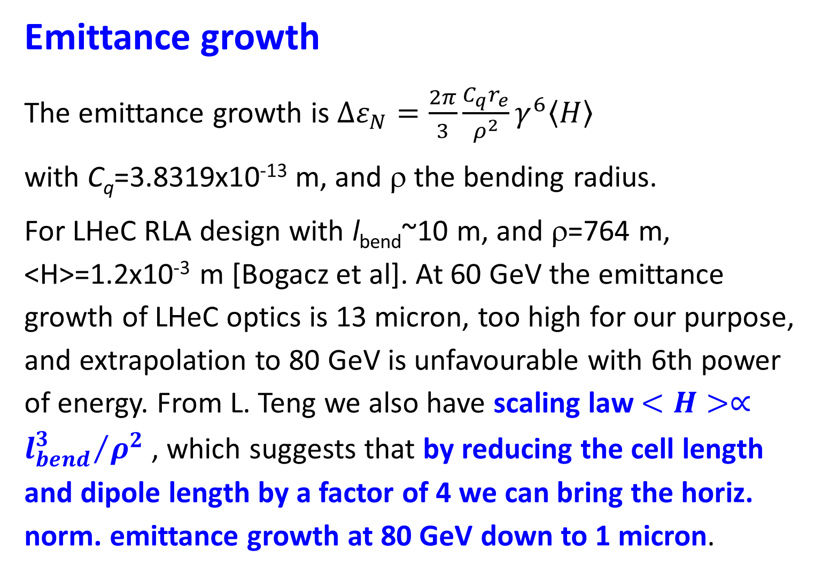
Emittance growth
The emittance growth is $∆ε_{N}=\frac{2π}{3}\frac{C_{q}r_{e}}{ρ^{2}}γ^{6}〈H〉$
with C_{q}=3.8319x10⁻¹³ m, and ρ the bending radius.
For LHeC RLA design with l_{bend}~10 m, and ρ=764 m, <H>=1.2x10⁻³ m [Bogacz et al]. At 60 GeV the emittance growth of LHeC optics is 13 micron, too high for our purpose, and extrapolation to 80 GeV is unfavourable with 6th power of energy. From L. Teng we also have scaling law $<H>∝{l_{bend}^{3}}/{ρ^{2}}$ , which suggests that by reducing the cell length and dipole length by a factor of 4 we can bring the horiz. norm. emittance growth at 80 GeV down to 1 micron.
Δε_{Ν,x}≤1 μm:
reduced LHeC cell length
52 → 13 m
will do
Valery Telnov thinks this scaling is too optimistic

Slide 22
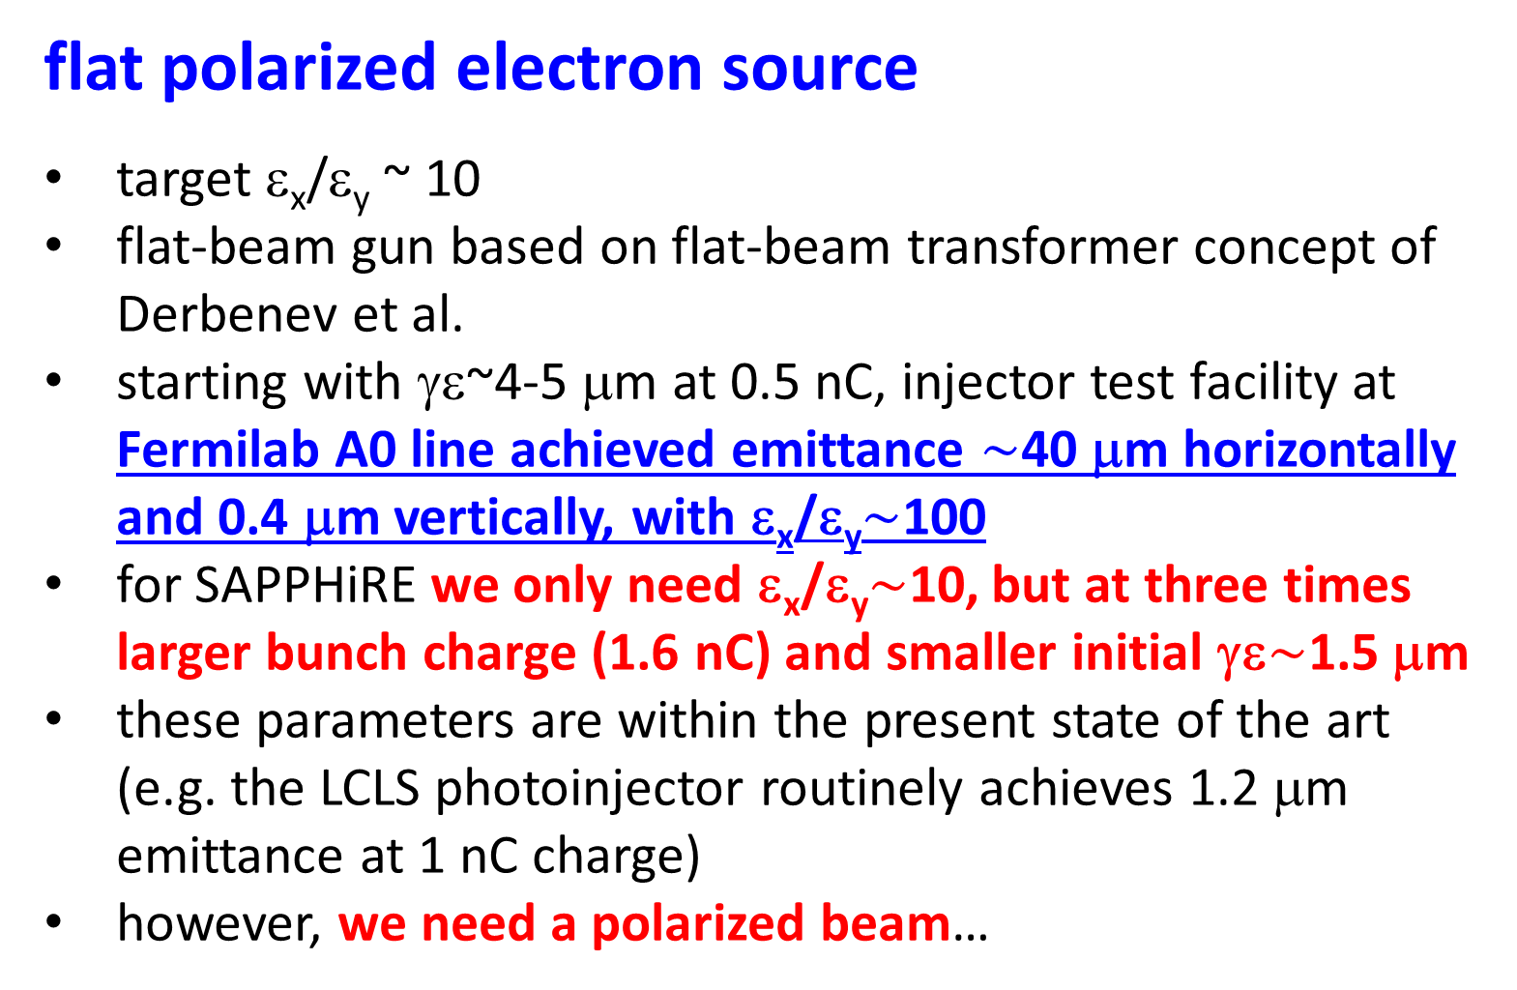
flat polarized electron source
target ε_{x}/ε_{y} ~ 10
flat-beam gun based on flat-beam transformer concept of Derbenev et al.
starting with γε~4-5 μm at 0.5 nC, injector test facility at Fermilab A0 line achieved emittance $\sim$40 μm horizontally and 0.4 μm vertically, with ε_{x}/ε_{y}$\sim$100
for SAPPHiRE we only need ε_{x}/ε_{y}$\sim$10, but at three times larger bunch charge (1.6 nC) and smaller initial γε$\sim$1.5 μm
these parameters are within the present state of the art (e.g. the LCLS photoinjector routinely achieves 1.2 μm emittance at 1 nC charge)
however, we need a polarized beam…
Valery Telnov stressed this difficulty

Slide 23
normalized emittance for 1 nC has been reduced from tens of μm to 1 μm
Bruce Carlsten, SPACE CHARGE 2013
SLAC
polarization?
Boeing
BNL
LANL – AFEL
BNL/UCLA/SLAC
LANL - APEX
BNL/KEK/SHI
BNL/UCLA/SLAC
LCLS scaling:
PITZ scaling:

Slide 24

can we get $\sim$ 1-nC polarized e⁻ bunches
with $\sim$1 μm emittance?
long-standing R&D efforts:
low-emittance DC guns
(MIT-Bates, Cornell, SACLA?, JAEA, KEK,
Daresbury, …)
[E. Tsentalovich, I. Bazarov, B. Militsyn, et al]
polarized SRF guns (FZD, BNL, …)
[J. Teichert, J. Kewisch, et al]

Slide 25
Cornell DC gun
The answer is a qualified 'yes‘. Presently we have demonstrated 90% emittances of 0.5mm-mrad at 80pC/bunch and 0.2mm-mrad at 20pC/bunch for 2ps rms bunches with the gun voltage and photocathode we are using. The scaling with charge is bunch_charge^(1/2) meaning that numbers around 2-3 mm-mrad should be doable from our gun today [for 1-2 nC charge].
We are working on further improving our gun and laser shaping, expecting to halve the emittance even when using the same photocathodes we have today. Better photocathodes automatically translate into smaller emittances and many pursue this venue as well
Ivan Bazarov, 7 Nov 12
SACLA pulsed “DC” gun
I think our gun almost meets your requirement except for the repetition rate
Hitoshi Tanaka, 7 Nov 12

Slide 26
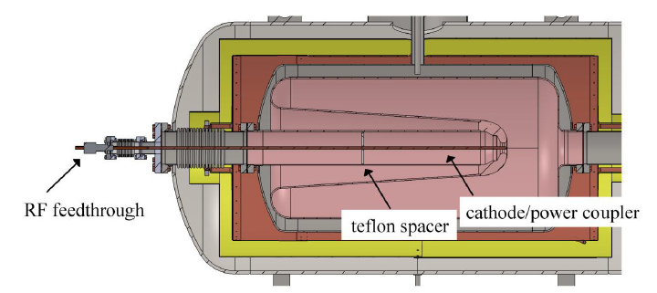
Rossendorf polarized SRF gun
Für 2013 wollen wir die 2. Version der SRF-Gun in Betrieb nehmen. Das neue Cavity erreichte im Test am Jlab ein Peakfeld von 43 MV/m. Mit diesen Werten sollten wir 1 nC Ladung mit 500 kHz Reprate im CW (0.5 mA average current) erreichen. Die Emittanz könnte etwa 2 µm sein. Auf 1 µm könnte man etwa kommen, wenn wir vom Gausslaser zum Flat-top übergehen (analog zu PITZ/XFEL gun).
Mit der Inbetriebnahme der 2. Gun, wird dann auch das Kathodentransfersystem ausgetauscht, und wir denken dann auch die GaAs-Kathoden zu testen. Ergebnisse dann im Jahr 2014.
Jochen Teichert, 12 Nov 12
BNL QWT polarized SRF gun
    simulations of 5 μm emittance
    at 10 nC with 112 MHz gun
Tor Raubenheimer, 14 Nov 2012

Slide 27
recent e⁻ gun progress (LHeC/FCC-eh)
cryogenic photocathodes (L. Cultrera et al.,
Cornell, PRST-AB 18, 113401 (2015); F. Hug)
DC gun for CBETA (K. Smolenski, Cornell; E. Jensen) –
delivered 75 mA (!) 2.6 days lifetime @ 65 mA
PERLE gun design (Daresbury, B. Militsyn, T. Noakes)
γε< 25 μm (!?), 20 mA

Slide 28
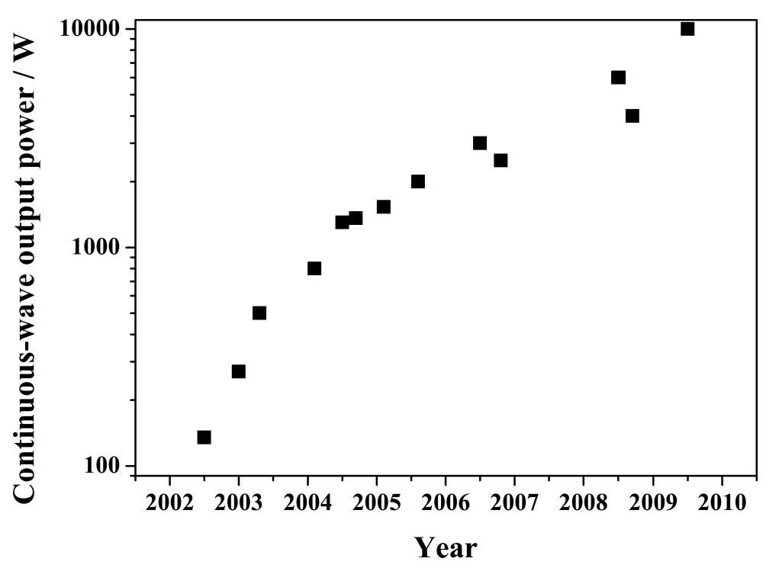
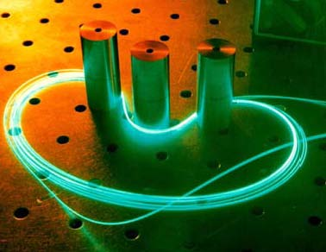
laser progress: example fiber lasers
power evolution of cw double-clad
fiber lasers with diffraction limited
beam quality over the past decade:
factor 100 increase!
Source: Fiber lasers and amplifiers: an ultrafast performance evolution, Jens Limpert, Thomas Schreiber, and Andreas Tünnermann, Applied Optics, Vol. 49, No. 25 (2010)

Slide 29
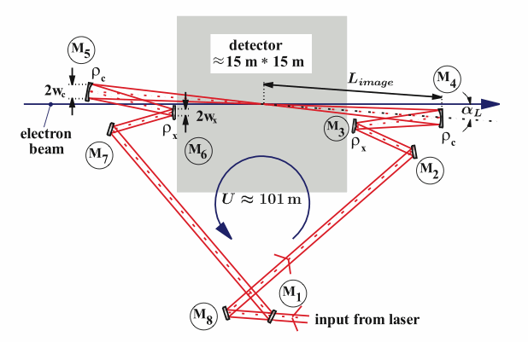
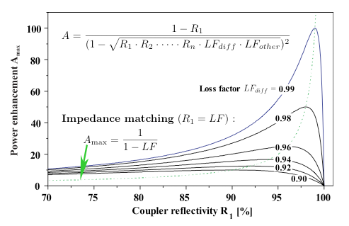
passive optical cavity
→
relaxed
laser
parameters
K. Moenig et al, DESY Zeuthen

Slide 30
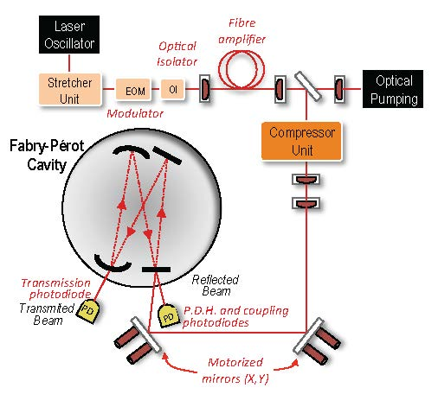
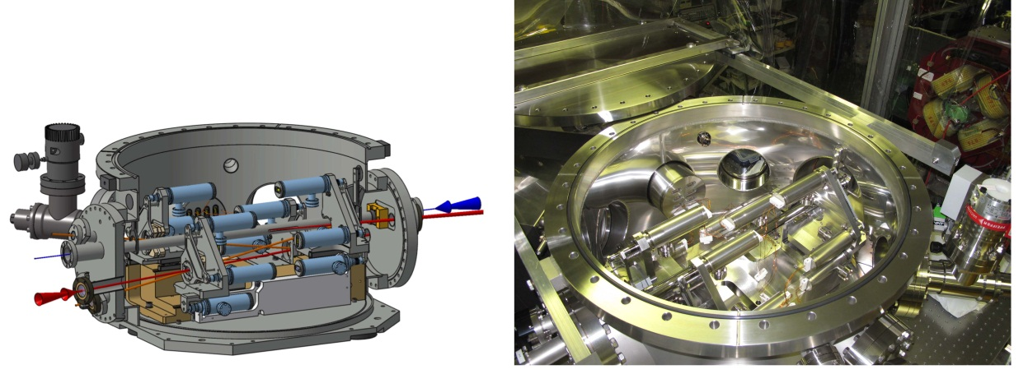
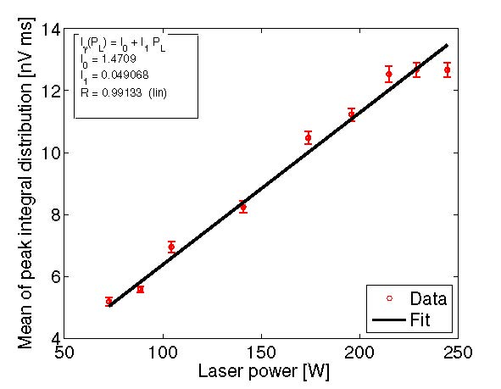
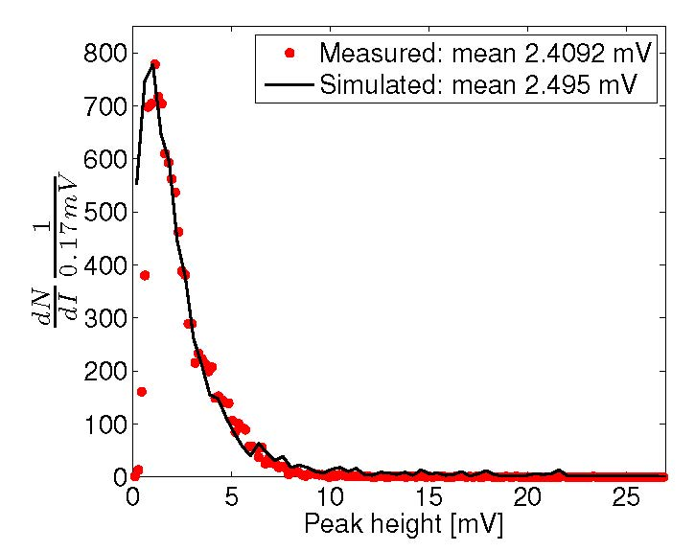
LAL MightyLaser experiment at KEK-ATF
non-planar high finesse four mirror Fabry-Perot cavity;
first Compton collisions observed in October 2010
I. Chaikovska, N. Delerue, A. Variola, F. Zomer et al
Vacuum vessel for Fabry-Perot cavity installed at ATF
Optical system used for laser power amplification and to inject laser into FPC
Plan:
improve laser
and FPC mirrors
& gain several
orders
Comparison of measured and simulated gamma-ray energy spectra from Compton scattering
Gamma ray spectrum for different FPC stored laser power
I. Chaikovska, PhD thesis to be published

Slide 31
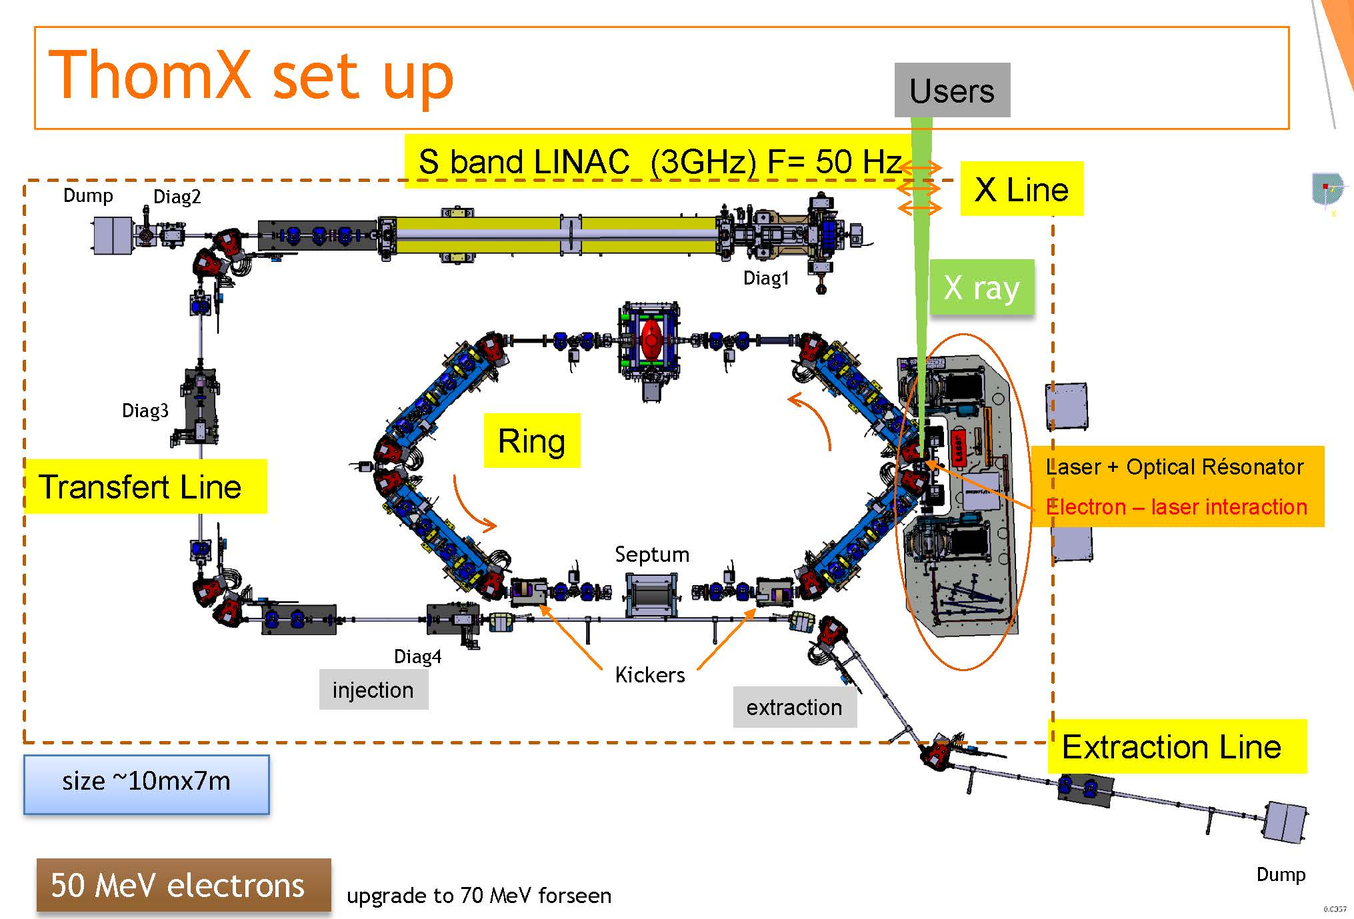
ThomX at LAL – commissioning in 2018
demonstrator for γγ collider technologies
under construction
16
H. Monard

Slide 32
self-generated FEL γ beams
(instead of laser)?
e⁻
(80 GeV)
wiggler
converting some
e⁻ energy into
photons (λ≈350 nm)
e⁻
(80 GeV)
e⁻ bend
optical
cavity
mirrors
Compton
conversion
point
e⁻ bend
γγ IP
“intracavity powers at MW levels are perfectly reasonable” – D. Douglas, 23 August 2012
example:
λ_{u}=200 cm, B=0.625 T, L_{u}=100 m, U_{0,SR}=0.16 GeV, 0.1%P_{beam}≈25 kW
scheme developed
with Z. Huang

Slide 33
SAPPHiRE R&D items
γγ interaction region
large high-finesse optical cavity
high repetition rate laser
FEL in unusual regime
separation scheme for beams
  circulating in opposite directions
  polarized low-emittance e⁻ gun
  detector

Slide 34
fitting the LHeC
LHeC
SAPPHiRE
FCC-eh
HE-LHeC
FCC-ee injector

Slide 35
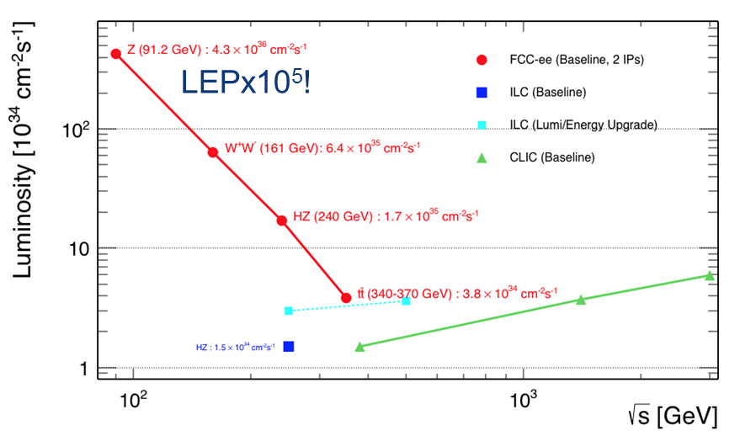
total luminosity of proposed future e⁺e⁻ colliders
FCC-ee
FCC-ee
A. Blondel, Lepton-Photon 2017

Slide 36

FCC-ee injector parameters (summer 2017)
Y. Papaphilippou
Accelerator | FCCee-Z |  | FCCee-W |  | FCCee-H |  | FCCee-tt
Energy [GeV] | 45.6 |  | 80 |  | 120 |  | 175
Type of filling | Full | Top-up | Full | Top-up | Full | Top-up | Full | Top-up
LINAC # bunches, with 2.8 GHz RF | 2 |  | 1
LINAC repetition rate [Hz] | 200 |  | 100
LINAC/SPS bunch population [10¹⁰] | 2.5 | 0.25 | 1.25 | 0.25 | 1.11 | 0.44 | 2.55 | 1.28
# of LINAC injections | 244 | 3538 | 364 |  | 59 |  | 64
SPS bunch spacing [ns] | 2.5 |  | 40 |  | 390 |  | 360
# SPS cycles | 10 |  | 20 |  | 14 |  | 1
SPS # of bunches | 488 | 7076 | 364 |  | 59 |  | 64
SPS cycle time [s] | 1.72 | 18.19 | 4.14 |  | 1.09 |  | 1.14
SPS duty factor | 0.79 | 0.94 | 0.91 |  | 0.15 | 0.70 | 0.16
BR # of bunches | 4880 | 70760 | 7280 |  | 826 | 826 | 64
BR cycle time [s] | 20.2 | 184.9 | 88.8 |  | 21.3 |  | 7.1
#of BR cycles | 29 | 1 | 4 | 1 | 8 | 1 | 10 | 1
# of injections/collider bucket | 2 | 1 | 4 | 1 | 8 | 1 | 10 | 1
Total number of bunches | 70760 |  | 7280 |  | 826 |  | 64
Filling time (both species) [sec] | 1171.6 | 369.8 | 710.4 | 177.6 | 340.2 | 42.5 | 142.8 |  | 14.3
Injected bunch population [10¹⁰] | 4.0 | 0.2 | 4.0 | 0.2 | 7.1 | 0.35 | 20.4 |  | 0.10
maximum current needed:
0.8 μA e-
0.8 μA e+
$\sim$1000x lower than LHeC w/o energy recovery!

Slide 37
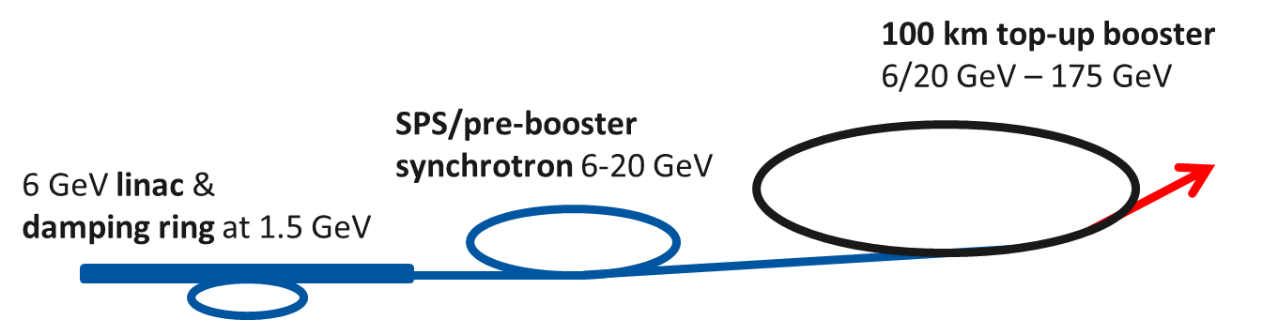
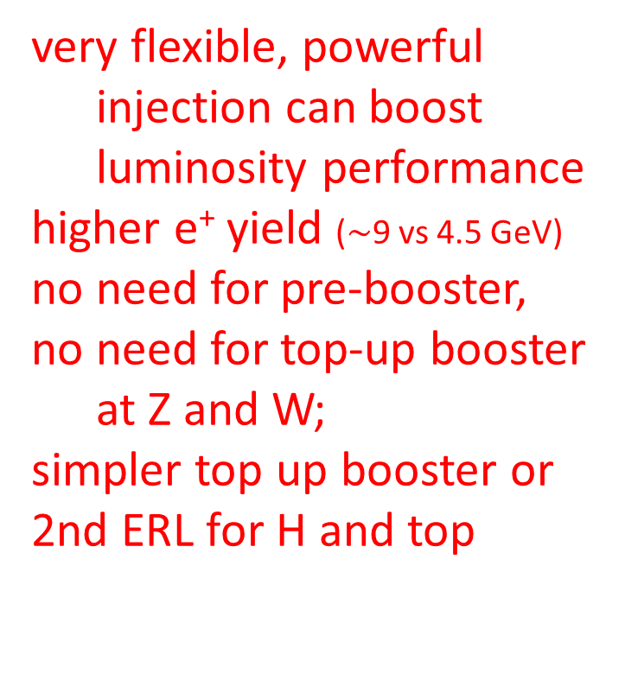
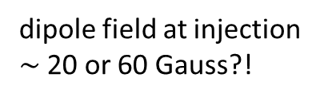

S. Ogur et al.
present FCC-ee injector baseline
dipole field at injection
$\sim$20 or 60 Gauss?!
very flexible, powerful
injection can boost
luminosity performance
higher e⁺ yield ($\sim$9 vs 4.5 GeV)
no need for pre-booster,
no need for top-up booster
at Z and W;
simpler top up booster or
2nd ERL for H and top
LHeC: perfect FCC-ee injector!
3 or 4 loops
10 GeV cw linac
E-
E-
e⁺
10 GeV cw linac
e⁺ target at $\sim$9 GeV
e⁻
e⁻ source
out
in
e⁺ damping ring

Slide 38
D. Shatilov
parameter | Z | W | H (ZH) | ttbar
beam energy [GeV] | 45.6 | 80 | 120 | 175
arc cell optics | 60/60 | 90/90 | 90/90 | 90/90
momentum compaction [10⁻⁵] | 1.48 | 0.73 | 0.73 | 0.73
horizontal emittance [nm] | 0.27 | 0.28 | 0.63 | 1.34
vertical emittance [pm] | 1.0 | 1.0 | 1.3 | 2.7
horizontal beta* [m] | 0.15 | 0.2 | 0.3 | 1
vertical beta* [mm] | 0.8 | 1 | 1 | 2
length of interaction area [mm] | 0.42 | 0.5 | 0.9 | 1.95
tunes, half-ring (x, y, s) | (0.569, 0.61, 0.0125) | (0.577, 0.61, 0.0115) | (0.565, 0.60, 0.0180) | (0.553, 0.59, 0.0343)
longitudinal damping time [ms] | 414 | 77 | 23 | 7.5
SR energy loss / turn [GeV] | 0.036 | 0.34 | 1.72 | 7.8
total RF voltage [GV] | 0.10 | 0.44 | 2.0 | 9.5
RF acceptance [%] | 1.9 | 1.9 | 2.3 | 5.0
energy acceptance [%] | 1.3 | 1.3 | 1.5 | 2.5
energy spread (SR / BS) [%] | 0.038 / 0.132 | 0.066 / 0.153 | 0.099 / 0.151 | 0.147 / 0.192
bunch length (SR / BS) [mm] | 3.5 / 12.1 | 3.3 / 7.65 | 3.15 / 4.9 | 2.45 / 3.25
Piwinski angle (SR / BS) | 8.2 / 28.5 | 6.6 / 15.3 | 3.4 / 5.3 | 1.0 / 1.33
bunch intensity [10¹¹] | 1.7 | 1.5 | 1.5 | 2.7
no. of bunches / beam | 16640 | 2000 | 393 | 48
beam current [mA] | 1390 | 147 | 29 | 6.4
luminosity [10³⁴ cm⁻²s⁻¹] | >200 | >30 | >7 | >1.6
beam-beam parameter (x / y) | 0.004 / 0.133 | 0.0065 / 0.118 | 0.016 / 0.108 | 0.095 / 0.157
luminosity lifetime [min] | 70 | 50 | 42 | 39
time between injections [sec] | 122 | 44 | 31 | 32
allowable asymmetry [%] | ±5 | ±3 | ±3 | ±3
required lifetime by BS [min] | 29 | 16 | 11 | 12
actual lifetime by BS (“weak”) [min] | > 200 | 20 | 20 | 24
e± current for required lifetime [μA] | 0.26 | 0.05 | 0.014 | 0.003

Slide 39
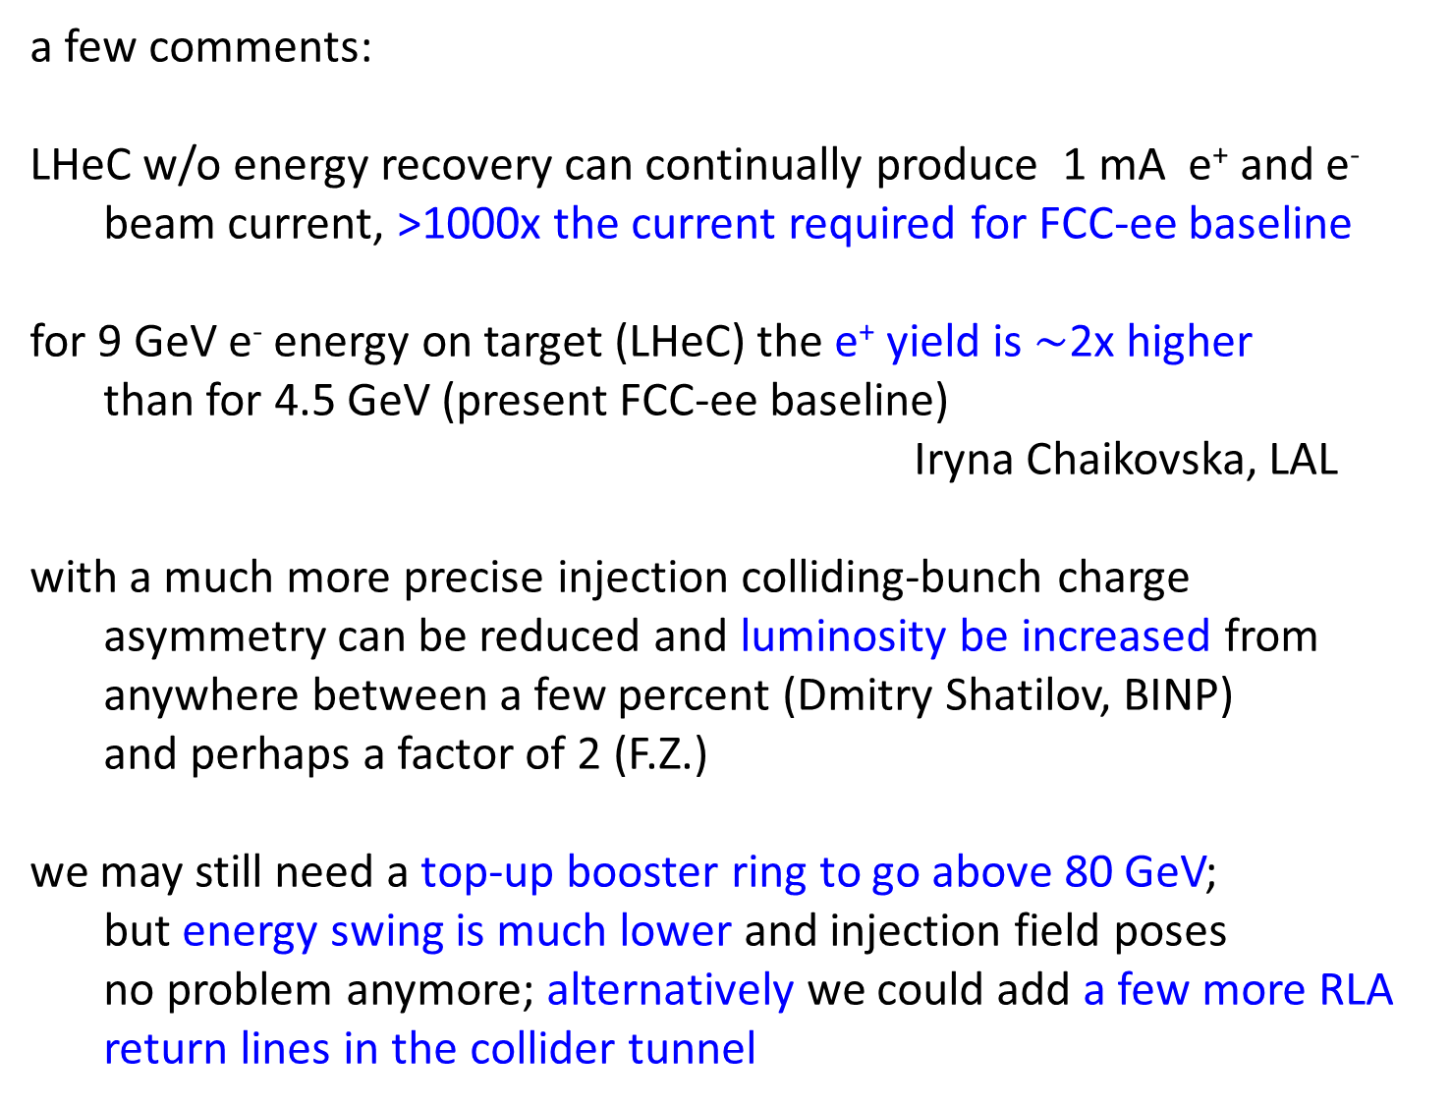
a few comments:
LHeC w/o energy recovery can continually produce 1 mA e⁺ and e⁻
beam current, >1000x the current required for FCC-ee baseline
for 9 GeV e⁻ energy on target (LHeC) the e⁺ yield is $\sim$2x higher
than for 4.5 GeV (present FCC-ee baseline)
Iryna Chaikovska, LAL
with a much more precise injection colliding-bunch charge
asymmetry can be reduced and luminosity be increased from
anywhere between a few percent (Dmitry Shatilov, BINP)
and perhaps a factor of 2 (F.Z.)
we may still need a top-up booster ring to go above 80 GeV;
but energy swing is much lower and injection field poses
no problem anymore; alternatively we could add a few more RLA
return lines in the collider tunnel

Slide 40
fitting the LHeC
LHeC
LHeC-FEL
FCC-eh
HE-LHeC
FCC-ee injector

Slide 41
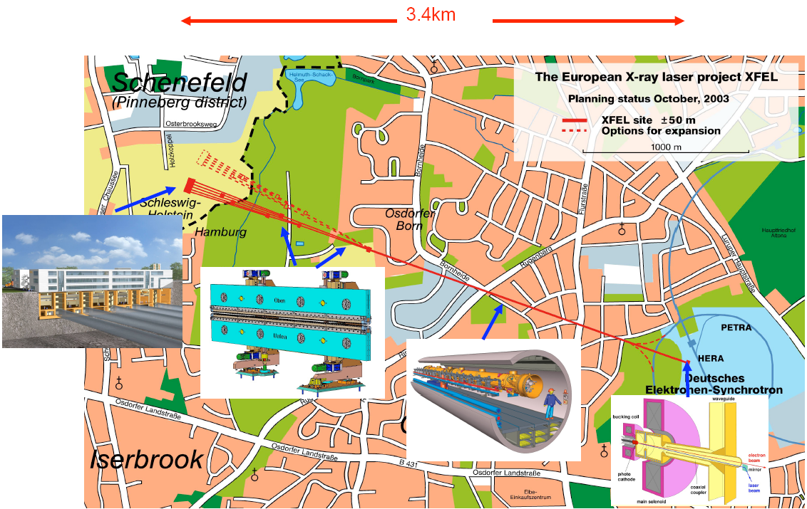
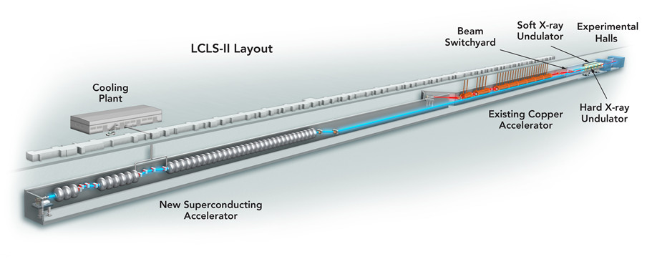
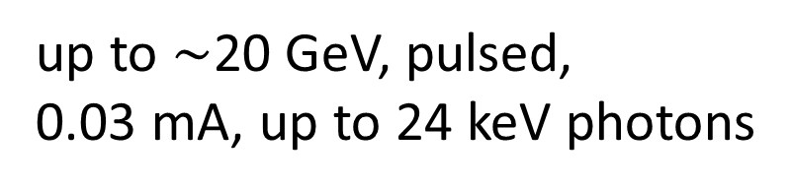
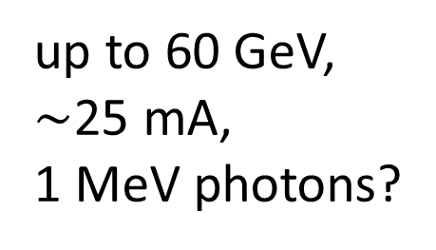
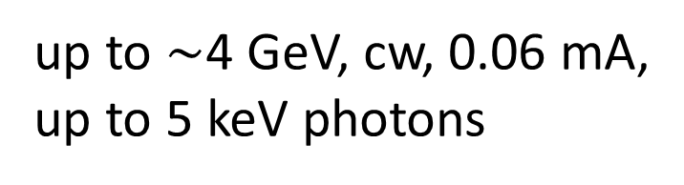
European XFEL, Hamburg, 2017
LCLS-II, SLAC, 2021?
up to $\sim$4 GeV, cw, 0.06 mA,
up to 5 keV photons
up to $\sim$20 GeV, pulsed,
0.03 mA, up to 24 keV photons
H. Schopper
LHeC-FEL
undulator
up to 60 GeV,
$\sim$25 mA,
1 MeV photons?
10 GeV cw linac
3-15x higher beam energy
(10-200x higher γ energies),
300-600x higher current
10 GeV cw linac

Slide 42
conclusions
LHeC + SAPPHiRE + HE-LHC + FCC-ee + FCC-eh are all tantalizing projects
ERL complex offers natural staging scenarios and an optimum utilization of resources
SAPPHiRE and LHeC = some of the cheapest possible options to further study the Higgs – but, esp. SAPPHiRE, not easy
(HE-)LHeC & FCC-eh = discovery machines
LHeC’s RLA = the perfect FCC-ee injector
LHeC-FEL = a great leap for X-ray science!

Slide 43


ARIES APEC workshop on “Compton sources, gamma-gamma colliders and gamma factories”
- Padua, 2 days, November or December 2017
Organizers: Marco Zanetti (INFN Padua), Frank Zimmermann (CERN)
Programme Committee (tentative and tbc):
Luca Serafini, INFN Milano; Alessandro Variola, INFN-LNF & ELI; Witek Krasny, LNPHE Paris;
Fabian Zomer, LAL Orsay ; Noboru Sasao, Okayama U.; Massimo Ferrario, INFN-LNF; Zhirong
Huang, SLAC; Valery Telnov, BINP & NSU; Weiren Chou, IHEP Beijing; Yoann Zaouter,
Amplitude Systemes; ...
ARIES APEC Task 6.6 "Far Future Concepts & Feasibility"

Slide 44
References for LHeC and SAPPHiRE:
[1] S. A. Bogacz, J. Ellis, L. Lusito, D. Schulte, T. Takahashi, M. Velasco, M. Zanetti, F. Zimmermann, ‘SAPPHiRE: a Small Gamma-Gamma Higgs Factory,’ arXiv:1208.2827
[2] D. Asner et al., ‘Higgs physics with a gamma gamma collider based on CLIC I,’ Eur. Phys.
J. C 28 (2003) 27 [hep-ex/0111056].
[3] J. Abelleira Fernandez et al, ‘A Large Hadron Electron Collider at CERN - Report on the
Physics and Design Concepts for Machine and Detector,’ Journal of Physics G: Nuclear
and Particle Physics 39 Number 7 (2012) arXiv:1206.2913 [physics.acc-ph].
[4] Yuhong Zhang, ‘Design Concept of a γ−γ Collider-Based Higgs Factory Driven by Energy Recovery Linacs,’ JLAB Technote JLAB-TN-12-053, 31 October 2012
[5] E. Nissen, ‘Optimization of Recirculating Linacs for a Higgs Factory,’ prepared for HF2012
[6] J. Limpert, T. Schreiber, A. Tünnermann, ‘Fiber lasers and amplifiers: an ultrafast performance evolution,’ Applied Optics, Vol. 49, No. 25 (2010)

