Slide 1

Fabrication Status of the first
802 MHz Prototype Cavities for PERLE
F. Marhauser
LHeC Workshop CERN
11-13 September 2017

Slide 2
Overview
Jefferson Lab has a contract with CERN to build
  One single-cell fine-grain niobium 802 MHz cavity (manufactured)
  Two single-cell OFHC 802 MHz cavities
  One 5-cell fine-grain 802 MHz cavity
  The remaining cavities are advancing rapidly
In addition, Jefferson Lab has looked into:
  Higher Order Mode (HOM) coupler design
  Cryomodule design
  This design work is preliminary
    Funding is required to make more progress
LHeC and FCC-eh Workshop
CERN 11-13 September 2017

Slide 3
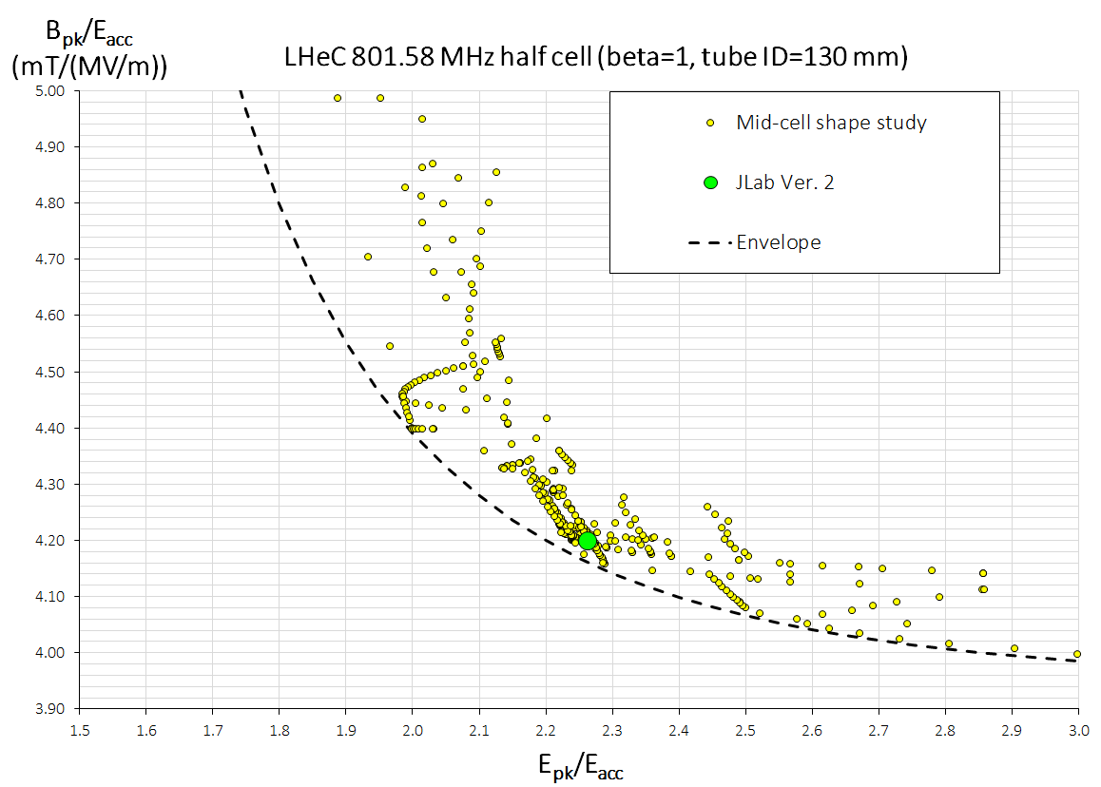
Surface Peak Fields
At E_{acc} = 20 MV/m → B_{pk} ~ 84 mT (B_{pk}/E_{acc} ~ 4.2 mT/(MV/m))
  Avoids potential Q₀-slope
Risk at 20 MV/m is field emission, small E_{pk}/E_{acc} can become important
Main parameter to minimize peak field ratios is cavity iris diameter (ID) → small ID
However, if ID is too small, HOM-damping can be compromised
ID: 130 mm (fixed)
Positive wall angle
Statistic of 350 cell shapes
Negative wall angle (re-entrant shape)
Frank Marhauser
LHeC and FCC-eh Workshop
CERN 11-13 September 2017
Notes:
Red Interior Page Design 1

Slide 4
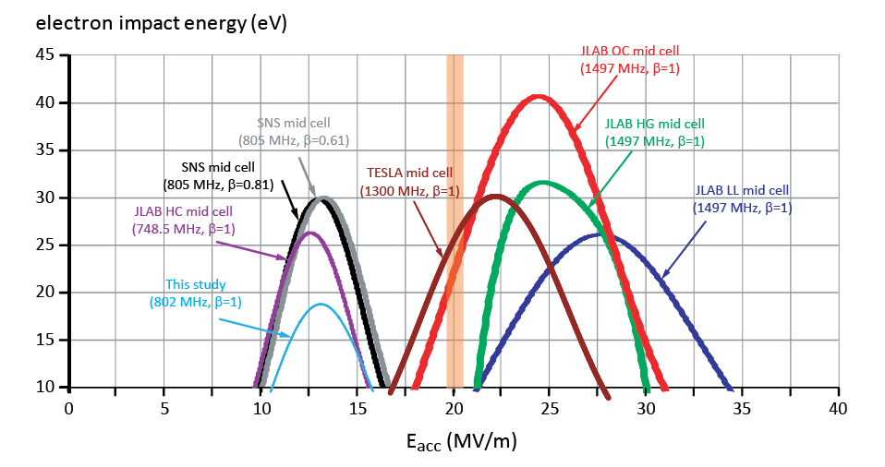
Typical Cell Multipacting Barrier
Flatter equator in JLab’s design lowers secondary impact energy
Frank Marhauser
LHeC and FCC-eh Workshop
CERN 11-13 September 2017
Notes:
Red Interior Page Design 1

Slide 5
Parameter Table for Cavity Versions
Parameter | Unit | Value | Value | Value
Cavity type |  | JLab/PERLE | CERN Ver. 1 | CERN Ver. 2
Frequency | MHz | 801.58
Number of cells |  | 5
L_{active} | mm | 917.9 | 935 | 935
Long. loss factor (2 mm rms bunch length) | V/pC | 2.742 | 2.894 | 2.626
R/Q = V_{eff}²/(ω*W) | Ω | 523.9 | 430 | 393
R/Q/cell | Ω | 104.7 | 86.0 | 78.6
G | Ω | 274.6 | 276 | 283
R/Q∙G/cell |  | 28788 | 23736 | 22244
Eq. Diameter | mm | 328.0 | 350.2 | 350.2
Iris Diameter | mm | 130 | 150 | 160
Tube Diameter | mm | 130 | 150 | 160
Eq./Iris ratio |  | 2.52 | 2.19 | 2.19
Wall angle (mid-cell) | degree | 0 | 12.5 | 12.5
E_{peak}/E_{acc} (mid-cell) |  | 2.26 | 2.26 | 2.40
B_{peak}/E_{acc} (mid-cell) | mT/(MV/m) | 4.20 | 4.77 | 4.92
k_{cc} | % | 3.21 | 4.47 | 5.75
N²/k_{cc} |  | 7.78 | 5.59 | 4.35
cutoff TE₁₁ | GHz | 1.35 | 1.17 | 1.10
cutoff TM₀₁ | GHz | 1.77 | 1.53 | 1.43
Frank Marhauser
LHeC and FCC-eh Workshop
CERN 11-13 September 2017
Notes:
Red Interior Page Design 1

Slide 6
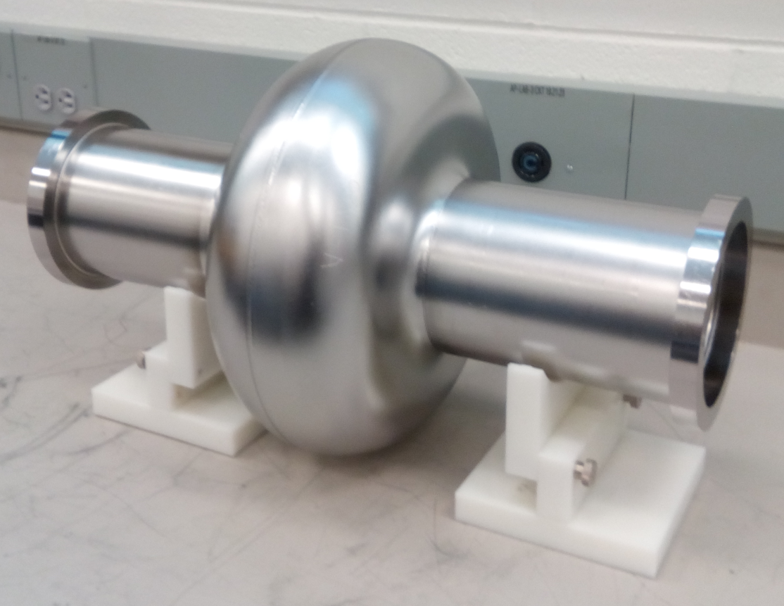
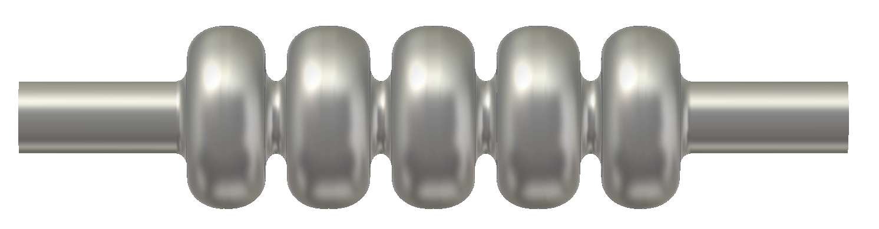
Deliverables (based on SOW with CERN)
- First 802 MHz Niobium single-cell cavity has been
completed at JLab, the cavity is now being post-
processed prior to vertical RF testing
2 copper 802 MHz cavities will be produced for R&D purposes and will be sent to CERN
One bare Niobium five-cell 802 MHz design is being fabricated, completion expected by end of Sept. 2017
Frank Marhauser
LHeC and FCC-eh Workshop
CERN 11-13 September 2017
Notes:
Red Interior Page Design 1

Slide 7
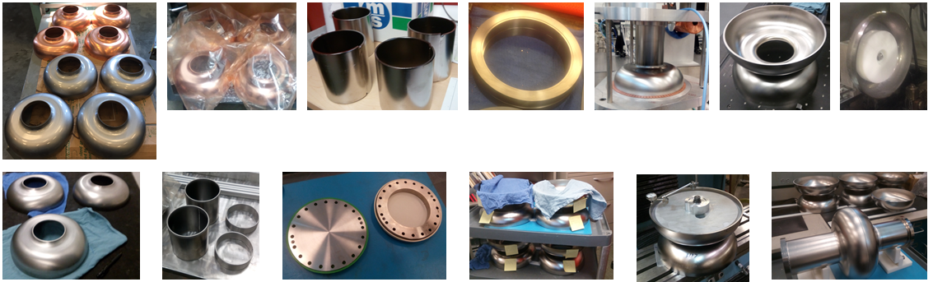
Status of Deliverables
Cavity | Qty. | Material | Half cells deep- drawn | Beam Tubes deep-drawn/ rolled | Flanges machined | End group EBW (end cell + tube + flange) | Dumb- bells EBW | Machining/ Trimming | Cavity EBW
1-cell | 1 | FG Nb | 2/2 | 2/2 | 2/2 NbTi flanges | 2/2 | n/a | done | done
1-cell | 2 | OFHC Cu | 4/4 | 4/4 not EB-welded and machined | 4/4 SS 316 LN | not yet started | n/a | equator trimming after EBW | -
5-cell | 1 | FG Nb | 10/10 | 2/2 | 2/2 NbTi flanges | 2/2 | 4/4 | in progress | -
Frank Marhauser
LHeC and FCC-eh Workshop
CERN 11-13 September 2017

Slide 8
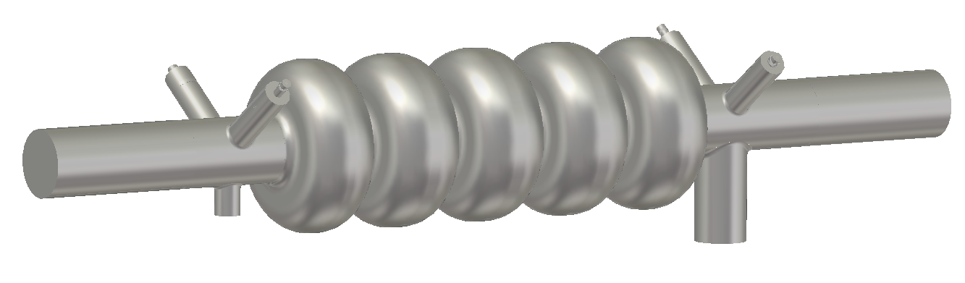
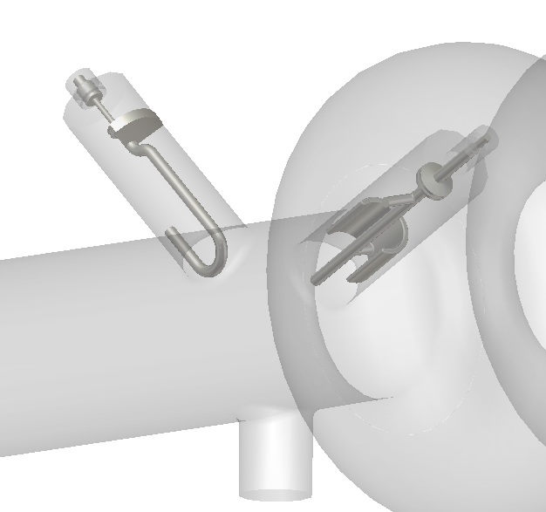
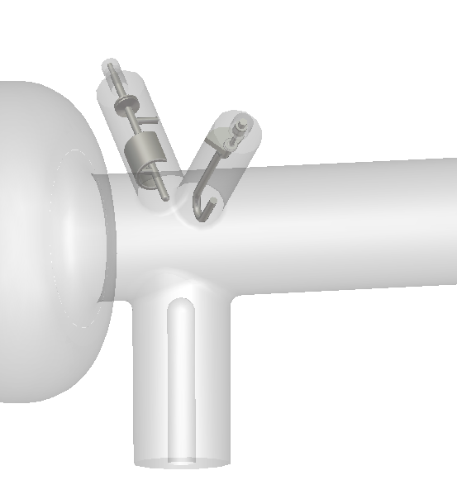
Which HOM-Coupler Technology ?
First approach should be to utilize existing coupler technology, but this needs
scaling to new frequency and tube ID
For instance: scale LHC HOM couplers (and FPC)
HOM end group 2
HOM end group 1
Main coupler
4 HOM couplers per cavity ?
  LHC-type coaxial loop coupler is narrowband coupler for dipole modes
  LHC-type coaxial antenna/capacitive coupler is more broadband
Frank Marhauser
LHeC and FCC-eh Workshop
CERN 11-13 September 2017
Notes:
Red Interior Page Design 1

Slide 9
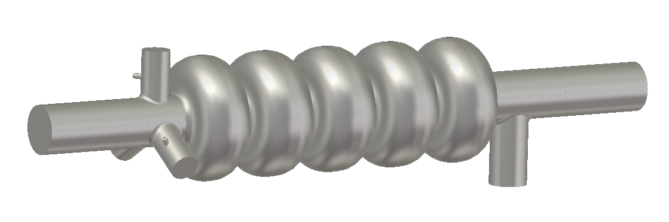
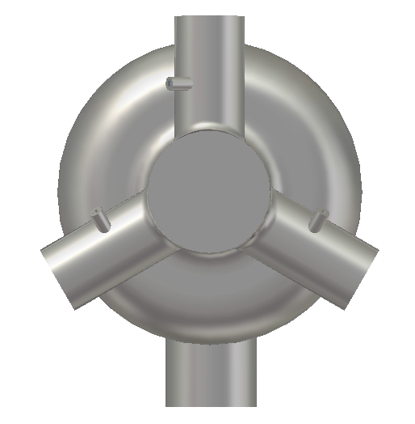
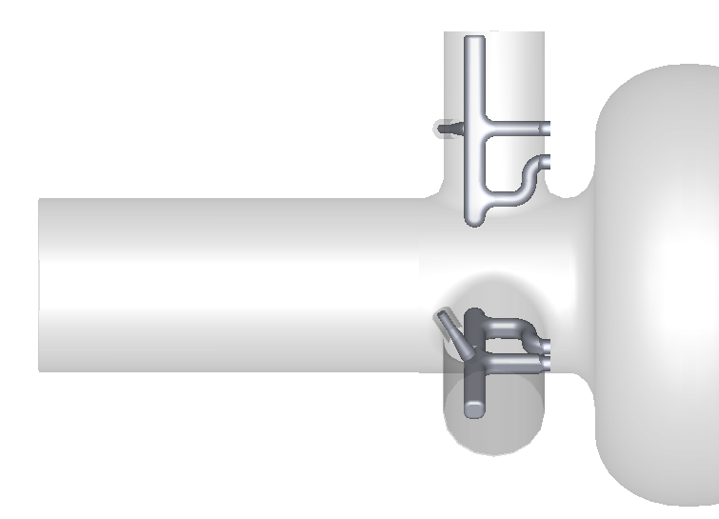
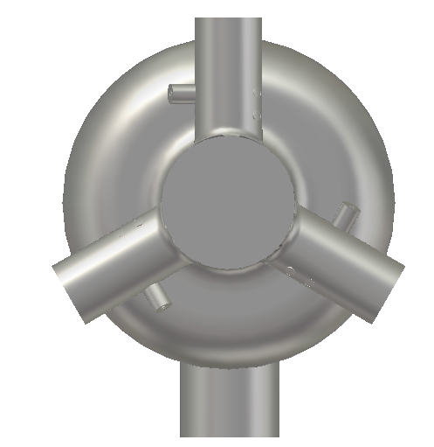
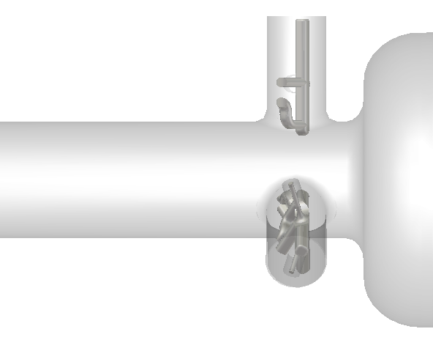
Which HOM-Coupler Technology ?
A better solution would be utilizing 3 couplers for HOM end group
Minimizes dependence on mode polarization
HOM end group
Main coupler
Scaled JLab-type couplers
Scaled TESLA-type coaxial couplers
Frank Marhauser
LHeC and FCC-eh Workshop
CERN 11-13 September 2017
Notes:
Red Interior Page Design 1

Slide 10
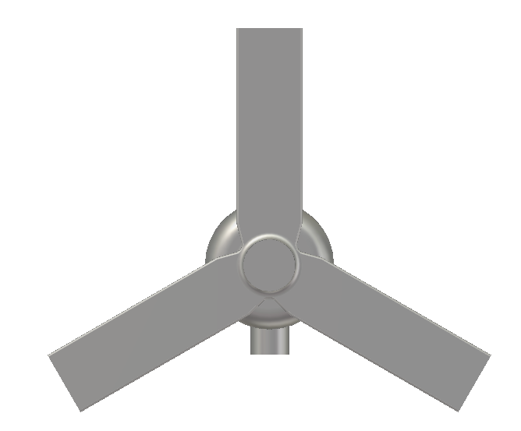
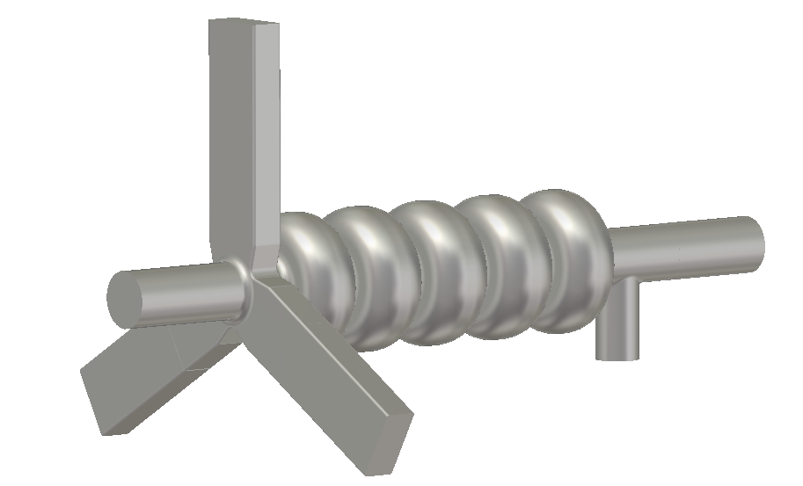
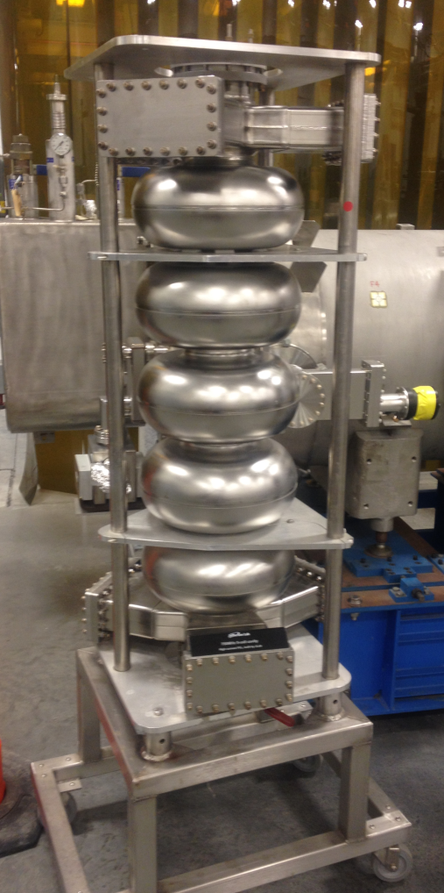
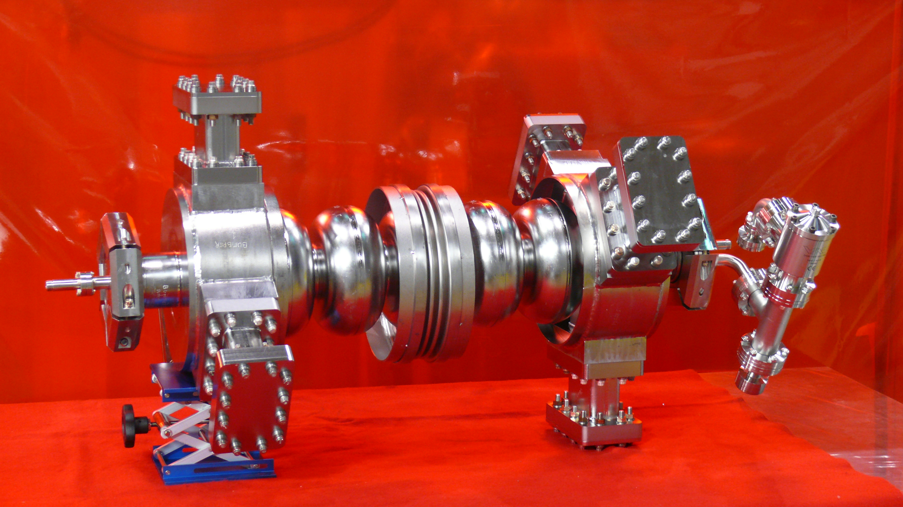
Which HOM-Coupler Technology ?
HOM waveguides only required if beam current increases significantly
Main coupler
HOM end group
Scaled JLab High Current (HC) waveguide couplers
750 MHz HC cavity prototype
1.5 GHz HC cavity prototype
Frank Marhauser
LHeC and FCC-eh Workshop
CERN 11-13 September 2017
Notes:
Red Interior Page Design 1

Slide 11
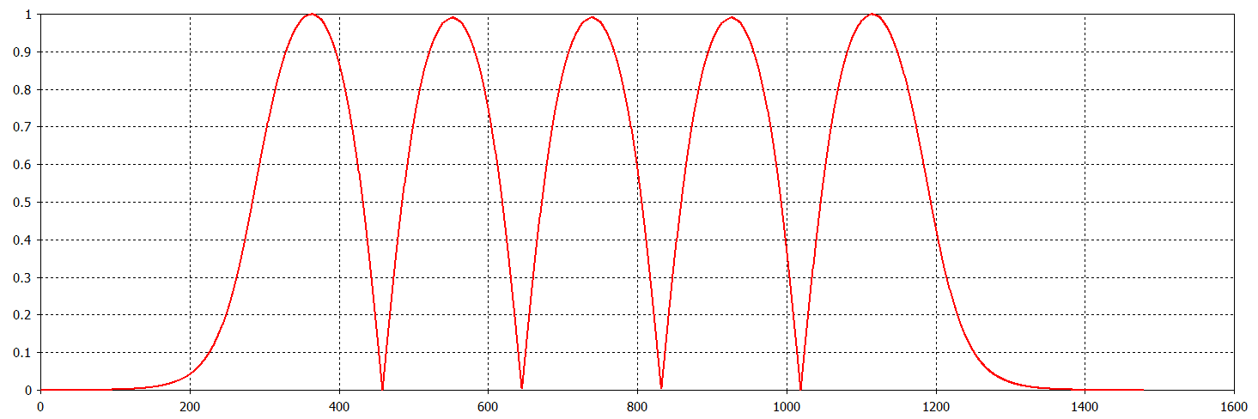
JLab/PERLE
For the prototype PERLE cavity we have chosen a single-die design
(end cells are trimmed shorter)
PERLE cavity identical to CERN FCC prototype under construction
Optimized for high current operation
On axis |Ez|
Frank Marhauser
LHeC and FCC-eh Workshop
CERN 11-13 September 2017
Notes:
Red Interior Page Design 1

Slide 12
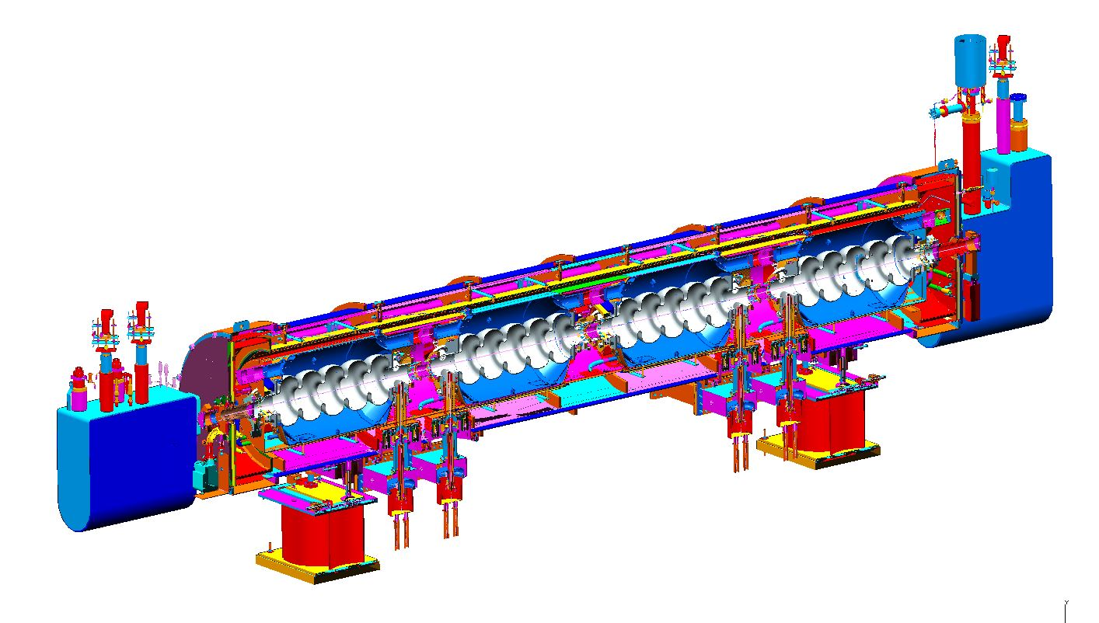
SNS-like cryomodule
Cavity fits well in SNS type (805 MHz) cryomodule
Cost and fabrication processes well understood
Some updates for pressure code have been made by ORNL
Plans prepared to build new modules for SNS Power Upgrade
Fresh cost estimate in hand, can be adapted to PERLE
Bob Rimmer
LHeC and FCC-eh Workshop
CERN 11-13 September 2017

Slide 13
Summary
CERN FCC cavity prototypes are progressing well
  Expected completion in September 2017
  Cutting off the beam tubes from the bare 5-cell cavity and welding new end groups to the cavity to investigate HOM-damping scenarios would be a good next step
Preliminary evaluation of HOM’s has been carried out
  Either coax or waveguide would work (waveguide is probably overkill)
  Three couplers should be sufficient (needs to be checked)
  Strong cell-to-cell coupling is good for HOM damping
Design for PERLE cavity is identical to CERN FCC cavity
  Ready for detailed end group design work
  Prototype cavity could be built 6 months after funding becomes available if CERN 5-cell prototype cavity is modified
    One year would be required starting from scratch
Jefferson Lab will provide a budgetary estimate for an SNS-type cryomodule for PERLE
LHeC and FCC-eh Workshop
CERN 11-13 September 2017
Notes:
Red Interior Page Design 1

