Slide 1
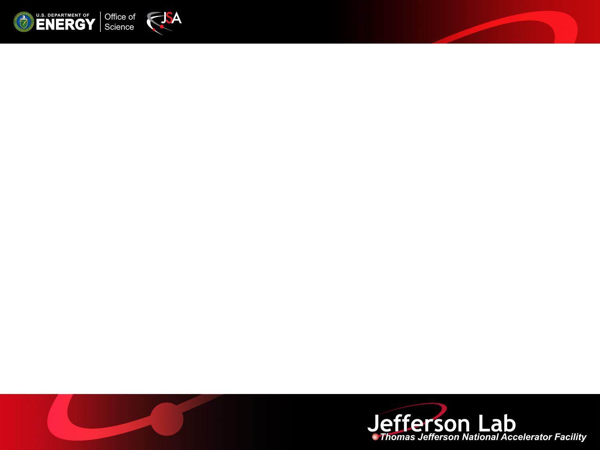

Update on Lattice Design and Synergies with JLEIC
  Alex Bogacz
  for JLab's Study Group on PERLE*
  *A. Bogacz, D. Douglas, A. Hutton, F. Marhauser, C. Tennant, R. Rimmer, Y. Roblin
LHeC and FCC-eh Workshop
CERN, 11-13 September 2017

Slide 2
Motivation for PERLE
Bridge between 1 MW and 100 MW scale ERLs
  Present state-of-art 1 MW scale, single-pass ERLs (IR/UV JLAB FELs) have already posed several beam dynamics challenges:
    Formation and merging of CW train of high-charge, space-charge dominated bunches
    Acceleration and delivery of beam with properly configured phase space to warrant efficient energy recovery
    Preservation of beam quality/stability in presence of collective effects, errors and imperfections
  The LHeC 60 GeV ERL (100 MW scale ERL), would need a ‘stepping stone’ − test facility, such as PERLE (10 MW scale, 3-pass ERL) to ‘leap’ two orders of magnitude in beam power.
  Synergy with JLEIC Cooler, where similar beam dynamics issues need to be studied: e.g. CSR, micro-bunching, halo formation.
LHeC and FCC-eh Workshop
CERN 11-13 September 2017

Slide 3
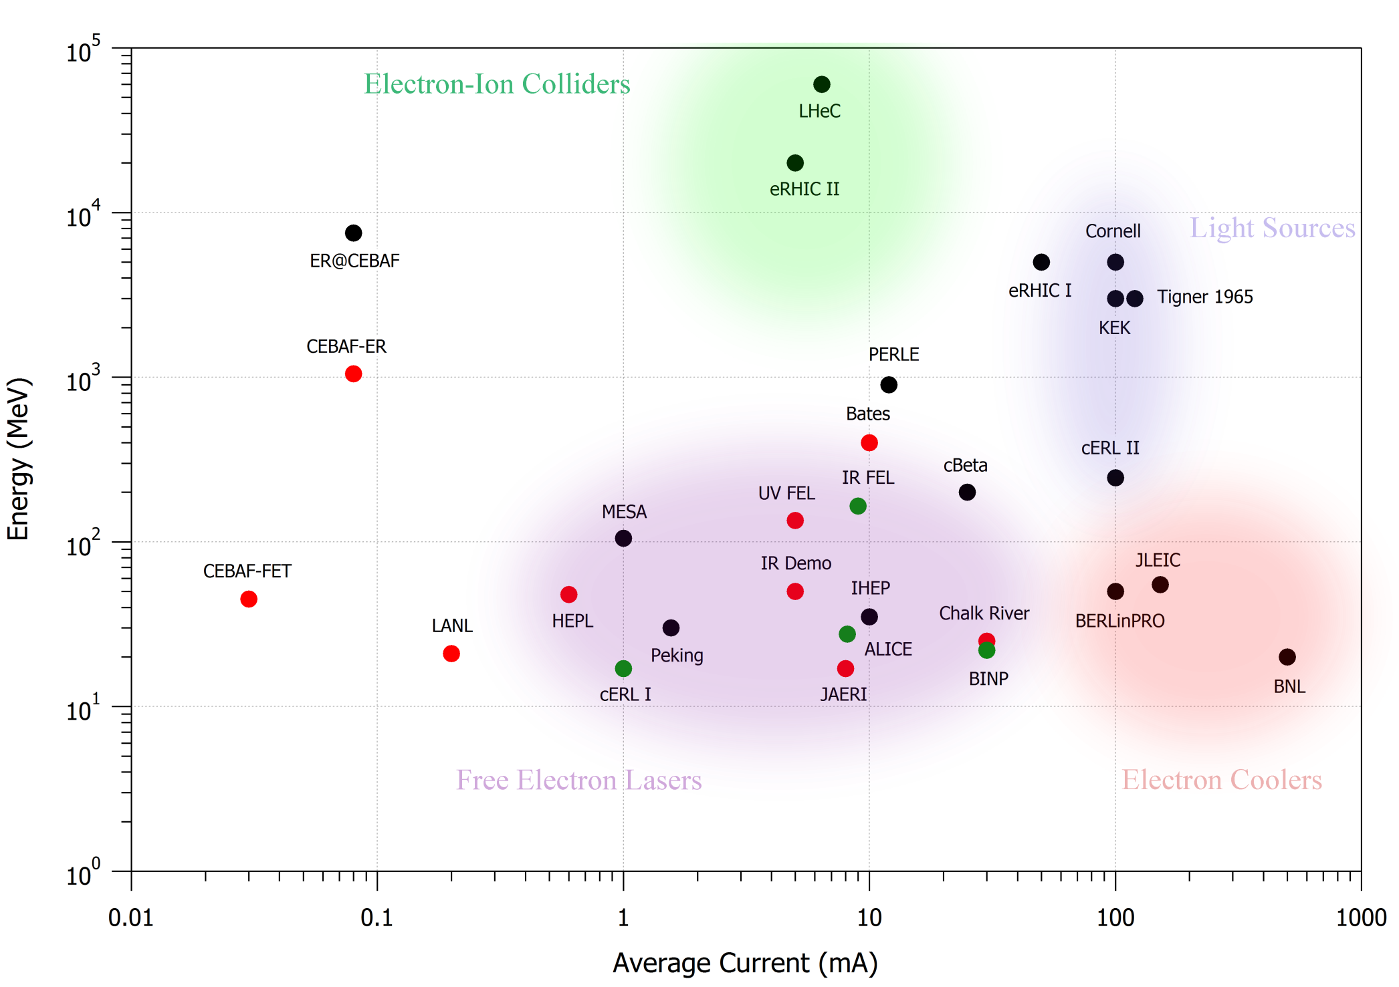
State of Art ERL Landscape
1 GW
CW with P_{beam}>P_{RF}
100 MW
S-DALINAC
(CCR Driver)
JLEIC
(“Light”
Cooler)
10 MW
legacy
operating
under construction
proposed
1 kW
10 kW
100 kW
1 MW
LHeC and FCC-eh Workshop
CERN 11-13 September 2017

Slide 4
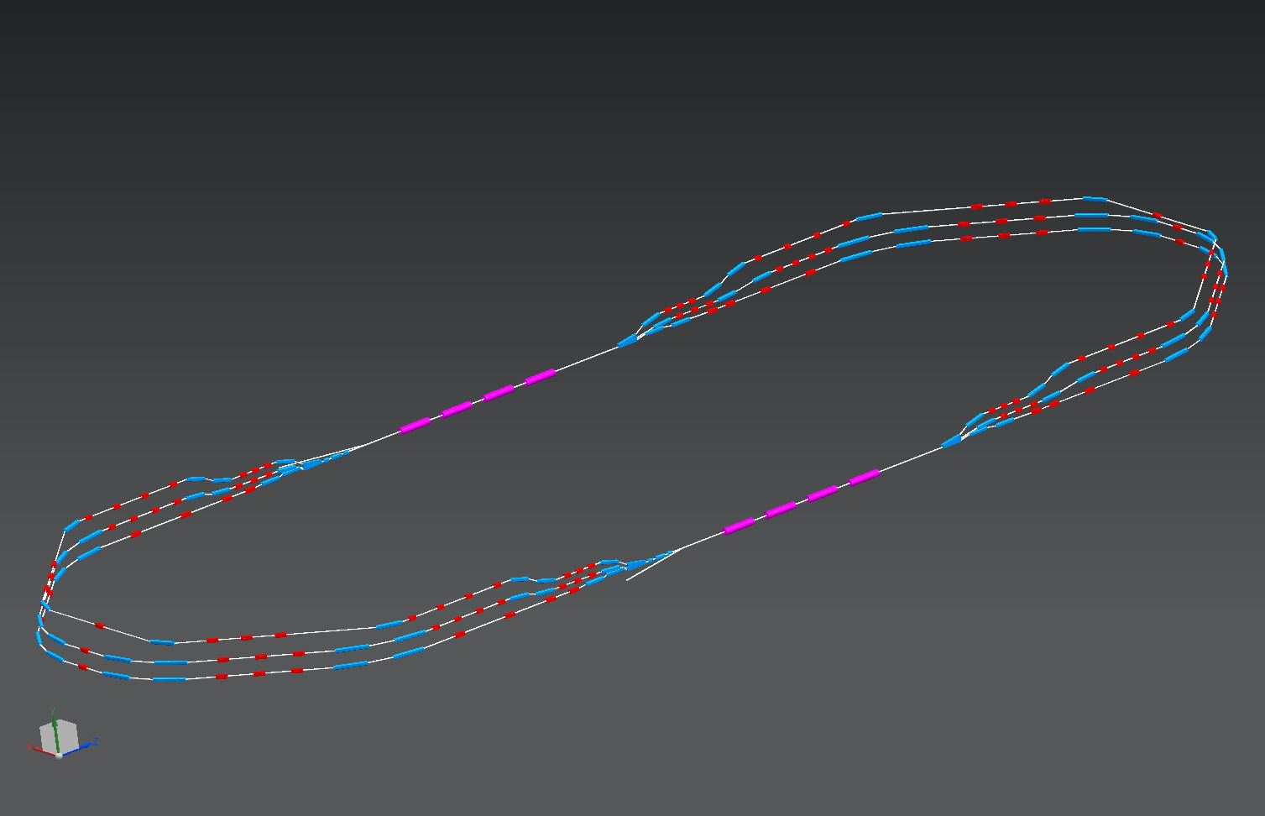

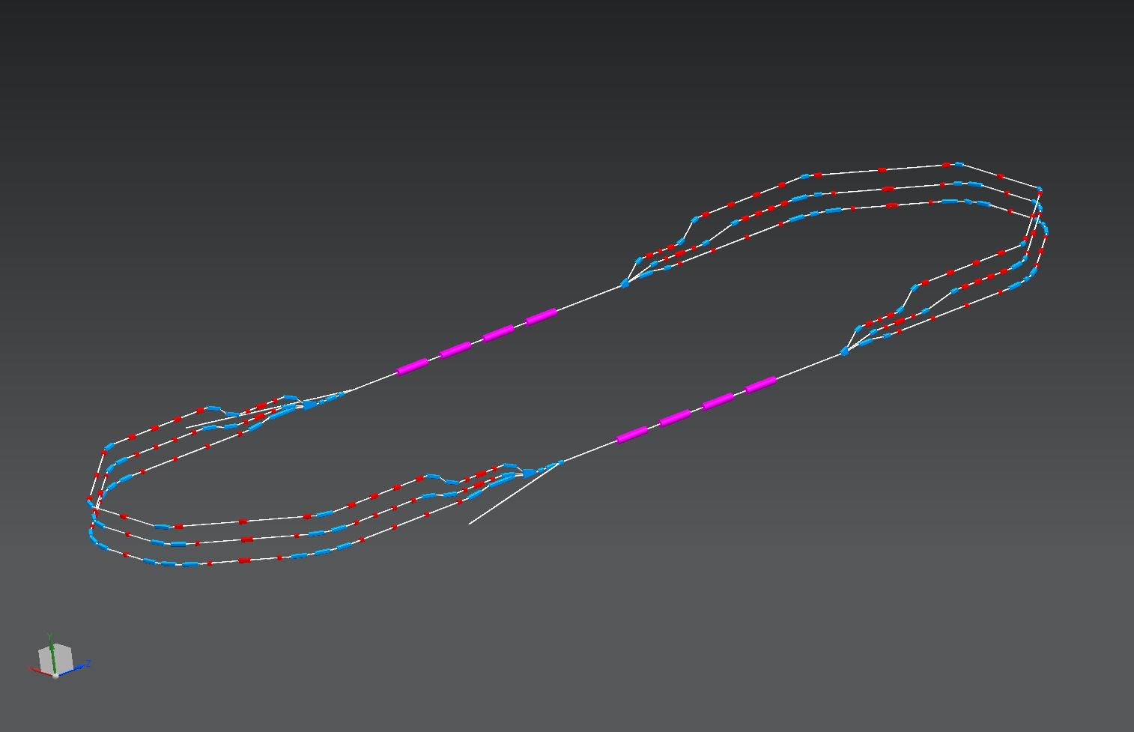

PERLE Downsizing
CDR (900 MeV)
Alessandra Valloni
Alex Bogacz
14 m
‘Lean’(400 MeV)
45 m
5.5 m
24 m
LHeC and FCC-eh Workshop
CERN 11-13 September 2017

Slide 5
PERLE@Orsay − Layout
400 MeV
1 : 3 : 5
ΔE = 65.5 MeV
5.5 m
0.8 m
injector
5 MeV
24 m
ΔE = 65.5 MeV
2 : 4 : 6
5 MeV
dump
ΔC = λ_{RF}/2
LHeC and FCC-eh Workshop
CERN 11-13 September 2017

Slide 6
PERLE@Orsay − Layout
400 MeV
1 : 3 : 5
ΔE = 65.5 MeV
5.5 m
0.8 m
injector
5 MeV
24 m
ΔE = 65.5 MeV
2 : 4 : 6
5 MeV
dump
ΔC = λ_{RF}/2
Three passes ‘up’ + Three passes ‘down’
LHeC and FCC-eh Workshop
CERN 11-13 September 2017

Slide 7
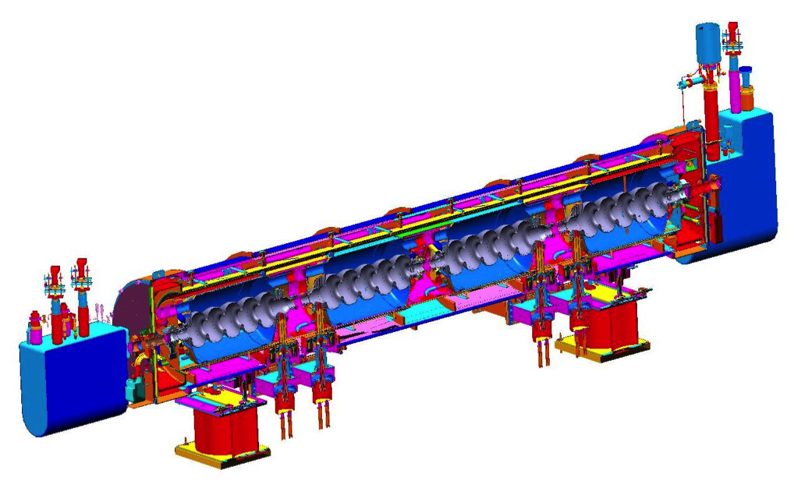



Linac, Cryo-module − Layout
SNS-like cryomodule
801.58 MHz RF, 5-cell cavity:
λ = 37.40 cm
L_{c} = 5λ/2 = 93.50 cm
Grad = 17.5 MeV/m (16.4 MeV per cavity)
ΔE= 65.5 MeV per Cryo-module
8.491 m
10
Linac length: 26 × λ_{RF}
BETA_X&Y[m]
0
0
BETA_X
BETA_Y
9.72
Re-injection chicane
Cryo-module (8.491 m)
LHeC and FCC-eh Workshop
CERN 11-13 September 2017

Slide 8
Multi-pass ER Optics
12
BETA_X&Y[m]
Acceleration
0
0
BETA_X
BETA_Y
DISP_X
DISP_Y
59.2518
E_{inj}
E₁
E₂
E₃
E₄
E₅
E₆
12
BETA_X&Y[m]
Deceleration
0
0
BETA_X
BETA_Y
DISP_X
DISP_Y
59.2518
E₆
E₅
E₄
E₃
E₂
E₁
E_{inj}
LHeC and FCC-eh Workshop
CERN 11-13 September 2017

Slide 9
Flexible Momentum Compaction Arc
10
2
399 MeV
4×45⁰ bends
Q_{x,y} = 1.25
BETA_X&Y[m]
DISP_X&Y[m]
0
-2
0
BETA_X
BETA_Y
DISP_X
DISP_Y
7.70429
triplet: Q1 Q2 Q3
singlet: Q4
triplet: Q3 Q2 Q1
Quadrupoles:
Q1 L[cm] =10 G[T/m] = - 23.6
Q2 L[cm] =15 G[T/m] = 28.2
Q3 L[cm] =10 G[T/m] = - 22.4
Q4 L[cm] =10 G[T/m] = 8.6
Dipoles: (91.2 cm long)
B = 1.2 Tesla
LHeC and FCC-eh Workshop
CERN 11-13 September 2017

Slide 10
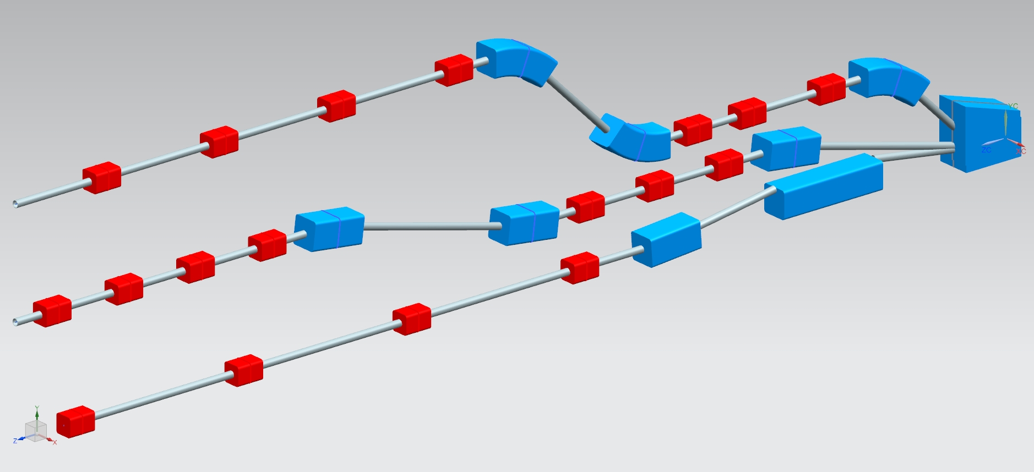
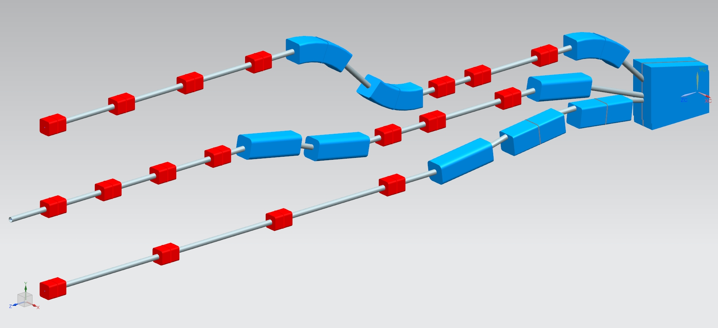
Vertical Switchyard CEBAF-like Architecture
Dipoles: (20 and 40 cm long)
B = 0.8 Tesla
Energies1 : 3 : 5
T. Michalski
Dipoles: (30 cm long)
B = 1.2 Tesla
Energies1 : 2 : 3
LHeC and FCC-eh Workshop
CERN 11-13 September 2017

Slide 11
Vertical Spreaders − Optics
Spr. 1 (71 MeV)
Spr. 5 (333 MeV)
20
1
20
1
BETA_X&Y[m]
DISP_X&Y[m]
BETA_X&Y[m]
DISP_X&Y[m]
0
-1
0
-1
0
BETA_X
BETA_Y
DISP_X
DISP_Y
4.27981
0
BETA_X
BETA_Y
DISP_X
DISP_Y
4.023
vertical step I
vertical step II
vertical chicane
LHeC and FCC-eh Workshop
CERN 11-13 September 2017

Slide 12
Arc 1 Optics (71 MeV)
20
Isochronous Arc
2
BETA_X&Y[m]
pathlength: 42 × λ_{RF}
DISP_X&Y[m]
0
-3
0
BETA_X
BETA_Y
DISP_X
DISP_Y
15.71
2-step vert. Spreader
180⁰ Arc
2-step vert. Recombiner
Spr. dipoles:
4× 45⁰ bends
L = 20 cm
B = 9.5 kGauss
Arc dipoles :
4×45⁰ bends
L = 45.6 cm
B = 4.5 kGauss
Rec. dipoles:
4× 45⁰ bends
L = 20 cm
B = 9.5 kGauss
quads: L = 10 cm G ≤ 1 kGauss/cm
LHeC and FCC-eh Workshop
CERN 11-13 September 2017

Slide 13
Vigorous R&D Program towards TDR
Linear lattice optimization
Initial magnet specs
Momentum acceptance and longitudinal match
End-to-End simulation with synchrotron radiation, CSR and micro-bunching
Correction of nonlinear aberrations (geometric & chromatic) with multipole magnets (sextupoles, octupoles)
RF cavity design, HOM content BBU studies
Injection line/chicane design
Space-charge studies at injection
Diagnostics & Instrumentation
Multi-particle tracking studies of halo formation
Final magnet specs
Engineering design
LHeC and FCC-eh Workshop
CERN 11-13 September 2017

Slide 14
JLEIC Cooler (Circulating Cooler Ring + ERL)
Same-cell energy recovery in SRF cavities
Uses harmonic kicker to inject and extract from CCR
Assumes high charge, low rep-rate injector
(with subharmonic acceleration and bunching)
top ring: CCR
ion beam
magnetization flip
magnetization flip
ion beam
B < 0
B > 0
B > 0
B < 0
linac
beam dump
injector
fast extraction kicker
septum
septum
fast injection kicker
circulating bunches
extracted
injected
De-chirper
vertical bend
Re-chirper
bottom ring: ERL
LHeC and FCC-eh Workshop
CERN 11-13 September 2017

Slide 15
PERLE vs JLIC Cooler − Baseline Parameters
Name | EIC cooler | PERLE
Institute | JLab | LAL Orsay
# Re-Circulations | 1 | 3
RF Frequency [GHz] | 0.952 | 0.8
Bunch Frequency [MHz] | 8 | 40
Energy gain / linac [MeV] | 50 | 65.5
Bunch charge @ inj [pC] | 3200 | 375
Bunch length [ps] | 21.0 | 10
Transverse emittance [gamma mm mrad] | 36 | 6
Av. Current @ inj [mA] | 140 | 15
Injector Energy [MeV] | 5 | 5
Max beam energy @ end of accel [MeV] | 55 | 400
Max beam power @ end of accel [MW] | 7.7 | 6
Max total current in cavity [mA] | 280 | 90
Power on dump [MW] | 0.7 | 0.075
LHeC and FCC-eh Workshop
CERN 11-13 September 2017

Slide 16
PERLE/JLEIC Cooler Synergy
High charge/current/beam power – constitutes unexplored performance regime
  Behavior of high charge and low Δp/p beam in SRF environment
Host of collective effects come into play; mitigation needed
  CSR, Longitudinal S-C micro-bunching
  resistive wall, IBS, Touschek scattering, BBU
Interaction of beam with environment lies in uncharted territory
  Beam-gas scattering, ion accumulation, wakes/impedance
Both ERL’s performance is critically dominated by halo
  Mechanisms for halo formation, characterization, evolution and control
LHeC and FCC-eh Workshop
CERN 11-13 September 2017

Slide 17
Summary
PERLE is a unique ‘test bed’ for next generation of high power ERLs
  Testing multi-pass beam dynamics in energy recovery mode
  Probing limits of transporting non-equilibrium beams with high ratio of beam power to installed RF power
  Mitigation of longitudinal phase-space distortion due to wakes, including CSR and longitudinal S-C
  Preservation of beam quality/stability in presence of collective effects, errors and imperfections
Arc Optics Architecture
  Isochronous Arcs with Flexible Momentum Compaction (FMC) Optics
  Configured with two styles of 1.2 Tesla ‘curved bends’
Switchyard
  Two-step, Vertical Spreaders/Recombiners with matching sections: Linacs-Arcs
Synergy between PERLE and JLEIC Cooler, where similar beam dynamics issues need to be solved
LHeC and FCC-eh Workshop
CERN 11-13 September 2017

