Slide 1
Dimensions, pressures and temperatures of cryogenic circuits for the SPL
U. Wagner
TE-CRG

Slide 2
Topics
Introducing remarks
Basics
  Basic parameters
  Basic schemes
Design criteria
  He II cooling loop
  Coupler cooling loop
  Thermal shield cooling loop
Summary Table

Slide 3
Introduction
General note
As no in-depth study exists the actual “Baseline” concerning T and p values closely follows the design data of the ILC project
Some of the choices presented here may be discussed and could be changed
All dimensions given are:
  Depending on installed mass flow / cooling capacity
  Intended to give an order of magnitude
  i.e. not precise on the mm

Slide 4
Basic parameters
Assumptions that are considered as decided
The following is considered as decided:
  Cooling of the cavities with helium II at ~ 2.0 K
  Cavities inside the saturated bath
Anything else may be discussed / changed
  Examples
  Cooling of the couplers :
  5-8 K best compromise? (why not 4.5 K – 300 K e.g.)7
  Cooling of the thermal shield:
  40 – 80 K: typical choice by DESY; 50-75: typical choice by CERN

Slide 5
Basic parameters
HP-SPL , LP-SPL
No decision is taken concerning the HP-SPL or LP-SPL option
Both options are considered in this presentation

Slide 6
Basic parameters
Pressures and temperatures as proposed at the moment
Line | Temperature | Pressure
Header A | 2.2 K | 0.3 MPa
Header B | 2.0 K | 3.1 kPa
Header C | 5.0 K | 0.55 MPa
Header D | 8.0 K | 0.50 MPa
Header E | 50 K | 1.8 MPa
Header F | 75 K | 1.7 MPa
These values are fixed
The rest is for “orientation” only and may be modified

Slide 7
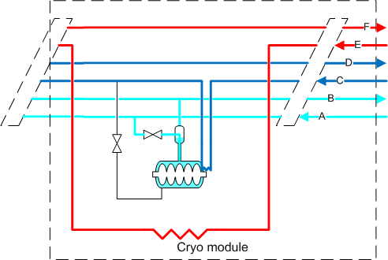
Basic Schemes
Cooling loops shown on a single cavity
Thermal shield and coupler cooling in “series”
Thermal shield cooling loop
Coupler cooling loop
He II cooling loop

Slide 8
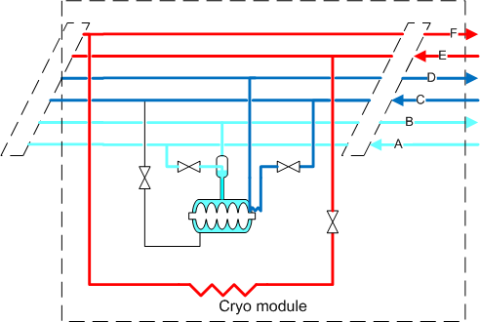
Basic Schemes
Cooling loops shown on a single cavity
Thermal shield and coupler cooling in “parallel”
Thermal shield cooling loop
Coupler cooling loop
He II cooling loop
Only main header dimensions considered in this presentation

Slide 9
He II cooling loop
Design criteria
Line A
  Nominal conditions: T = 2.2 K; p = 3.0 bar (my choice)
  Criteria:
    pressure drop during:
      Nominal operation
      Cool-down
      Warm-up
Distribution baseline
  Parallel cooling -> One HeII loop per module
Conditions uncertain / may be done via Line C

Slide 10
He II cooling loop
Design criteria
Line B
  Nominal conditions: T = 2.0 K; p = 31 mbar
  Criteria:
    Pressure distribution in line B in nominal operation
      Chosen limit: < +/- 10 mK saturation temperature spread in bath
    Line B may have a function as “quench buffer”
      This is not considered for the moment
Distribution baseline
  Parallel cooling -> One HeII loop per module

Slide 11
He II cooling loop
Design criteria, installed mass flow
 | LP-SPL |  | HP-SPL
 | Low β | High β | Low β | High β
Flow / module [g/s] | 1.4 | 2.0 | 5.5 | 9.3
Total flow [g/s] | 50 |  | 271

Slide 12
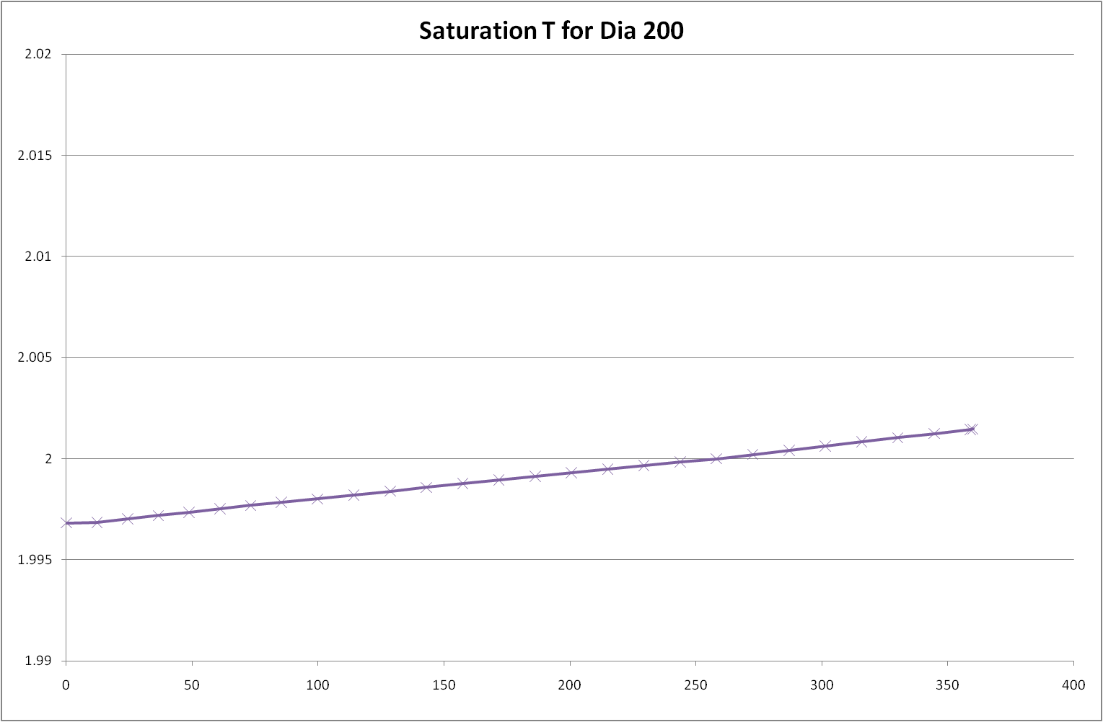
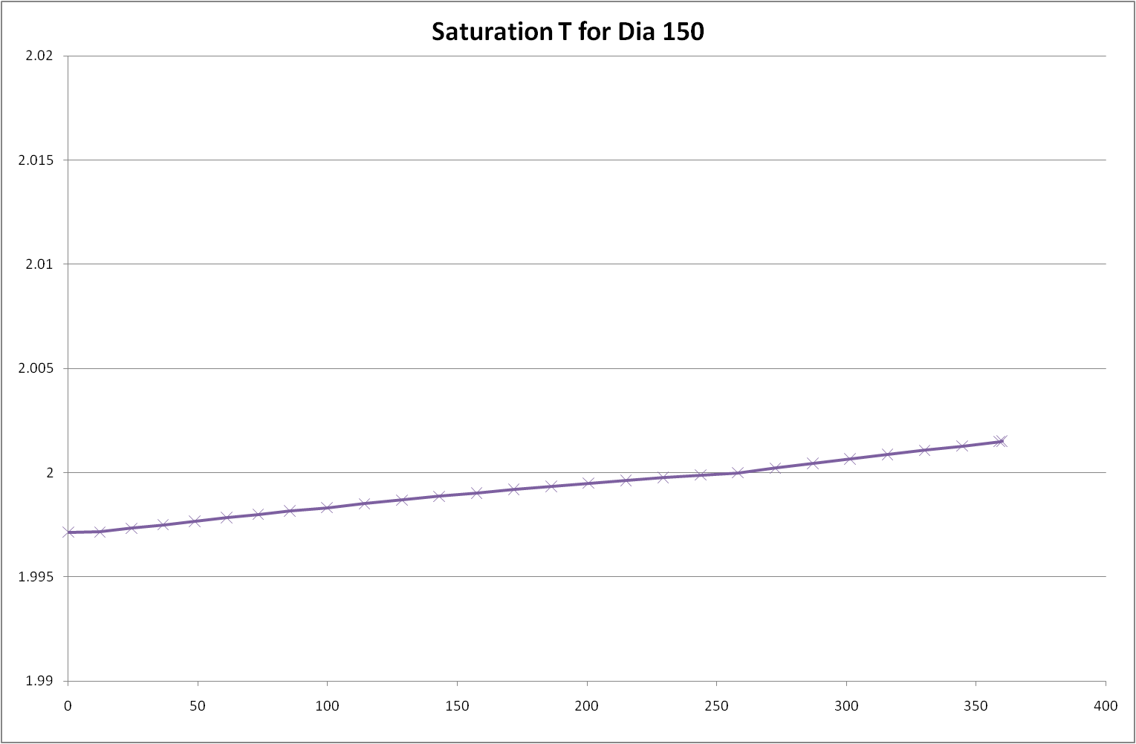
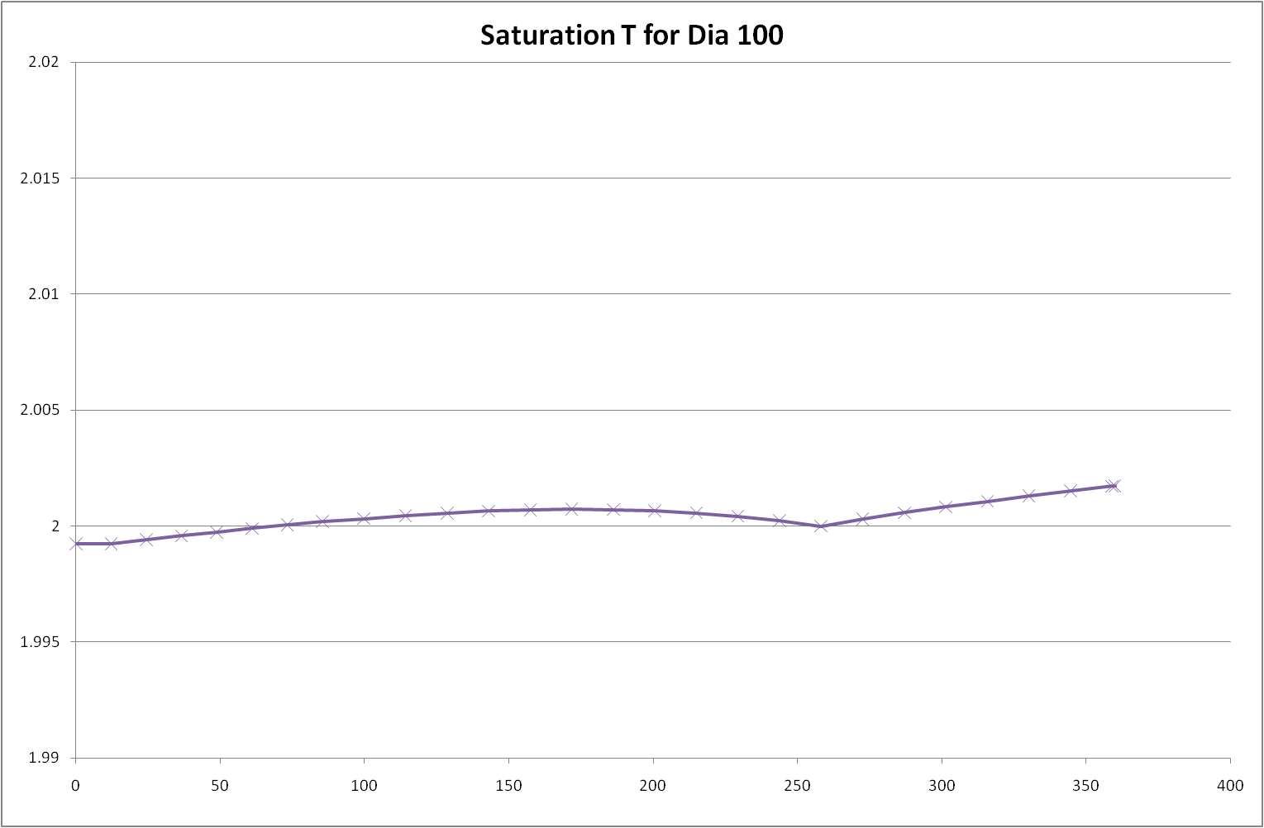
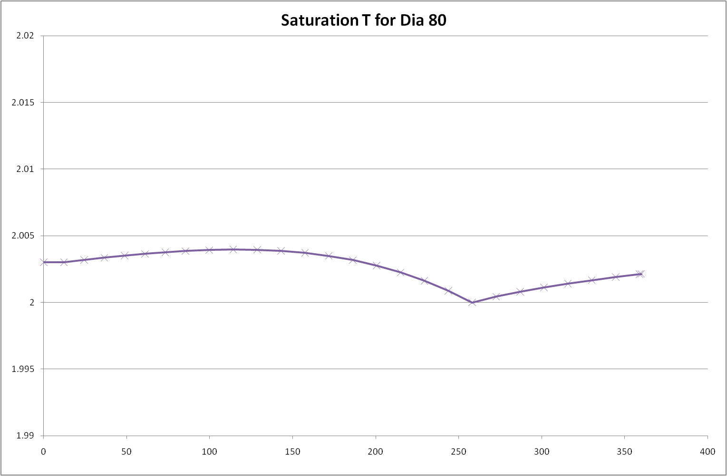
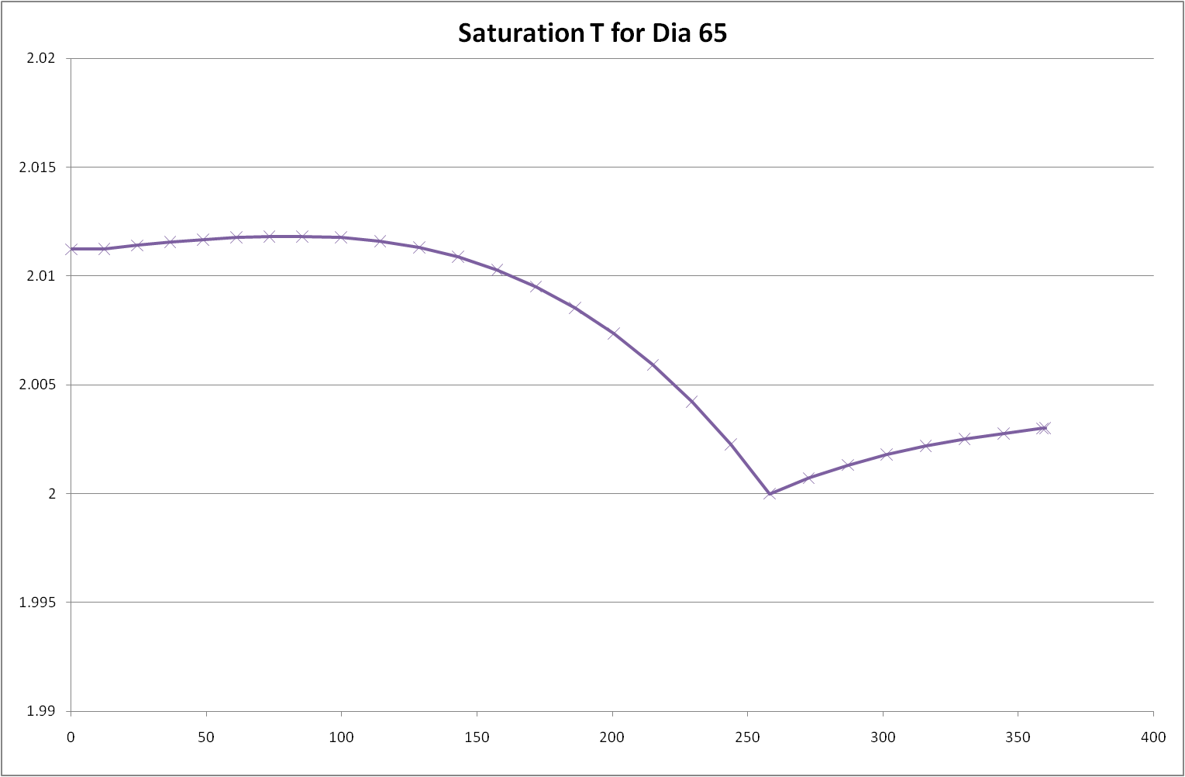
He II cooling loop
Diameter of the pumping line “Line B” LP-SPL

Slide 13
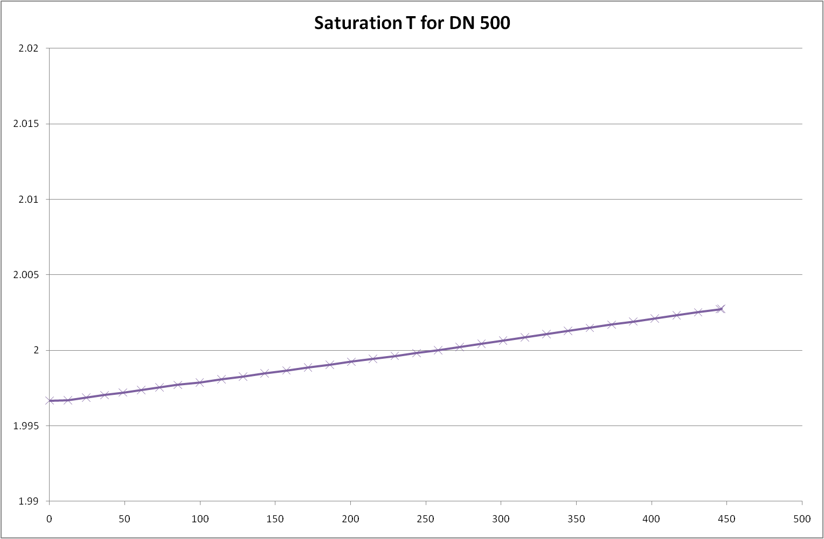
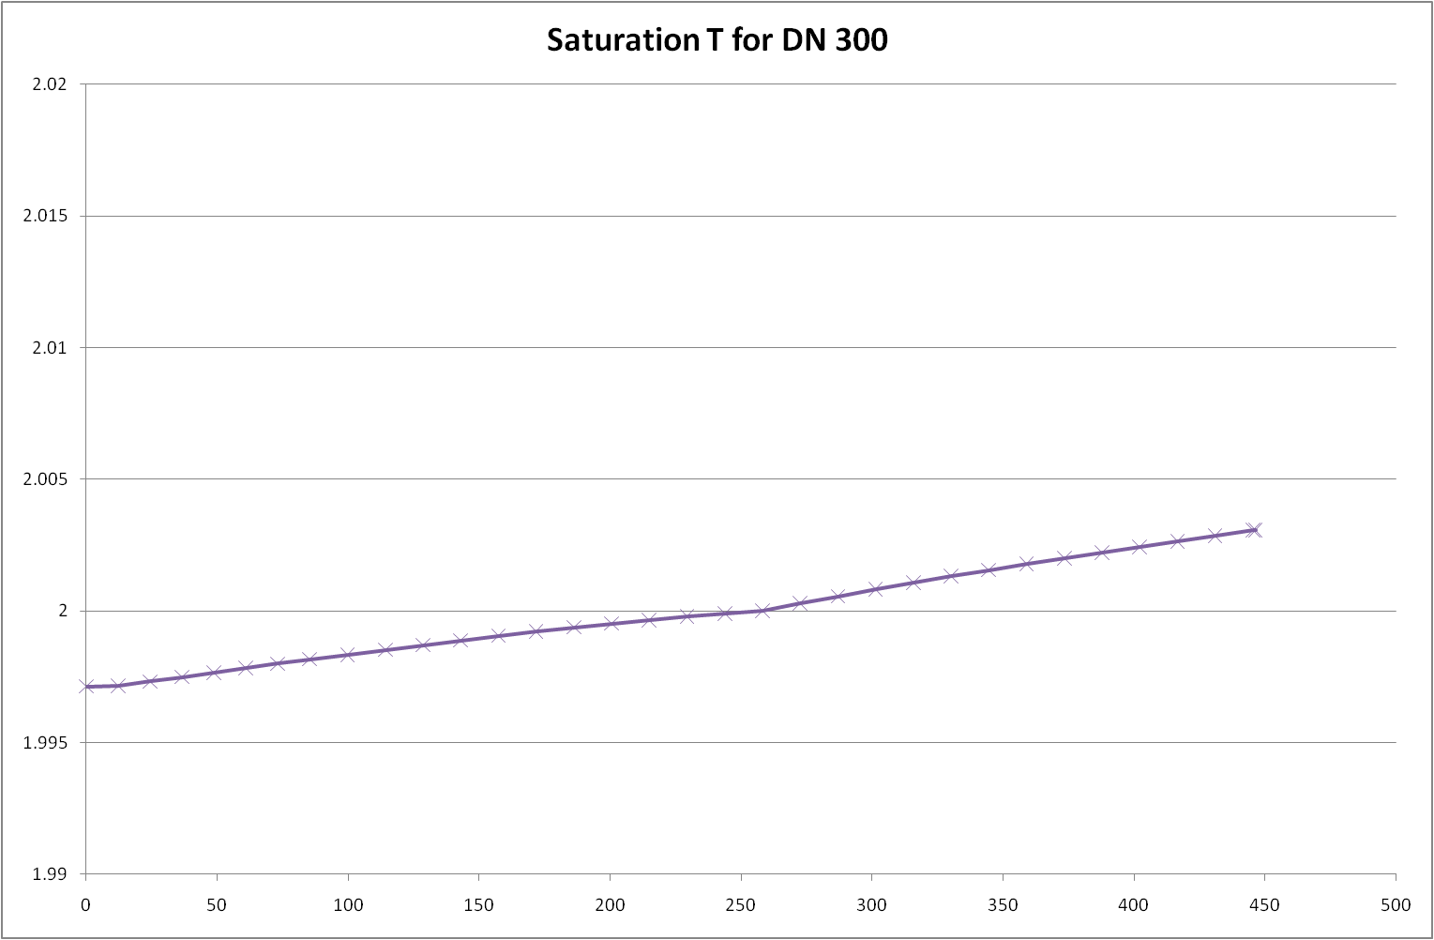
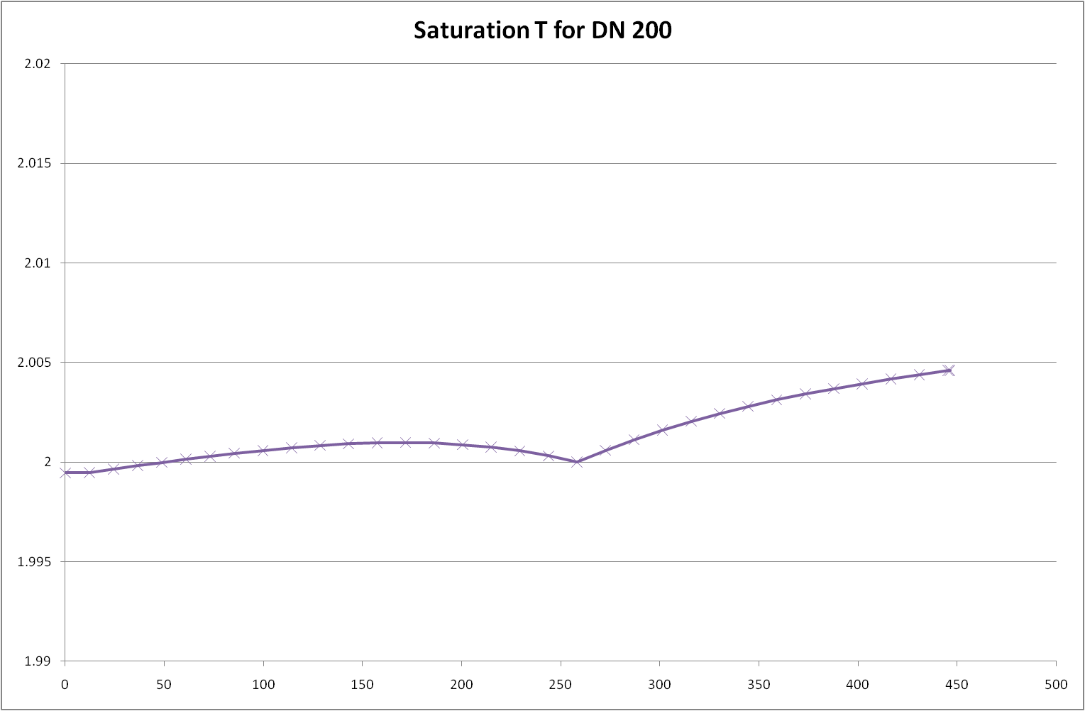
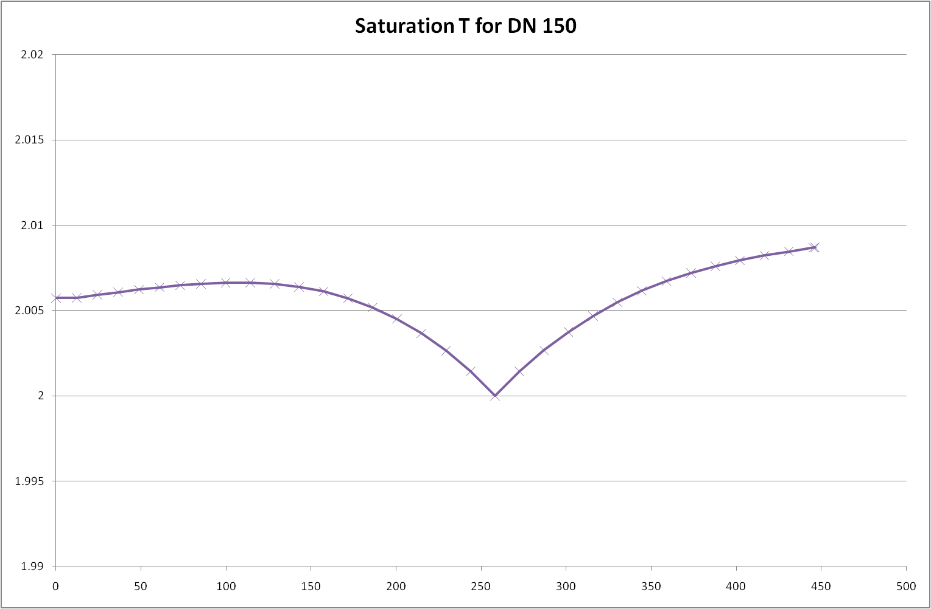
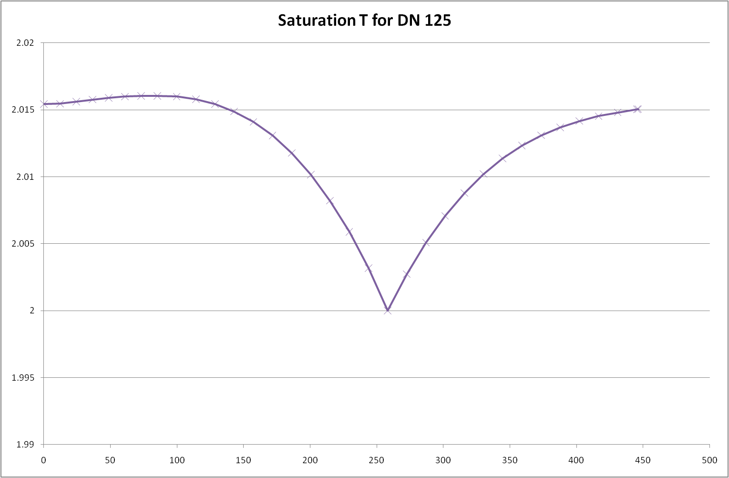
He II cooling loop
Diameter of the pumping line “Line B” HP-SPL

Slide 14
Coupler cooling loop
Design criteria
Line C and Line D
  Nominal conditions: T = 5.0 K to 8.0 K; p = 5.5 bar to 5.0 bar
  Criteria:
    pressure drop during:
      Nominal operation
    Line C only:
      Cool-down
      Warm-up
Distribution baseline
  Series cooling -> full flow over full length
    Mass flow
      LP-SPL: 48 g/s; HP-SPL: 57 g/s
Conditions uncertain / may be done via Line A
Conditions similar -> same size LP/HP

Slide 15
Thermal shield cooling loop
Design criteria
Line E and Line F
  Nominal conditions: T = 50 K to 750 K; p = 18 bar to 17.5 bar
  Criteria:
    pressure drop during:
      Nominal operation
Distribution baseline
  Series cooling -> full flow over full length
    Mass flow
      LP-SPL: 82 g/s; HP-SPL: 98 g/s
Cool-down / Warm-up not design criterion
Conditions similar -> same size LP/HP

Slide 16
Design pressure
We like to avoid opening of cold safety valves
Design pressure for cryogenic helium circuits PN25
  Where possible
  i.e. all lines except Line B
Line B design pressure to be defined
  Proposal 6 bar or 3 bar

Slide 17
Summary Table LP-SPL
Present proposal as working basis
 | Line A | Line B | Line C | Line D | Line E | Line F
Nominal T [K] | 2.2 | 2.0 | 5.0 | 8.0 | 50 | 75
Nominal p [Mpa] | 0.3 | 0.003 | 0.55 | 0.5 | 1.8 | 1.75
Design Pressure | PN 25 | PN 6 | PN 25 | PN 25 | PN 25 | PN 25
Min. Di [mm] | 30 | 70 | 30 | 30 | 50 | 50

Slide 18
Summary Table HP-SPL
Present proposal as working basis
 | Line A | Line B | Line C | Line D | Line E | Line F
Nominal T [K] | 2.2 | 2.0 | 5.0 | 8.0 | 50 | 75
Nominal p [Mpa] | 0.3 | 0.003 | 0.55 | 0.5 | 1.8 | 1.75
Design Pressure | PN 25 | PN 6 | PN 25 | PN 25 | PN 25 | PN 25
Min. Di [mm] | 30 | 150 | 30 | 30 | 50 | 50

Slide 19
Last Slide
Thank you for your attention

