Slide 2

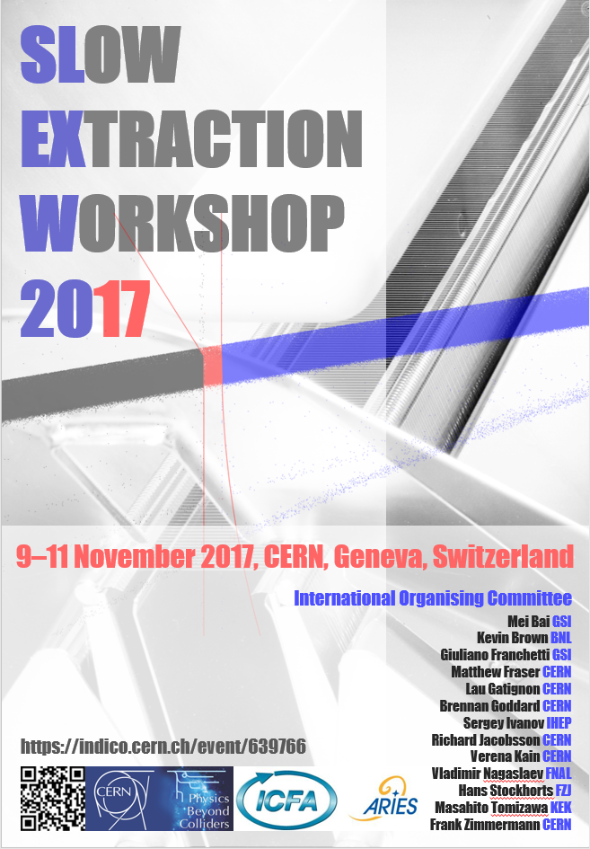
Welcome address and workshop objectives
Brennan Goddard
CERN
Accelerator Beam Transfer

Slide 3
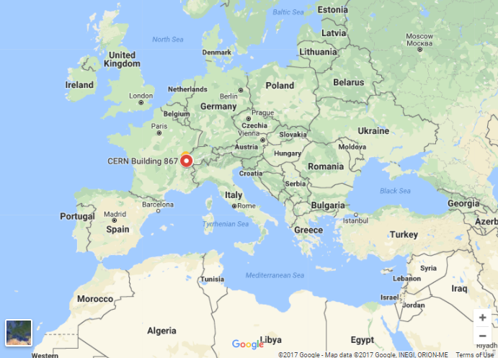
Welcome to Geneva, to CERN, and to this Workshop
Building on success of 2016 Slow Extraction Workshop (GSI).
The 2017 workshop aims to address topical issues associated with Slow Extraction, as well as providing a forum for discussing between experts in this specialised domain.
Organised under the auspices of ICFA and ARIES (successor of EuCARD2). It is supported by CERN Physics Beyond Colliders study.
56 participants registered:
Thanks for your interest and presence!

Slide 4
Organisation and IOC
Mei Bai GSI
Kevin Brown BNL
Giuliano Franchetti GSI
Matthew Fraser CERN
Lau Gatignon CERN
Brennan Goddard CERN (chair)
Sergey Ivanov IHEP
Richard Jacobsson CERN
Verena Kain CERN
Lucie Mainoli CERN (administrative support)
Vladimir Nagaslaev FNAL
Hans Stockhorst FZJ
Masahito Tomizawa KEK
Frank Zimmermann CERN

Slide 5
In case of any problems/questions…
Lucie.Mainoli@cern.ch +4175 411 6898
Brennan.goddard@cern.ch +41 75 411 5161
Matthew.Fraser@cern.ch +41 75 411 6271

Slide 6
Coffee and lunch “sessions”
Thurs and Friday:
  Wakeup coffee: 08:00 – 08:45
  Mid-morning coffee: ~10:30 – 11:00
  Lunch: 12:45 – 14:00
  Afternoon coffee: ~15:30 – 16:00
Note that lunch is NOT provided – CERN restaurant 1 and restaurant 2 are both within walking distance

Slide 7
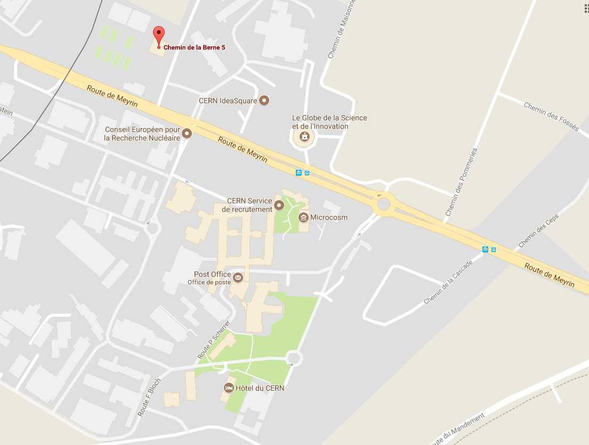
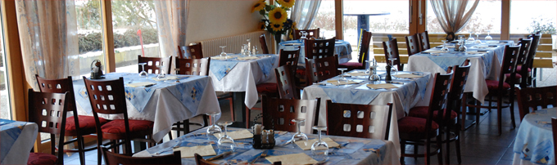
Workshop dinner: Thurs 19:30
Included in registration: 42 people are signed up
In the SMASH restaurant
Opposite CERN main entrance – easy by foot

Slide 8
Visit
Saturday morning after discussion sessions
Bus organized from outside building 6 at 11:15 (gather under the bridge)
Guided visit to TE/ABT septum workshop and CERN Control Centre: both at Prevessin site
Bus will bring people back to Meyrin site at 13:00

Slide 9
Workshop timetable - i
Four ‘presentation’ sessions Thurs & Fri
  Slow Extraction at existing and new facilities (B.Goddard chair)
  Existing and new loss reduction methods (K.Brown & M.Fraser)
  Beam quality and improving spill structure (S.Ivanov & V.Kain)
  Hardware: reducing loss, activation and dose (M.Tomizawa)

Slide 10
Workshop timetable - ii
Three ‘discussion’ sessions Fri and Sat
  Session summaries and discussion (G.Franchetti, B.Goddard, V.Nagaslaev)
  Follow-up from 1st Workshop, proposals for collaboration (G.Franchetti)
  Outlook and priorities for 3rd Workshop (V.Nagaslaev)
  As it’s a workshop, we can have some flexibility in the topics and times

Slide 11
Ambitious objectives
Get input from clients (physicists, medical users, RP, ...) on constraints (detector pile-up, impact of harmonic content, dose stability requirements, impact of beam loss, ...)
Look forward to future requirements, and implications for spill quality and loss control
Review attainable SE performance, in terms of losses and harmonics content.
NEEDS

Slide 12
Ambitious objectives
Get input from clients (physicists, medical users, RP, ...) on constraints (detector pile-up, impact of harmonic content, dose stability requirements, impact of beam loss, ...)
Look forward to future requirements, and implications for spill quality and loss control
Review attainable SE performance, in terms of losses and harmonics content.
Recall theoretical limitations on loss levels and harmonic content, and dependence on machine configuration etc.
Propose and discuss potential mitigation measures and new technologies or accelerator physics developments for improvement.
NEEDS
IDEAS

Slide 13
Ambitious objectives
Get input from clients (physicists, medical users, RP, ...) on constraints (detector pile-up, impact of harmonic content, dose stability requirements, impact of beam loss, ...)
Look forward to future requirements, and implications for spill quality and loss control
Review attainable SE performance, in terms of losses and harmonics content.
Recall theoretical limitations on loss levels and harmonic content, and dependence on machine configuration etc.
Propose and discuss potential mitigation measures and new technologies or accelerator physics developments for improvement.
Identify promising research threads and opportunities for synergy between laboratories, including experimental programmes
Find ways to build collaboration on the engineering challenges and solutions
Further educational and institutional knowledge retention concerning slow extraction techniques, technologies and limitations.
NEEDS
IDEAS
SYNERGY

Slide 14
Concluding remarks
Slow extraction is crucial for many clients
Presents many challenges: both to clients and accelerators
  Spill structure
  Machine stability
  Beam dynamics and simulation
  Beam losses
  Activation
Challenge = Opportunity
Looking forward to an intense and fascinating few days together!

