Slide 2
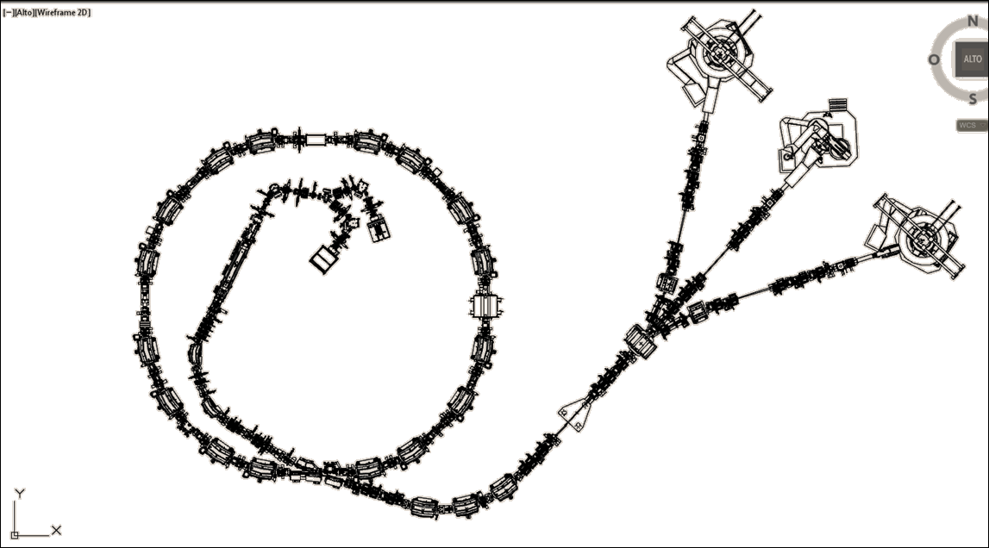
CNAO Machine
CNAO is the only Italian facility for cancer treatment with protons (60-250 MeV) and carbon ions (120-400 MeV/u). The first patient was treated with protons in 2011. Now it treats about 50 patients per day.
2 ECR sources
RFQ+IH
77.6 m ring
Three treatment rooms: two equipped with a horizontal line and one equipped with a horizontal and a vertical line

Slide 3
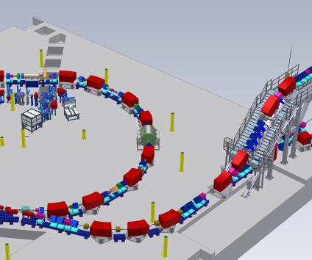
HEBT Chopper
The HEBT line is equipped with a safety system: the HEBT chopper. It is made up of 4 fast magnets interlaced with three dipoles that allow to fast turn on/off the beam.
it is used to control the dose delivered to the patient and to synchronize irradiation with breathing.

Slide 4
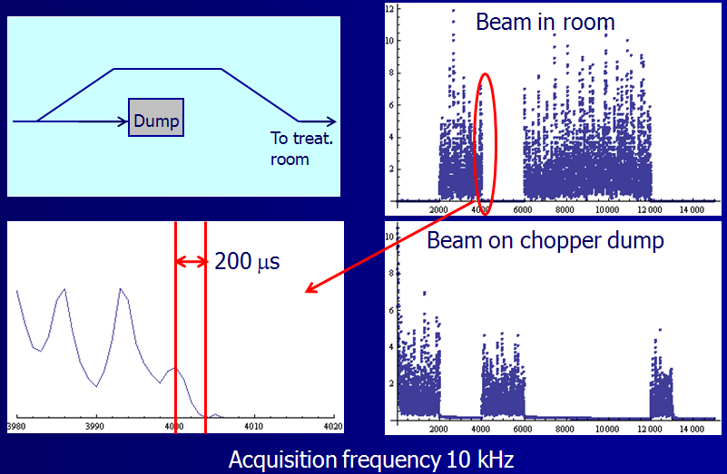
Chopped beam
Chopper ON
Chopper OFF
The chopper stops (and starts) the beam within 200 μs.

Slide 5
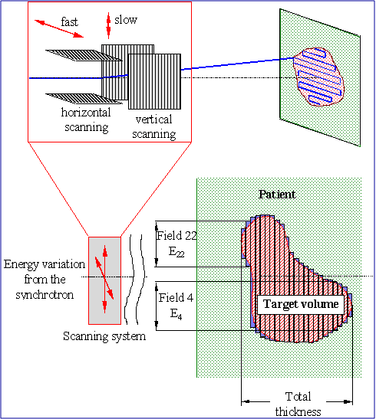
Active systems
The dose is delivered to the patient by an active system.
The depth is regulated changing the energy from the machine while two fast magnets paint the tumor in the two transverse directions.
Two Ionization chambers measure the delivered dose in order to control the scanning magnets and the HEBT Chopper.

Slide 6
Treatment execution
Synchrotron magnets
Extraction
Interspill
HEBT magnet
Treatment duration
0 sec<Extraction<4 sec
1.8sec<Interspill<2.2 sec for protons
2.1sec<Interspill<2.5 sec for carbon ions
Treatment duration dependent on tumour size (1 min-50 min)

Slide 7
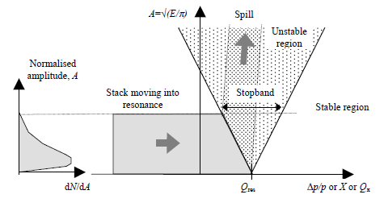
Resonant slow extraction
The extraction is realized by a third order resonance mechanism:
The machine tune is near 1.666 and a resonance sextupole feeds this resonance creating an unstable region. When beam enters this unstable region it can be captured by an electrostatic septum for the extraction.
Steinbach diagram shows beam and resonance in the amplitude-momentum space

Slide 8
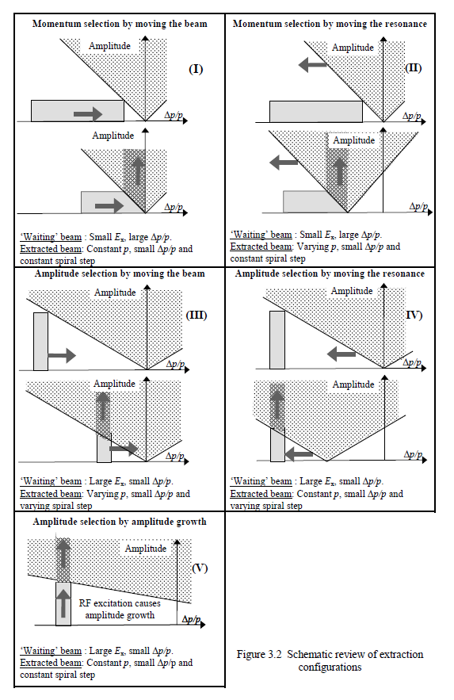
Extraction methods
Moving beam
Moving resonance
Momentum
selection
Moving beam
Moving resonance
Amplitude growth (RF-KO)
Amplitude
selection

Slide 9
Resonant slow extraction
The scheme adopted at CNAO is the «Momentum selection moving beam» scheme
The waiting beam has small emittance and large momentum spread
The extracted beam has small momentum spread.
Lattice parameters are constant during the spill
Extraction takes place from a range of emittances and this smoothes the spill
Hardt condition can be applied
A front-end acceleration mechanism can be added
Extraction separatrix and spiral step constant during extraction.
Band profile, high frequency ripple tolerant.
Amplitude
No particles with
small amplitude
(hollow beam)
ε₀
Band
ε_{F}
Q_{res}
δQ_{min}
δQ_{max}
X’
X_{ES}

Slide 10
Head and tail of extraction
Amplitude
The head and the tail of the beam can’t
irradiate the patient because beam size and position are different than during the center of the spill.
So by the use of the HEBT chopper the head and the tail of the beam are sent to the HEBT dump.
(b)
Δp/p
Head
Tail

Slide 11
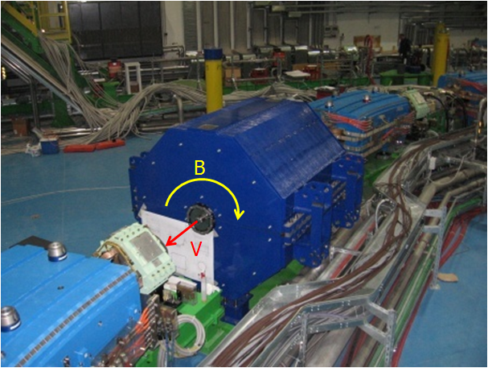
Betatron core
At CNAO the element used to accelerate the beam into the resonance is a betatron core, i.e. a magnet in which a little FEM (about 1 V) is produced by a changing current (about 40 A).
ΔΦ = 2.46 Wb

Slide 12
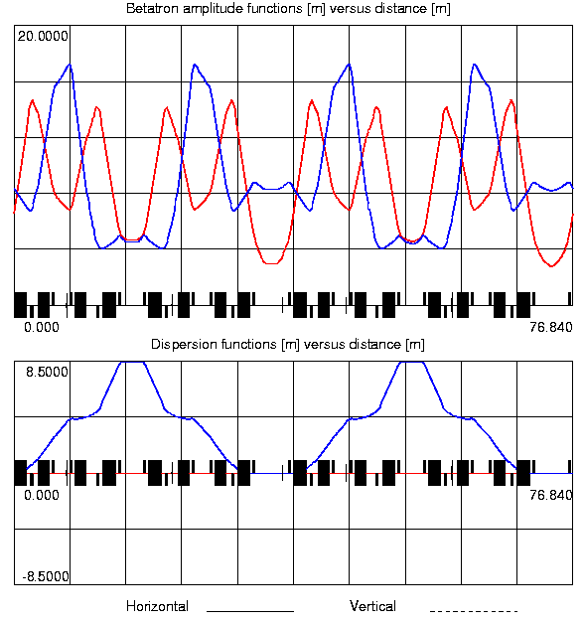
Synchrotron Optics
2 Superperiods
2 Closed dispersion bumps
1 Dipole Family
3 Quadrupole Families
3 Sextupole Families (two family to
Adjust chromaticity and one for the resonance)
Horizontal chromaticity at extraction -4

Slide 13
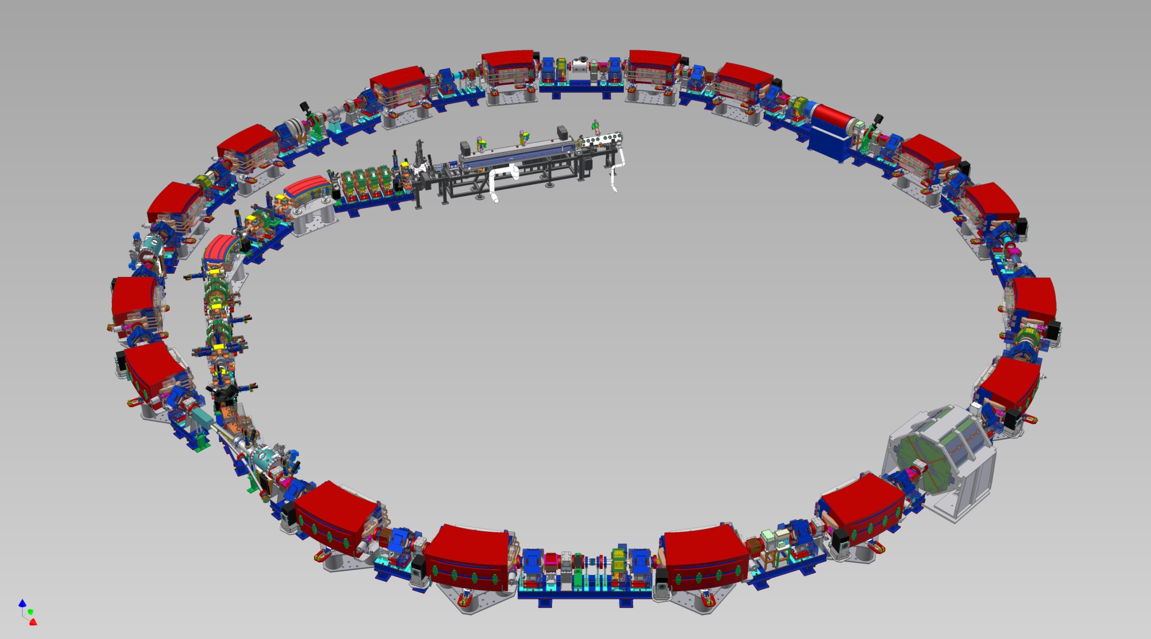
Synchrotron details
Resonance
sextupole
D = D’ ≠ 0
RF cavity
D = D’ = 0
Betatron

Slide 14
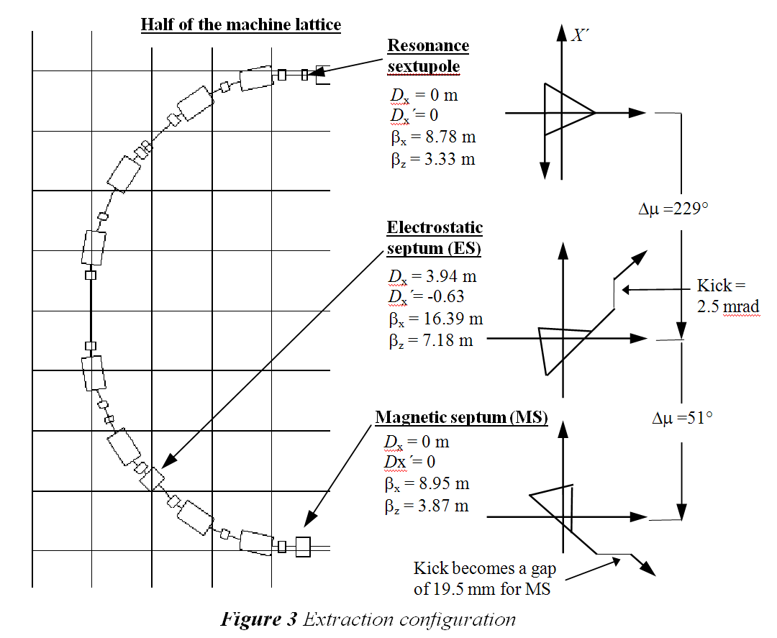
Extraction setup at CNAO

Slide 15
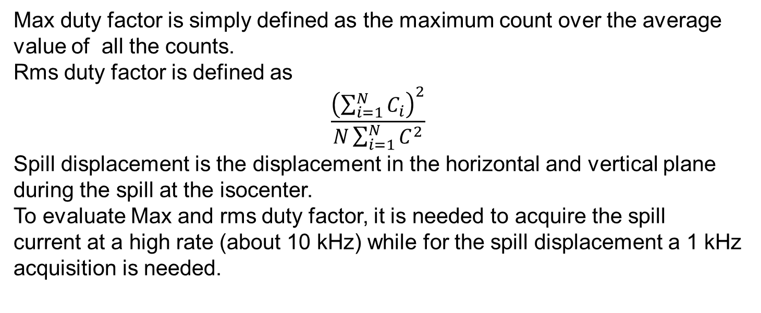
Spill Quality
Spill quality can be described using three parameters:
Spill «max duty factor»
Spill «rms duty factor»
Spill displacement
Max duty factor is simply defined as the maximum count over the average value of all the counts.
Rms duty factor is defined as
$$\frac{{\left(\sum_{i=1}^{N}{C_{i}}\right)}^{2}}{N\sum_{i=1}^{N}{C_{}^{2}}}$$
Spill displacement is the displacement in the horizontal and vertical plane during the spill at the isocenter.
To evaluate Max and rms duty factor, it is needed to acquire the spill
current at a high rate (about 10 kHz) while for the spill displacement a 1 kHz acquisition is needed.

Slide 16
Spill Quality
The three parameters are obviously correlated but
Spill displacement depends on the dispersion
Max duty factor is greatly affected on normal statistic variations because it uses the highest count during the spill
The rms duty factor is the most efficient parameter for the optimization
Examples of correlation among the three spill quality parameters

Slide 17
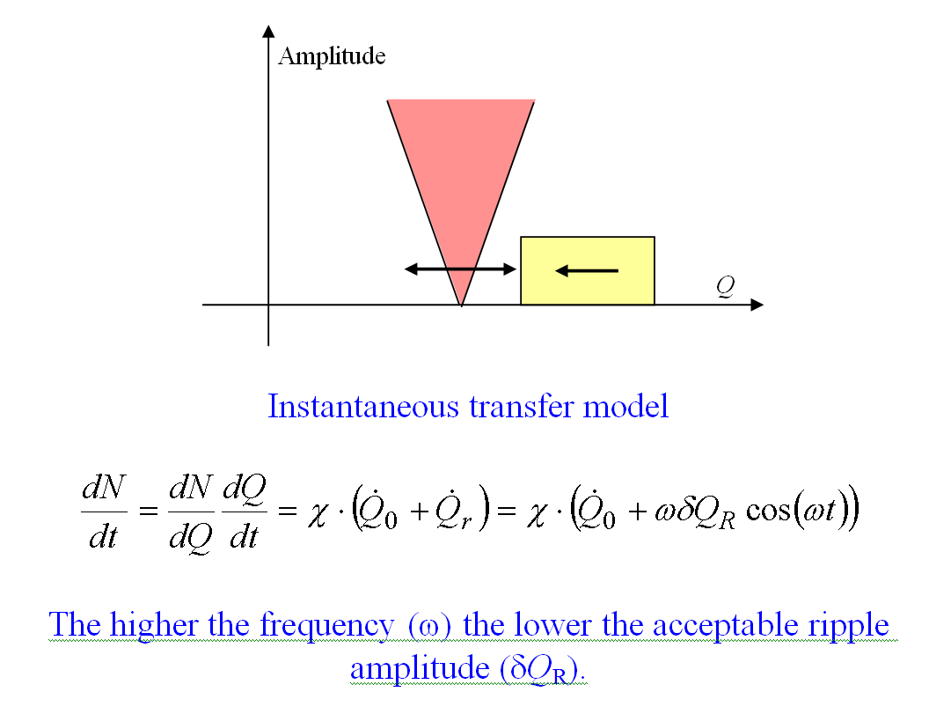
Tune ripple
X’
X_{ES}

Slide 18
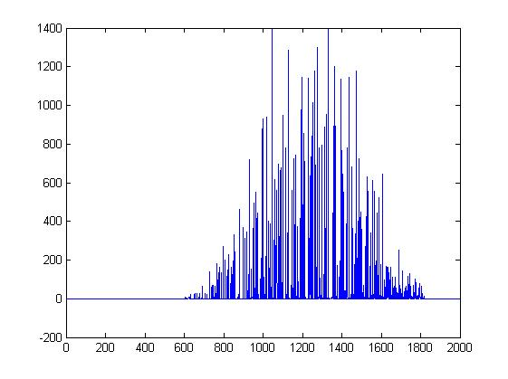
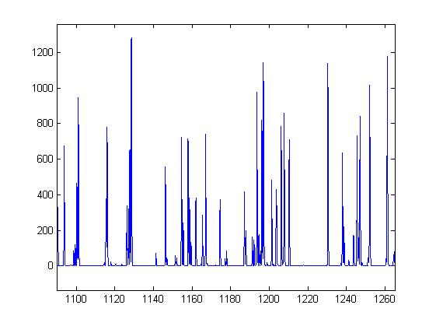
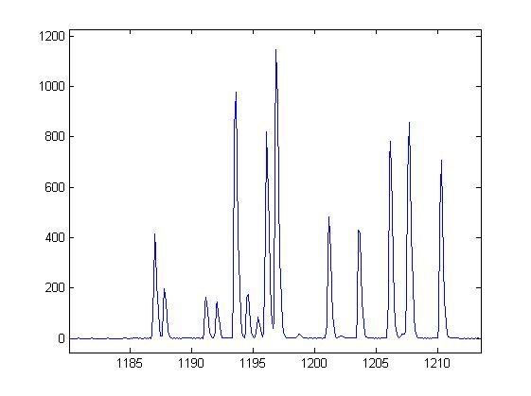
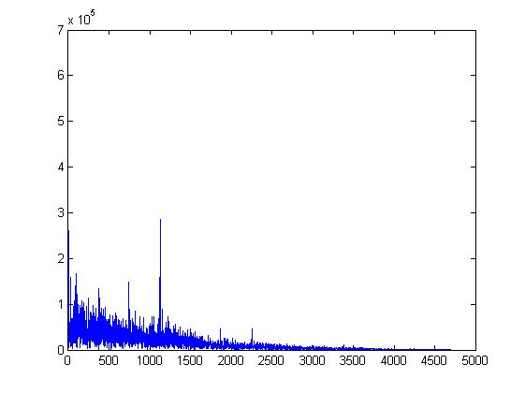
Spill spectrum
FFT of the current signal:
Several contributions at low
Frequencies with a peak at 1.2kHz

Slide 19
Spill duty Factors

Slide 20
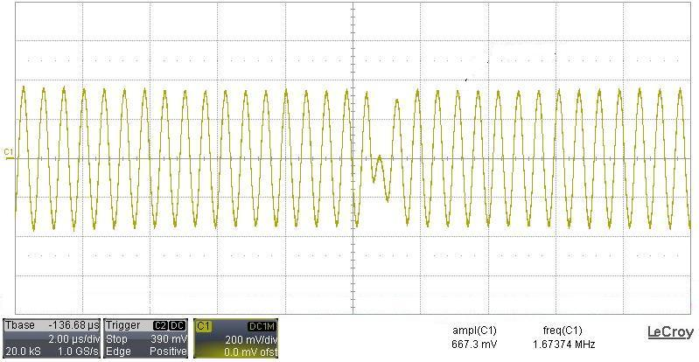
Beam Manipulation for extraction
After acceleration beam is shaped in momentum space in order to obtain a uniform momentum distribution with a great momentum spread.
The RF gym consists in a 180 degree phase jump («RF jump») to increase and flatten the momentum distribution before switching off the RF («RF OFF») for the debunching.
Phase Jump of the RF voltage
in the CNAO RF cavity

Slide 21
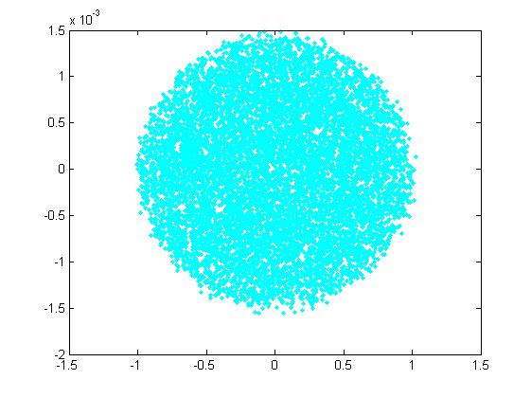
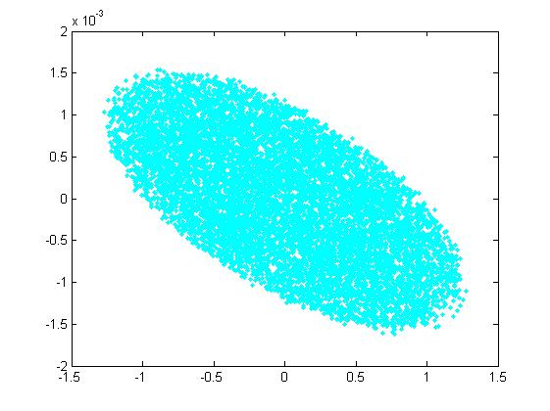
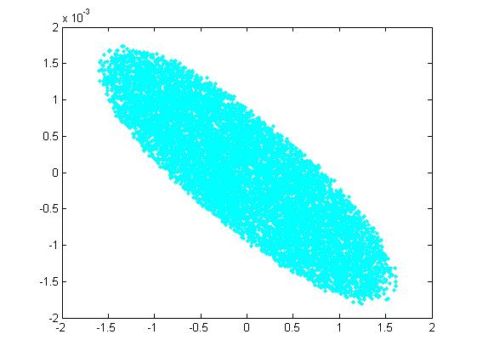
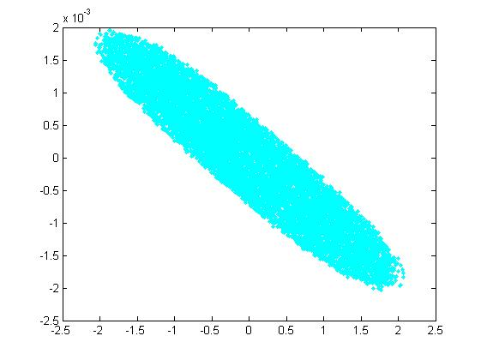
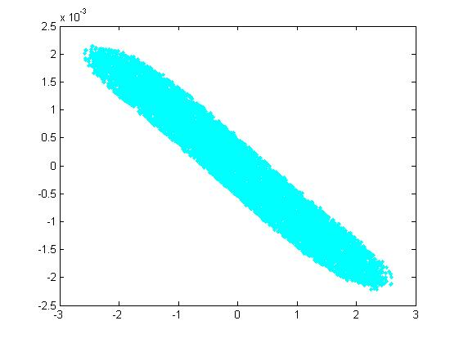
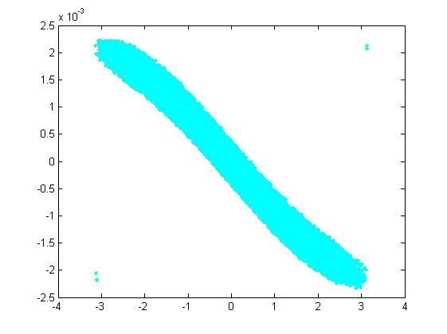
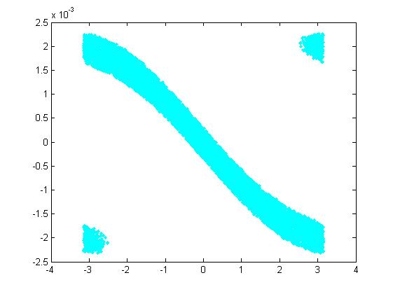
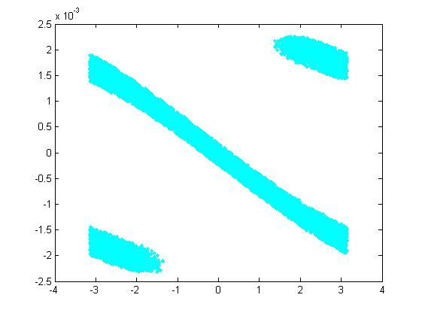
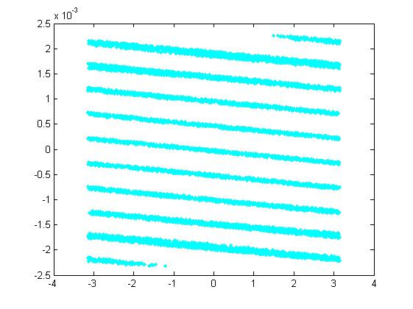
Phase Jump and RF OFF: longitudinal phase space evolution
0 microsec: end of acceleration and RF Phase Jump
300 microsec: RF OFF
T=0
T=50micro
T=100micro
T=150micro
X axis: rad
Y axis: momentum spread
T=200micro
T=250micro
T=300micro
T=400micro
T=2000micro

Slide 22
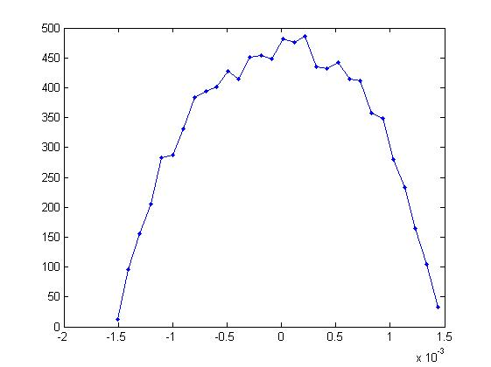
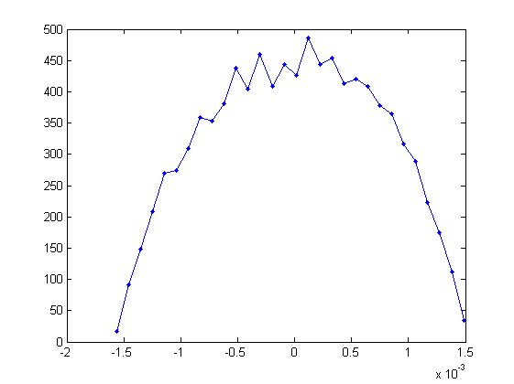
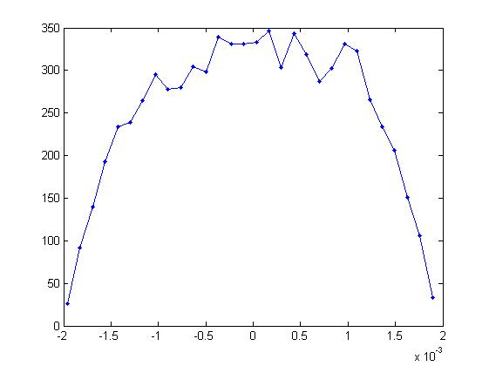
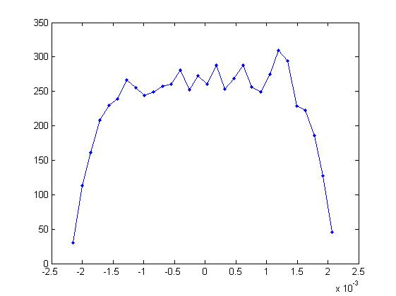
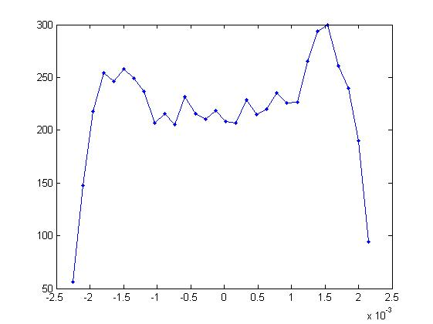
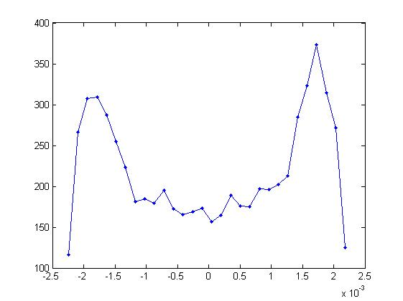

Phase Jump and RF OFF: momentum distribution evolution
T=0
T=50micro
T=150micro
T=200micro
T=250micro
T=300micro
T=400micro
T=2000micro
0 microsec: end of acceleration and RF Phase Jump
300 microsec: RF OFF

Slide 23
Phase Jump and RF OFF
To adjust momentum distribution at each energy one can adjust the time
Between RF jump and RF OFF, the voltage before RF jump or the voltage
During phase jump. The goal is to flatten as much as possible the momentum distribution.
The «spikes» at the beginning and the end are preferrable because the head and the
Tail of the beam are cut by the chopper and the distribution inbetween is more
Flatten than the case without «spikes»
At CNAO the time between RF Jump
And RF OFF is fix (400 microsec) while
Fine adjustment is obtained changing
The voltage during the phase jump that is
Lower or higher the voltage during acceleration

Slide 24
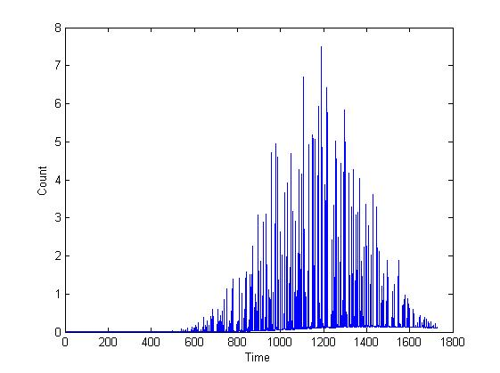
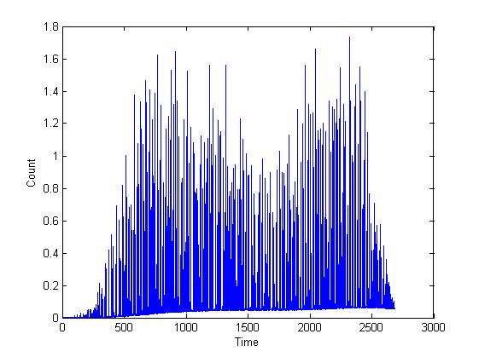
Beam time profiles
Considering the amplitude-momentum extraction, the time profile of the beam arriving at the isocenter is an indirect measurement of the momentum spread distribution
Without phase Jump
With phase Jump

Slide 25
Phase Jump effects
Increase the time of extraction
Reduce the spill displacement
Improve Spill duty factors

Slide 26
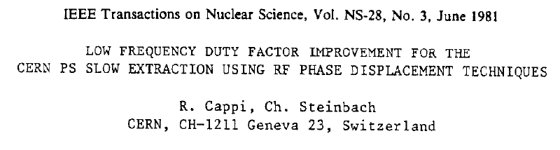


Empty bucket channelling
The idea of the empty bucket channelling is to create an empty bucket switching the RF cavity at a frequency far from the beam energy.
Creating an empty bucket the particles move in the small phase interval between the bucket separatrices so they cross the resonance energy with a greater energy speed.
Increased component

Slide 27
Empty bucket: some general rules
The beam energy engaged by the resonance must be smaller than the bucket half heigth, so the higher is the voltage the greater are the improvements on the spill
The bucket must be properly positioned with respect to the resonance
Notes:
Garden hose

Slide 28
Empty Bucket results
Carbon ions
Protons

Slide 29
Empty Sweeping Bucket (Empty S-Bucket)
In the Empty Bucket channelling gym the RF bucket is stationary. Optimization
Process consists in changing its position while the voltage is the maximum achievable
By the hardware. To improve the spill quality a great part of the beam is lost
in the ring (30-50%).
If the bucket is not stationary but moves at a high frequency it is possible
To reduce beam losses and improve spill quality. This is the so called
Empty Sweeping Bucket gym.

Slide 30
Empty Sweeping Bucket (Empty S-Bucket)
Several schemes have been tested for the frequency sweping.
1.
.
.
.
.
Δf
4.
.
.
.
.
.
.
.
.
Δf
.
.
Random values
t
t
2.
5.
Δf
Δf
t
t
There is no a scheme better than the others:
Changing the parameters for each scheme it is possibile to obtain the same
results
3.
Δf
t

Slide 31
Empty S-Bucket Parameters
f
DeltaFSweep
DeltaFBuck
SweepPeriod
t
Bucket Voltage
DeltaFBucket: Frequency of the Bucket with respect to the acceleration energy
DeltaFSweep: Frequency gap during the sweep
Sweep period
Beam position at the end of acceleration
Changing these parameters one changes the position of the bucket with respect to the extraction V-gap and to the beam.
For each energy a multiple scan has been performed changing all these parameters except of the sweep period whose value has been fixed considering the performances of the LLRF at 100 microsec (20 periods of the LLRF DSP).

Slide 32
Empty S-Bucket Optimization
For 6 different voltages (1kV, 2kV, 3 kV, 4kV, 5kV, 6kV) we changed the frequency of the Bucket from 3 kHz to 15 kHz and for each frequency the beam position has been changed from -32 to -18 mm. Furthermore it has been checked that it is possible to use DeltaFBuck=DeltaFsweep.
For each setpoint, one has measured the three spill quality parameters and the extraction efficiency.

Slide 33
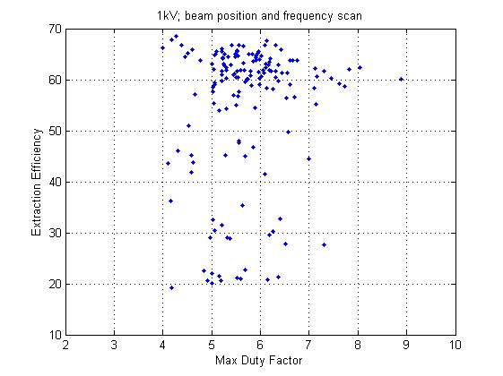
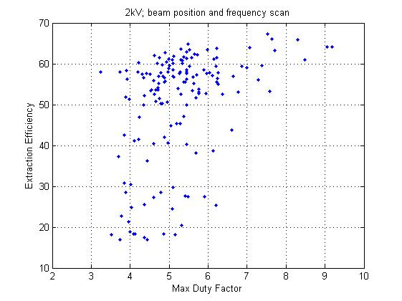
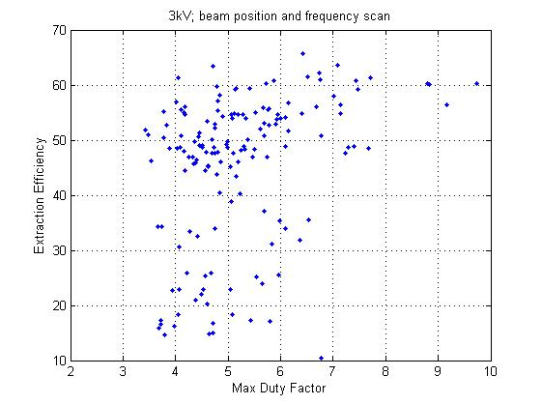
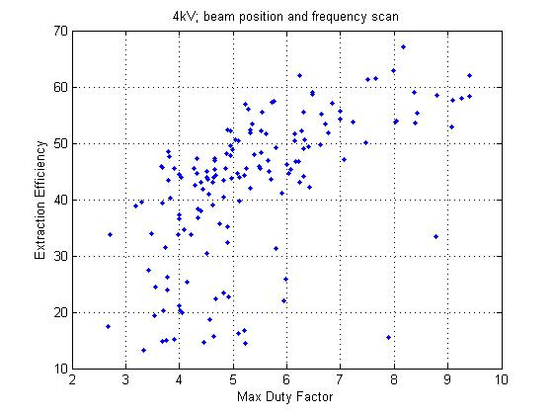
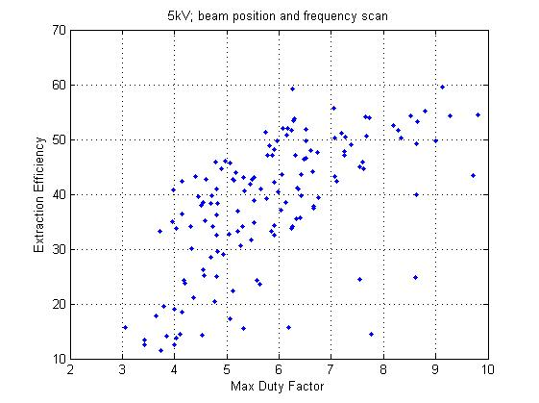
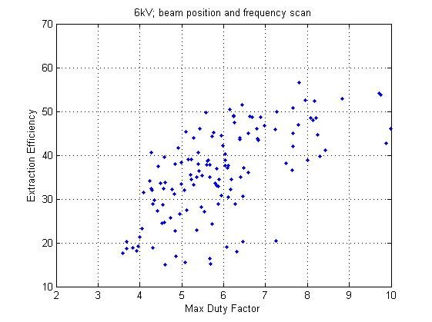
Max Duty Factor with different Bucket Voltages

Slide 34
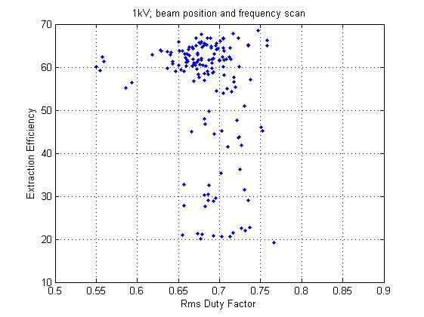
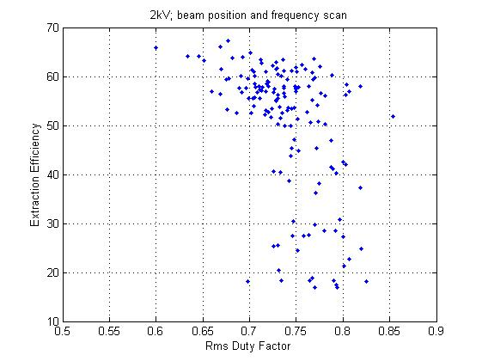
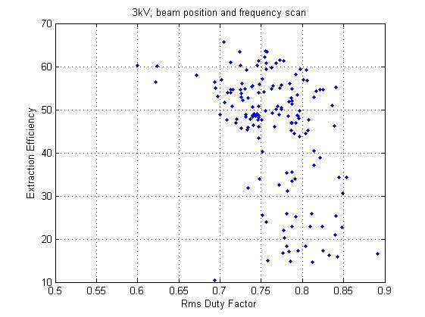
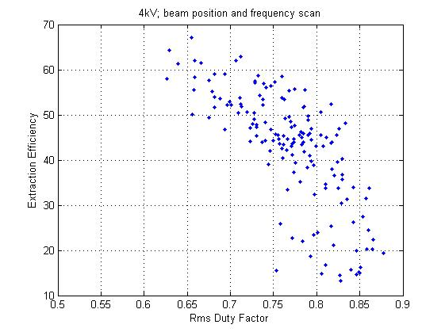
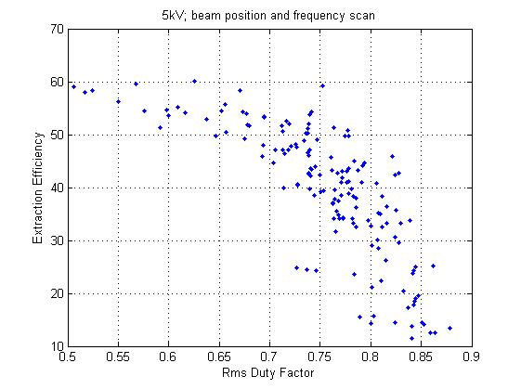
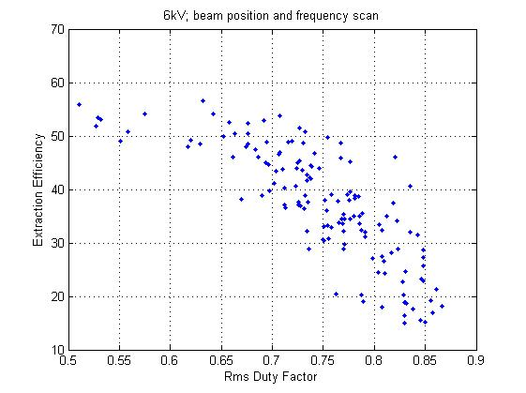
Rms Duty Factor with different Bucket Voltages

Slide 35
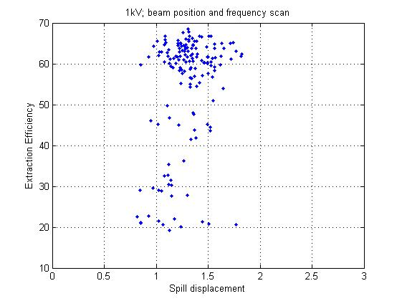
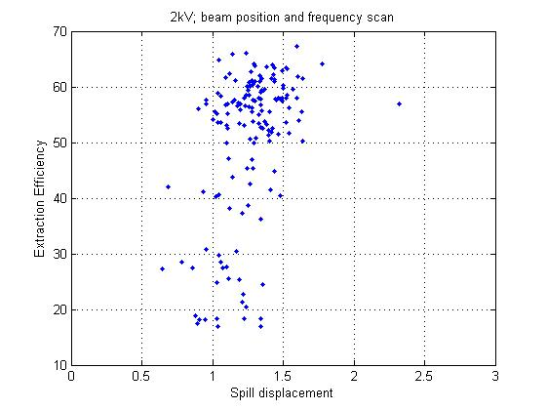
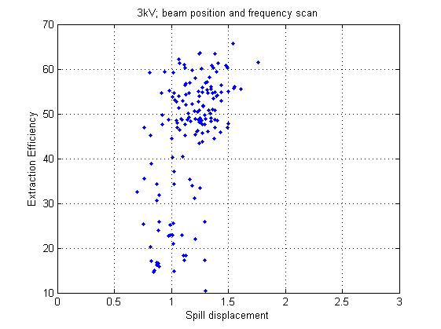


Spill Displacement with different Bucket Voltages

Slide 36
Optimization Example (270 mm carbon ions)
An important result is that changing properly the parameters we can use a small
voltage

Slide 37
Optimization Example (270 mm carbon ions)
Voltage | Pos | dFEB | dFsweep | Max Duty Factor | Efficiency | Rms Duty Factor | Displacement
1000 | -30 | 4000 | 4000 | 4.262472558 | 68.57315 | 0.747035696 | 1.306644
1000 | -26 | 5000 | 5000 | 4.372974957 | 66.74211 | 0.689029509 | 1.319388
1000 | -31 | 4000 | 4000 | 4.002199504 | 66.23597 | 0.758193532 | 1.350726
1000 | -30 | 10000 | 10000 | 4.451534964 | 64.40586 | 0.712449185 | 1.26446
1000 | -22 | 9000 | 9000 | 4.105935916 | 43.51527 | 0.723134077 | 1.521287
1000 | -22 | 4000 | 4000 | 4.303436727 | 46.07482 | 0.750798837 | 0.951034
2000 | -26 | 9000 | 9000 | 4.208751363 | 60.3255 | 0.787868445 | 1.50008
2000 | -30 | 10000 | 10000 | 3.894650619 | 58.41135 | 0.803531178 | 1.055559
2000 | -31 | 10000 | 10000 | 3.730001365 | 58.05708 | 0.76381321 | 1.464773
2000 | -25 | 10000 | 10000 | 4.194701633 | 57.92923 | 0.736724723 | 1.523523
2000 | -29 | 13000 | 13000 | 4.411808042 | 57.67183 | 0.749907977 | 1.453624
2000 | -24 | 11000 | 11000 | 4.309912227 | 57.38846 | 0.74927711 | 1.494404
2000 | -28 | 13000 | 13000 | 4.341590694 | 56.49348 | 0.776556278 | 1.22791
2000 | -25 | 9000 | 9000 | 3.243968175 | 57.97136 | 0.818738909 | 1.220845
2000 | -24 | 9000 | 9000 | 3.9149181 | 56.14556 | 0.802618489 | 1.28201
2000 | -28 | 14000 | 14000 | 4.363114629 | 52.28023 | 0.716578283 | 1.393541
2000 | -23 | 12000 | 12000 | 3.878962128 | 51.9188 | 0.853645254 | 1.418699
2000 | -25 | 14000 | 14000 | 3.97659024 | 51.25261 | 0.751574888 | 1.399496
2000 | -29 | 15000 | 15000 | 4.351441395 | 49.83938 | 0.743900571 | 1.1
2000 | -23 | 14000 | 14000 | 4.235585855 | 46.88841 | 0.787030556 | 1.280568
2000 | -22 | 9000 | 9000 | 4.222870537 | 41.45425 | 0.787214143 | 1.407439
2000 | -22 | 8000 | 8000 | 3.84543336 | 42.51304 | 0.799809749 | 1.268013
2000 | -22 | 4000 | 4000 | 4.107377965 | 41.1766 | 0.789641767 | 0.931225

Slide 38
Empty Sweeping Bucket vs Empty Bucket
Carbon ions
Proton ions

Slide 39






Frequency domain comparisons
No Empty Bucket
Empty Bucket
Empty Sweeping Bucket
zoom
zoom
zoom

Slide 40

Air core quadrupole
It is possible to correct the tune ripple using a fast quadrupole (air core quadrupole). At CNAO one has tryed to use it in a feedforward way but
It was not possible since the phase of the harmonics change spill per spill
The solution is to drive
The quad in a feedback way
Using the signal from a fast (10 kHz) detector

Slide 41
Air core quad with feedback
Feedback
start
Feasibility tests using the Signal from a scintillator that cannot be used in normal treatments because it is beam destructive.

Slide 42

Thin Foil CEM
To feedback the air core quadrupole during treatments a very low interceptive monitor is needed.
The use of a thin metallic foil (0.8 um Al foil) that, hit by the beam, emits secondary electrons, collected by a single Channel Electron Multiplier (CEM) seems a good solution.

Slide 43


Thin Foil CEM
Installation on line scheduled in April 2018

Slide 44

Ripple compensation
Integration time 100 us (10 kHz data)
100 ms
Empty S-bucket
No compensation
Empty Sbucket + ACQ feedback
Empty bucket

Slide 45
Conclusions
During the extraction the tune ripple affects strongly the spill quality
Several cures have been tested and are used to improve beam quality:
RF phase Jump
Empty bucket Channelling
Empty sweeping bucket
Air core quadrupole feedback

Slide 47

Hardt condition

