Slide 1
Simple Considerations for the ESS Diffuser
Vladimir Nagaslaev
2nd SE Workshop, CERN
10 November, 2017

Slide 2
Simplest geometry for the diffuser
Pre-scattering:
Losses predominantly occur for the small portion of the beam that passes through the septum plane at low angle
This portion can be deflected to a small angle by the diffuser plane in front of the septum plane
Pre-scattering must be small to not cause losses
Works best with low density materials (e.g. Carbon, Titanium)
Higher density foils also can be used (Mo,W)
Effect of pre-scattering is largest for the foil septa

Slide 3
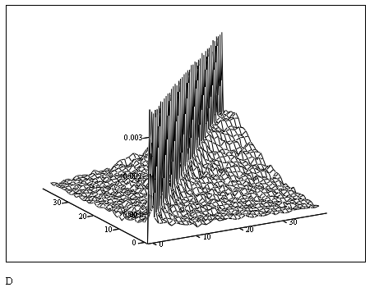
Simple simulations for the diffuser
Septum
Reserved 0.5m
Diffuser on the same precision frame
Start: X1
End: X2
What is an optimal diffuser geometry?
Minimizing the final RMS scattering angle:
For every X1, X2:
Track a beam through D and septum
Choose D density to minimize final rms angle
Continue scanning X1 and X2
Map of scattering angle rms vs X1 and X2

Slide 4
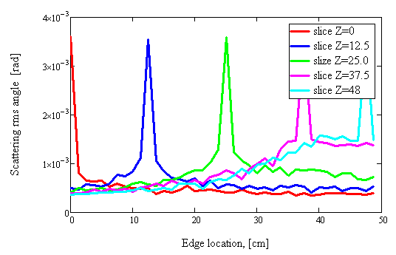
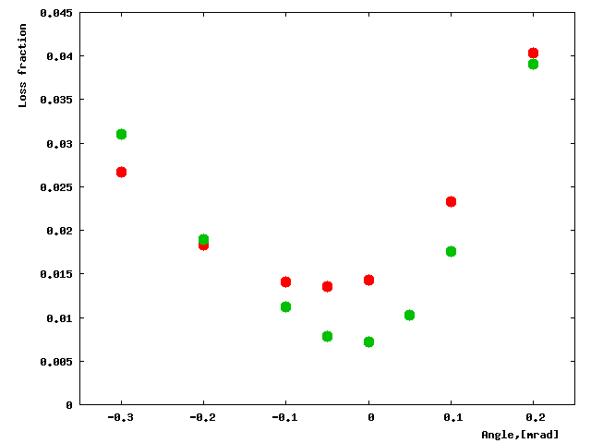
Simple simulations for the diffuser
Map of rms angle vs X1 and X2
Slicing the map across X1 or X2
Material is most effective at X1=0, but best is to fill the entire length*
The minimum density is always optimal**
High density foils work well if sparsely populated (Mo)
Titanium foils is a good choice
50u foils, 2.6mm spacing:
Green– with diffuser; Red – without diffuser

