Slide 1
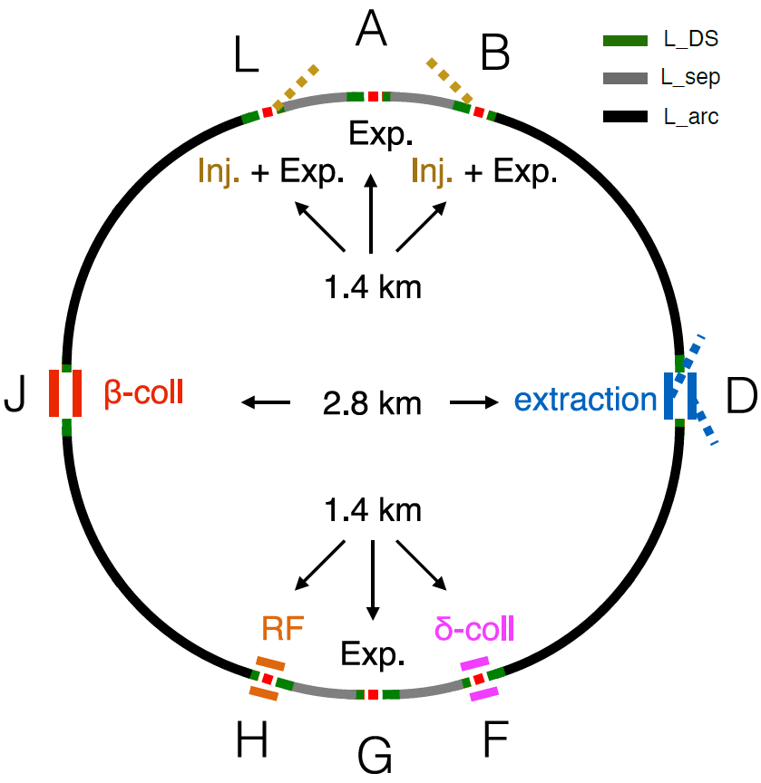
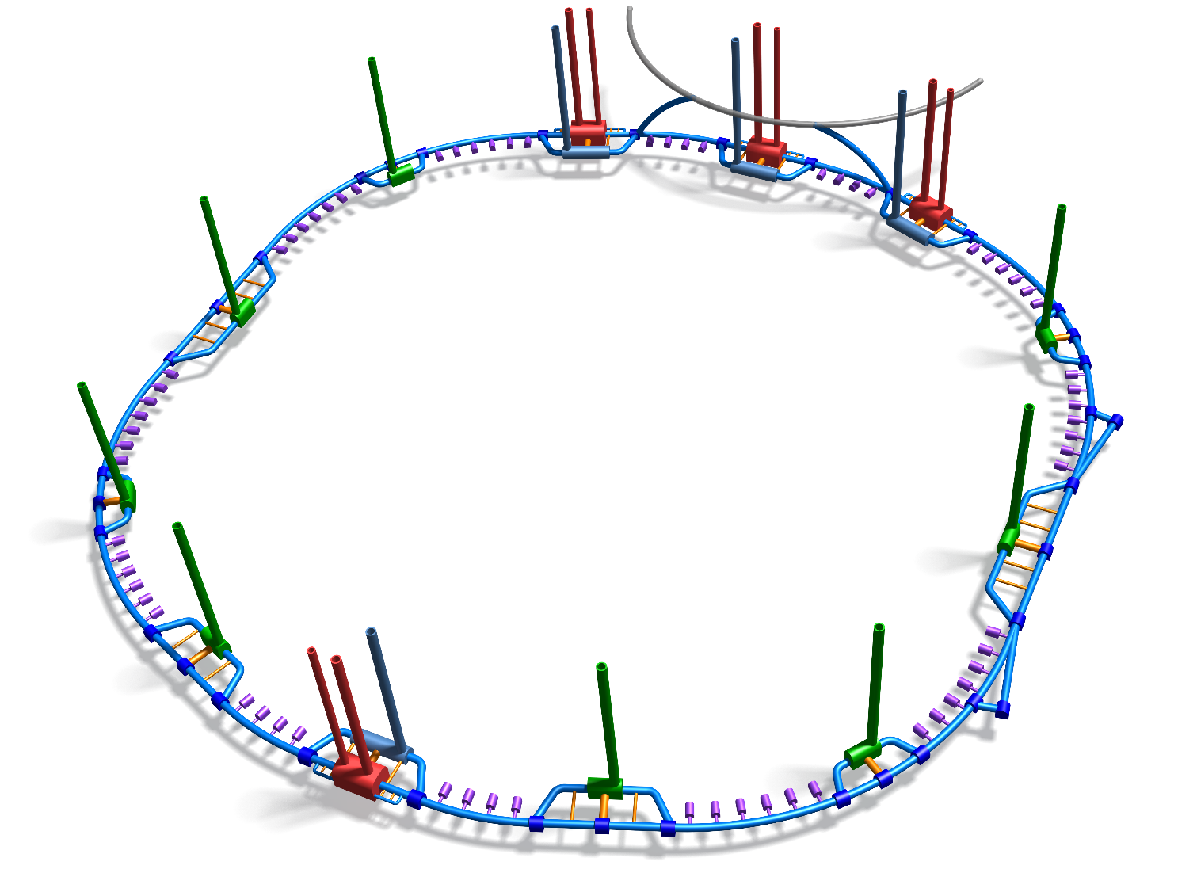
Schematic update – 97.75 km:

Slide 2
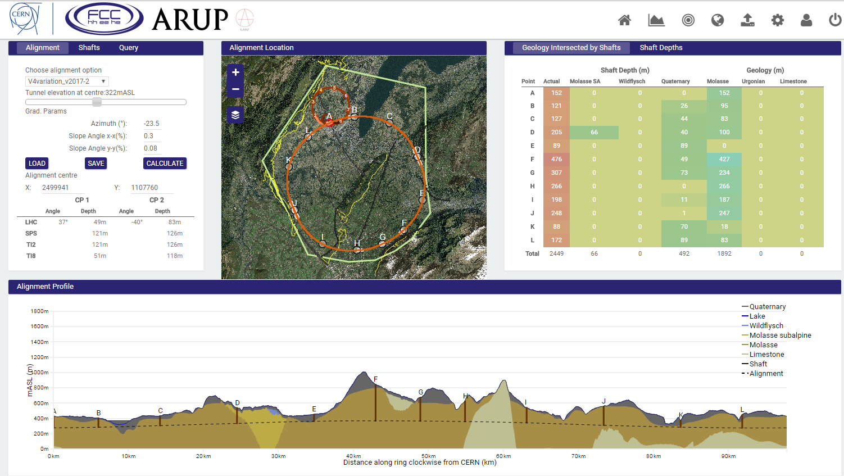
Avoids Jura and Pre-alps limestone
Shafts L,A&B in “reasonable” locations
Total shaft depths significantly reduced from previous versions
Shaft at experimental point at G not too deep.

Slide 3
Passing through moraines under lake.
At deepest point, approximately 110 m of moraines below alignment level. Alignment 79 m below surface.

Slide 4
2. Shaft and cavern currently located in moraines, however, there is potential to move this shaft.

Slide 5
3. Very deep shaft at F

Slide 6
4. Approximately 25 m above limestone

