Slide 1
SPS LIU Beam Dump - Strategic Review
R.Morton

Slide 2
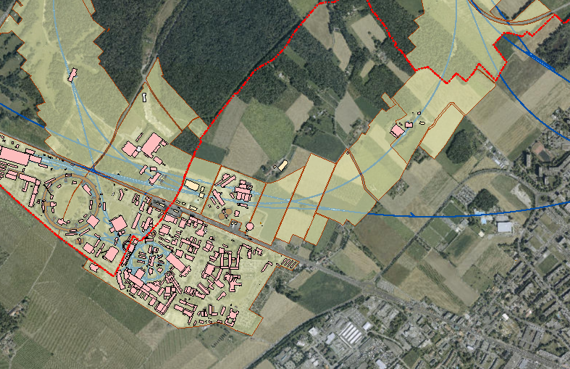
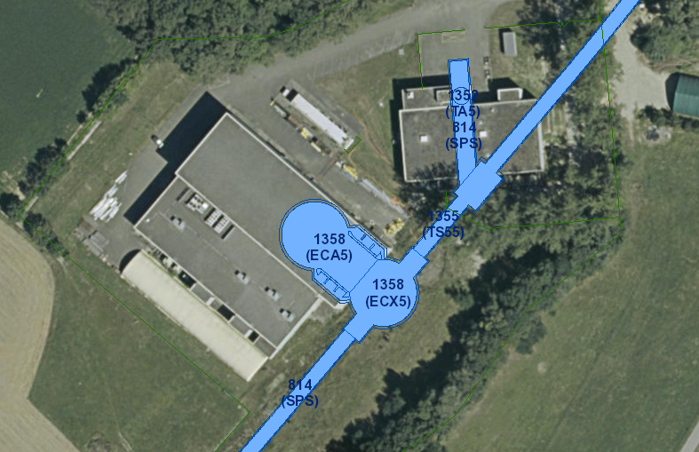
1. Location - LIU-SPS internal beam dump Pt.5
AERIAL VIEW
CERN DOMAIN
BA5
BA5
CERN SITE VUE
INTERNAL BEAM DUMP

Slide 3
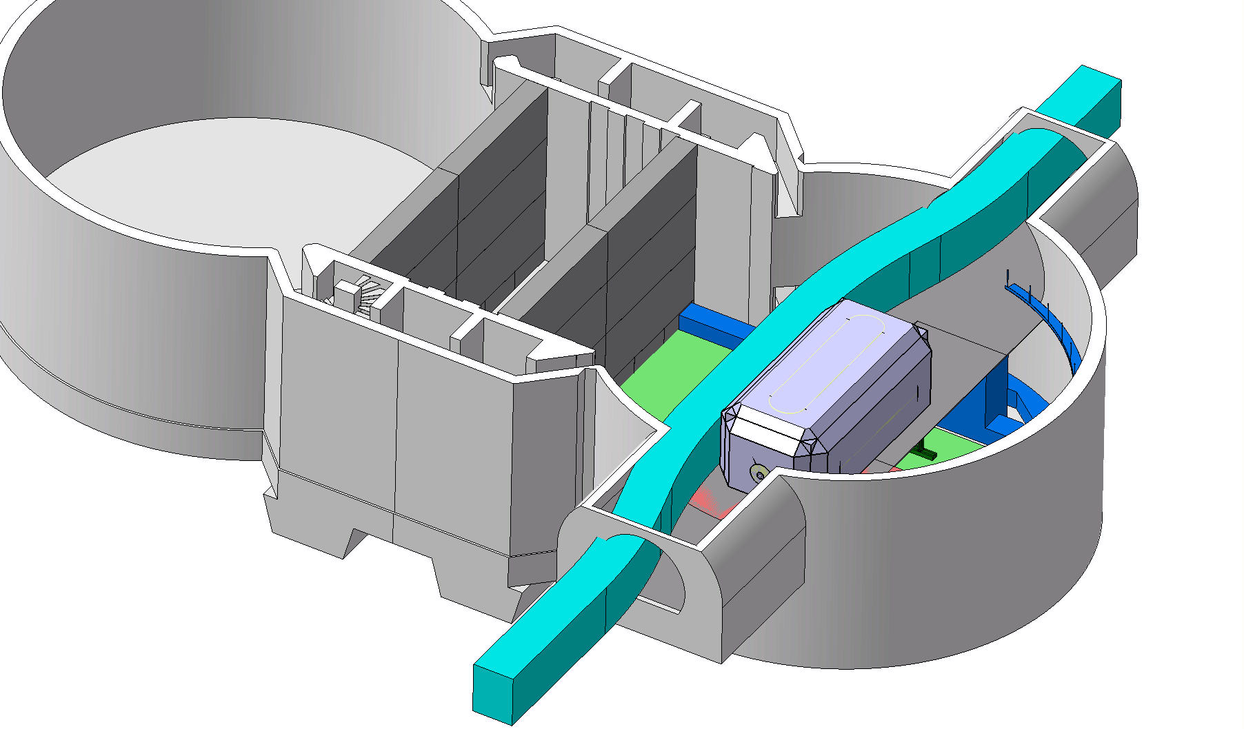
1.Project location within BA5
Transport swept path
New beam dump shielding blocks

Slide 4
2.Technical description – Beam Dump
The project objectives are:
Create a new structural support for the inline beam dump and shielding blocks
Provide a stable transport passage through the ECX5
Enlarge the tunnel eye on the SPS 5-6 tunnel side of ECX5 to allow for the transport passage and new cable runs.
The works consist of:
Mass concrete block to support the beam dump
Modification of the existing beam bridge and reinstallation
Provision of a system type bridge for the transport path
Enlargement of one side of the tunnel eye to accommodate the transport passage.
Main Constraints:
9 month construction window
RP working conditions
Access via the ECA5 shaft with half of the shielding wall removed
All cables on the left hand side of the tunnel eye will remain in place
Current estimated value of the works is 2.5 million CHf (currently under review)
Atkins Consultancy for design 200KCHf plus possible site supervision

Slide 5
2. Technical Description
Phase two Dump support Drawings
Overall scheme and construction sequence
Second phase works concrete blocks

Slide 6
2. Technical Description
Phase two Dump support Drawings
Second phase works topping slabs
Second phase works green bridge relocation

Slide 7
2. Technical Description
Phase two Dump support Drawings
Second phase works – topping slab reinforcement

Slide 8
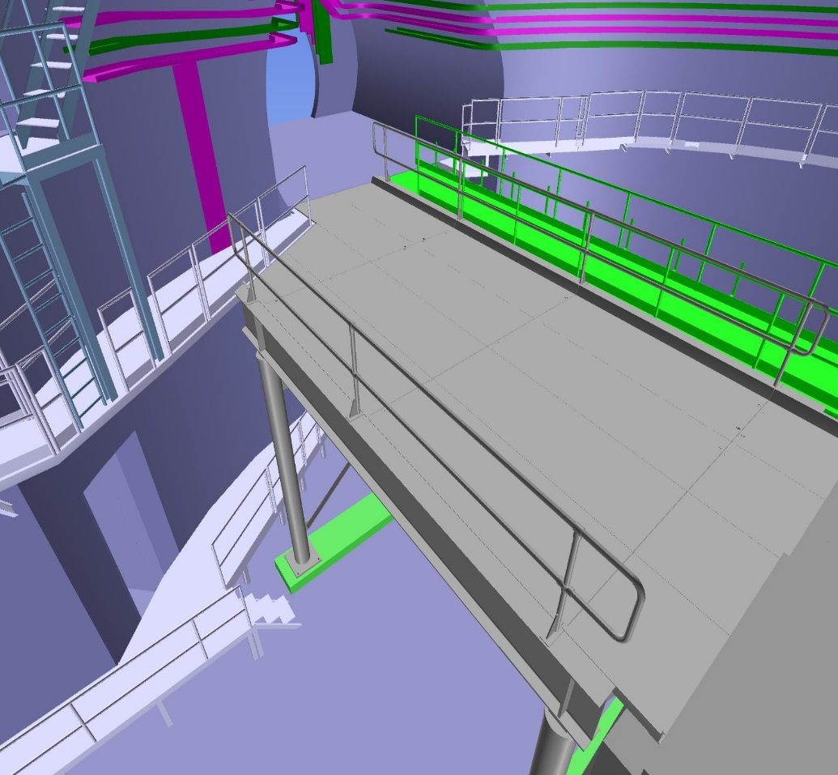
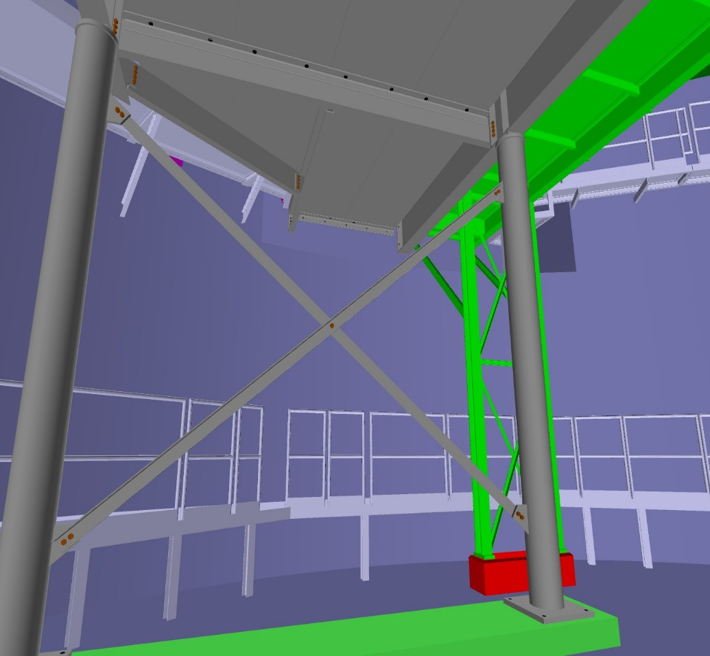
2. Technical Description
ECX5 Bridge elements
System bridge based on a performance specification shown in grey, with modified and repositioned existing beam line bridge in green

Slide 9
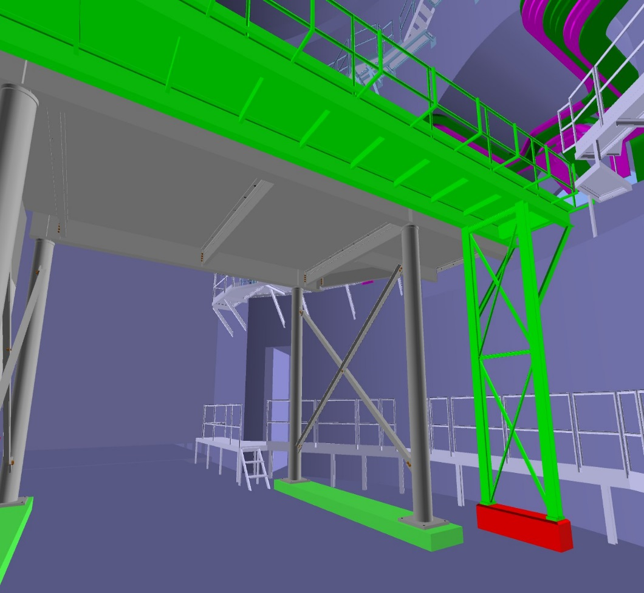
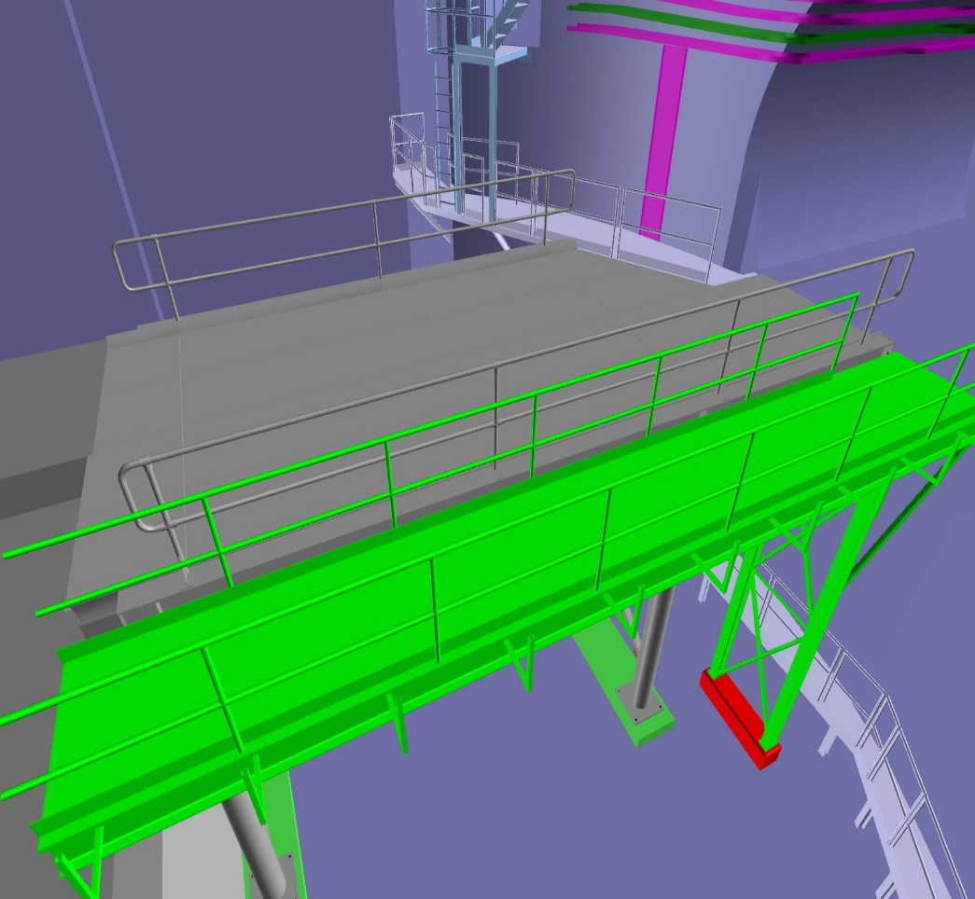
2. Technical Description
ECX5 Bridge elements
Existing bridge to be modified in situ or brought to surface for modification if RP allow

Slide 10
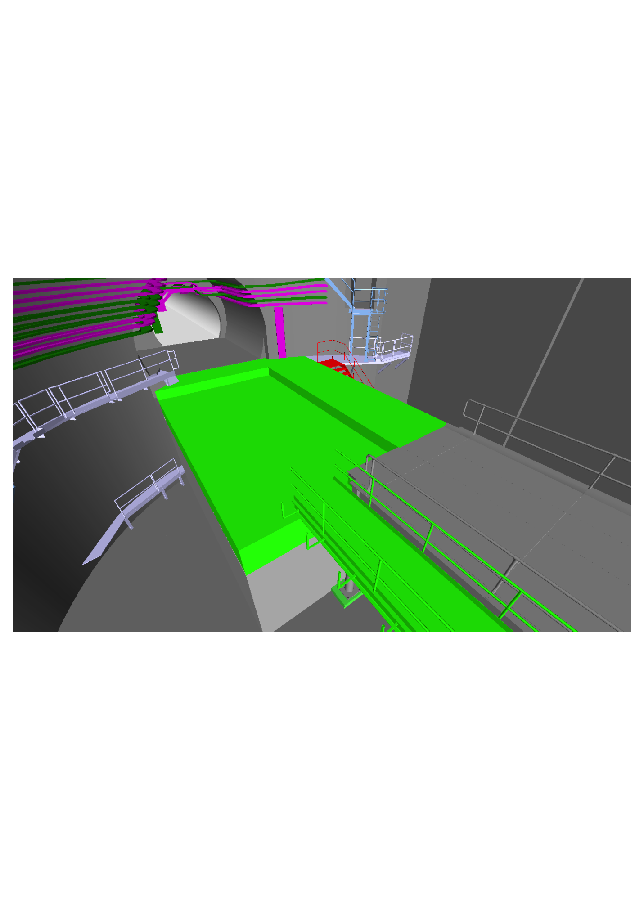
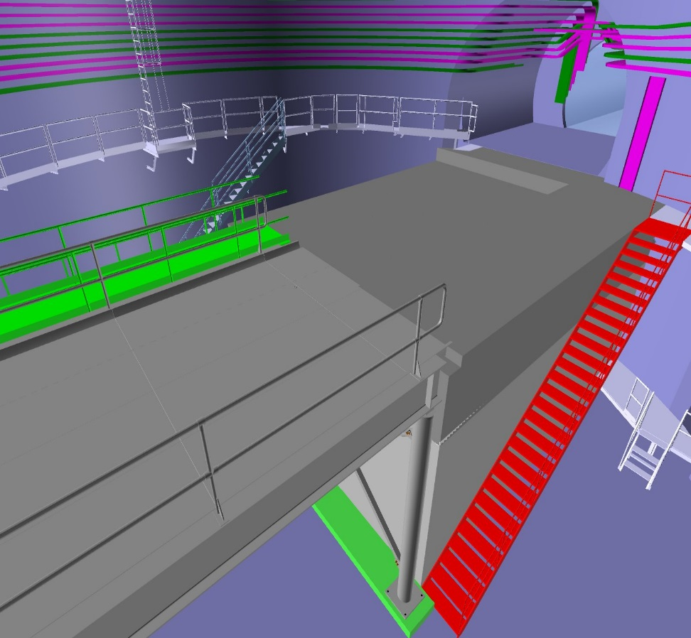
2. Technical Description
ECX5 Bridge elements
Recess in upper level of concrete support to accommodate the beam dump shielding

Slide 11
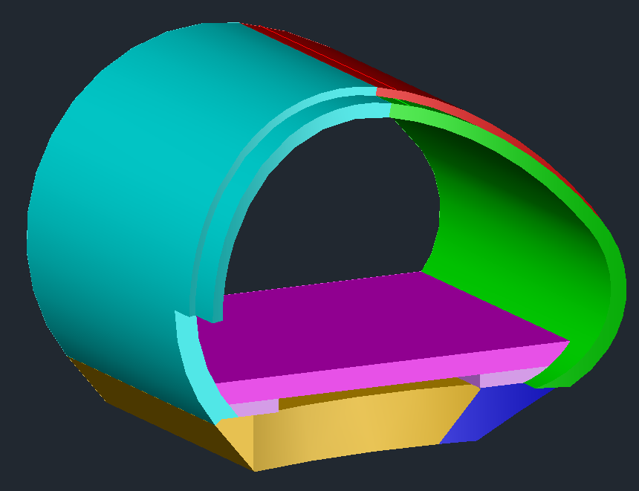
2. Technical Description
Tunnel Eye enlargement
Tunnel eye enlargement shown in Green and blue
Invert slab design has been recently changed to a solid invert (no void for swelling)

Slide 12
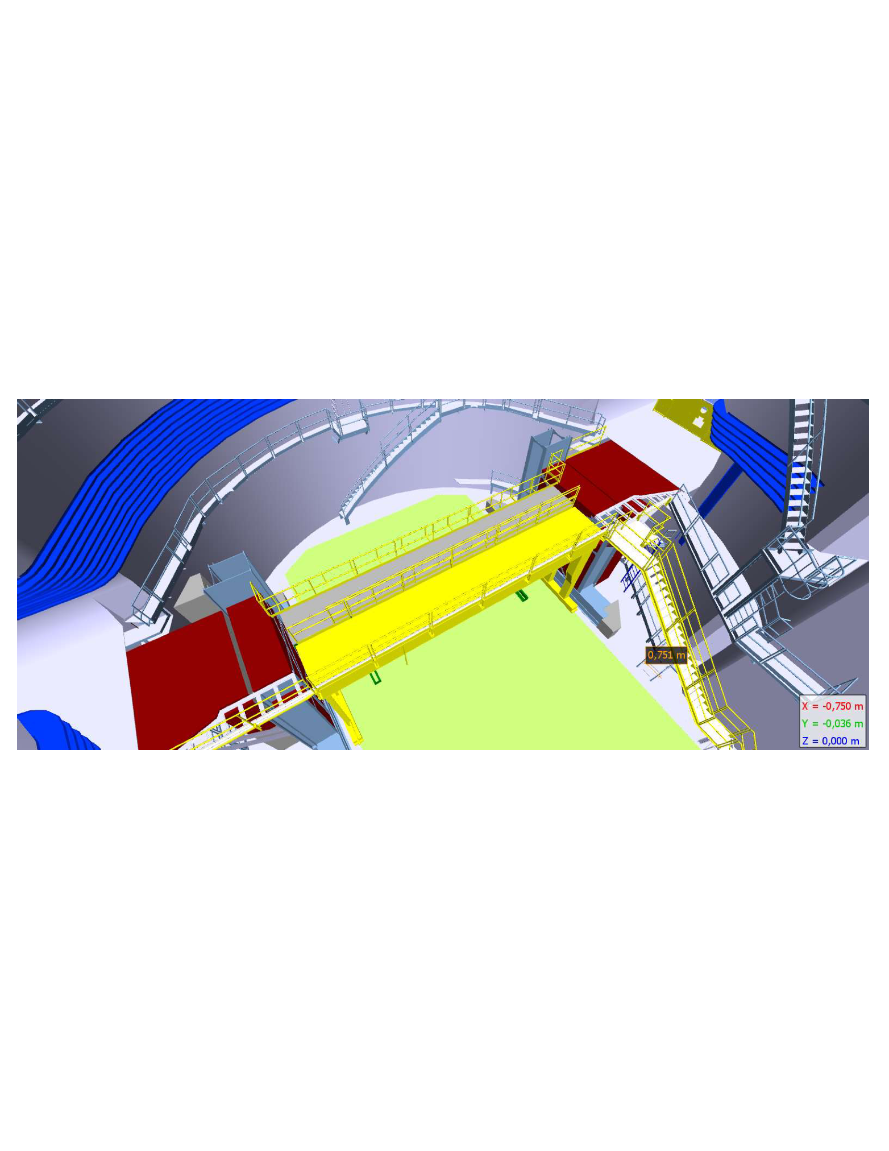
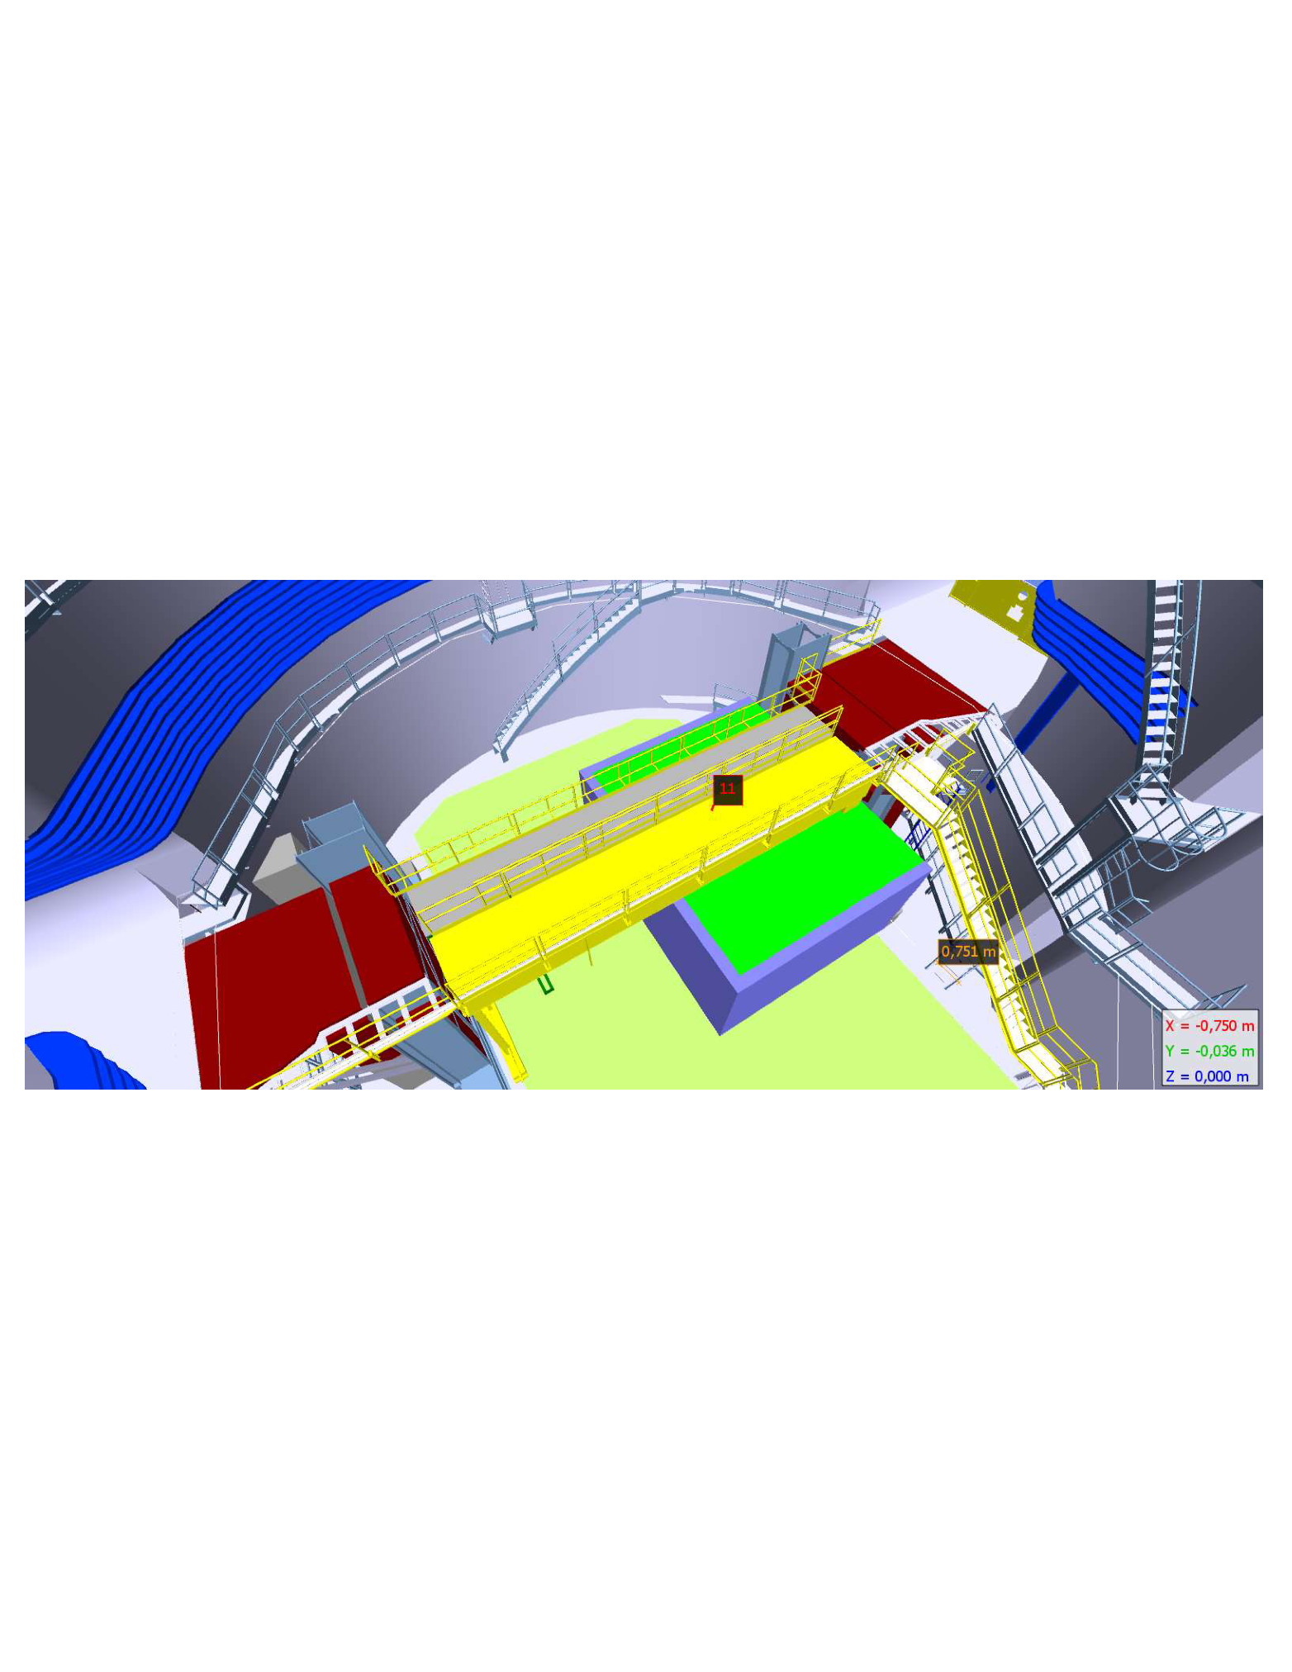
3.Construction phases
Phase 1 support (completed in EYETS 2107)

Slide 13
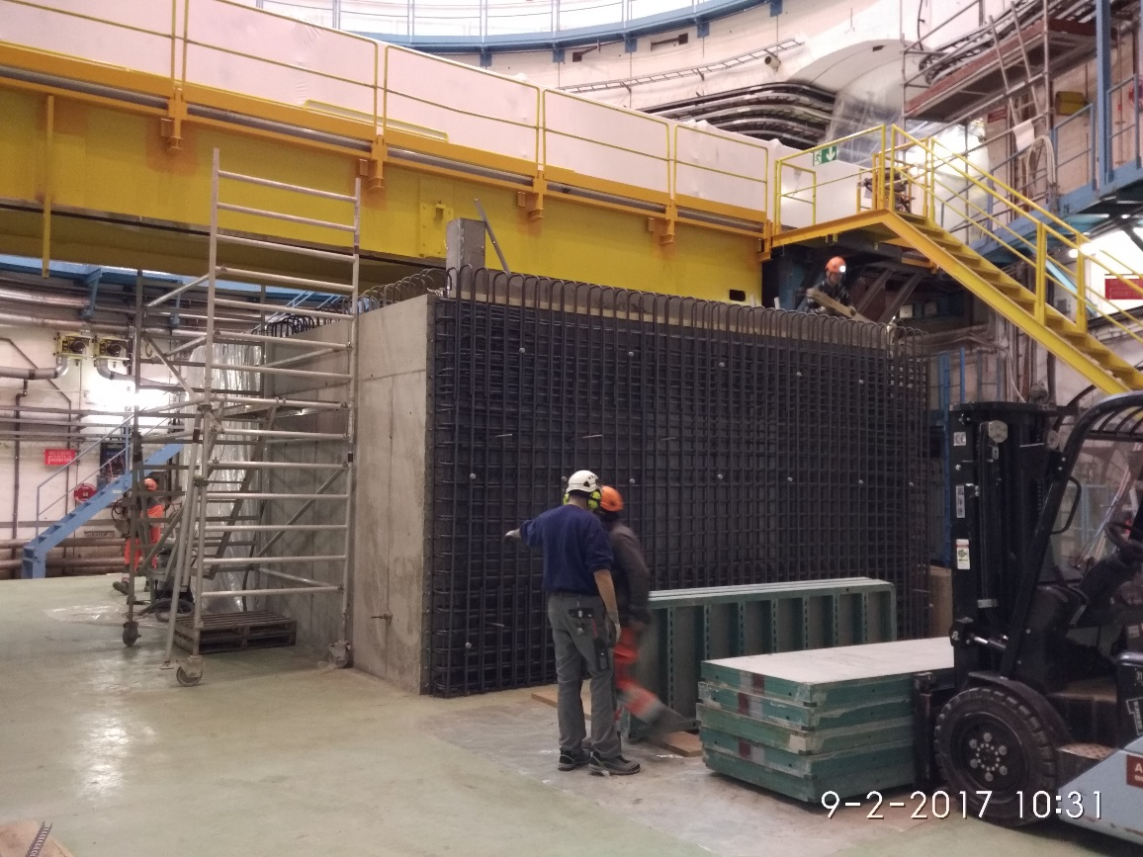
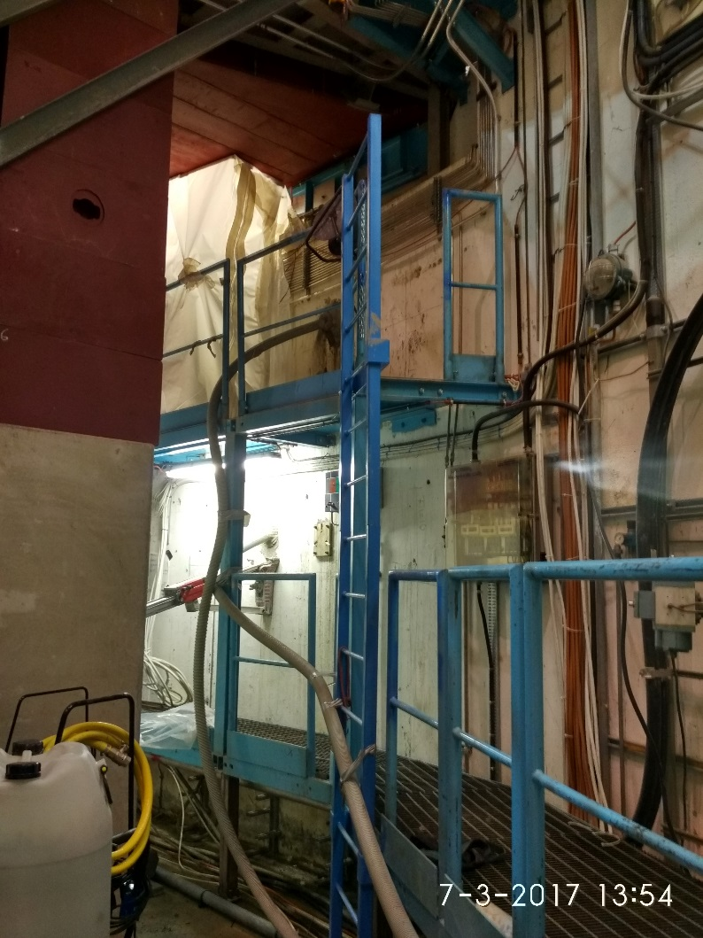
3.Construction phases
Phase 1 support (completed in EYETS 2017)
Light weight mass concrete block completed by Grisoni during EYETS and concrete samples taken for testing

Slide 14
3.Construction phases
Phase 1 support (completed in EYETS 2107)
Georadar exploration in the tunnel eye
  Inconclusive with respect to the presence of steel reinforcement bars and steel ribs behind the lining
  The thickness of the concrete matches with the construction drawings.

Slide 15
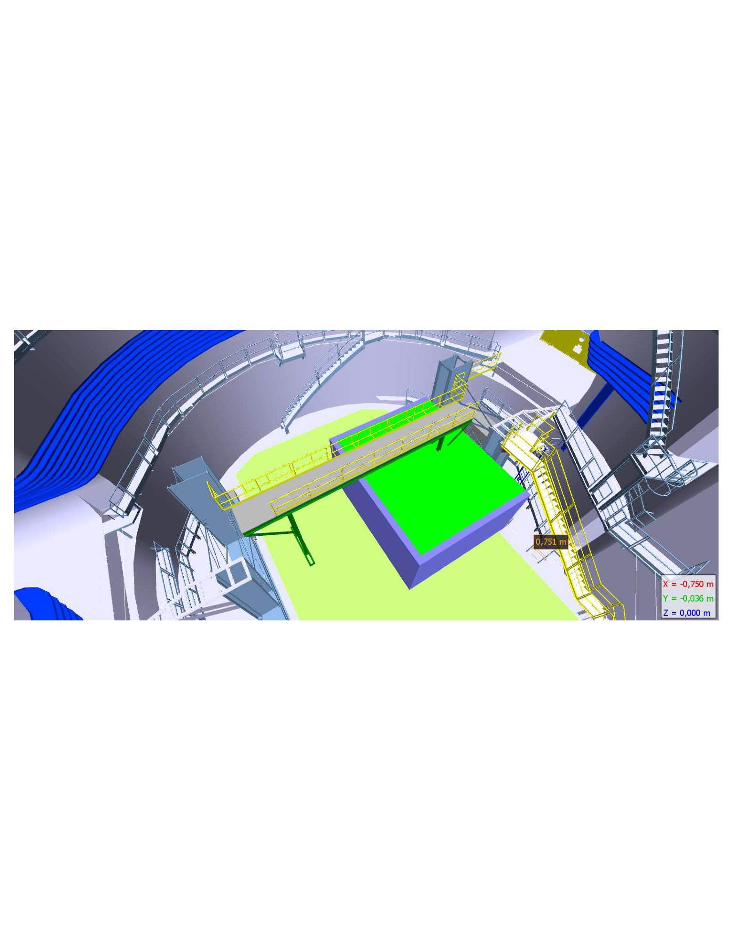
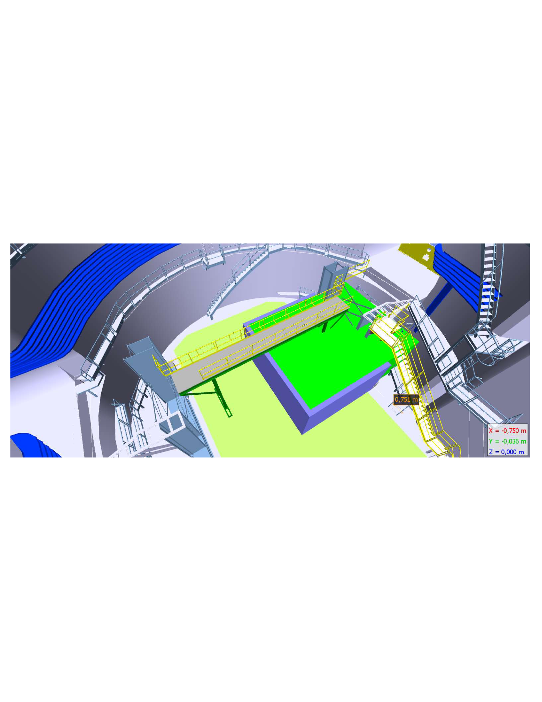
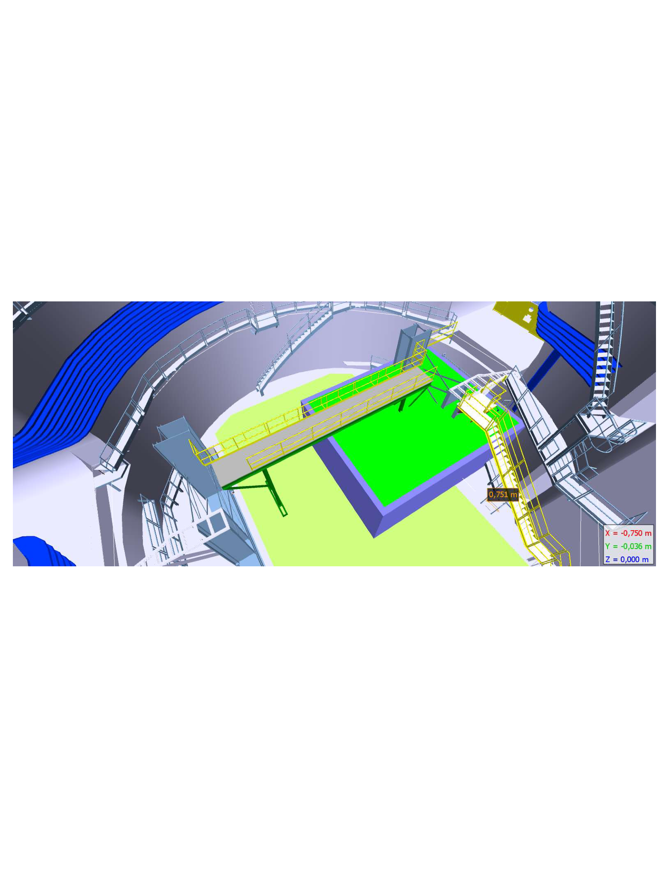
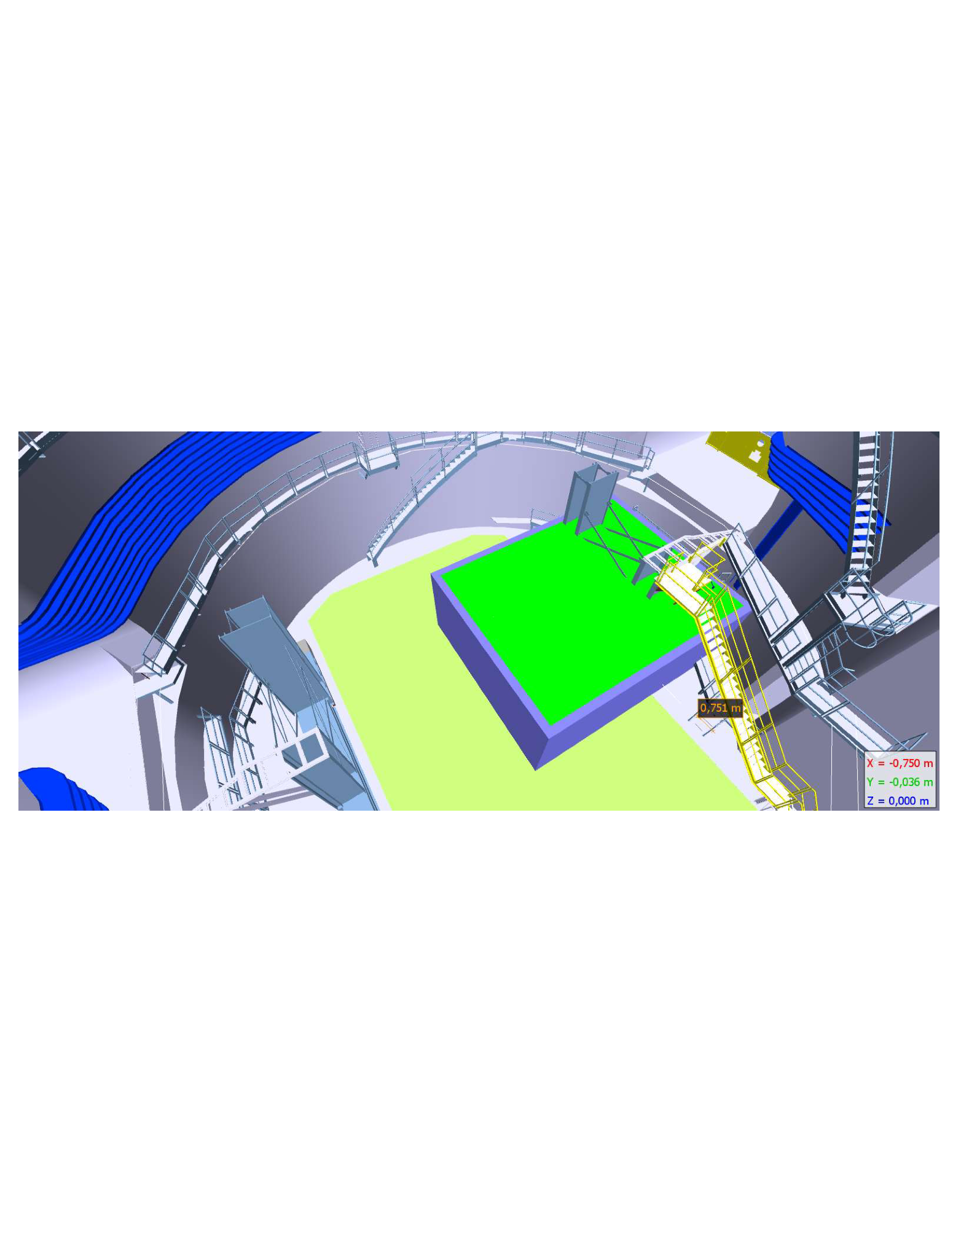
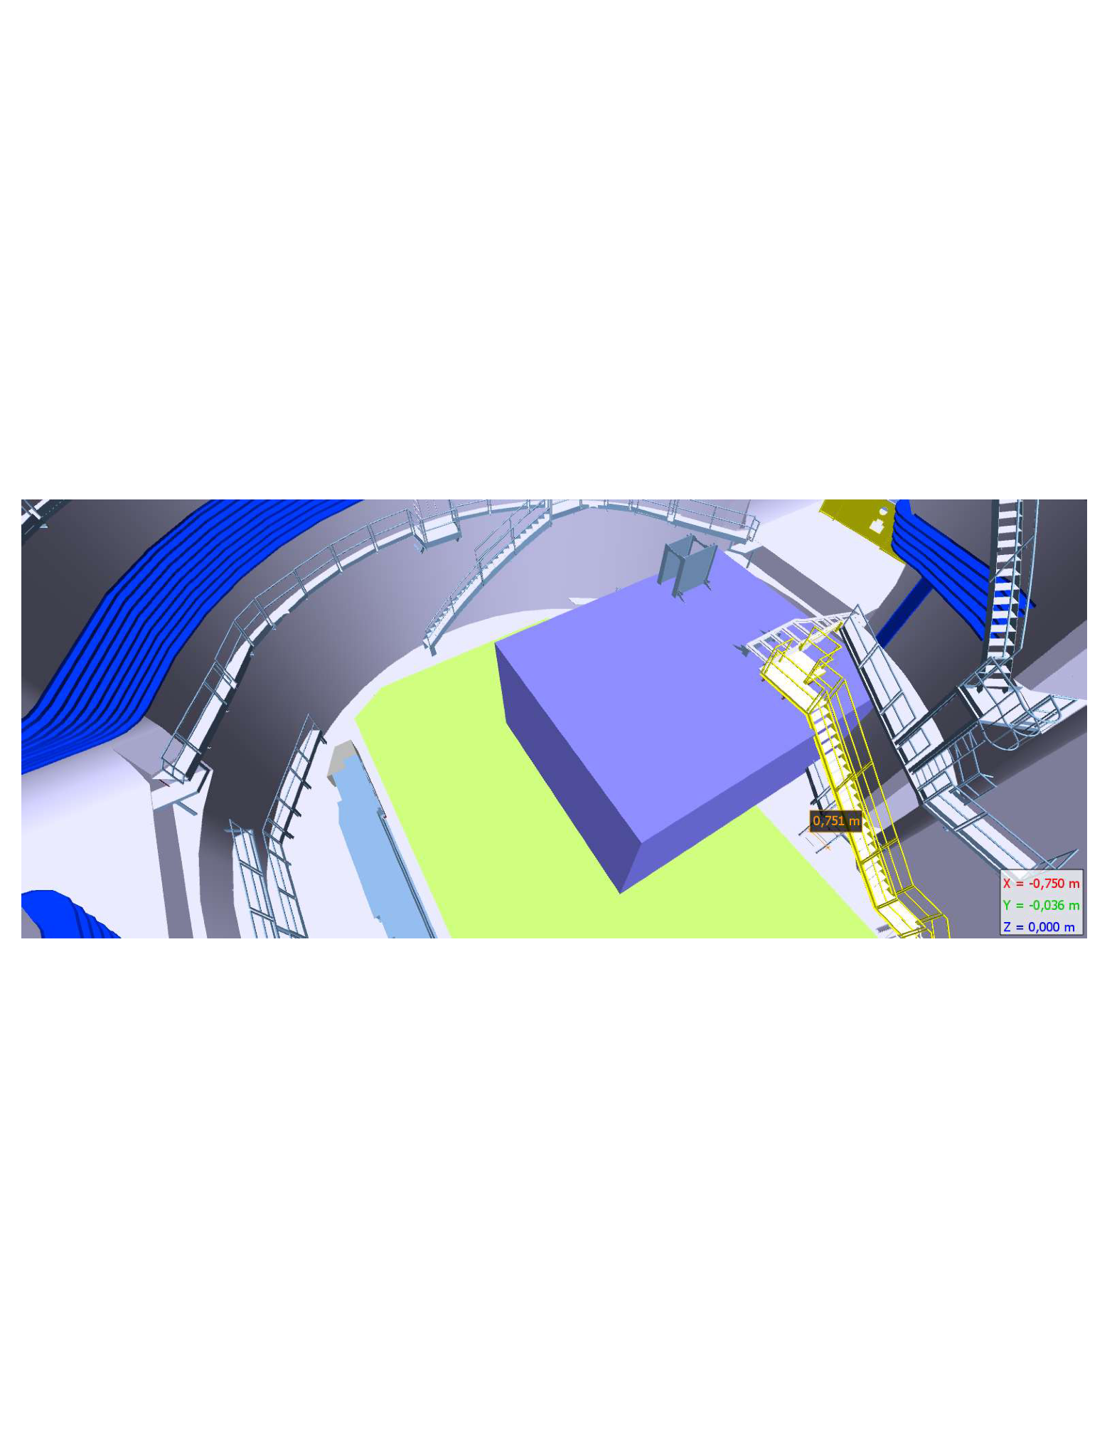
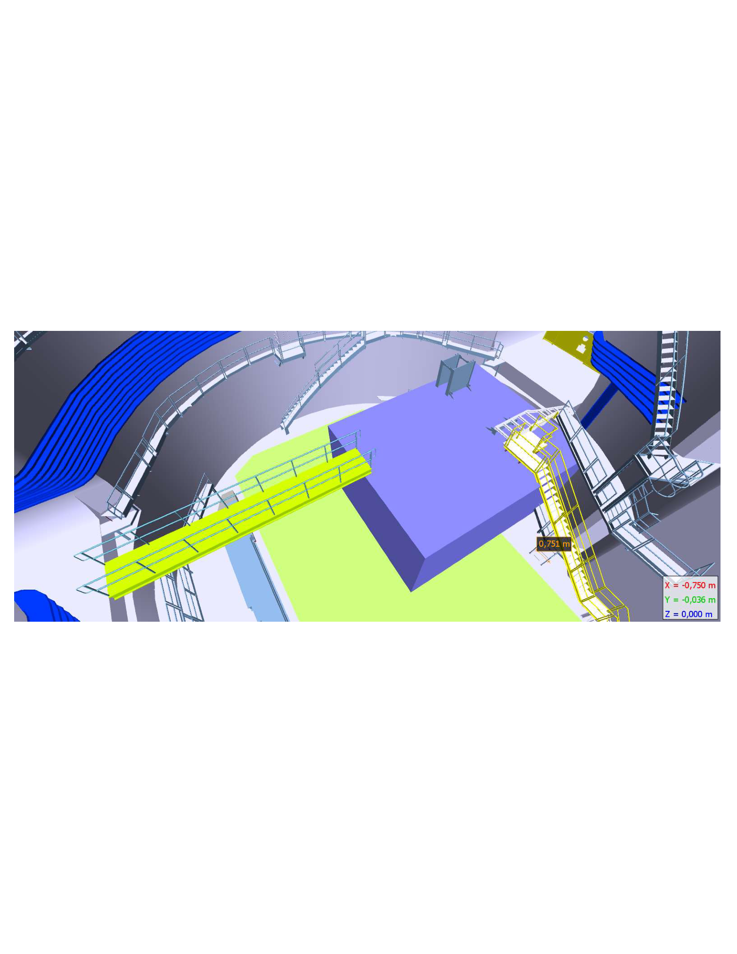
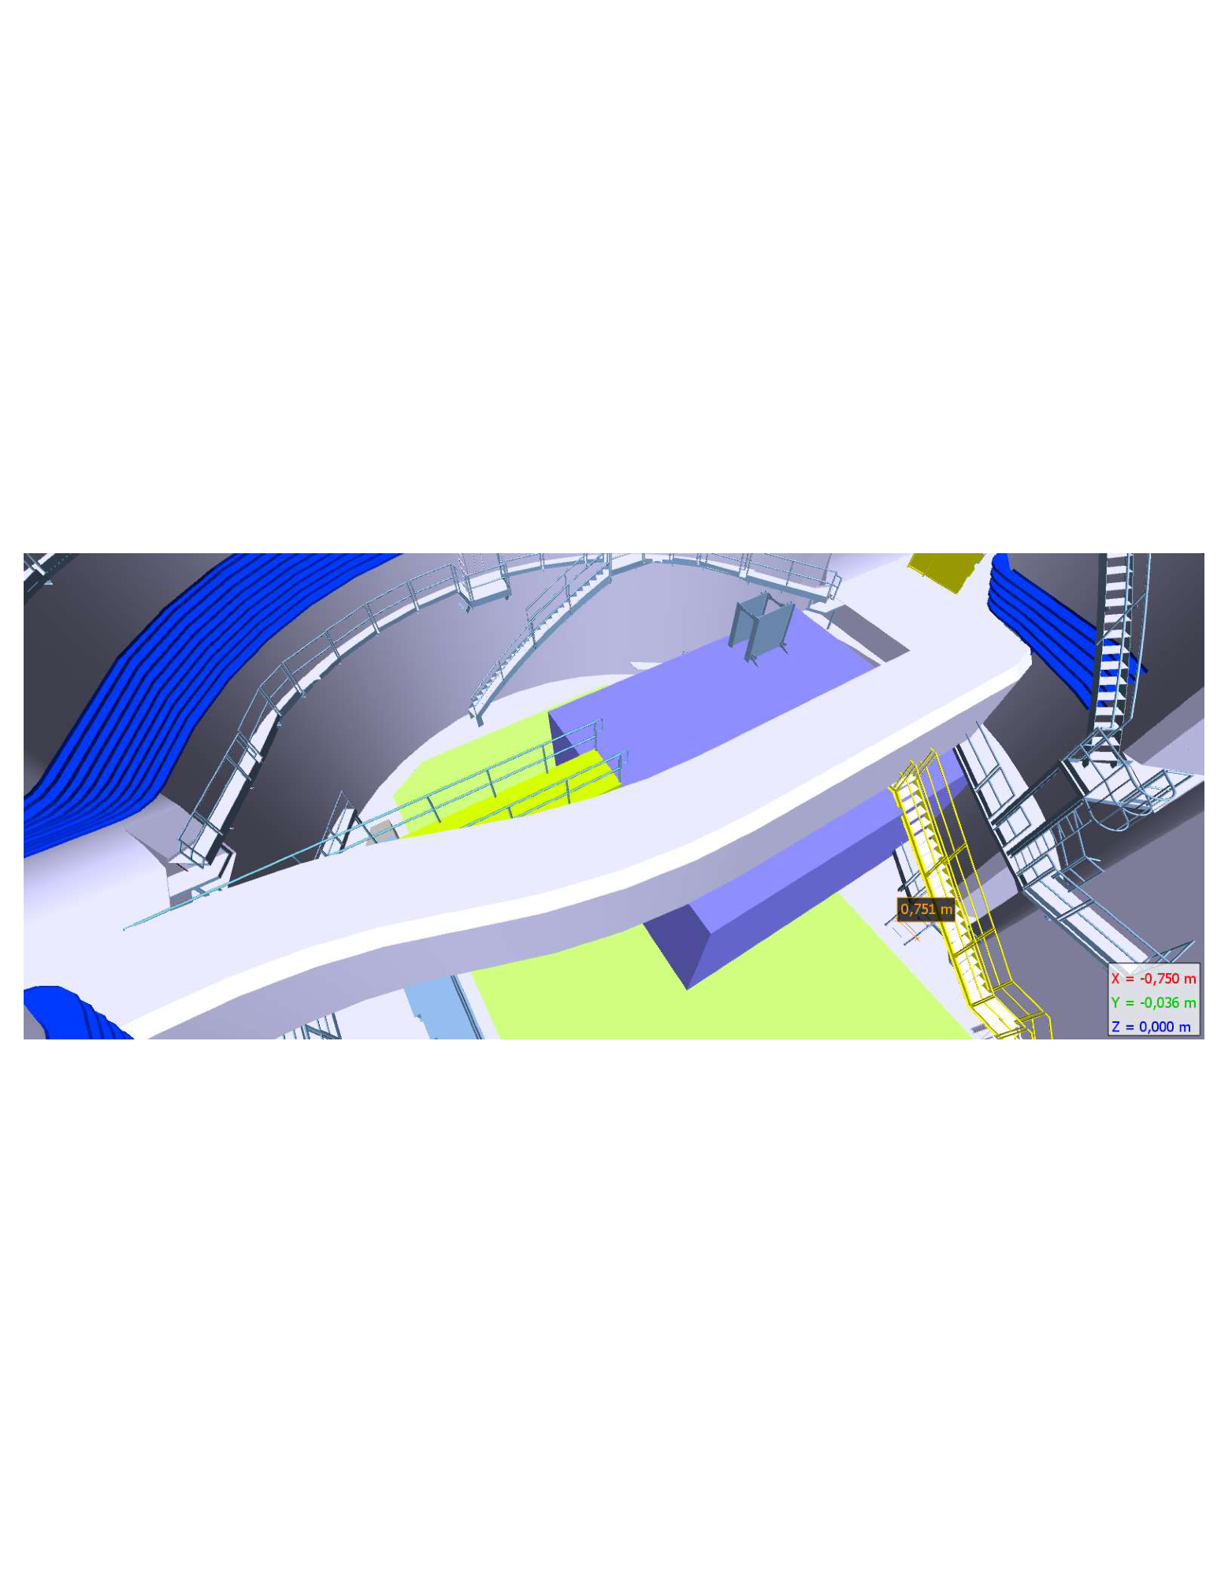
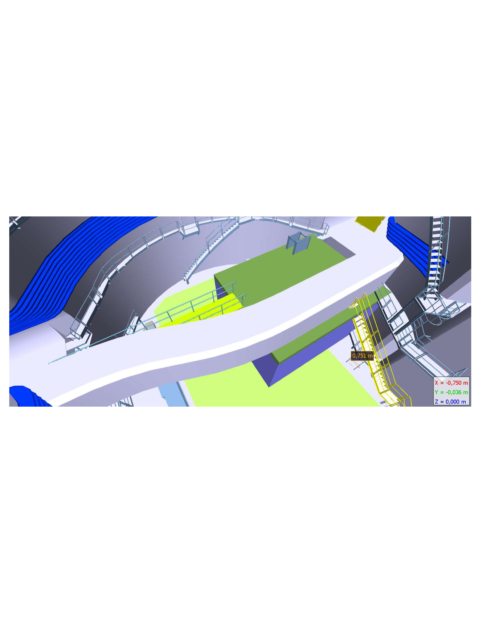
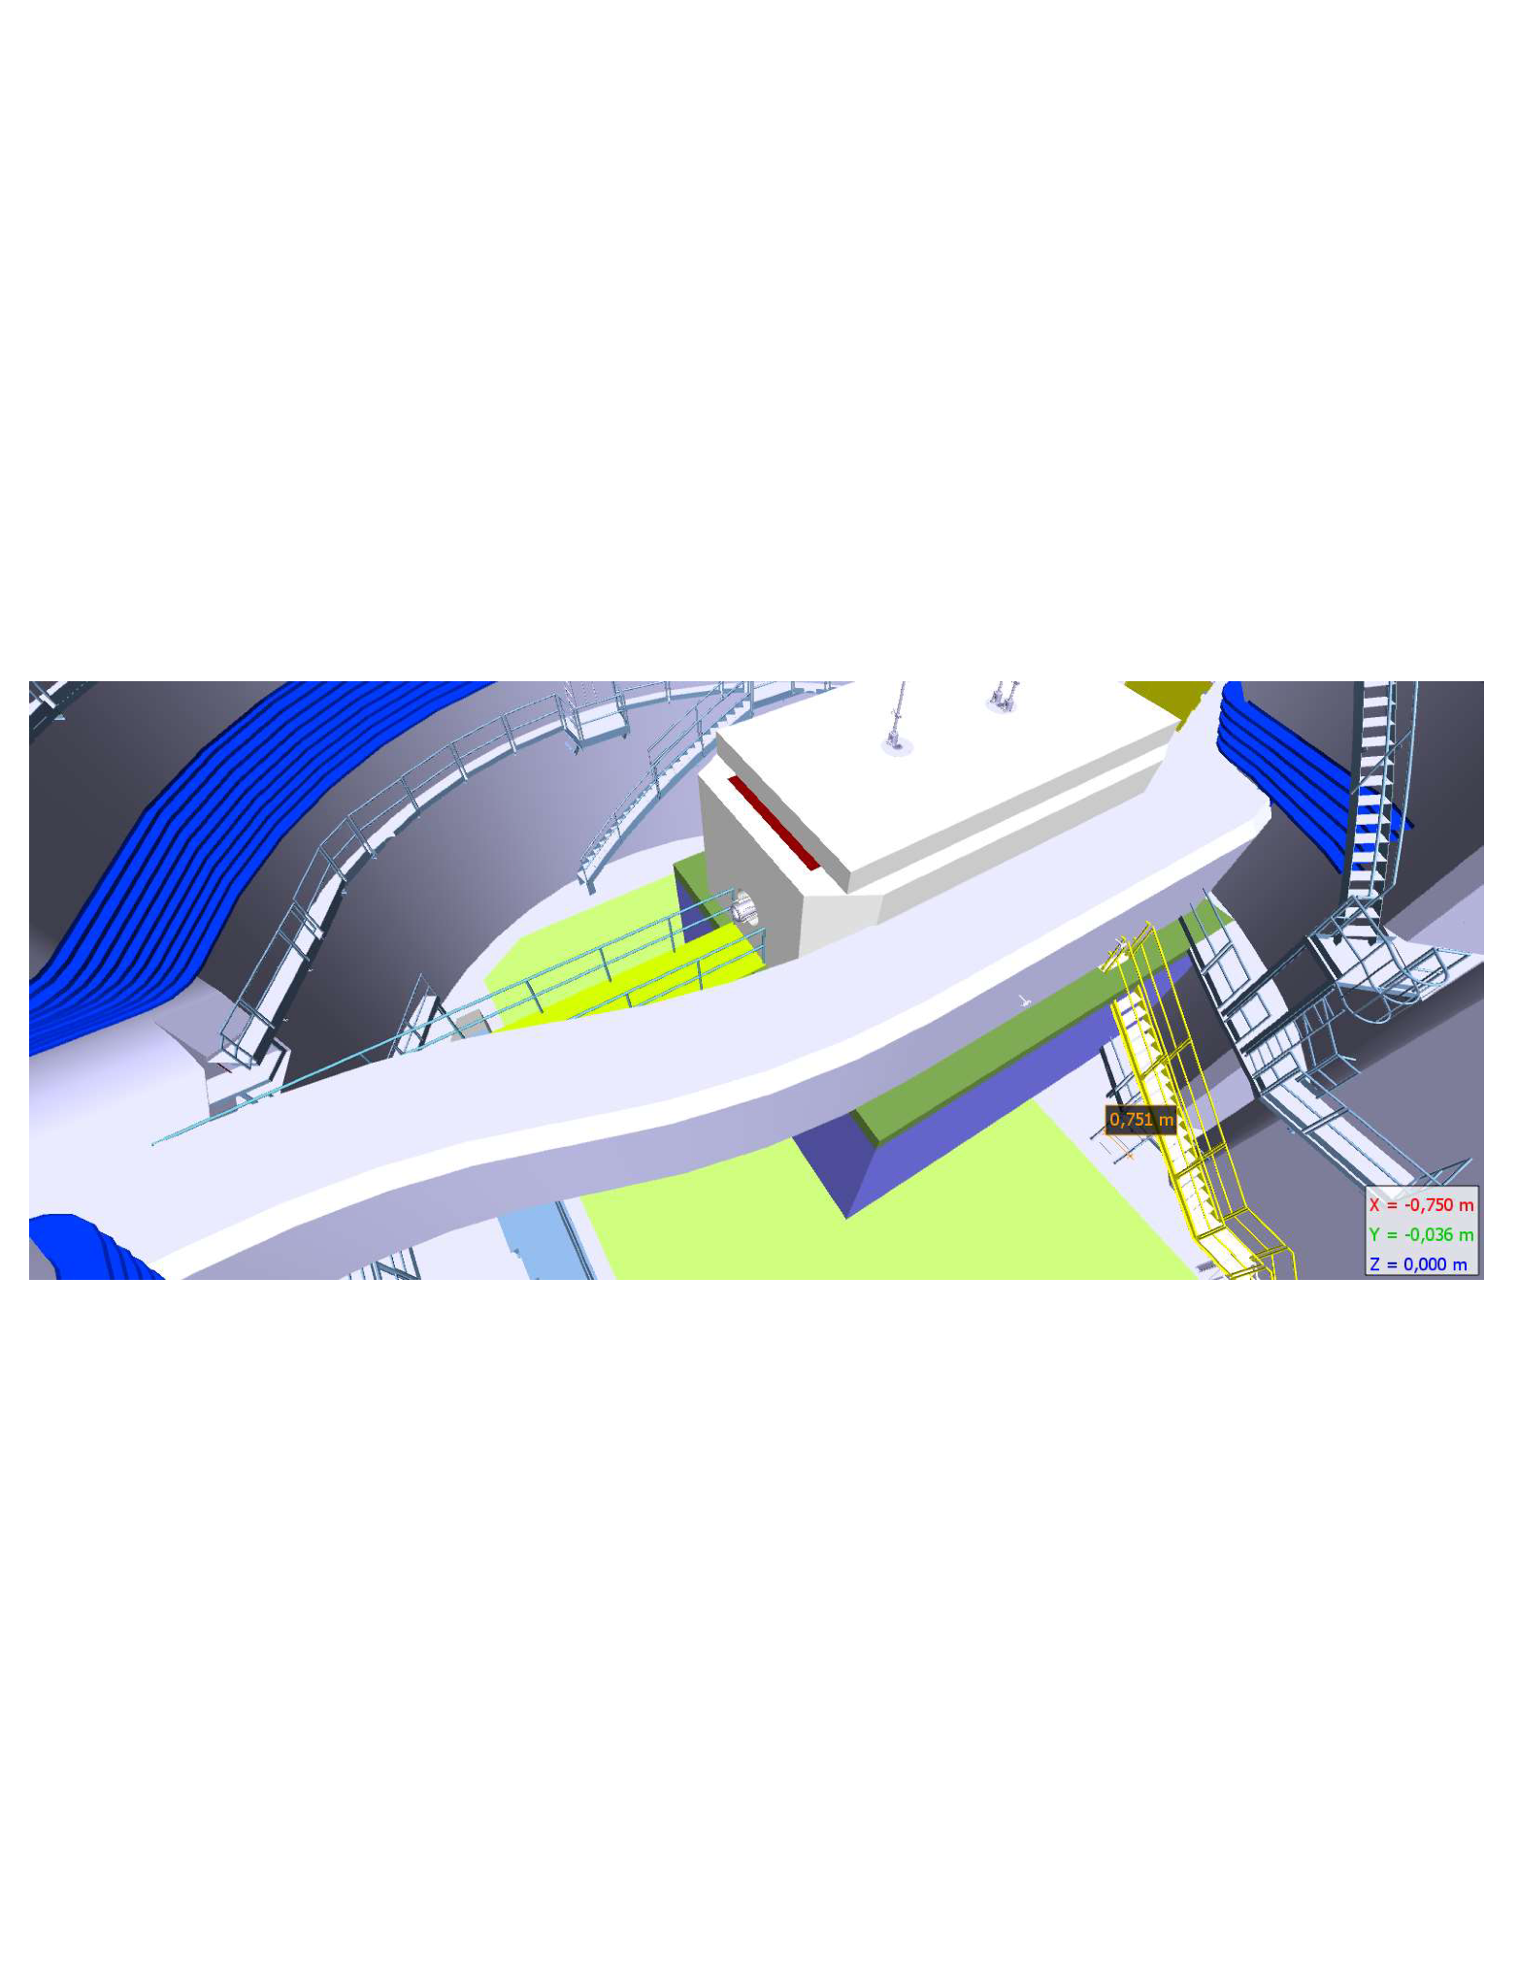
3.Construction phases
Phase 2 support, Bridge and tunnel eye - LS2

Slide 16
4.Project Strategy -> Organisation
LIU Project Leader:
Malika Mahhedi TE-ABT
SPS upgrade LIU Coordinator:
Brennan Goddard TE-ABT
Beam related activities:
RF, Magnets, Ops, Alarms, interlock, controls,
Dump design:
Antonio Perillo Marcone EN-STI-TCD
Power Convertors and kicker installation: Etienne Cartlier TE-ABT-EC
SPS Beam Dump Project Leader: Etienne Carlier TE-ABT-EC
Vacuum: Chiara Passquino TE-VSC-BVO
Transport: Jean-Louis Grenard EN-HE-HH
Cooling Ventilation: Willy Van Den Brouke EN-CV-PJ
Radio Protection: Helmut Vincke HSE-RP-AS
Survey: Patrick Bestmann EN-ACE-SU
Civil Engineering: R. Morton SMB-SE-FAS
Civil Engineering Consultant: ATKINS Keith Jones
Draftsman
SMB-SE-DOP
Site supervision:
SMB-SE-CEB

Slide 17
4.Project Strategy -> Civil Engineering
Tender Design Phase: - Tender CE design end May 2017: Atkins (frame contract)
- Final SI during YETS 2017/18 – Frame contract or specialist contractor
- Construction design 2018– Final detailing for construction : Atkins
IPT process : - Market Survey: SMB – Ready for issue end May 2017
- List of firms by mid July 2017
- Tender for firms : IT for CE works to be issued September 2017 based on CERN standard contract
- Submit to March 2018 FC
- Contract award mid April 2018
Execution Phase : - Offsite planning and preparation (including bridge procurement) April 2018 – end March 2019
- Works execution April 2019 to January 2020
- On site supervision from original designer required during excavation phase of works (Awaiting Atkins offer).

Slide 18
5.Status of Civil Engineering activity
Phase one concrete complete
Phase 2 concrete design 90% complete – on hold pending finalisation of dump design
Basis of design for the tunnel eye is complete
Detailed design to tender phase is now ongoing
Atkins are working on tender drawings, phasing and calculations for the tunnel eye.
DR complete
Market survey in preparation

Slide 19
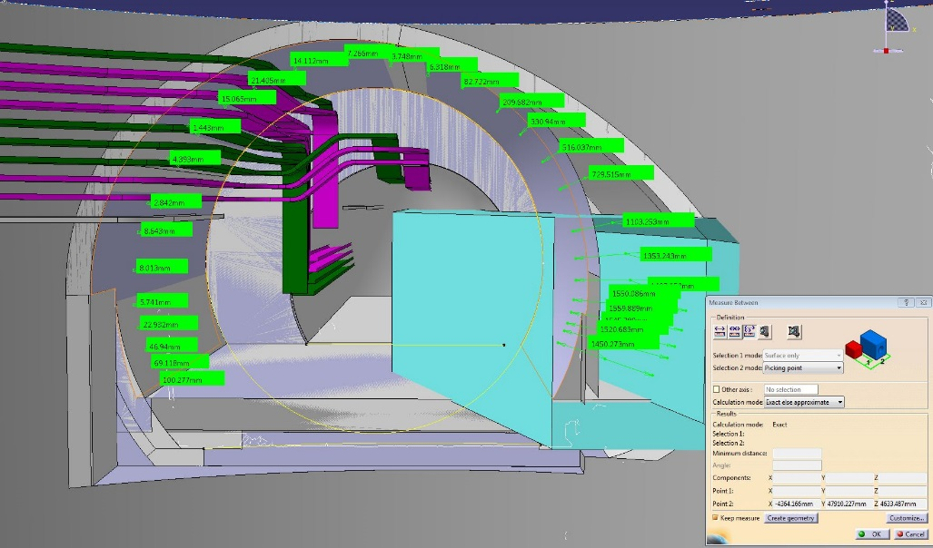
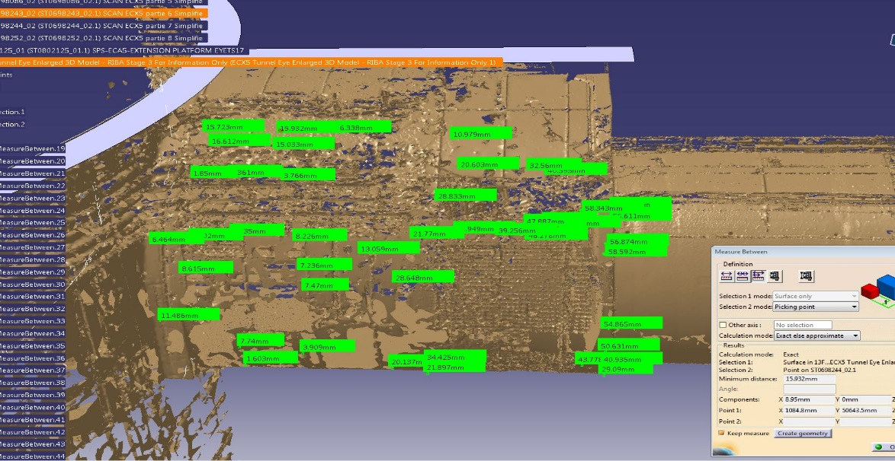
5.Status of civil engineering activities
DOP checks on as built scans
In the critical connection point in the crown of the tunnel we have between 10 and 20mm difference between the scan and the model
For the invert the tunnel to shaft interface is within 5mm of the scan increasing to 50mm at the interface with the SPS

Slide 20
6.Project Documentation
Share Point site has been used throughout the development of the project to exchange information with Consultant and Contractor: https://espace.cern.ch/CE-LSS5-SPS-dump/_layouts/15/start.aspx#/

Slide 21
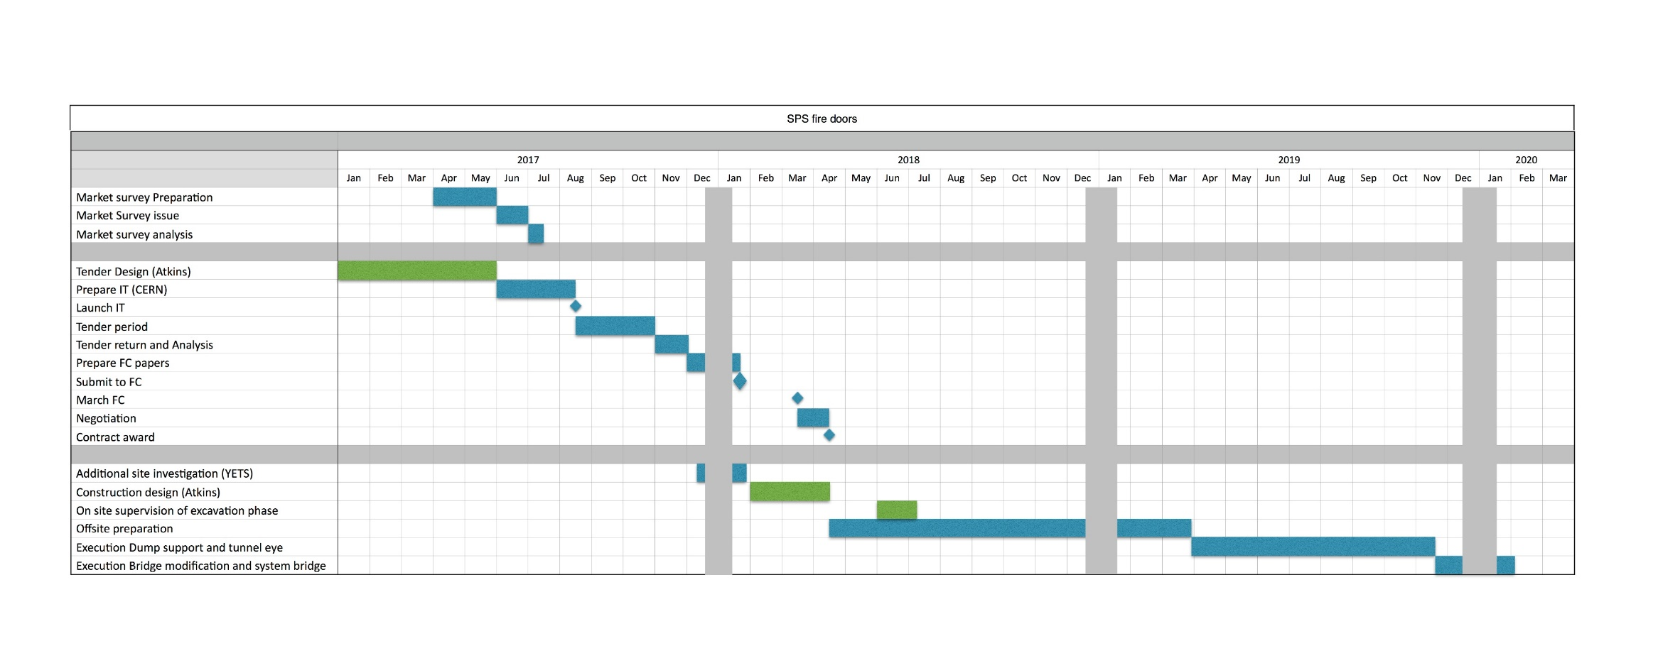
6.Planning

Slide 22
7.Risks
Risk | Potential mitigation
Inclusion of the system bridge procurement based on a performance specification | Include a detailed procedure for the approval of the chosen solution to ensure all our needs are met.
Schedule – coactivity maximum available time available is 9 months, de-cabling campaign must be complete before we start | Early detailed planning required. Further site investigation during YETS to eliminate or confirm geological risk
Re-measurement – although small quantities the shotcrete price is often used to weight the pricing in favour of of the contractor | Requires detailed method of measurement and procedure relating to primary lining and decision process for bad ground
Dimensional accuracy of the design compared to existing | There are significant (50mm) differences between the theoretical tunnel and the as built. Definition of construction tolerances and contractor responsibility to be clearly defined in the spec and drawings.
Contractor proposed alternatives | Early involvement will allow verification and analysis of cost benefit to CERN
Considerably better ground conditions resulting in significantly different method of construction | Renegotiate rates for site installations, other?
Structural issues with existing lining | Some remedial measures may be necessary before or during the works. This element should form part of the contingency budget

Slide 23
8.Budget
Expenditure to date
Year | Activity | Cost
2016 | Floor screed in ECA5 | 61k Chfs
2017 | Phase one dump support | 117k Chfs
2017 | Carrotage concrete tests | 7k Chfs
2017 | Geo-radar | 5,5k Chfs
2017 | Modifications to BB5 | 1,5k Chfs
2017 | Consultancy costs to date | 40k Chfs
 | Total to date: | 232k Chfs
Current IT estimate (to be revised to take into account Tender design
for September Client review) 2,500k Chfs
Remaining Atkins consultancy fees (not yet invoiced) 150k Chfs
Site supervision and support costs 50k Chfs
Other costs (further SI etc) 30k Chfs
Total 2730k Chfs

Slide 24
9.Outstanding issues
Dump Support and bridge modifications:
Upper concrete blocks and decking need final dump design to complete
Position of access stairs to be agreed
Barrier details to finalise
Floor finishes need to be defined under the shielding blocks
Drainage details for contaminated water
Tunnel eye enlargement:
Additional SI information to be incorporated into design if needed
Final number, position and fixing details for cable trays
Central cable tray can be moved during construction-can they be moved permanently
Site supervision

Slide 25
10.Next actions
Final Civil engineering 3d model to be uploaded so integration around the bridge can be completed
Complete the market survey and start IT preparation
Urgently need to start the LS2 planning in detail with all other activities.
Budget review and detailed planning review when IT is ready.

Slide 26
Questions..

