Slide 1

Hollow Electron Lens Harware kick-off meeting
Adriana Rossi BE-BI
E-Lens HW meeting – kick off 22 May 2017

Slide 2
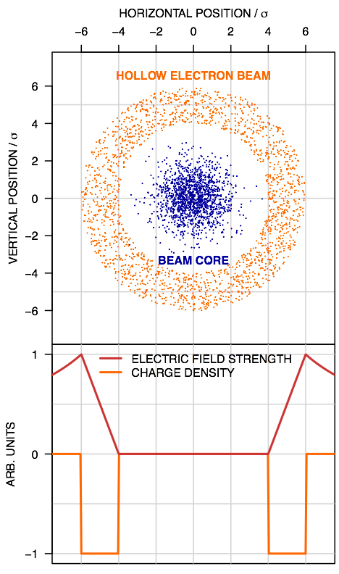
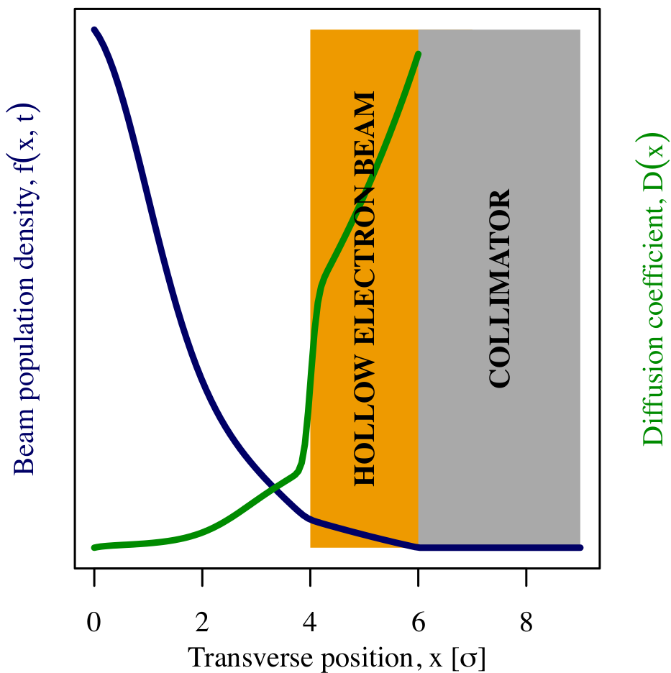
Motivation for HEL in HL-LHC
Depletion of halo below collimator opening
The angular kick θ experienced by a proton at radius r traversing a hollow electron beam enclosing current I_{er} over region of length L
For conter-propagating e- p+
e-beam from 4 to 6 sigma ≈ radii from 1.2 to 1.8 mm over a distance ~3m
Electron beam hollowed =>
core ≈ not affected (in field-free region)
+ no effects on impedance
Margin for beam jitters / CC failure
*
r

Slide 3
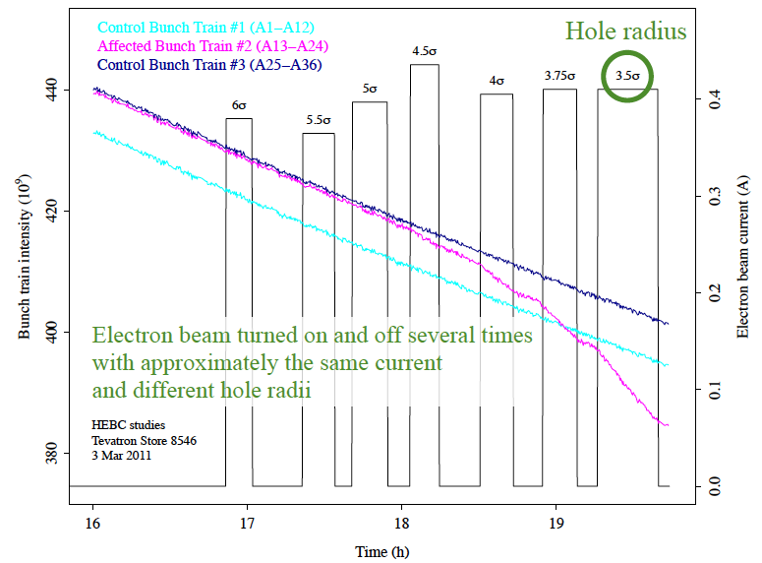
Review of the need for hollow e-lenses for the HL-LHC (CERN, 6-7 October 2016)
https://indico.cern.ch/event/567839/
Successfully demonstrated at Tevatron (Stancari)
Review conclusions:
  A hollow e-lens will mitigate CC
  failures (large betatron oscillations)
  if < 2 σ
  HL-LHC less sensitive to transients
  due to small variations of orbit, tune
  and other parameters
  Implement active beam halo
  control using a hollow e-lens

Slide 4
Review of the HEL concept readiness for integration into the HL-LHC baseline (O. Bruning) wk42
Review if CERN has all information at hand to estimate the individual cost items for the hollow e-lens and to prepare a tentative production schedule (including potentially required prototype developments and R&D milestones) for implementing the e-lenses during LS3 and to assure sufficient space and infrastructure in the designated areas for the installation of the hollow e-lenses during LS3.
Is CERN ready to:
  estimate the total cost and resource requirements for the e-lenses (including the technical development)?
  reserve sufficient space for the e-lenses in IR4?
  specify the technical infrastructure needs in IR4 to avoid future iterations on key services at a later stage?
  identify which components of the e-lenses need to be produced in-house and which components could be outsourced?
Have all the implied technical groups identified the required resources for implementing the e-lens development (including the required technical development for finalising the technical design by the end of LS2) and integration (for the e-lenses installation in LS3 and operational exploitation as of the start of Run4)?

Slide 5
Hollow Electron Lens
Electron gun 5Ax10kV
Modulator
Instrumentation
Collector
Main SC solenoid 3-5 T
Gun solenoid 0.2-0.4T
Bending SC solenoids ~3T
6.4 – 6.5 m

Slide 6
Hollow Electron Lens
Electron gun 5Ax10kV
Collector
V_{CA}
+
–
Heater
PC
Anode modulator
V_{CO}
V_{CA}≤10kV, I_{anode}
– +
Cathode –
Collector
PC
Medium voltage
High current
V_{CA}-V_{CO}, I_{beam}=5A
–
+
Cathode
PC
High voltage (10kV)
low current (losses)
V_{CA}, I_{tube}

Slide 7
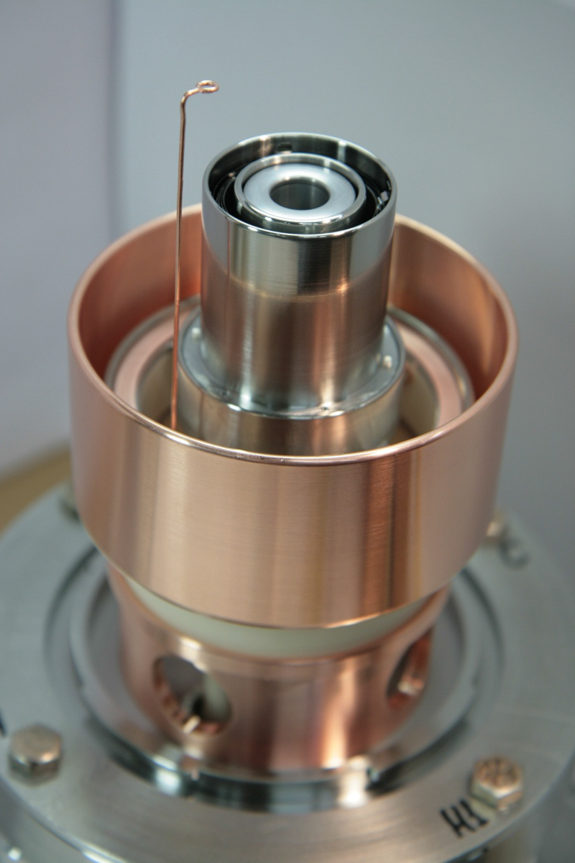
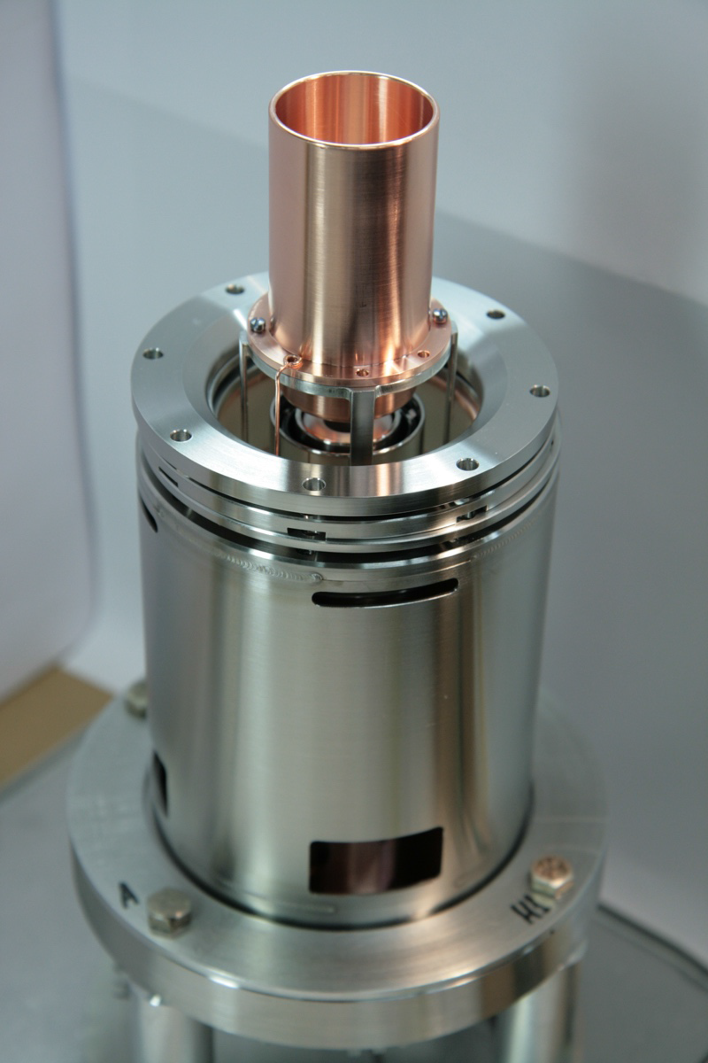
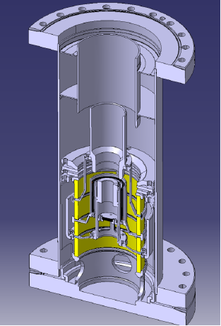
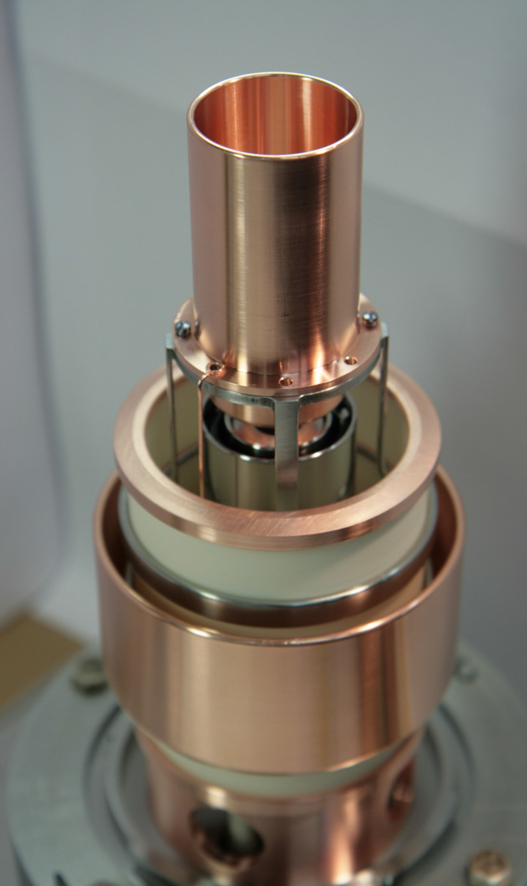
CHG1 built at CERN, based upon Fermilab design
Anode
Hollowed cathode

Slide 8
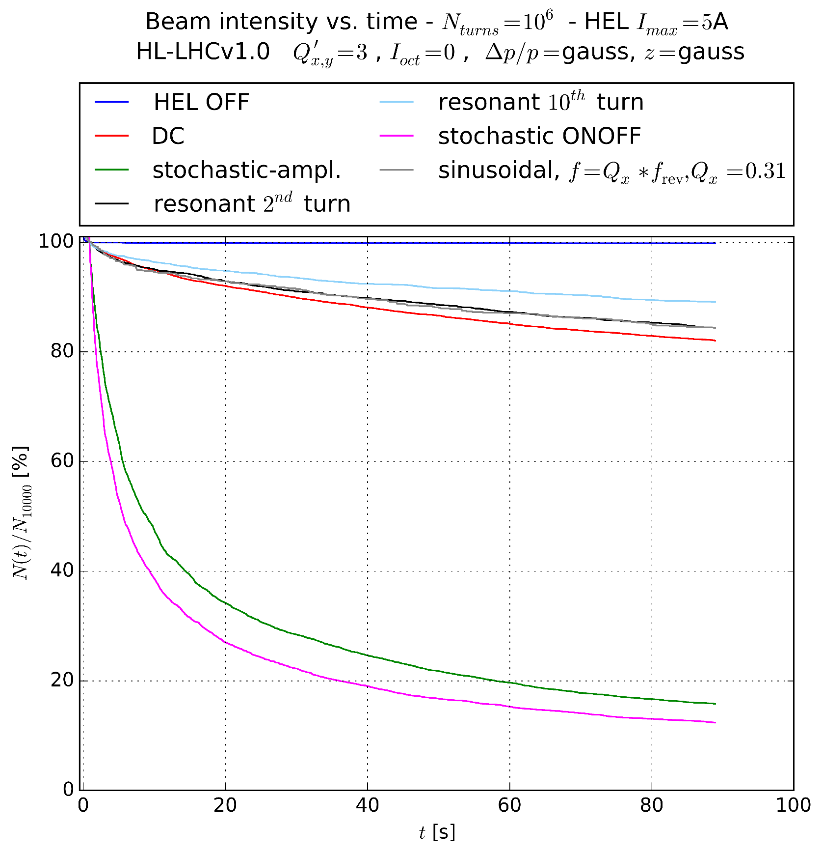
Specifications
Electron gun
  5A (for kick) x 10 kV (to transport electrons)
  Ring from 1.2 to 1.8 mm with B_{main} ~ 4T
  ➔ r_{egun} ≈ 5.5 – 8.3 mm (under design)
Anode modulator
  0 – 10 kV
  3 per revolution = 33 kHz to
  be able to leave a fraction
  of beam intact and keep flexibility.
  200ns rise time

Slide 9
Specifications
Anode modulator
  0 – 10 kV
  3 per revolution = 33 kHz to
  be able to leave a fraction
  of beam intact and keep flexibility.
  200ns rise time
  LINAC4 H⁻ chopper? BE-RF
  Kickers? TE-ABT
Power
Control
Interlocks
Software (timing, pattern . . .)

Slide 10
