Slide 1
Preliminary integration of Hollow e-lenses
EDMS No: 1764989 v.2 (V.1. Presented on 26th TCC 16/03/2017)
References: 1765930.v.1
M. Alcaide Leon, Paolo Fessia
Contributions
HEL conceptual design and parameters: D. Perini, C. Zanoni
Beam optics and HEL technical coordination: A.Rossi
HEL 3D Modelling: A. Kolehmainen
3D Integration Modelling: M. Gonzalez
QPS requirements: D. Wollmann, R. Denz, A. Verweij
Power Converters requirements: M. Martino & Y. Thurel
Vacuum requirements: P. Santos
Cryogenics requirements: S. Claudet
EDMS No: 1764989 v.2. 22/05/2017

Slide 2
INDEX
    Introduction to HEL
    Preliminary integration of HEL in HL-LHC machine and technical services in the tunnel of 4L
    Preliminary integration of technical services in service caverns of 4L
    Conclusions

Slide 3
REMARK
    This is a preliminary integration study of the Hollow e-lenses in the machine lay-out for HL-LHC and its technical services in the tunnel and service caverns with the present conceptual design of the device (EDMS No: 1765930.v1). The conceptual design is subject to change due to further technical optimizations and definitions by the WPs involved in its design. In particular possible integration in the Hollow e-lenses of Beam Instrumentation that are not accounted here and for which the possible impact on the device and layout is not known.

Slide 4
Introduction to HEL

Slide 5
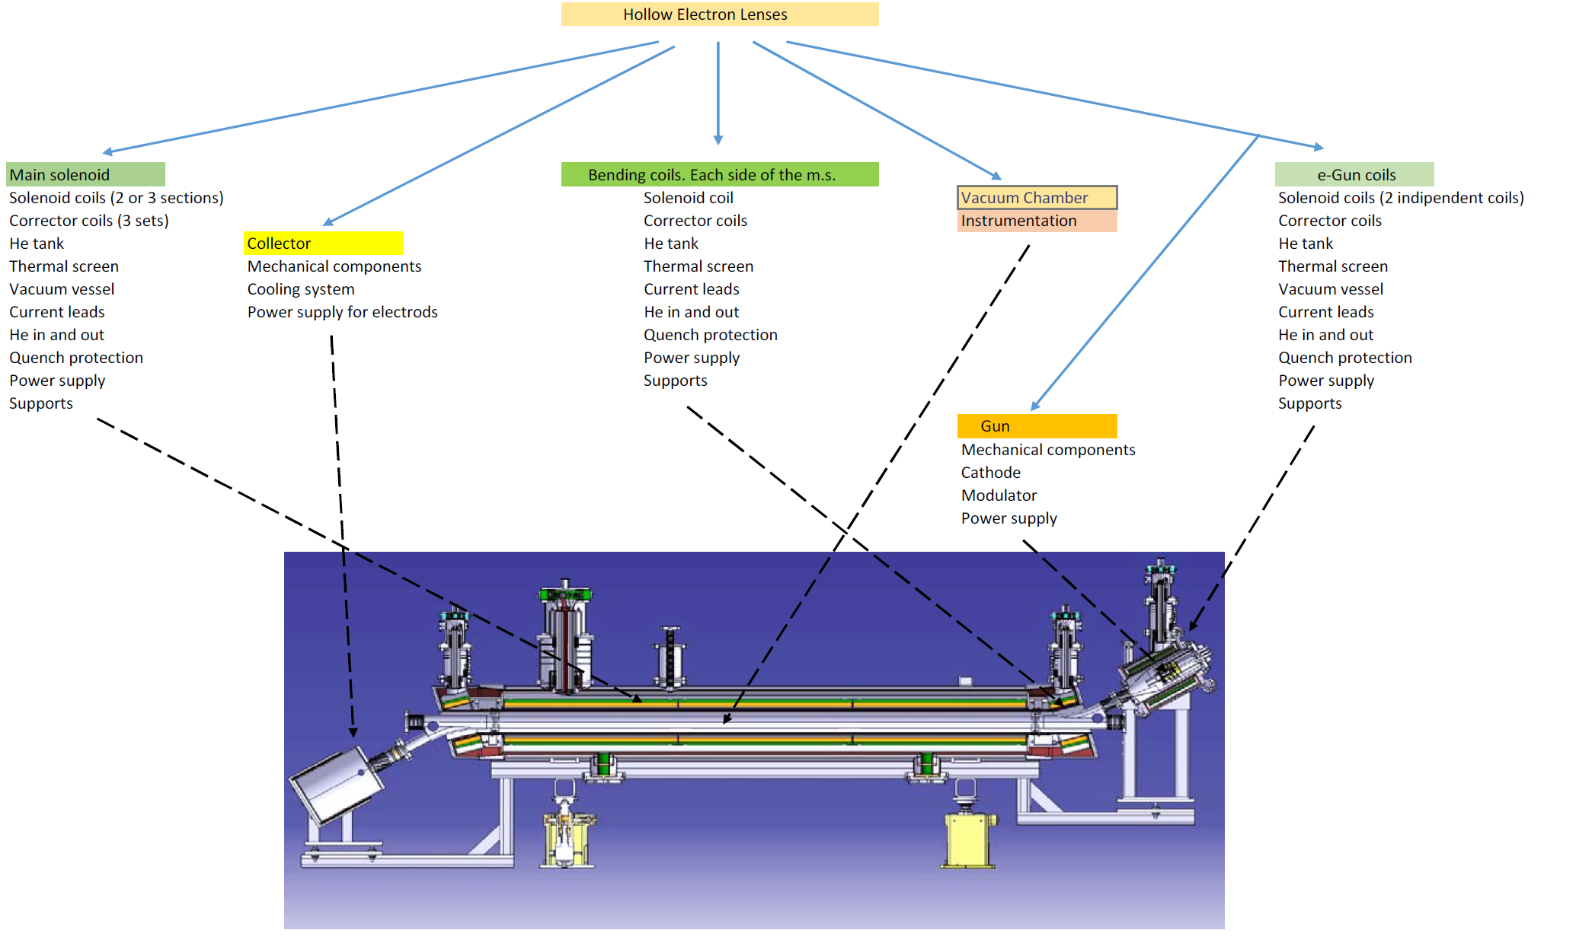
HEL- Components
Sector valve for e-gun
1764989 v.1

Slide 6
HEL- Parameters
Nominal magnetic field of the main solenoid | 4 T
Inner radius of the hollow electron beam @ nominal fields | 0.9 mm (3 σ)
Outer radius of the hollow electron beam @ nominal fields | 1.8 mm (6 σ)
Nominal magnetic field in the e-gun cathode | 0.2 T
Inner diameter of the cathode | 8.05 mm
Outer diameter of the cathode | 16.10 mm
Inner radius of the hollow electron beam @ 4 T with 0.1 T @ cathode | 0.635 mm
Outer radius of the hollow electron beam @ 4 T with 0.1 T @ cathode | 1.275 mm
Nominal current at the cathode | 5 A
Dimensions of the hollow electron beam and of the emitting cathode. As an example we give the dimensions that can be obtained changing the e-gun tuneable solenoid from the nominal level of 0.2 T to 0.1 T.

Slide 7
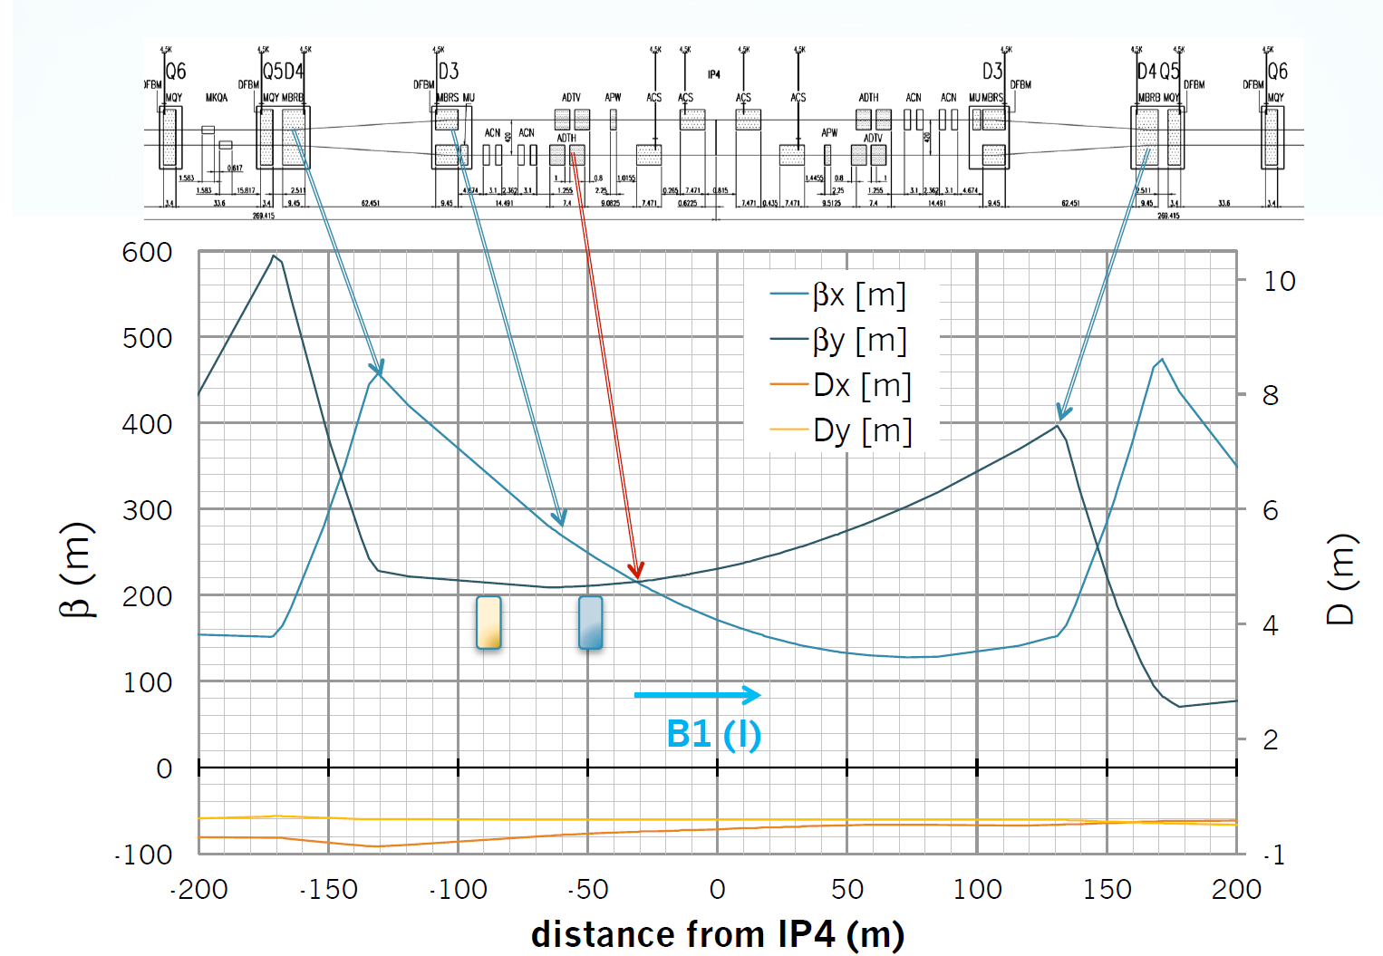
HEL- Optics
Courtesy of Adriana Rossi

Slide 8
Preliminary integration of HEL in HL-LHC machine and technical services in the tunnel of 4L*
*Please note that 4R is symmetric to 4L

Slide 9
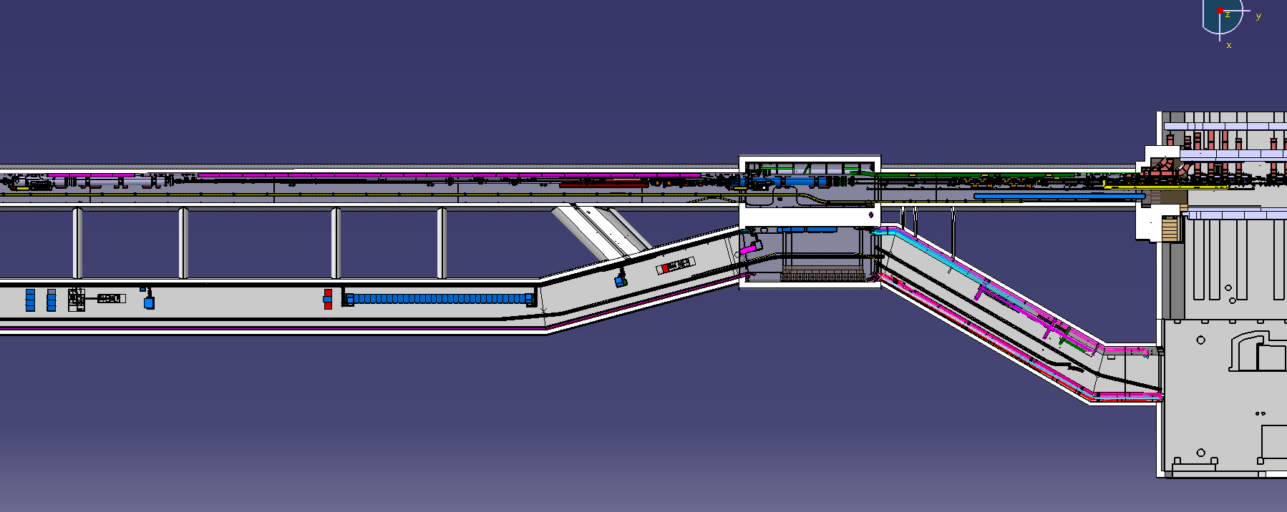
Overview of LSS4 P4L
B2
B1
RB44
RA43
D3L4
HEL
ADT
ACS
UJ44
UA43
UL44
US45
ST0676534_01

Slide 10
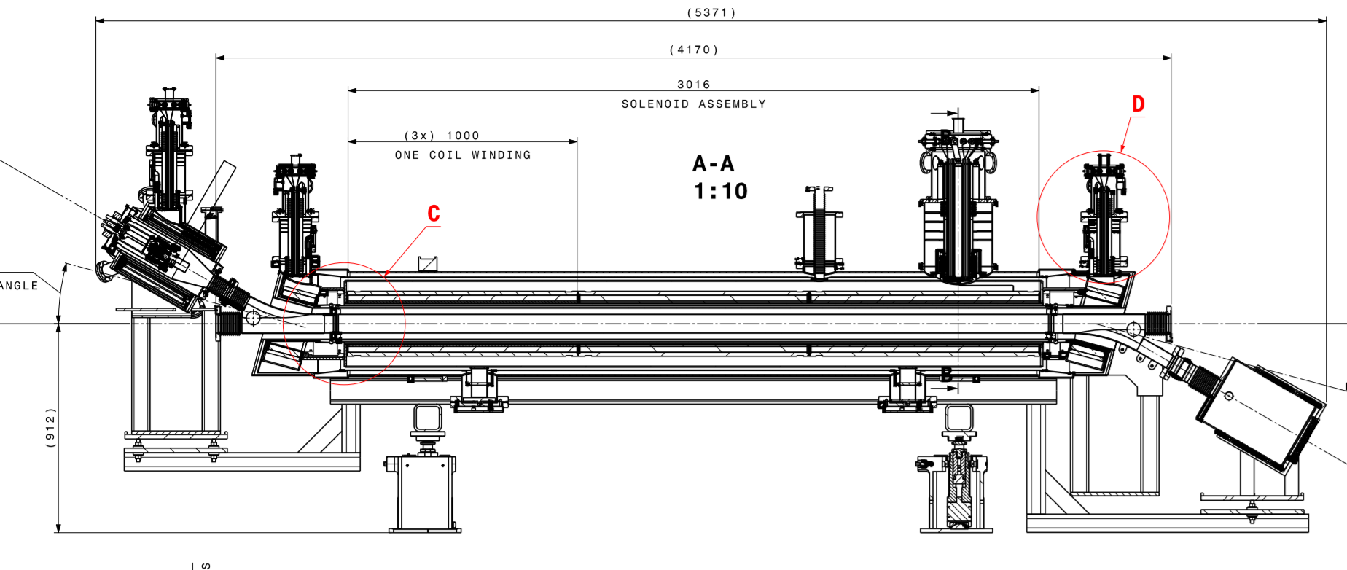
HEL - Dimensions

Slide 11
HEL - Dimensions
Conceptual design: Transverse profile instrumentation foreseen,+ 70-80 cm

Slide 12
HEL - Dimensions
Total length used for this integration 6171 mm

Slide 13
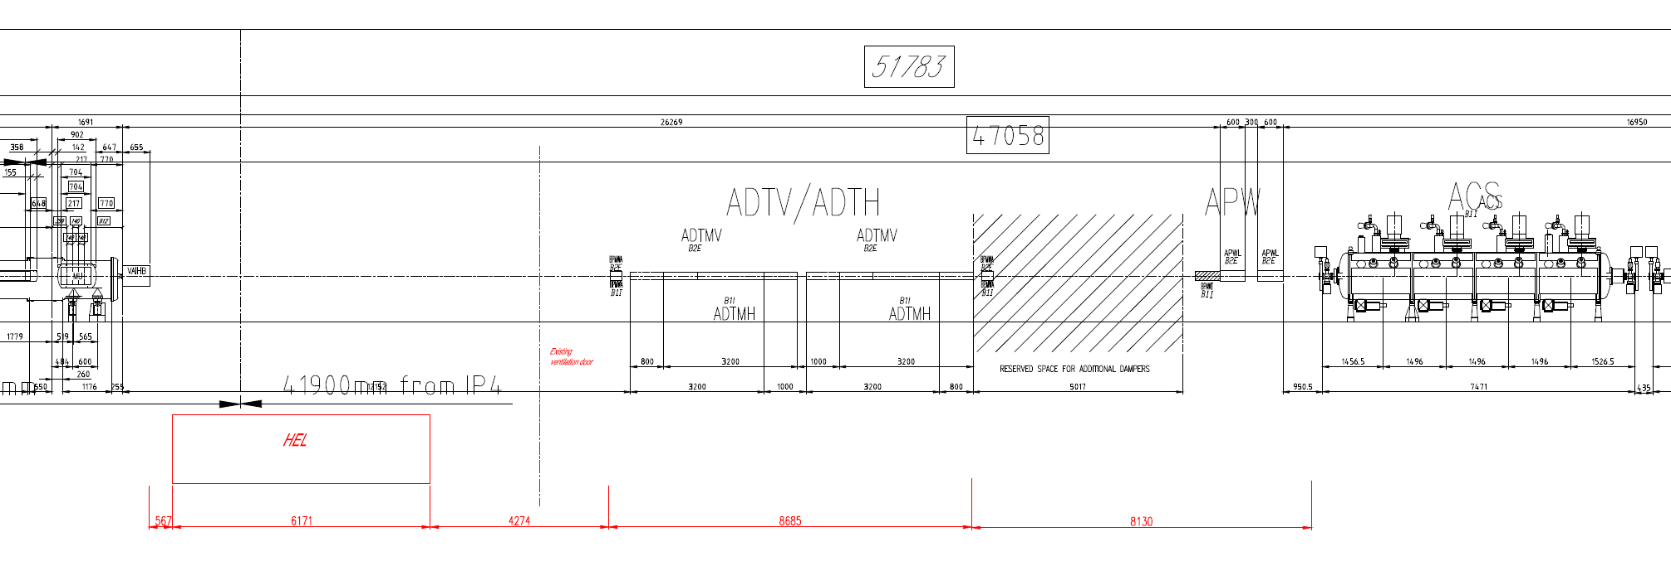
Sketch layout with HEL - 4L
Total length of RF zone (from HEL to IP): 37357 mm
Distance from IP4: 43529 mm

Slide 14
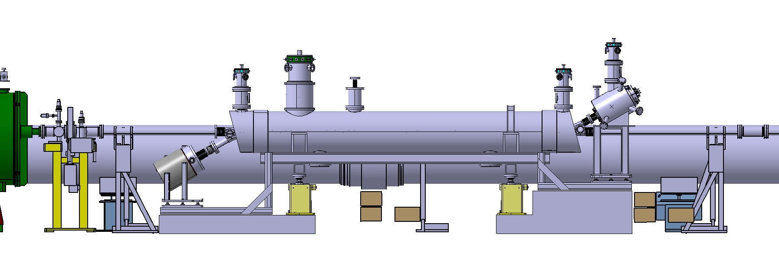
Layout integration in HL-LHC machine
New design of vacuum chamber supports to gain some space
ST0574939_01

Slide 15
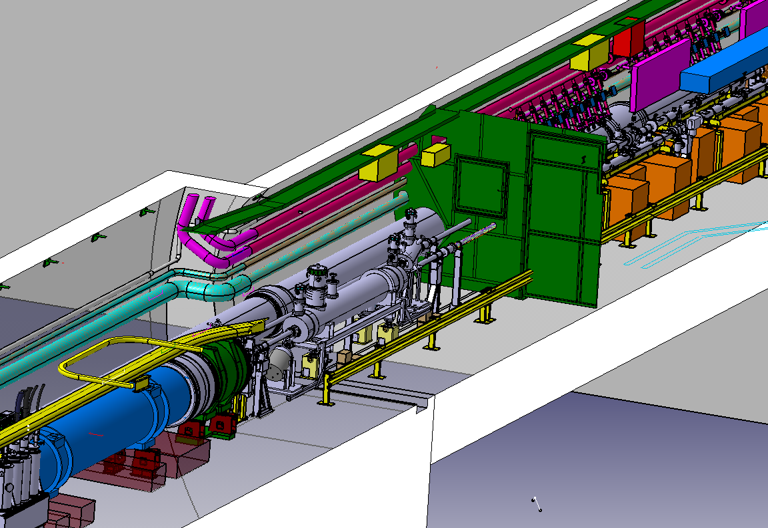
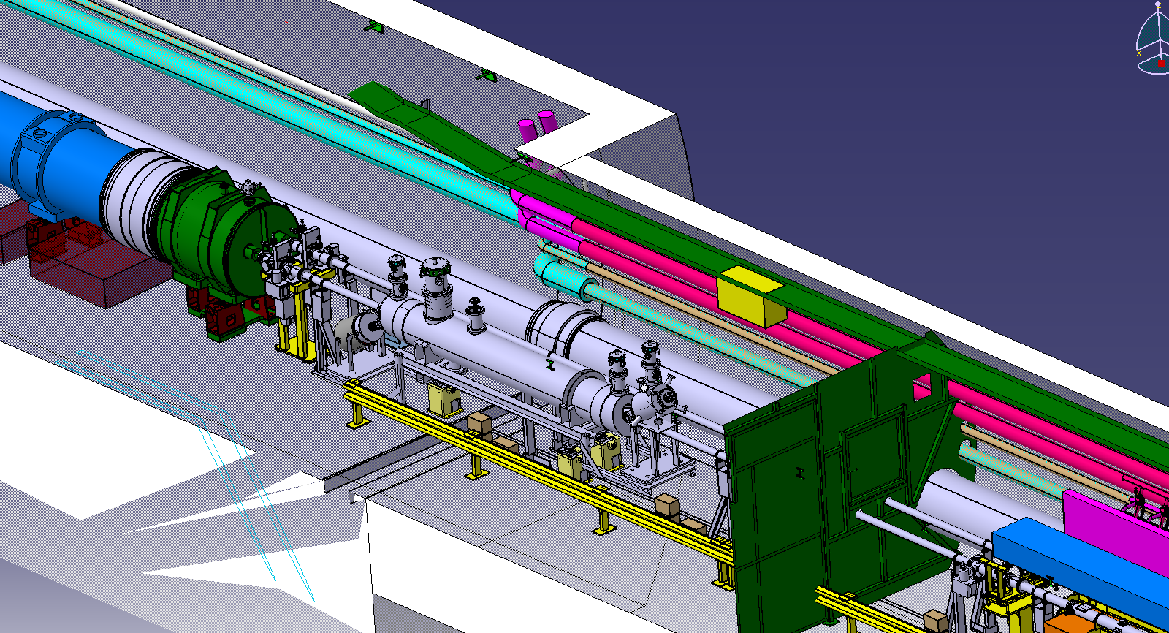
Layout integration in HL-LHC machine
ADT
Ventilation door
V.C Supports
HEL
D3
DFB
ST0676534_01
ST0676534_01

Slide 16
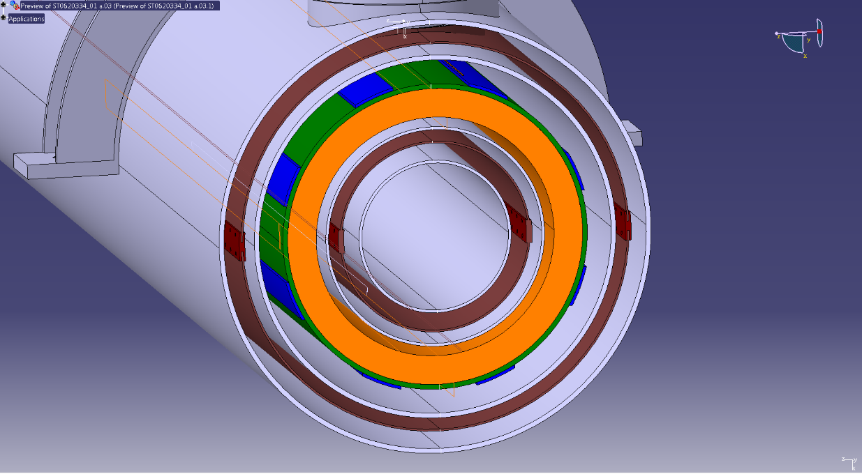
Interface of HEL with other equipment
Vacuum:
    Vacuum pressure during operation must be lower 10⁻¹¹ mbar.
    Vacuum chamber NEG coated.
    Vacuum chamber inner diameter: 80 mm.
    Vacuum chamber material: cooper.
    Bake-out temperature: 250°C.
    25 mm bake-out jacket.
    Sector valve for the e-gun:
      Exchange procedure to be study.
    The design of the collector should avoid degassing.
      In case of collector degassing, ion pumps or in worst case 1 m length NEG coated vacuum pipe on both sides of the HEL should be installed. (Not in present layout proposal) → to be studied by the HEL team and WP12.
    2 x Current Transformer
    2 x Beam Position Monitor
    2 x Gas Jet Monitor
454 mm
135mm
BI:

Slide 17
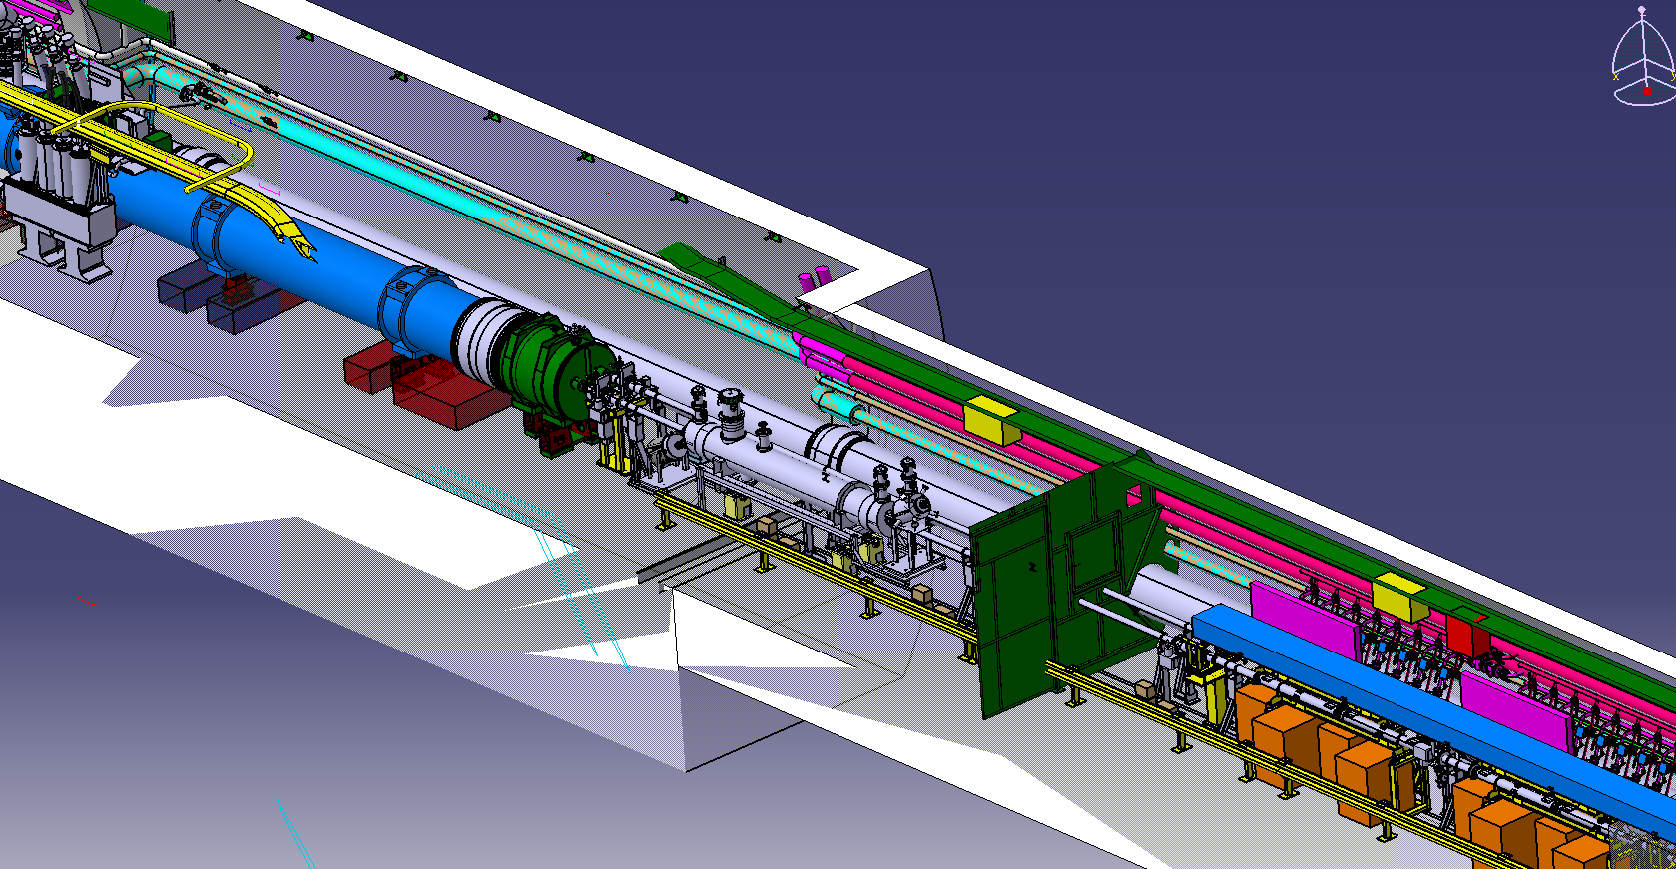
Interface with other equipment in the tunnel
  Cryogenics supply:
    Option 1: from existing jumpers coming from D3 or RF modules (first one to be checked but improbable)
    Option 2: New dedicated service module and jumper
      Possibility to install one dedicated service module for HEL leaving space for a future service module for new xxxMHz module or,
      install a double service module with two jumpers for HEL and future xxxMHz module
Option 1
Option 2
~14 m
ST0676534_01
ST0676534_01

Slide 18
Tunnel general services
  Water cooling pick up for collector
  Services for e-gun powering:
    to be identified

Slide 19
Preliminary integration of technical services in Service caverns of 4L*
*Please note that 4R is symmetric to 4L

Slide 20
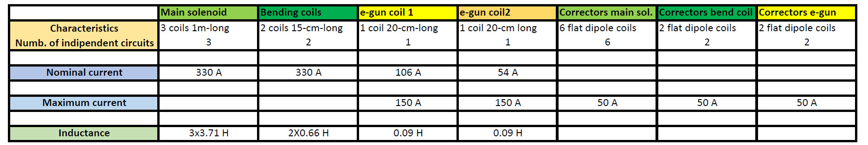
Power supplies - Circuit rating
450 A
450 A

Slide 21
Power supplies - Circuit rating
450 A
450 A
  Total number of independent circuits: 17
      7 PC x HL-LHC600A-10V
      10 PC x Cancun 50
  Total number of racks: 6 PC racks + 1 control rack
    Spare slots taken into account
    Water cooling for HL-LHC600A-10V

Slide 22
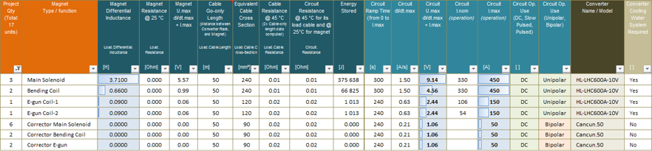
Power supplies - Characteristics
  Cabling characteristics:
    Waiting for AC and DC cabling definition and integration
    First check from EN-EL→ Installed power in UA43/47 should be enough

Slide 23
HEL – Other racks needs
  QPS:
    EE system needed?→ Study by WP7 to see if they are self protected
    Racks → 2 min, 6 max (if EE needed)
    Location: together with the PCs
  BI: 2 racks for control
  E-gun: sofisticated system, maybe in-kind contribution →reserve 2 racks for control

Slide 24
Racks needs summary
System | Min. racks | Max. racks
Power converters | 7 | 8
QPS | 2 | 6
BI | 2 | 2
E-gun | 1 | 2
Total | 12 | 18

Slide 25
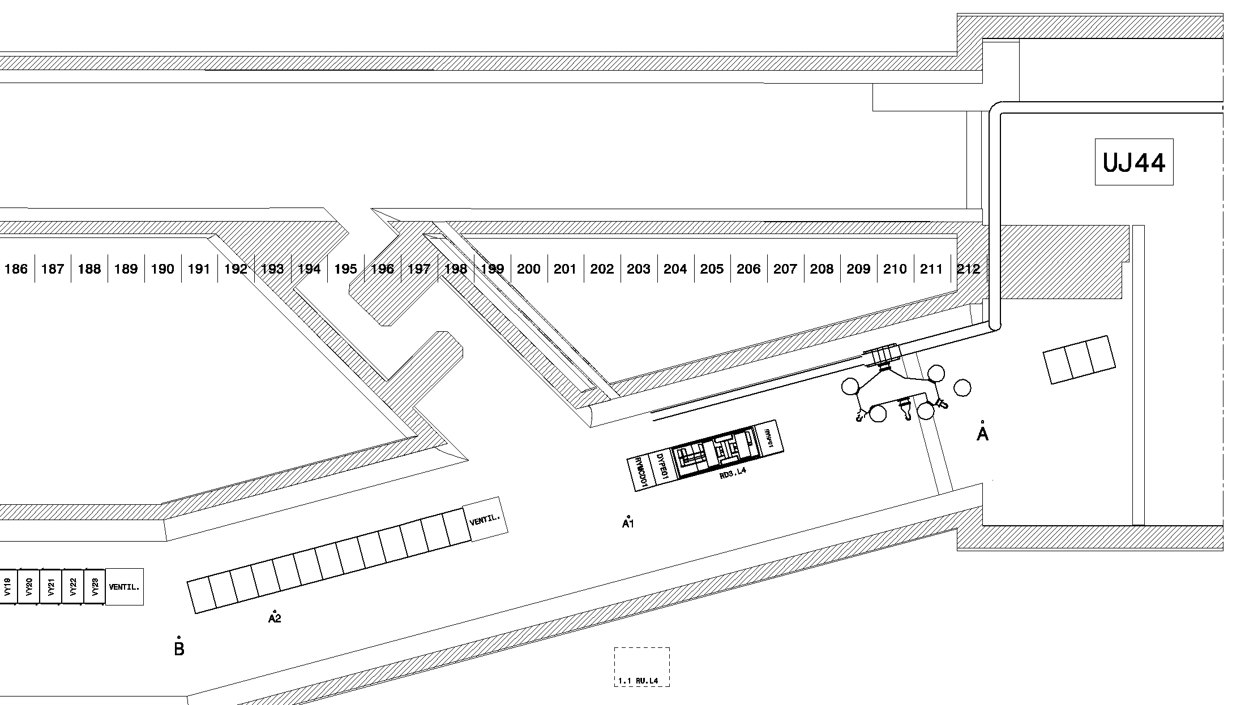
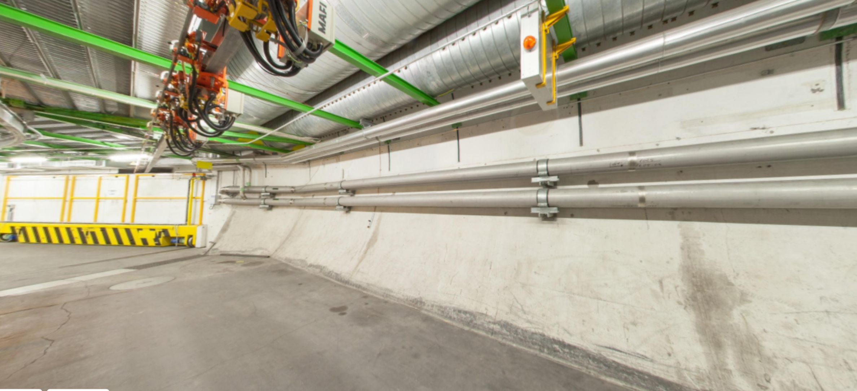
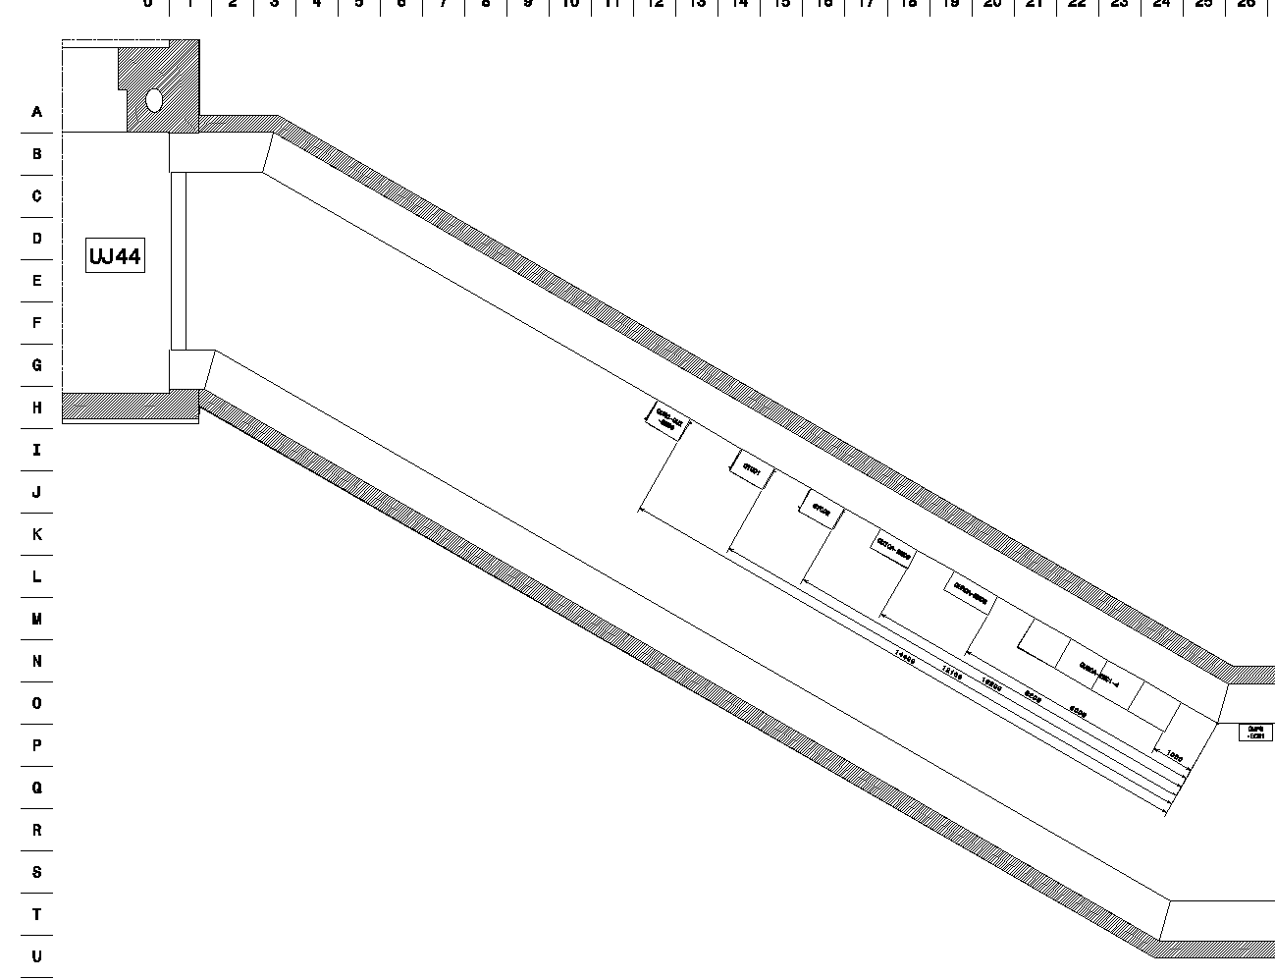
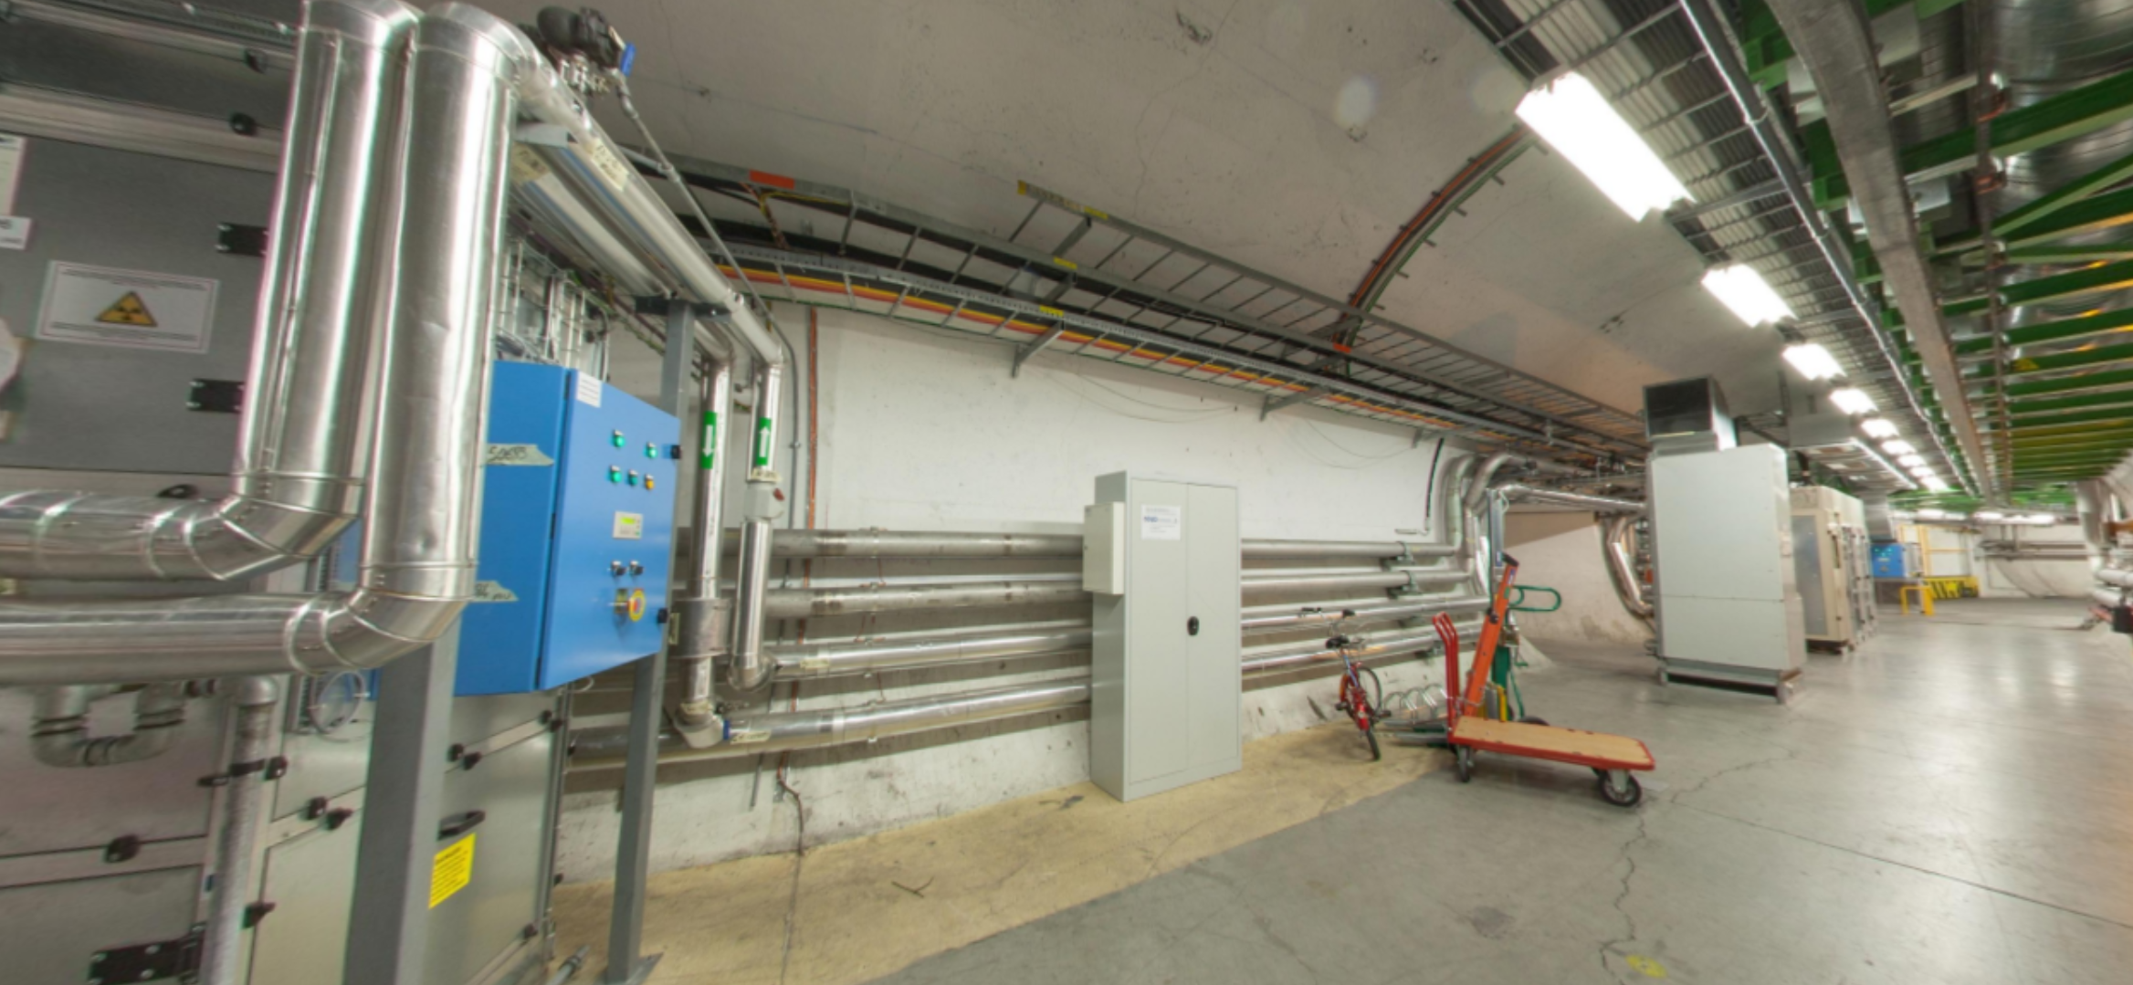
Option 1: UA43 & UL44 (P4L) / UA47 & UL46 (P4R)
Racks- Location
UA43
4 racks
14 racks
UL44

Slide 26
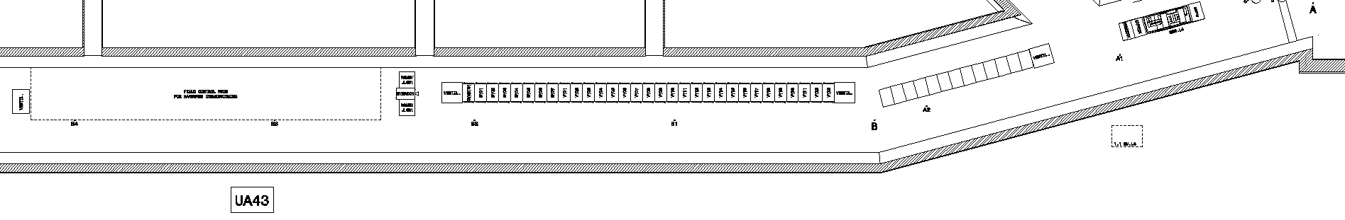
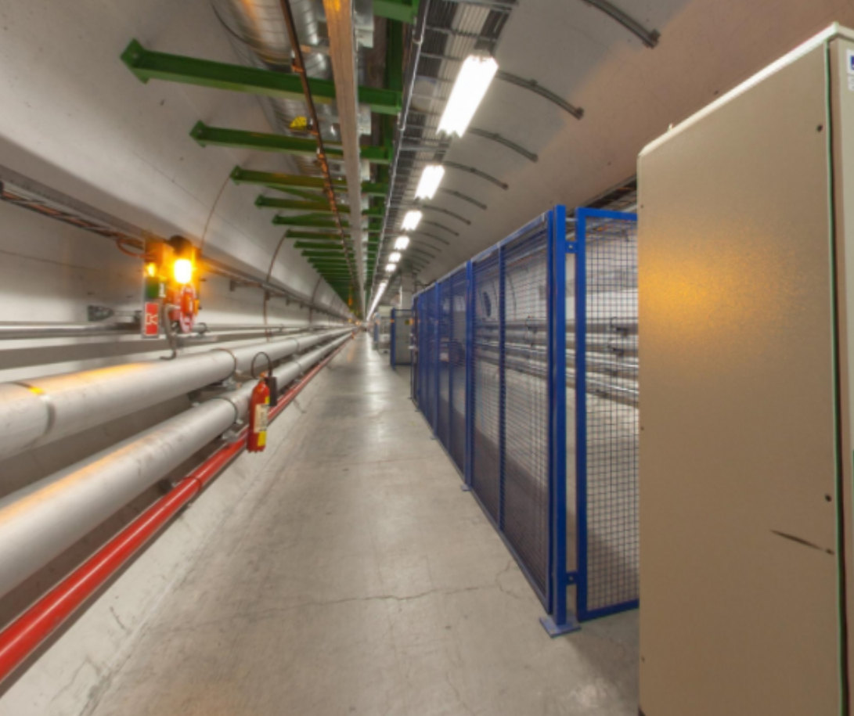
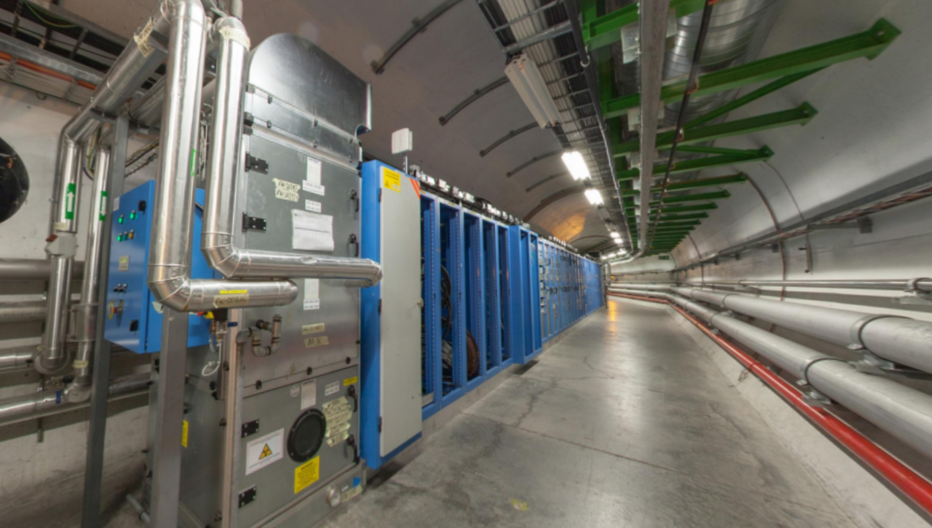
Option 2: UA43 (P4L) / UA47 (P4R)
Racks- Location
4 racks or more
4 racks or more
UA43
14 racks

Slide 27
Conclusions

Slide 28
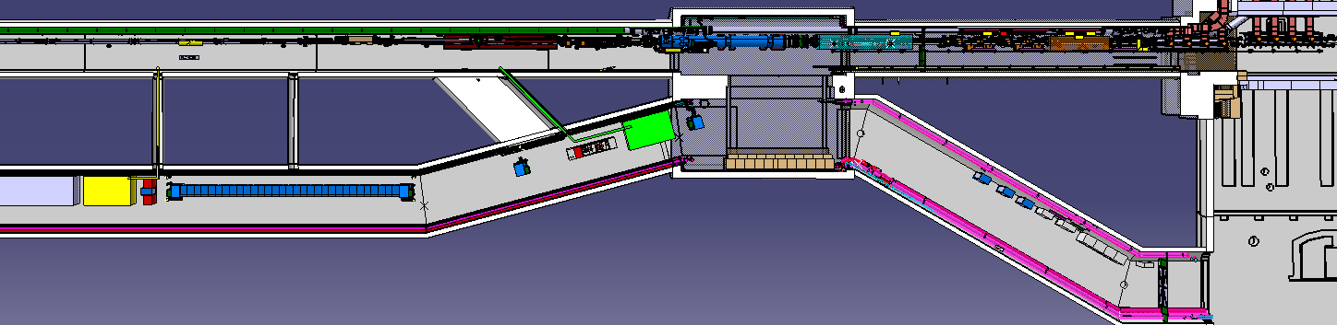
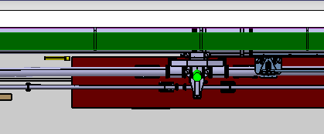
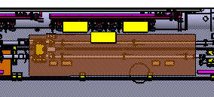
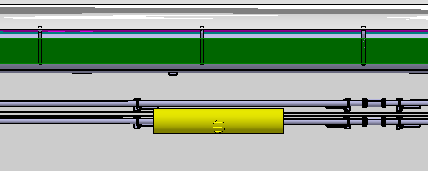
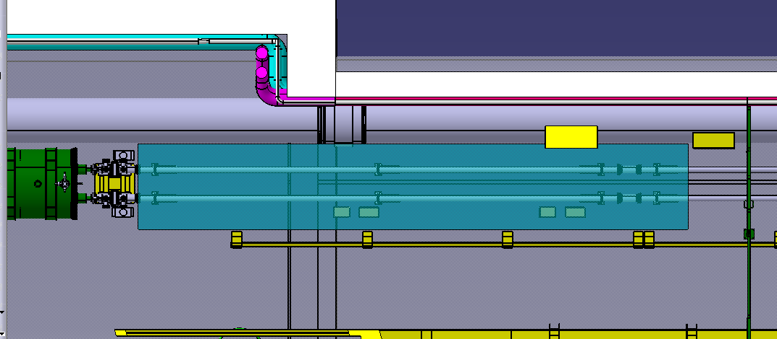
Overview of LSS4 P4L until D4 for HL-LHC
B2
UA43
B1
BSR - New extraction
and hutch
BSR - Old extraction
and hutch
NEW ADT: existing reservation
HEL and racks
ST0676534_01

Slide 29
HEL – Conclusions
  In view of a possible technological and integration review in autumn this year the integration and service analysis should be updated taking into account:
    Results of EE computation
    Addition of Beam Instrumentation equipment and its impact on the HEL design and of the general services requirements
    A detailed analysis of other ancillary equipment that should be placed in the LHC tunnel (e-gun ancillaries?)
    Cabling routing from PC to HEL should be defined and integrated

Slide 30
Thank you

Slide 31
Extra slides

Slide 32
Interface of HEL with other equipment
From inside to outside in grey the room temperature vacuum tank, in brown the thermal screen, in grey the helium tank wall, in orange the main solenoid, in blue the corrector coils generating a horizontal and a vertical dipole. Then follow the helium tank wall, the thermal screen and the vacuum tank. The overall external diameter is 454 mm.
454 mm
135mm
BI:

Slide 33
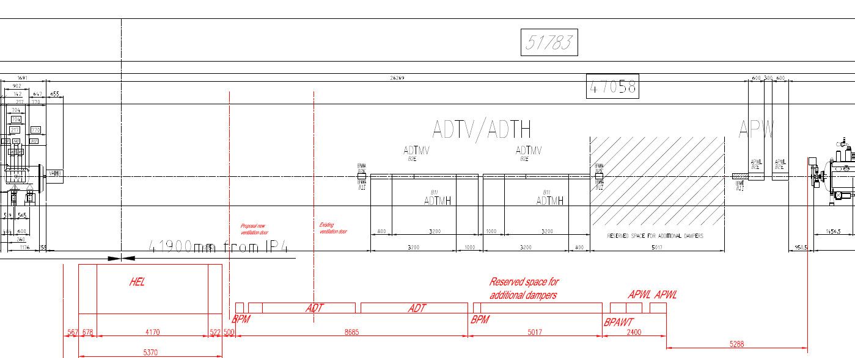
Sketch layout in case of possible RF upgrade

Slide 34
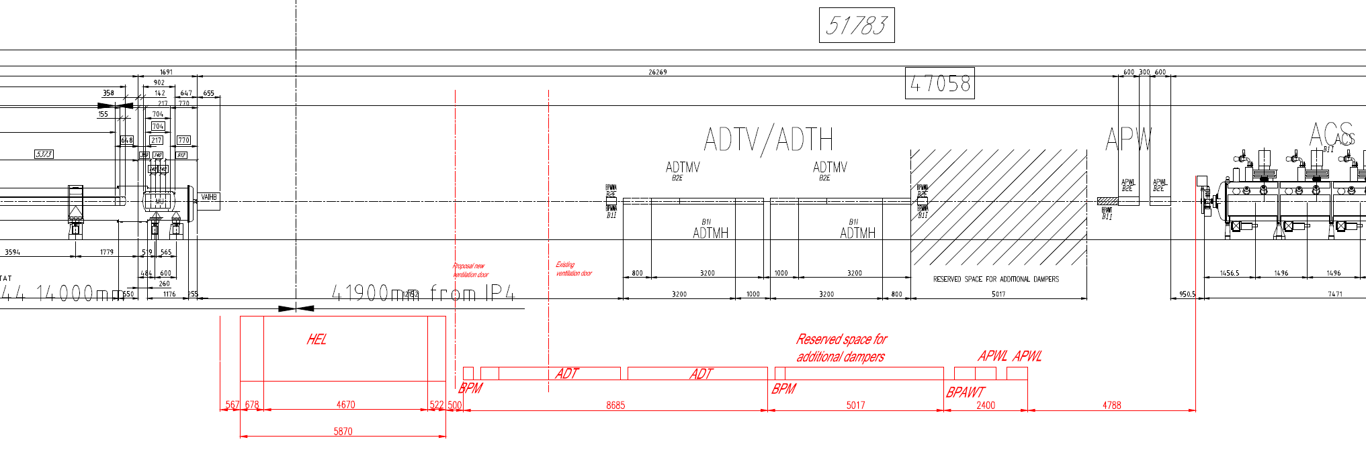
Sketch layout in case of possible RF upgrade with arbitrarily longer HEL
(+500 mm for instrumentation)

Slide 35
HEL – Conclusions
System | Type | Description | Actions
Gas Position Monitor | Open option | It will increase the length of the device, therefore decrease space between HEL and BPM after ADT | Wait to see if it is going to be included
Gun and collector degassing | Design optimization | Design of electrons gun and collector to avoid degassing, otherwise 1m of vacuum chamber in both extremes of HEL with NEG coating needed | Design of the collector avoiding degassing
Space for pumps | Design optimization | Not so much space for the ion pump in e-gun | Interaction with Vacuum for HEL design
Supports for vacuum chamber | Design optimization | Support of vacuum chamber between HEL and Valve takes space maybe needed | Design of new supports
Racks options | Integration study | Two options for racks, depending on total number of racks needed and space availability | Conduct integration studies
Cryogenic supply | Technical study | Two options for cryogenic supply | Conduct studies
EE | Technical study | On-going study to see if the coils are self-protected, it will save space for EE racks | Wait for results
DC Cabling | Study | DC cabling and integration has to be studied | Conduct studies

