Slide 1

Update on LHC Electron Lens design
Diego Perini
22.05.2017

Slide 2
Outlines
Introduction
Design of the main components
  Main solenoid , cryostat
  Gun and collector regions
Conclusions
Pascal Simon – University of Darmstadt.
Samuel Riekki, Jakko Harjuniemi, Ville Nikkarinen, J. Uurasmaa, J. Markkanen, J. Puska, E. Jussila – Lapland University of Applied Sciences.
David Buglass - Oxford University
Federico Meneghetti – University of Padua
Contributions of:
Giulio Stancari (FNAL), Stefano Redaelli, Adriana Rossi, Giorgia Gobbi, Carlo Zanoni, Antti Kolehmainen.

Slide 3
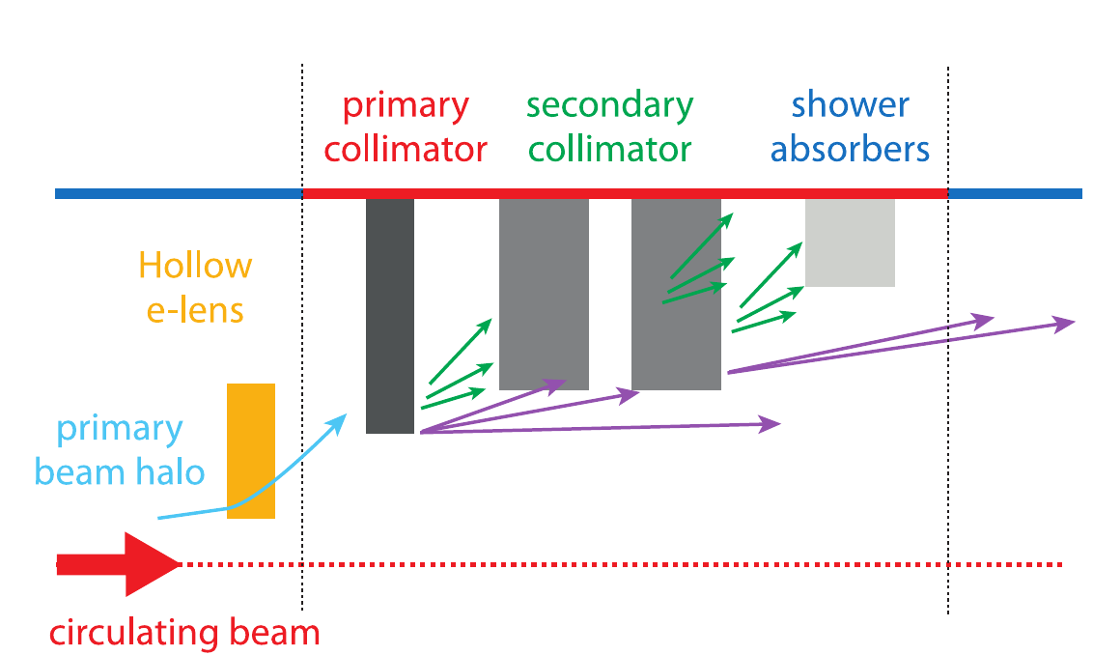
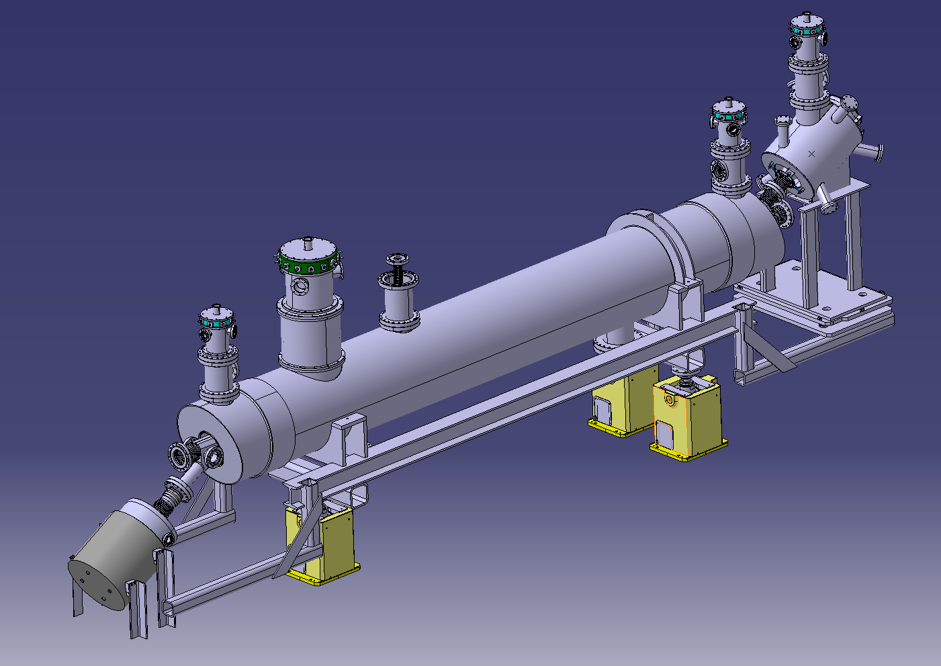
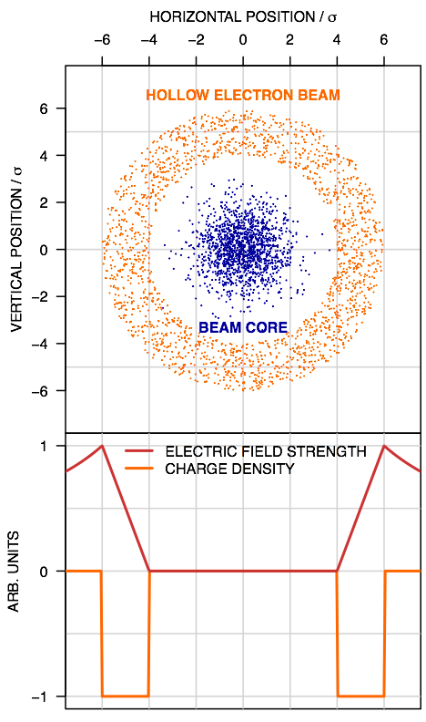
Introduction
e-gun
Hollow electron beam
The Hollow Electron Lenses will be integrated in the HL-LHC collimation system.
Halo particles are kicked to higher amplitudes by the electromagnetic field of the electron beam.
Proton beam
Collector
Electrons are generated by the cathode of an e-gun.
They travel along the proton beam
They are intercepted by the collector.
Superconducting solenoids cooled at 4.2 K generates the field to steer the electron trajectories.

Slide 4
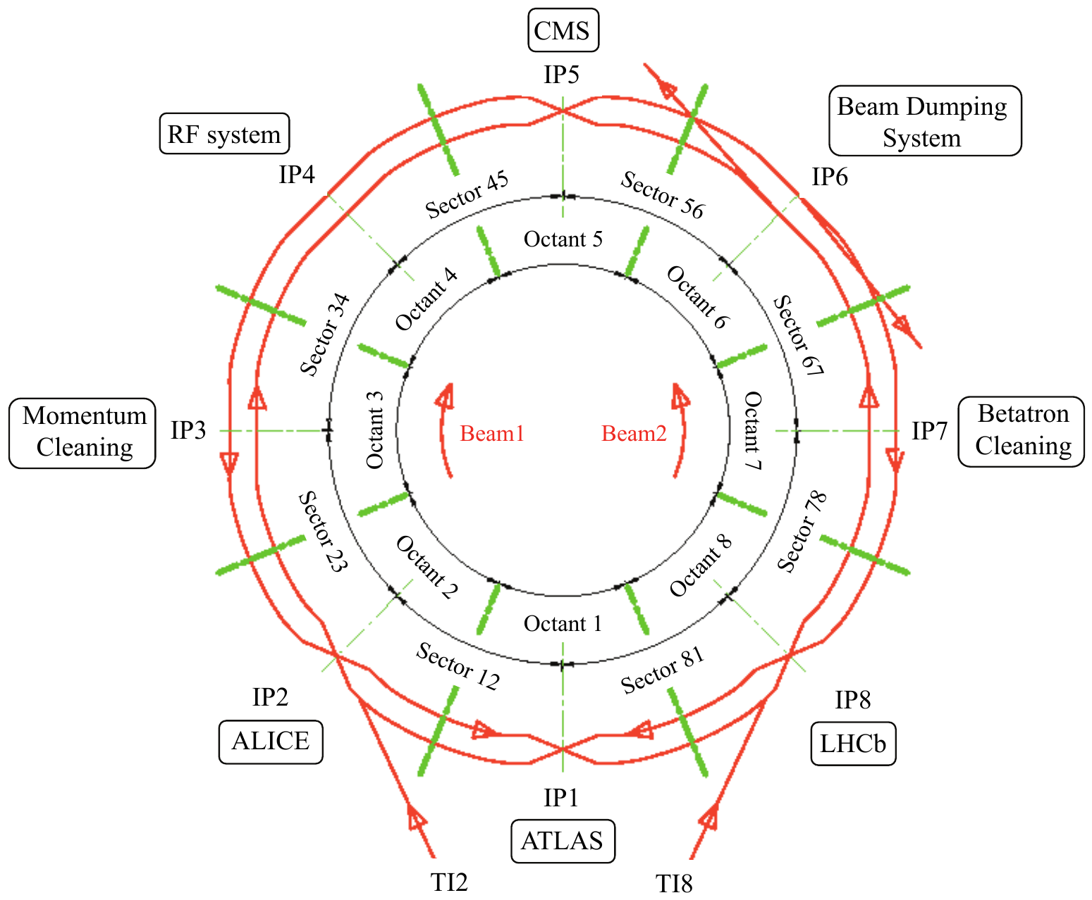
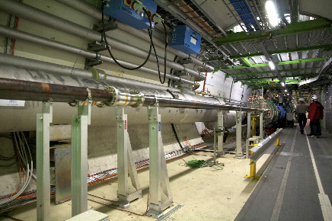
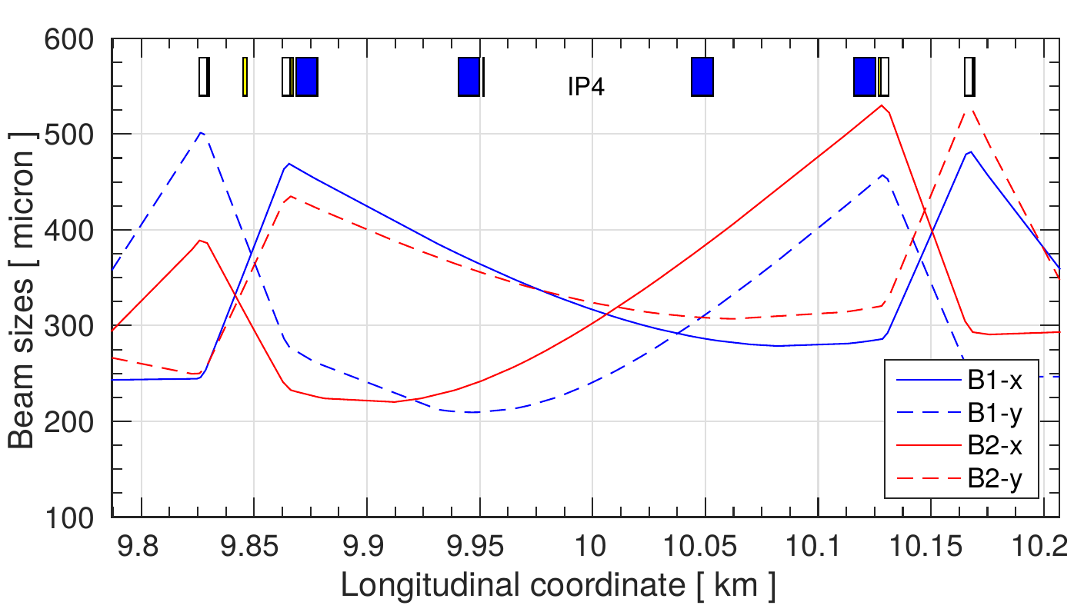

Introduction
Best place found: IR4
  Space available and $β_{x}≈β_{y}$
Candidate locations for the electron lenses are RB-44 and RB-46 at Point 4, on each side of the interaction region IR4.
The beam to beam distance is 420 mm.
The longitudinal available space is limited
Compact design
Simple construction and maintenance.
Intensity and size of the e-beam required for HL-LHC are demanding

Slide 5
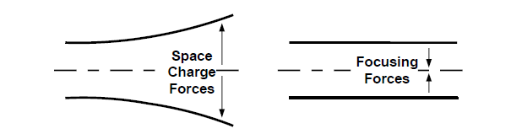
Introduction
The field level determines the radius of the e-beam. The dimensions of the electron beam in two points along its path follow the equation:
Where r₀ and r₁ are the radii of the electron beam in point 0 (cathode) and 1 (main solenoid) and B₀ and B₁ are the magnetic field in points 0 and 1 respectively.
But:
The HEL must be compact, magnetic fields must be reasonable.
Field seen by electrons must be always larger than 0.15 – 0.20 T.
Dimensions of the cathode must be technically feasible.
When the ratio of fields changes the relative position of the solenoids changes.
Despite the use of corrector and of an independent solenoid for the e-gun
The range of achievable field ratios is limited

Slide 6
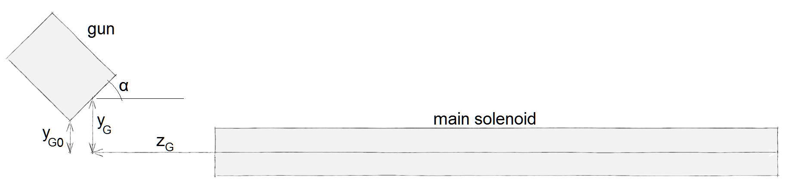
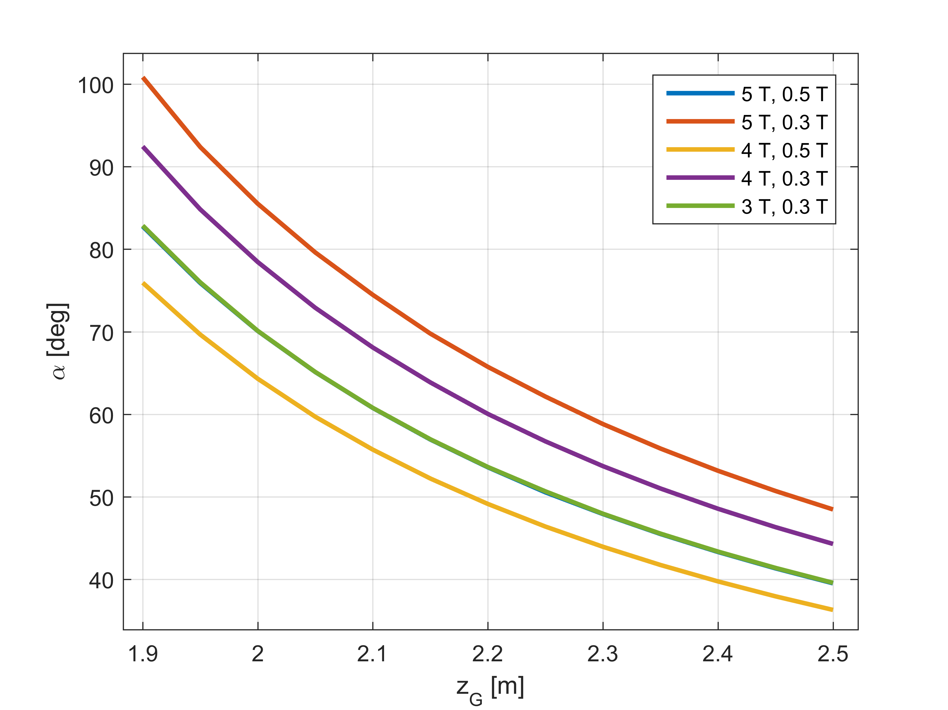
Introduction
The electrons travel along the e-gun solenoid longitudinal axis and must enter in the main solenoid along its longitudinal axis.
For different field ratios the optimal longitudinal position Z_{G} and the inclination angle α change.

Slide 7
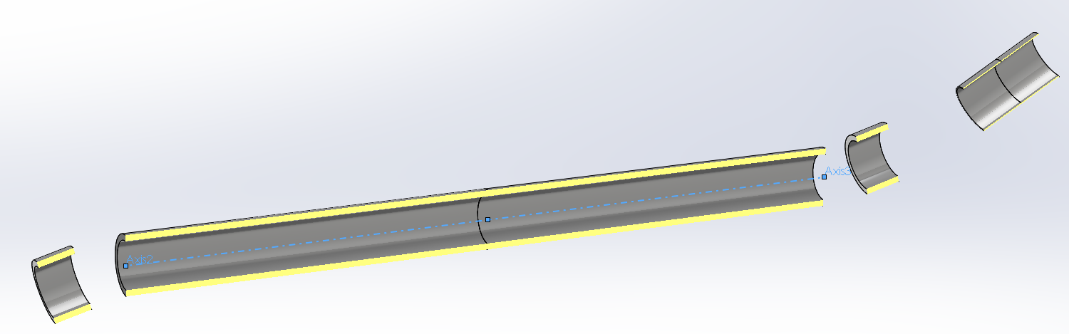
Design of the main components
E-gun solenoid (tuneable field)
Fixed field part
Need of space for the instrumentation.
Nominal magnetic field of the main solenoid | 4 T
Inner radius of the hollow electron beam @ nominal fields | 0.9 mm
Outer radius of the hollow electron beam @ nominal fields | 1.8 mm
Nominal magnetic field in the e-gun cathode | 0.2 T
Inner diameter of the cathode | 8.05 mm
Outer diameter of the cathode | 16.10 mm
Inner radius of the hollow electron beam @ 4 T with 2 T @ cathode | 5.7 mm
Outer radius of the hollow electron beam @ 4 T with 2 T @ cathode | 11.4 mm
Nominal current at the cathode | 5 A
(*)
Use at the injection.
(*) A 25 mm outer diameter cathode would require a 5T central solenoid and a 0.1 T at the e-gun cathode. 0.1 T is not enough.

Slide 8
Design of the main components
Main parameters of the superconducting solenoids
(operating temperature 4.2 K)
All coils are wound using Nb-Ti wire. The insulated wire has a rectangular cross section of 1.65 mm x 1.05 mm with a copper to superconductor area ratio of 4. The critical current measured at 5 T and 4.2 K is at least 750 A.
Main solenoid
Total length | 3 m
Number of turns (per layer and per m of length) | 606
Number of layers of superconductor | 16
Total thickness of the coil (after curing) | ~ 21 mm
Coil inner diameter | 200 mm
Nominal field | 4 T
Maximum operation field | 5 T
Current at 4 T | 330 A
Inductance (total for the 3 m) | 3 x 3.71 H
Bending solenoids (2 coils)
Total length | 0.15 m
Number of turns (per layer) | 91
Number of layers of superconductor | 16
Total thickness of the coil (after curing) | ~ 21 mm
Coil inner diameter | 220 mm
Current (with main solenoid at 4 T) | 330 A
Inductance | 0.66 H
Gun solenoid - constant field part
Total length | 0.2 m
Number of turns (per layer) | 121
Number of layers of superconductor | 5
Total thickness of the coil (after curing) | ~ 6 mm
Coil inner diameter | 220 mm
Field with 94 A | 0.4 T
Maximum operation field | 0.6 T
Nominal current | 106 A
Inductance | 0.09 H
Gun solenoid – Cathode (tuneable part)
Total length | 0.2 m
Number of turns (per layer) | 121
Number of layers of superconductor | 5
Total thickness of the coil (after curing) | ~ 6 mm
Coil inner diameter | 220 mm
Nominal field | 0.2 T
Maximum operation field | 0.6 T
Current at 0.2 T | 54 A
Inductance | 0.09 H
Cable size, number of turns, nominal currents, inductances are reasonable achievable parameters. They could change in function of the industrial standards and the know how of the producer.

Slide 9
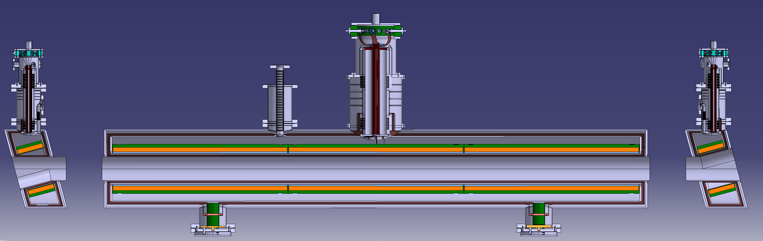
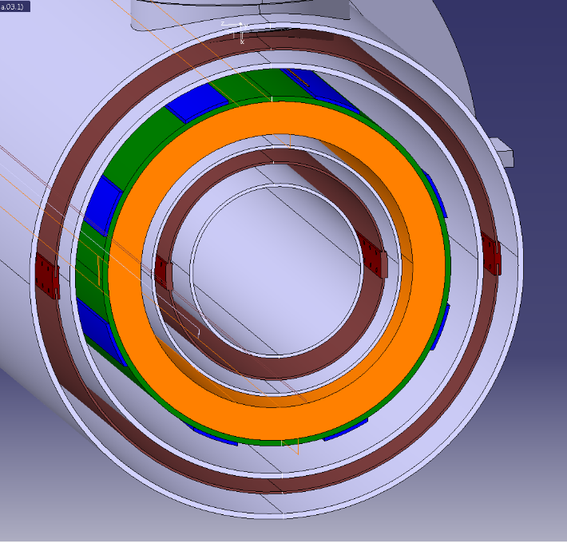
Design of the main components
3000
Cross section of the HEL cryostat. In the centre there is the bore for the room temperature vacuum chamber (not shown here). The bore diameter is 135 mm. Then from inside to outside in grey the room temperature vacuum tank, in brown the thermal screen, in grey the helium tank wall, in orange the main solenoid, in blue the corrector coils generating a horizontal and a vertical dipole. Then follow the helium tank wall, the thermal screen and the vacuum tank. The overall external diameter is 454 mm.
Type | Heat On Cold Mass (4.2K)
G10 Supports | 0.24 W
Radiation | 0.68 W
Current Leads | 4.51 W
Instrumentation | 1.00 W

Slide 10
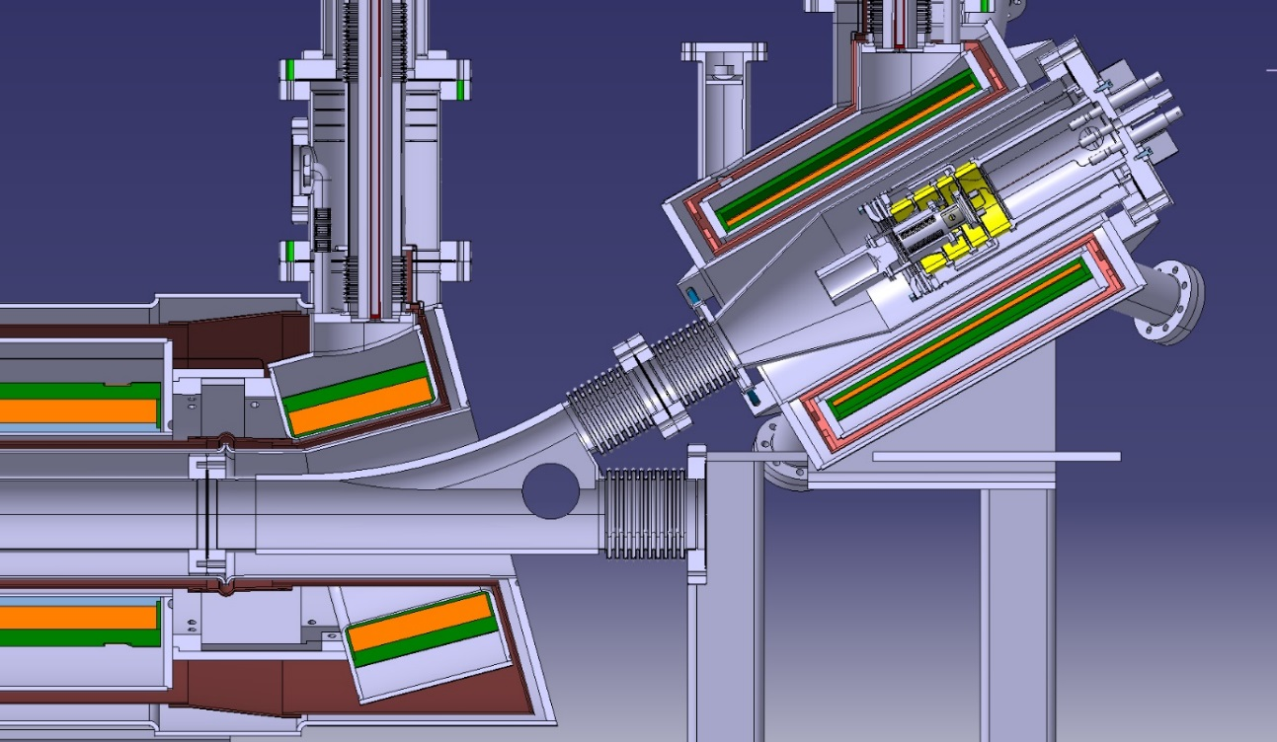

Slide 11
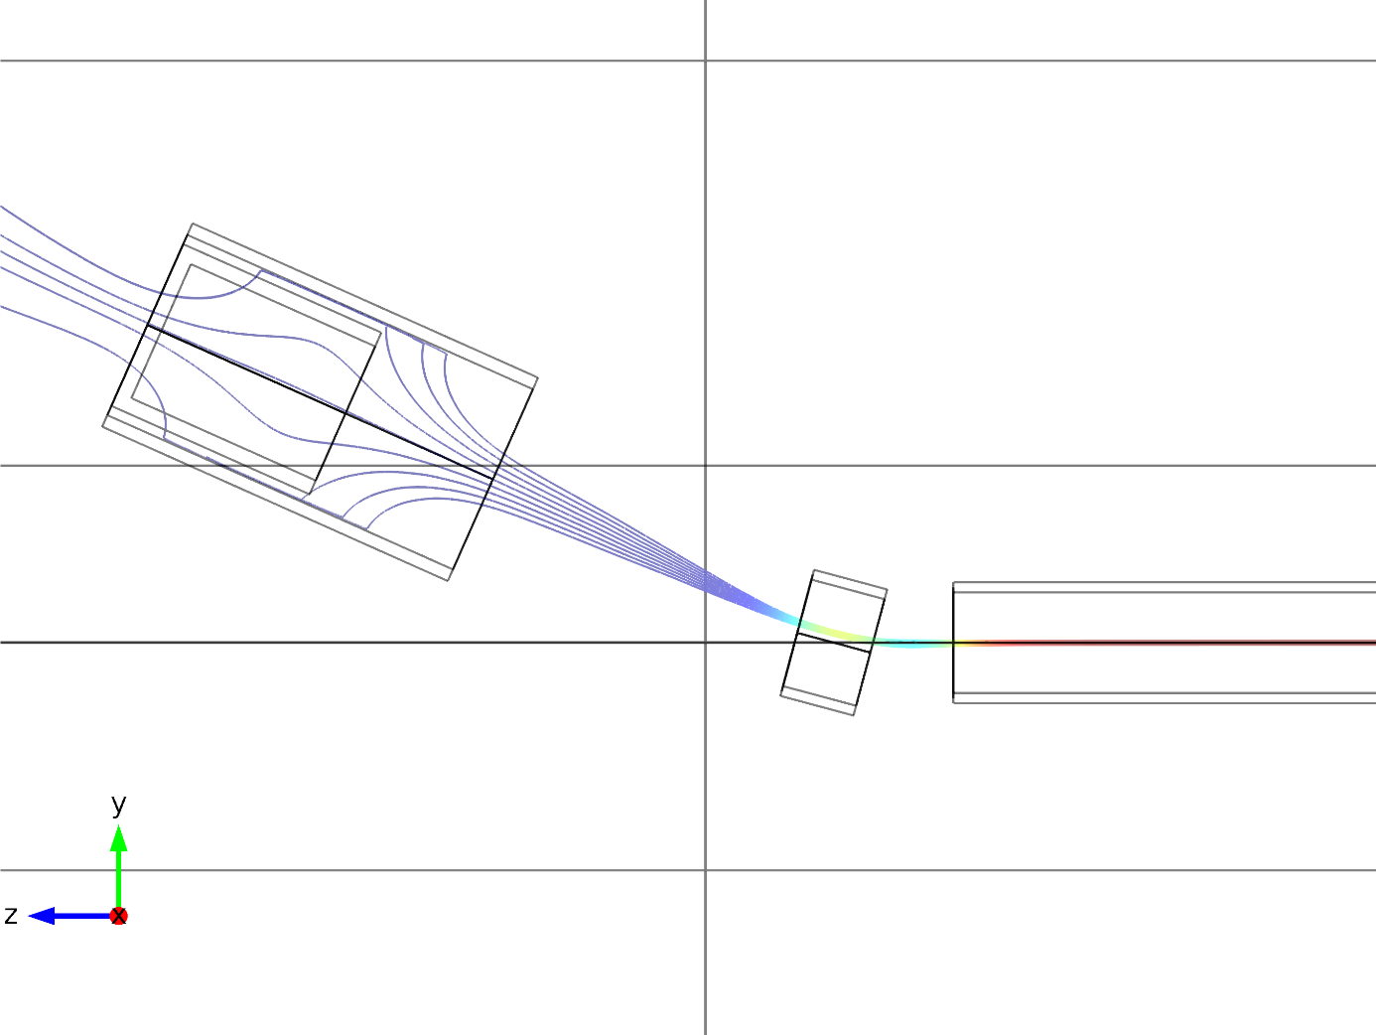
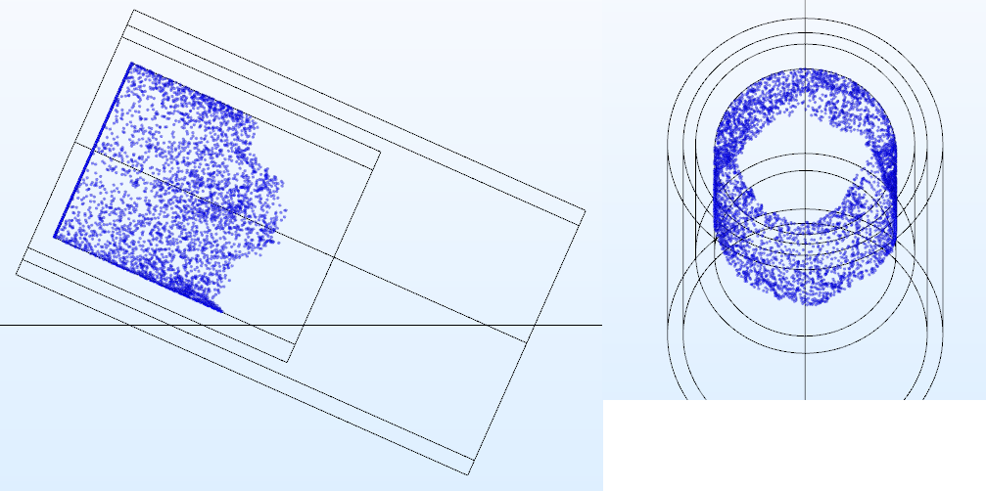
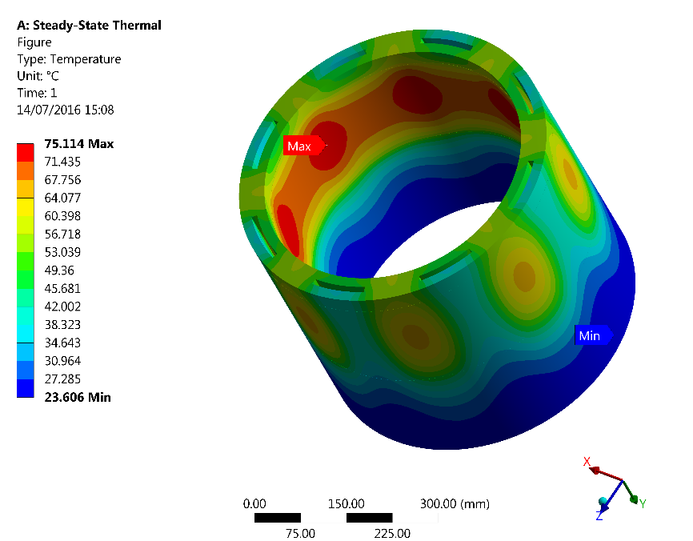
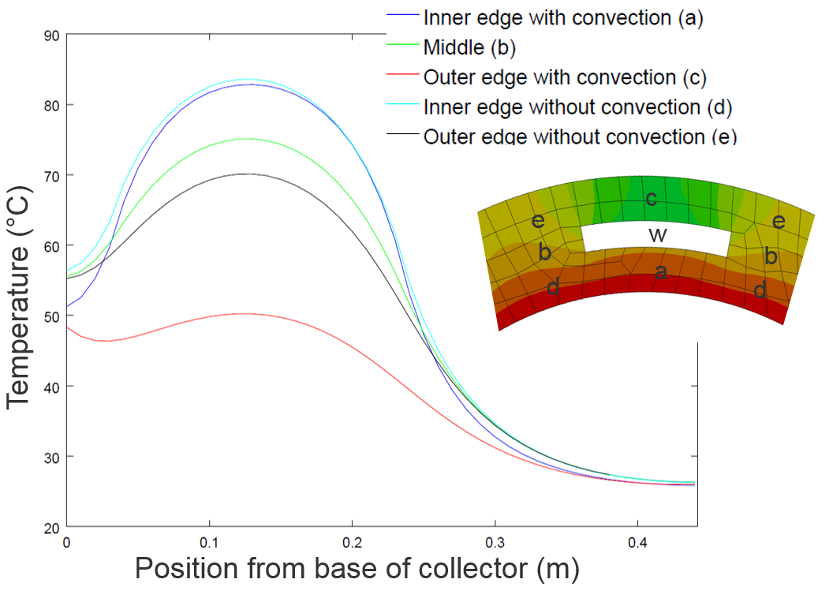
Design of the main components
Collector main parameters
Collector in ETP copper
Maximum power absorbed | 50 kW
Maximum temperature | 85ºC
Maximum speed of the cooling water | 1 m/s
Water flux | 8 l/s
Inner diameter | 145 mm
External diameter | 175 mm
Height | 400 mm
5 A , 10 kV => 50 kW of power to absorb

Slide 12
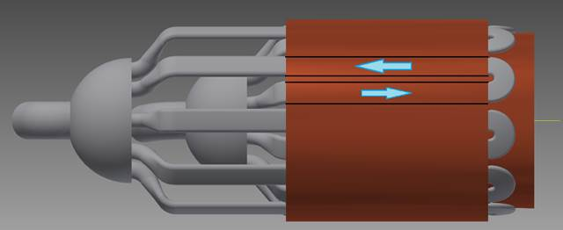
Design of the main components
Collector and cooling circuit configuration (collaboration with LUAS Kemi).
Possibility of few degrees adjustment

Slide 13
Conclusions
The situation today:
The field configuration and consequently the magnet system is defined.
We have a ‘reasonable’ solution that can be discussed with suppliers / in kind contributors. Drawings will be ready in few weeks.
At this stage it is useless to go deeper into construction details. It is better to discuss these points with the manufacturers.
The geometry has to be validated / approved from the beam dynamic view point. The computations we did do not consider the space charge effect.
There is the possibility of tuning a bit some parameters (field, angles, cathode size) to fulfil the requirements coming from the previous point.
This is final tuning of the mechanical structures, not re-design. It requires a few computations and we have all the analysis models ready.

Slide 14
Spare slides

Slide 15
Design of the main components
Instrumentation:
Beam Gus Curtain (E. Barrios, G. Schneider, R. Veness)
BGC test layout.
HEL
190
Possibility of measuring the position of the two beams with the same instrument.
It will take time to develop the prototype.
It has to be included / integrated in the HEL.

Slide 16
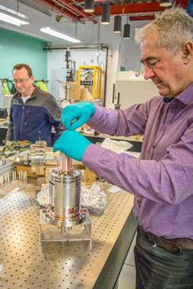
E-guns, cathodes, production tests
Test programme for guns and cathodes
Test of the e-gun with a 25 mm cathode from a Heatwave.
Almost finished.
Test of the e-gun with a 25 mm cathode from Ceradyne.
Cathodes under production. Tests after summer.
Test of the ‘minimum modification’ e-gun with a 16 mm cathode from BJUT/BVERI
Cathodes ordered. Delivery end of the year.
Drawings for gun modification ready.
Gun parts will be produced soon.
Test of a ‘small’ e-gun with a 16 mm cathode from BJUT/BVERI.
Cathodes ordered. Delivery end of the year.
Drawings of the gun ready.
Gun designed and built by the end of the year.
Test of a ‘small’ e-gum with a 9 mm cathode from BJUT.
Cathodes ready by end of the year (coll. with BJUT)
Gun designed and built by the end of the year

Slide 17
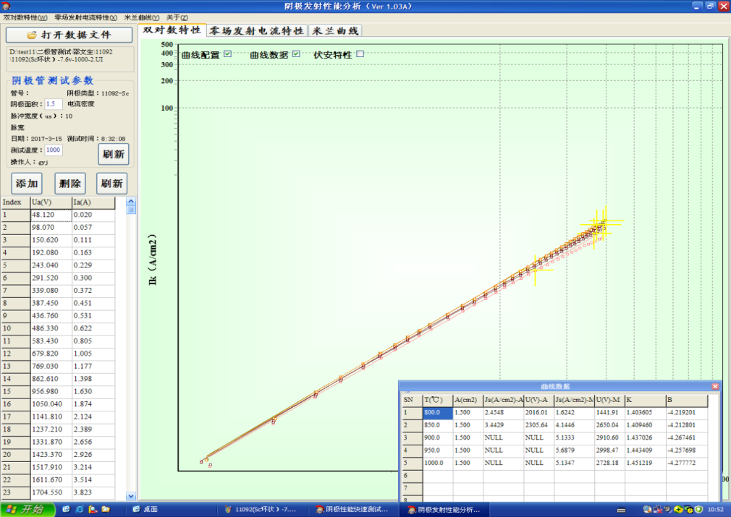
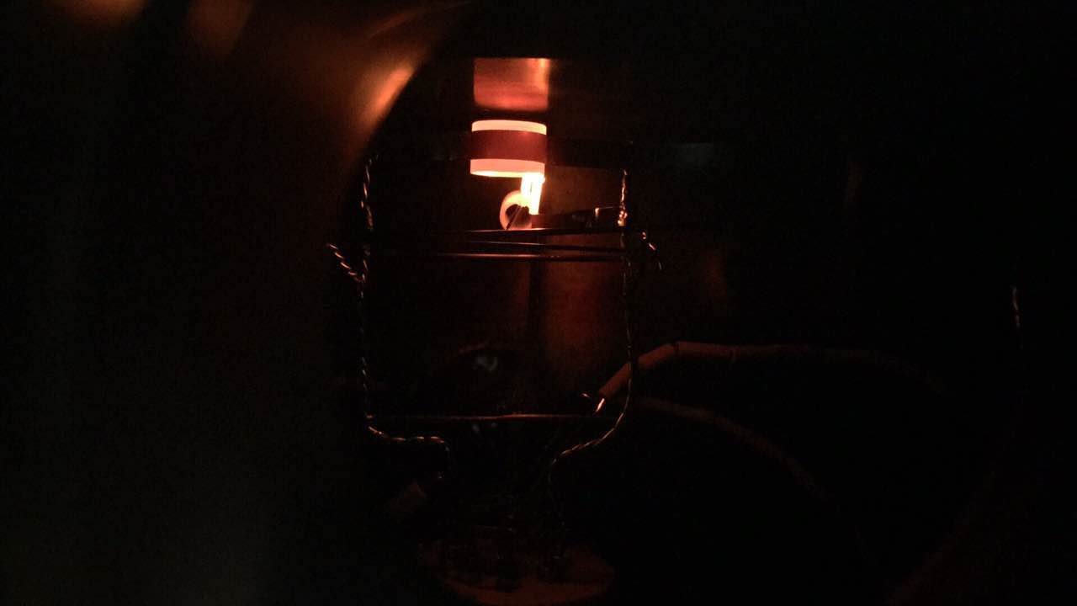
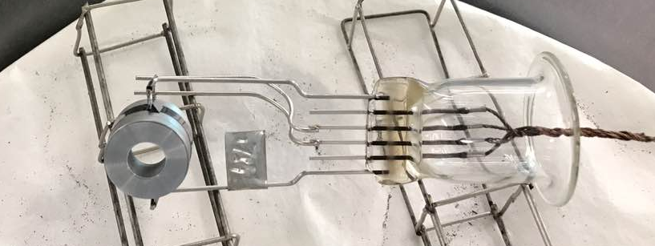
E-guns, cathodes, production tests
First nice results of the 16-mm test cathode obtained by BJUT / BVERI
Cathode No：001# Type：Scandate
Outer diameter: 16.1mm
Internal diameter：8.05mm Emission Area :1.5cm²;
T(℃b) | Saturation Current density J a（A/cm²）
800 | 1.6
850 | >4.1
900 | >5.1
950 | >5.7
1000 | >5.1
All pictures: courtesy of BVERI Beijing

Slide 18
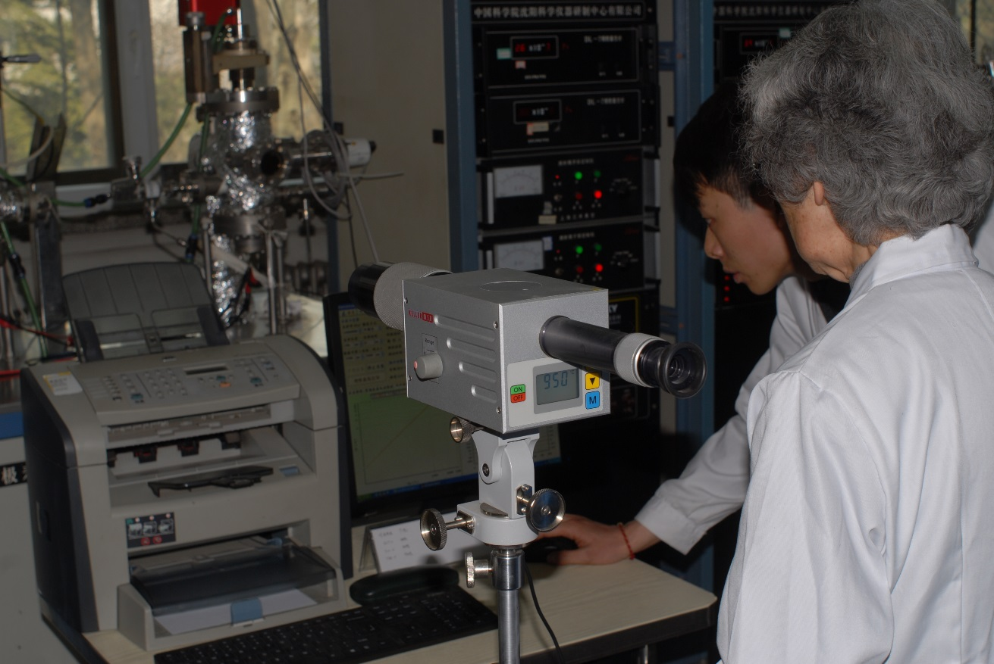
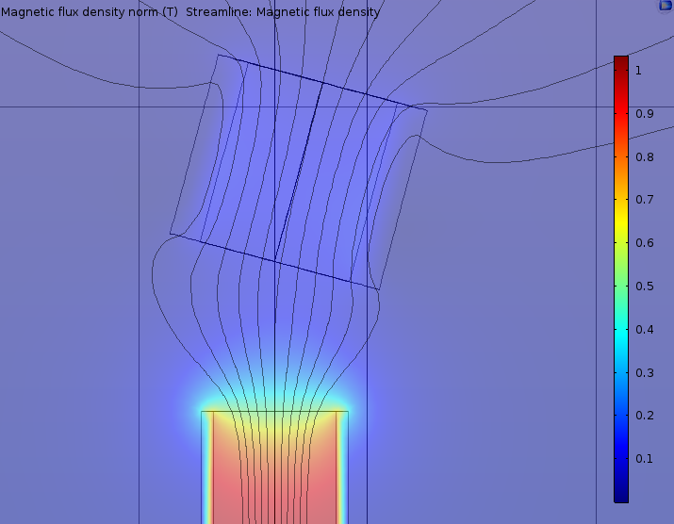
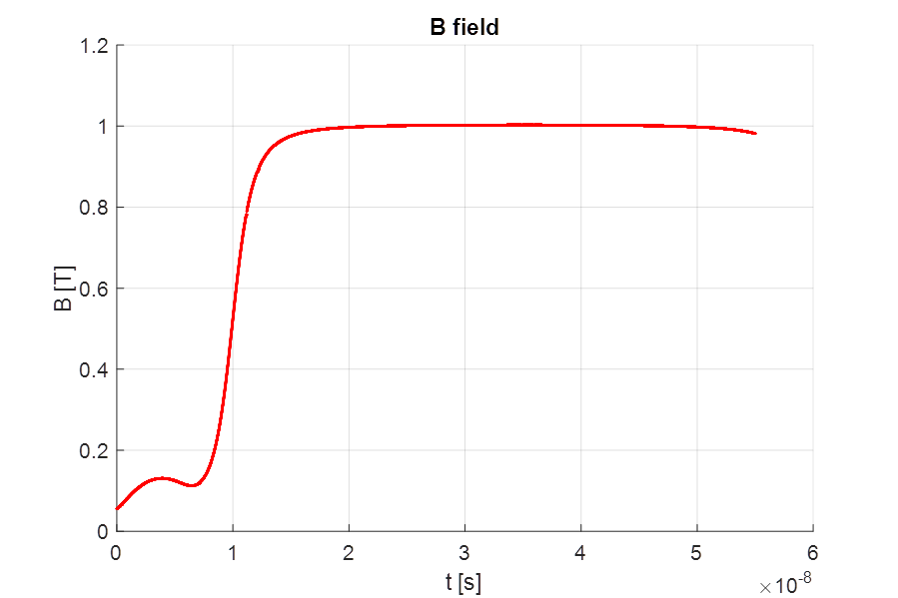
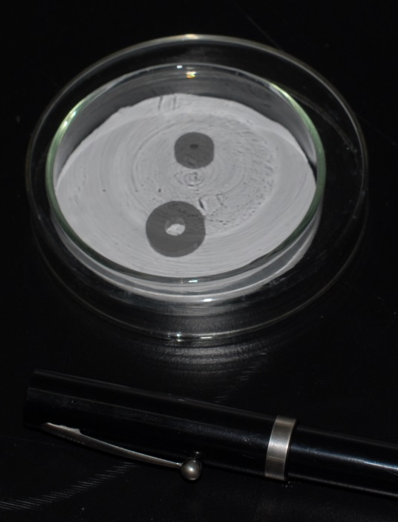
E-guns, cathodes, production tests
BJUT Beijing is developing a scandate cathode 4 mm / 8 mm. First test carried out on a 3 mm / 9 mm cathode shows that they have the necessary current density to reach 5 A.
Smaller cathodes means lower magnetic fields, simpler protection, less powerful power supplies and simpler construction.
Courtesy of BJUT (Beijing University of Technology)
This is not the baseline. But I think it can be useful to dedicate a bit of time to this possibility.

Slide 19
Thank you for your attention

