Slide 1


Open Accelerator
Information System
Johannes Gutleber
CERN
May 16, 2017

Slide 2
ARIES H2020
Aims
  Develop European particle accelerator infrastructures
  Improve performance, availability and sustainability of particle accelerators
  Transfer technologies to society
  Enlarge the European accelerator community
Key figures
  May 2017 – April 2021 (4 years)
  24.8 M€ (10 M€ EC contribution)
  41 partners from 18 countries
  Coordinated by M. Vretenar (CERN)

Slide 3
Open Information System - WHY
To assess RAMS characteristics of a “complex technical system” and plan performance/cost improvements, quality data about systems and subsystems is needed
  From experience the biggest challenge
  TNA calls for SLA known KPI if you want to make it work
”Discovered by industry” decades ago
  EuReDatA 1973 covering all industrial installations
  EDF EIREDA 1997 European industry
  Nuclear - ISO 6527 1984
  Oil & Gas – ISO14224
  Offshore/Onshore – OREDA 1981
  SPARTA – 2014 (windparks)

Slide 4
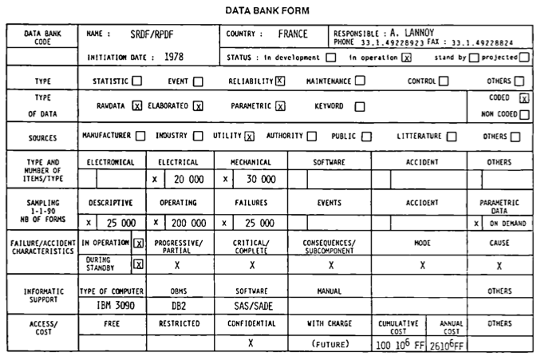
EuReDatA Example Form

Slide 5
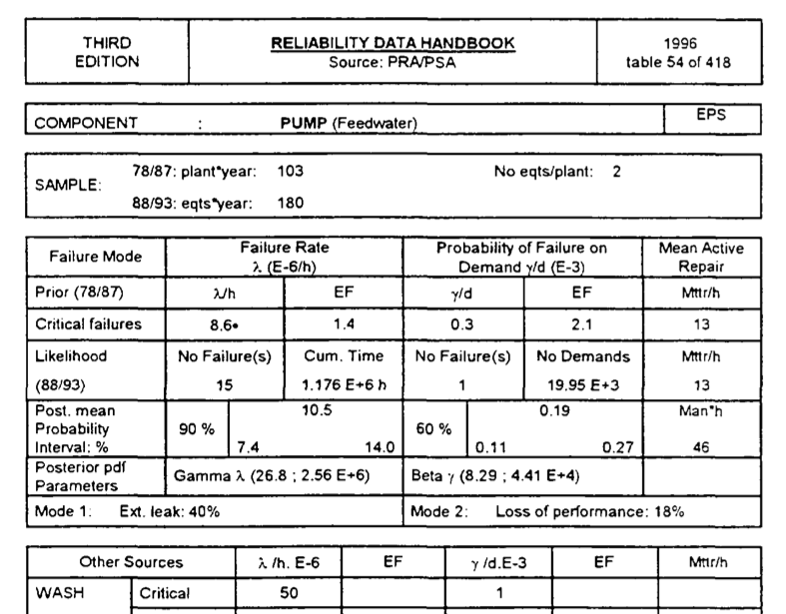
EIREDA Example

Slide 6
OREDA Example

Slide 7
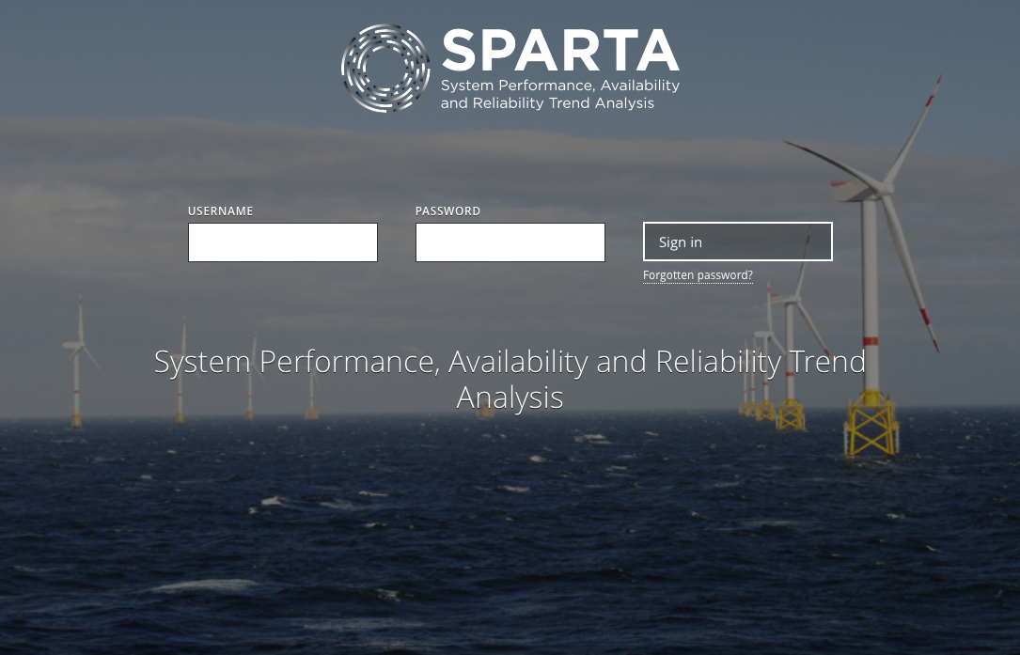
Data-sharing initiative since 2014
All ten UK offshore windpark developers participate
  Centrica, Dong Energy, EDF, E.on, RWE Innogy, ScottishPower Renewables, SSE, Statkraft, Statoil, Vattenfall
GOAL: share “robust and reliable benchmarked data”

Slide 8
WHAT the Information System Contains
Structures of accelerator installations
  Different levels of granularity
  Reliability information (MTTF, MTTR) permitted at all levels in statistical form
  Possible links to historic information and operation conditions
Element information
An access and data anonymization concept
  Permit members providing information
  Permit validation of information (data quality)
  Different methods to query data (e.g. by matching characteristics ranges, by element, by system, according to quality criteria)

Slide 9
Element Information
Technical
Principle of operation
Design characteristics
Origin (manufacturer, intended use data)
Operation characteristics (to be able to compare)
Maintenance and test intervals
Environmental conditions
Links to failure data
Statistical information

Slide 10
HOW - Approach
Requirements and architecture by experienced software and systems engineers
  Austrian Institute of Technology, formerly Seibersdorf Research Centres
  Pilot comes free of charge in addition (Oracle)
Input from an experienced user who has an immediate need
  Heidelberg Ion Therapy facility with 2 operating synchrotrons (Heidelberg and Marburg)
Opportunity for CERN
  Ensure that for CERN a system is conceived that can support RAMS studies and where CERN can profit from data eventually provided by other partners, too.

Slide 11
Diverse data from different locations
Fault tracking,
Logbooks,
Observations,
Estimates
Historical
records
Handbooks,
Data initatives
Information
System
PDF(characteristics, quality, conditions)
Model driven
Design and improvement

Slide 12
WHY more than what exists?
In our community there exists no common data collection initiative.
OREDA example: improve safety and cost-effectiveness in the design and operation of facilities
Over the time gather history from as many as possible different data sources
Compare data among different information providers
To plan for future machines, base on data from different existing machines
Technical facts: cannot impose one system, failure histories in different formats and with different granularities, incomplete data

Slide 13
A Concrete Activity
AIT develops architecture, specification and pilot
  Note: database work + API, not yet user interface
  UI work depends on progress and remaining budget
HIT fills in exemplary information and validates concept
CERN
  reviews the approach
  contributes with existing data from a system tbd
  verify is usable, e.g. LINAC4
At ARIES meetings interest the community
  CNAO, MedAustron, DESY/XFEL, Soleil, ALBA, Ciemat, PSI, ELI, KIT, LUND

Slide 14
Timeline
Requirements and architecture: until end 2017
Prototyping of information system: 2018
Accelerator partial model at HIT: Q2: 2018
Data entry at HIT: Q3+Q4 2018
Involvement of CERN for review and validation?
  Needs selection of case study
  Technical student in 2018 or 2019
    Model a system
    Enter data and/or couple with data sources
    Work on GUI

