Slide 1
Application of Classical and Modern Dependability Engineering Methods for Project Management of a Large Research Facility
Estrella Vergara
EN-ACE group
24th May 2017

Slide 2

Classical and Modern Dependability Engineering Methods
Objective: This thesis aims to apply classical and modern dependability engineering analysis to the Project Management of complex scientific facilities
Classical Methods:
Inputs
Fixed data
Models
Dependability studies focused on two type of events:
  Events that cause damage on the investment, personnel and/or environment: e.g. safety system failure, accident that has not been taken into account or human/operator errors, etc.
  Events that decrease the machine availability: incorrect machine design, poor maintainability, machine protection oversized, etc.
Outputs
to optimise
Minimising these aspects → machine reliability optimised
Tooling: statistics, Monte-Carlo simulation, fault tree analysis, etc.

Slide 3
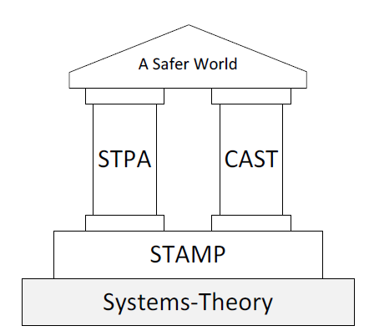
STAMP philosophy (1/2)
Prediction of operational breakdowns for Systems of Systems (SoS)
System-of-System ^{[1], [2]} :
    Operational and Managerial independence of constituent systems
    Evolutionary development process
    Emergent behavior
    Geographical distribution
    Interdisciplinary
    Heterogeneity of the constituent systems
    Network of systems
  Project Management of a Large Research Facility
✓
✓
✓
✓
✓
✓
✓
System-of-System: STAMP should work
STAMP Systems-Theoretic Accident Model and Processes
STPA Systems-Theoretic Process Analysis
CAST Causal Analysis based on STAMP
[1] Maier, M.W. (1998). Architecting principles for System-of-Systems. Syst.-Eng., 1: 267-284
[2] DeLaurentis, D.A. (2008). Understanding Transportation as Sos Problem, in Sos Engineering (ed M.Jamshidi). John Wiley & Sons, Inc., Hoboken, NJ, USA

Slide 4

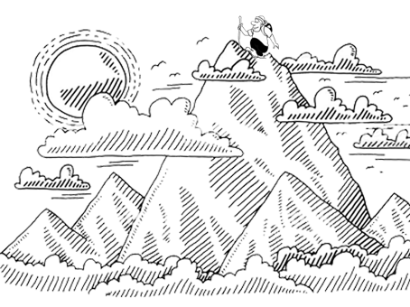
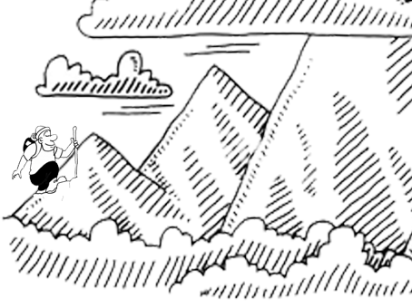
STAMP philosophy (2/2)
“Instead of building analyses on the assumption that accidents are caused by chains of directly related events and that these events occur simultaneously by change, STAMP highlight the fact that accidents occur because systems allow them to occur.”^{[3]}
Paradigm change
According to Einstein: “Progress in science (moving from one paradigm to another) is like climbing a mountain”
Old paradigm
New paradigm
New paradigm includes the old one
[3] F. Asplund, J. El-khoury, M. Törngren. Safety-Guided Design through System-Theoretic Process Analysis, Benefits and Difficulties. KTH Royal Institute of Technilogy, Stockholm, Sweden

Slide 5
Work Plan (1/2)
Selection of two systems:
  A simple system and a SoS
  Systems that have suffered an incident in the past (if possible)
Electrical rack damaged by an animal
Man locked in a MAD
String2
He Leak in the Cryo-line
Crystal collimator, TCSPM
A31L2 magnet exchanged in the LHC
Training quench
…
STPA and classical analysis:
  Comparing both methodologies in two different types of systems
  Would it have been possible to predict these incidents using STAMP methods?
Reliability and availability of both systems in order to understand the process

Slide 6
Work Plan (2/2)
Risk and dependability study on Project Management (PM)
  If we consider PM as a SoS, would it be possible to apply these methods ?
Inputs
Fixed data
Models
Outputs
to optimize
Reliability and availability, including STAMP risk analysis, on PM:
  SoS under analysis: planning, preparation, control and implementation of an LHC long shutdown / particle accelerator installation, etc.
  SoS Mission: completion of all the required tasks within the accepted time and cost
  Mission performance indicators: project delay, over-costs, non-performed activities, injured/casualties, environment damage, etc.
  Events (hazards): interruption of activities, activities delay, incompatible activities, external interruptions, etc.
  Risk mitigation: flexible planning, field monitoring, preventing scheduled maintenance, etc.
  Find a model that makes a planning for a new project or a technical stop more reliable

Slide 7
Thanks for your attention!
Estrella Vergara
evergara@cern.ch

