Slide 1
BI Work Package for LIU IONS
Meeting on LIU and BE/BI activities
CERN

Slide 2
Summary
Instruments covered:
LINAC3:
  Pepper Pot
  Faraday cups
  SEM grids
LEIR ring and LEIR injection lines:
  Orbit measurement system
  BPMs injection lines

Slide 3
Pepper Pot
Pepper Pot ITL: now with enlarged aperture and better signal/noise
Results with beam:
  PP is still aperture restriction in V plane. Beam divergence larger than the beam dynamics models of 3 years ago.
  Successfully emittance reconstruction in some beam conditions. But operation remains tedious, and above all background very high.
Shielding from PP plate to MCP to partially suppress the background has been installed.
Installation foreseen for end of May 2017

Slide 4
Faraday Cups (FC)
    FC ITL: new detector installed: working to specs
FC ITF
  Being designed
  Installation YETS 2017-2018
  20 kCHF
Modification of FC ITM was cancelled

Slide 5
SEM Grids
SEM grids ETL: New electronics to measure injected and extracted beam
  Prototype to be tested on 1 SEM (LEIR) in May
  Modifications to FESA class needed
  10 kCHF
SEM grids ITF, ITH (6 SEMs): change from bands to wires
  Done in EYETS 2016-2017
  15 kCHF
SEM grids ITL/ITM (4 SEMs): request for new wire layout
  Design on going
  Installations YETS 2017-2018
  10 kCHF

Slide 6
BTVs
Screen Replacement of:
ITE.BTV10
  Done during ITE BPM installation 2017
EE.BTV10:
  Done at the same time as IPM installation 2017
ER.BTV12 (PP, EIS):
  Was not replaced, sector not open. Cancelled

Slide 7
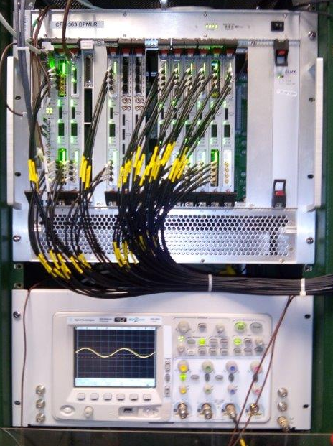
LEIR orbit system
Upgrade digital part of LEIR orbit system
  AD/ELENA electronics
  140 kCHF Specifications (BI/ABP) to be finalised
  Installed in EYETS 2016-2017
  Runs in parallel to existing system
  Switch when happy with new system
  The trajectory part of the firmware and software will be available by summer 2017.

Slide 8
Injection Line BPMs
9 new BPMs ITE, ETL and EI
220 kCHF
ECR document for 2 BPM in ITE line and 2 BPM in EI line: LEI-BPM-EC-0001. Approved.
2 ITE line BPMs installed in EYETS, and have seen first beam. Perturbed by secondary electrons.
Manufacturing of 7 remaining BPMs and supports finished July 2017
Vacuum system design around remaining BPMs will be done during first half of 2017.
Cables for all 9 BPMs pulled
Remaining BPMs to be installed in YETS 2017-2018
Electronics: Not yet clear if digitisers can be recuperated from CTF3

Slide 9
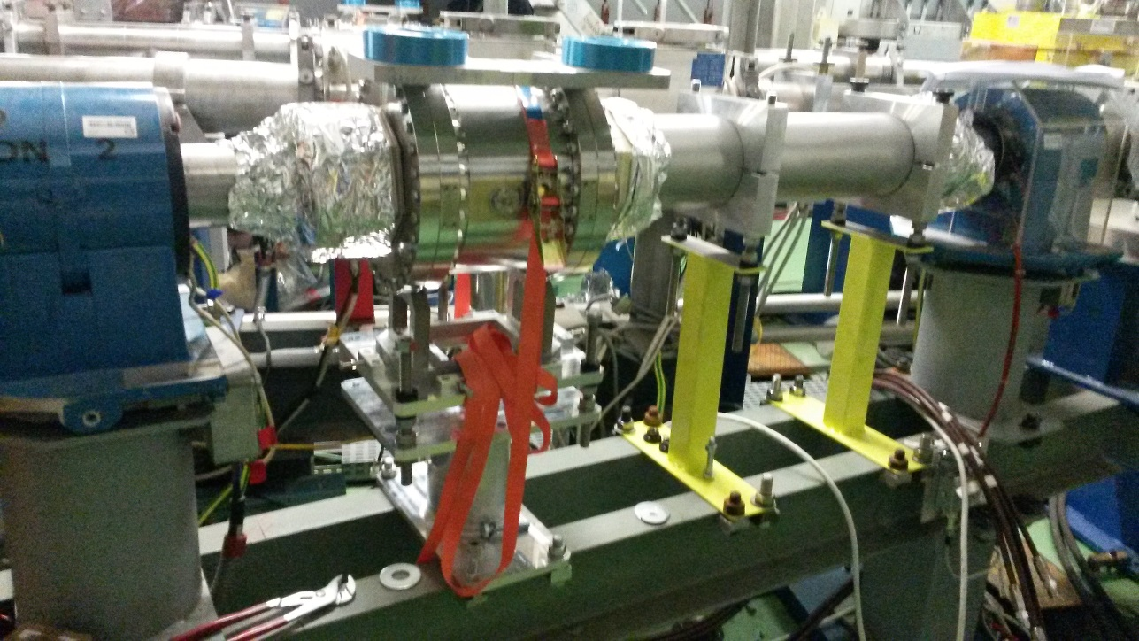
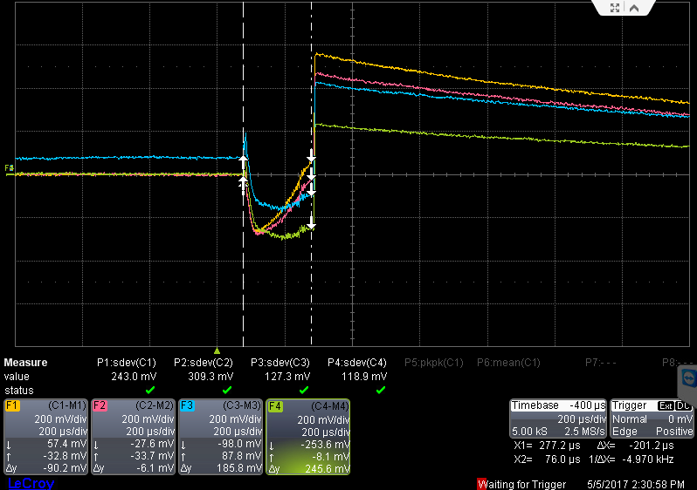
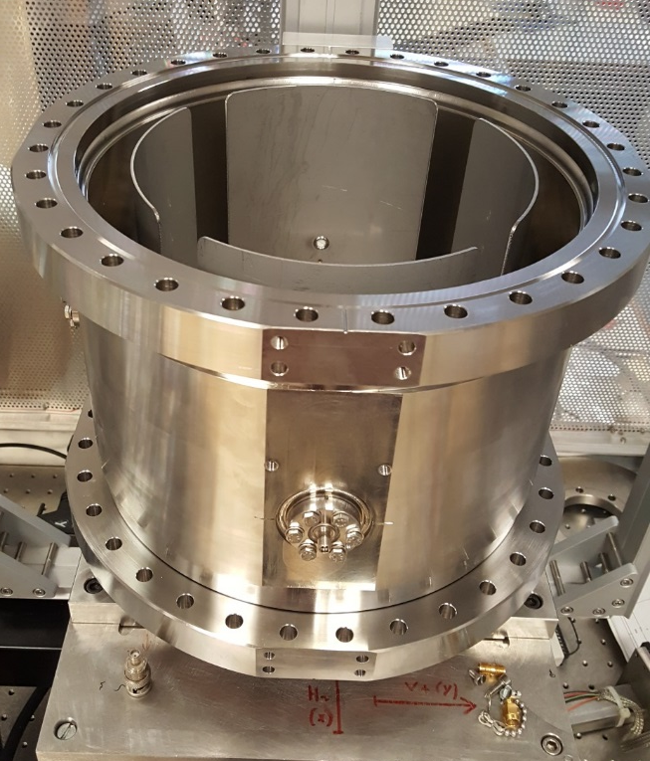
Injection Line BPMs

Slide 10
Summary Spending Profile
 | 2017 kCHF | 2018 kCHF | Code | In PLAN
FC ITF | 20 | - | 64050 | 11197
SEM Grids ITF, ITH | - | - | 64050 | 11196
SEM Grids ITL-ITM | 10 | - | 64050 | 10058
SEM electronics ETL | - | - | 64050 | Not required
Injection line BPMs | 220 | 25 | 64053 | 11119
LEIR orbit system | 32 | - | 64053 | Not required
118k transferred to BI budget beginning of the year
The vacuum chambers (and their supports) to complete vacuum insertions around the pick ups are paid elsewhere (VSC and project) ~50k for 2017
Injection line BPMs (and supports)
  In 2017 130k already committed.
  Another ~40k ++ foreseen from atelier principal.
  ADC’s 35k? + 10k other electronics
  → 215 + kCHF
64050 for 2017: 42% charged, 44% committed
64053 for 2017: 20% charged, 60% committed

Slide 11
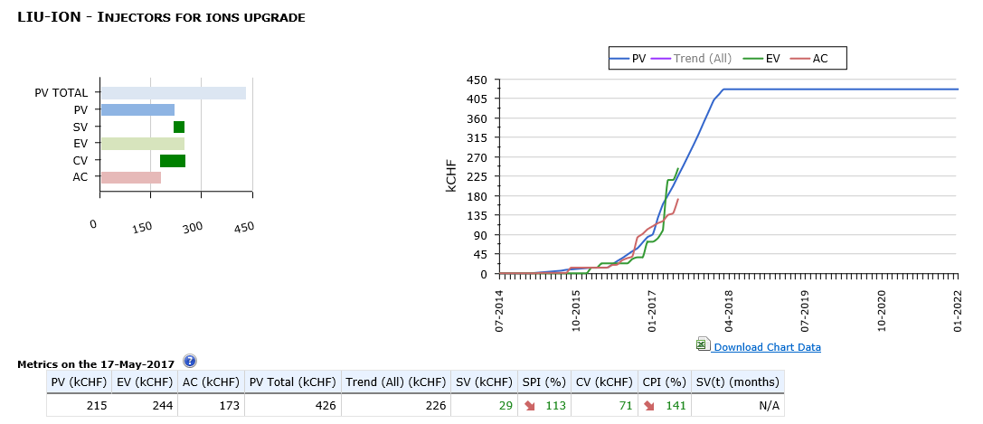
LIU-ION EVM Curves
1.2

Slide 12
LIU Crosstab by Machine
CET objective 1 May
Charges 19%
Commitments 57%

Slide 13
Questions
Confirm that all the specifications are ok:
  ITF FC specifications
  SEM grids Specifications/layout
  LEIR orbit system specifications

Slide 14
END OF PRESENTATION

