Slide 1

BI LIU-PS
Status 2017-LS2
Instrumentation covered:
New Fast Wire-Scanners
BGI
BLM IC
BLM diamond
Injection SEM grid
Ring SEM + Turn by Turn
Injection BTV
Fast BPM in the ring (wide-band pickup)

Slide 2
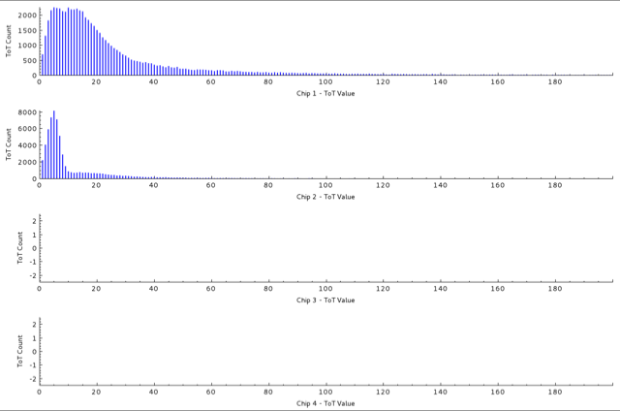
Status
WS: Decission pending
BGI:
  V -> not enough budget left for its construction
  H -> First results obtained
BLM IC: Installed
  System in preparation for tests
BLM diamond: Installed
  Pending connection to the digitizer (power limiters may be needed)
Injection Semgrid: Line in review (W. Bartmann)
  Design drawings indicate the frame may be in the path of the circulating beam
Semgrid txt:
  Electronics in test, plans not changed (tests by the end of the year)
Injection BTV
Fast BPM: Installed
  Digitizer for OASIS acquisition recuperated from a dismantled system (BE/CO). Not charged to BI

