Slide 1

LIU-SPS review for BI
Emphasis:
  Milestones for 2017
Instruments:
  Diamond BLMs
  Fast (ring) BCT
  BSRT
  BGI
  Head-tail
  SPS Orbit and fibres
  SBDS
Budget situation
Conclusion
Lars Jensen
On behalf of the BE/BI Group

Slide 2
Diamond BLMs
LSS1 (new detector installation) (scraper)
  Done:
    Electronics installed and connected
  To do:
    Connect optical fibre (EN-EL)
    Develop and commission software
    System commissioning (Q2/2017)
LSS4, LSS6, UA23, UA87 (existing)
  Done:
    New electronics delivered
  To do:
    Develop and test software
    System commissioning (Q2/2017)

Slide 3
Fast BCT (ECA5)
LSS5 location (existing)
  Done:
    New BCW detector installed (51932)
    New electronics installed
  To do:
    Software development (expert tools)
    System commissioning (Q2/2017)

Slide 4
BSRT (LSS5)
Done:
  Electronics complete for old location
  New location from LS2 (516) agreed (low H dispersion)
  Cost estimates provided (mechanics / optics)
To do:
  Assess performance reach for operational use (2017)
  BI software specifications pending

Slide 5
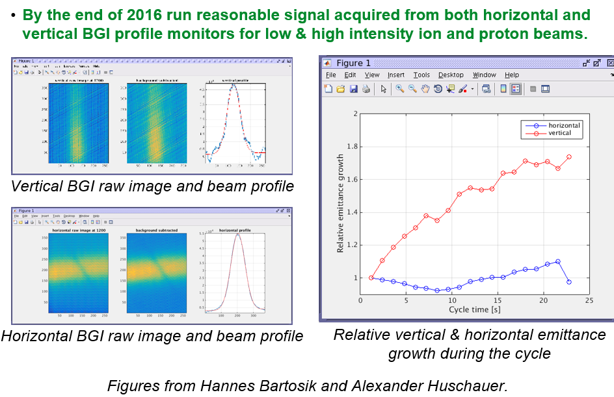
BGI
Done:
  System made much more reliant (radiation)
  Agree on V location from LS2 (detectors and magnets) as per the general SSR (E. Carlier)
To do:
  2017: Performance assessment of SPS BGI systems
    Competing with PS BGI instrument
  2018->LS2
    Make plans for BI HW (consolidation?) and SW
  LS2: Move vertical device to new location with magnets

Slide 6
Head-tail
Done
  Working system for MD users
To come
  Software to be finalised and put into operation (Q3/2017)

Slide 7
Upgrade SPS Orbit (MOPOS)
Done:
  ..
To do:
  Budget review ..

Slide 8
SBDS for BI
Done
  ..
To do
  Decide on beam profile / position (ABT/STI)
  Decide on BLM location

Slide 9
Budget situation
Code description | Code | 2017 | 2018 | 2019
BLM Upgrade (Fast) | 64041
Transverse Profile upgrade (BSRT) | 64042
Transverse diagnostics (H/T) | 64043
BCT upgrades (ring) | 64044
SBDS for BI | 64045
New MOPOS electronics | 64046
Optical fibres | 64724

Slide 10
Conclusions and outlook
..
..
..

