Slide 1
Update of LHCb at High Luminosity
R. De Maria
WP2 Meeting 23/5/2017

Slide 2
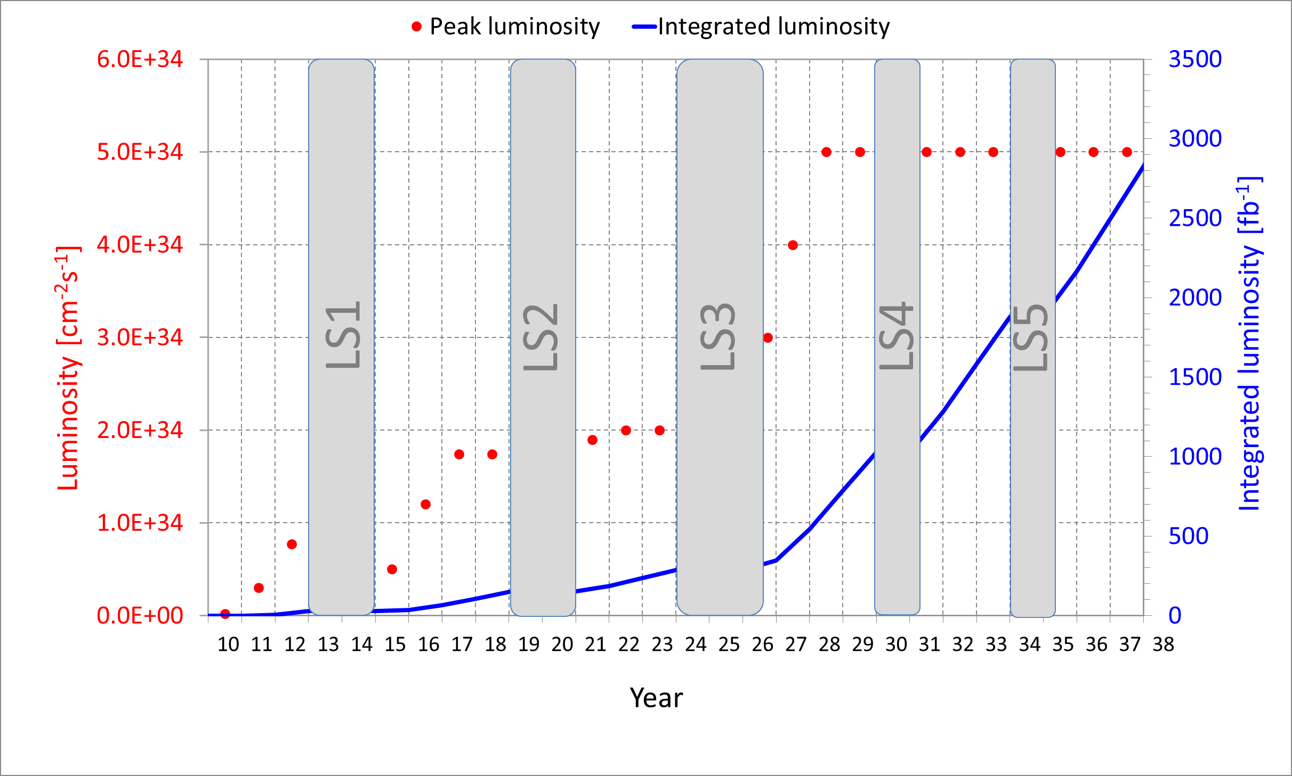
LHCb
 | Run II | Run III | Run IV | Run V-VI
Duration [years] | 3.5 | 3 | 3.5 | 5
L [10³² cm⁻²s⁻¹ ] | 4 | <20 | 20 | 100-200
Int. L [fb⁻¹] | ~8¹⁾ | ?³⁾ | 50²⁾ | 300²⁾
Ppb [10¹¹] | 1.1 | 1.1→2.2 | 2.2 | 2.2
Bunches in IP8 | 2036→ 2378 | 2572 or 2378 | 2572 or 2378 | 2572 or 2378
Emit [µm/γ] | 2.8 | 2.8→2.1 2.5→1.7 | 2.1 or 1.7 | 2.1 or 1.7
¹⁾Assuming 5.8 fb ⁻¹ , 2 fb ⁻¹ in 2016 with 4 10³² cm⁻²s⁻¹ and 2036 bunches, extrapolating to 2378 bunches and same efficiency.
²⁾ target.
³⁾ Scaling in Run IV gives 35 fb ⁻¹, then target in Run III does not need strictly need higher levelled luminosity.
Notes:
2017 2fb-1 at 4e32 for 2036 2572

Slide 3
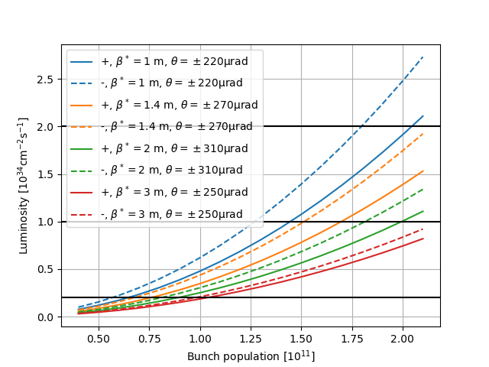
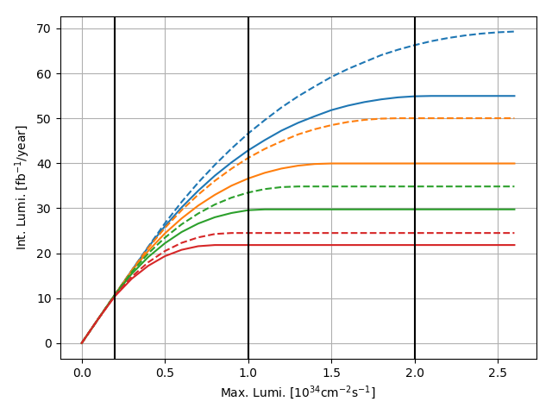
Peak and Integrated luminosity
Estimates for 2.5 µm/γ and 2378 colliding bunches based on scalings from a 250 fb ⁻¹ fill for ATLAS and CMS.
Large impact of spectrometer polarity on luminosity.
Difficult to reach the final target of 300 fb ⁻¹,
unless extending the target of Run IV beyond 50 fb ⁻¹.

Slide 4
Aperture and crossing angle
Horizontal crossing aperture limited by TCDDM (Beam 2) then triplet
Vertical crossing aperture limited by triplet
Crossing angle limited by orbit corrector strength to 310 µrad (with 20 µrad margin and repaired MCBY)
Protected aperture 14.6 σ (best aperture for worst phase advance from MKD)
Maximum crossing angle without or (*) with new TCDDM
β* [m] | H* [µrad] | H [µrad] | V [µrad]
1 | ±220 | ±165 | ±115
1.4 | ±270 | ±220 | ±160
2 | ±310 | ±265 | ±205
3 | ±310 | ±310 | ±250

Slide 5
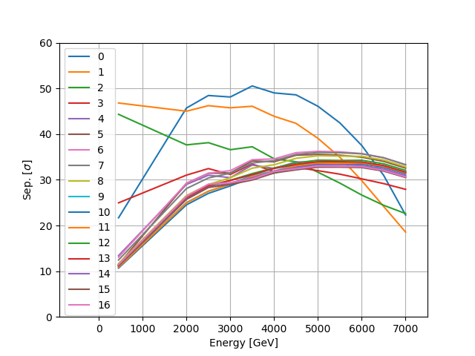
Ramp and squeeze
Present ramp and squeeze:
H Crossing -170 µrad → -250 µrad [0.45 → 7TeV]
V Separation -3.5 mm → -1 mm [2 → 7TeV]
V Angle offset -40 µrad → 0 [2 → 7TeV]
β* 10 m → 3 m [2 → 7TeV]
Most of the LR above 30σ,
Minimum is still about 20σ
Bad polarity

Slide 6
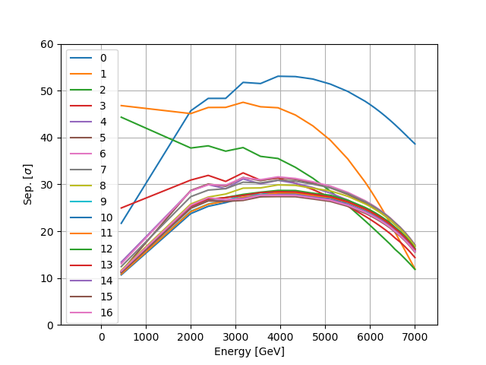
Ramp and squeeze
Pushed case β*=1, ramp and squeeze:
H Crossing -170 µrad → -220 µrad [0.45 → 7TeV]
V Separation -3.5 mm → -1 mm [2 → 7TeV]
V Angle offset -40 µrad → 0 [2 → 7TeV]
β* 10 m → 1 m [2 → 7TeV]
All LR in between 12 and 18 σ
Bad polarity

Slide 7
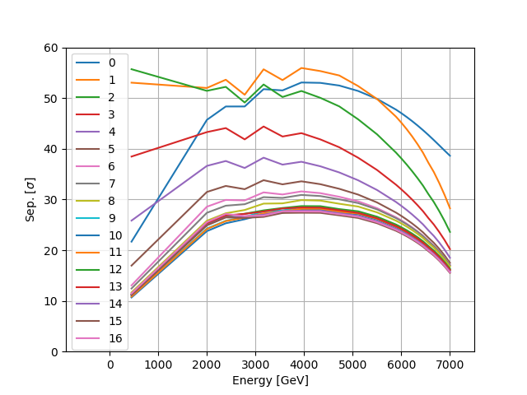
Ramp and squeeze
Pushed case β*=1, ramp and squeeze:
H Crossing -170 µrad → -220 µrad [0.45 → 7TeV]
V Separation -3.5 mm → -1 mm [2 → 7TeV]
V Angle offset -40 µrad → 0 [2 → 7TeV]
β* 10 m → 1 m [2 → 7TeV]
All LR in above 16 σ
Good polarity

Slide 8
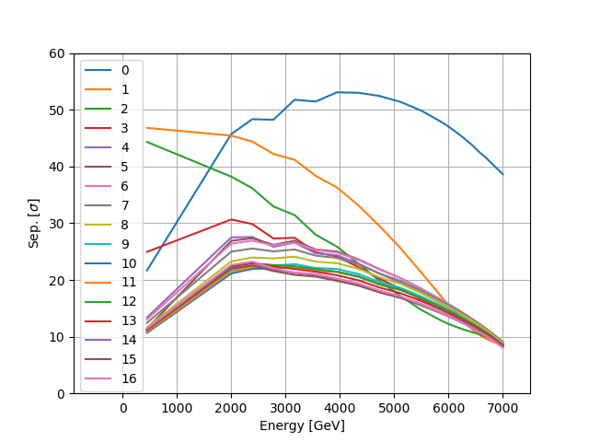
Ramp and squeeze
Vertical crossing β*=1, ramp and squeeze:
Crossing -170 µrad → -115 µrad
Separation -3.5 mm → -0.5 mm [2→7 TeV]
Crossing plane 0 → 90° [from 2→7 TeV]
V Angle offset -40 µrad → 0 [from 2→7 TeV]
β* 10 m → 1 m [from 2→7 TeV]
Previous case required exchange of TCDDM, however now all LR around 10 σ.

Slide 9
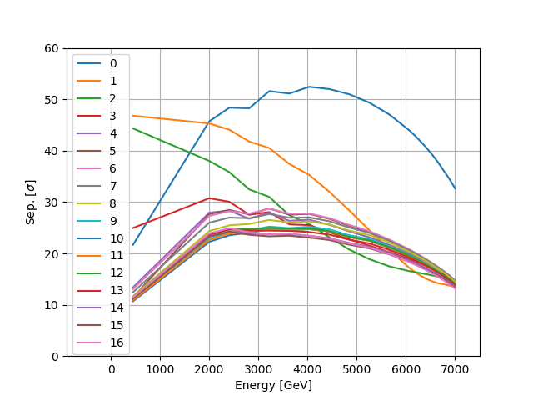
Ramp and squeeze
Vertical crossing β*=1.4, ramp and squeeze:
Crossing -170 µrad → -160 µrad
Separation -3.5 mm → -0.5 mm [2→7 TeV]
Crossing plane 0 → 90° [from 2→7 TeV]
V Angle offset -40 µrad → 0 [from 2→7 TeV]
β* 10 m → 1.4 m [from 2→7 TeV]
Increasing to β*=1.4, put LR to about 14 σ.
Overall vertical crossing does not seem too advantageous.
However one needs to solve the TCDDM problem.

Slide 10
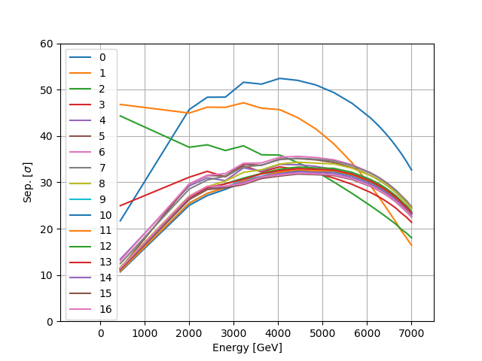
Ramp and squeeze
Pushed case β*=1.4, ramp and squeeze:
H Crossing -170 µrad → -270 µrad [0.45 → 7TeV]
V Separation -3.5 mm → -1 mm [2 → 7TeV]
V Angle offset -40 µrad → 0 [2 → 7TeV]
β* 10 m → 1.4 m [2 → 7TeV]
Most LR above 22 σ.
Assuming new TCDDM.
Bad polarity

Slide 11
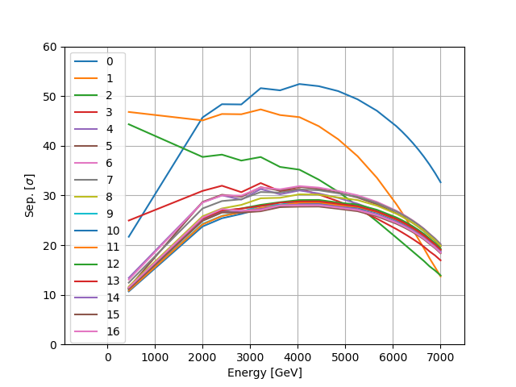
Ramp and squeeze
Pushed case β*=1.4, ramp and squeeze:
H Crossing -170 µrad → -220 µrad [0.45 → 7TeV]
V Separation -3.5 mm → -1 mm [2 → 7TeV]
V Angle offset -40 µrad → 0 [2 → 7TeV]
β* 10 m → 1.4 m [2 → 7TeV]
Most LR above 19 σ.
With present TCDDM.
One could look at flat beams for higher luminosity
Bad polarity

Slide 12
Back-up

Slide 13
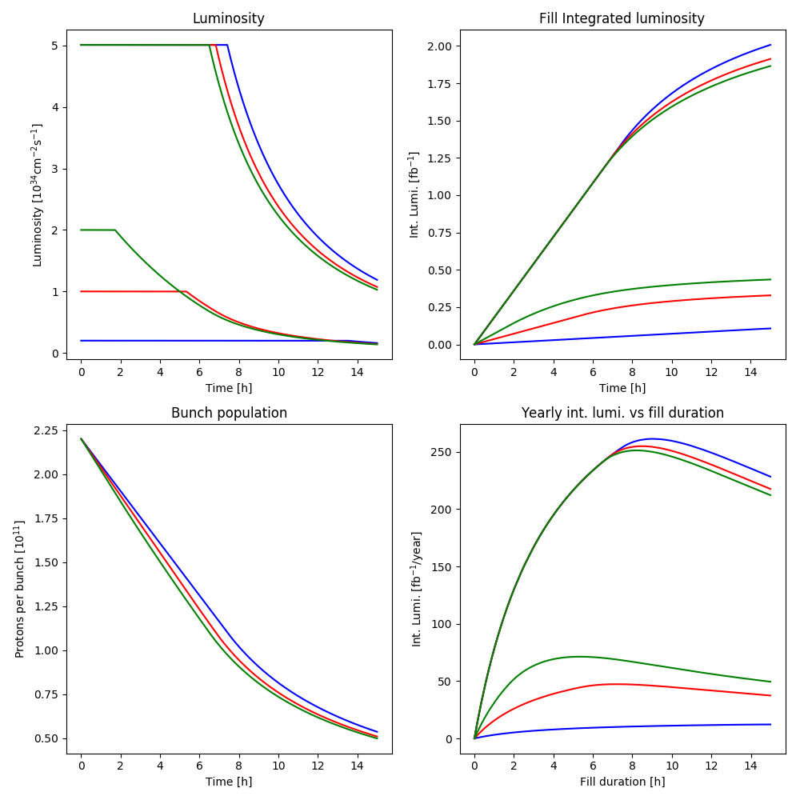
Luminosity scenarios
Scenario with large (2.7 10³⁴ cm⁻²s⁻¹ )IP8 virtual luminosity
Small impact on Atlas/CMS

Slide 14
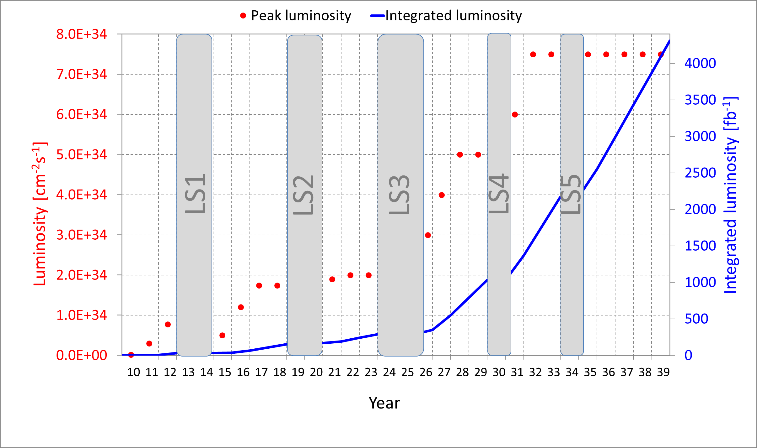
HL-LHC Targets
After LS4, proton physics days increase from standard 160 days to 200 and after LS5 to 220
HL-LHC: mid 2026 to end 2039 after LS4
Reach ≥ 3000 fb⁻¹ by
  Maximize availability, levelled luminosity per bunch, number of bunches, bunch population, brightness.
  Crab-cavities to alleviate geometric reduction factor to small β* and long bunches and pile-up density.

Slide 15
Injector Brightness and LHC Filling Schemes
Production scheme | ppb [10¹¹] | ε [μm] | Inj. | BPI | Colliding 1,5/2/8
Standard | 1.3→2.3 | 2.8→2.1 | 13 | 288 | 2748/2494/2572
BCMS | 1.3→2.3 | 2.5→1.7 | 20 | 144 | 2544/2205/2308
 |  |  | 12 | 288 | 2736/2258/2378
8b+4e STD | 1.6→2.5 | 2.4→2.1 | 13 | 144 | 1960/1163/1806*
8b+4e BCMS | 1.6→2.5 | 1.2→1.8 | 20 | 96 | 1696/1470/1538*
80b | 1.3→2.3 | 1.3→2.1 | 14 | 240 | 2732/2476/2549
 |  |  | 12 | 320 | 2800/2246/2606
50 ns | 1.8 | 1.8 | 13 | 144 | 1374/1247/1286
Single | >3.0 | >1.5 | n/a | 1 | n/a
RunII → HL-LHC
*scaling
New scheme thanks to 200 ns rise time, BCMS very close to standard for IP1/5.
288bpi BCMS and 320bpi 80b cannot be tested in Run II due to transfer line limitations.
Will always short non-colliding train be needed, can they at least collide?
H. Bartosik, G. Iadarola, X. Buffat, C. Schwick

Slide 16
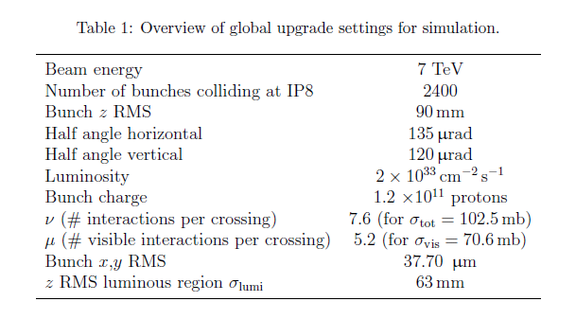
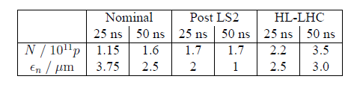
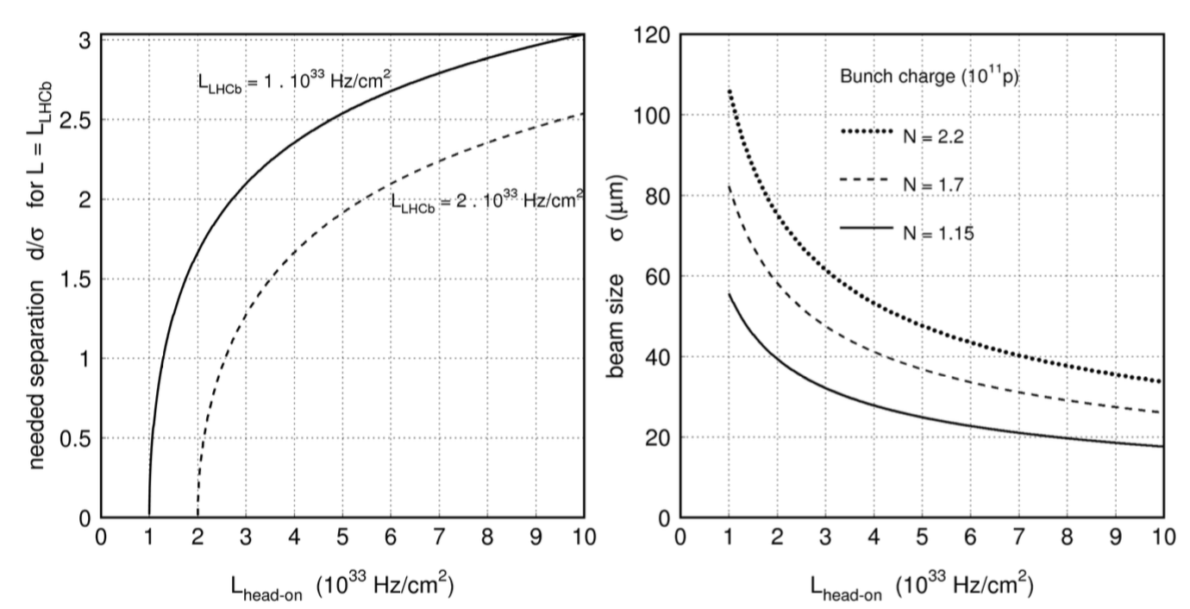
Velo upgrade references
2013, Velo TDR
LHCb Tracker Upgrade TDR
20/7/2014, Velo Approval
M. Giovannozzi, Velo aperture, 9th TREX 5/11/2015
R. Appleby et, al, VELO aperture considerations for the LHCb Upgrade, CERN-ATS-Note-2012-101
Neglects crossing angle effects, assume levelling but also 1.7 10¹¹ for run III

