Slide 1
News from beam-beam SixTrack development
J. Barranco, R. De Maria, L. Deniau, G. Iadarola,
D. Pellegrini, K. Sjobak, I. Shreyber
Thanks to G. Arduini, D. Banfi, S. Fartoukh, M. Giovannozzi, E. Metral, Y. Papaphilippou, T. Pieloni for discussions
WP2 meeting 23/5/2017

Slide 2
Beam-beam kick recap.
Strong beam is sliced in both 4D and 6D model according to the longitudinal charge distributions and centroid positions
4D uncoupled beam-beam kick uses d_{x}, d_{y}, Σ_{xx}, Σ_{yy} to calculate the kick in Δp_{x,y} for each weak particle
6D beam-beam effects are introduced by the Synchro beam mapping such that
  Δp_{x,y} is calculated for the d_{x}, d_{y}, Σ_{xx}, Σ_{yy} at the effective interaction point using (ct, p_{x}, p_{y}, Σ) at the reference IP
  a Δp_{t} (emerging from the ct dependence) is also applied
  with crossing angle a translation, rotation and a boost change the reference frame in which <p_{x,y}>, X,Y, P_{x,y} = 0
With coupling the uncoupled form is used in a rotated frame (ct dependent for the 6D kick)
1976, "Potential of a Three-Dimensional Gaussian Bunch", S. Kheifets, PETRA Note 119, 3D electric potential
1980, Closed expression for the electrical field of a two-dimensional Gaussian charge, M. Bassetti, A. Erskine, CERN-ISR-TH-80-06; 4D beam beam kick
1992, A Symplectic Beam-Beam Interaction with Energy Change, K. Hirata, F. Ruggiero, SLAC-PUB-10055, KEK Preprint 92-117; Synchro beam mapping (SBM) for head-on beam-beam effects.
1994, Don’t Be Afraid of Beam-Beam Interactions With a Large Crossing angle, K. Hirata. SBM with crossing angle
2001, 6D Beam-Beam Kick including Coupled Motion, L.H.A. Leunissen, F. Schmidt,G. Ripken; SBM with crossing angle and coupling

Slide 3
Options in Standard SixTrack BB interface
lhc=0, uses as input:
  position of the strong beam w.r.t the weak beam
  Σ_{xx}, Σ_{yy} and other Σ elements are calculated from the weak beam optics
  slicing is computed internally using as input number of slices, crossing angle (xang), and slices slope (xstr) [1];
lhc=1, as before but inverting x with y;
lhc=2, as lhc=1:
  Σ_{xx}, Σ_{yy} are taken as input in fort.2 (generated by MadX from the values created by the beam-beam macros)
  other elements of Σ are computed like lhc=1;
[1] J. Barranco, On-going SixTrack code development, 30/5/2013, LHC-Beam-beam meeting

Slide 4
6D Beam-Beam in SixTrack
Timeline:
1996 6D kick BCC code from Hirata
2000 6D code in SixTrack with coupling (coupling not used in production)
9/2/2011 lhc=2 option introduced by E. Laface for flat beam with 4D lenses
30/12/2013 lhc=2 fix for 6D and phi2 for effective crab angle by J. Barranco for 6D
24/3/2014 discussion and decision to change 6D interface to fix 6D issues:go on with previous fix in the short term, then implement general solution
11/5/2014 lhc=2 option in SixTrack release for Boinc
11/9/2015 sigma matrix calculation in MadX requested
24/9/2015 last test/code/manual sent by Javier and reviewed/integrated by Kyrre
12/4/2017 MadX production release with sigma matrix calculation available
19/4/2017 Javier code merged with new expert interface merged by Kyrre and Riccardo
10/3/2017 Gianni started verifying equations from papers and code,
bug in 6D boost identified and fixed by Gianni and merged by Riccardo,
likely bug in coupling angle sign and other numerical issues under investigations
5/5/2017 beam-beam macro beam being adapted by Dario
5/5/2017 bug in sigma matrix calculation identified by Dario and corrected by Irina
17/5/2017 impact of boosti bug assessed with a tune scan by Dario
17/5/2017 macro completed and mask updated and tested in SixDesk (studies on going) by Dario

Slide 5
Generalization of the interface
Needed to simulate in 6D:
  flat optics without relying on weak optics information
  crab crossing or other complex strong charge distributions
  dynamic effects like separation collapse or strong orbit noise using DYNK (to do)

Slide 6
EXPERT interface
Position of the strong beam w.r.t the weak beam, Σ elements, crossing angle are taken as input and completely decoupled from weak beam.
1-slice 6D element supported to allow arbitrary longitudinal distribution and crab crossing with RF curvature via external slicing
No special slice slope angle
New developments from release 4.6.16: [1]
Standard and Expert method produces same results
Standard and Expert interface now coexists and Expert input format is generated by SixTrack
[1] K. Sobjak, https://github.com/SixTrack/SixTrack/pull/246

Slide 7
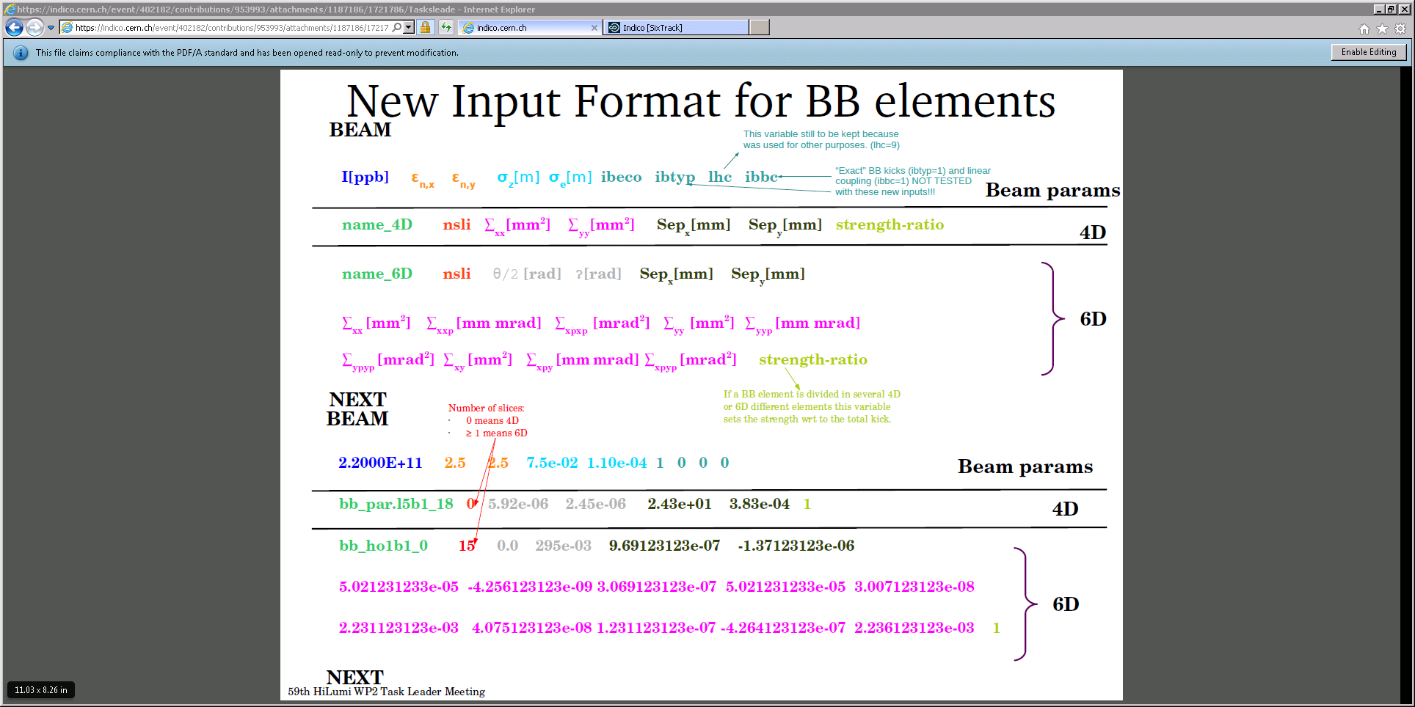
J. Barranco, Status of new input definition of the beam-beam lens in SixTrack,
13/11/2015, 59th WP2 meeting

Slide 8
EXPERT interface (example)
Standard
bb_ho5b1_0 20 9.111827660e-07 -1.350224489e-06 1.000000000e+00 5.026457379e-05 5.026457406e-05 0.000000000e+00
bb_ho1b1_0 20 9.669766338e-07 -1.378612898e-06 1.000000000e+00 5.026457379e-05 5.026457406e-05 0.000000000e+00
BEAM
2.2000e+11 2.5 2.5 7.5000e-02 1.1000e-04 1 0 0 0
bb_ho5b1_0 15 295e-6 0.0 295e-6
bb_ho1b1_0 15 295e-6 1.57 295e-6
NEXT
Expert
bb_ho5b1_0 20 0.000000000e+00 0.000000000e+00 0.000000000e+00 0.000000000e+00 0.000000000e+00 0.000000000e+00
bb_ho1b1_0 20 0.000000000e+00 0.000000000e+00 0.000000000e+00 0.000000000e+00 0.000000000e+00 0.000000000e+00
BEAM
EXPERT
2.2000e+11 2.5 2.5 7.5000e-02 1.1000e-04 1 0 0 0
bb_ho5b1_0 15 2.9500000000001e-004 0.0000000000000e+000 9.1118276600001e-007 -1.3502244890000e-006
5.0034903462428e-005 -9.593556151459e-008 2.24428543738e-003 5.021051982892e-005 7.5280318127904e-007
2.2365333052480e-003 -1.663390341512e-009 -1.5308153223e-009 7.342199089562e-010 -6.517402396885e-009 1.000
bb_ho1b1_0 15 2.9500000000001e-004 1.5700000000001e+000 9.66976633800002e-007 -1.3786128980000e-006
5.0520079639196e-005 -6.010182490910e-007 2.22276103671e-003 5.028688389602e-005 7.7037643894229e-007
2.2330903791604e-003 -3.652801218428e-009 2.66101452881e-008 3.638680415249e-008 1.1594595769731e-007 1.000
NEXT
Expert input is also written by SixTrack in the standard output

Slide 9
Update beam-beam macros
Former 4D beam-beam MadX macros from Stephane now write in the mask SixTrack Expert input by computing missing Σ-matrix elements for each slice
  centroid with crab effects and Σ_{11,33} were already computed
  first sanity checks shows good agreement with previous models (cannot be reproduced fully because they were inconsistent)
  Test on full studies on-going
  Tracking with Beam 4 under investigation
mad/six mad sixtrack
sig11 1.00000002447 0.002246565358 0.00224656530302
sig12 1.00000002437 0.0001498270964 0.000149827092749
sig22 0.999999999265 6.00464297e-05 6.00464297441e-05
sig33 0.999999994158 0.01125155011 0.0112515501757
sig34 0.999999994116 -0.0007503841707 -0.000750384175115
sig44 0.999999999041 6.003852509e-05 6.00385251476e-05
sig13 1.00000001226 0.0001896193048 0.000189619302476
sig14 1.00000001153 -1.264601973e-05 -1.26460195841e-05
sig23 1.00000001153 1.264601973e-05 1.26460195842e-05
sig24 1.00000001202 -1.686933683e-06 -1.68693366273e-06
Mad vs SixTrack
Sigma matrix calculations

Slide 10
Differences old to new macros
Old macros for 6D
Σ_{11,33} and x_{B2},y_{B2} computed from an ideal machine
x_{B1},y_{B1} add from imperfect orbit by MadX
Crossing angle input manually
Σ_{12,22,34,44,13,14,23,24,34} computed by Sixtrack based B1 optics
Σ_{13,14,23,24,34} discarded
New macros for 6D
Σ_{full} for and x,px,y,py for B1,2 computed from an ideal machine in MadX
Σ_{13,14,23,24,34} discarded pending verifications
Input for Beam 1
Beam 4 possible (under development)

Slide 11
Review of the the 6D beam-beam routines
(Is the physics implemented correctly?)

Slide 12
Review of the 6D beam-beam routines
Addressing two questions:
What is the code supposed to do?
  Mathematical derivation of the implemented numerical model
Is the code doing what it is supposed to do?
  Verify the implementation of the above numerical model

Slide 13
Mathematical derivation
The code implements the Synchro Beam Mapping in the presence of:
Crossing angle (φ)
Arbitrary crossing plane (α)
Optics at the IP described by a general 4D correlation matrix (Σ-matrix) → hour glass effect, elliptic beams, alphas, and linear coupling at the IP are included in the modeling)
This makes the mathematical derivation quite heavy
Implementation in Sixtrack in largely based on:
6D Beam-Beam Kick including Coupled Motion, L.H.A. Leunissen, F. Schmidt, G. Ripken, 2001
… but important parts (e.g. inverse boost, “optics de-coupling” including longitudinal derivatives) are not reported in the paper nor anywhere else, to our best knowledge…

Slide 14
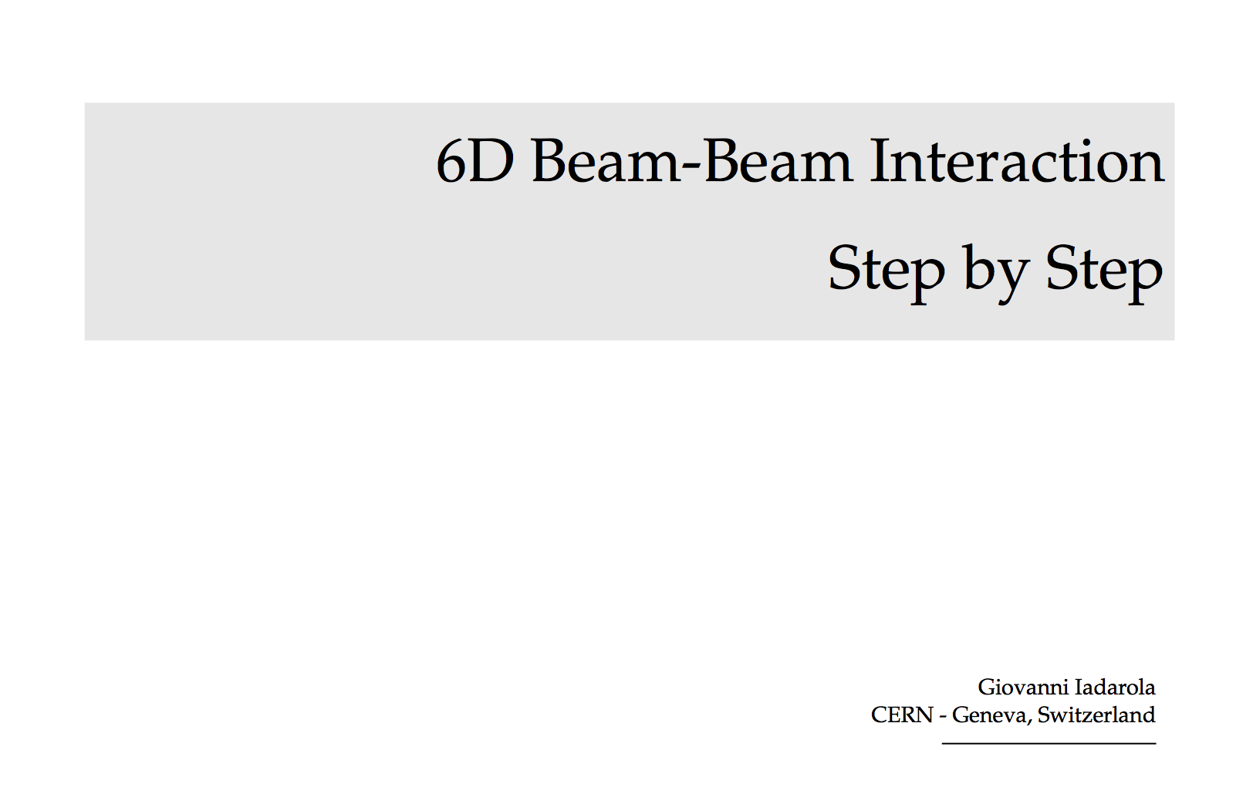
Mathematical derivation
Invested some time in understanding and re-constructing the mathematical treatment trying to use as little as possible the source code as a reference
  Independent reconstruction of the equations to verify the implementation in Sixtrack and to be used as a basis for a modern implementation (GPU compatible, for example)
  Parts not available in literature (mainly inverse Lorentz boost, and a large fraction of the coupling treatment) had to be re-derived
Drafted a document including the full set of equation to enable a possible re-implementation (and avoid that somebody has to redo the same exercise in ten years)
DRAFT

Slide 15
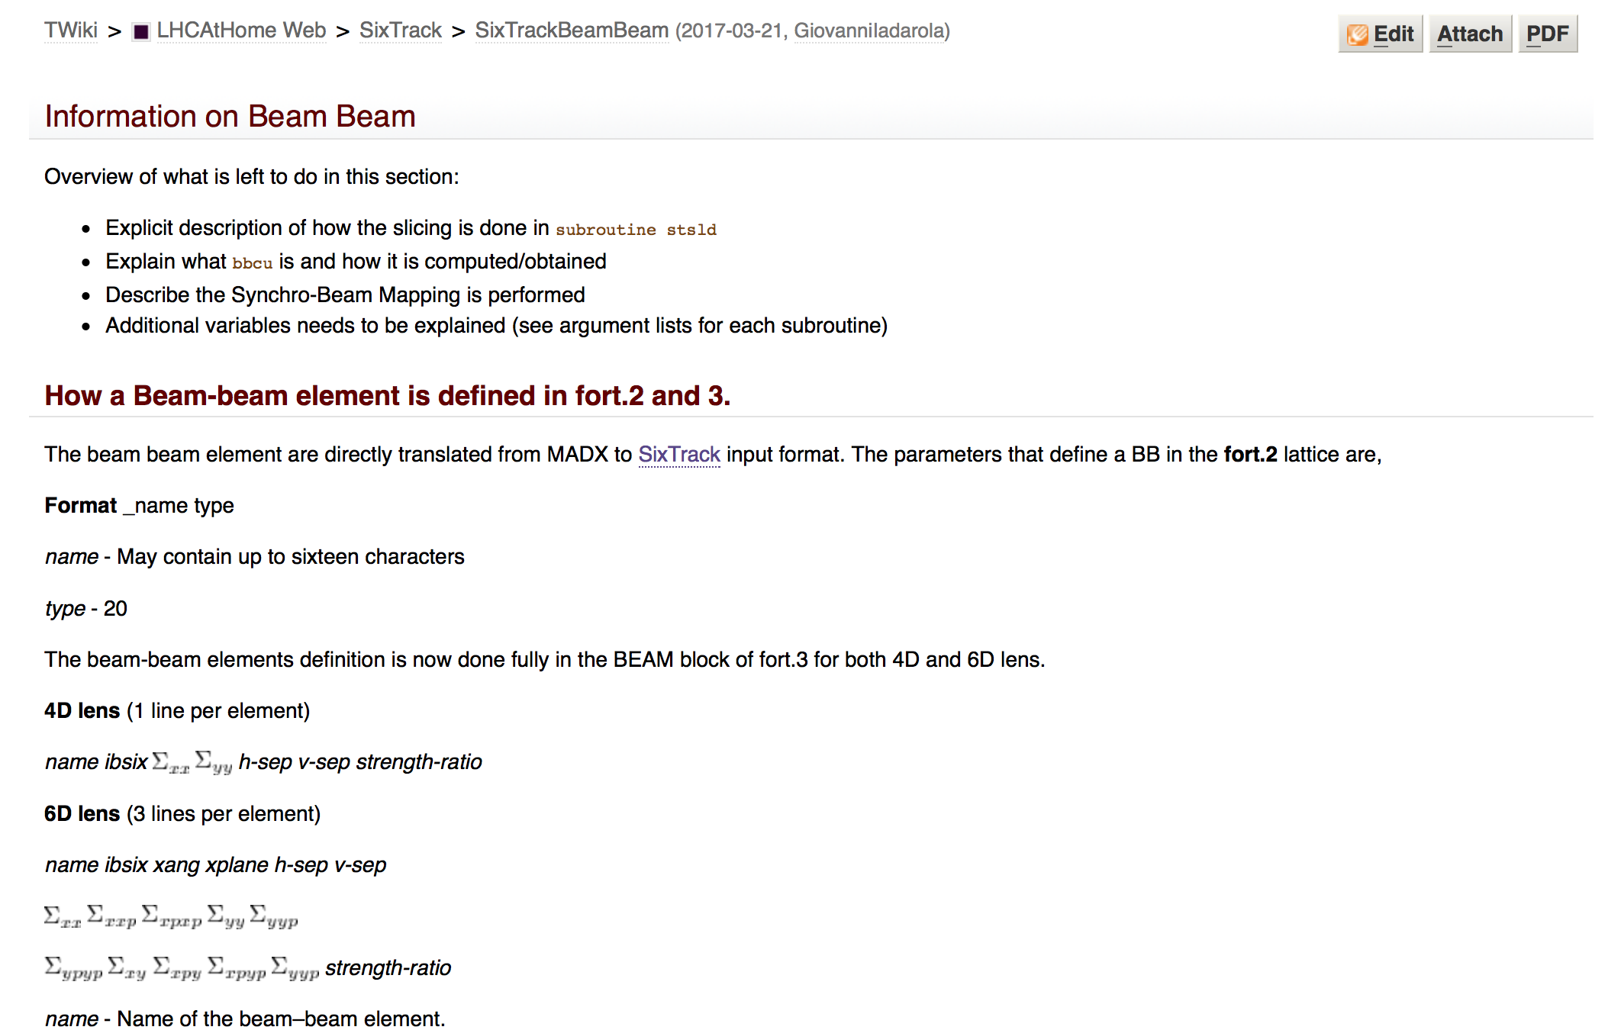
Verification of the implementation
Started from previous work done by J. Barranco
  Identified and described the interface of the main functional blocks
  Built tables with the descriptions of the cumbersome notation used in the code
Moved to the understanding and testing of the source code…

Slide 16
Verification of the implementation
Very difficult to identify problems by using the full tracking simulations
  Need to test the single routine “on the bench”
Procedure being performed for each functional block
  Built a quick C/python implementation from the equations in the document
  Extracted the corresponding sixtrack source code and compiled as of a stand-alone python module (f2py)
  “Stress test” performed on the two: consistency checks, comparison against each other

Slide 17
Verification of the implementation
Present status of the verification for the different functional blocks:
Module | Tests performed | Outcome
Boost/anti-boost | Comparison Sixtrack vs C/python routine Checked that the two cancel each other | Bug identified and corrected
Beam-beam forces (with potential derivatives w.r.t. sigmas) | Comparison sixtrack vs C/python routine Force compared against Finite Difference Poisson solved (PyPIC) Other derivatives compared against numerical integration/derivation | All checks passed
Beam shape propagation and coupling treatment | Comparison Sixtrack vs C/python routine Comparison against MAD for a coupled beam line Crosscheck with numerical derivation | Ongoing: Uncoupled beams look OK Coupling under investigation: different problems already identified
Computation of the kicks | Still to be tested | Still to be tested
Slicing | Still to be tested | Still to be tested
Complete review to be presented later this year

Slide 18
Problem in the inverse boost
Problem identified with “bench-test” (large crossing angle, test particle very off momentum and large px, py)
Boost and anti-boost should cancel each other exactly
Error after boost + anti-boost
Python test routine
x 4.3e-19
px 0.0
y 4.3e-19
py 3.e3-17
sigma 0.0
delta 1e-16
SixTrack routine
x 6.5e-19
px 0.065
y 4.3e-19
py 0.027
sigma 0.0
delta 2.0e-17

Slide 19

Problem in the inverse boost
Problem identified with “bench-test” (large crossing angle, test particle very off momentum and large px, py)
Boost and anti-boost should cancel each other exactly
Discrepancy found between in the anti-boost between derived equations and SixTrack source code:
TRACK(2)=(TRACK(2)+CALPHA*SPHI*H1)*CPHI
TRACK(4)=(TRACK(4)+SALPHA*SPHI*H1)*CPHI
The lines should be:
TRACK(2)=(TRACK(2)*CPHI+CALPHA*TPHI*H1)
TRACK(4)=(TRACK(4)*CPHI+SALPHA*TPHI*H1)
Digging a bit we found out that the issue was already present in Hirata’s code from 1996, on which the Sixtrack implementation is based

Slide 20
Problem in the inverse boost
Problem identified with “bench-test” (large crossing angle, test particle very off momentum and large px, py)
Boost and anti-boost should cancel each other exactly
Error after boost + anti-boost
Python test routine
x 4.3e-19
px 0.0
y 4.3e-19
py 3.e3-17
sigma 0.0
delta 1e-16
SixTrack routine
x 6.5e-19
px 0.065
y 4.3e-19
py 0.027
sigma 0.0
delta 2.0e-17
SixTrack corrected
x 6.5e-19
px 5.55e-17
y 4.3e-19
py 0.1e-19
sigma 0.0
delta 2.0e-17

Slide 21
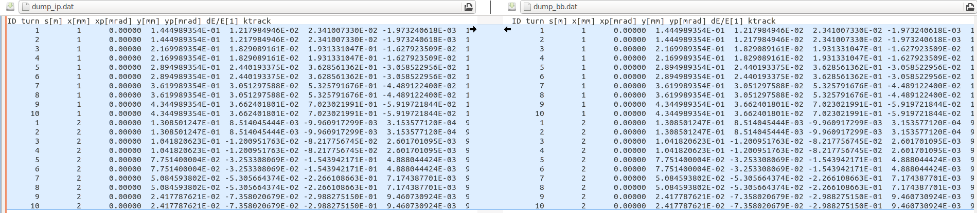
Problem in the inverse boost
Problem confirmed by Riccardo simulating a beam-beam interaction with zero intensity in the strong beam
Original implementation
Coordinates before interaction
Coordinates after interaction
Corrected implementation
Coordinates before interaction
Coordinates after interaction

Slide 22
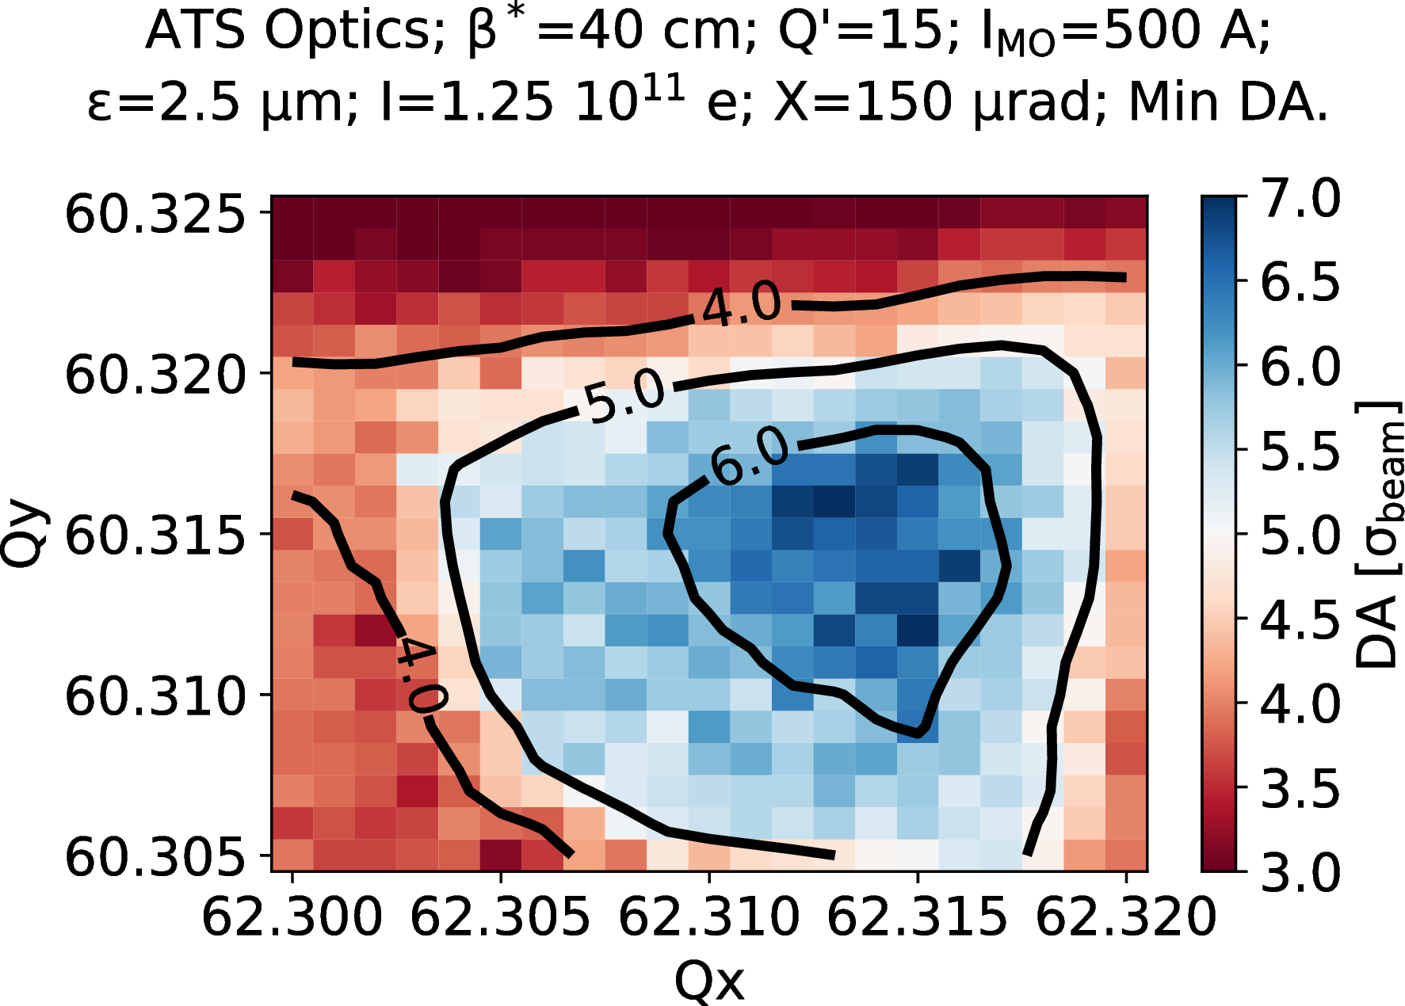
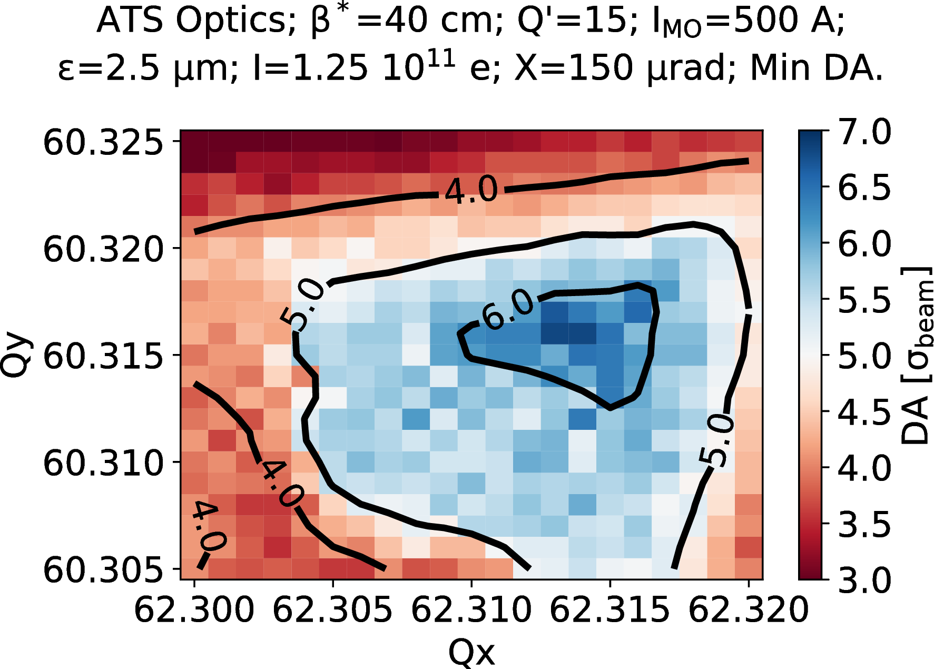
Problem in the inverse boost
Impact on realistic simulation study assessed by Dario
Tune scans comparison with 2017 ATS optics show no dramatic change, but slightly worse DA
Old version
Corrected version

