Slide 1
Issue tracking
Keeping track of tasks, bugs, etc
  Dump thoughts so that they’re not forgotten
  “Client” reports/requests
  Monitor progress
  Manage, prioritise and assign tasks
  Traceability
  Integrated with code commits (Atlassian tools)
  Documentation
@ CERN -> JIRA

Slide 2
Agile methodologies
SCRUM
  Very focused team work
  Takes a fair amount of resources
  Sprints of ~2 weeks max
  Each sprint has a dedicated backlog
  Careful planning (breakdown of tasks/stories and estimation of required resources)
  By the book? -> stand-up meetings every day

Slide 3
Agile methodologies
KANBAN
  Essentially a ToDo list
  Divided in columns according to progress

Slide 4
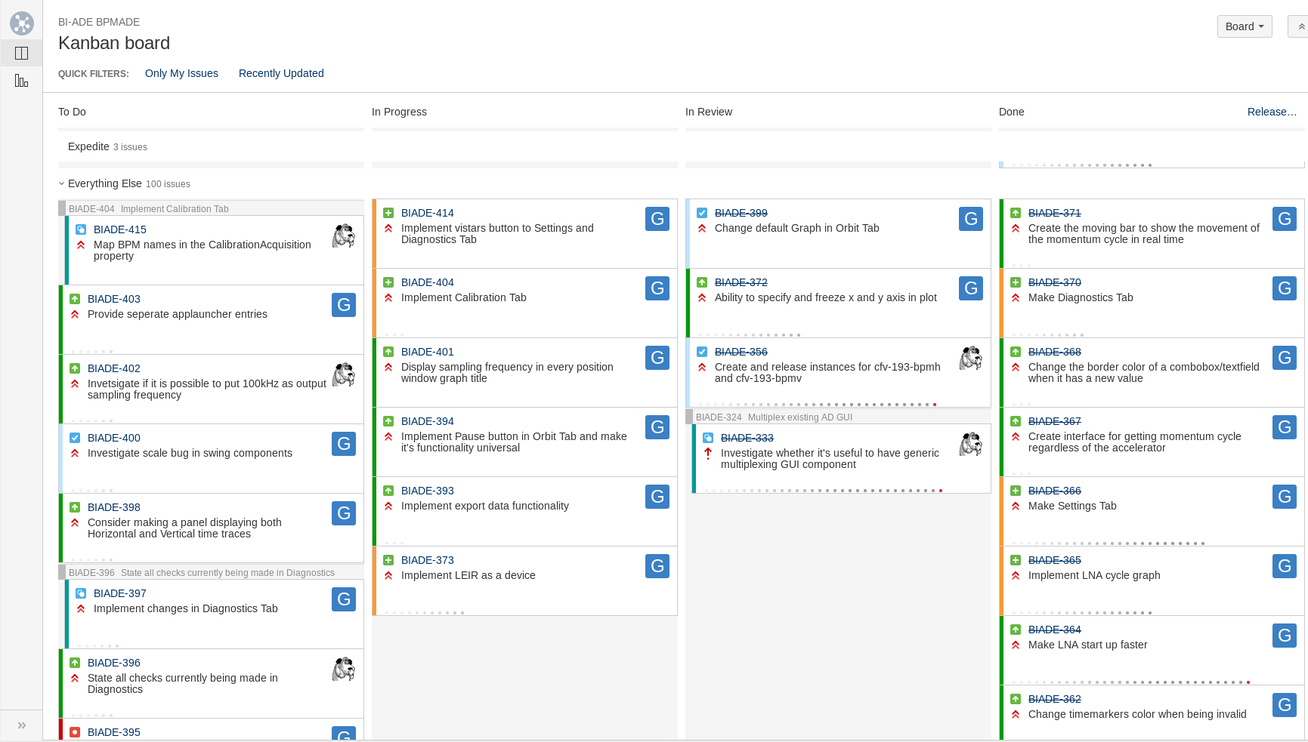
Agile methodologies

Slide 5
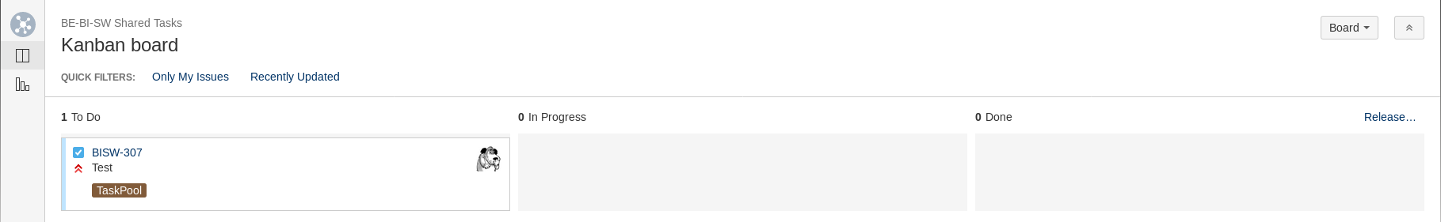
Collaborative working proposal
Pool of self contained tasks
Spread knowledge
Encourage collaborations (e.g. code reviews)
Light-weight Kanban board
Informal weekly meeting over coffee
HowTo? Create issues with EPIC = TaskPool

