Slide 2

LHC and non-LHC beams in the LHC injector complex after LIU
H. Bartosik and G. Rumolo
CERN, LIU beam parameter meeting, 26 May 2017

Slide 3
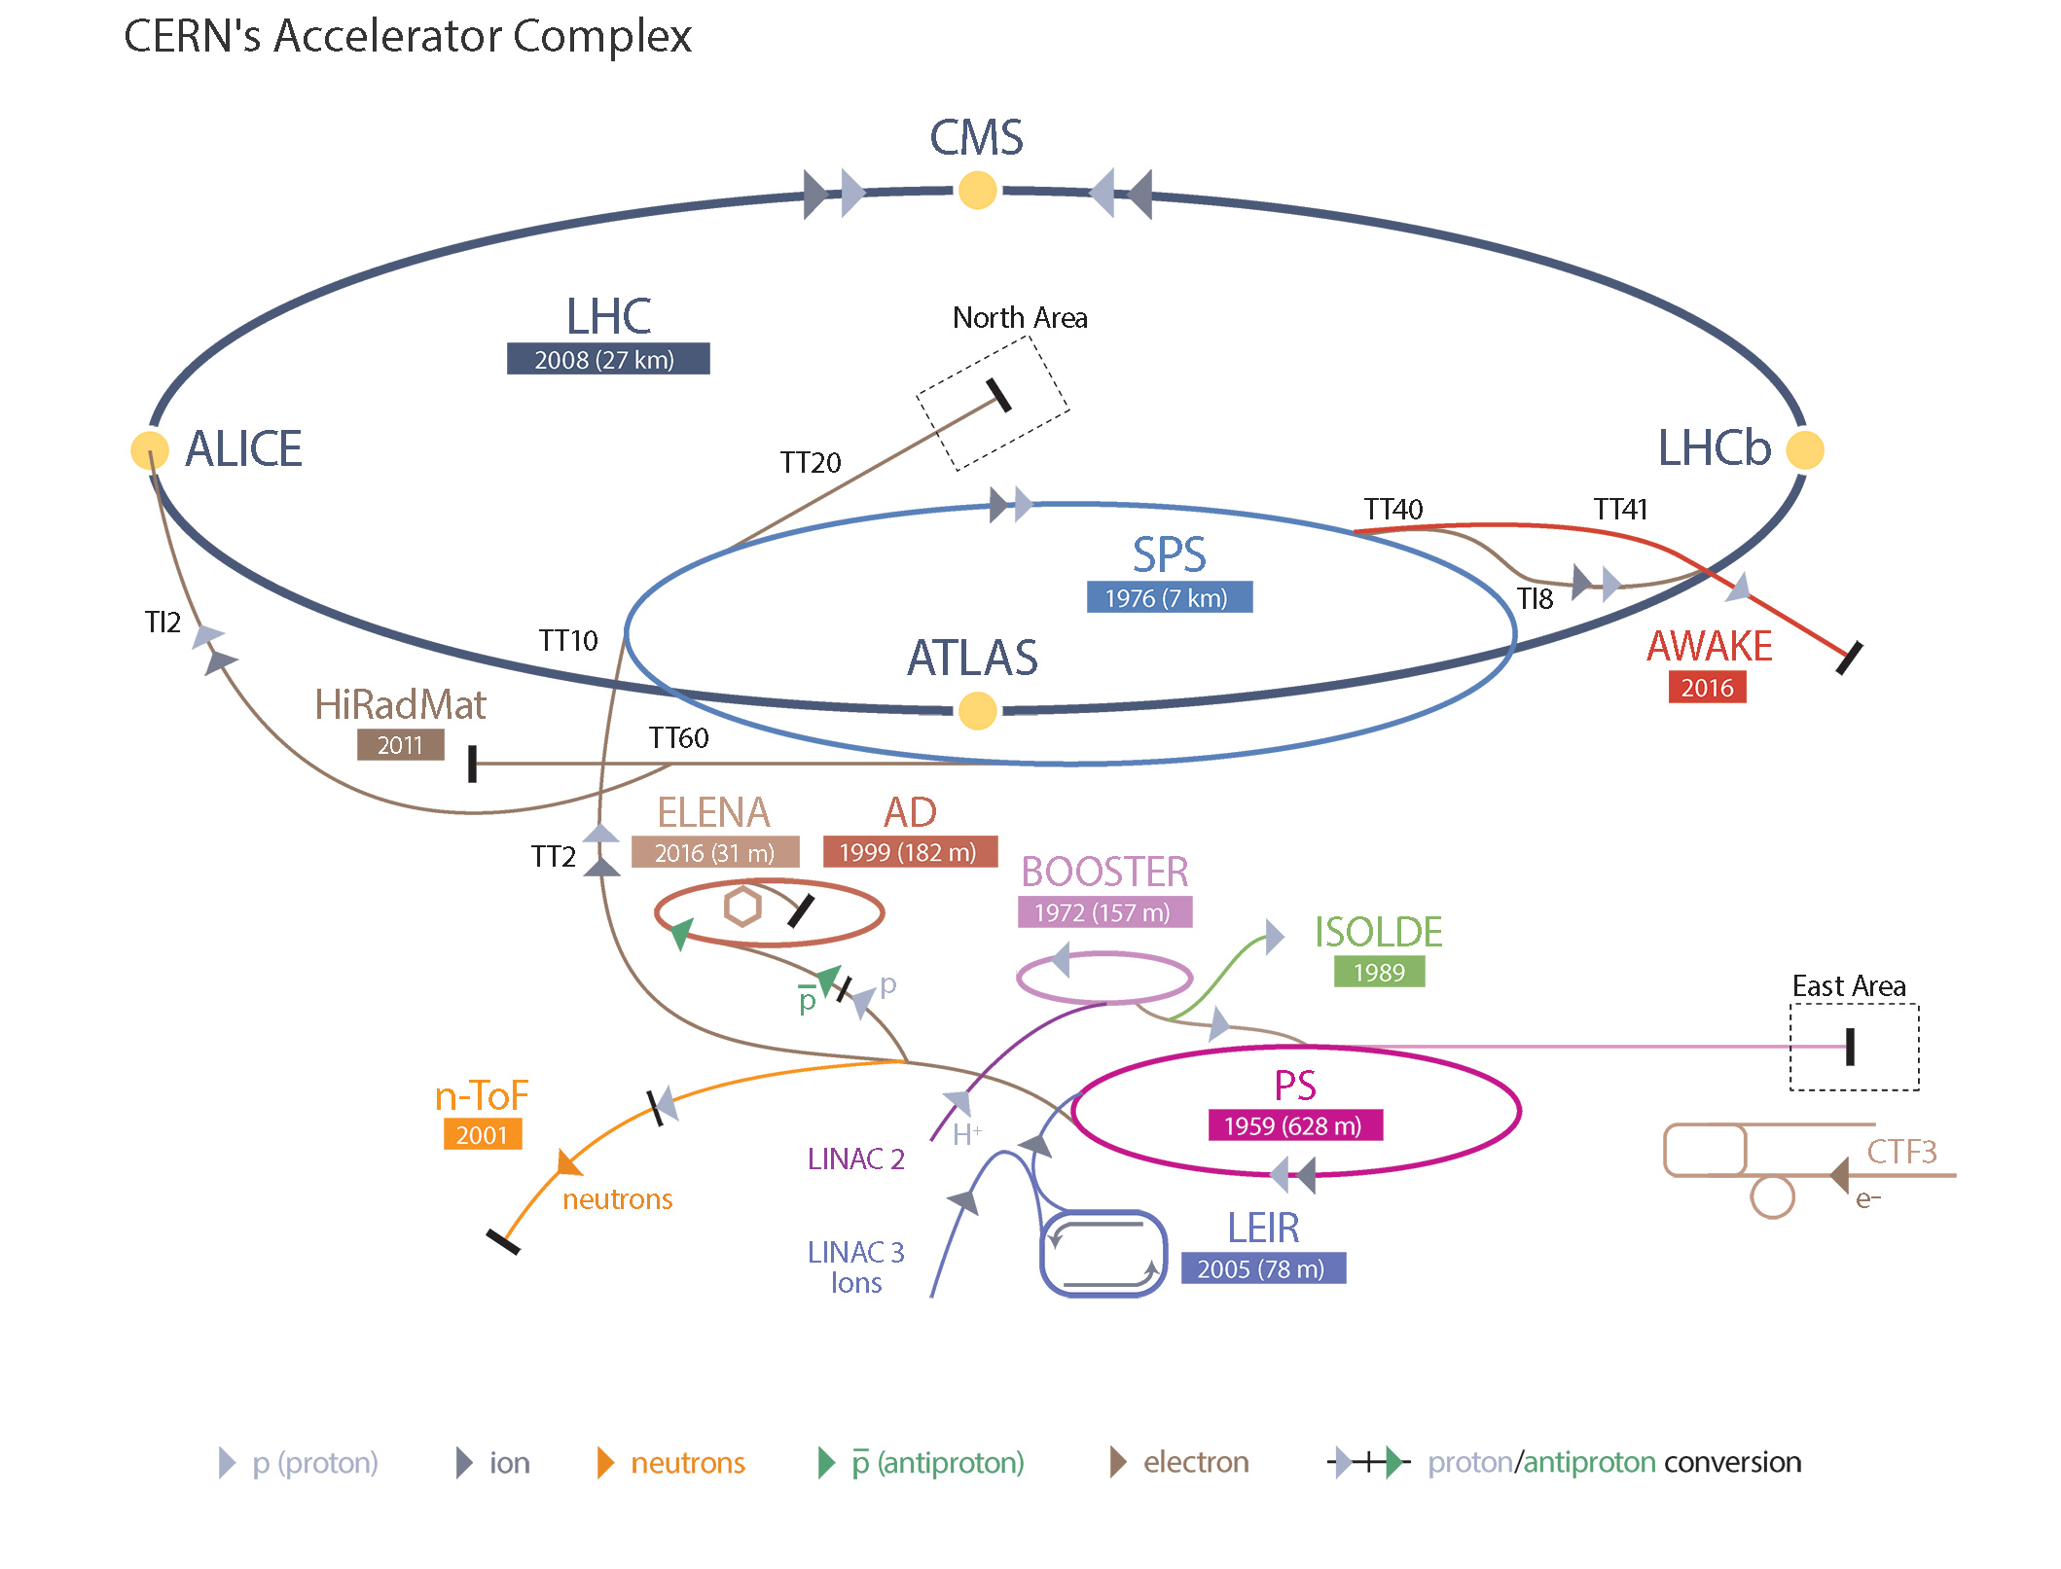

CERN accelerator complex
LS4
LS5

Slide 4

LHC Injectors Upgrade (LIU)

Slide 5
LHC beams
Presently LIU parameters match HL-LHC request (with some known risks associated)
As was discussed in Chamonix, both variants of the LHC beam (standard and BCMS) are of interest for HL-LHC operation
  The BCMS beam could be for the moment still limited to 2e11 p/b with 1.4 μm at the SPS exit due to TCDI (highest intensity point validated with simulations by EN/STI)
  Applying a scaling law, one could say that 2.3e11 p/b with 1.7 μm at the SPS exit (called BCMS+ in Chamonix – and reported in our table) would still be acceptable, however full validation from EN/STI is pending.
In the meanwhile, both sets of parameters should be considered when specifying new BIDs
  Certainly the BCMS has a lower emittance and spot size on the BID, however intensity per bunch upstream from SPS is lower (but 8 bunches in PS instead of 6)
For non-LHC (FT target) beams, the LIU policy has been always to ensure that the upgrades would not deteriorate their performance
  But do the upgrades have potentially a positive impact (of interest)? Can this be quantified?
  Can we aim at designing objects that would possibly not become bottlenecks for future non-LHC beams at best of our knowledge today?
Notes:
What about the 8b+4e considered as back up option if e-cloud not cured??
But TCDI experience teaches that higher brightness could indeed limit to lower intensity?

Slide 6
PSB & ISOLDE
LS4
LS5

Slide 7
ISOLDE
Future beam to ISOLDE after LIU upgrades
  Connection of PSB to Linac4 and new RF system based on broad-band Finemet cavities will allow increasing the intensity of the beams out of the PSB
    H- charge exchange injection at 160 MeV
    Transverse and longitudinal painting
    Increased RF power
  Constraints to estimate the maximum current available from PSB
    Linac4 current and flat top of distributor
    RF power after upgrade to full Finemet RF system
    2% accepted losses during the injection process
    Preservation of the present level of activation on vertical septa at recombination, which limits the vertical emittance of the extracted beams to 6 μm at 1.4 GeV and 8 μm at 2.0 GeV
    Space charge at injection and during the cycle, which depends also on the transverse and longitudinal painting scheme
    Horizontal instabilities along the cycle (known ‘weak point’ close to future injection energy, but also other points along the cycle) → cause still unknown
Notes:
For 2 GeV: Full upgrade of the BTY line to ISOLDE, upgrade of all the dumps in ISOLDE, modification of the experiment front-end.
To make full use of high intensity, improvement of shielding needed to lift 2 υA limit

Slide 8
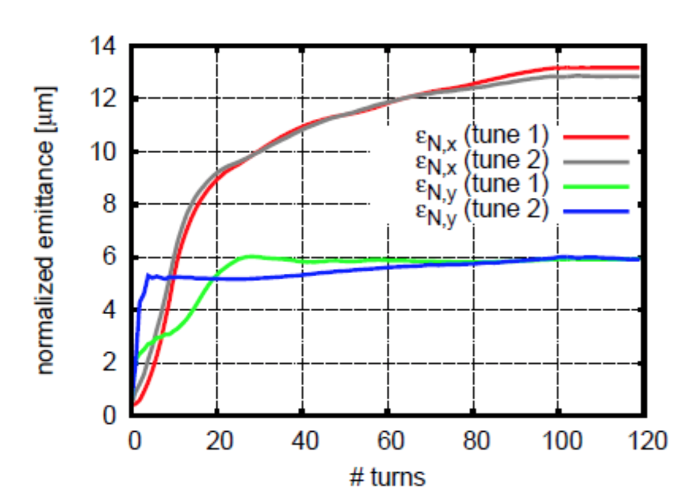
ISOLDE
Assuming
  40 mA from Linac4 (26 mA after chopping)
  Injection over 100 turns (at least 400 us flat top for the distributor)
  Transverse and longitudinal painting schemes at injection
End of injection process
1.6 x 10¹³ p per pulse and per ring
Emittances of 13 and 6 μm in x and y, respectively
Twice as much as available today from PSB, maybe a bit higher with 2 GeV (with 15 and 8 μm emittances)
J. Abelleira, in LIU-PSB Injection meetings
Notes:
For 2 GeV: Full upgrade of the BTY line to ISOLDE, upgrade of all the dumps in ISOLDE, modification of the experiment front-end.
To make full use of high intensity, improvement of shielding needed to lift 2 υA limit

Slide 9
PS & users
LS4
LS5

Slide 10

nTOF
Plans for the Medium to long Term
  Target exchange during LS2
  Technical choices for new target not yet finalised, however
    Will lift present limitation to 1.66 x 10¹² pot/s
    Ideally able to take >10¹³ pot/pulse (presently 0.8x10¹³ pot/pulse)
Protons to nTOF: future
  A few factors limit present intensity of nTOF beams
    Fast transverse instability at transition crossing (mainly due to the impedance of the kickers)
    RF power for acceleration and bunch rotation before extraction (short bunches for resolution)
    Losses at extraction septum (due to the large dp/p for short bunches)
  Beam after LS2 and LIU upgrades
    Transverse stability?
    Lower transverse emittance should become available (to check production in the PSB + space charge in the PS) → Reduction of losses at extraction
Notes:
Instability at transition crossing mainly due to kicker impedance?

Slide 11

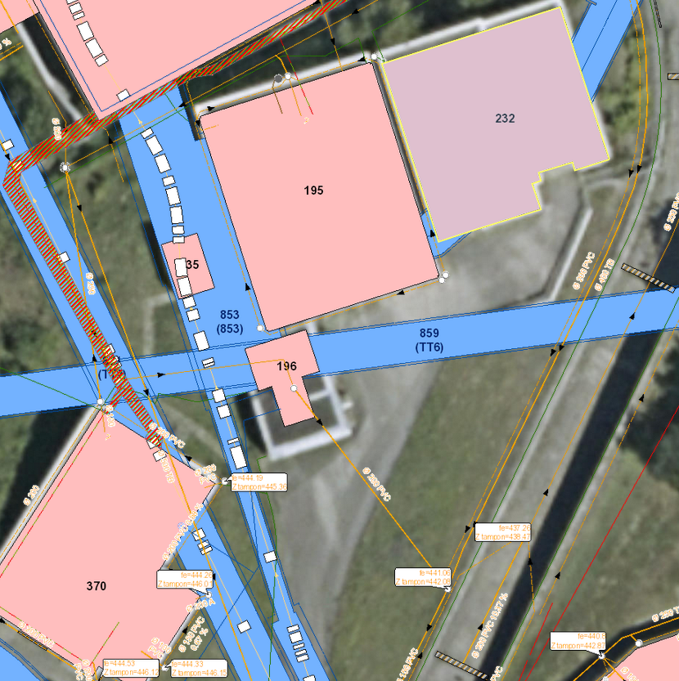
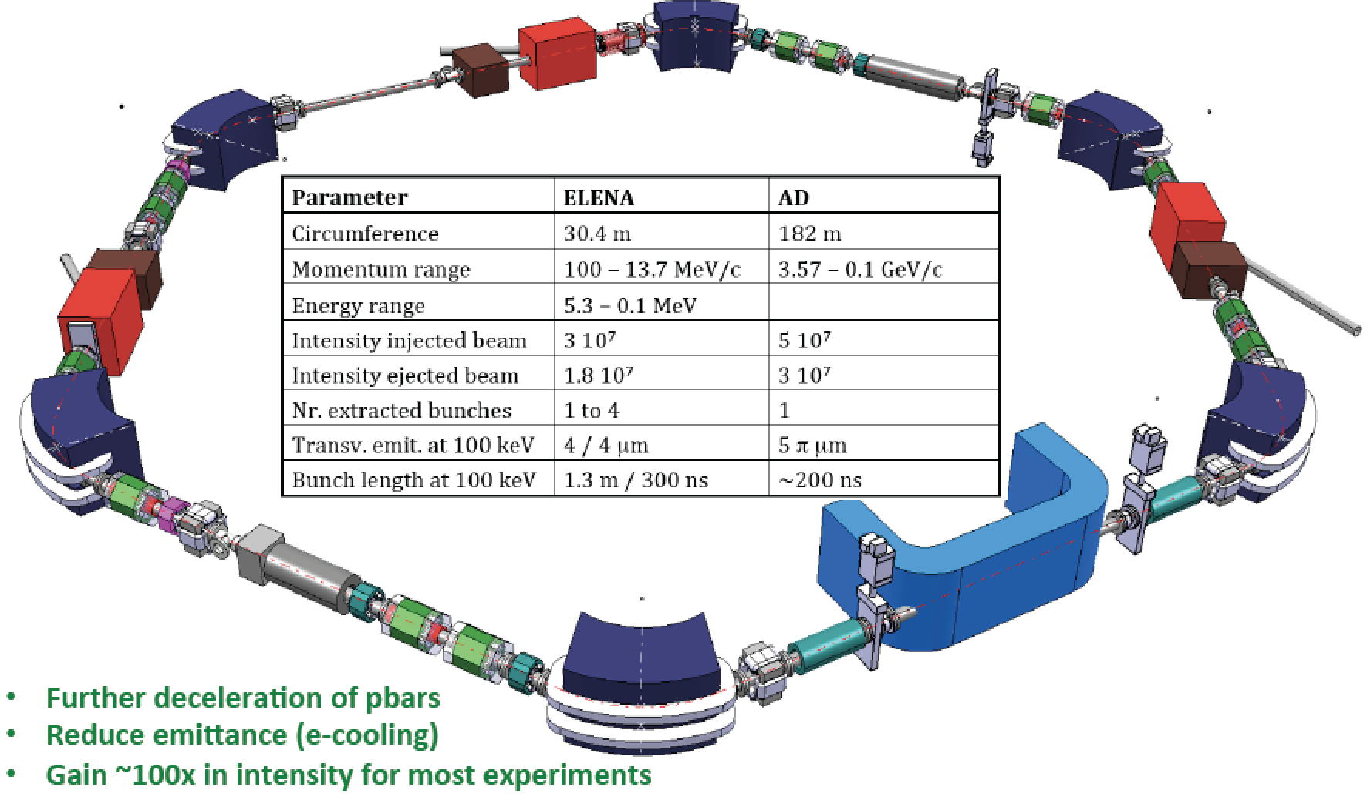
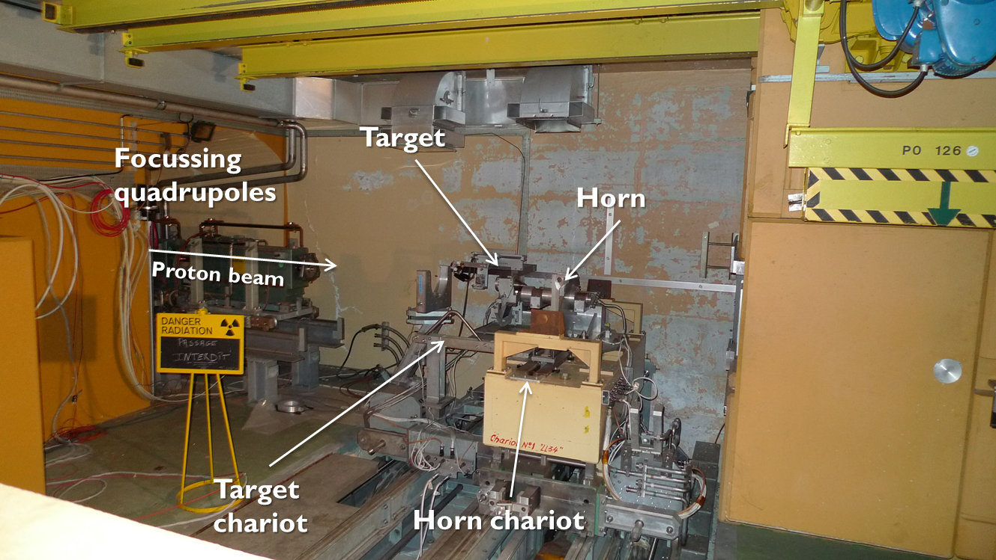
AD, ELENA
Protons to AD/ELENA: present and future
  Due to the AD deceleration cycle and stochastic cooling, AD takes beam every ~100 s
  The intensity of the AD beam (~1.5 x 10¹³ pot/pulse) mainly limited by shielding in the AD ring
  Similar AD beam request in the future (depends on improvement of AD shielding), however transverse emittance could be lower thanks to Linac4 and 2 GeV upgrade
    Any gain from this? Do we need to study possible lower transverse emittances of future AD/ELENA beams?
Notes:
stacking with 2.4 s won’t be possible anymore after consolidation of the

Slide 12
East Area
Protons to East Area: present and future
  Maximum repetition rate of East cycles is 2.5 s, limited by rms power of extraction septum (SMH57) → currently running with 5 cycles per ~30 s supercycle
  The intensity of the EA beams is in the range of 1 – 5 x 10¹¹ p/spill (and the emittance is not an important parameter)
  No change expected in the East beam request in the future, maybe ion beams should be also included for irradiation tests

Slide 13
SPS & users
LS4
LS5

Slide 14

HiRadMat
Protons to HiRadMat: present and future
  Beams from single bunches (10¹¹ p/pulse) to full LHC beams (pulses of 288 bunches with 1.2 x 10¹¹ p/b) are shot to HiRadMat for an integrated time of few days per year (typically ~10 experiments/year) with non-negligible time for set up
  Main limitation from environmental impact, i.e. the release of radio isotopes to the environment
  → Future of HiRadMat beams is mainly expected to follow future of LHC beams

Slide 15

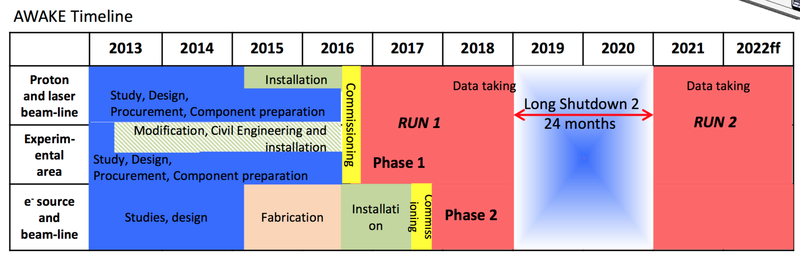
AWAKE
Protons to AWAKE: present and future
  Bright intense short single bunches (highest 3D density, desired value of up to 5 x 10¹¹ p/pulse – with bunch rotation at 400 GeV)
  LIU improvements expected to enhance the beam quality from Run 2 onwards
    RF power upgrade and longitudinal impedance reduction will have an effect on beam stability and the efficiency of bunch shortening
    Lower transverse emittances from Linac4 and 2 GeV?
    Need to study the future of LHCINDIV-type beams (production in PSB, transfer through PS, space charge in SPS – not trivial as TMCI at transition encountered presently above 4e11 p/bunch)
Notes:
How much intensity can we inject within 0.4 um – can we make it even brighter by scraping down intensities larger than 5e11 p?

Slide 16
North Area (and BDF)
Protons to North Area: present and future
  ~2 x 10¹³ p/spill are sufficient to fulfill the needs of the present experiments, 4 x 10¹³ p/spill assumed for future operation (for spill of ~9 s, needs to be lower for shorter spill)
  4.2 x 10¹³ p/spill assumed for BDF with a slow extraction on third integer over 1 s (maybe longer if peak rate of extracted protons not compatible with safe operation of septa) – assumption based on CNGS intensities in the past → translates into 2.3 x 10¹³ per injection with 92% transmission in SPS
  → Studies needed of beam production in the PSB, low vertical emittance, high intensity MTE
BDF

Slide 17
Final considerations
LHC beam parameters
  Well defined for post-LIU operation
  Not only standard production scheme, but also BCMS needs to be considered as possible beam for future LHC physics production
Other beams (non-LHC)
  Parameters being defined also within PBC context
  ISOLDE beams studied and expected to deliver 1.6e13 p/ring in the future (although time and full extent of intensity reach needs to be further verified – depending on simulations, studies and hardware limitations, e.g. debuncher amplifier)
  Higher intensity for other FT users is envisioned
    Seems certain for nTOF and BDF
  The question of the production of the non-LHC beams in the PSB remains the main open question, because with Linac4 brighter beams will be certainly in reach (up to the space charge limit of PSB and PS) – but is it interesting and requested by any experiments?
In general, is it reasonable to aim in the future at double brightness for all beams when specifying new BIDs? Or is this condition too stringent and we need more realistic simulations and directions from PBC? → For discussion

Slide 18
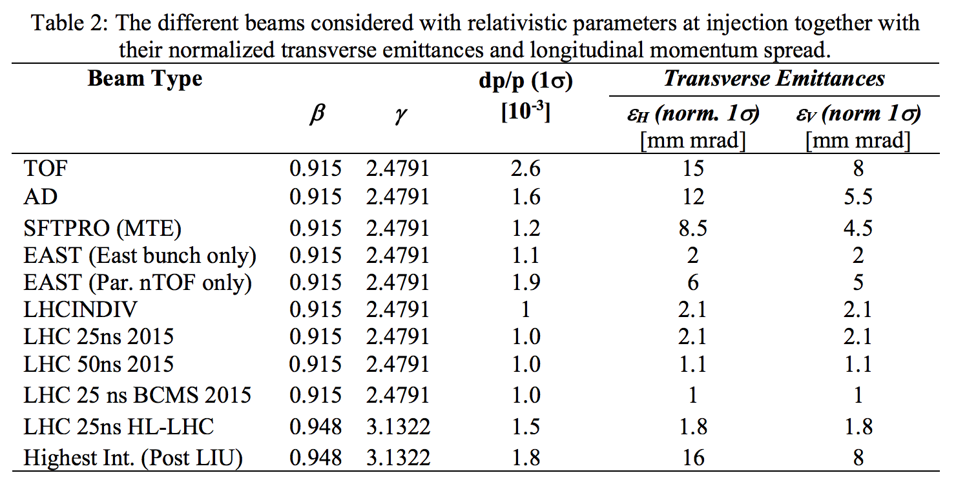
Final considerations
EDMS 1612292
  Assumes present beam parameters for non-LHC beams (2016 Beam doc)
  Includes a hypothetical case ‘Highest Int. (post-LIU)’ with 5000e10 p, whose parameters are obtained from simple scaling rule …
  Are we happy, or should we scale at least the ‘Highest Int. (post-LIU)’ from the simulated future ISOLDE 2 GeV (6400e10 p with emittances of 13 and 6 um → 5000e10 p with emittances of 10 and 5 um)

Slide 19
Final considerations
Including 20% margin, ‘Highest intensity’ is a fictitious case like in EDMS 1612292, but with ‘scaled emittances’ taking Linac4 into account
BDF and ‘Highest Intensity’ refer to single batch PSB-PS transfer
BDF could be extracted at higher energy in the future with MTE
 | Intensity ( 10¹⁰ p) | Momentum (GeV/c) | ε_{x} (μm) | ε_{y} (μm) | δp/p
LIU/HL-LHC (standard) | 2400 (6b) | 26 | 1.8 | 1.8 | 4e-4
LIU/HL-LHC (BCMS) | 1600 (8b) | 26 | 1.4 | 1.4 | 4e-4
BDF | 2800 (8b) | 14 | 12 | 3 | 1e-4
nTOF | 1600 (1b) | 20 | 12 | 6 | 8e-4
Highest intensity | 5000 (8b) | 26 | 12 | 5 | 1e-4

Slide 21
TCC2 target experiments and SHiP (general-purpose fixed target facility to search for hidden particles)
Former CERN Neutrino to Gran Sasso (CNGS) 2006-2012. Now AWAKE: Proton-driven plasma wakefield acceleration experiment
TCC2 targets
HiRadMat: test area to evaluate the effect of high-intensity pulsed beams on materials or accelerator components

