Slide 1
Thermal analyses for HL-LHC
LORENA VEGA
ACKNOWLEDGEMENTS:
M. BARNES, v. Vlachodimitropoulos, W. WETERINGS

Slide 2
Index
Heating problem
Thermal model
Validation
Ferrite yoke temperature calculation
Predicted temperatures for HiLumi
Cooling alternatives

Slide 3
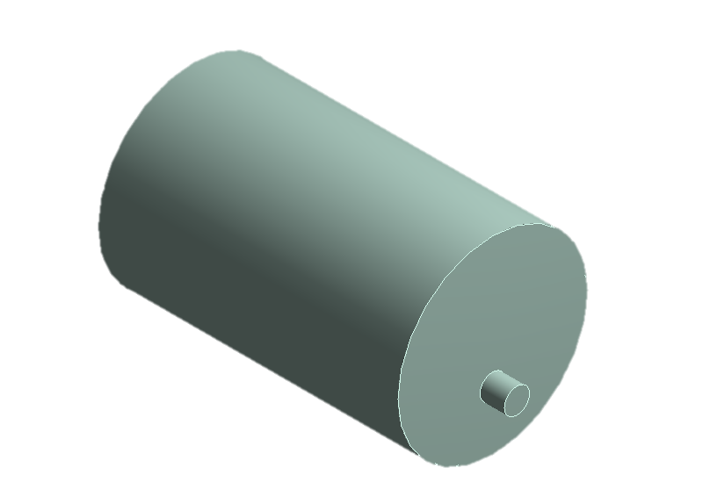
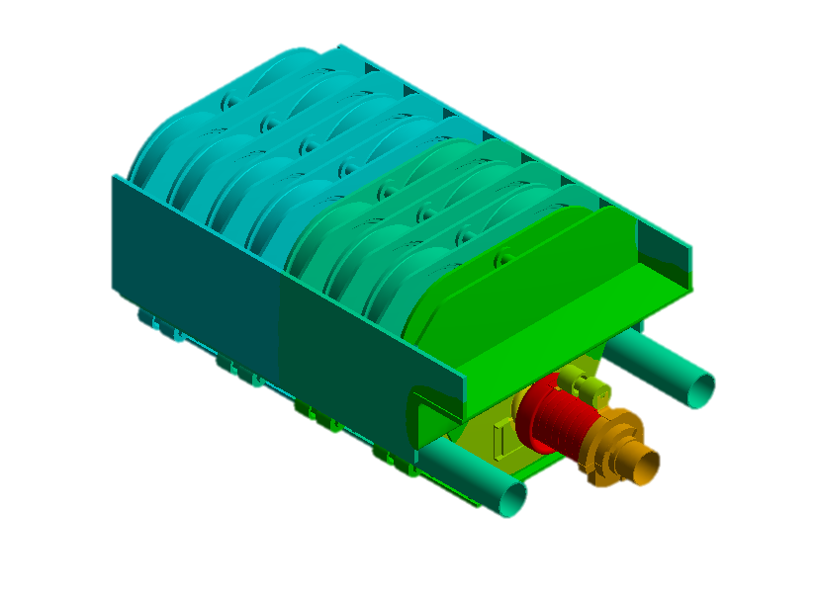
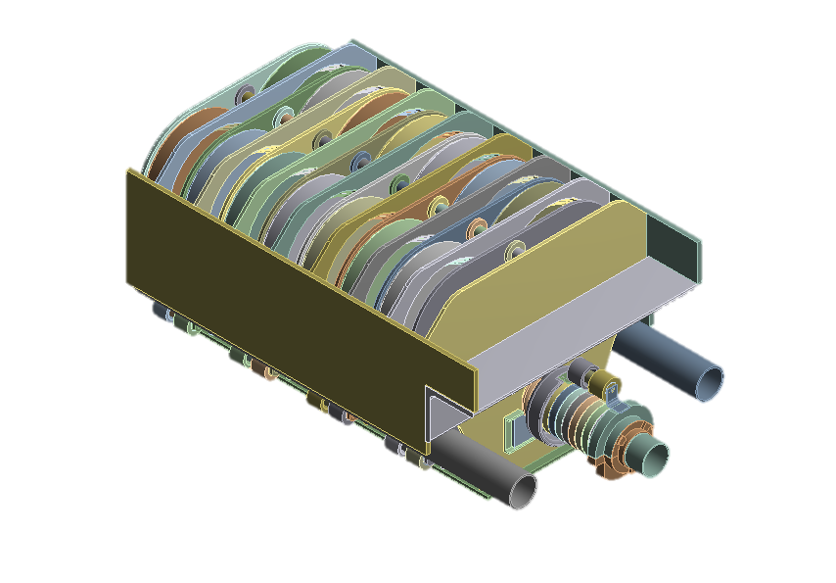
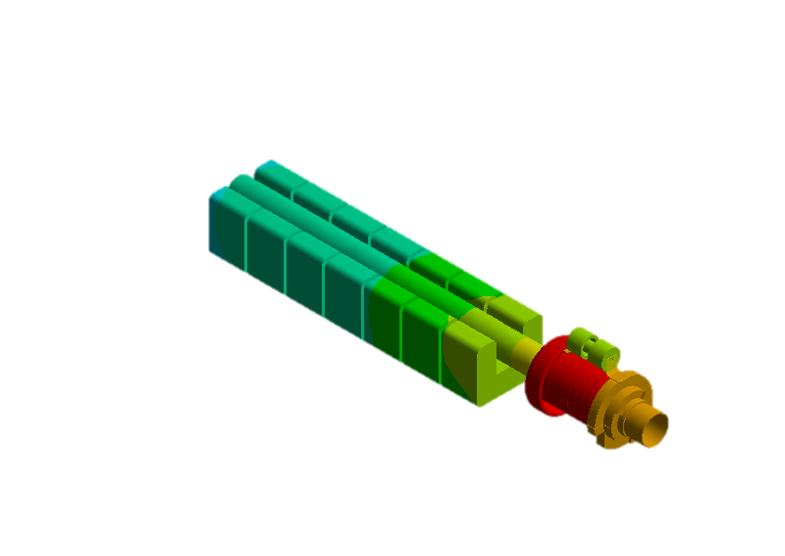
1. Heating problem
MKIs only pulse 12 times to fill the LHC but the high intensity beam circulates through the aperture of these magnets constantly for many hours: this leads to beam induced heating.
The heat is deposited in a non-uniform way: mostly at the entrance of the magnet (see Vasilis’ talk).
Temperature always below the Curie temperature to avoid mis-injected beam!
Ferrite yoke
 | Type of ferrite | Curie temperature
Yokes | 8C11 | 125°C
Rings | 4M2/4B3 | 200/250°C
Circulating beam

Slide 4
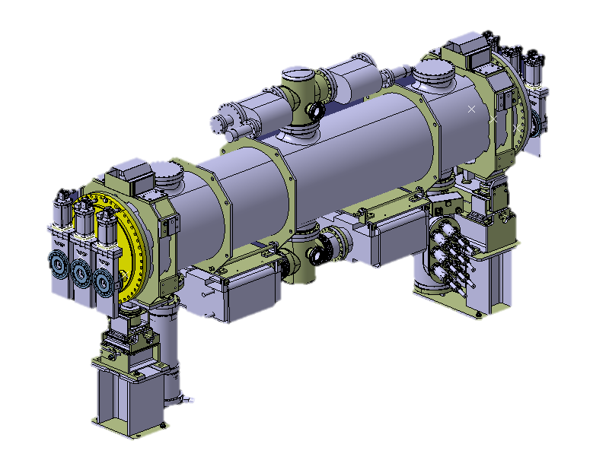
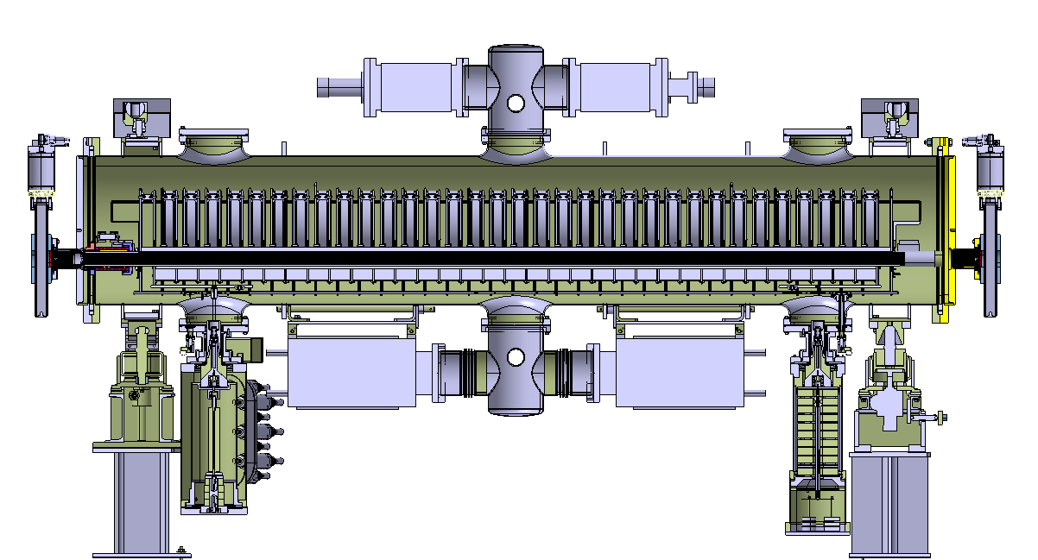
2. Thermal model
3.5 m
0.54 m
Complex geometry: big dimensions and many components
Need to simplify the model for analysis to reduce the computational cost without a significant loss of accuracy.

Slide 5
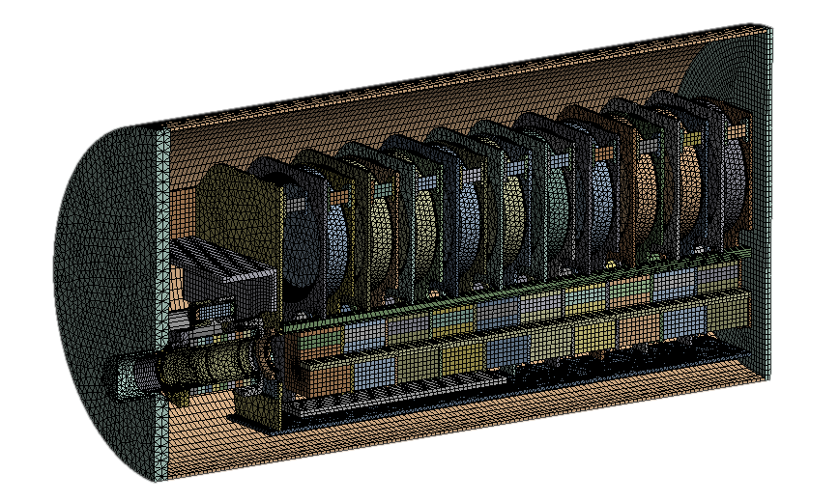
2. Thermal model
Simplifications:
Symmetry in the longitudinal axis.
Only 10 first cells are modelled.
  As the power deposition is close-to-uniform from the 3rd yoke to the last yoke, simulations with up to 16 cells have been done to see from which cell the longitudinal heat transfer can be considered adiabatic: 10 cells are sufficient (temperature drop between 10th and 11th yokes is less than 2%).

Slide 6
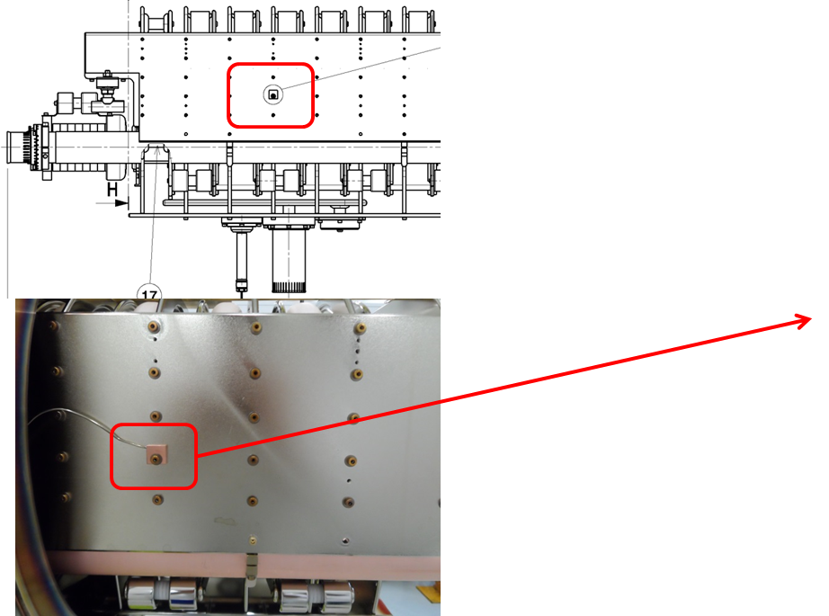
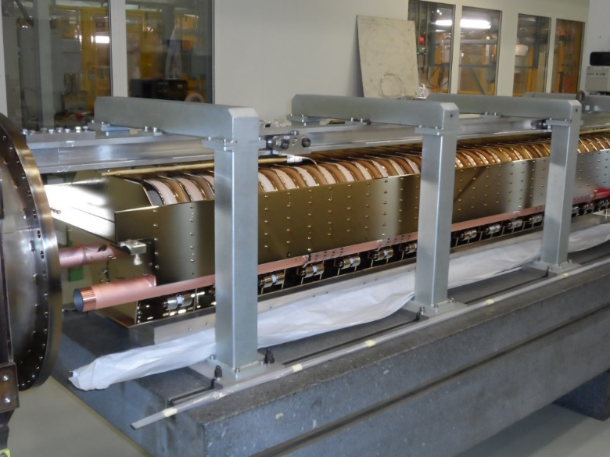
3. Validation of the model
The numerical model has been validated by simulating the calculated power for several operational fills of LHC.
The predicted temperatures are then compared with measured temperatures in one of the installed MKIs (MKI8D).
PT100 sensors are not installed directly in the ferrite yoke: there is one towards each of the upstream and downstream ends, on the side plate and on the clamp in contact with the rings.
PT100 at side plate
PT100 at ferrite rings

Slide 7
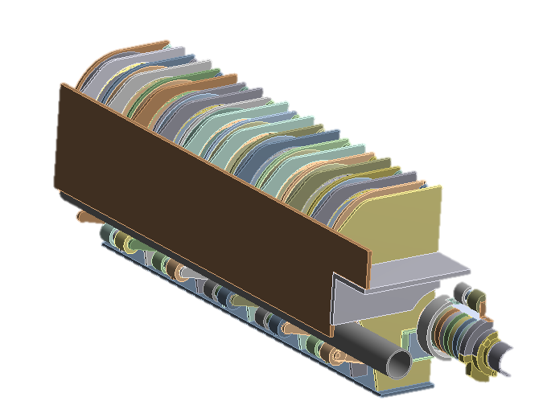
2. Validation of the model
Power loss is scaled to measurements by a factor of x4 (see Vasilis talk).
Jackets are included in the model.
Good agreement for Magnet_Up
Not so good agreement for Tube_Up: it is maybe due to uncertainties in the model for the contact resistance between rings and clamp of PT100

Slide 8
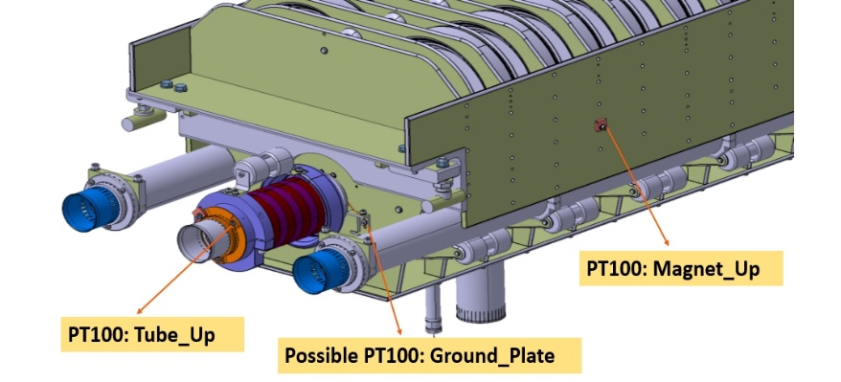
4. Proposal: changing location of PT100
Location | Increase of temperature with 25% more power | Evaluation
Ferrite yoke | 11% | Reference
Ferrite rings | 13% | Good
Side plate | 4% | Bad: change
Ground plate | 14% | Good: proposed location
The PT100 should be located in parts with high sensitivity to the power loss: for changes in the power, corresponding changes in temperature.
For evaluating the quality of the present locations, the same transient simulation used for the validation has been re-run with 25% increased power depositions and the bake-out jackets not included.
Drawback: design changes to reduce power in the yoke are planned and we might miss the quantitative comparison to other MKIs.
Proposal for a prototype MKI during 2018: move Magnet_Down to Magnet_Up, and Magnet_Up to Ground plate.

Slide 9
5. Ferrite yoke temperature
Potentially the most accurate way to predict ferrite yoke temperatures is to run a transient thermal simulation with the power data calculated for a specific fill: several days of CPU time!
A simpler and more pessimistic approach is to consider steady-state conditions. Different values of power can be considered for a cycle: peak, average or “flat” part.

Slide 10
5. Ferrite yoke temperature
Calculating the ferrite yoke temperature considering the maximum power of a cycle as steady-state is very pessimistic due to the long thermal time-constant of the magnet: it takes several hours to cool down or heat up.
The following percentages depend on the duration of the fill and the initial conditions (e.g. the initial temperature due to the previous fill)
Power | Value (W) | Temperature Ferrite yoke#1/ Ring#9 | Comparison | Difference
Peak of the cycle | 130.7 | 114°C / 153°C | Maximum: 78.4°C / 111.5°C | 38% / 31%
After the peak | 117.2 | 107°C / 142°C | Maximum: 78.4°C / 111.5°C | 33% / 25%
Average of the cycle | 91 | 90.5°C / 119°C | Maximum: 78.4°C / 111.5°C | 17% / 8%
Steady-state part during transient | 71.3 | 76 °C / 99°C | Steady: 76.2°C / 100.6°C | 1% / 1%

Slide 11
6. Expected temperatures for HiLumi
Ferrite 4M2
Ferrite 8C11

Slide 12
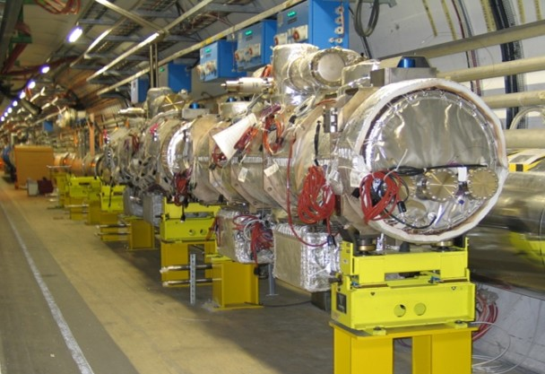
7. Cooling alternatives
Removal of the bake-out jackets
Bake-out jackets are left in place on the MKIs in the LHC tunnel: this is in case there is a need for an in-situ bake-out since there is insufficient space to install them in the tunnel.
They isolate thermally the MKIs vacuum tanks from the local environment.
It is recommended to remove the jackets for future operation: predictions show that the ferrite yoke temperature decreases by 7% for a given power deposition. Alternatively, for a given temperature, the power deposition can be 18% higher without jackets.

Slide 13
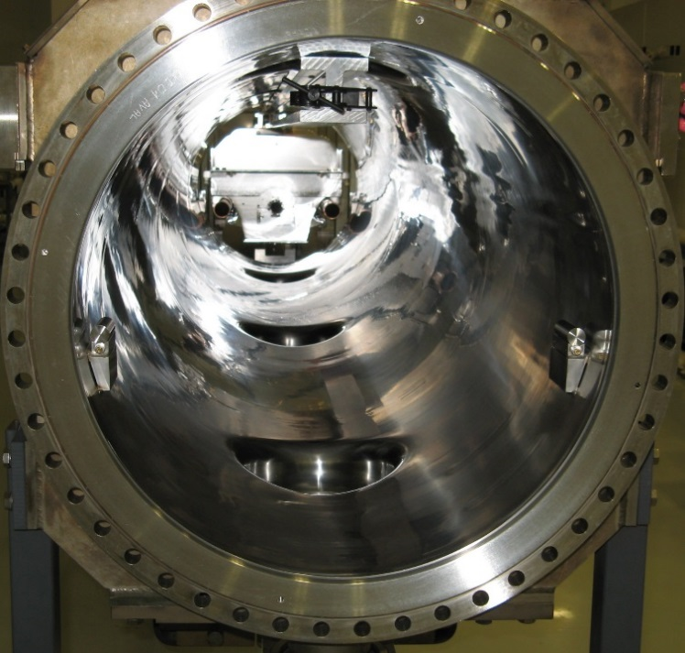
7. Cooling alternatives
Increase thermal emissivity of the vacuum tank
Ferrite 4B3
Ferrite 4M2
Ferrite 8C11
Very shiny surface of the tank: low thermal emissivity
As a result of the low thermal emissivity of the internal surface of the MKI vacuum tanks (ε=0.14), cooling of the ferrite yoke by thermal radiation is presently limited.
Several surface finishes have been considered: laser treatment, carbon coating, multilayer optical coatings deposited by magnetron sputtering, developed by Polyteknik AS, and coatings deposited by thermal spray (plasma spray and flame spray)
Although increasing the emissivity reduces both the maximum temperature and the thermal time-constant, so that the yokes cool down more rapidly, the temperatures are not reduced enough.

Slide 14
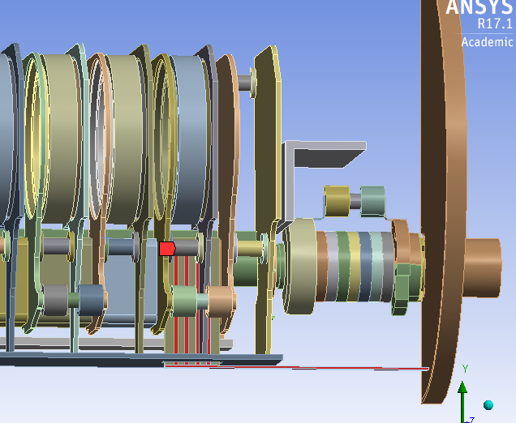
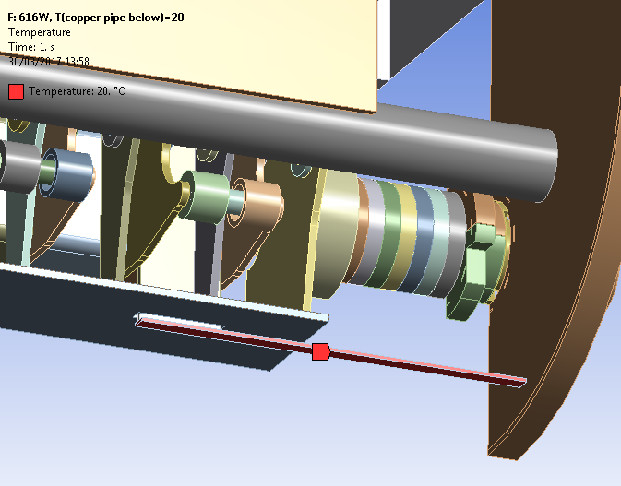
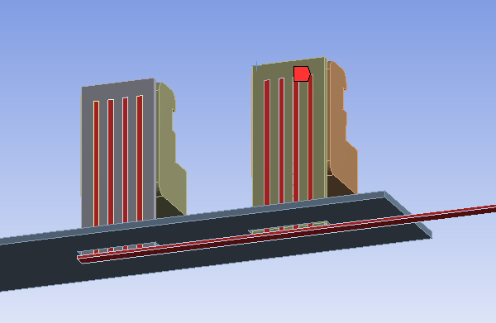
7. Cooling alternatives
Cooling of the ferrite yokes
Ferrite 4B3
One alternative is to cool the ferrite yokes with a cold plate: AlN (good thermal conductor and electrical insulator.
If only the first yoke is cooled like this, its temperature will be reduced from 238°C to 93°C but the subsequent yokes approach the Curie temperature: necessary to cool down the first and the third yokes to ensure that all of them remain below the 125°C.
Additional cooling is required for the ferrite rings as their temperatures are otherwise predicted to exceed their Curie point (200 and 250°C).
Ferrite 4M2
Ferrite 8C11

Slide 15
7. Cooling alternatives
Cooling of the ferrite rings
With the beam screen design implemented during LS1, cooling the rings to 20°C is not enough: the first 5 yokes are still above the limit.
Ferrite 4B3
Ferrite 4M2
Ferrite 8C11

Slide 16
7. Cooling alternatives
Cooling of the ferrite rings and changing the overlap length
With the new proposed design (56 mm overlap length, see Vasilis’ talk), the temperature of the yokes is still above the limit.
Cooling the rings reduces drastically the temperature of the ferrite yokes too, so that all ferrite is below the Curie temperature.
A design of a water cooling system, for the ferrite rings, is currently under development: water cooled pipes around the rings.
Ferrite 4B3
Ferrite 4M2
Ferrite 8C11

Slide 17
* Thermal analysis of the new design
Ferrite 4B3
Ferrite 4M2
Ferrite 8C11
A prototype with the new design is planned to be installed during Run2 (see Vasilis’ talk)
With the new design, and considering the worst case scenario, the hottest ferrite yoke (#1) would be below the Curie temperature (101.5°C), but the hottest ring would be in the limit (200°C).
Removing the bake-out jackets would reduce approximately a 7% the temperature of the yokes and a 2% the temperature of the rings: not enough.
In the case of the post-LS1 design, the hottest ferrite yoke would reach 103.5°C and the hottest ring, 146.6°C, both below the limit.

Slide 18
8. Conclusions
  For HiLumi operation, the predicted temperatures of both the ferrite yokes and the rings are well above the Curie point.
  For current design, cooling the ferrite yokes with a cold plate would maintain the yoke temperatures below the Curie point, but the ferrite rings would be above their limit: additional cooling is necessary.
  For current design, cooling the ferrite rings is not enough: the ferrite yokes temperature would be above the limit.
  Combining the new proposed design (reduced overlap length from 117 to 56mm) with cooling of the ferrite rings is the best approach: all the components (rings and yokes) are below the Curie temperature.

Slide 19
Thanks for your attention.

Slide 20
Spare slides

Slide 21
Spare slides

Slide 22
Misreading of Tube_Up PT100
The PT100 located at the entrance rings shows several rapid changes: not realistic.
It might be related to a loss in thermal contact between the rings and the clamp due to different thermal expansion .
This phenomena happens in all the magnets.
In Magnet 8B, the measurements are the best for this fill.
The measurements of Magnet 8D are scaled from 8B data (8D temperatures are 1.2 times 8B)
8D=1.2*8B

