Slide 1

Future Circular Collider
Daniel Schulte for the FCC team
Riga, May 2017

Slide 2
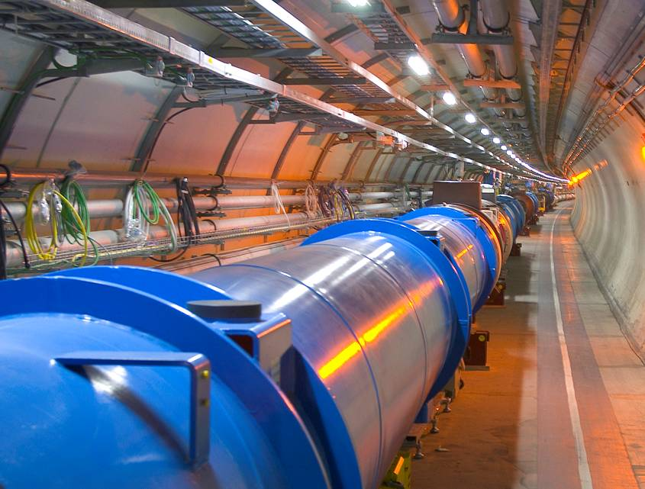
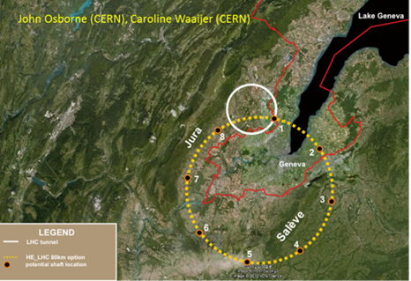
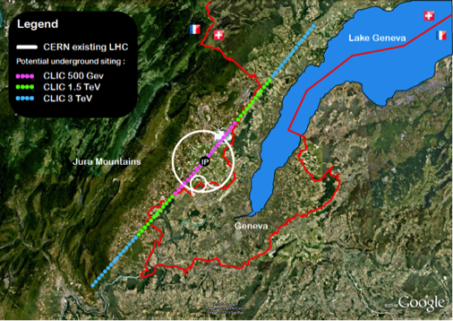
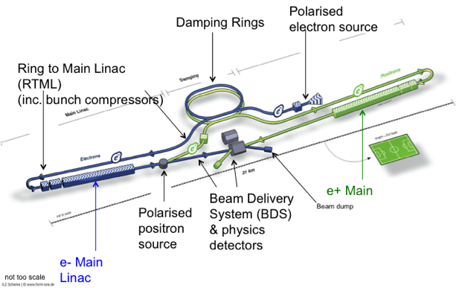
European Strategy
Highest priority is exploitation of the LHC including luminosity upgrades
Europe should be able to propose an ambitious project after the LHC
  Either high energy proton collider (FCC-hh)
    With potential first lepton stage
  Or high energy linear collider (CLIC)
Europe welcomes Japan to make a proposal to host ILC
Long baseline neutrino facility

Slide 3

Discoveries by Colliders
Standard Model
Particles and forces
LHC:
Higgs-boson
Colliders are powerful instruments in High Energy physics
for particle discoveries and precision measurements

Slide 4


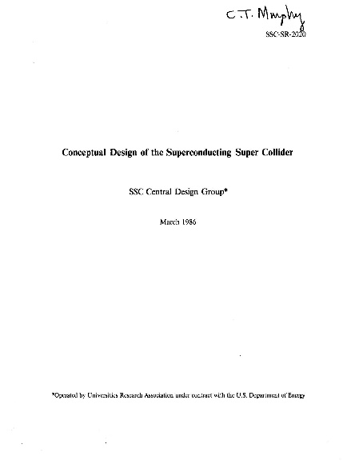
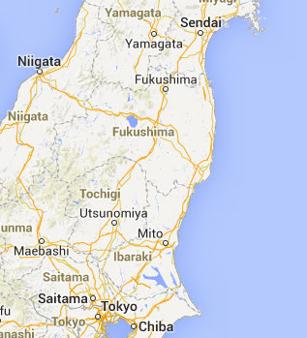
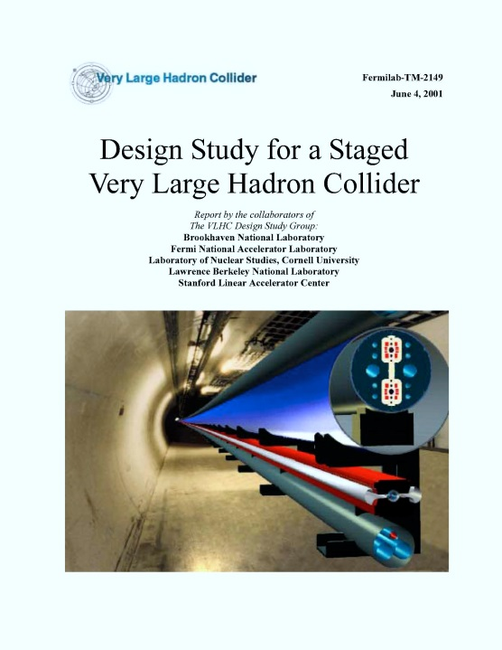
Previous Studies
ELOISATRON
SSC
Supercolliders Superdetectors: Proceedings of the 19th and 25th Workshops of the INFN Eloisatron Project
SSC CDR 1986
TRISTAN II
Exploit synergies with other projects and prev. studies
VLHC
VLHC Design Study Group Collaboration
June 2001. 271 pp.
SLAC-R-591, SLAC-R-0591, SLAC-591,
SLAC-0591, FERMILAB-TM-2149

Slide 5
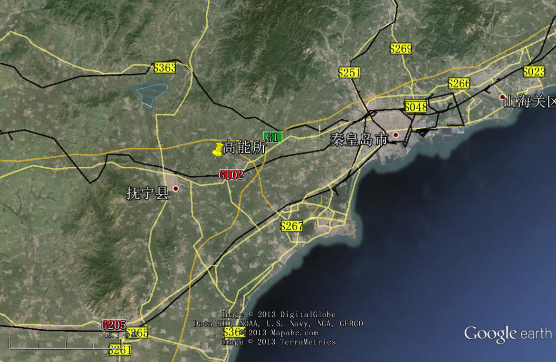
SppC
Qinhuangdao (秦皇岛）
CepC, SppC
50 km
100 km
easy access
300 km east
from Beijing
3 h by car
1 h by train
“Chinese Toscana”
Yifang Wang

Slide 6
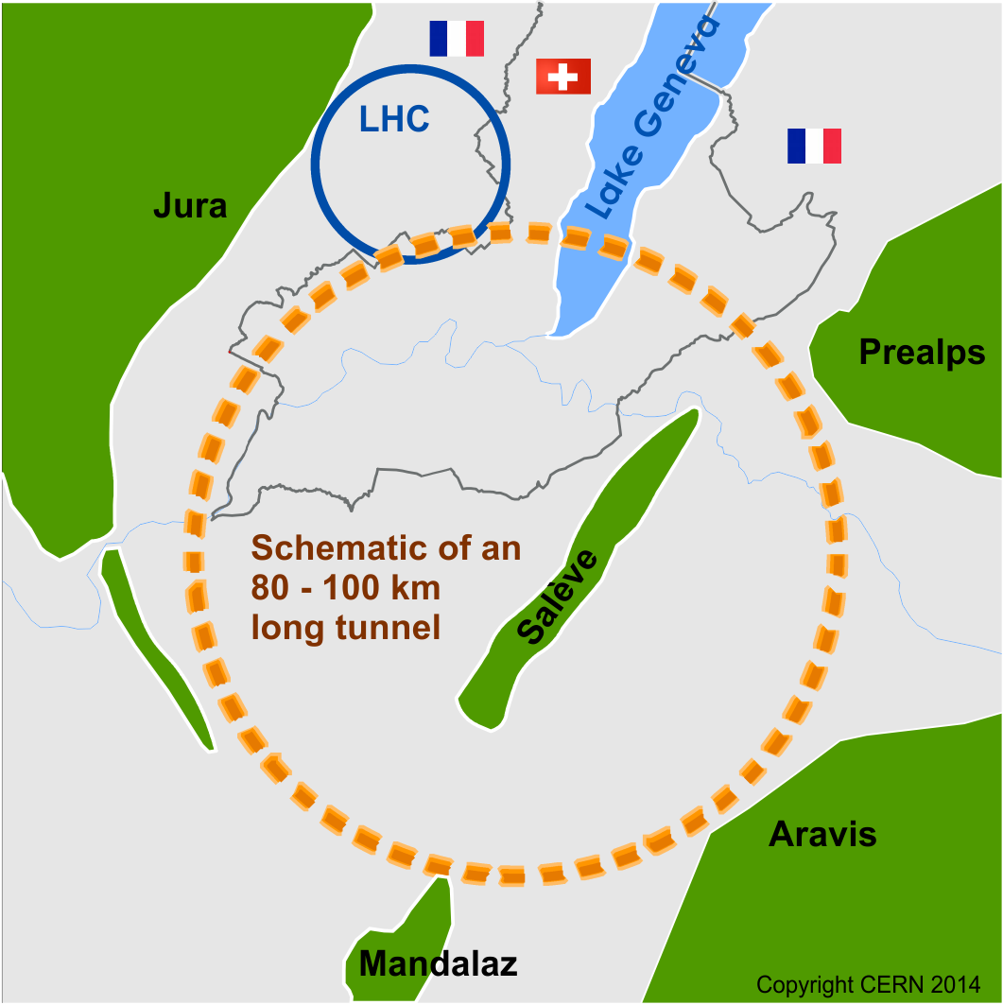
FCC Scope
Develop CDR until 2018
FCC-hh
pp collider (ion option)
100 TeV cms energy
  defines infrastructure requirements
FCC-ee
e⁺e⁻ collider
potential intermediate step
FCC-he
additional option

Slide 7
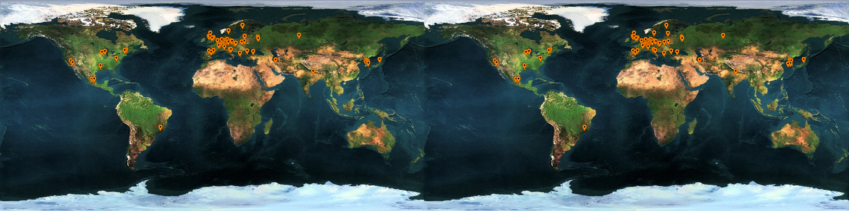



























FCC Collaboration
74 institutes
26 countries + EC
Status: April, 2016

Slide 8
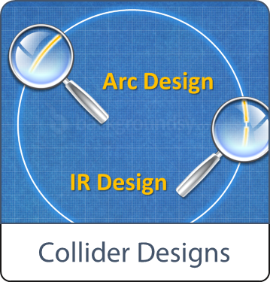

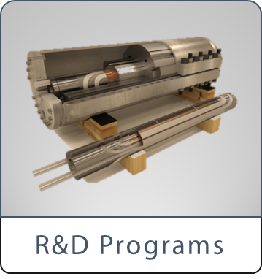

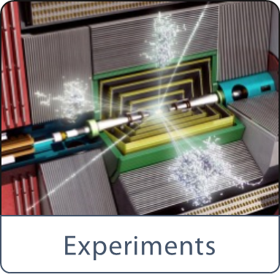

Scope of Conceptual Design

Slide 9
Timeline
1980
1985
1990
1995
2000
2005
2010
2015
2020
2025
2030
2035
Constr.
Physics
LEP
Design
Proto
Construction
Physics
LHC – operation run 2
HL-LHC - ongoing project
Design
Construction
Physics
~20 years
FCC – design study
Design
Proto
Construction
Physics
Must advance fast now to be ready for the period 2035 – 2040
Goal of phase 1: CDR by end 2018 for next update of European Strategy

Slide 10
Future Hadron Collider Basic Parameters
 | LHC (HL-LHC) | HE-LHC (tentative) | FCC-hh Baseline Ultimate |  | SPPC
Cms energy [TeV] | 14 | 14 | 100 | 100 | 71
Luminosity [10³⁴cm⁻²s⁻¹] | 1 (5) | 5 | 5 | 20-30 | 12
Machine circumference | 27 | 27 | 97.75 | 97.75 | 54
Arc dipole field [T] | 8 | 8 | 16 | 16 | 20
Bunch distance [ns] | 25 | 25 | 25 | 25 (5) | 25 (10/5)
Background events/bx | 27 (135) | 135 | 170 | <1020 (<202) | 490 (196/98)
Bunch length [cm] | 7.5 | 7.5 | 8 | 8 | 7.55
For FCC-hh baseline currently consider 25ns bunch spacing, for ultimate consider small bunch spacing to reduce background per crossing

Slide 11
FCC-hh Layout
Layout has changed according to site requirements
Two high-luminosity experiments (A and G)
Two other experiments combined with injection (L and B)
Two collimation insertions
  Betatron cleaning (J)
  Momentum cleaning (E)
Extraction insertion (D)
Clean insertion with RF (H)
Circumference 97.75km
Can be integrated into the area
Can use LHC or SPS as injector

Slide 12
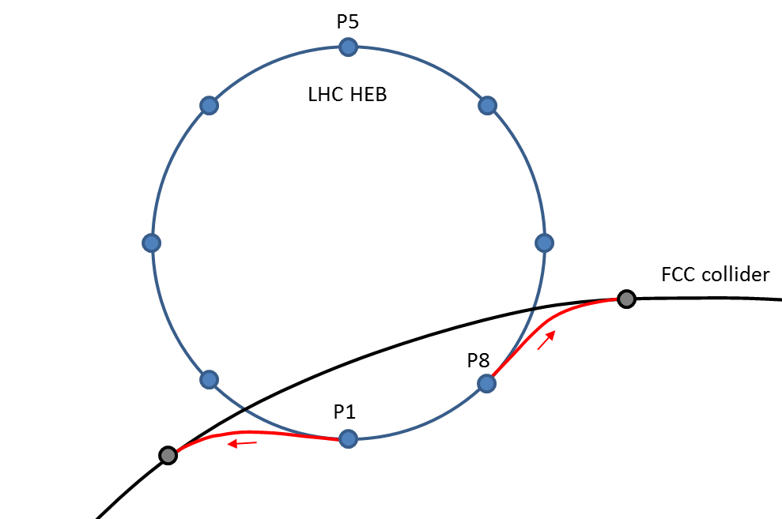
FCC Injection and Site Study
Detailed site studies are ongoing
Geology
Surface buildings
…
97.75km ring fits well into the Geneva area
LHC can be used as injector
Small changes on LHC
The two tunnels would match nicely
Energy and beam quality are sufficient
Also consider SPS and FCC tunnel for injector
SPS located at the right place

Slide 13
Arc and Required Magnet Strength
Arc length is 83.75km
80% is filled with dipoles
i.e. 67km
Hence, bending radius in dipole magnets ρ=10.66km
Field: (16-ε)T

Slide 14
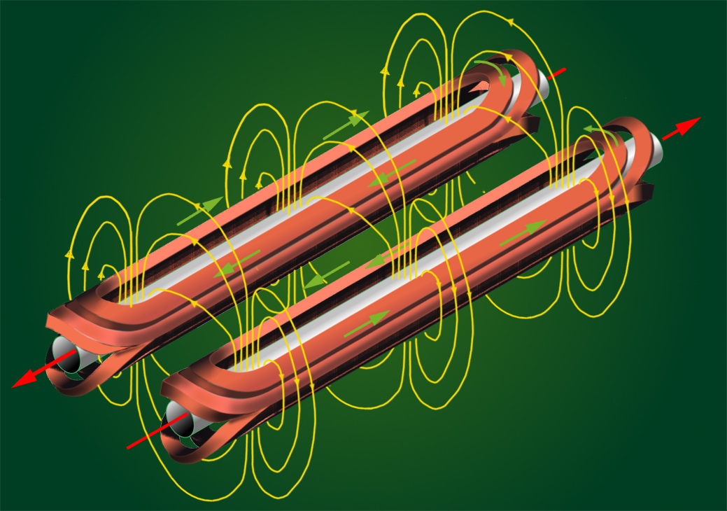
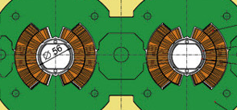
Dipole Basic Concept (“Cosine Theta”)
B
I(φ)
φ
I(φ)

Slide 15

Limits for the Field
The cable can quench (superconductivity breaks down)
if the current is too high
If the magnetic field is too high
This limits the achievable field
  In theory
  Even lower limit in practice (shown)
Can use different materials
  Nb-Ti is used for LHC
  Nb₃Sn is used for high luminosity upgrade

Slide 16
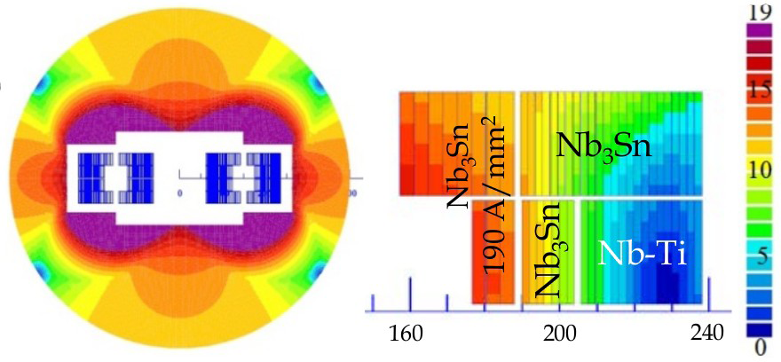
Cost Effective Magnet Design Example
Nb₃Sn is more costly than Nb-Ti
Use both materials
Coil sketch of a 15 T magnet with grading, E. Todesco

Slide 17

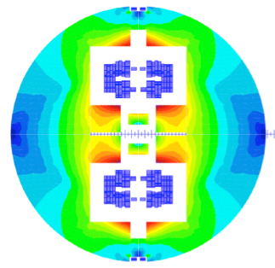
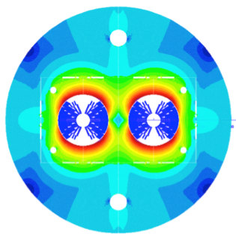

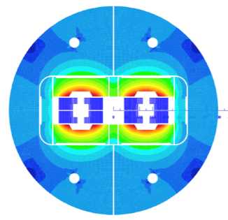
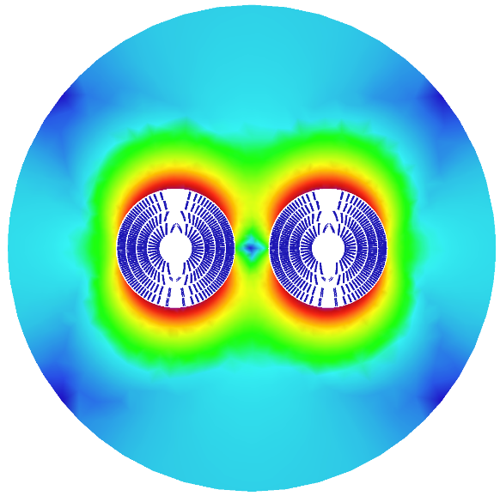
Magnet Designs
Cos-theta
Common coils
Swiss contribution
via PSI
Canted
Cos-theta
Blocks
Down-selection of options end 2016 for detailed design work
Model production 2018 - 2022
Prototype production 2023 – 2025

Slide 18
Parameters and Luminosity Target
Baseline
250fb⁻¹ per year (including shutdowns)
Ultimate
1000fb⁻¹ per year
5ns more important
 | Baseline | Ultimate
Luminosity L [10³⁴cm⁻²s⁻¹] | 5 | 20
Background events/bx | 170 (34) | 680 (136)
Bunch distance Δt [ns] | 25 (5)
Bunch charge N [10¹¹] | 1 (0.2)
Fract. of ring filled η_{fill} [%] | 80
Norm. emitt. [μm] | 2.2(0.44)
Max ξ for 2 IPs | 0.01 (0.02) | 0.03
IP beta-function β [m] | 1.1 | 0.3
IP beam size σ [μm] | 6.8 (3) | 3.5 (1.6)
RMS bunch length σ_{z} [cm] | 8
Crossing angle [σ’] | 12 | Crab. Cav.
Turn-around time [h] | 5 | 4

Slide 19
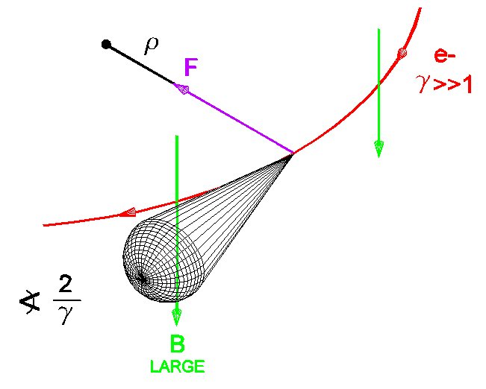
Synchrotron Radiation
At 100 TeV even protons radiate significantly
Total power of 5 MW
Needs to be cooled away
Equivalent to 30W/m /beam in the arcs
Protons loose energy
They are damped
Emittance improves with time
Typical damping time 1 hour

Slide 20
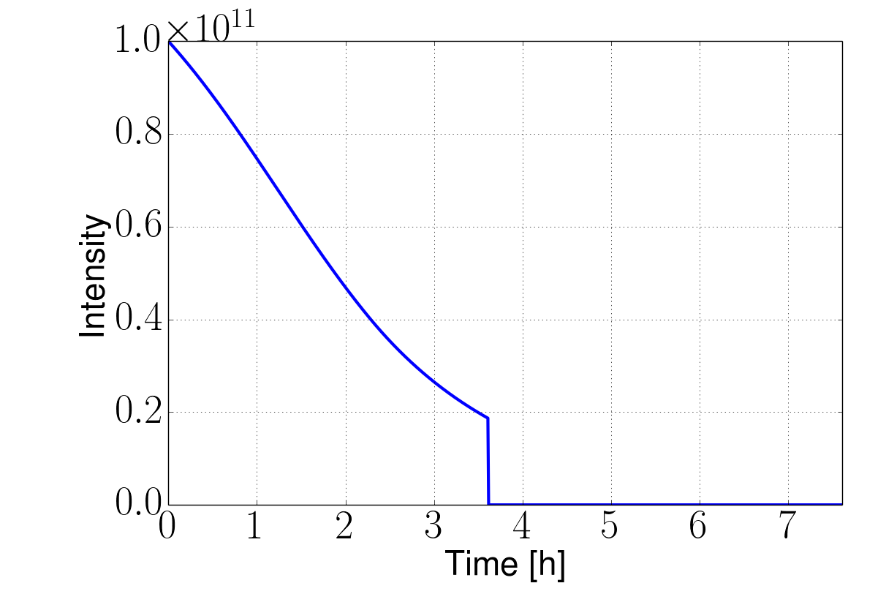
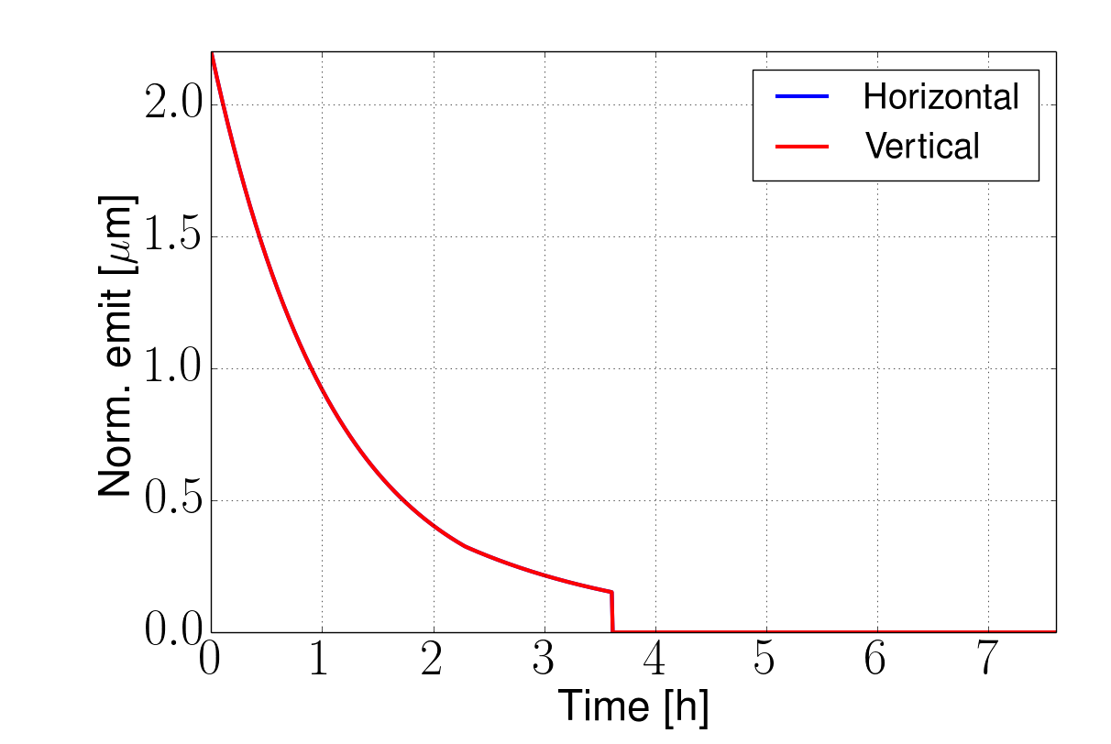
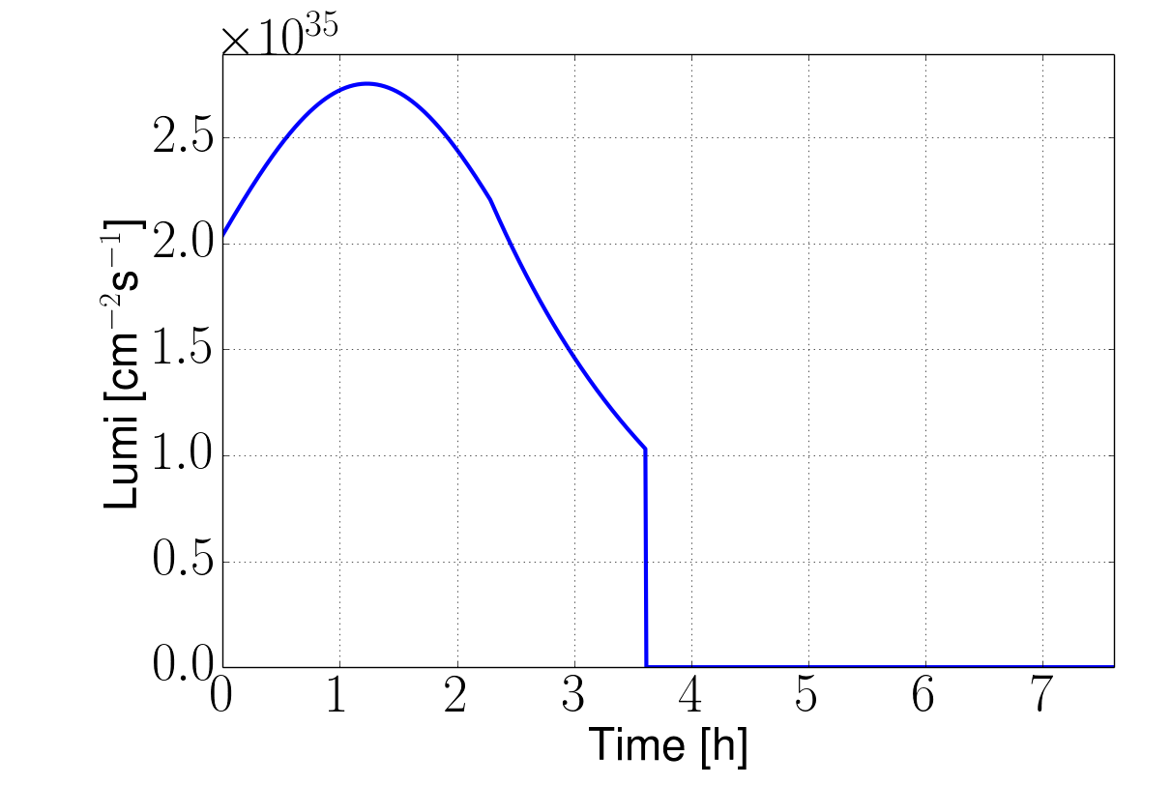
Luminosity During a Run
Developing model including all relevant effects
Iterations required
Can reach >8fb⁻¹/day with ultimate for ξ=0.03
    5000fb⁻¹ per 5 year run
Beam is burned quickly
  Another reason to have enough charge stored
Ultimate example, 25ns, no luminosity levelling
8fb⁻¹/day
Turn-around time

Slide 21
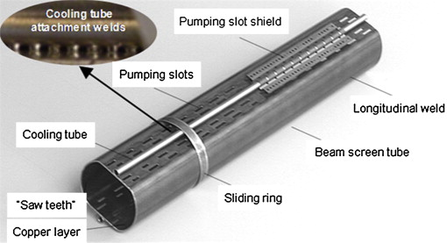
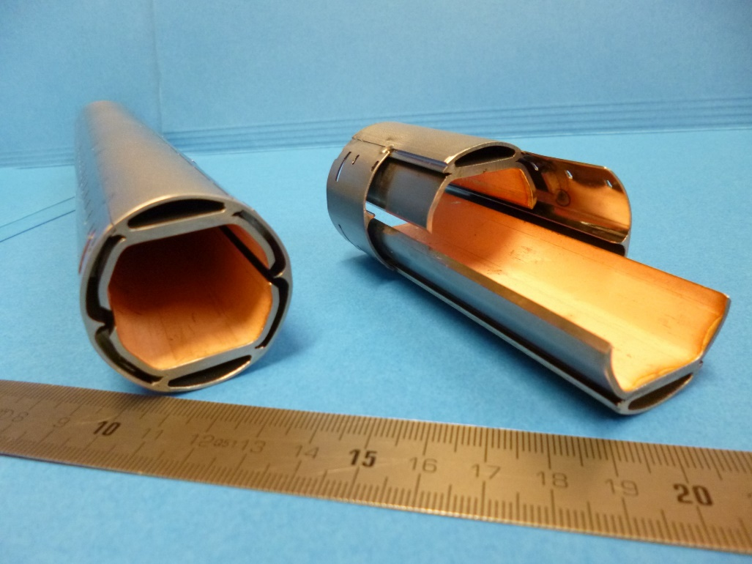
Beamscreen Design
LHC beamscreen
Beamscreen protects magnets from synchrotron radiation and other heat inducing processes

Slide 22
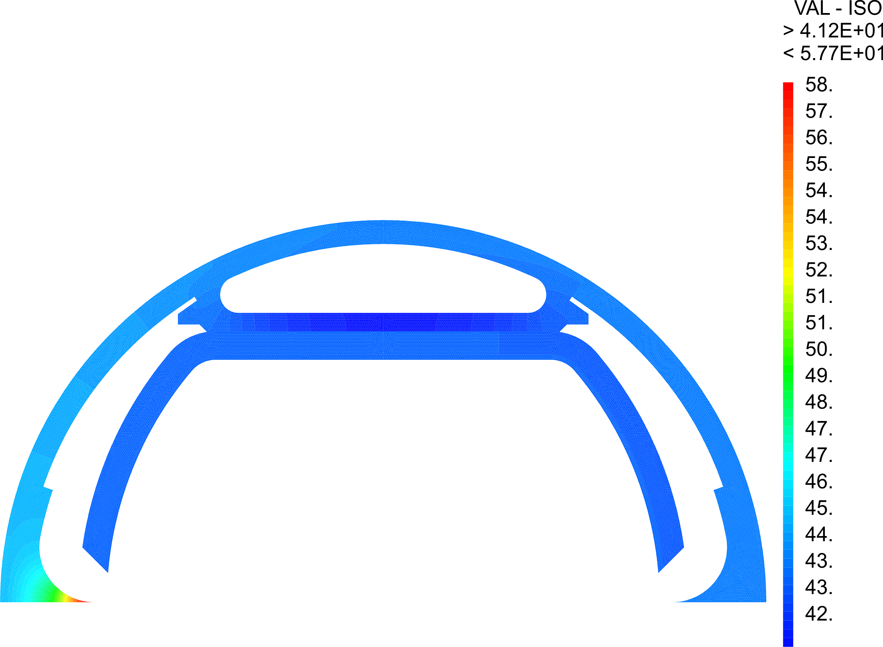
Example: Beam Screen Design
5 MW synchrotron radiation
3,500 MW cooling power at 2K
Need to shield the magnet with beamscreen at 50K
Need 100 MW
Magnets at 2K
Vacuum insulates
Heat transfer
Cryogenics:
50K
Space for helium flow

Slide 23
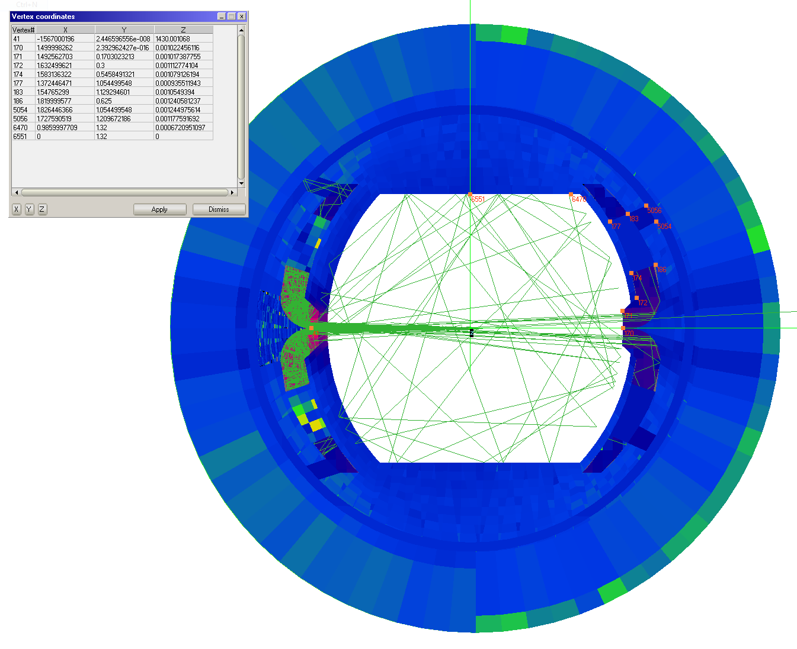
Example: Beam Screen Design
Heat transfer
Vacuum:
Pumping holes
Localisation of synchrotron radiation

Slide 24
Example: Beam Screen Design
Beam physics and RF
Impedance:
- Aperture >26mm
0.3mm copper coating
Pumping holes shielded by slit

Slide 25
Example: Beam Screen Design
Strong forces if magnet quenches

Slide 26
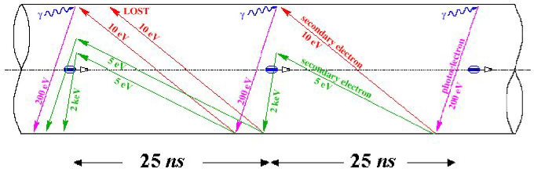
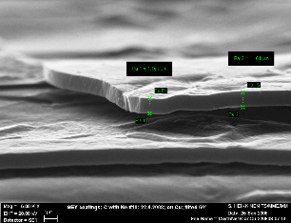
Example: Beam Screen Design
LESS
a-C
Surface treatment against electron cloud
How much does it add to the impedance?

Slide 27
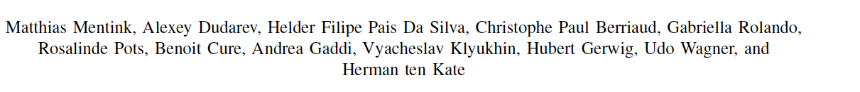
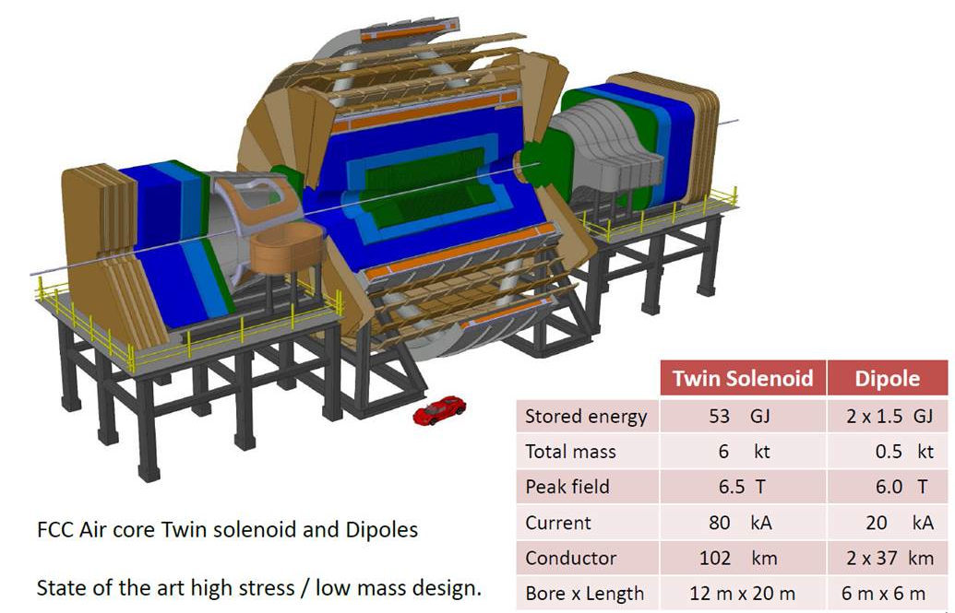
(Almost) Current FCC Detector Model

Slide 28
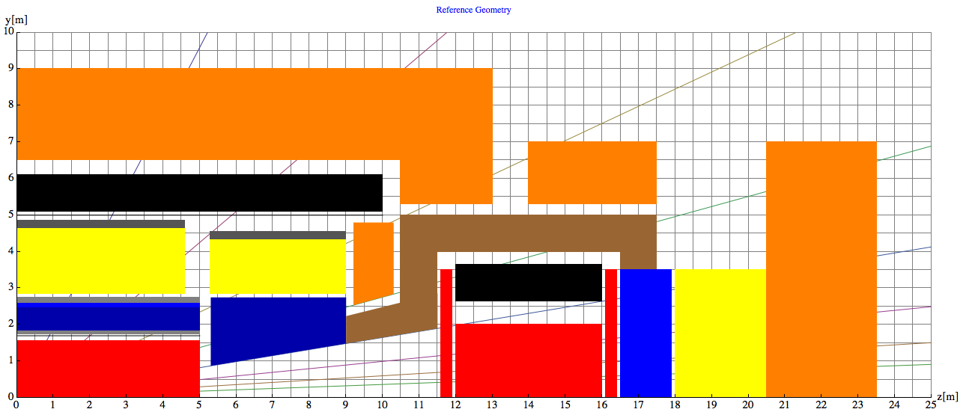
FCC Machine Detector Interface
Experiments like to stay at L*=45m to allow for other solutions
But high cost for this
Tracking
Ecal
HCAL
Magnets and cryostat
Muons
No dipole any more
But forward solenoid
Add. protection
TAS
Triplet
Hall half length: 35m
L*=45 m
Detector half length 23.5m
Space to open 11.5m

Slide 29

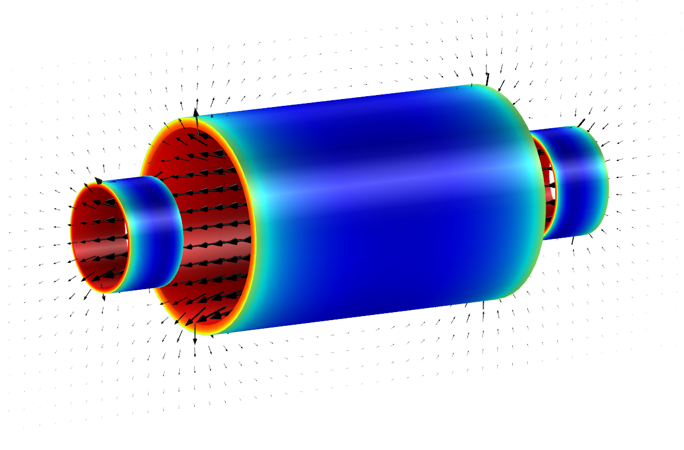
Detector Solenoid
Today’s baseline:
4T/10m bore 20m long Main Solenoid 4T Side Solenoids – all unshielded
14 GJ stored energy, 30 kA and 2200 tons system weight

Slide 30
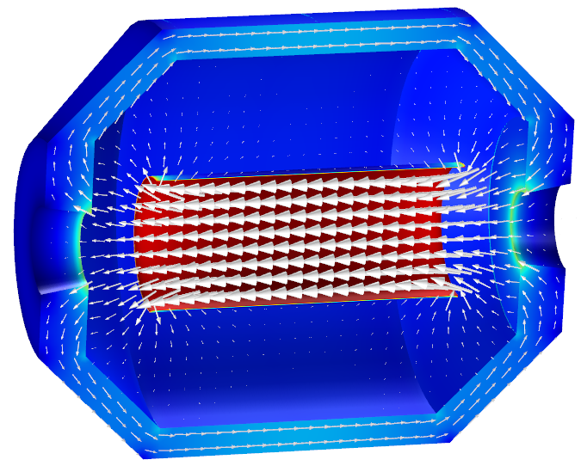
Alternative
4T/4m Ultra-thin, high-strength main solenoid allowing positioning inside the e-calorimeter (side solenoids not shown)
0.9 GJ stored energy, elegant, 25 t only,
but needs R&D!
ECAL + HCAL
Tracker
Has to be thin not to compromise physics

Slide 31
High-luminosity Insertions
High-luminosity Insertions
Beam size is limited by aperture in the magnets

Slide 32
Radiation from Beam-beam
Shield (TAS)
Magnets
Total power of background events 100-500kW per experiment
  Car or truck engine
Already a problem in LHC and HL-LHC
  Lifetime of magnets, heat load and quench
But under control with 50mm shielding

Slide 33
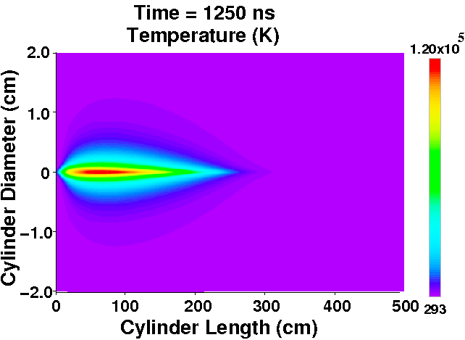
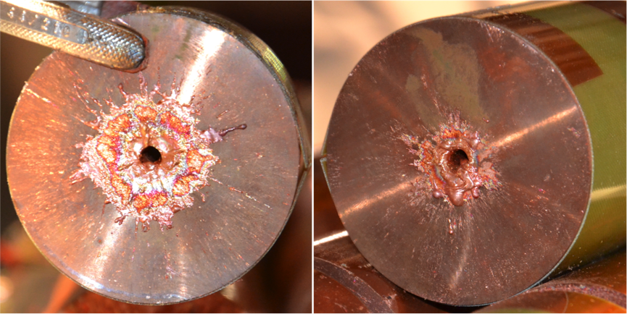
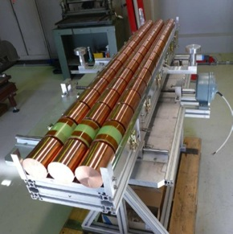
Beam Dump Considerations
8GJ kinetic energy per beam
Airbus A380 at 720km/h
2000kg TNT
400kg of chocolate
  Run 25,000km to spent calories
O(20) times LHC
Hydrodynamic tunneling
Simulation show beam will penetrate ~ 300 m in Copper, assuming no dilution.
→ Dilution required!

Slide 34
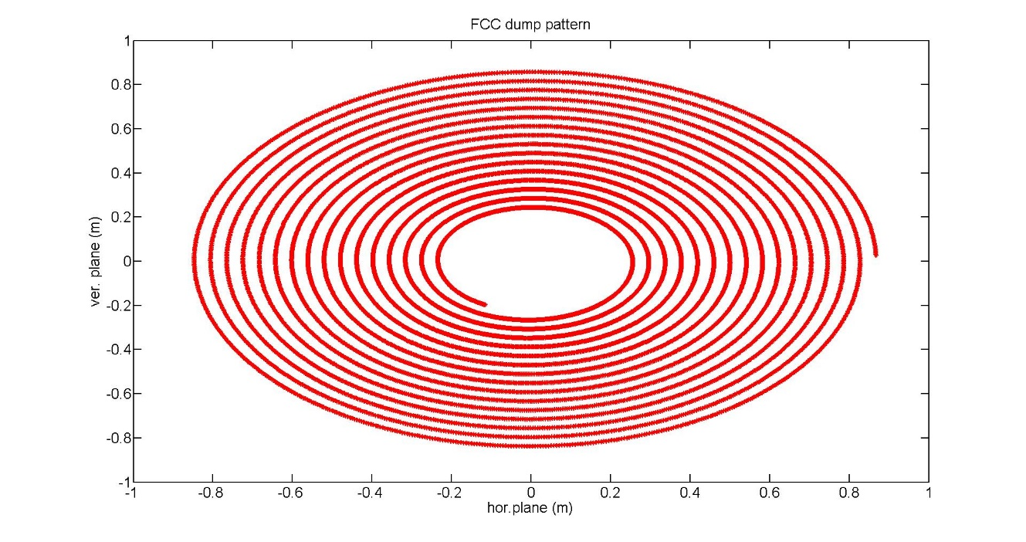
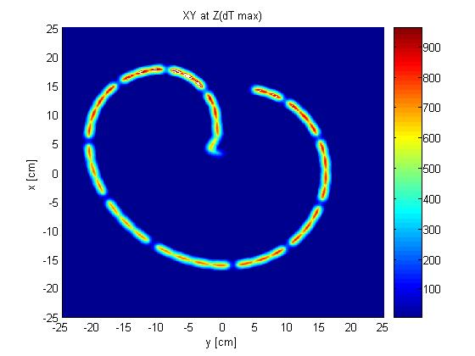
Dilution System
F. Burkart et al.
2.5 km dump line
1.4 km dump insertion
2.8 km collimation insertion
Kicker
Septum
10 mrad bend
Dilution
Absorber
2m
Fluka studies of required pattern:
Bunch separation > 1.8 mm
Branch separation: 4 cm
Keeps T<1500°C
Horizontal and vertical kicker system as in the LHC
~ 300 m, ~150kickers, to be optimized
Large magnet apertures required towards dump
Different solutions studied
Require up to 80cm radius
LHC pattern (same scale)

Slide 35
Collimation System
Three main goals:
Protect from injection failure
Protect from asynchronous beam dump
Removes particles that enter the tails
Much more challenging in FCC than in LHC due to much higher beam power

Slide 36
Collimation
Collimation system should sustain high beam losses
This gives time to identify and fix the problem
Main challenge to sustain 11MW losses:
Beam loss can induce high heat load in some collimators
  Up to 250kW (20 x LHC values)
  New design to avoid collimator to deform
Small leakage into cold arcs can induce quench
  Additional collimators in dispersion suppressors

Slide 37
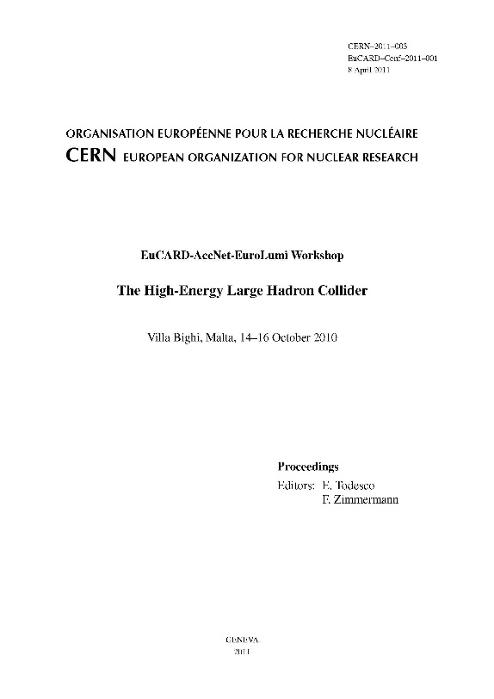
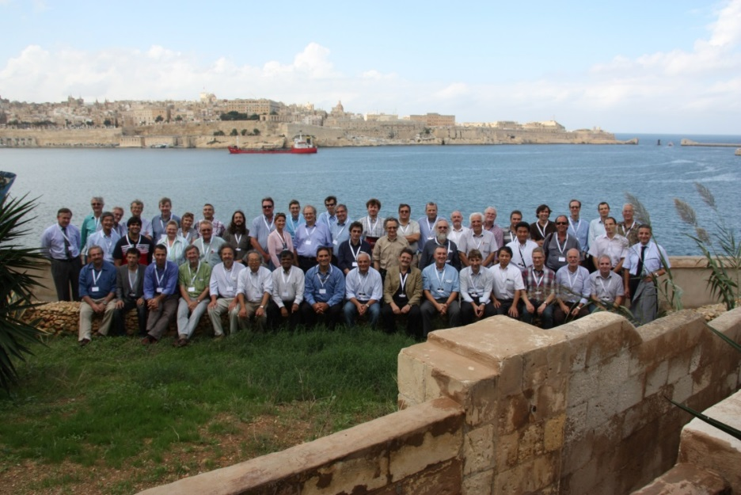
HE-LHC
FCC study continues effort on high-field collider in LHC tunnel
2010 EuCARD Workshop Malta;
Yellow Report CERN-2011-1
based on 16-T dipoles developed for FCC-hh
extrapolation from (HL-)LHC and from FCC developments
Present focus: optics scaling, infrastructure requirements & integration
FCC study continues effort on high-field collider in LHC tunnel
2010 EuCARD Workshop Malta;
Yellow Report CERN-2011-1
based on 16-T dipoles developed for FCC-hh
extrapolation from (HL-)LHC and from FCC developments
Present focus: optics scaling, infrastructure requirements & integration
EuCARD-AccNet-EuroLumi Workshop: The High-Energy Large Hadron Collider - HE-LHC10,
E. Todesco and F. Zimmermann (eds.), EuCARD-CON-2011-001; arXiv:1111.7188; CERN-2011-003 (2011)

Slide 38
FCC-ee Rational
Can use FCC-hh tunnel
  Tunnel cost has to be paid only once
Can operate at
  90 GeV (“Tera-Z”)
  160GeV (W pairs)
  240GeV (Higgs via Zh)
  350GeV (top threshold, higgs productions via Zh and WW)

Slide 39
FCC-ee Parameters
parameter | FCC-ee (400 MHz) |  |  |  |  | CEPC | LEP2
Physics working point | Z |  | WW | ZH | tt_{bar} | H
energy/beam [GeV] | 45.6 |  | 80 | 120 | 175 | 120 | 105
bunches/beam | 30180 | 91500 | 5260 | 780 | 81 | 50 | 4
bunch spacing [ns] | 7.5 | 2.5 | 50 | 400 | 4000 | 3600 | 22000
bunch population [10¹¹] | 1.0 | 0.33 | 0.6 | 0.8 | 1.7 | 3.8 | 4.2
beam current [mA] | 1450 | 1450 | 152 | 30 | 6.6 | 16.6 | 3
luminosity/IP x 10³⁴cm⁻²s⁻¹ | 210 | 90 | 19 | 5.1 | 1.3 | 2.0 | 0.0012
energy loss/turn [GeV] | 0.03 | 0.03 | 0.33 | 1.67 | 7.55 | 3.1 | 3.34
synchrotron power [MW] | 100 |  |  |  |  | 103 | 22
RF voltage [GV] | 0.4 | 0.2 | 0.8 | 3.0 | 10 | 6.9 | 3.5

Slide 40
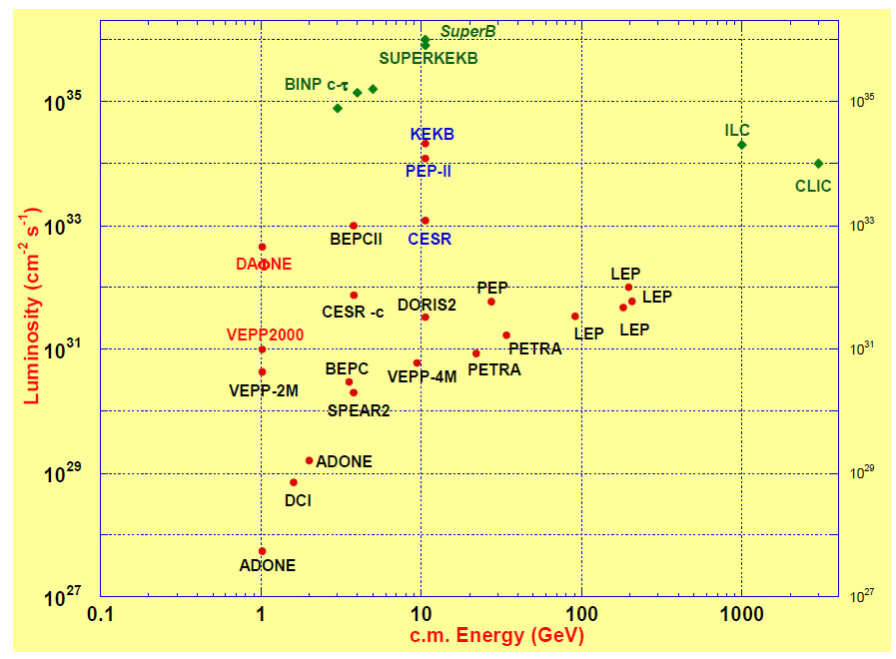
Ingredients
LEP:
high energy
SR effects
B-factories:
KEKB & PEP-II:
high beam
currents
top-up injection
DAFNE: crab waist
Super B-factories
S-KEKB: low β_{y}*
KEKB: e⁺ source
HERA, LEP, RHIC:
spin
gymnastics
FCC-ee

Slide 41
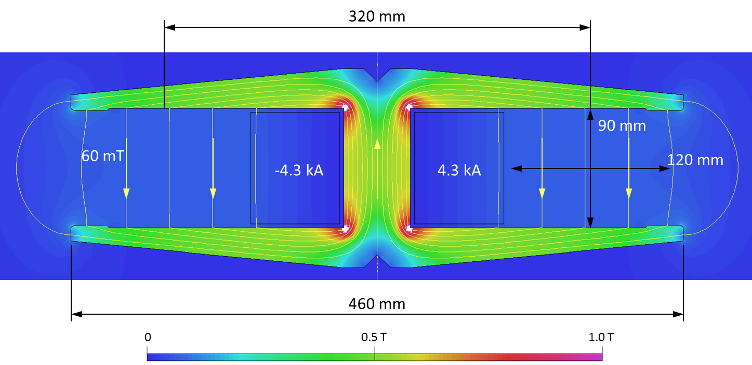
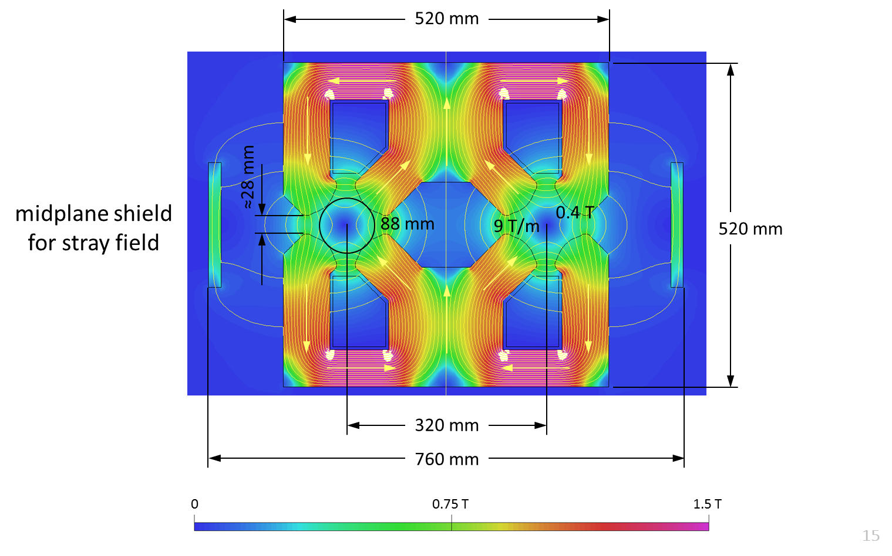
Magnet Design
Dipole:
twin aperture yoke
single busbars as coils
Quadrupole:
twin 2-in-1 design
Novel arrangements allow for considerable savings in Ampere-turns and power consumption
Less units to manufacture, transport, install, align, remove,…

Slide 42
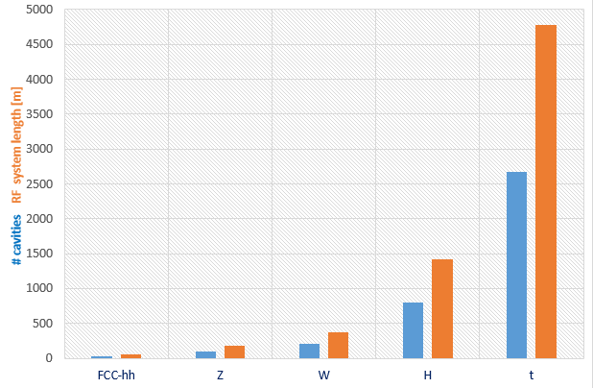

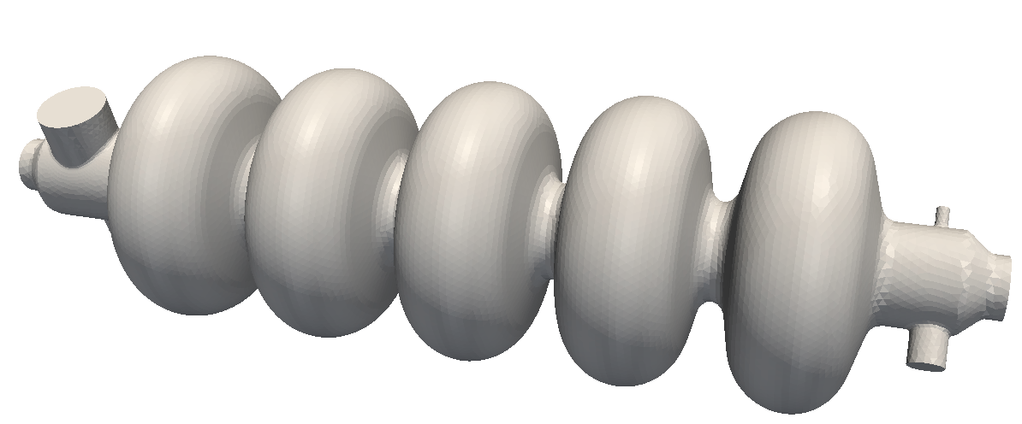
RF System Requirements
Very large range of operation parameters
“Ampere-class” machines
Naive scale up from an hh system
 | V_{total} GV | n_{bunches} | I_{beam} mA | ΔE/turn GeV
hh | 0.032 |  | 500
Z | 0.4/0.2 | 30000/90000 | 1450 | 0.034
W | 0.8 | 5162 | 152 | 0.33
H | 5.5 | 770 | 30 | 1.67
t | 10 | 78 | 6.6 | 7.55
x6
x12
≈ 16 x 1 cell 400MHz,
“high gradient” machines
Voltage and beam current ranges span more than factor > 10²
No well-adapted single RF system solution satisfying requirements

Slide 43
RF System Design
400 MHz single-cell cavities preferred for hh and ee-Z (few MeV/m)
Baseline Nb/Cu @4.5 K, development with synergies to HL-LHC, HE-LHC
R&D: power coupling 1 MW/cell, HOM power handling (damper, cryomodule)
hh
Z
W
≈ 16 cells per beam
≈ 100 per beam
(+ 100 for booster ring)
≈ 210 per beam
(+ 210 for booster ring)
400 or 800 MHz multi-cell cavities preferred for ee-ZH, ee-tt and ee-WW
Baseline options 400 MHz Nb/Cu @4.5 K, ◄▬► 800 MHz bulk Nb system @2K
R&D: High Q₀ cavities, coating, long-term: Nb₃Sn like components
W
H
t
≈ 200 per beam
(+ 200 for booster)
≈ 800 per beam
(+ 800 for booster)
≈ common 2600 cells for both beams
(+ 2600 for booster)

Slide 44
Matching of Layouts
Need crossing angle between the beams
Two tunnels to avoid strong bending of beam
Have to find a solution consistent with FCC-hh

Slide 45
Conclusion
The FCC study aims at CDR for European strategy update (2018)
First baseline exists
  Much more work required to optimise
  Help would be very welcome
More work to be done
  Exciting technological challenges
  Exciting beam physics
  Exciting physics
We are looking for more collaboration
We are looking for good people
  Including PhD students
Many thanks to the FCC team for the work and to you for the opportunity to present the project

Slide 47
Arc Cell Layout
Longer cell
better dipole filling factor
Shorter cells
more stable beam
12 dipoles with L=14.3m
L_{cell}=214.755m
Fill factor about 80%
Field (100km ring): (16-ε)T

Slide 48
Dipole Basic Concept (“Cosine Theta”)
B
I(φ)
φ
I(φ)

Slide 49
Magnet Design Issues
Field level
  Higher field level allows to use a smaller ring
  But is technically challenging
Aperture
  A larger aperture means more volume with the magnetic field
  Larger stored energy and larger forces
  Higher cost
The field quality
  Unwanted non-linear field components
  Especially at injection (low field)
  Can make particles move chaotic and be lost
The cost
  The most costly component in the machine

Slide 50
Limits for the Field
The cable can quench (superconductivity breaks down)
if the current is too high
If the magnetic field is too high
This limits the achievable field
  In theory
  Even lower limit in practice (shown)
Can use different materials
  Nb-Ti is used for LHC
  Nb₃Sn is used for high luminosity upgrade

Slide 51
Cost Effective Magnet Design
Nb₃Sn is much more costly than Nb-Ti
Use both materials
Coil sketch of a 15 T magnet with grading, E. Todesco

Slide 52
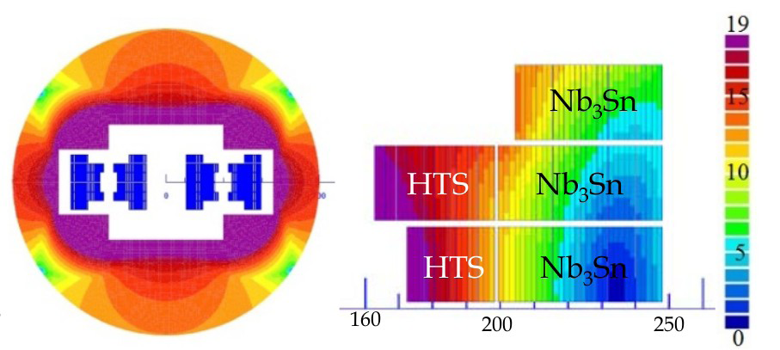
Cost Effective Magnet Design II
HTS is even more expensive than Nb₃Sn
Even more complex design
Coil sketch of a 20 T magnet with grading, E. Todesco

Slide 53
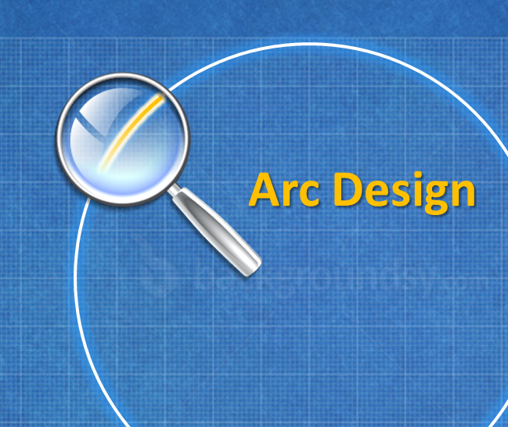



EuroCirCol
Arc Design
EIR Design
Cryo Beam Vacuum
High Field Magnet
CERN | IEIO
TUT | Finland
CEA | France
CNRS | France
KIT | Germany
TUD | Germany
INFN | Italy
UT | Netherlands
ALBA | Spain
CIEMAT | Spain
STFC | United Kingdom
UNILIV | United Kingdom
UOXF | United Kingdom
KEK | Japan
EPFL | Switzerland
UNIGE | Switzerland
NHFML-FSU | USA
BNL | USA
FNAL | USA
LBNL | USA
Japan
KEK
Finland
TUT
EU co-funded design study for FCC-hh, focus on core activities
United Kingdom
STFC, UNILIV, UOXF
Netherlands
UT
Germany
KIT, TUD
France
CEA, CNRS
CERN
Switzerland
EPFL, UNIGE
Italy
INFN
Spain
ALBA, CIEMAT

Slide 54
Power for Cooling
Beam screen cooling
Cold bore cooling

Slide 55
The Key Challenges
Energy
  Limited by the machine size and the strength of the bending dipoles
Luminosity
  Need to have enough beam and maximise the use of the beam for luminosity production
Beam power handling
  The beam can damage the machine
  Quench the magnets
  Create background in the experiments
  Need a concept to deal with the beam power
Cost
  The total cost is a concern, so we have to push everything to the limit to reduce cost
  Most things will become difficult

Slide 56
Choice of Temperature
Can only use some temperatures in order to maintain good vacuum
<20, 40K-60K, 100K-120K, >190K
300MW
200MW
100MW
But at 100K the impedance is about twice as high as at 50K
Choose 50K
Need 20x5MW=100MW for cooling
Proton beams emit about 5MW of synchrotron radiation
About 30W/m/beam

Slide 57
Note: EuroCirCol
Arc Design
EIR Design
Cryo Beam Vacuum
High Field Magnet
CERN | IEIO
TUT | Finland
CEA | France
CNRS | France
KIT | Germany
TUD | Germany
INFN | Italy
UT | Netherlands
ALBA | Spain
CIEMAT | Spain
STFC | United Kingdom
UNILIV | United Kingdom
UOXF | United Kingdom
KEK | Japan
EPFL | Switzerland
UNIGE | Switzerland
NHFML-FSU | USA
BNL | USA
FNAL | USA
LBNL | USA
Japan
KEK
EU co-funded design study for FCC-hh, focus on core activities
Accepted in 2015
Finland
TUT
United Kingdom
STFC, UNILIV, UOXF
Netherlands
UT
Germany
KIT, TUD
France
CEA, CNRS
CERN
Switzerland
EPFL, UNIGE
Italy
INFN
Spain
ALBA, CIEMAT

