Slide 1
LINAC 4 BPM
Michele Bozzolan (BI/PI)
BI day, 29-06-2017
With contributions from J.Tan (BE/BI) & J.B. Lallement (BE/ABP)

Slide 2
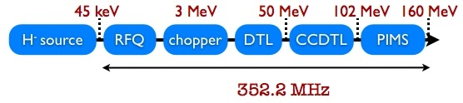
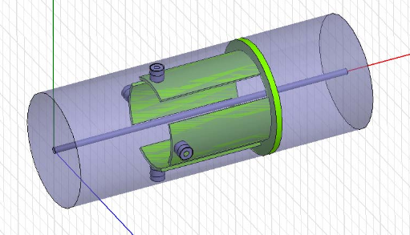
LINAC 4 Overview
Normal conducting LINAC aimed to replace LINAC 2 after LS2
H⁻ ions
80m long
Macro-pulse lenght up to 600μs @ 30mA average current
2 BPMs in DTL, 7 in CCDTL, 6 in PIMS, 10 in the transfer line
BPM type: Shorted stripline
  Compact size
  Easy calibration of the coax cable

Slide 3





LINAC 4 beam
1.2s
Intensity
600μs
Macropulses
time [s]
Intensity
$$\frac{1}{f_{RF}}=2.8ns$$
Bunches
(18 ... 222 injected into the PSB per turn)
$$σ=10ps .. . 800ps$$
Time [ns]
Intensity
What we measure
Spectral components
$$f_{RF}$$
$${2f}_{RF}$$
$${3f}_{RF}$$
Frequency

Slide 4


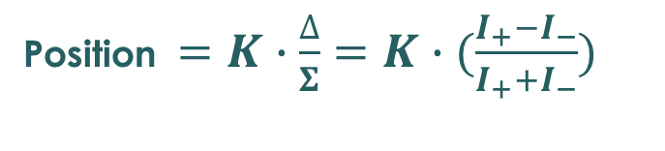
Image current principle
I₊
Conducting Beam pipe
+
-
v≈c
+
I₋
Electric field is null inside (and outside) the pipe
Relativistic charges produce TEM fields
Free electrons of the metal compensate for the beam’s field
Measuring the image current in opposite location of the pipe allow us to estimate beam location and intensity.
Position $=K∙\frac{∆}{Σ}=K∙(\frac{I_{+}−I_{−}}{I_{+}+I_{−}})$
Intensity ${ \sim Σ=(I}_{+}+I_{−})$
sensitivity

Slide 5
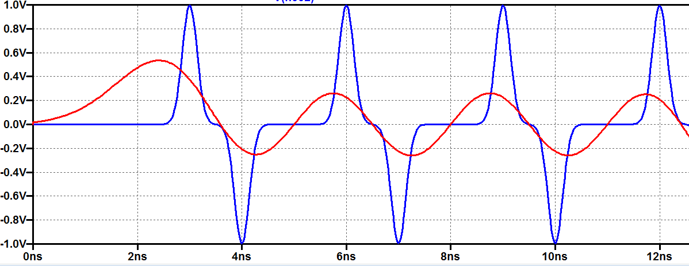






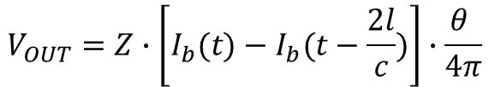
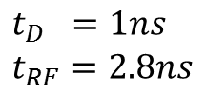
Shorted Stripline BPM (relativistic beam)
$$t_{D}=\frac{2l}{c}$$
Z=50Ω cable
V_{out}
R=50Ω
Z=50Ω stripline
t
$$θ$$
$$V_{OUT}=Z∙\left[I_{b}(t)−I_{b}(t−\frac{2l}{c})\right]∙\frac{θ }{4π}$$
$$l$$
Gaussian bunches
response
$$t_{RF}=\frac{1}{f_{RF}}$$
$$t_{D} =1ns \\ t_{RF}=2.8ns$$
V_{out}
$$σ=0.2ns$$
$$σ=1.5ns$$
Signal strenght is bunch shape dependant:
V_{OUT} = f{ I , σ , ...}
No absolute intensity measurement is possible (in general)

Slide 6
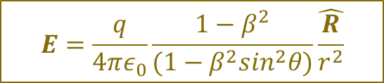


Electric field of a point charge
Static case
Uniform motion
$$v=β∙c$$
$$E=\frac{q}{4π{ε_{0}r}^{2}}\hat{r}$$
$$E=\frac{q}{4πε_{0}}\frac{1−β^{2}}{(1−β^{2}\sin^{2}θ)}\hat{\frac{R}{r^{2}}}$$
Field produced by the charge is the same but
field lines get compressed by the lorentz factor when seen from
an observer at rest (i.e. our instrument)

Slide 7
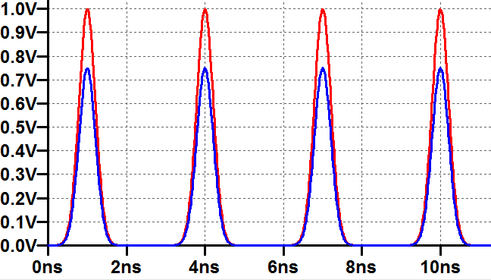
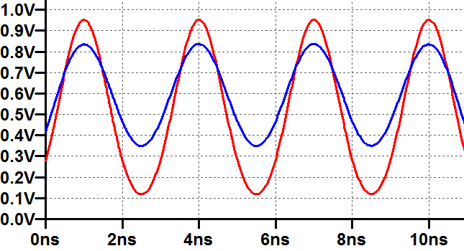
Low β effects
Relativistic beam: β≈1→ v≈c
Low beta beam: β<1
d₁
pipe
d₂
pipe
I₊
I₊
-
-
-
offset
-
-
-
offset
I₋
I₋
Region of image charges
Overlapping
I₊
I₊
I₋
I₋
1) Lower β flatten the signals (i.e. less HF components) → less amplitude
2) The furthest image current is more affected → higher position sensitivity

Slide 8
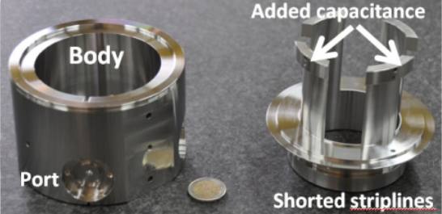
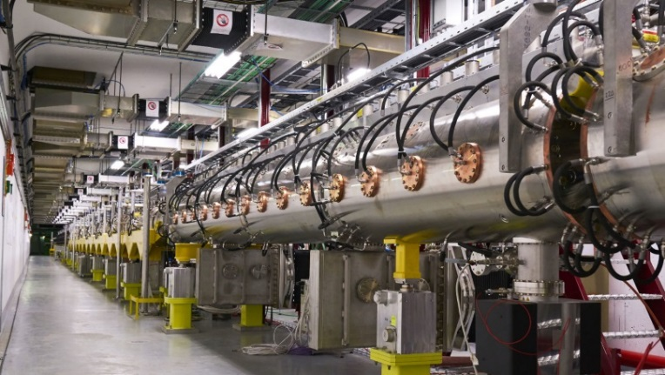
BPM system overview
TUNNEL
50 ...100m coax
FARADAY CAGE
352MHz
-40 ... 0 dBm
FEC
Analog front end
22MHz
ADC
16 bit
88Msps
H+
LPF
LPF
352MHz
Cal signal
H-
330MHz
L.O.
V+
V-
Individual signal treatment of the 4 electrodes
352MHz component (30MHz BW) measured
Compensation of cable and amplifier chain by calibration pulse injection

Slide 9
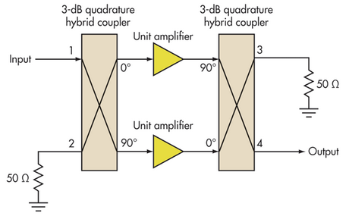
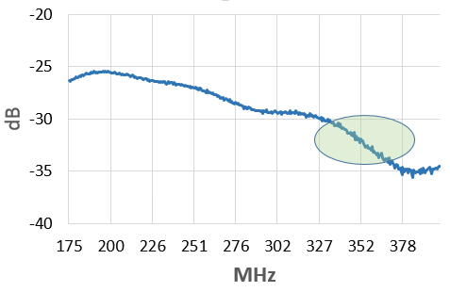
Analog Front End
Linear over the signal dynamic range
Good input match
Low noise
attenuator
(Ideal) Balanced amplifier features:
3dB higher dynamic range
Perfect input match
No noise degradation
Main limitation: hybrid coupler
L4 AFE input match
L4 AFE main features:
operating region
Gain: 2 ... 48dB in 0.5db steps
P1dB: > 15dBm (input power)
N.F. : 12dB
Power: 8W

Slide 10
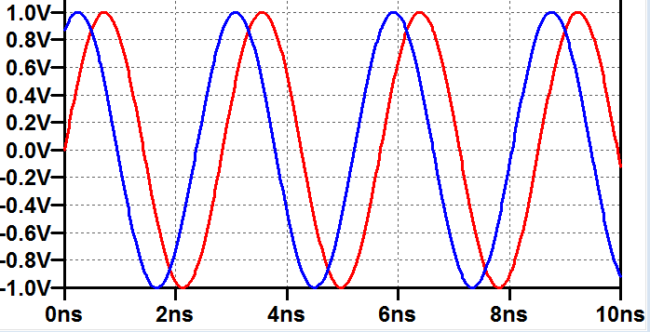




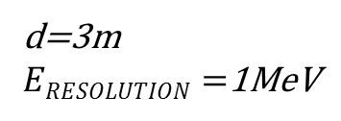


Energy measurement by time of flight
BPM
A
BPM
B
Drift space
$$t=\frac{d}{βc} → β=\frac{d}{ct}$$
$$v=β∙c$$
$$d$$
d=3m
$ERESOLUTION=$1MeV
Direct time delay measurement is not practical
Time resolution ~ 1ns
RF=352MHz
φ_{RESOLUTION}=5°
Time resolution =40ps
Phase delay give excellent time resolution but integer delay of half RF period (K) is unknown.
In L4: ~10<K<hundreds
-π<$∆φ<+\text{π}$
integer
$$∆φ$$
$$∆t=\left(\frac{K}{2}+\frac{∆φ }{2π}\right)∙\frac{1}{f_{RF}}$$

Slide 11
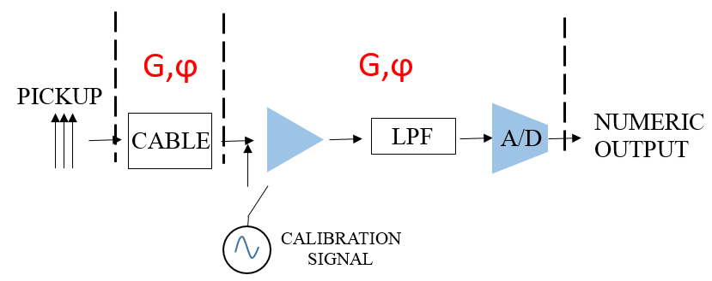
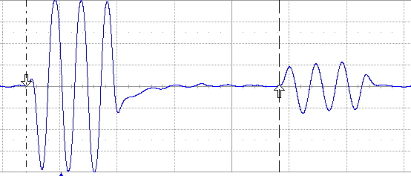




Calibration
Measure of amplitude asymmetries between + & - signal paths
Measure of phase delay between different PUs acquisition chain
ELECTRONICS
$$G_{CABLE}=\sqrt{\frac{A_{REFLECTED}}{A_{DIRECT}}}$$
Calibration signals
Direct pulse
Reflected pulse
$$φ_{CABLE}=\frac{ϕ_{REFLECTED}\text{−}ϕ_{DIRECT}}{2}$$
$${G′}_{ELECTRONICS}=A_{DIRECT}$$
Relative measures
${ϕ′}_{ELECTRONICS}=$ $ϕ_{DIRECT}$
2*cable delay
Calibration mismatch ~ 1/1000
Position error for 30mm sensitivity ~ 30um

Slide 12
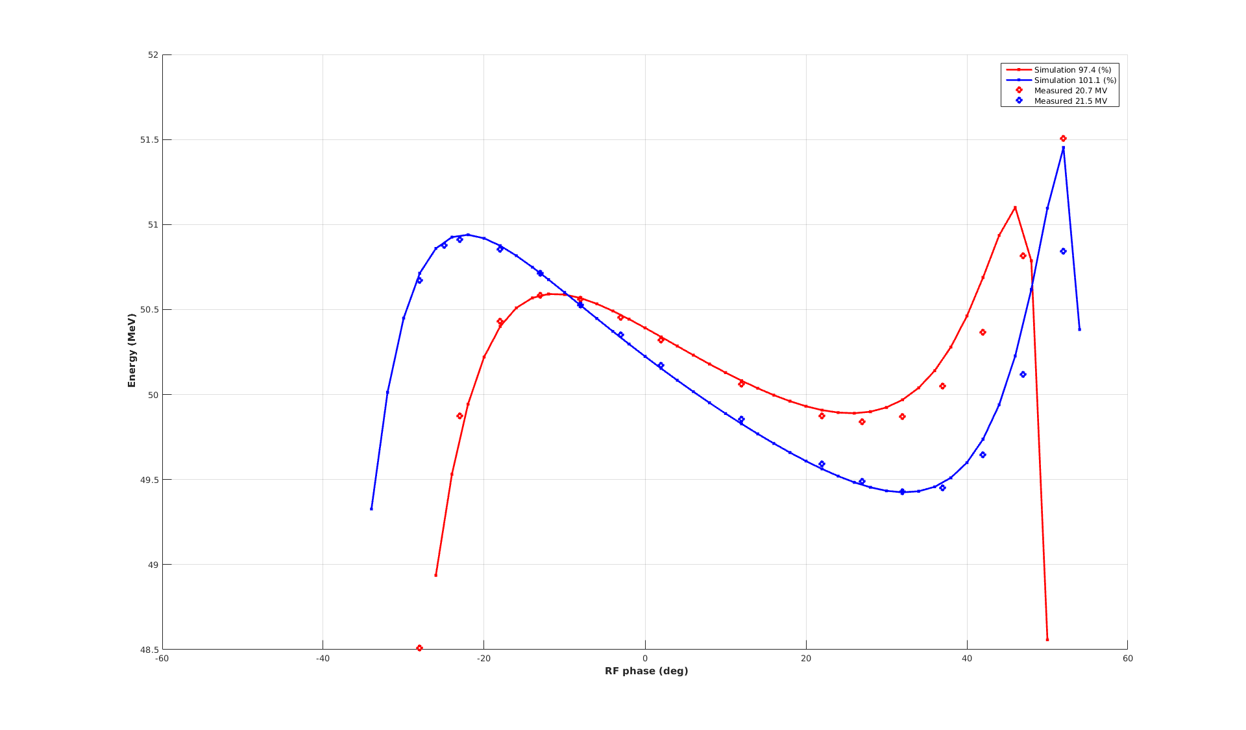
LINAC 4 cavity tuning
BPM A
BPM B
BPM C
Each cavity must be setup (in terms of voltage and phase) to match the simulated beam dynamic conditions
Following cavities are unpowered and detuned
52
Meas. @ 20.7MV
Simulation 101%
Meas. @ 21.5MV
51
DTL3
cavity
Kinetic energy [MeV]
50
From LINAC4 elogbook
49
Simulation 97%
-60
-40
-20
0
20
40
60
RF phase [deg]

Slide 13
Status and outlook
BPMs have been installing during the L4 construction phases (2014 ... LS2)
New FESA class developed (2017) to solve issues with server crashes
New JAVA based expertGUI under development
TOF still measured by a python scrypt.
A BI server application and an OP GUI application are under development
Algorithm for the estimation of TOF at the lowest energies to be improved

