Slide 2
Wire scanner calibration application
By Marta Vicente Romero
BI-SW

Slide 3
Wire scanner calibration application
  Introduction
  Calibration Bench
  Analysis
  Overview ExpertGUI
  Architecture
  Demo
  Future and conclusions
  Questions

Slide 4
1 Introduction
  Application used to perform the position calibration of currently operational wire scanners in PS and PSB
  Aim is to automatize the construction of calibration tables of scanners before their installation in the corresponding machine
    For different speeds
    For both movements, in/home

Slide 5
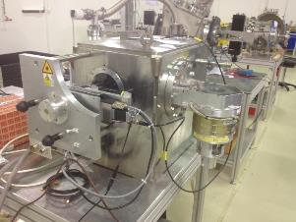
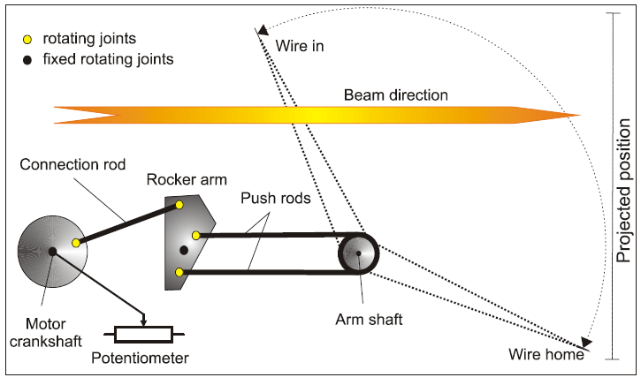

2 Calibration Bench
Based on the acquisition of laser beam for a set of known positions
Result: A table of projected position versus the observable : potentiometer value
Laser
Splitter
Combiner
Photodiode
Two different calibration benches -> different calibration configuration

Slide 6
3 Analysis
  Needs
      Problems detected by the use of the application
      New requirements (by the “calibration team”)
  Obsolete architecture

Slide 7
3 Analysis
Needs
    Problems detected by the use of the application.
      Difficulties to follow the workflow
      Tedious handmade tasks
          Deploy calibration files
          Edition of the result

Slide 8
3 Analysis
Needs
    New requirements:
        Automation of handmade task
        New features:
            Edition: calibration tables edition, peak tables edition, application settings edition.
            Deploy calibration tables and save to a repository
            Task simplification
        Addition of data visualization:
                Charts: calibration tables visualization, position check errors.
        Improve the workflow
            Less steps for the user
            Usability

Slide 9
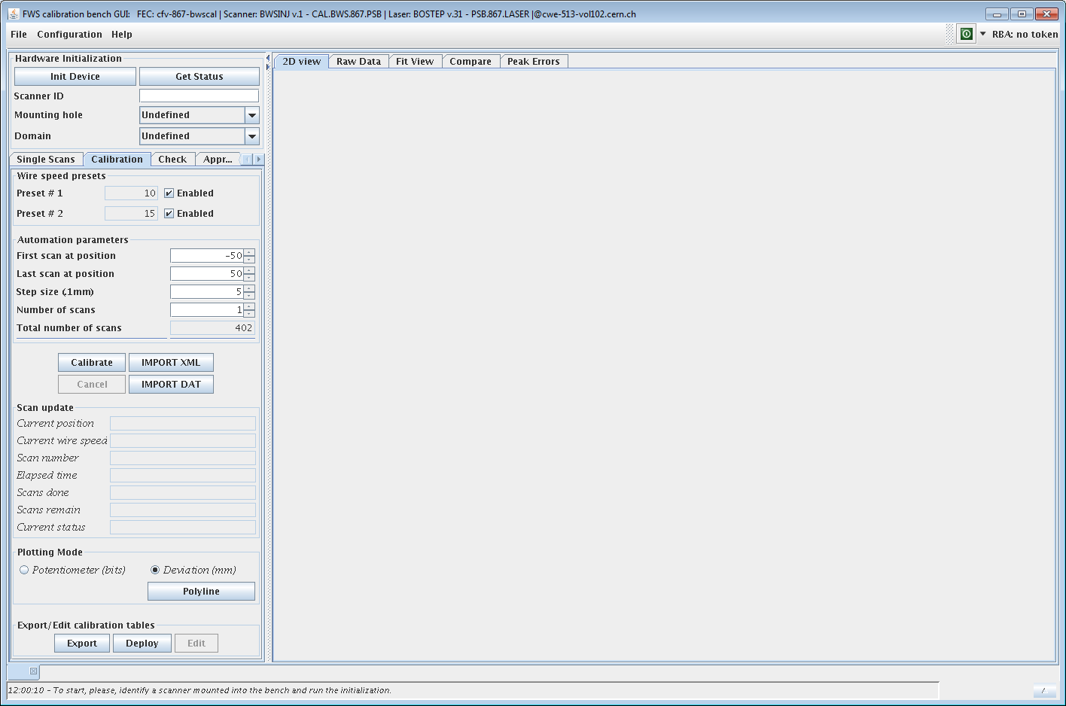
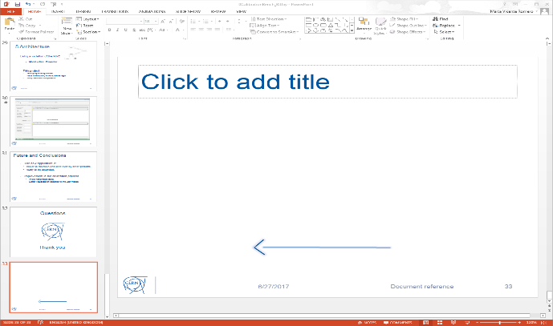
3 Analysis
  Obsolete architecture
      Difficult to maintain and add new requirements.
      Serious improvements were needed.
Solution!!
New Application
Using old data structures
Obsolete!

Slide 10
4 Overview ExpertGUI
Device Control
FESA CLASSES
Wire scanner
(BWSINJ)
Stepping Motors
(BOSTEP)
PS.867.LASER
CAL.BWS.867.PS
PS.867.DIODE
PSB.867.LASER
CAL.BWS.867.PSB
PSB.867.LASER
Laser
Splitter
Combiner
Photodiode

Slide 11
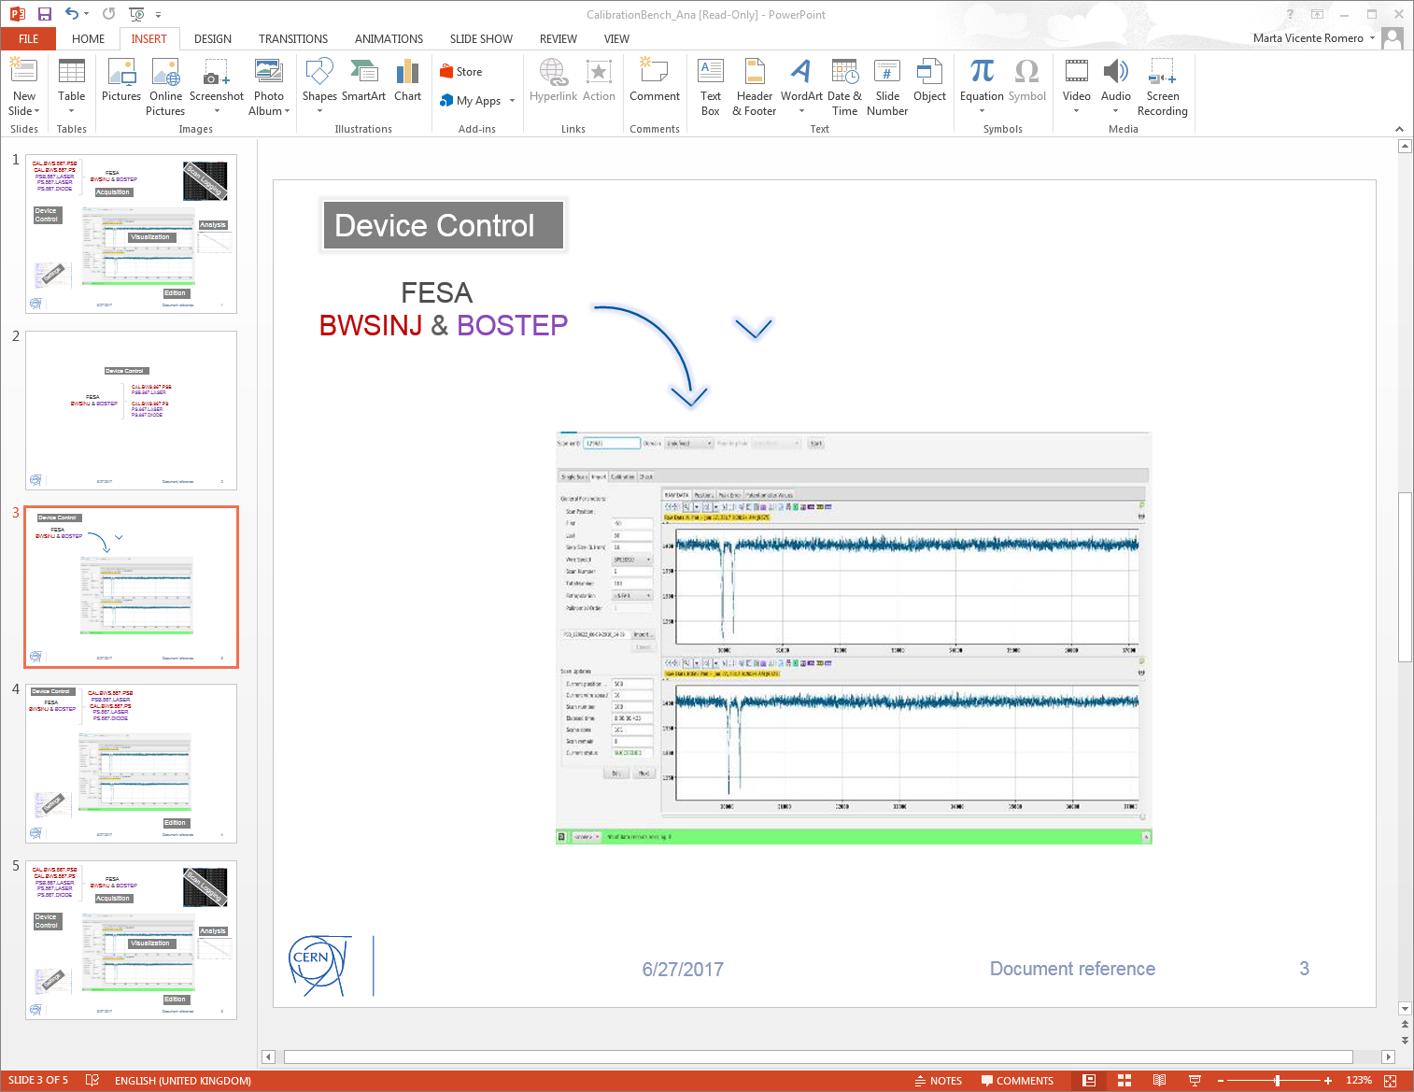
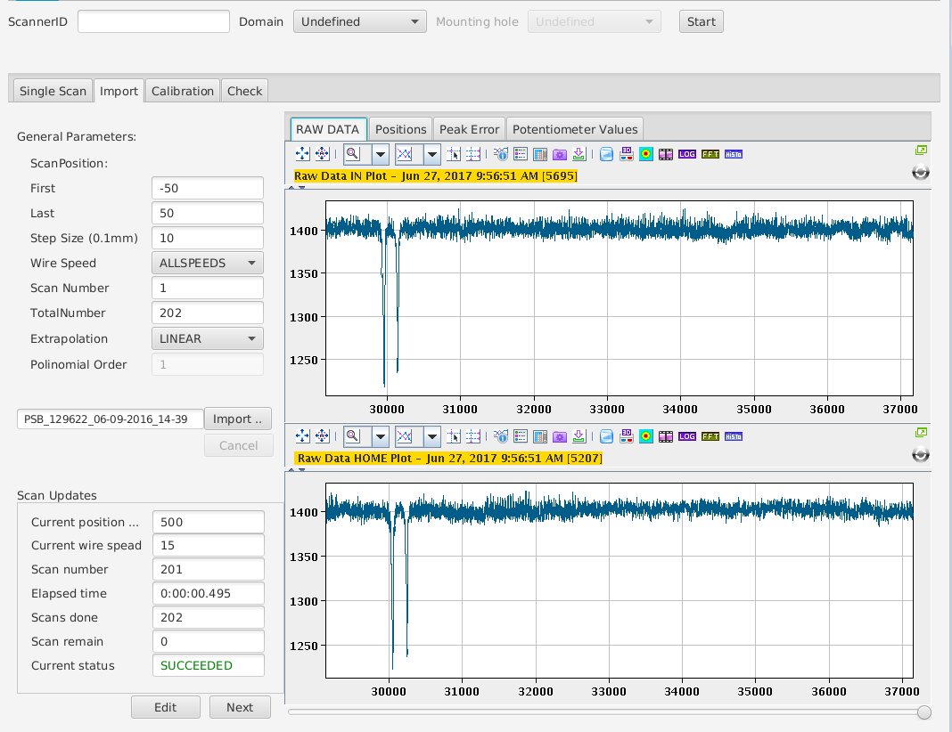
Device Control
FESA
Wire Scanners & Stepping Motors
Acquisition
Settings

Slide 12


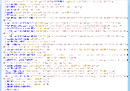
Device Control
FESA
Wire Scanners &
Stepping Motors
Acquisition
Settings
Application Settings

Slide 13


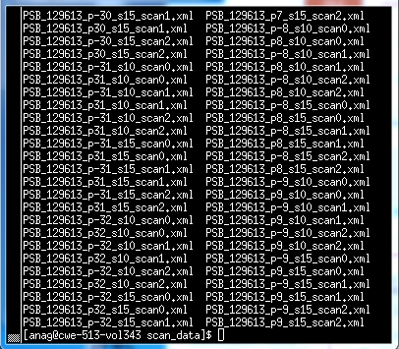
Device Control
FESA
Wire Scanners &
Stepping Motors
Acquisition
Settings
Application Settings
Scans Logging

Slide 14
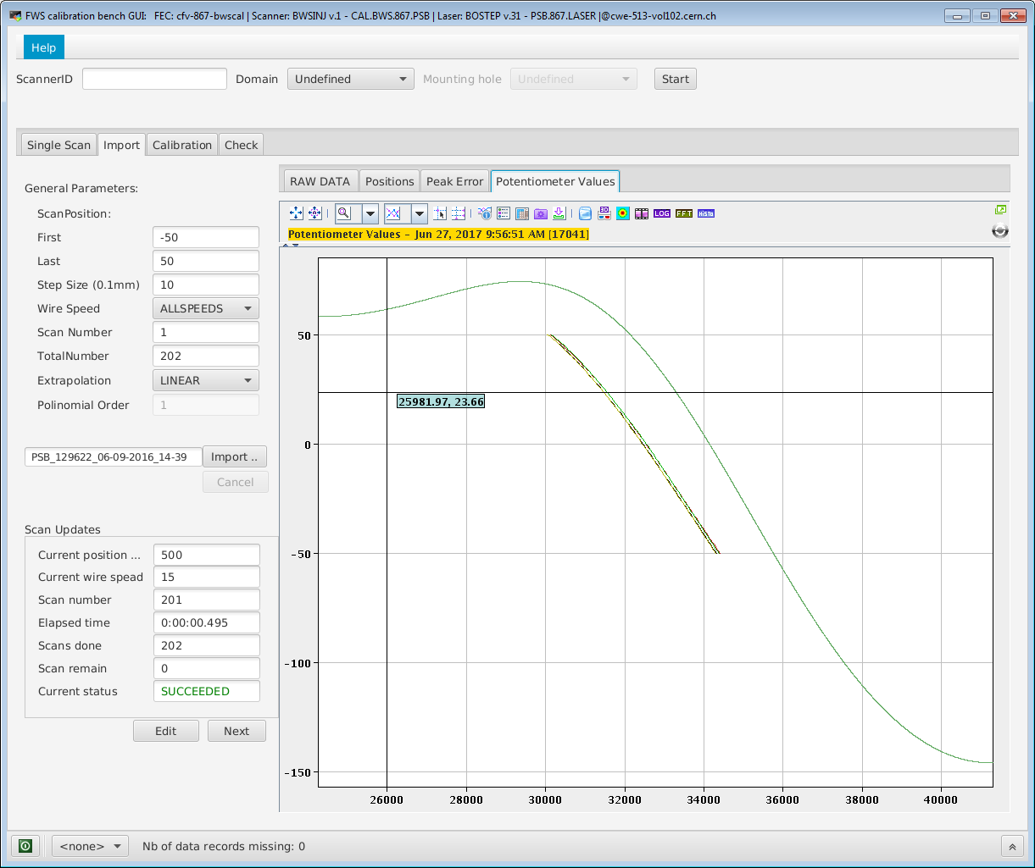
Device Control
FESA
Wire Scanners &
Stepping Motors
Acquisition
Settings
Analysis and Tables
Application Settings
Scans Logging

Slide 15
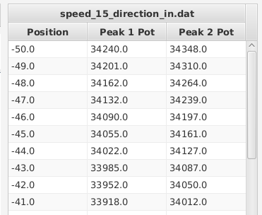

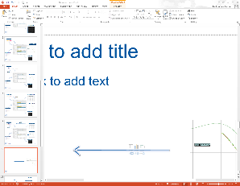
Device Control
Edition
FESA
Wire Scanners &
Stepping Motors
Acquisition
Settings
Analysis and Tables
Application Settings
Scans Logging

Slide 16

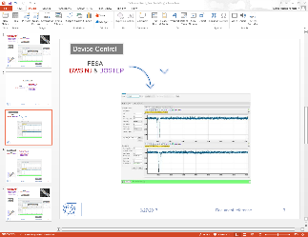
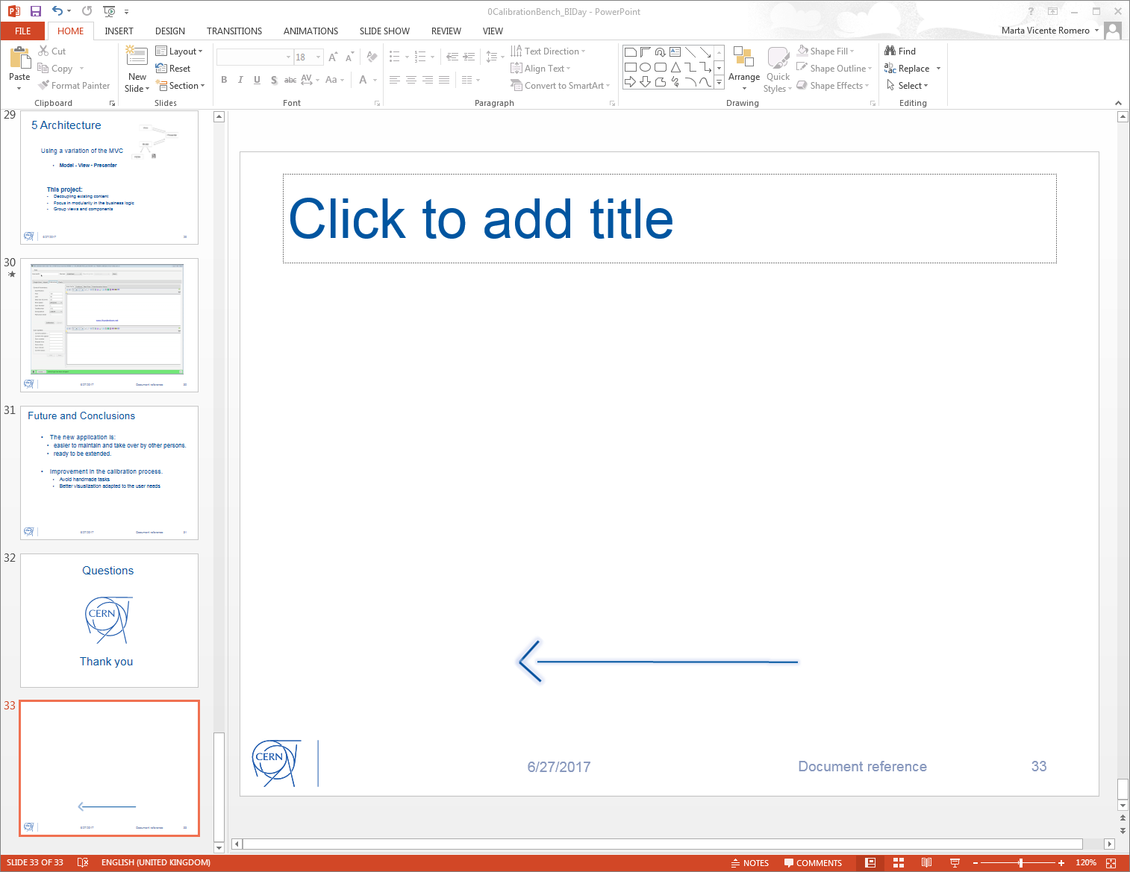
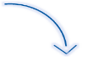
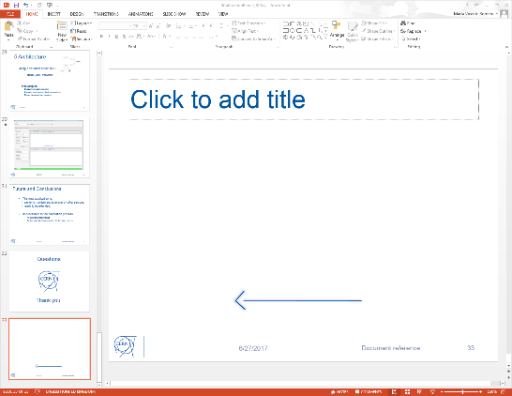
Git
Device Control
FESA
Wire Scanners &
Stepping Motors
Deploy
Edition
Analysis and Tables
Application Settings
Scans Logging

Slide 17
4 Overview ExpertGui
Main functionality:
  Hardware initialization
  Single Scans
  Calibration
  Import Scans
  Check
  Analysis (calculations and visualization)

Slide 18


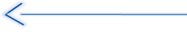
4 Overview ExpertGui
Workflow overview
Single Scan
HW Initialization
Calibration
Import
(Old Calibration)

Slide 19
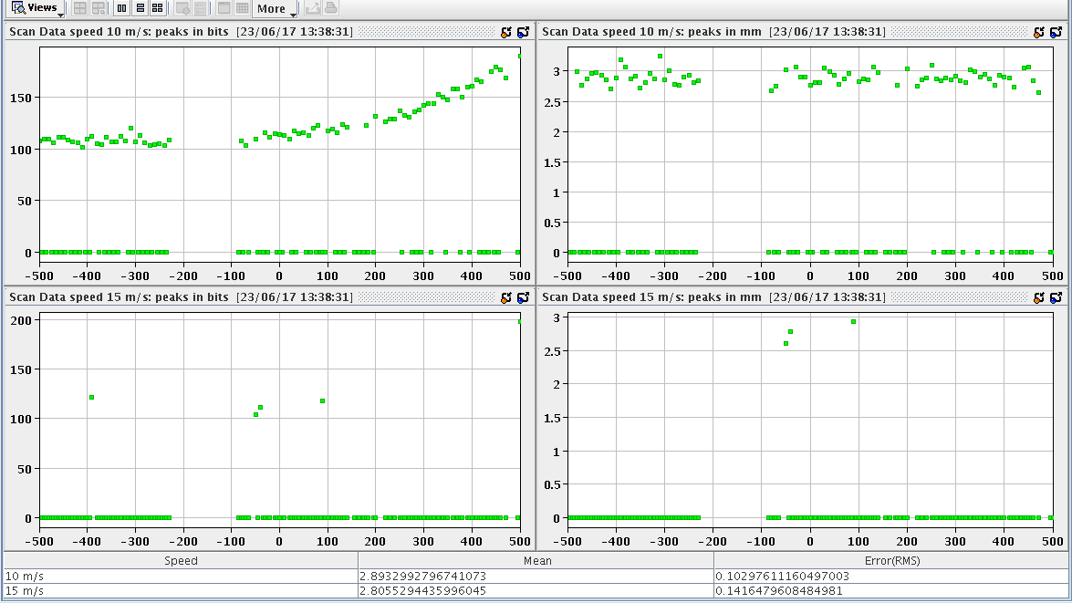
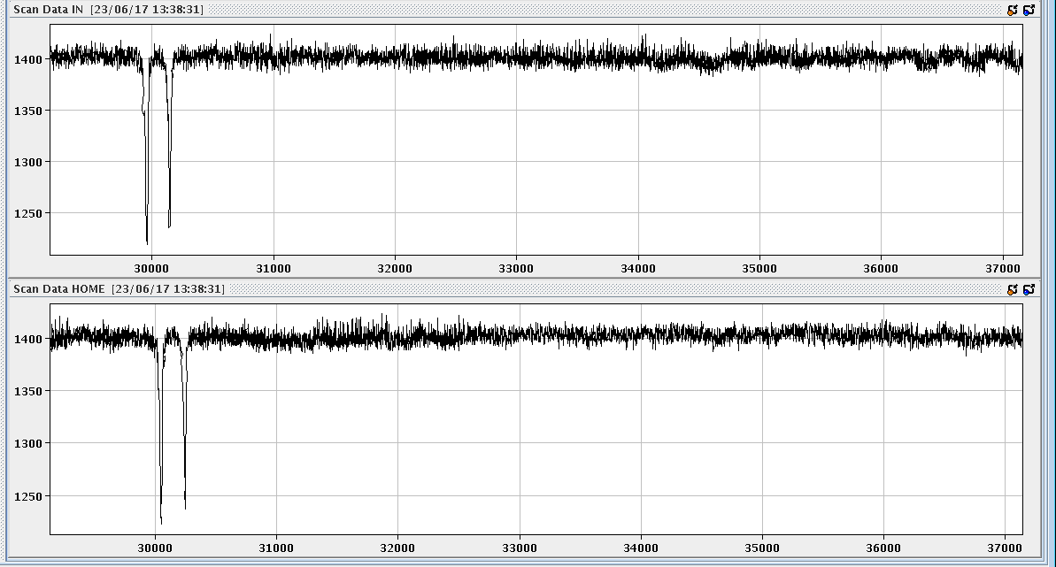
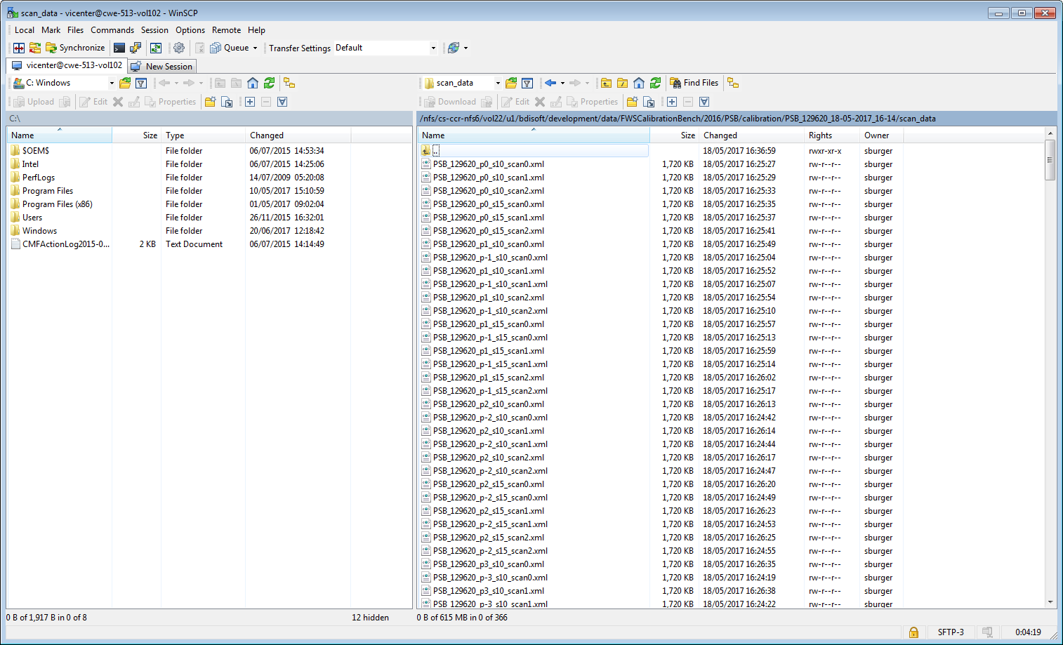
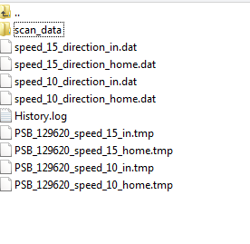
4 Overview ExpertGui
Data Visualization
Calibration
Calibration Files

Slide 20
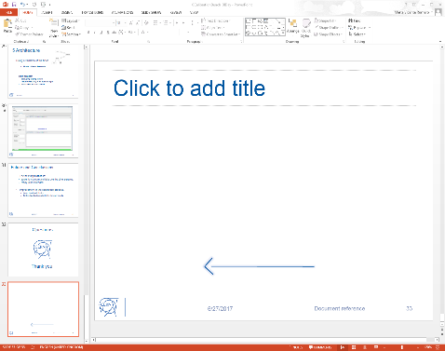
4 Overview ExpertGui
HW Initialization
Calibration
Edit Results

Slide 21

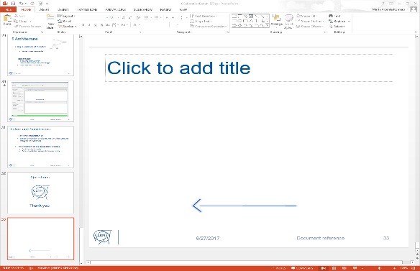
4 Overview ExpertGui
HW Initialization
Check Scan
Calibration
Edit Results

Slide 22

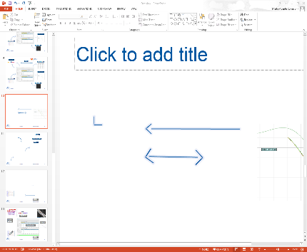
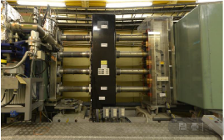
4 Overview ExpertGui
Deploy
HW Initialization
Calibration
Check Scans
Edit Results
Wire scanners

Slide 23
5 Architecture
  New BI Software guidelines:
  ExpertGUIs moving to JavaFX
  Unification under common architecture base on Model – View – Controller (MVC)
      modularity, reusability, maintenance, extensibility.

Slide 24
5 Architecture
  ExpertGUIs moving to JavaFX
  BI – SW section utilities.
    Tools develop by the section
    Common development guidelines
  CO standard components have been included. (https://wikis.cern.ch/display/GUI/Reference+Guide)
    General frame.
    RBAC Authentication.
    Logger utilities.
  Current state: Combination of JavaFX with Swing components.
        Property system and bindings, fxml, css.
        ☹ Missing features from swing

Slide 25
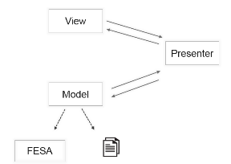
5 Architecture
  Using a variation of the MVC
  Model - View - Presenter
      Model: Business logic: Scans data, analysis data, lookup tables calculation, errors, scan parameters, application settings.
      View: fxml files with view controls
      Presenter:
              Receives the user inputs from the view. It asks to the model to operate accordingly.
              Presentation of the data in the view.

Slide 26
5 Architecture
  Using a variation of the MVC
      Model - View - Presenter
    This project:
    Decoupling existing content
    Focus in modularity in the business logic
    Group views and components

Slide 27
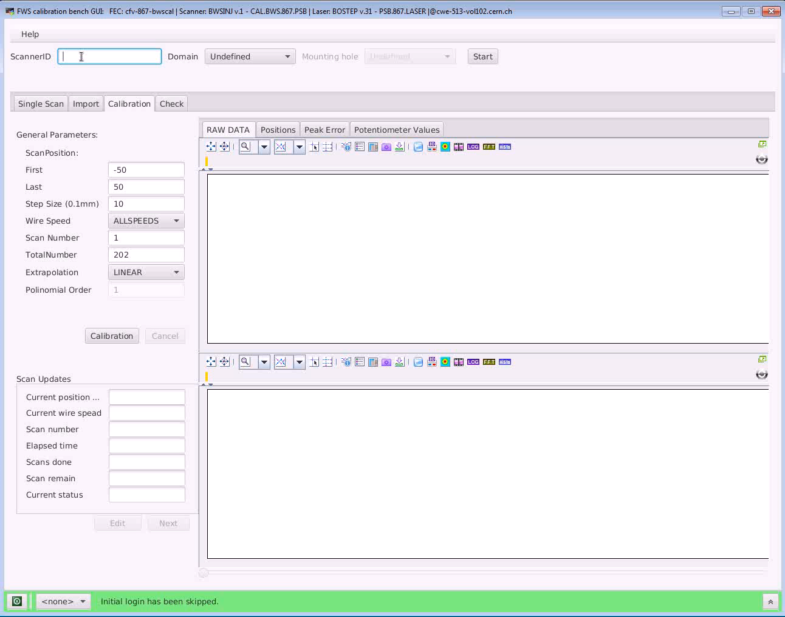

Slide 28
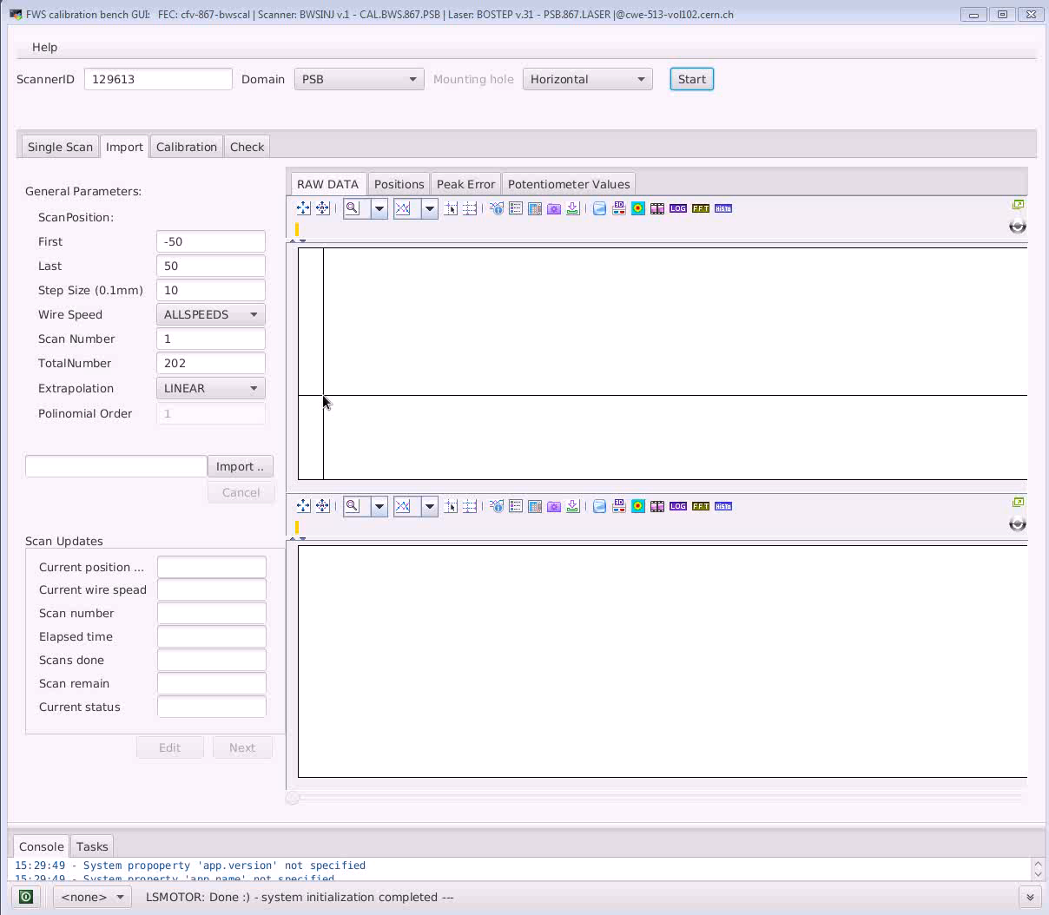

Slide 29
7 Future and Conclusions
  The new application is:
    easier to maintain and take over by other persons.
    ready to be extended.
  Improvement in the calibration process.
      avoid handmade tasks
      better visualization adapted to the user needs

Slide 30
Questions
Thank you

Slide 31
3 Overview ExpertGui
Device Control
Devices
FESA CLASS
PSB
PS
BWSINJ
(Wire scanner Injection)
CAL.BWS.867.PS
PS.867.LASER
PS.867.DIODE
CAL.BWS.867.PSB
PSB.867.LASER
BOSTEP
(Step In Motors)

Slide 32
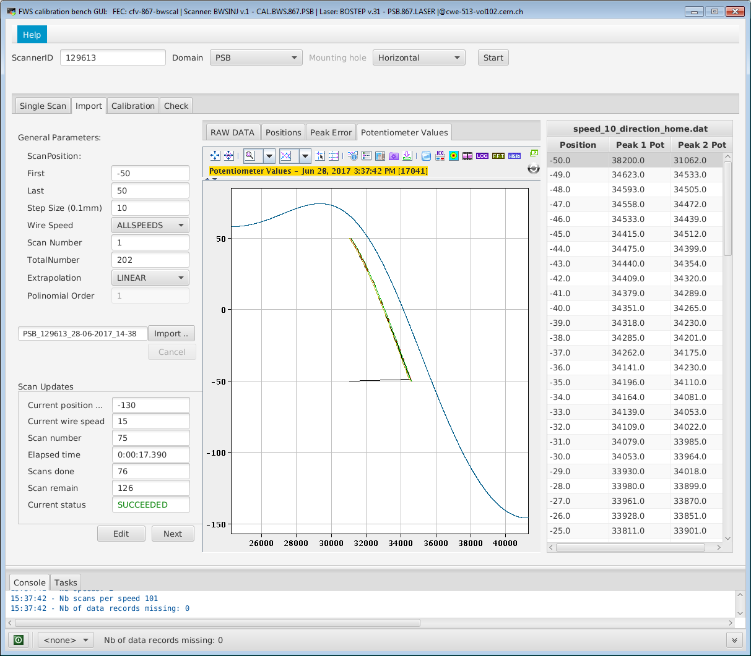
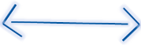
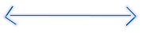
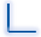

Slide 33
