Slide 1
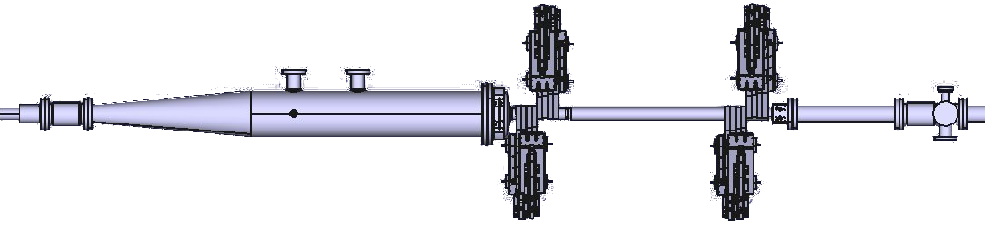


First LHC Transverse Beam Size Measurements with the
Beam Gas Vertex Detector
A. Alexopoulos on behalf of the BGV team
June 29, 2017, BI Day
Notes:
Thank you for the invitation and the opportunity I am given to share and discuss our experiences with the Beam Gas Vertex detector.
To which we refer to shortly as the BGV
BGV is a beam profile monitor device developed for the LHC and its high luminosity upgrade
I have been working on the project for a little over a year now ; That said…. (-> BGV collaboration)

Slide 2



The BGV team
A. Alexopoulos, C. Barschel, E. Bravin, G. Bregliozzi, N. Chritin, B. Dehning, M. Ferro-Luzzi, M. Giovannozzi, R. Jacobsson, L. K. Jensen, O. Rhodri Jones, V. Kain, R. Matev, M. Rihl, V. Salustino Guimaraes, R. Veness, S. Vlachos, B. Würkner
A. Bay, F. Blanc, S. Giani, O. Girard, G. Haefeli, P. Hopchev, A. Kuonen, T. Nakada, O. Schneider, M. Tobin, Q. Veyrat, Z. Xu
R. Greim, W. Karpinski, T. Kirn, S. Schael, A. Schultz von Dratzig, G. Schwering, M. Wlochal
…and significant support by LHCb collaboration & BE-BI community
Notes:
The BGV has been a collaboration between three institutes, CERN EPFL and university of Aachen
This is our current author list, but there are many people that were involved in the project in the past as well
We also need to thank the LHCb and Beam instrumentation community at CERN for the significant help in the project

Slide 3
Outline
The BGV Demonstrator
  Detector Design
  Readout System
BGV Data Analysis
  Analysis Method
  Results from 2016 LHC Run
Summary
Notes:
So the agenda for today is going to be quite straight forward
First I am going to give an introduction to the detectors operation principle and how it is implemented for the LHC
Then I will continue discussing about the developments during the 2016 LHC run 2, the analysis method used as well as the first results that we acquired from the detector

Slide 4
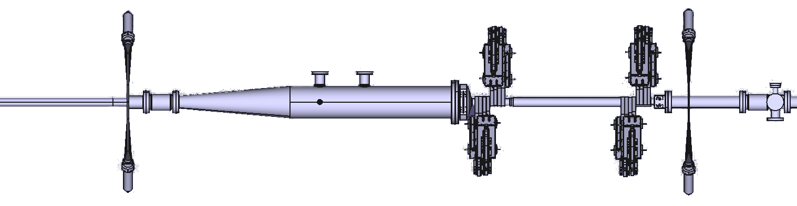


The BGV Demonstrator
Non-destructive beam size measurement
  Based on the reconstruction of beam-gas interaction vertices
  Independent of accelerator intensity or energy
  Target to estimate bunch-by-bunch beam size with a resolution of about 10% in 5 minutes
Tracking
Detector
Gas Injection
Beam 2
Hardware Trigger
Notes:
The detector consists of three main elements – the gas target, the hardware trigger and the tracking detector
A noble gas (neon in the case of the BGV) is injected in a vacuum chamber producing inelastic beam-gas interactions
Giving a local pressure bump up to 10^-7 compared to 10^-10 of the nominal LHC pressure
The charged particles produced in the beam-gas collisions are measured with high precision tracking detectors used to measure the position of the interaction vertices.
The gas pressure in the interaction volume is adjusted such as to provide an adequate trigger rate, without disturbing the beam.
The effect on the beam is negligible, as for a nominal LHC bunch (10^11 protons) a rate of 100Hz of inelastic beam-gas interactions (events) is expected
Each event meaning only one proton – gas nucleus collision
Beam profile measurement based on this method and detector was initially developed at the LHCb experiment.
Difference with the VELO is that the tracking is outside the vacuum – robust beam measurement device
** NOTE put the Neon/pressure

Slide 5
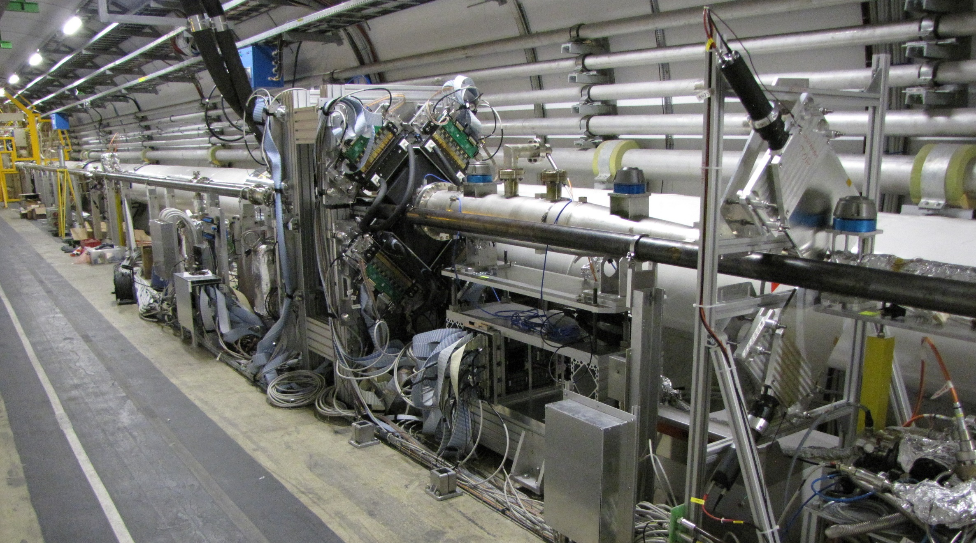
The BGV Demonstrator
Notes:
The BGV detector has been fully installed during 2016
It is situated at LHC point 4 in the beam 2 ring, where there is a straight section along with other beam instrumentation devices
And here you can see the actual components that we just discussed – the gas target the trigger and the tracking stations

Slide 6
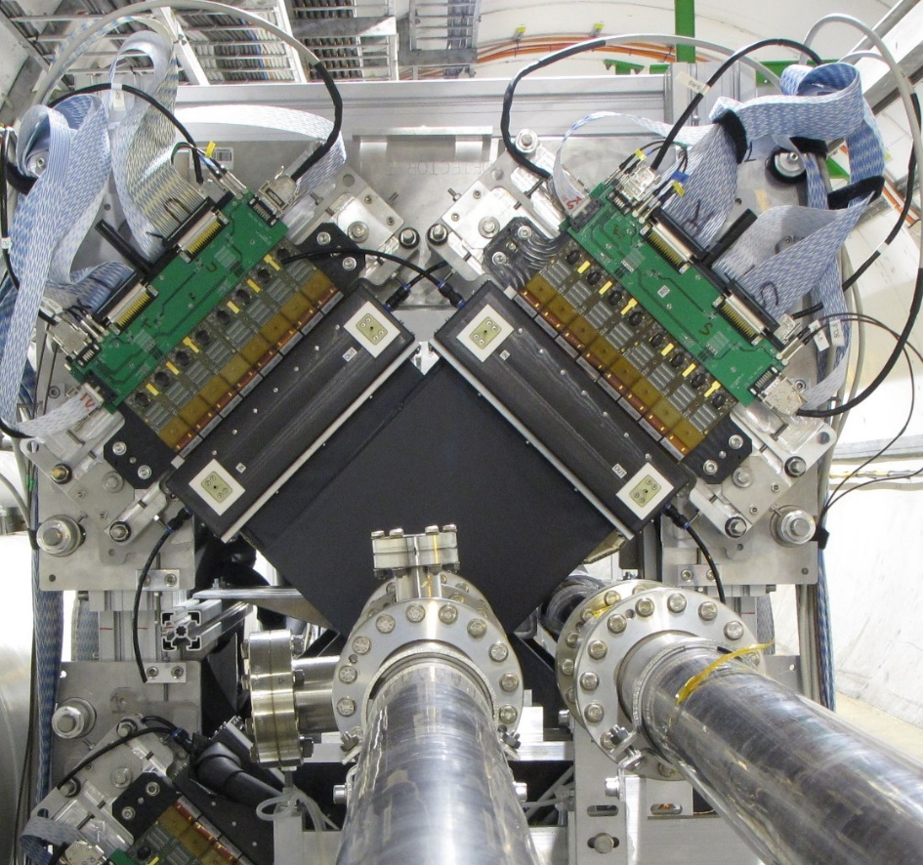
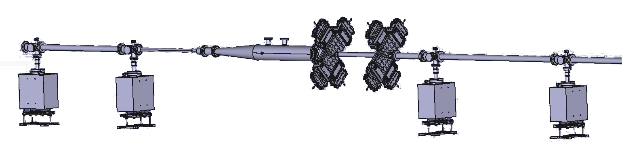
Detector Design
Tracking Detector
  Consists of 2 stations (‘near’ and ‘far’)
  4 scintillating fiber (SciFi) modules per station
    Each pair of modules is perpendicularly placed
    Module read out by 16 Silicon Photo Multipliers (SiPMs) of 128 channels each
Notes:
The tracking detector is situated behind gas target and consists of two stations 1m apart.
The building block of the tracking detector is the scintillating fiber module (SciFi )
Each station has 4 SciFi - a pair above and a pair below
The SciFi modules have several fibers that provide the one – dimensional position measurement
Within a pair the two modules have their fibers oriented perpendicular to each other to provide x-y position measurement
In one side of the module there is the readout which is done through silicon photo multipliers while in the other there is a mirror to increase light yield
Looking into a module from the top (point with laser or something !) we can see that each module has several (4 or 5) layers in depth/direction of the beam → next slide

Slide 7
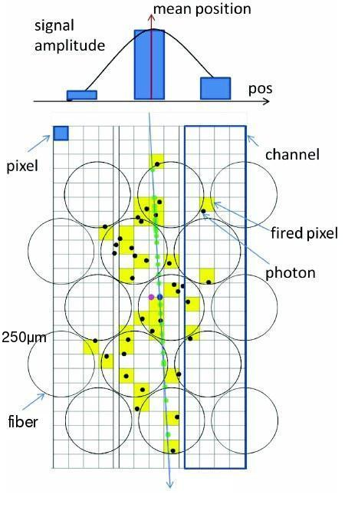
Detector Design
Tracking Detector
  Photons are generated in the fibers & detected by several pixels of the SiPM
  The signal of each channel is the sum of all fired pixels within the channel
  The crossing point is calculated as a weighted mean of the cluster’s channels
particle
Notes:
Therefore a traversing particle would go through all these fiber layers
Each SiPM channel has an array of pixels reading out the from one end of the fibers
And several pixels cover the area of each fiber with the fiber having a diameter of 250um
The final channel signal is the sum of all the fired pixels within this channel
More than one neighboring channels could have signal forming a cluster
60% probability of size=2, less than 3% of having more than 4 channels
Crossing point is a weighted mean of the clusters channels – position resolution down to 40um
The fibers are read out with silicon photo multipliers (SiPMs) which are liquid cooled C6F14 – SNR increase of a factor of 10. Cooling is needed to improve the signal to noise ratio by reducing the SiPM dark count rate which increases with radiation dose.
Therefore doing this within a pair of modules, we have a x-y position measurement of a crossing particle -> combining
NOPE
Each SciFi module is read out by 16 128-channel SiPM arrays operated in Geiger-M\"{u}ller mode.
layers (near-4, far-5)

Slide 8
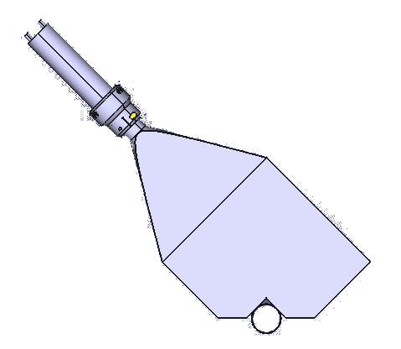
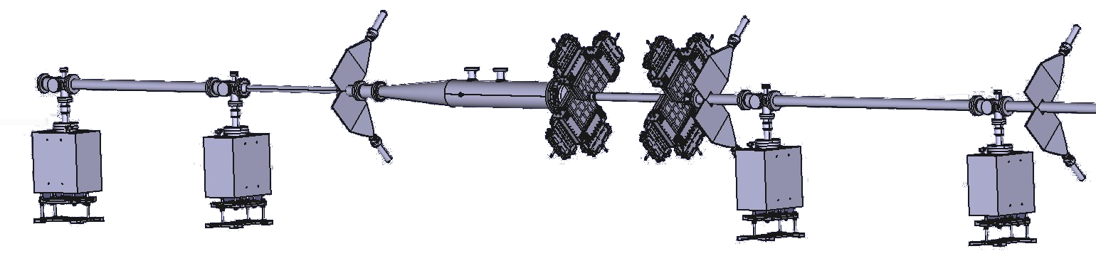
Detector Design
60mm PMT
Hardware Trigger
  Based on scintillator plates
  Three stations, ‘veto’, ‘signal’, ‘confirm’
    ‘confirm’ station to be commissioned during LHC 2017 run
  Read out through Photomultiplier Tubes (PMT)
  Combination of all signals is used as trigger
30cm
Notes:
The BGV trigger consists of scintillator plates with dimensions 30x30cm2
Arranged in 3 stations – veto, signal, confirm
For the 2016 run we only had the two first stations while the confirm station will be commissioned during the LHC 2017 run
Readout through photomultiplier tubes

Slide 9


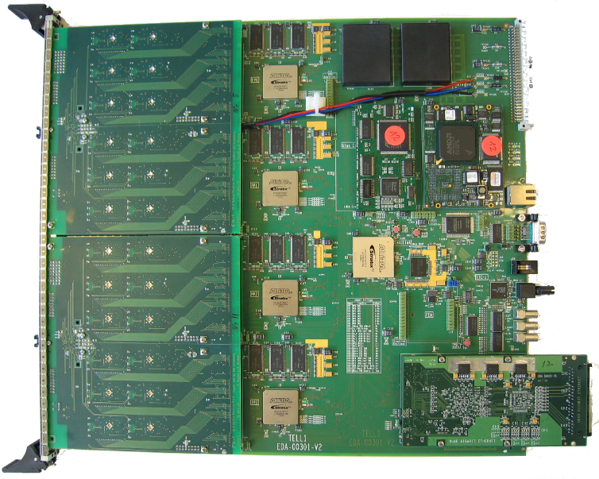
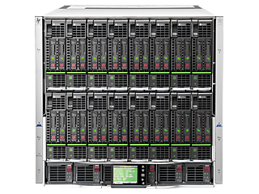
Readout System
LHC Tunnel
LHC Alcove
Hardware Trigger
Digitization
Data corrections
Zero-suppression
Cluster recognition
CPU Farm
Track reconstruction
Vertex localization
Beam size determination
Analog Front-End
60m
[1MHz]
[40MHz]
Notes:
The read-out chain of the BGV is based on hardware from the LHCb experiment.
The Beetle front-end ASIC receives the analogue signals from a SiPM - signals are first attenuated by a factor of around 200-500 via an RC circuit.
The Beetle has an analogue memory of a programmable maximum length of 160 stages with a serial read-out at the LHC bunch frequency 40MHz.
Subsequently, data are time-multiplexed on 4 output ports of 32 channels to form an analogue link (A-link) over which data are forwarded to the VELO repeater boards.
At the repeater boards the signal data is amplified and sent over 60m of cables to the TELL1 boards for digitization.
The timing control of the data acquisition system is supervised by the ODIN board.
The board accepts the input from the hardware trigger and then sends a trigger to the Beetle chips to start transmission of the data.
Timing studies of the coarse and the fine delays have been performed to ensure that the correct slot of the Beetle memory is retrieved.
Some numbers regarding the DAQ numbers (1MHz maximum – NZS limitations)

Slide 10
Outline
The BGV Demonstrator
  Detector Design
  Readout System
BGV Data Analysis
  Analysis Method
  Results from 2016 LHC Run
Summary

Slide 11
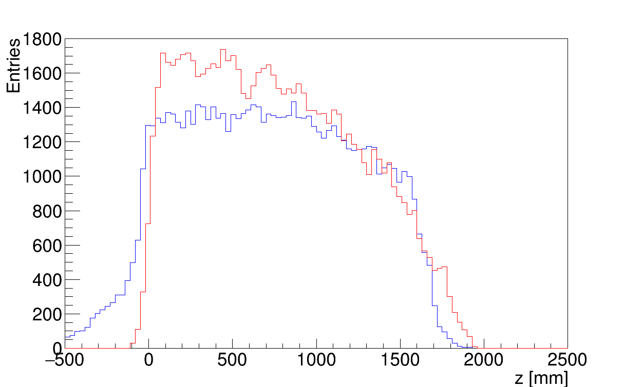
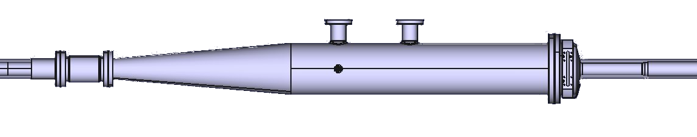
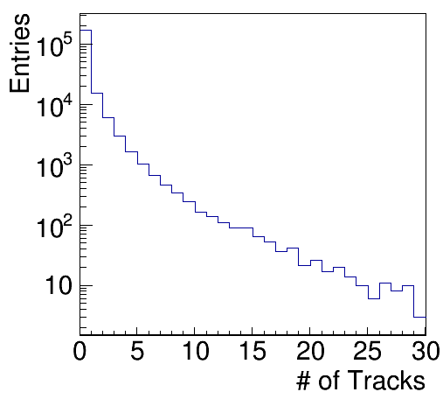
BGV Data analysis
Monte Carlo
Data
Triggering issues
  In 2016 the majority of the events did not contain any “reconstructible” tracks
  Reduced statistics
  The distribution of the points of closest approach to the z-axis for the reconstructed tracks matched the simulation
Notes:
From the 2016 datasets we could clearly observe that a lot of the acquired events did not contain any reconstructible tracks
This lead to the trigger upgrade that we mentioned before (confirm station), while further work on this is ongoing
the tracks that could be reconstructed seemed to originate from the expected location / that being within the region of the gas target
Still the limited statistics forced us to search for different methods rather going straight for vertexing using the tracks → next
This method is appropriate because errors that are related to the vertexing resolution are canceled out

Slide 12

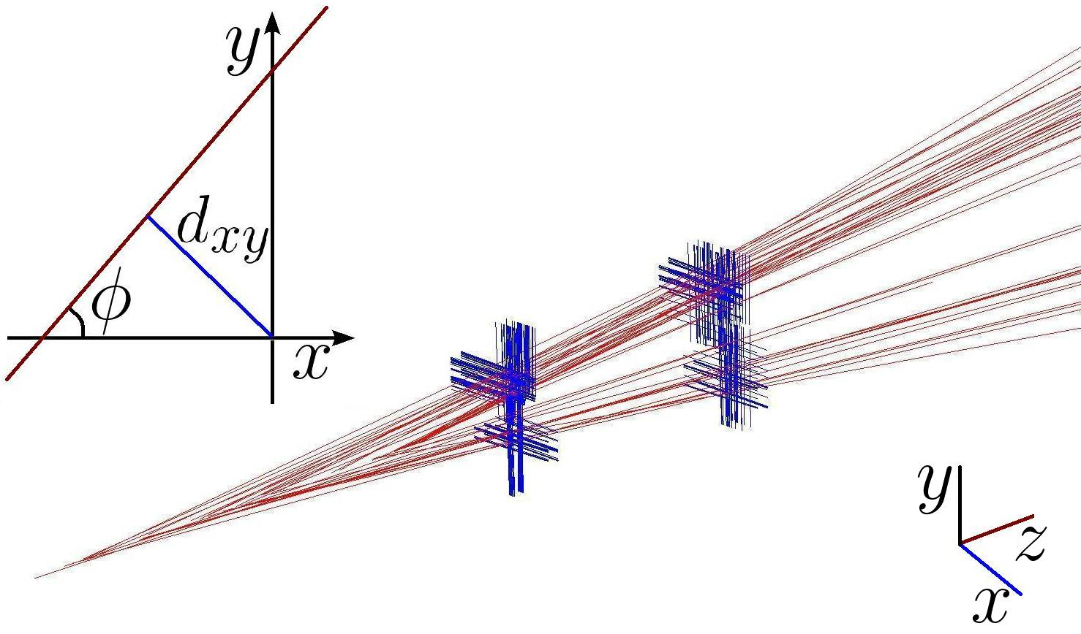
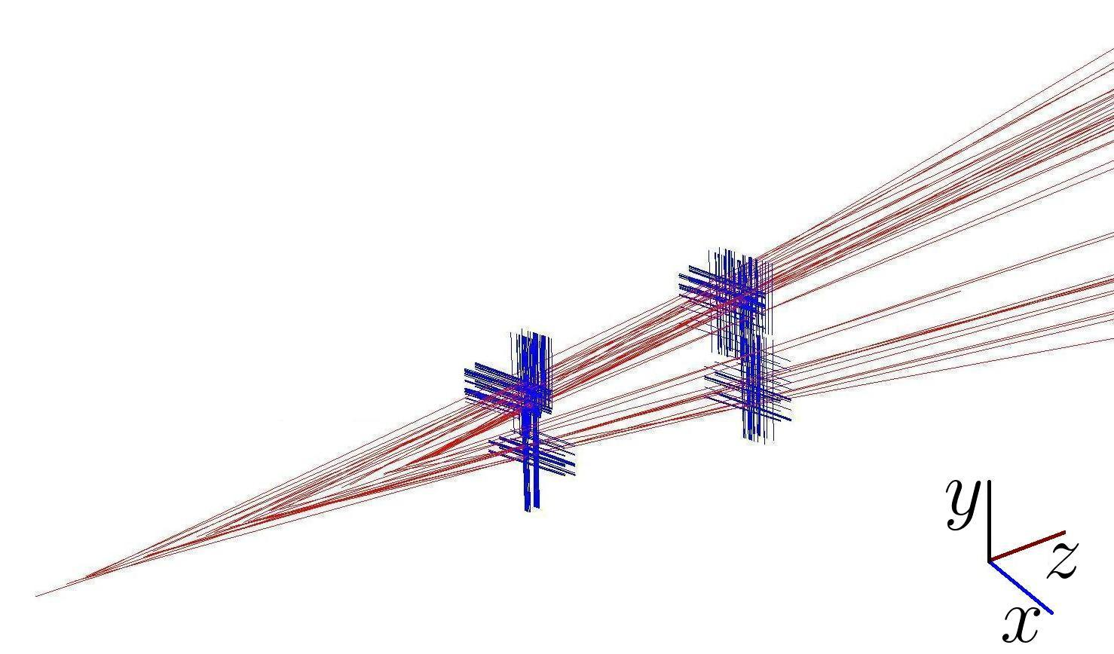

Analysis Method
Use tracks & impact parameter
correlations to measure beam
position and size
Impact parameter
  Distance of closest approach of reconstructed tracks to the z-axis
Azimuthal angle
  Angle between the x-y projection of the track & the x-axis
Notes:
So here we can see an example of an event that happens in the BGV
We can see the clusters/channels that fired and the linear fit that lead to the definition of the tracks
The z-axis corresponds to the direction of the beam while the x-y is the transverse plane
Projecting tracks to the x-y axes we get two quantities with which we are going to analyze our data
These quantities are:
The impact parameter – distance of closest approach of the tract to the x-y axis
The azimuthal angle which refers to the angle between the projected track and the x-axis

Slide 13
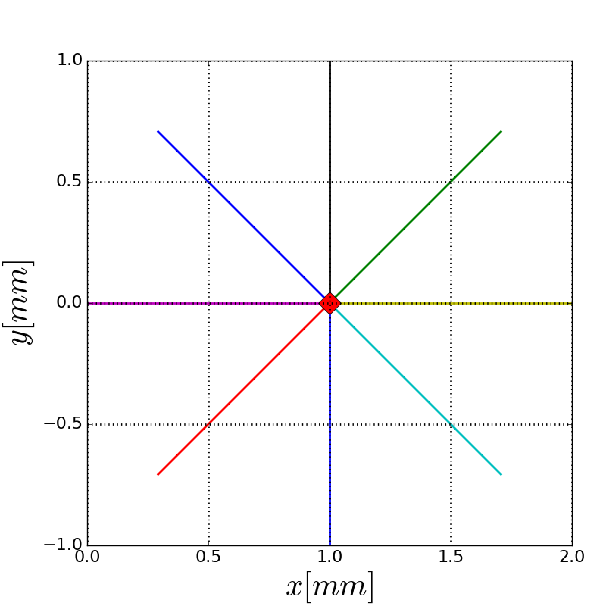
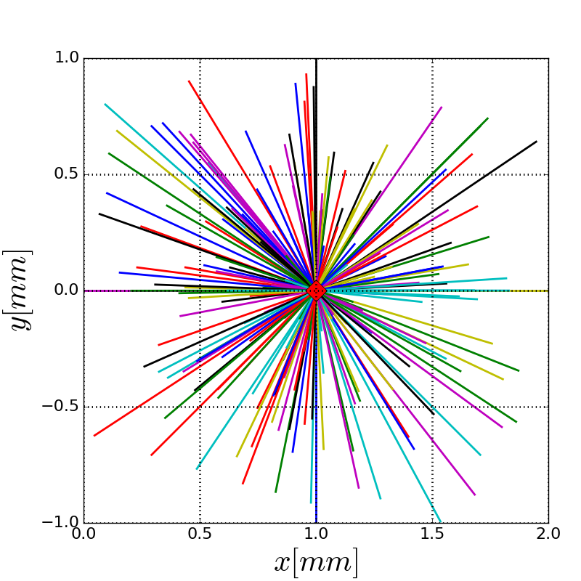
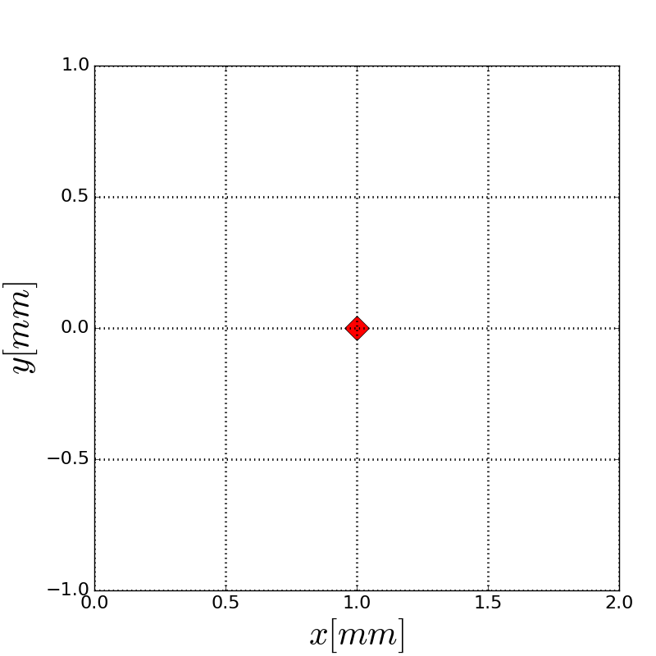
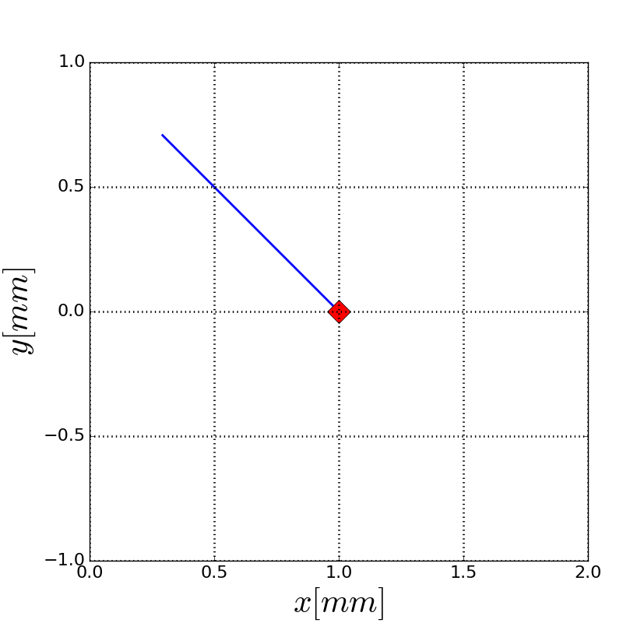
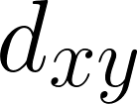

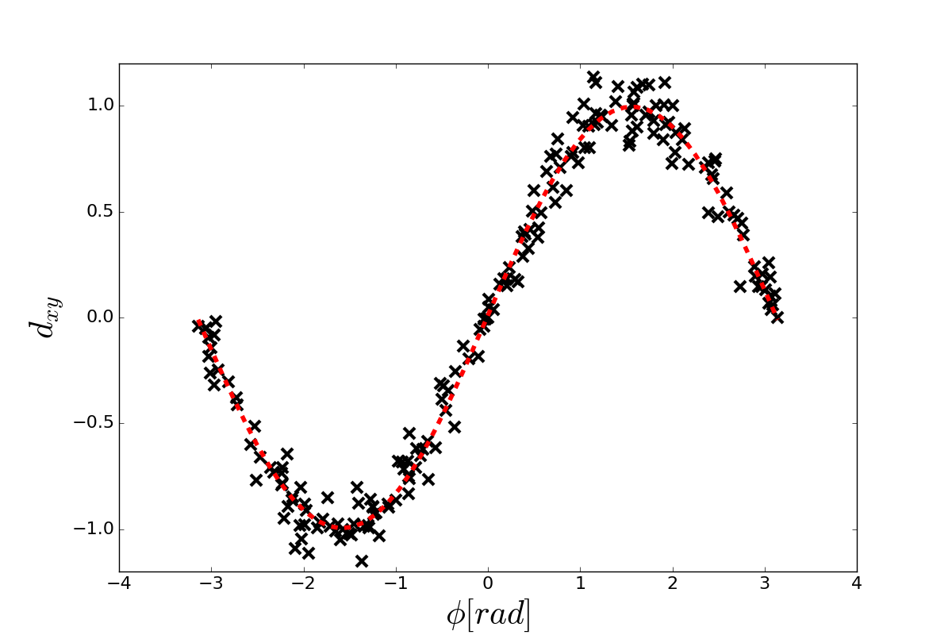
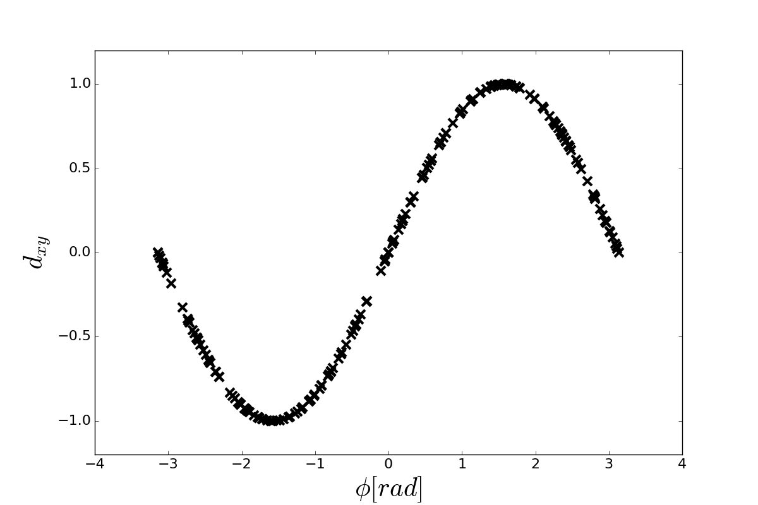
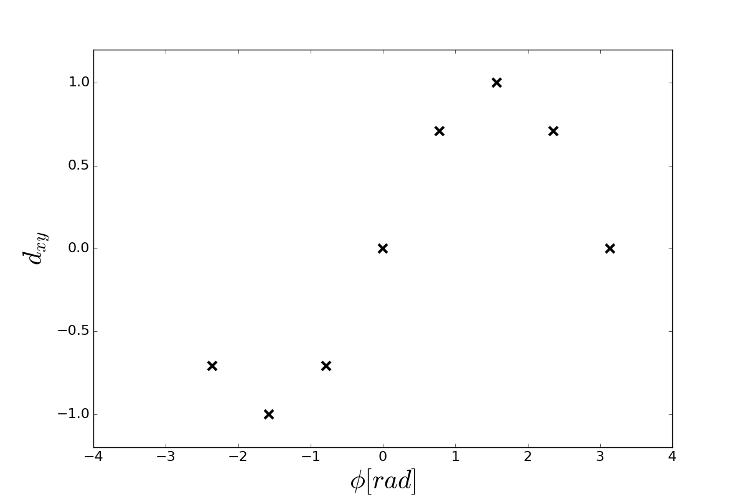
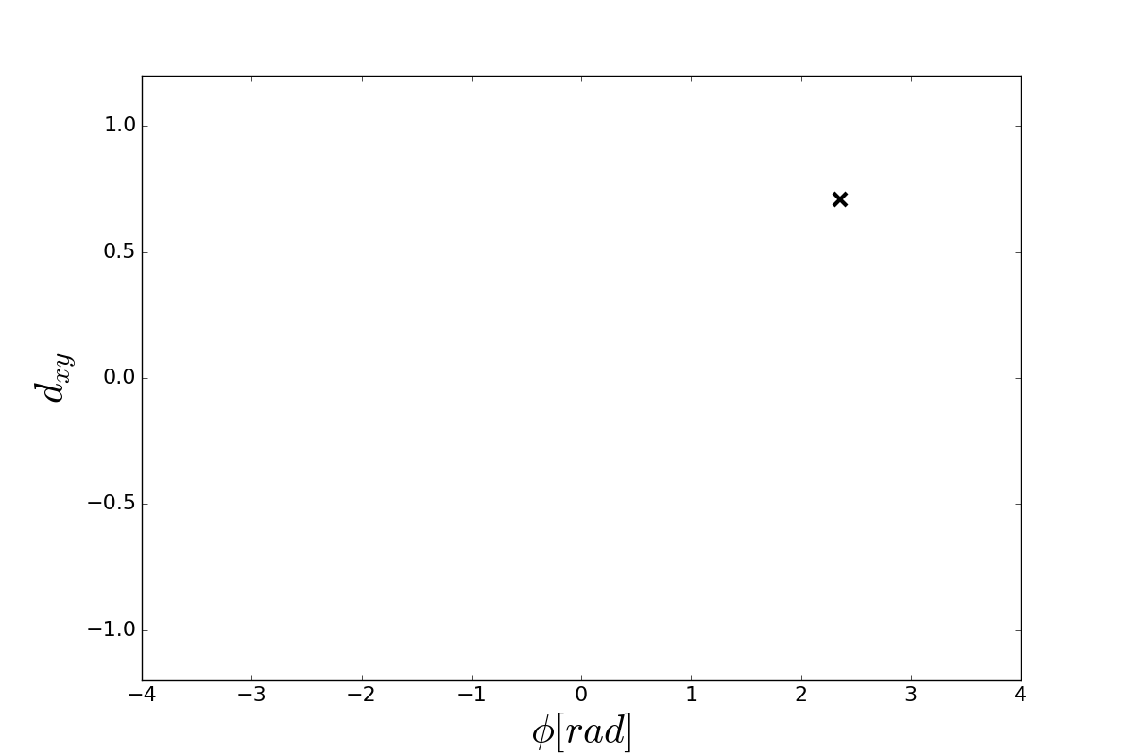


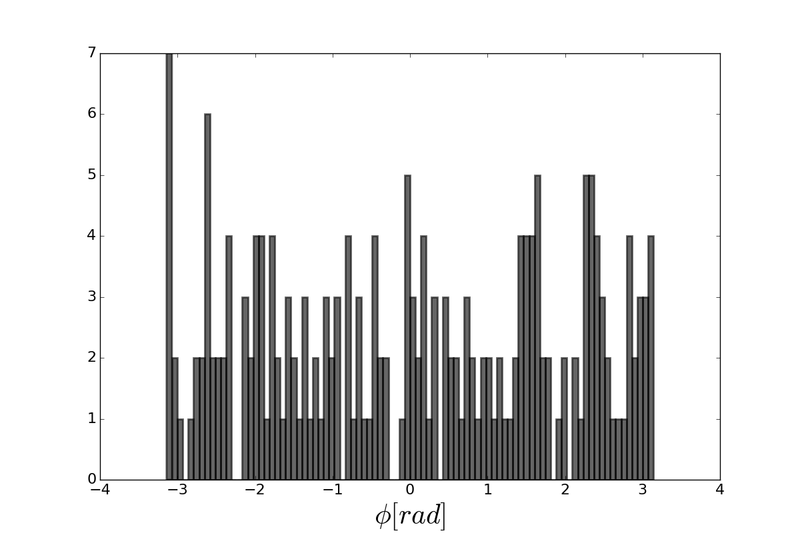
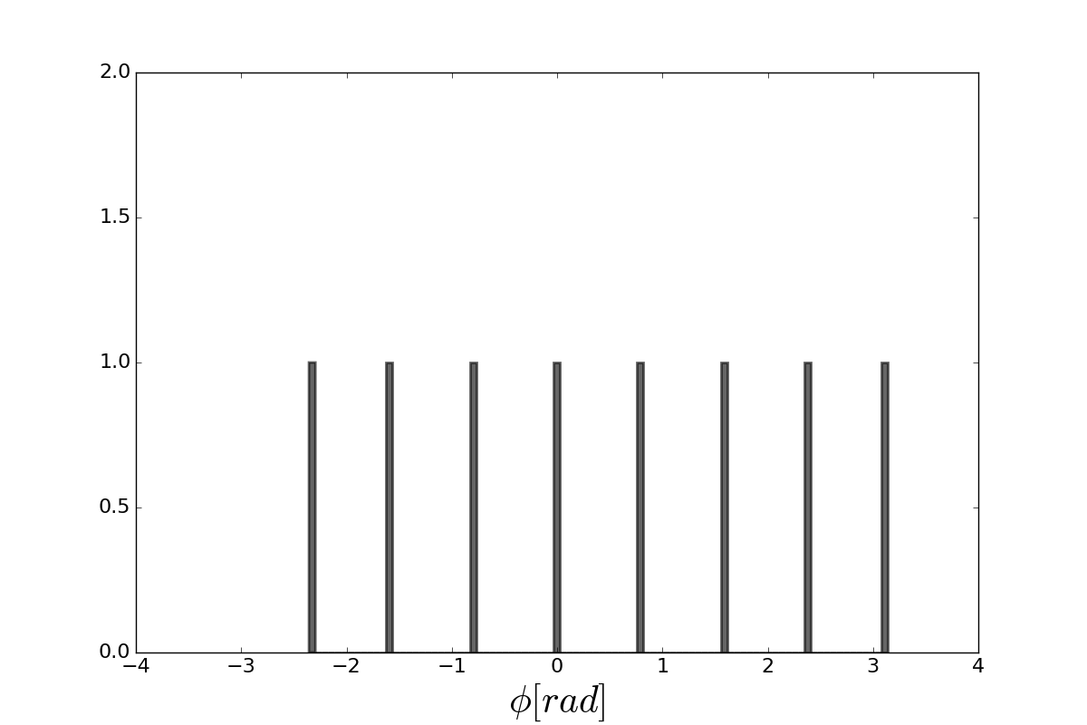
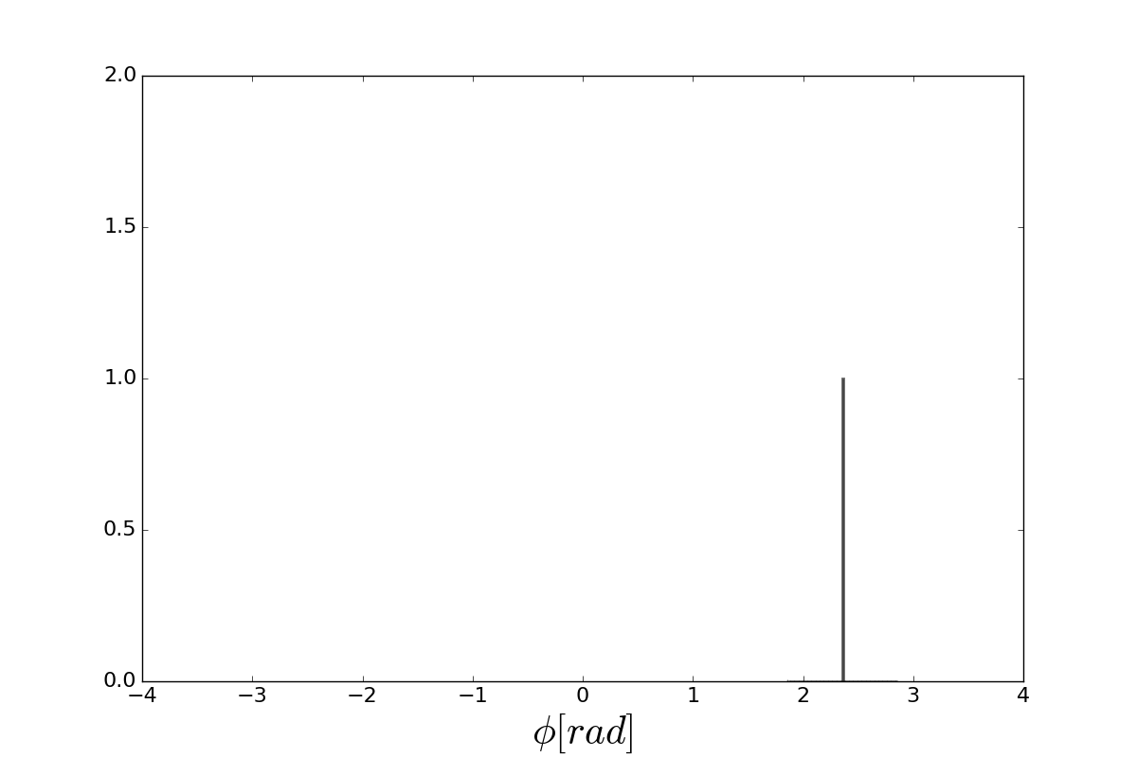
Analysis Method
y
Beam Position
  Using the impact parameter to azimuthal angle correlation, the position can be calculated as:
x
Counts
Notes:
So how can we get the position from these parameters
Assuming that the beam position is set to a specific position (that is 1,0 in this case)
Then a track projection example would be like this and its corresponding impact parameter would be this and phi
Getting a few more examples for known azimuthal angles would create already a visible correlation
With more statistics we can definitely see the correlation which is described by this equation
Fitting the data to the equation would return the original beam position

Slide 14
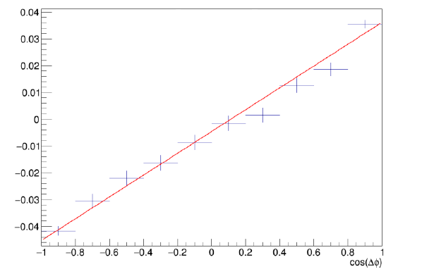



Analysis Method
Beam Size
  Using the impact parameter correlation of tracks produced by a beam-gas interaction the beam size is measured as:
  Assuming that at BGV location (optics)
Notes:
For the beam size we are using the impact parameter correlation of the tracks originating from the same vertex
The event-by-event displacement due to the finite beam width affects all particles of a single beam-gas interaction in the same way, thus a correlation is introduced.
The achievable accuracy for the beam spot width depends very well on the impact parameter resolution
The square of the beam size is the slope of the line fitted to the data

Slide 15
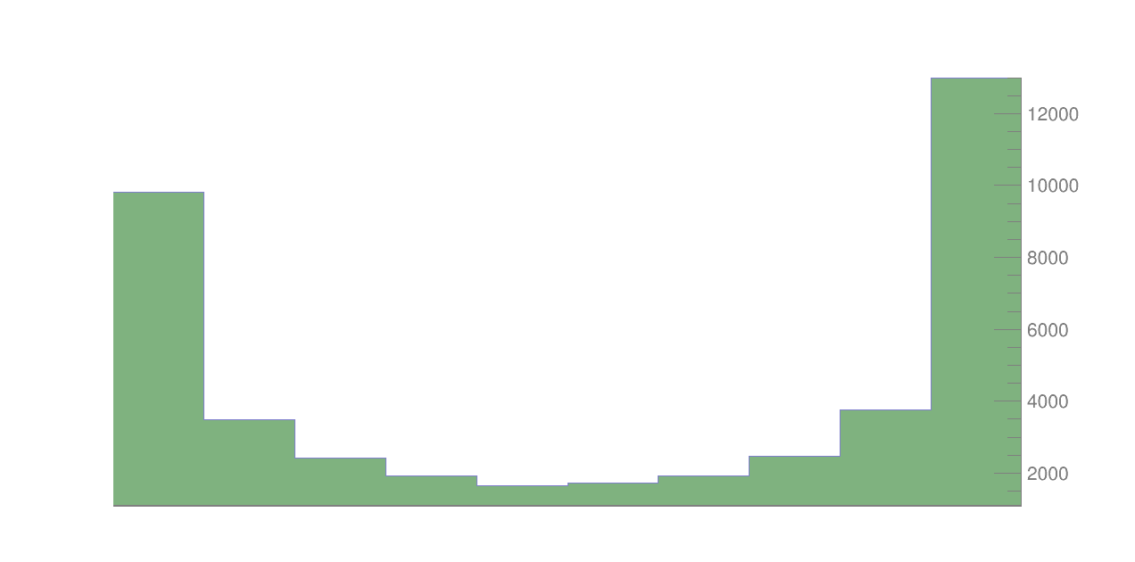
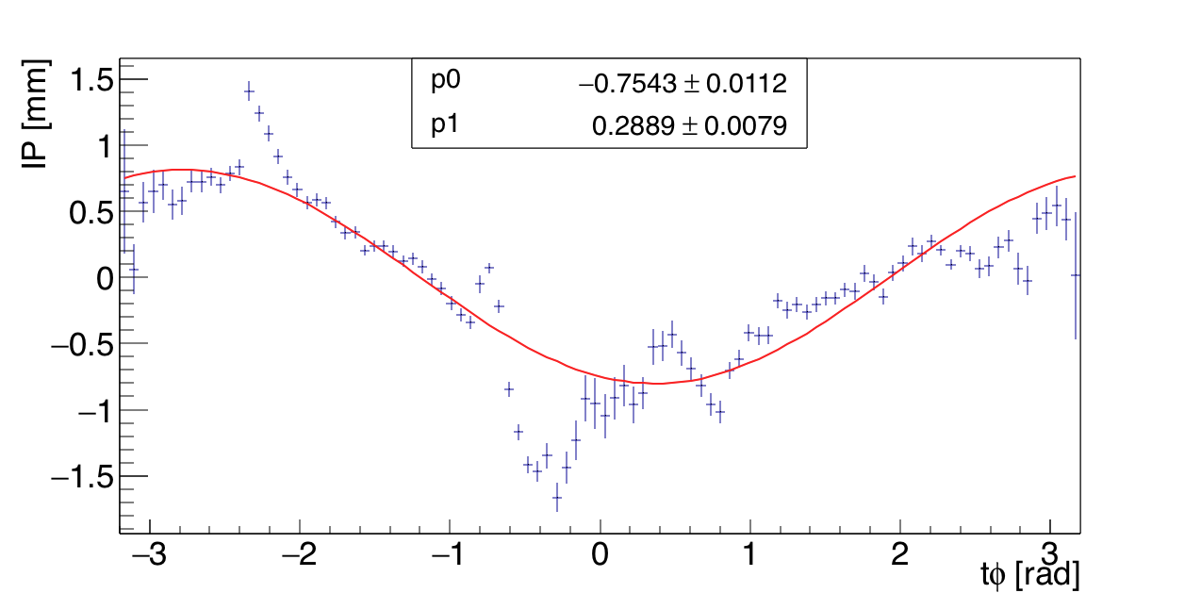
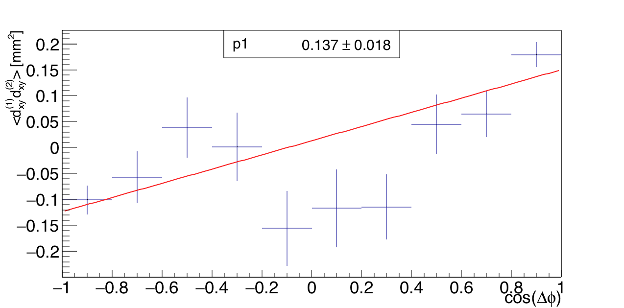
LHC 2016 Run Results
Initial results with limited statistics
Beam position
Beam Size
Notes:
This are the first data with limited statistics but still the correlations between the quantities are visible leading to an estimation of beam position and size
Still though with a significant error
Data had artifacts that we still don’t understand (like the beam position peaks)
N.B
Vertexing precision: 2 tracks->~100um, 20 tracks->~40um

Slide 16
Summary & Outlook
First commissioning steps were successfully completed
Transverse beam profile measured with 0.13mm statistical error
  Not yet allowing for a full comparison with other instruments
Several enhancements for 2017:
  Zero-suppression in the read-out FPGAs Increase statistics (100x)
  Trigger upgrade Improve the event selection
  Cross-calibration with other LHC instruments

Slide 17
Backup Slides

Slide 18
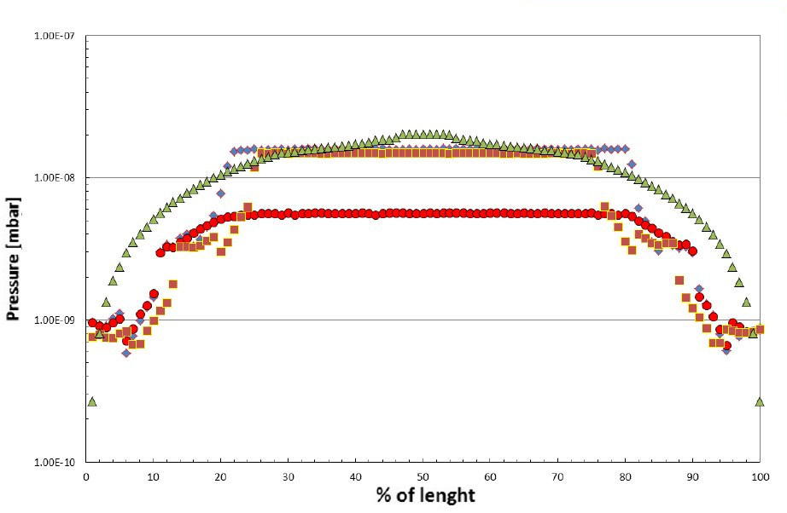
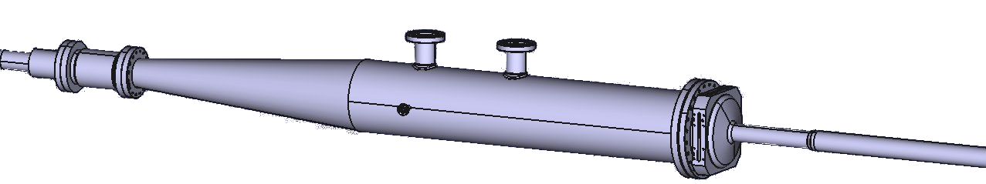
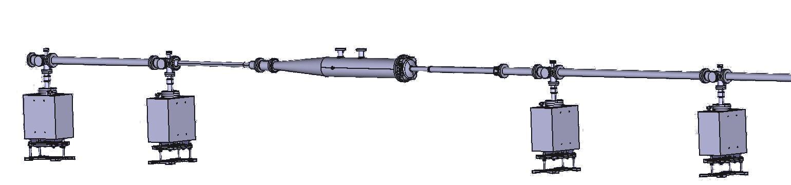
Detector Design
Gas Target
  Pressure bump up to 10⁻⁷ mbar
  instead of 10⁻¹⁰ mbar
  Adjustment of the trigger rate
Optimized shape to provide
sharp decrease outside of the
BGV vacuum chamber
2m
Reduced thickness & density
of the exit window to minimize
multiple scattering
Reduced beam pipe diameter
to maximize acceptance
Notes:
1. Gas (neon) injection from the middle of the gas target giving a local pressure bump of up to about 10^-7 mbar.
- This is only changing our triggering rate increasing probability to have a beam-gas interaction / in general expecting one vertex per event.
2. The BGV gas target shape was optimized to provide a sharp pressure decrease outside the vacuum chamber minimizing the diffusion of gas particles to the beam pipe.
3. The beam pipe along the tracking detector has been modified with a reduced diameter of \SI{52}{mm} instead of \SI{80}{mm} and minimum material so that the tracking modules can be as close as possible to the beam to increase the acceptance.
4. In order to reduce multiple scattering of particles produced by the beam-gas interactions, the thickness and density of the exit window towards the tracking detector has been minimized, ranging from 3.25mm down to 1.15mm close to the beam pipe.

Slide 19
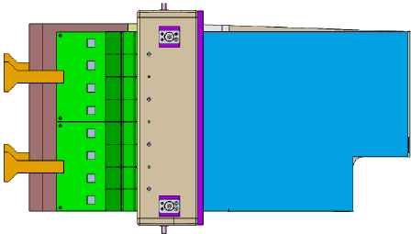
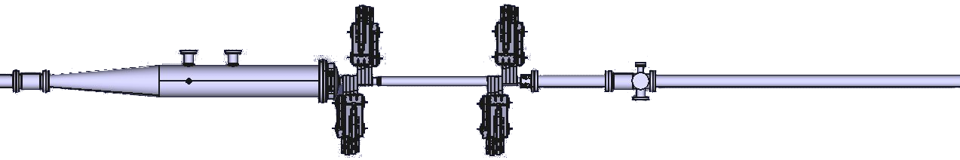
Detector Design
Tracking Detector
  Tracks are reconstructed provided that a valid cluster is detected on each layer
y
14 15 13 12
6 7 5 4
x
2047 1024
0 1023
0 1 3 2
8 9 11 10
Notes:
Green – normal mats / red – stereo layers 2 degrees
Normal/Stereo layer will create the search window for the perpendicular module
Create search windows for consecutive modules in order to find appropriate clusters in other modules and group them together to form a track
If matched valid clusters are found within 8 modules (top / bottom) then the track can be reconstructed and used for the analysis

Slide 20
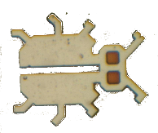

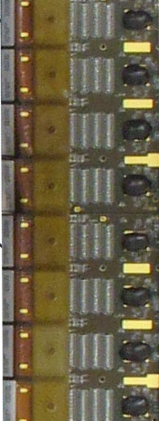
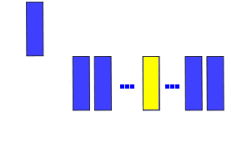
Readout System
LHC Tunnel
Hardware Trigger
L0 Latency
Readout Manager (ODIN)
Analog FE
Digitization (TELL1)
CPU Farm
25ns
RPT
60m
Notes:
The read-out chain of the BGV is based on hardware from the LHCb experiment.
The Beetle front-end ASIC receives the analogue signals from a SiPM - signals are first attenuated by a factor of around 200-500 via an RC circuit.
The Beetle has an analogue memory of a programmable maximum length of 160 stages with a serial read-out at the LHC bunch frequency 40MHz.
Subsequently, data are time-multiplexed on 4 output ports of 32 channels to form an analogue link (A-link) over which data are forwarded to the VELO repeater boards.
At the repeater boards the signal data is amplified and sent over 60m of cables to the TELL1 boards for digitization.
The timing control of the data acquisition system is supervised by the ODIN board.
The board accepts the input from the hardware trigger and then sends a trigger to the Beetle chips to start transmission of the data.
Timing studies of the coarse and the fine delays have been performed to ensure that the correct slot of the Beetle memory is retrieved.
Some numbers regarding the DAQ numbers (1MHz maximum – NZS limitations)

Slide 21
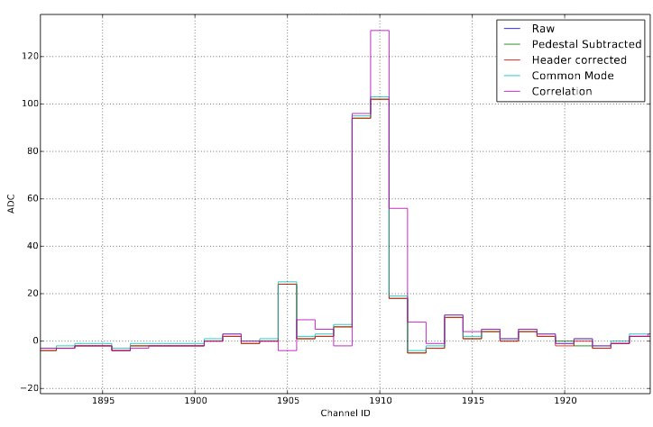
BGV Data analysis
Channel
Correlation
Data corrections
  Pedestal subtraction
  Common mode noise suppression
  Channel correlation
Data Metrics
  Track Multiplicity
  POCA z-distribution
  Pseudorapidity…
Monte Carlo
Data
Notes:
Data corrections
Pedestal – the adc value from the Beetles is non-zero and fluctuates – special runs define the pedestal without bias
Common mode – a signal in one channel can result in a shift to the value of several other channels
Correlation – electrical coupling cross-talk on the FE boards – attenuator circuit
Data Metrics
POCA – point of closest approach points z coordinate to be inside target gas volume
Track multiplicity – Too many events with no or too few tracks – trigger upgrade

Slide 22
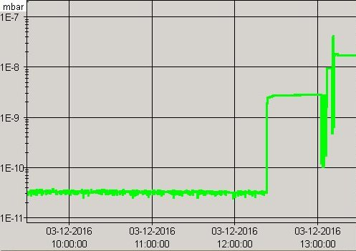
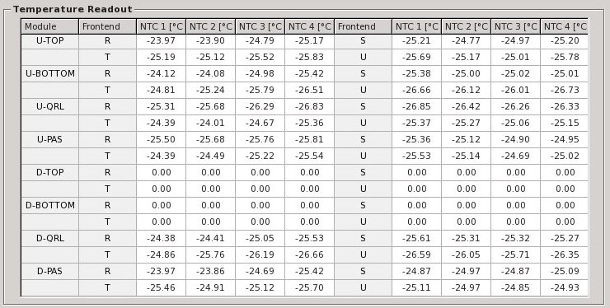
LHC 2016 Run Results
Results from fill 5570
  Beam properties
    Energy : 6.5 TeV
    Intensity : (B2) 1.8 x 10¹³ / 684p
  Gas Pressure : 6.0 x 10⁻⁸ mbar
  SiPMs Temperature: -25ºC
  Acquisition duration of ~5 minutes
  Trigger rate <1kHz
Notes:
+ Trigger rate actually reduced due to the read-out system acquiring non-zero suppressed data

