Slide 1




ODR/OTR emittance station at ATF2
M. Bergamaschi^{1,2}, A. Aryshev ³, K. Kruchinin ¹,
P. Karataev ¹,R. Kieffer², T. Lefevre², S. Mazzoni²
John Adams Institute at Royal Holloway, Egham, United Kingdom
CERN European Organisation for Nuclear Research, Geneva, Switzerland
KEK High Energy Accelerator Research Organization, Tsukuba, Japan

Slide 2
Overview
Motivations and Goals:
Develop a non-invasive transverse profile station for CLIC/ILC beams that can be scaled up
Develop, install and test a combined Optical Transition Radiation (OTR) and Optical Diffraction Radiation (ODR) emittance station at ATF2 at High Energy Accelerator Research Organisation (KEK)
To optimize sensitivity to micron and sub-micron beam sizes, we plan to observe ODR/OTR in the visible and far-UV wavelength range, down to approximately 200 nm

Slide 3
Overview
Manpower
RHUL | P. Karataev | Scientific coordination Beam tests
 | M. Bergamaschi | Simulations, Beam test, Instrumentation
 | K. Kruchinin | Beam test, Instrumentation
CERN BI | R. Kieffer | Beam test, Instrumentation
 | S. Mazzoni | Overall coordination Beam test
 | T. Lefevre
KEK | A. Aryshev | Beam test

Slide 4
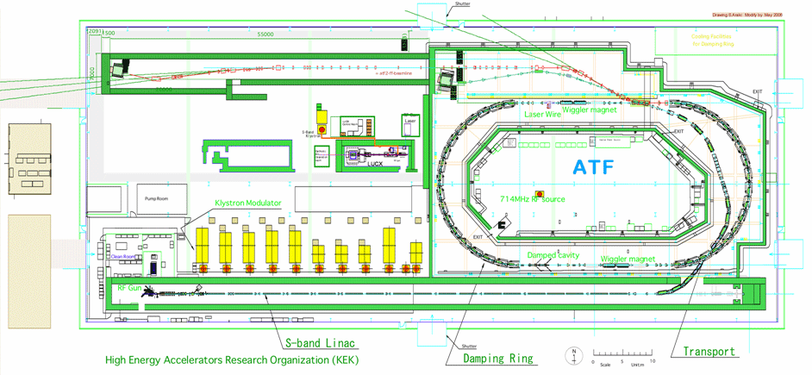
OTR-ODR experiment at KEK ATF2
ODR/OTR experiment location

Slide 5
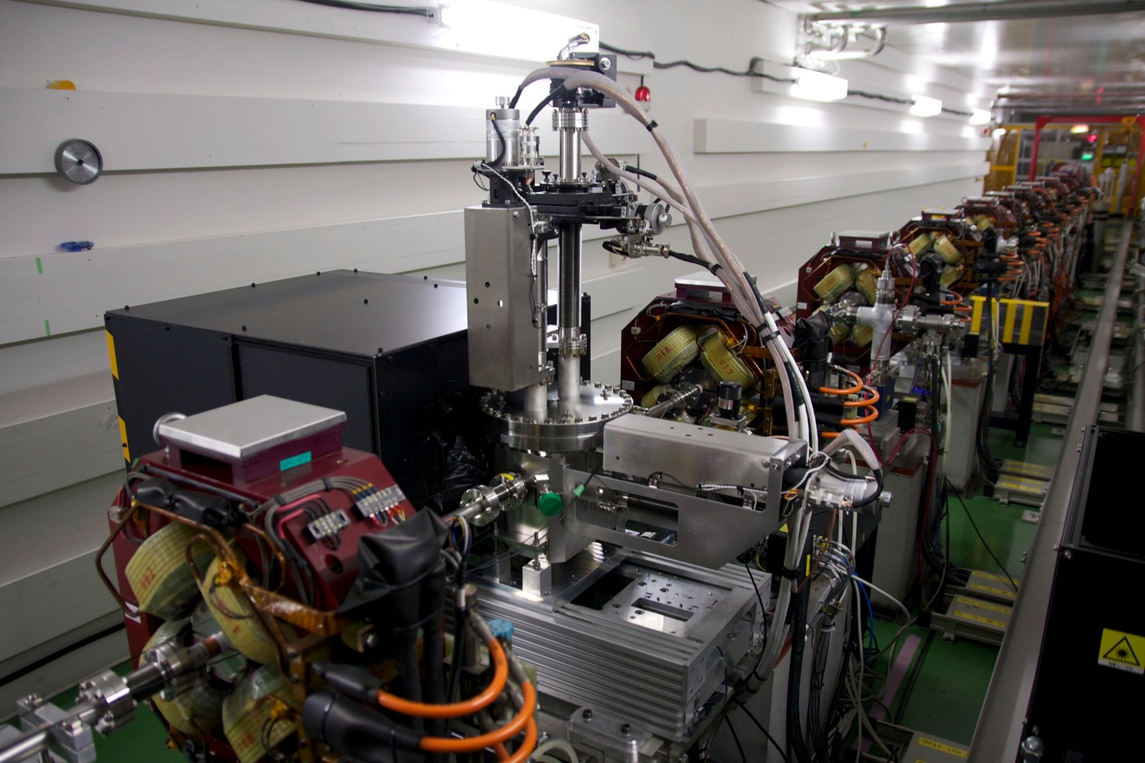
OTR-ODR experiment at KEK ATF2
The tank installed in February 2016 at the virtual interaction point of ATF2 where vertical beam can be focused to < 1um
Notes:
Installation in Feb 2016

Slide 6
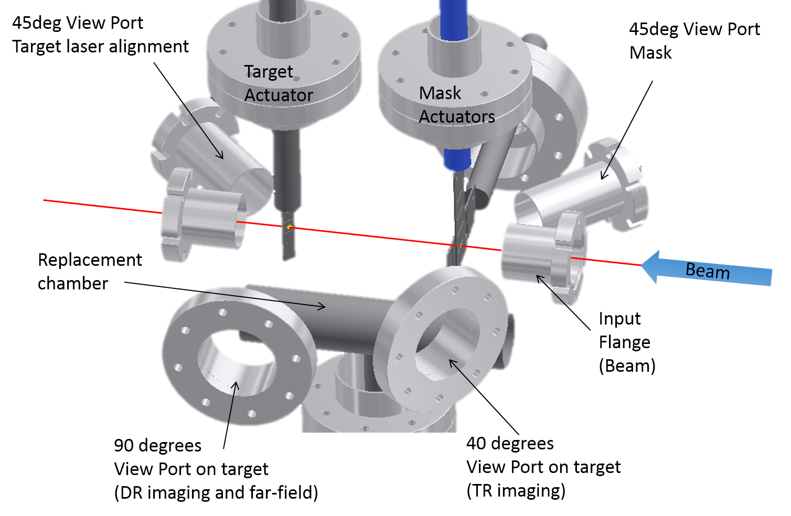
OTR-ODR experiment at KEK ATF2

Slide 7
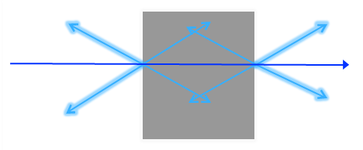
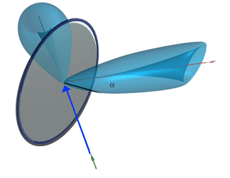
Optical Transition Radiation (OTR)
As predicted in 1946 by Frank and Ginzburg¹, Optical Transition Radiation is a broadband electromagnetic field emitted by a relativistic charged particle when it crosses boundary between two mediums of different dielectric constants.
Backward OTR photons
Forward OTR photons
e-
ε₁ = 1
Vacuum
ε₂ > 1
ε₁ = 1
Vacuum
Screen
The transverse component of the particle electric field produces surface polarization currents on the dielectric target. Target’s atoms are polarized, their relaxation lead to the emission of OTR photons (femtosecond time response)
Forward OTR
Backward OTR
Screen
Beam
1 V. L. Ginzburg and I. M. Frank, Zh. Éksp. Teor. Fiz. 16, 15 (1946); J. Phys. (Moscow) 9, 353 (1945)

Slide 8
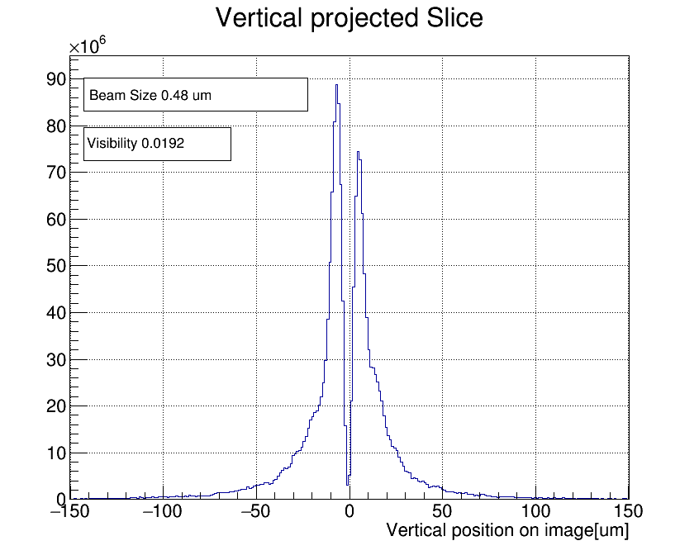
OTR Point Spread Function (PSF) for beam size measurements
Beam size 42 um
Beam size from 0.6
A Gaussian fit works fine down to approximately 10 microns beam size.
As the beam size decreases, the projected OTR vertical polarization component is dominated by the point spread function PSF of the OTR => smaller beam sizes using the visibility (Imin/Imax)

Slide 9
OTR experiment at ATF2
Quadrupole
QM1FF
Quadrupole
QM14FF
BPM
BPM
Linear Translational stage
sCMOS
Camera
Lens
Aluminium coating
Notes:
In vacuum-lens to minimize spherical aberration of the system

Slide 10
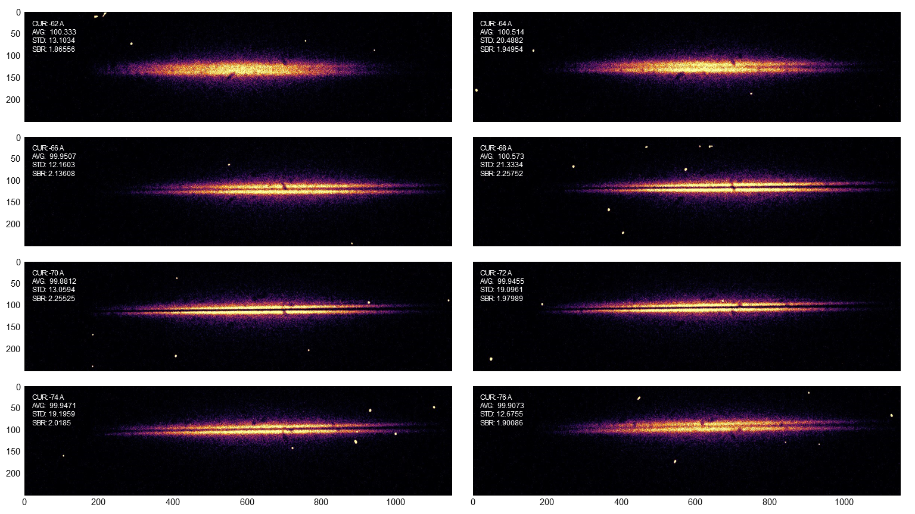
OTR beam size measurement at ATF2
OTR images for different value of QM14FF current => PSF sensitivity to different beam sizes

Slide 11
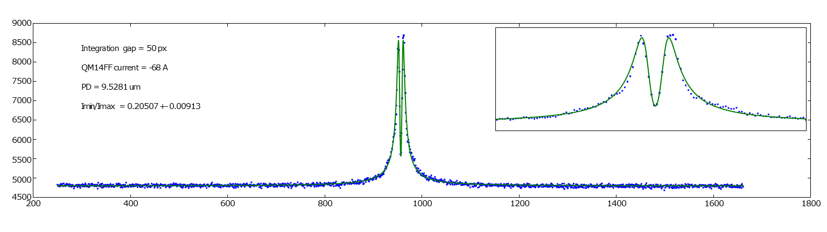
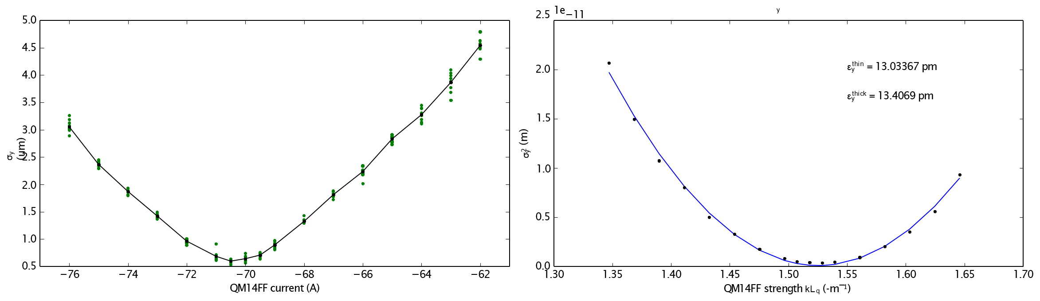
OTR beam size measurement at ATF2
Smallest beam size measured 600nm, emittance calculated with quadscan and thin lens approximation 13.034 pm

Slide 12
Optical Diffraction Radiation (ODR)
The transverse component of the electric field from the charged particle produces surface polarization currents on the dielectric slit. Atoms on the edge of the slit are polarized, their relaxation lead to the emission of ODR photons
ODR
photons
Slit target
Polarization currents
a
ODR
photons
Classical electrodynamics, John David Jackson

Slide 13
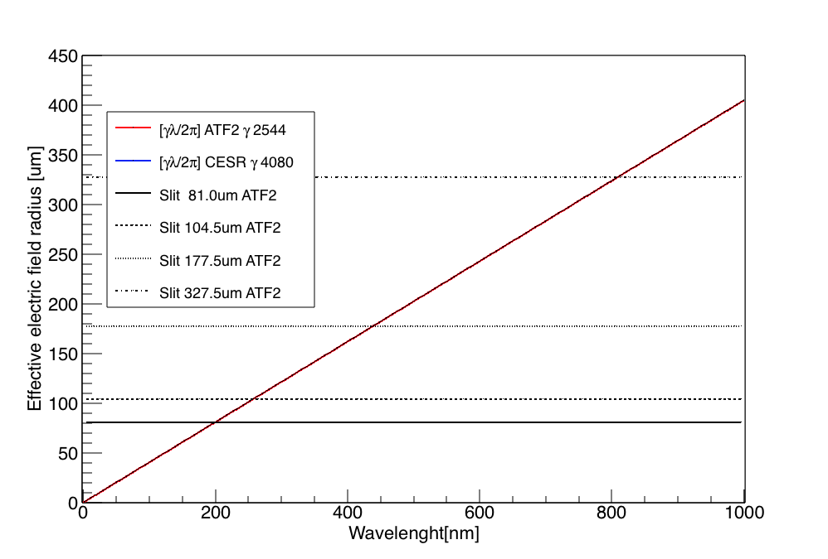
Optical Diffraction Radiation
The ODR photons yield is strongly dependent on the effective electric field radius and the slit aperture a (impact parameter)
OTR
No radiation
Deep UV
Infra Red
ODR

Slide 14
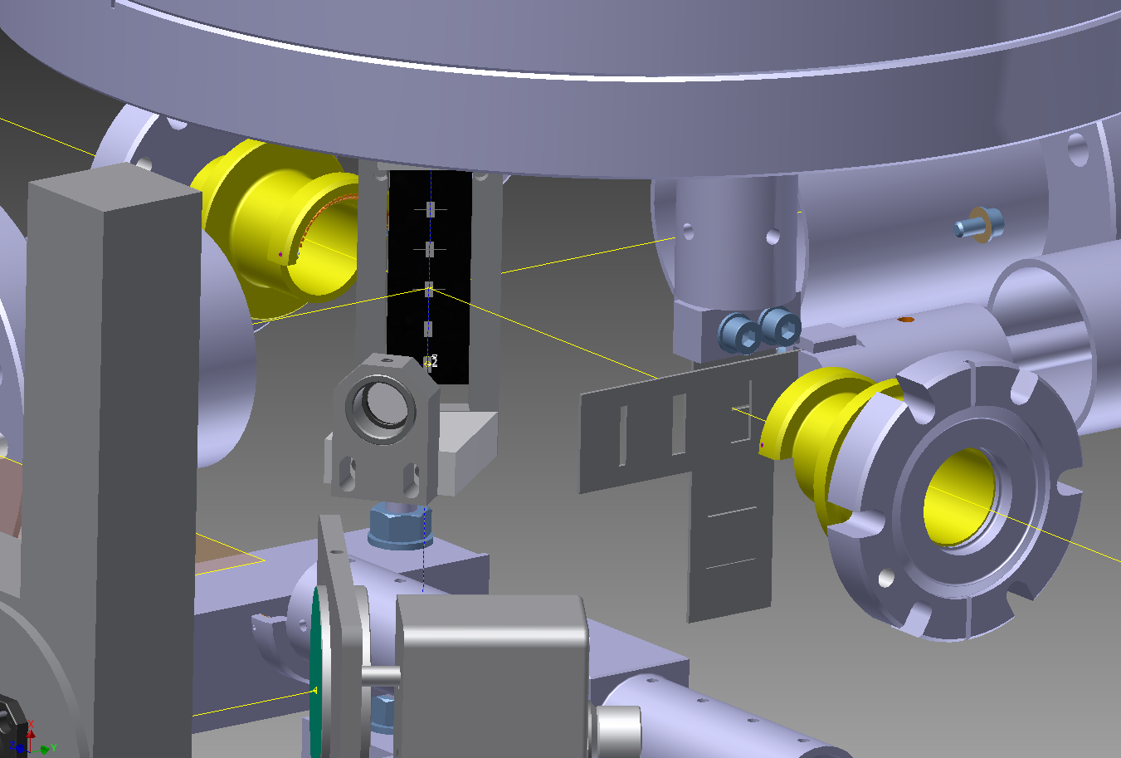
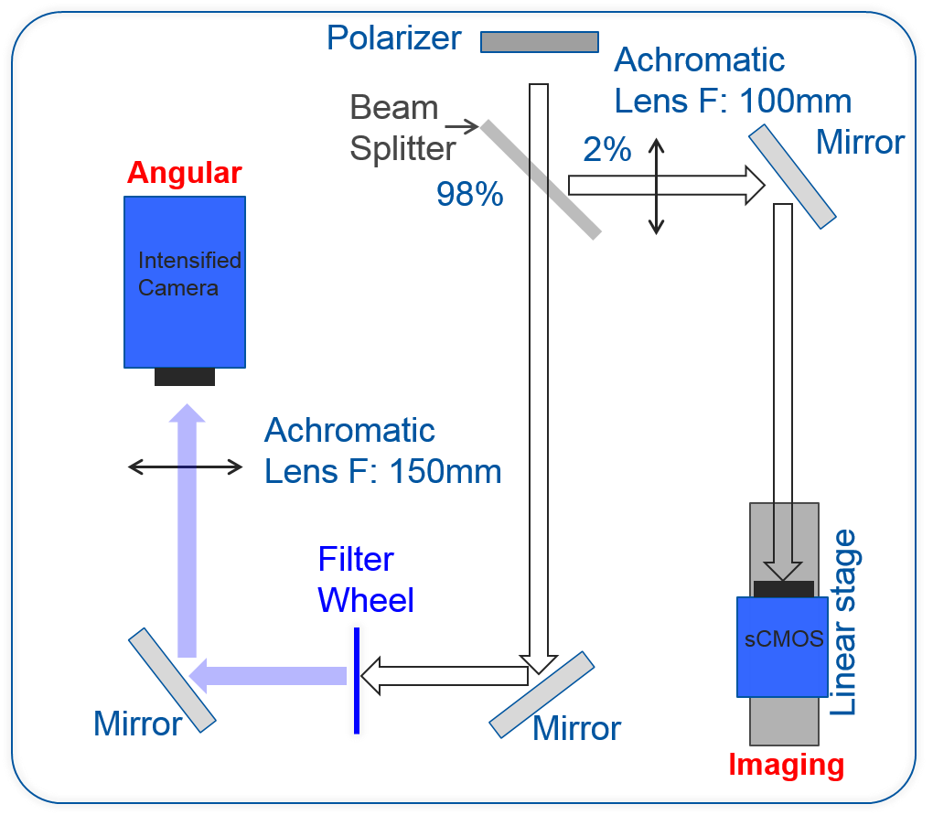
ODR experiment at ATF2
The target as 4 slits for ODR (49.7 to 201.7 um)
A couple of vertical and horizontal mask slits can be inserted 12.5cm upstream the target
TARGET
ODR
Masks
e- Beam
Synchronous Imaging and Angular acquisition for position filtering in angular

Slide 15
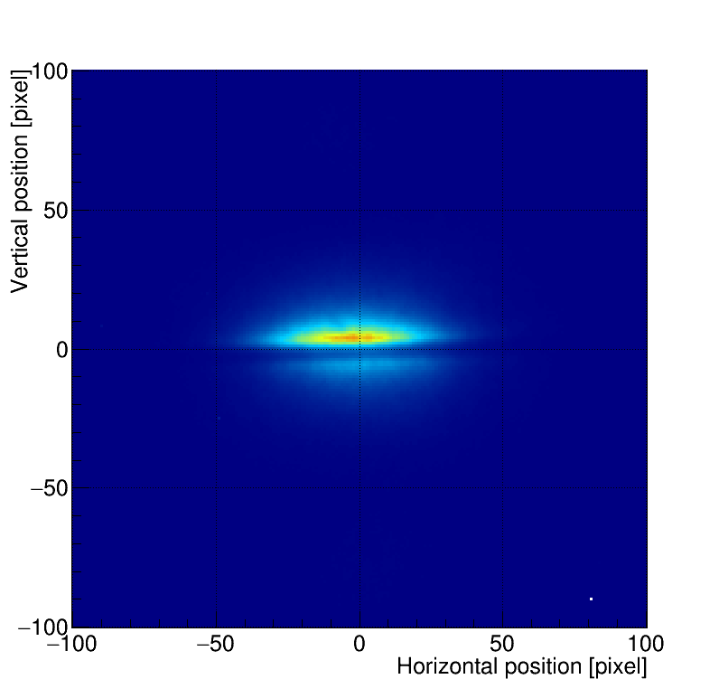
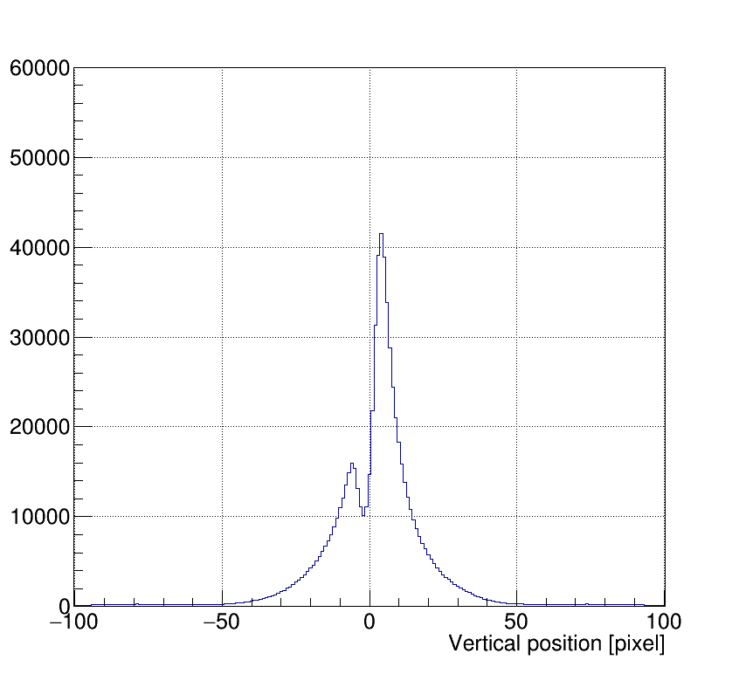
ODR in imaging
There is no visible beam size dependency of the pattern in imaging.
But the vertical position into the slit change the profile asymmetry => Optical Beam Position Monitor (BPM)
Offset

Slide 16
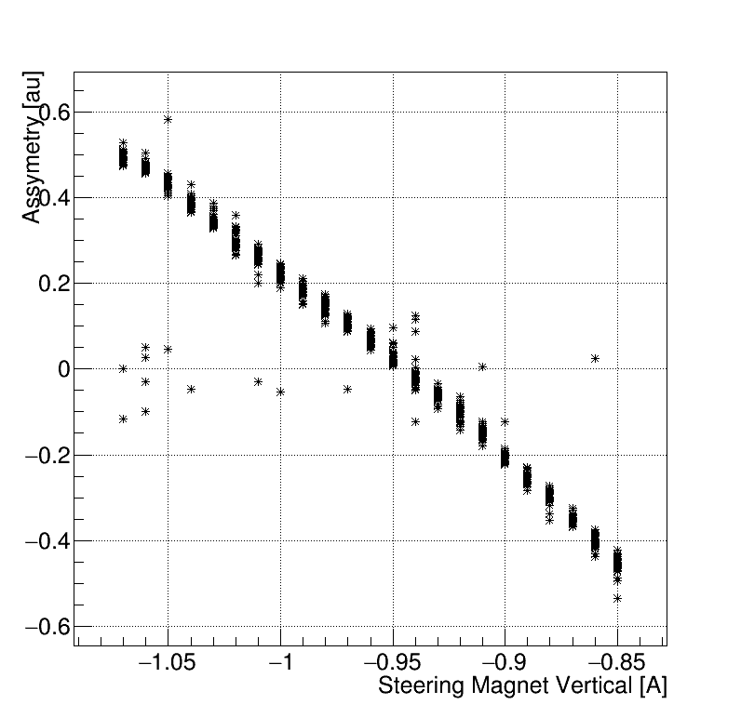
ODR imaging as an optical BPM
Slit: 56um
Beam size: 1um
30 shots statistics
Position resolution: about 1um
Steering magnet to scan the beam inside the slit
Asymmetry = (P_{min}-P_{max})/(P_{max}+P_{min})
Resolution ~1um
Steering -0.85A
P_{max}
Range 45um
P_{min}

Slide 17
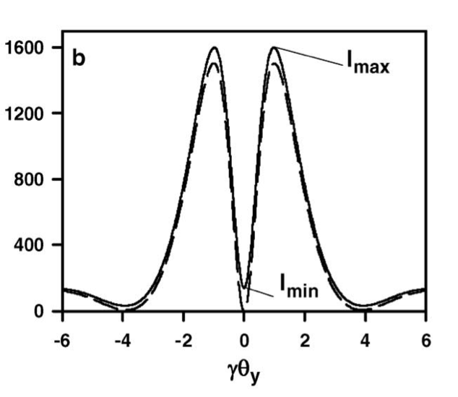
ODR for beam size measurements
The beam size is extracted from the visibility I_{min}/I_{max} of the projected vertical component of the ODR angular distribution
The angular distribution is obtained using a camera located at the focal plane of an optical lens (effective infinity)
ODR source
Aperture
An horizontal slit is used to measure a vertical beam size.
We use a polarizer to select only the vertically polarized ODR photons and 40nm BW filters to select the wavelength
d
f
Polarizer
Filter
Lens
CCD camera
On focal plane
Angular magnification

Slide 18
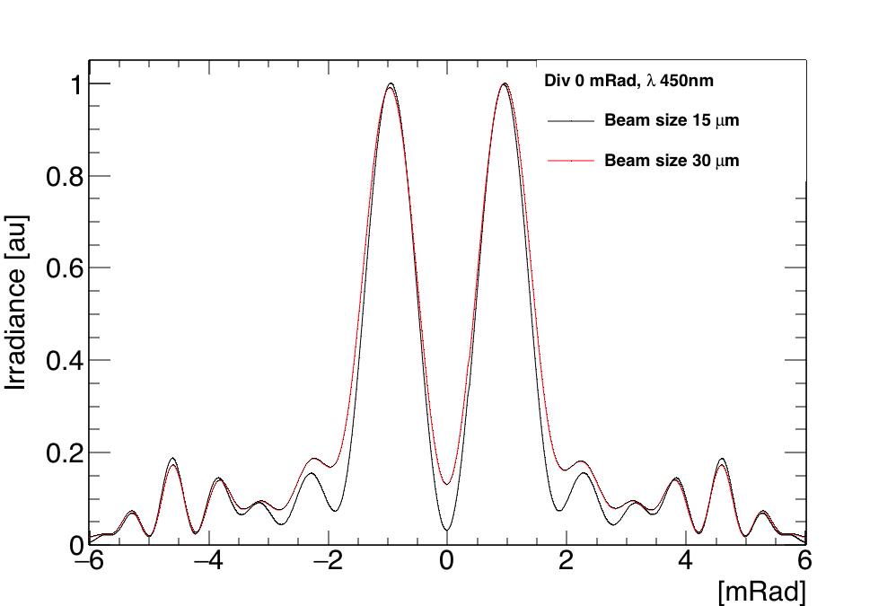
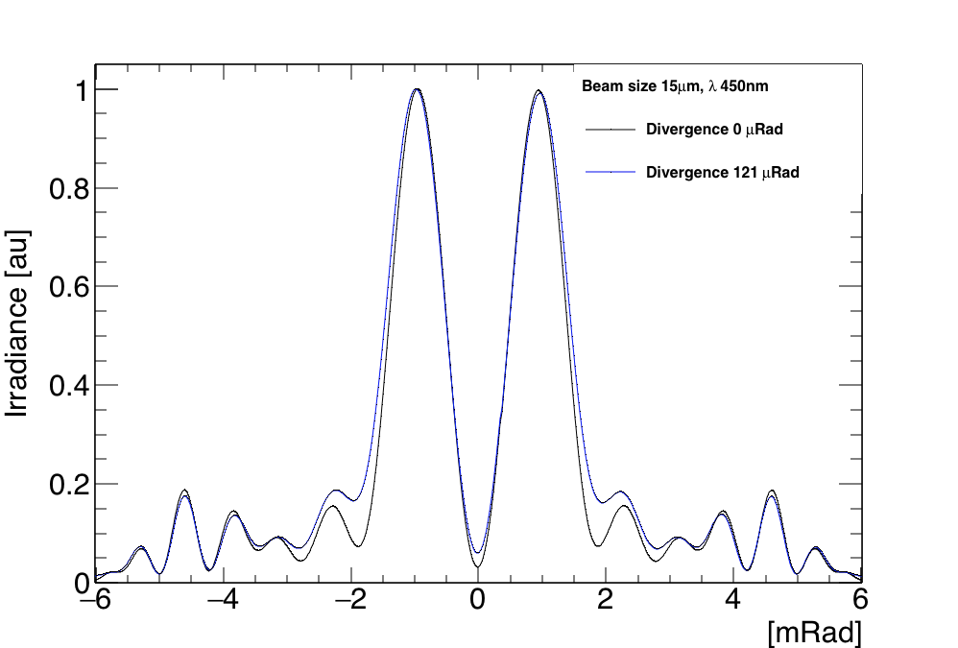
ODR angular distribution
Both beam size and beam divergence have an effect on the visibility of the ODR pattern
In the ATF2 case, using low emittance beams the impact of the beam divergence (nrad) on the visibility is negligible compared to the beam size

Slide 19
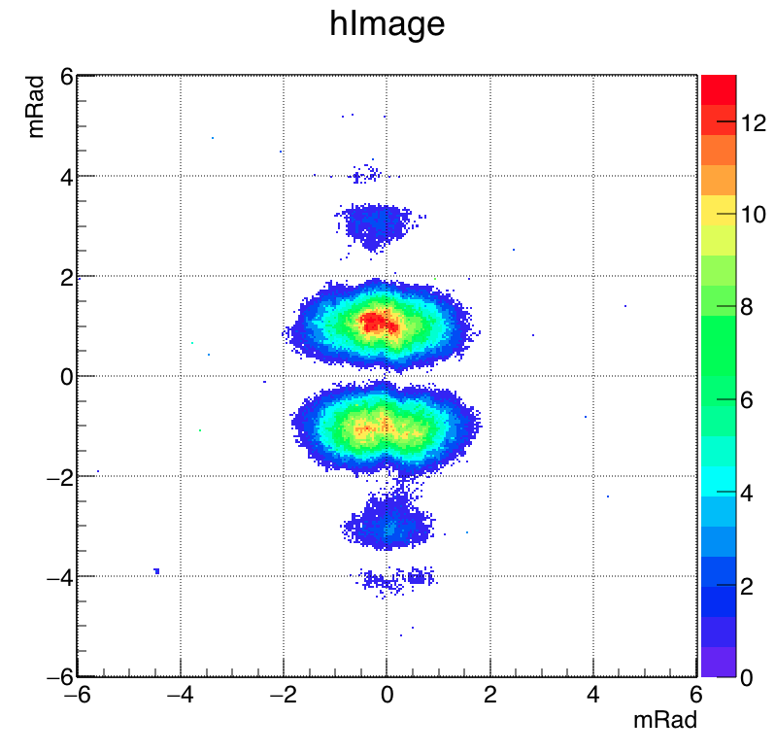
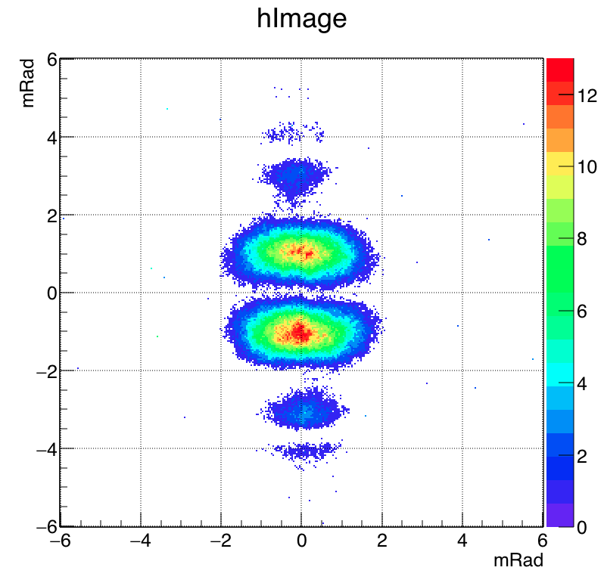
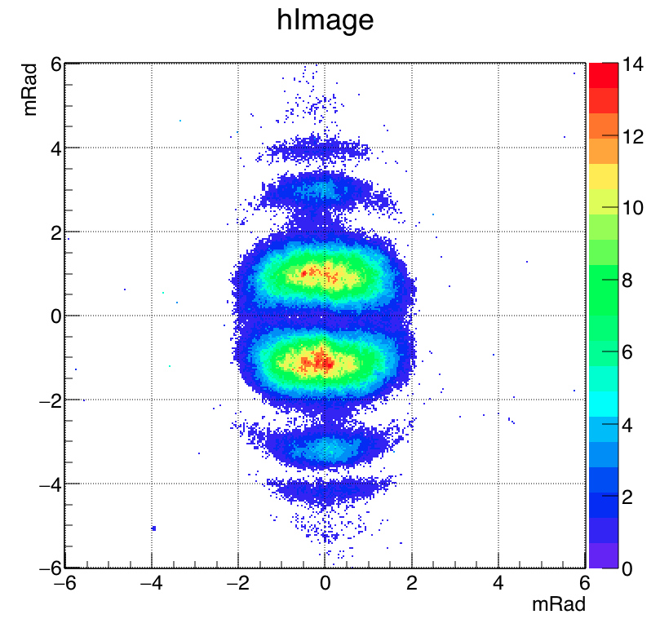
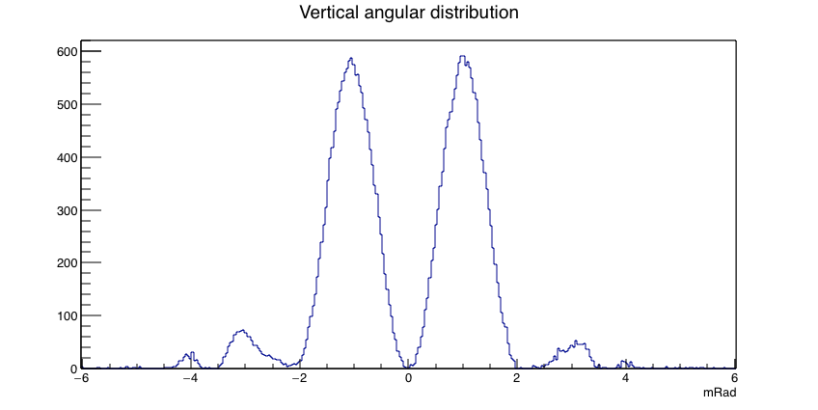
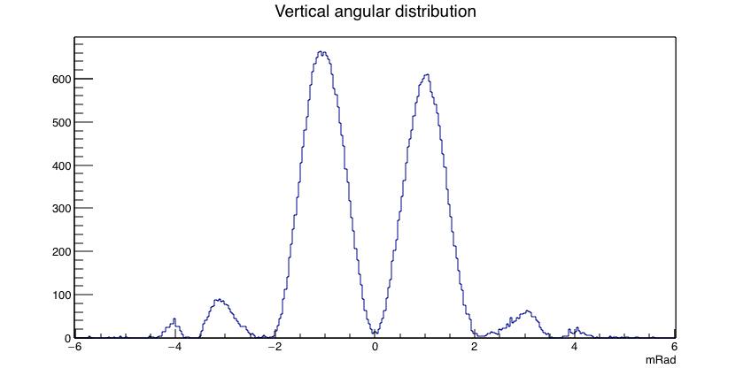
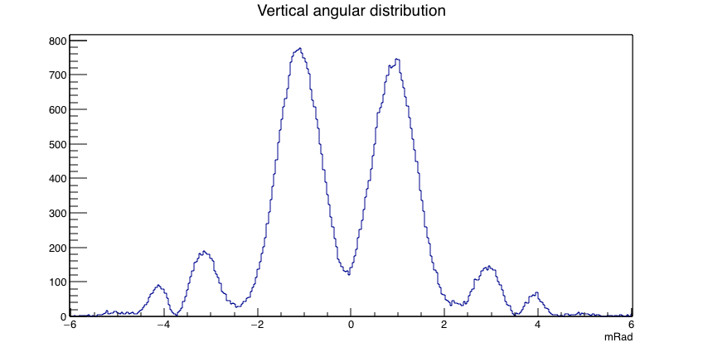
ODR angular distribution at ATF2
Filter:450nm Slit:105um Mask:202um Electron beam @ 1.3GeV ,1.2nC
Beam 18um (100images)
Beam 30um (100images)
Beam 1um (100images)
Beam 18um
Beam 30um
Beam 1um

Slide 20
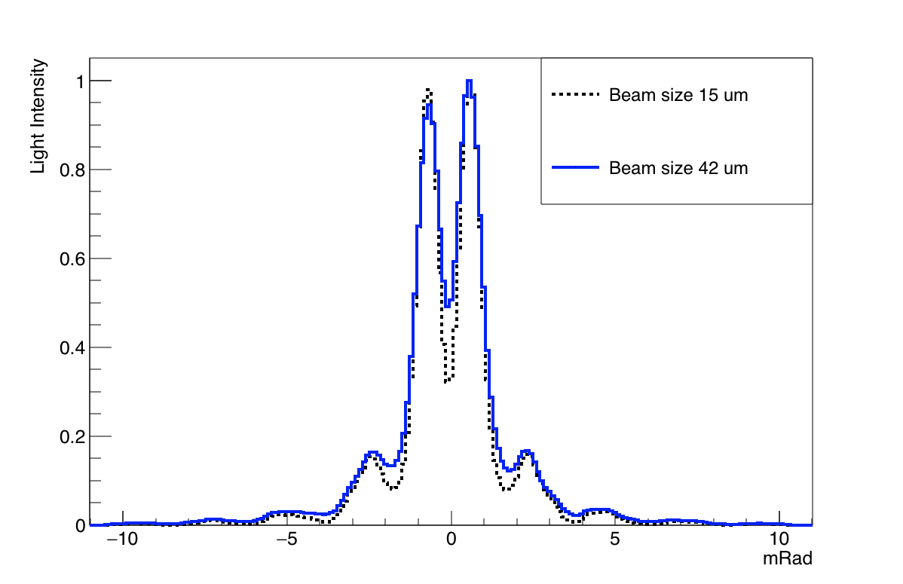
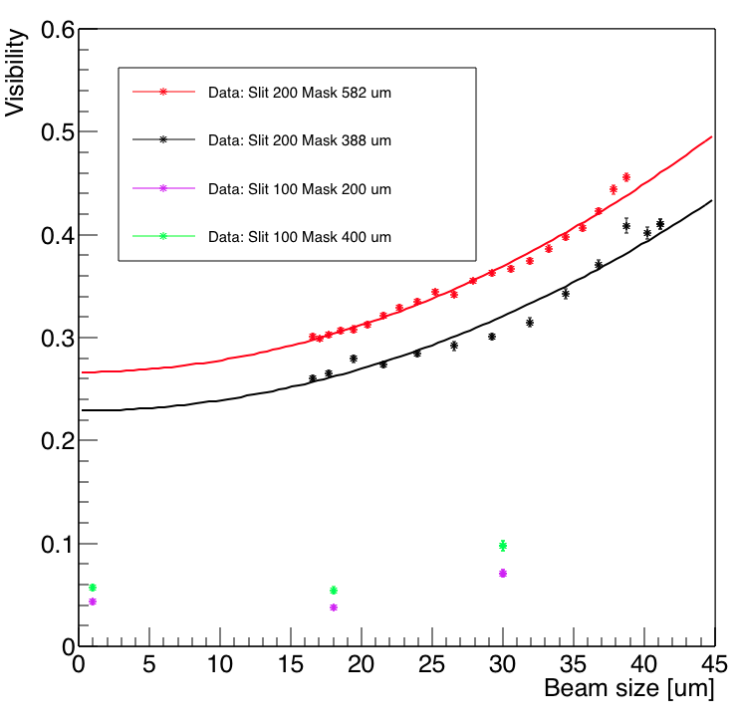
ODR beam size measurement
ATF2 ODR interference measurement for different target and mask combination
at 450 nm
ATF2 ODR interference measured profiles for different beam sizes at 450nm

Slide 21
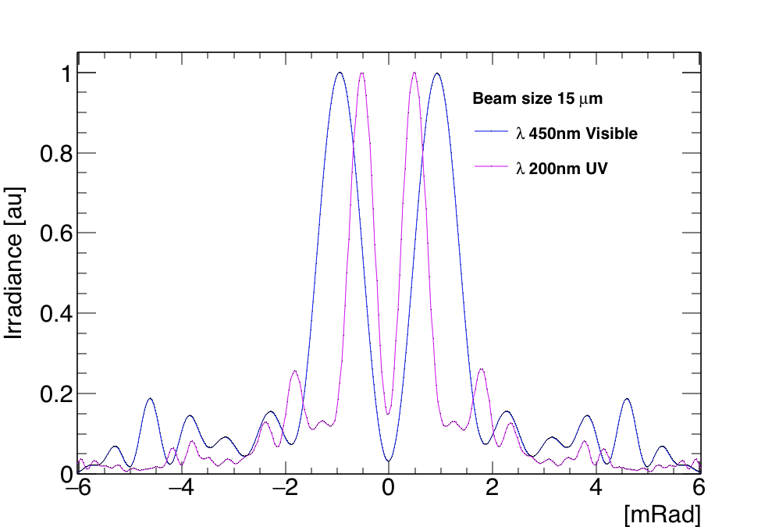
DR at ATF2 upgrade
Upgrading the setup to perform UV/Far-UV (200nm) angular beam size measurement
From visible range to UV
Enhance the sensitivity: (I_{min}/I_{max})
Imply the use of a smaller slit to respect the rule:
Give the possibility to measure smaller beam sizes!
Optical line under 1mBar vacuum needed.

Slide 22
DR at ATF2 upgrade
UV nitrogen tank
Polarizer
Lens
F: 400mm
Beam
Splitter
Mirror
Imaging
Mirror
PCO
DICAM
Intensified
Camera
2%
98%
Lens
F: 200mm
Filter
flipper
Filter
Wheel
Hamamatsu Intensifier
Lens
F: 75mm
Angular
PCO
sCMOS
3 inches Mirror
Linear stage
Mirror
Mirror

Slide 23
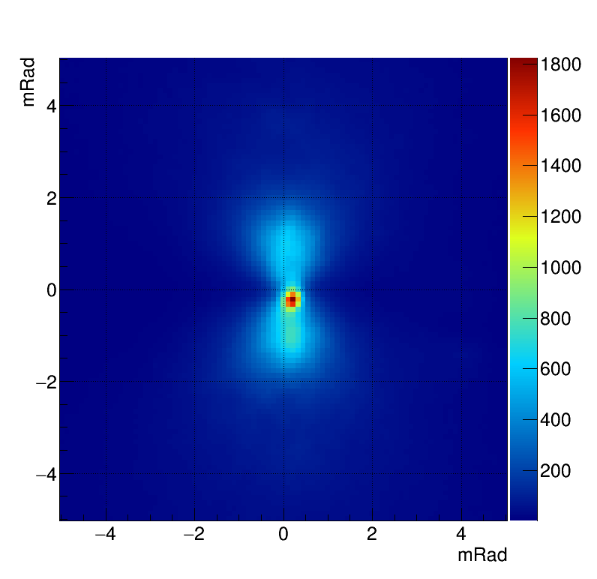
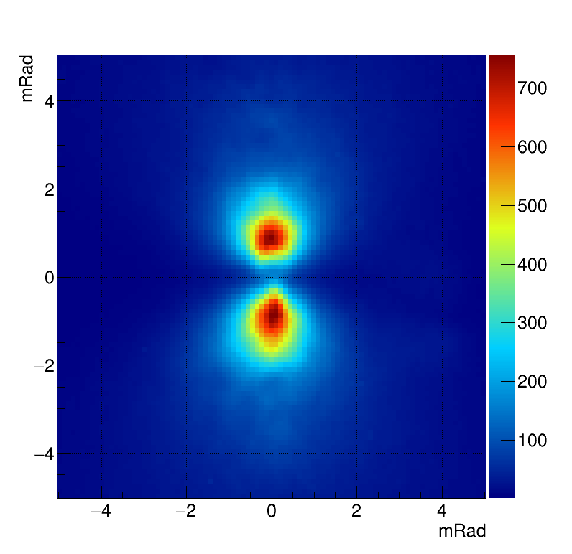
Synchrotron Radiation contribution
TR angular distribution without mask
TR angular distribution with mask

Slide 24
Summary
OTR achievements
Sub-micrometer beam size sensitivity has been demonstrated
Emittance measurement by the OTR PSF method are in good agreement with the measurements performed by conventional multi-otr system installed at ATF
ODR achievements
Possibility to use DR as an optical beam position monitor has been tested
Sensitivity to beam size of tenth of micrometers has beam demonstrated
Mask contribution to block synchrotron radiation has been observed

Slide 25
Thank you for your attention!

Slide 26
Backup slides

Slide 27
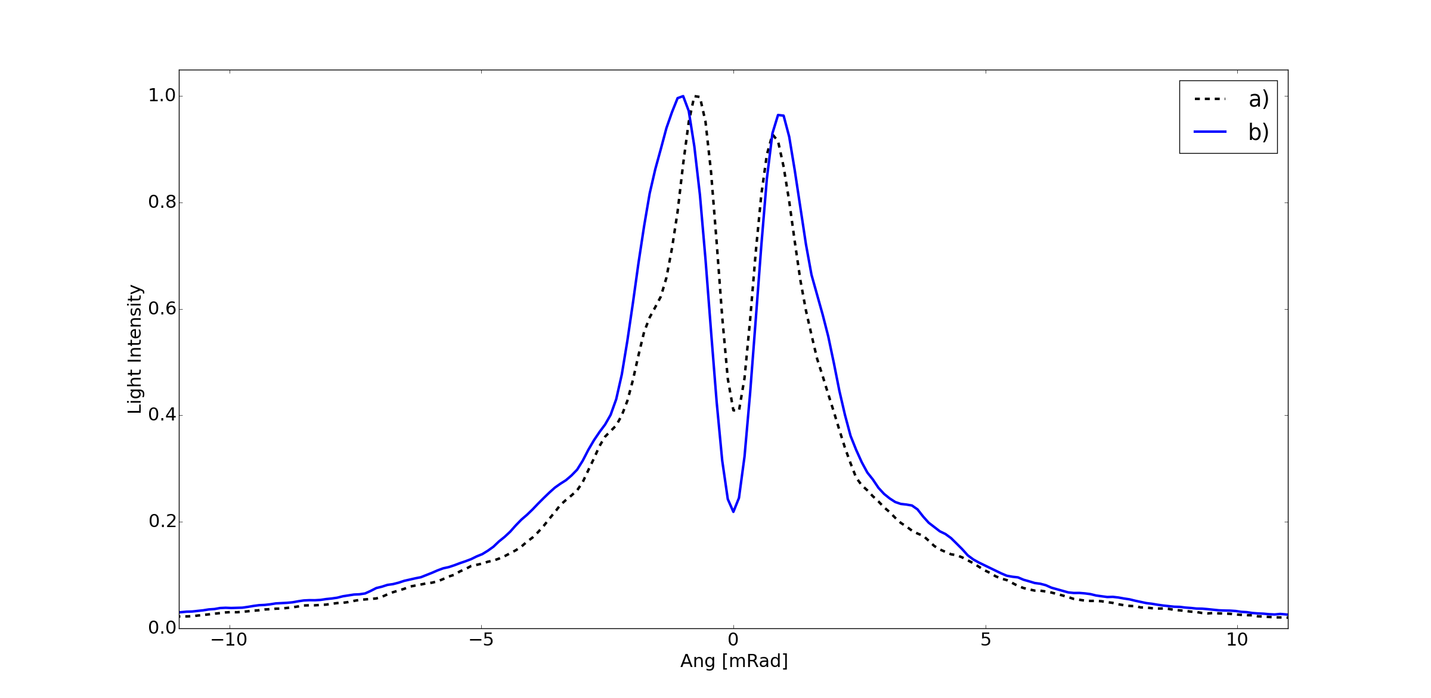
SR contribution
TR angular profile before (a) and after (b) beam orbit optimization

Slide 28
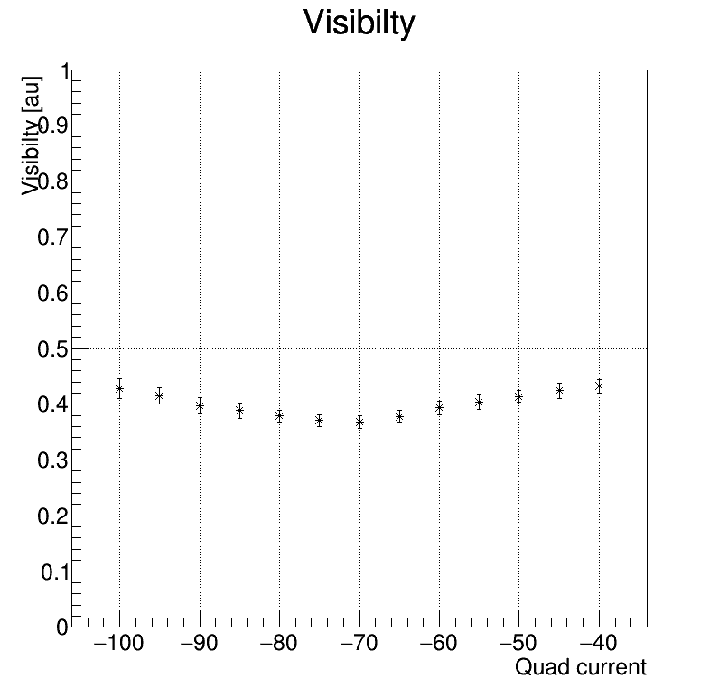
ODR beam size measurement
Quad scan in same condition then TR PSF,
beam size range 0.8 um to 10 um
$λ=450 nm$, mask$=156.0 µm$, target $=49.7µm$

Slide 29
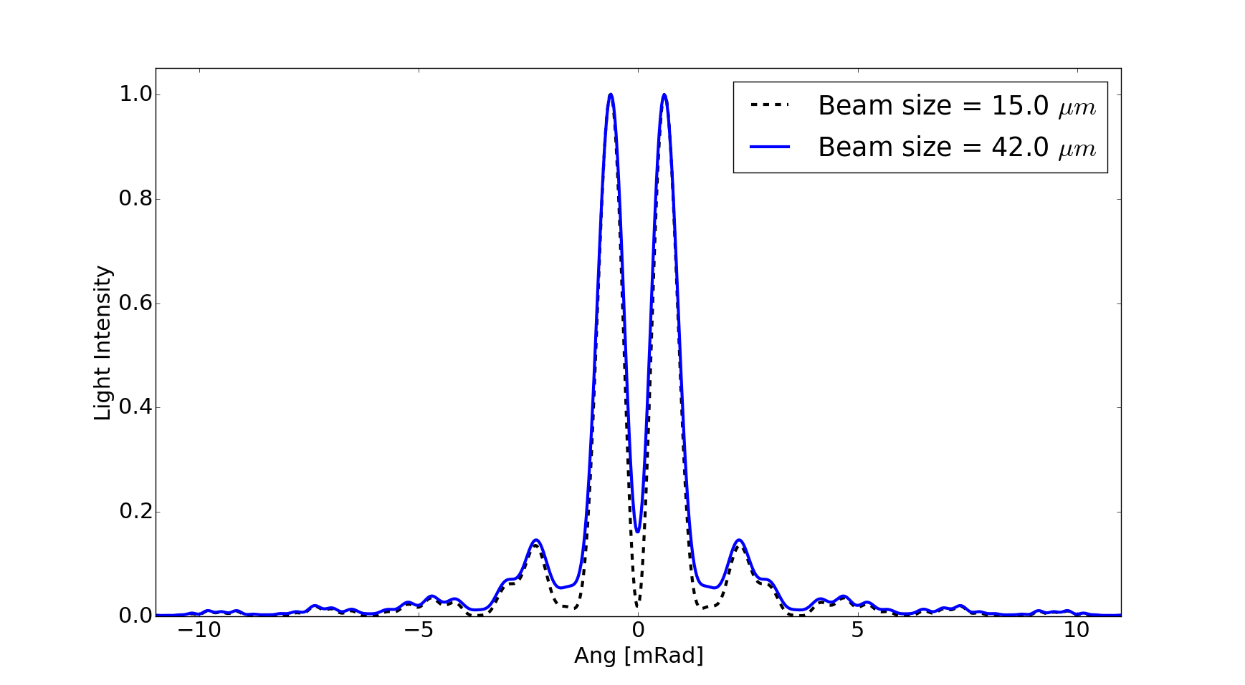
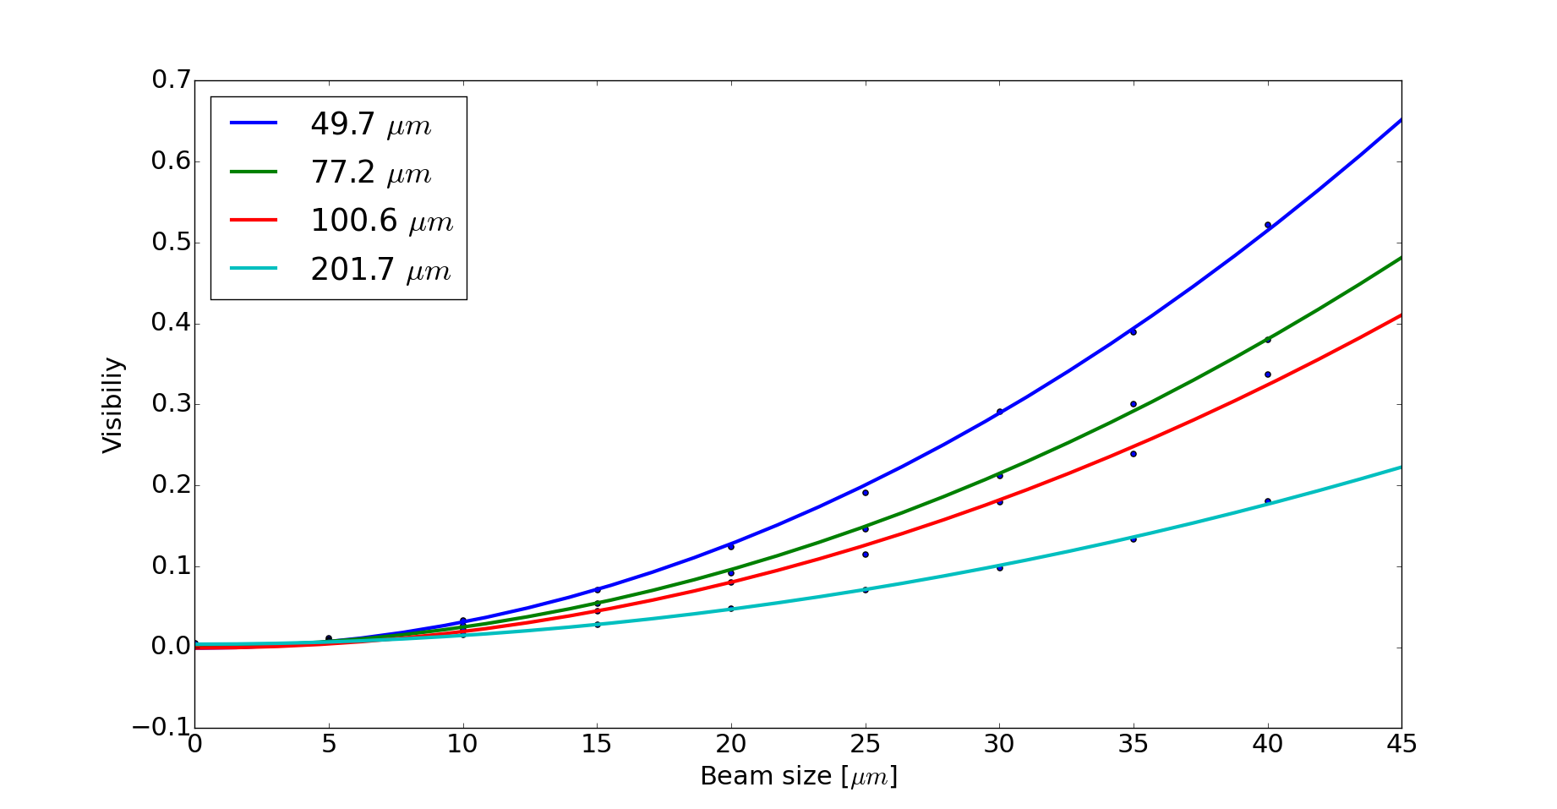



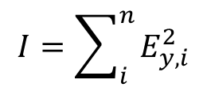
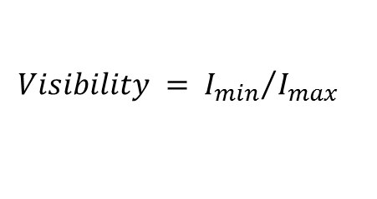
DR simulations
$E_{y,i}=\left\{\frac{e^{−\left[\left({a_{1}}/2\right)+z_{1}\right]\left(f−ik_{y}\right)}}{f−ik_{y}}−\frac{e^{−\left[\left({a_{1}}/2\right)−z_{1}\right]\left(f+ik_{y}\right)}}{f+ik_{y}}\right\}−e^{iΦ_{0}}\left\{\frac{e^{−\left[\left({a_{2}}/2\right)+z_{2}\right]\left(f−ik_{y}\right)}}{f−ik_{y}}−\frac{e^{−\left[\left({a_{2}}/2\right)−z_{2}\right]\left(f+ik_{y}\right)}}{f+ik_{y}}\right\}$ [1]
DR profile for different beam sizes
Simulated Visibility vs Gaussian beam size
for different target slit sizes
$λ=450 nm$, mask$=582.0 µm$, target $=201.7 µm$
$$I_{max}$$
Target size
$$I_{min}$$
$$I=\sum_{i}^{n}{E_{y,i}^{2}}$$
$$n=5000$$
$$d=130 mm$$
$$Visibility = {I_{min}}/{I_{max}}$$
[1] A. Cianchi et al., Non-intercepting electron beam size monitor using optical diffraction radiation interference, Phys. Rev. ST Accel. Beams 14,102803 (2011)

Slide 30
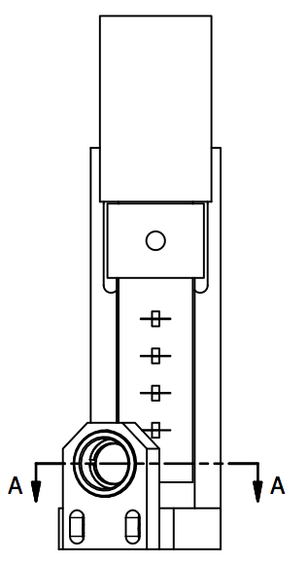
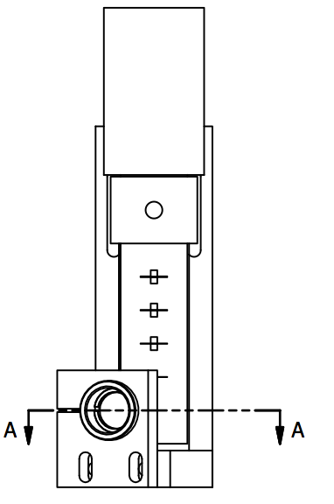
Target details
TARGET
Mirrored areas
6x4mm² around slits
MASK
Fully Mirrored
Slit 1 201.7um
Slit 1 399um
Slit 2 100.6um
Slit 2 198.9um
Slit 3 77.2um
Slit 3 149.2um
Slit 4 49.57um
Slit 4 100um

Slide 31
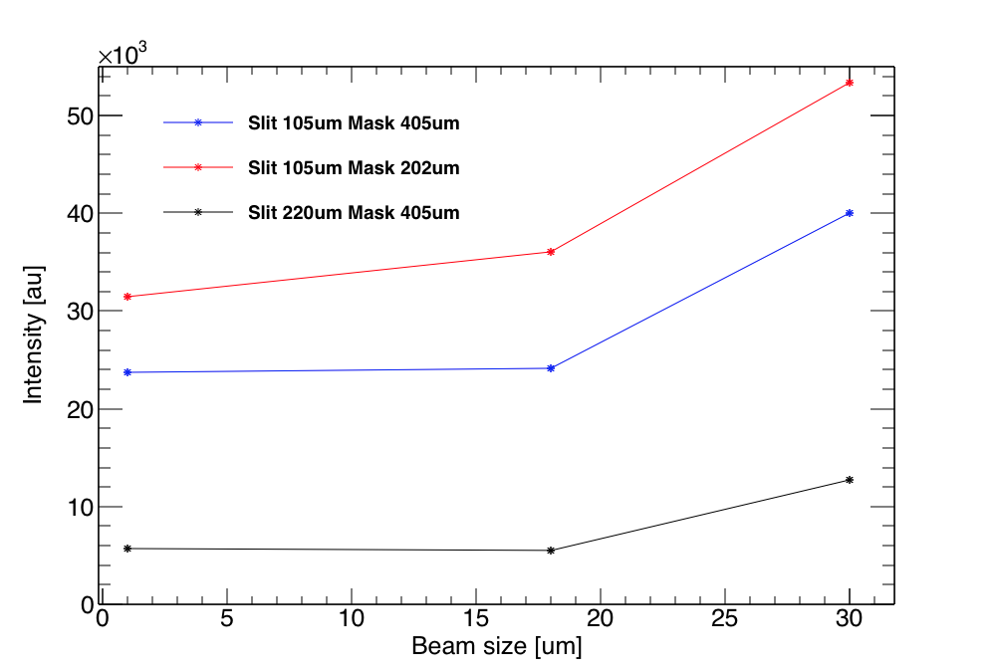
ODR light intensity with different mask
Filter: 450nm
ODRI
ODR
Beam
Mask
202um
Target
105um
ODRI
ODR
Beam
Mask
405um
Target
105um
ODRI
ODR
Beam
With a distance of 12.5cm between Mask and Target at 1.3GeV the ODR Interference is constructive and increases integrated image intensity
Mask
405um
Target
220um

Slide 32
ATF2 ODR Optical line upgrade (October 2016)
AIM: Synchronous Imaging and Angular acquisition for position filtering in angular.
Polarizer
Lens achromat
F: 100mm
Beam
Splitter
2%
Mirror
Angular
98%
PCO
DICAM
Intensified
Camera
Lens achromat
F: 100mm
Filter
Wheel
Linear stage
PCO
sCMOS
Mirror
Mirror
Imaging

