Slide 1
QPDB monthly meeting
Timo Tarhasaari and Tiina Salmi,
Tampere University of Technology
3rd May 2017

Slide 2
Status
We have been implementing the changes that we agreed at CERN
The Computed Quantities (CQ) introduced an additional requirement for the database manager
  Before the user interface (UI) and database manager were mixed together, now they are separated
  CQ is a separate part including the functions
  The database manager connects the UI, CQ, and the database
We have programmed a way to refer to the cells of each table by
  Table name (e.g. Magnets)
  Primary ID of the row (e.g. MQXFS03a), and
  column name (e.g. ISSL_nom)
We have programmed a way to follow the chain of linked tables
  Magnets-> Coils -> Layeres -> Cables -> Jc-fit
  We can pick the needed values for each function and evaluate it
90% of the functions ready in ”Magnets DB”, and 30% of the functions for the ”measurement DB”
The DB structure has been reorganized to meet the goals set at CERN and to accomodate the computed quantities (85% ready)

Slide 3
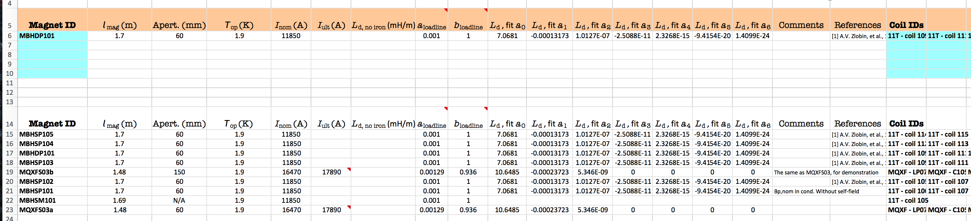
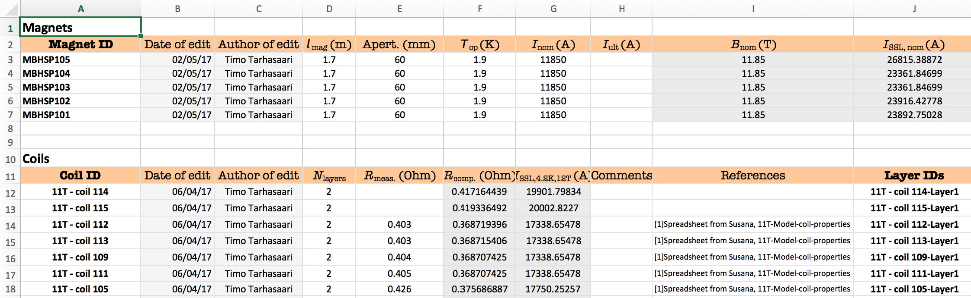
Screenshots
In EDIT-DB row the computed quantities do not show
In VIEW-DB the computed quantities show

Slide 4
Changes made in the DB structure wrt. to agreed at CERN
Status:
Magnet DB: ~Ready
Test set-up: ~Ready
Heater circuits and heater delays: Work in progress now
Now concrete heaters

Slide 5
Questions / open issues
Technical questions about 11 T parameter (list by email)
RRR-measurement and RRR value to strand:
  Which parameters for the measurement?
  Which value for the strand?
  What if no measurement?

